Slide 1
Machine Learning for Biomarker Discovery
Dr Griffin Farrow (griffin.farrow@nds.ox.ac.uk)
Prof Dan Woodcock
MSc in Genomic Medicine – 17th February 2026

Slide 2
Objectives
By the end of this lecture, you should understand:
What a biomarker is, and why we need to find them
How supervised and unsupervised machine learning can be used to find and test biomarkers
The pipeline of biomarker discovery, testing and application
How to use Python to discover and test biomarker panels

Slide 3
Disclaimer
It is not possible for us to teach everything that is needed to use ML for biomarker discovery in just 2 hours!
The intention of this course is to give you an idea of what the problem is and how people have tried to approach it
We have some practical coding exercises for you to get to see this in action

Slide 4
1. What is a biomarker?

Slide 5
What is a biomarker?
A biomarker is a measurable quantification of some biological process, state or condition
For example:
PSA (prostate specific antigen) in prostate cancer
BMI, weight-to-hip ratio
Gene expression signatures (e.g. PAM50 for breast cancer subtypes)
Polygenic risk scores
etc etc etc

Slide 6
What makes a biomarker useful?
Biomarkers are useful if they are:
objectively measurable
We can define a clear protocol for measuring the biomarker. Two people carrying out the measurement correctly will not disagree about the result.

Slide 7
What makes a biomarker useful?
Biomarkers are useful if they are:
objectively measurable
associated with meaningful biological or clinical endpoints
Is there an association that we understand between the biomarker and some endpoint we are trying to predict?
e.g. does it predict distinct disease phenotypes, drug response, patient outcomes, clinical covariates, ...
Biomarkers do not have to be predictive: some are diagnostic, some are for monitoring

Slide 8
What makes a biomarker useful?
Biomarkers are useful if they are:
objectively measurable
associated with meaningful biological or clinical endpoints
validated
More on this later...

Slide 9

For example: BMI
Is it objectively measurable?

Slide 10
For example: BMI
Is it objectively measurable?
Is it associated with a biological state?
BMI is associated with adiposity
Notably, it is controversial as a biomarker

Slide 11
For example: BMI
Is it objectively measurable?
Is it associated with a biological state?
BMI is associated with adiposity
Notably, it is controversial as a biomarker
Is it validated?
Extensively
Effectively, BMI is used to define overweight/obesity in many situations

Slide 12
Biomarker Validation
Generally, biomarkers are discovered in some dataset
But testing the performance of those biomarkers in the same dataset is biased
(By performance, we mean how strongly are they associated with the endpoint we care about?)

Slide 13
Biomarker Validation
Generally, biomarkers are discovered in some dataset
But testing the performance of those biomarkers in the same dataset is biased
What if there is a systematic effect in the dataset that we are really picking up?
Batch effects
Noise
Cohort effects
Confirmation bias

Slide 14
Biomarker Validation
How do we validate a biomarker?

Slide 15
Biomarker Validation
How do we validate a biomarker?
See whether the conclusions are true in an independent dataset
Does it still associate with the outcome we care about?

Slide 16
Biomarker Validation
How do we validate a biomarker?
See whether the conclusions are true in an independent dataset
Does it still associate with the outcome we care about?
Scientific/biological validation
Demonstration of the mechanistic/biological basis of a biomarker

Slide 17
Biomarker Validation
How do we validate a biomarker?
See whether the conclusions are true in an independent dataset
Does it still associate with the outcome we care about?
Scientific/biological validation
Demonstration of the mechanistic/biological basis of a biomarker
Clinical trials
For almost anything used to directly make patient decisions
In the UK, MHRA decides if it is “safe” and works as claimed; NICE decides if it should be adopted → very different hurdles

Slide 18

The pipeline of biomarker discovery
Data collected from some source (clinical trials, electronic health records, biobank etc
Exploratory data analysis
Biomarker discovery phase
Unsupervised ML
Prospective biomarker identified
Survival analysis
Validation in external datasets
Biomarker test designed
Academic Endpoint
Clinical trials & regulatory process

Slide 19
Why are biomarkers useful?
Biomarkers allow us to summarise and class our patients into distinct groups, which might decide different treatments or investigations
Precision medicine
Allows us to disentangle population effects from individual-level data
We can look for whether a patient has a particular pattern in their gene expression data, rather than carrying out RNAseq data for every single gene for every single patient

Slide 20
2. Why can machine learning help with biomarker discovery?

Slide 21
The evolution of biomarkers
Traditional biomarkers (e.g. BMI) are generally based on a single measurement, manually defined
Increasingly, biomarkers are moving to composite high-dimensional measurements, enabled by machine learning (data-driven)
e.g. gene-expression panels
e.g. ML-derived scores from imaging (MRI/CT)

Slide 22
Why is machine learning particularly good for this?
With modern technology, we are able to extract a huge amount of information from biological samples
e.g. whole genome sequencing, RNAseq, single-cell, MRI/CT imaging
Very high-dimensional, noisy data
Difficult/impossible for humans to spot reliable patterns
Perfect for ML algorithms
ML can reduce noise through aggregation, learn nonlinear features, handle high-dimensions naturally and much more

Slide 23
How is ML used in biomarker discovery?
Unsupervised ML
Where we do not know have known labels for the samples
Often exploratory
e.g. clustering, representation learning
Useful for finding groups of patients
This is the “discovery” part
Supervised ML
When we have potential distinct groups, how can we use data to build a test to classify them?
e.g. given an RNAseq array, how do we tell which cancer subtype a patient is?

Slide 24
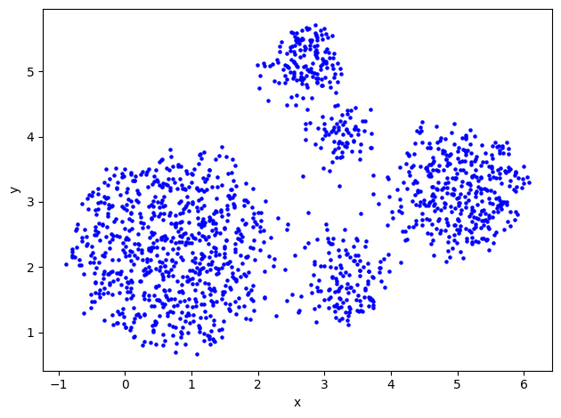
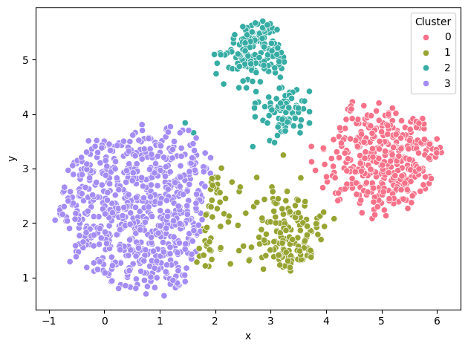
Clustering
Unsupervised machine learning
Can we find separate groups in our data, such that the elements of a group are more similar to each other than to other groups?
Many different types of clustering, useful in different situations
Hierarchical
KMeans
Spectral Clustering
etc
More information here: https://scikit-learn.org/stable/modules/clustering.html

Slide 25
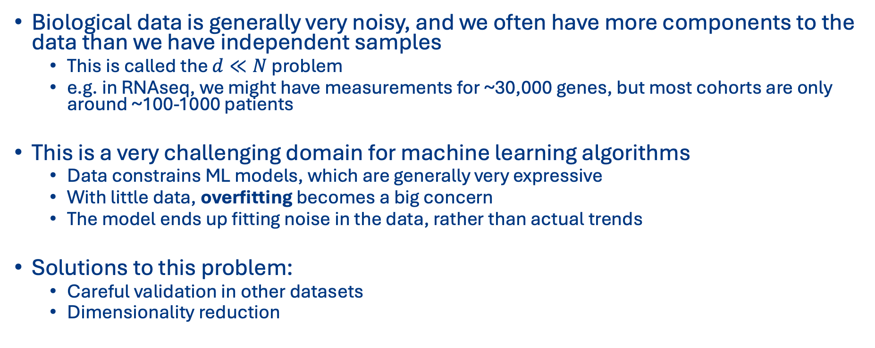
Dimensionality Reduction
Biological data is generally very noisy, and we often have more components to the data than we have independent samples
This is called the $d≪N$ problem
e.g. in RNAseq, we might have measurements for ~30,000 genes, but most cohorts are only around ~100-1000 patients
This is a very challenging domain for machine learning algorithms
Data constrains ML models, which are generally very expressive
With little data, overfitting becomes a big concern
The model ends up fitting noise in the data, rather than actual trends
Solutions to this problem:
Careful validation in other datasets
Dimensionality reduction

Slide 26
Dimensionality Reduction
This is probably the most important task in biomarker discovery
How can we reduce our dataset with many features, to one with fewer features, but that still captures the same science/trends/behaviour?
Potential approaches:
Remove or combine features based on known biology (e.g. pathways)
Remove features that are not in any way correlated with the outcome we care about
Choose ML algorithms that include feature selection as part of how they work

Slide 27
UMAP
UMAP = Uniform Manifold Approximation and Projection
This is an unsupervised machine learning technique that is frequently used in dimensionality reduction
It attempts to reduce very high-dimensional data to lower-D (usually 2D), whilst maintaining both local and global structure
Good for dimensionality reduction and visualisation: to try to understand what your data is telling you

Slide 28
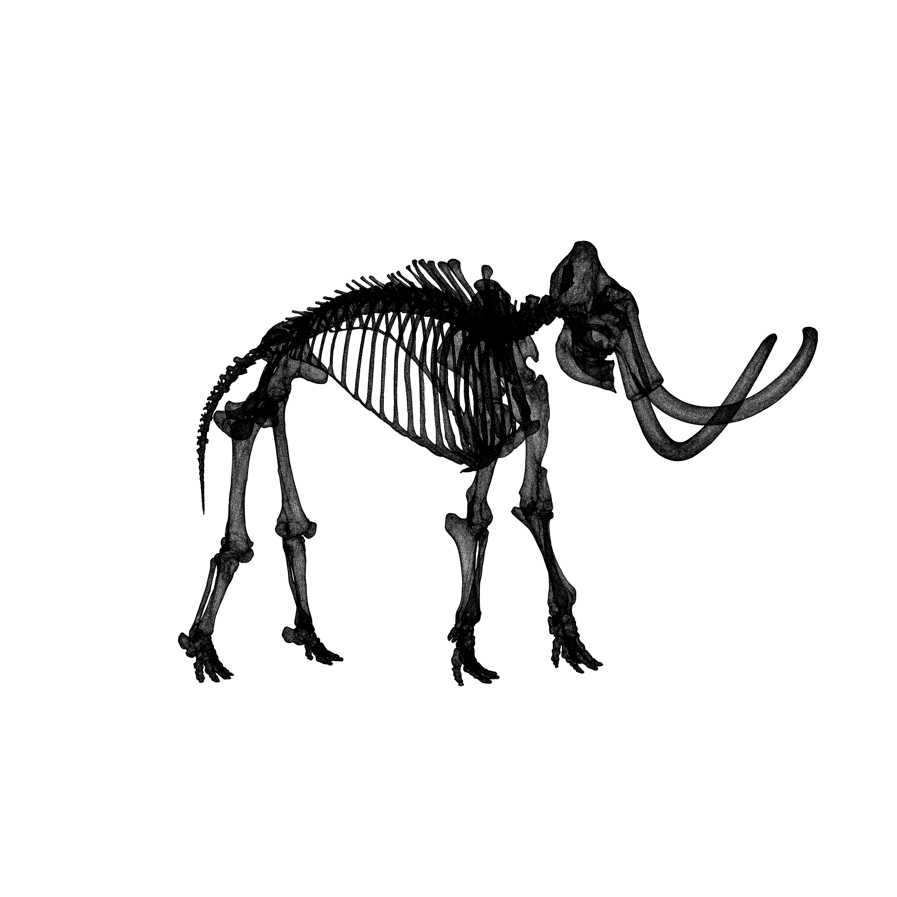
UMAP
Example from: https://github.com/MNoichl/UMAP-examples-mammoth

Slide 29
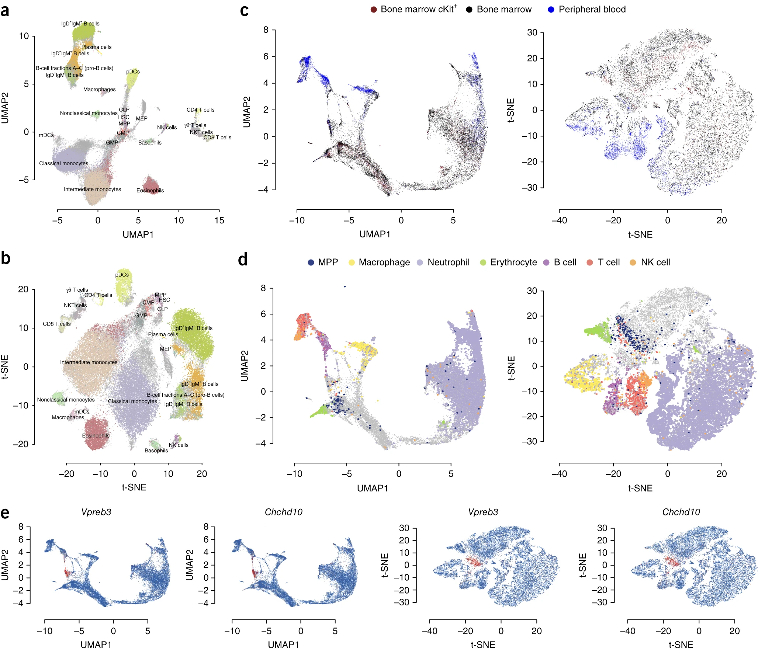
UMAP for single-cell
Becht, E., McInnes, L., Healy, J. et al. Dimensionality reduction for visualizing single-cell data using UMAP. Nat Biotechnol 37, 38–44 (2019). https://doi.org/10.1038/nbt.4314

Slide 30
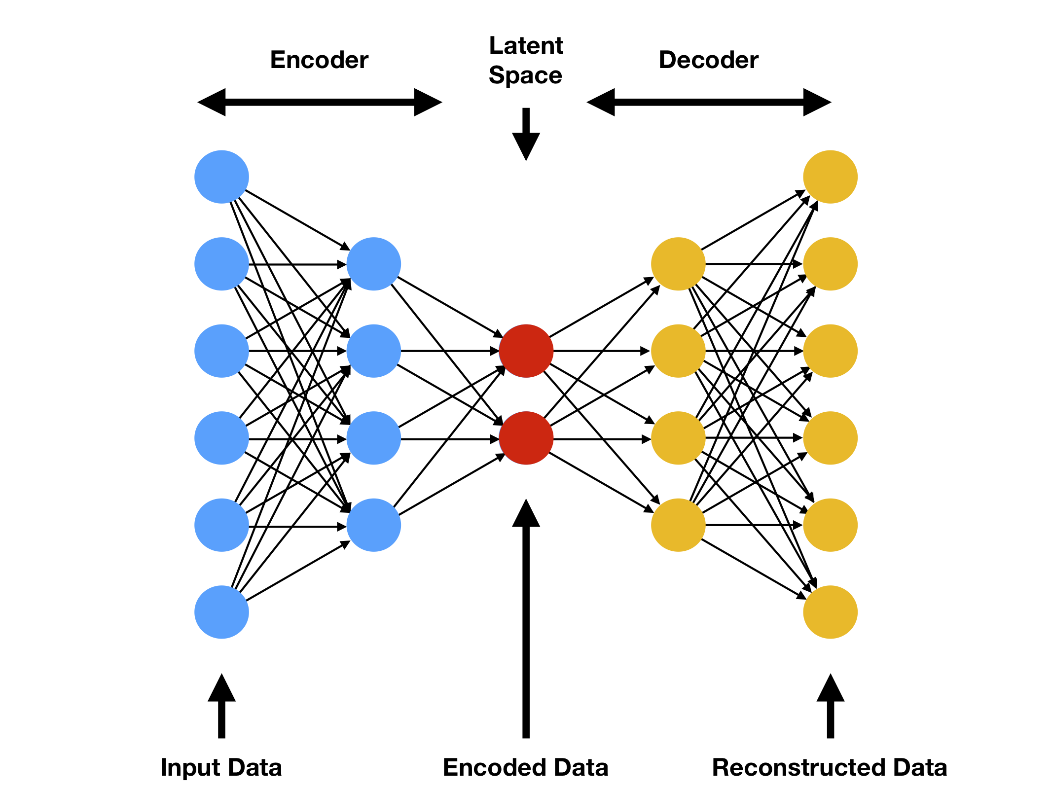
Autoencoders
A very important type of machine learning model is an autoencoder
This tries to compress the input data into a smaller number of features using a bottleneck architecture

Slide 31
Autoencoders
This smaller number of features is sometimes called a latent space
The idea of it is that those latent space variables represent the underlying processes in the data
They may cluster better, or make the structure beyond the noise more apparent
Biomarker discovery becomes finding the pattern in the latent space
Notes:
img src: https://www.compthree.com/blog/autoencoder/

Slide 32
Supervised Machine Learning
Let’s say we have identified groups of patients in our data through dimensionality reduction, exploratory analysis etc
Supervised machine learning lets us identify what patterns in our data predict those groups
This ends up being our biomarker
The ML algorithm can function as a biomarker test

Slide 33

Supervised Machine Learning: Example
RNAseq samples of HNSC extracted: 500 patients x 22,000 genes

Slide 34
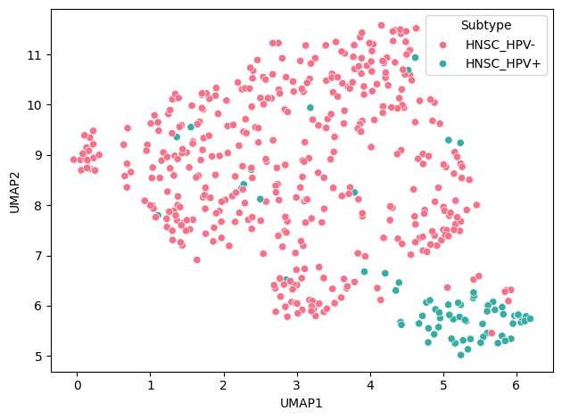
Supervised Machine Learning: Example
RNAseq samples of HNSC extracted: 500 patients x 22,000 genes
Exploratory data analysis, visualisation, UMAP
A very obviously separated group
Further investigation...
Turns out to be HPV-positive vs HPV-negative patients

Slide 35
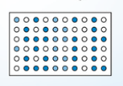
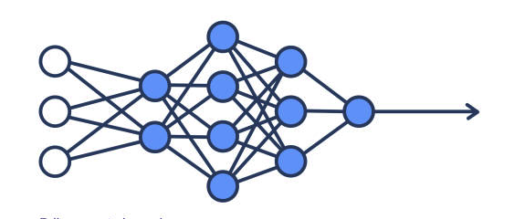
Supervised Machine Learning: Example
RNAseq samples of HNSC extracted: 500 patients x 22,000 genes
Exploratory data analysis, visualisation, UMAP
Can we predict HPV subtype from the gene expression profile?
Machine Learning Algorithm
HPV-Positive
HPV-Negative

Slide 36
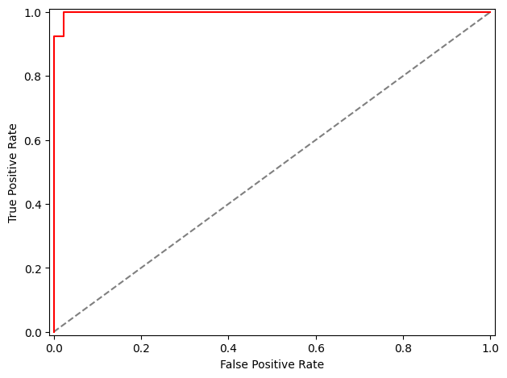
Supervised Machine Learning: Example
RNAseq samples of HNSC extracted: 500 patients x 22,000 genes
Exploratory data analysis, visualisation, UMAP
Can we predict HPV subtype from the gene expression profile?
Emphatically, yes!
So, we have a biomarker and test for HNSC subtypes

Slide 37
Supervised Machine Learning
Many models can be used in supervised machine learning
Classical “statistical” models:
Logistic regression
Linear regression
Simple, very interpretable
But linear and limited in expressiveness (might not capture complex patterns)

Slide 38
Supervised Machine Learning
Many models can be used in supervised machine learning
Classical “statistical” models:
Logistic regression
Linear regression
Statistical machine learning
Random forests/decision trees
Support vector machines
Nonlinear and expressive, but remain interpretable

Slide 39
Supervised Machine Learning
Many models can be used in supervised machine learning
Classical “statistical” models:
Logistic regression
Linear regression
Statistical machine learning
Random forests/decision trees
Support vector machines
Deep learning
Neural networks
Immensely powerful, but a black box (who knows what they are doing?)
High potential for overfitting

Slide 40
What model should I use?
Machine learning is a very empirical field
There is very rarely a clear “best” model to use in a situation
You try different ones and test them to see which gives you the best answer
In health data science, interpretable and well-validated models are generally more useful than powerful but complicated neural networks
In the practical part of this course, you’ll have a chance to play around with lots of different models

Slide 41
Model Evaluation
Machine learning is empirical
There are very rarely theoretical guarantees of what is “best”: we use what turns out to perform best
Model evaluation is the task of deciding what “best” looks like
Many, many different ways of doing this
https://scikit-learn.org/stable/modules/model_evaluation.html

Slide 42
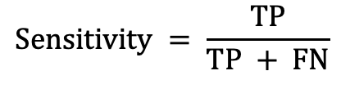
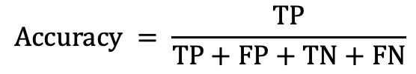
Confusion Matrix
 | Predicted Positive | Predictive Negative
Actually Positive | True Positive | False Negative
Actually Negative | False Positive | True Negative
With a binary classifier, we’re always predicting whether something else is Positive or Negative
This means that we can define a confusion matrix
Most ways of evaluating a classifier use this confusion matrix
$$Accuracy = \frac{TP}{TP+FP+TN+FN}$$
$$Sensitivity = \frac{TP}{TP + FN}$$

Slide 43
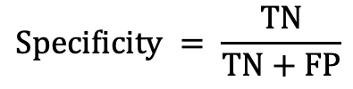
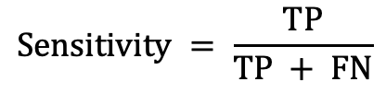
Confusion Matrix
We often get tradeoffs!
If we increase sensitivity, we get fewer false negatives; but we get more false positives
i.e. increasing sensitivity reduces specificity
In evaluating a biomarker, you need to decide what are the tradeoffs you are comfortable with
$$Sensitivity = \frac{TP}{TP + FN}$$
$$Specificity = \frac{TN}{TN+FP}$$

Slide 44
ROC-Curve
An important metric that is often more useful than confusion matrices is the receiver operating characteristic curve (ROC-curve)
This measures how often a classifier model ranks positive cases above negative cases
A classifier that is random would get it right 50% of the time

Slide 45


ROC-Curve
A useless classifier would be random: still correct 50% of the time (grey)
Area under the curve = 0.5

Slide 46

ROC-Curve
A useless classifier would be random: still correct 50% of the time (grey)
Area under the curve = 0.5
A perfect classifier would always put the positive cases above the negative ones, no matter the threshold (red)
Area under the curve = 1.0

Slide 47
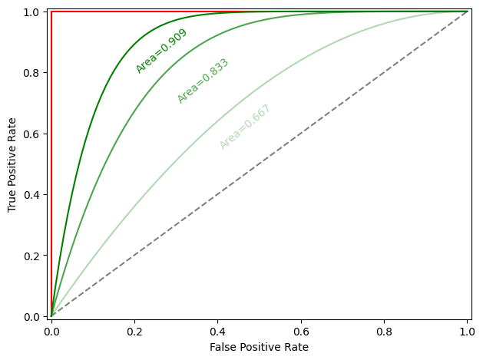
ROC-Curve
Realistic models appear somewhere between these two lines (green)
To evaluate a model, we can:
Plot the ROC curve
Measure the area under the ROC curve
A “better” model will produce a higher area under the curve

Slide 48
Practical Course

Slide 49
Practical Exercises
The practical exercises are designed to be self-guided
If you have any questions or problems, just ask!
The idea is to see how these techniques could be used - this is not at all comprehensive!
I’ll send out a full set of “solutions” after the end of the course

Slide 50
Tips for coding
Make mistakes!
Coding is iterative!
Nothing ever works first time
Visualise your data wherever you can
It gives you an idea what is going on
Use your peers and your teachers for help
AI is your friend
AI is exceptionally good at coding, especially in fixing bugs!
Try to write the code first yourself, but feel free to use ChatGPT/Claude/Gemini to help you if you get really stuck

Slide 51
Google Colab
Before the course, you were asked to make sure you all had a Google account
The course notebook runs in Google Colab, which is an online platform for running interactive Python notebooks
You can find the course content at this URL:
github.com/griffinfarrow/ML_for_Biomarker_Discovery
Your notebook will be saved in your personal Google Drive, so you can come back to it whenever you want

Slide 52
Summary

Slide 53
Summary
Thank you for coming along to the course, we hope you enjoyed it!
If you haven’t finished the practical exercises yet, try to finish them in your own time. This is hopefully a helpful companion to future work you might do in machine learning
We will send out some “solutions” in about a week

Slide 54
What should you be able to do?
Define what a biomarker is, and what a biomarker needs to be useful
Describe what the phases in biomarker discovery are
Understand how machine learning can help in biomarker discovery, and the types of machine learning that are used
See how to use pandas, UMAP and scikit-learn to read in data, filter it, and build machine learning models

Slide 55
What have we not really covered?
Sadly, there is only so much we can cover in 2 hours. We’ve tried to structure the course to cover as much breadth as possible, but we’ve sacrificed depth to do this.
There are many concepts in machine learning and biomarker discovery that we have not done proper justice to:
Hyperparameter tuning and cross-validation
Data cleaning and normalisation
Clustering
Survival analysis
At the end of the practical exercises, we’ve included links to several resources. We strongly recommend you check them out to understand a bit more about these topics!

Slide 56
Good luck!

Slide 57
Extension: How do we tell how good our biomarker is?

Slide 58
How do you tell if your biomarker works?
This is beyond the time constraints of this course
However, it is a crucial stage
Remember, a biomarker is only clinically useful if it is associated with some endpoint that we care about
The key tool here is survival analysis
The statistical analysis of time-dependent data
We aren’t just interested in whether events (such as death) occur, we are interested in how long it is before they occur

Slide 59
Survival Analysis: beyond the scope of this lecture
The aim of a lot of biomarkers is to predict the future progression of a disease
We can quantify whether they achieve this using survival analysis
Survival analysis models the time to an event, not just whether the event occurs
Complicated by censorship
We can’t just look at the fraction of people who had the outcome (say death), because they all have different times-to-event
There are three possibilities: the event doesn’t occur, the event has already occurred, or it hasn’t occurred yet
Censoring captures this information, but it requires different models for the prediction

Slide 60
Kaplan-Meier Curves: beyond the scope of this lecture
Kaplan-Meier curves show the “survival function”, which is the fraction of patients who have not experienced the event as a function of time
They visualise distinct outcomes
If two Kaplan-Meier curves are distinct, that implies statistically significant survival differences

Slide 61
Cox Proportional Hazards Models: beyond the scope of this lecture
Another approach in survival analysis is to quantify “how much more likely is the event, given the biomarker”
This allows us to make statements like “a patient with this biomarker is five times more likely to need this treatment”
In effect, it gives us relative risk between groups
It also allows us to control for other features
If a biomarker is associated with more lethal disease, but also all the patients who have that biomarker are above 80, is it the age or the biomarker that is really predicting the outcome?
The Cox Proportional Hazards Model is used to do this: https://www.emilyzabor.com/survival-analysis-in-r.html#the-cox-regression-model

Slide 62
Survival Analysis
As with most things, you don’t need to write the code for this analysis yourself
There are software packages that do it for you
In R: the “survival” package:
https://www.emilyzabor.com/survival-analysis-in-r.html (also just a really useful resource to read)
In Python: the “lifelines” package:
https://lifelines.readthedocs.io/en/latest/

