Slide 1
QuizzyBee
By Team Vulture

Slide 2
Contents
Team Member Introductions
App Description
App Demo

Slide 3
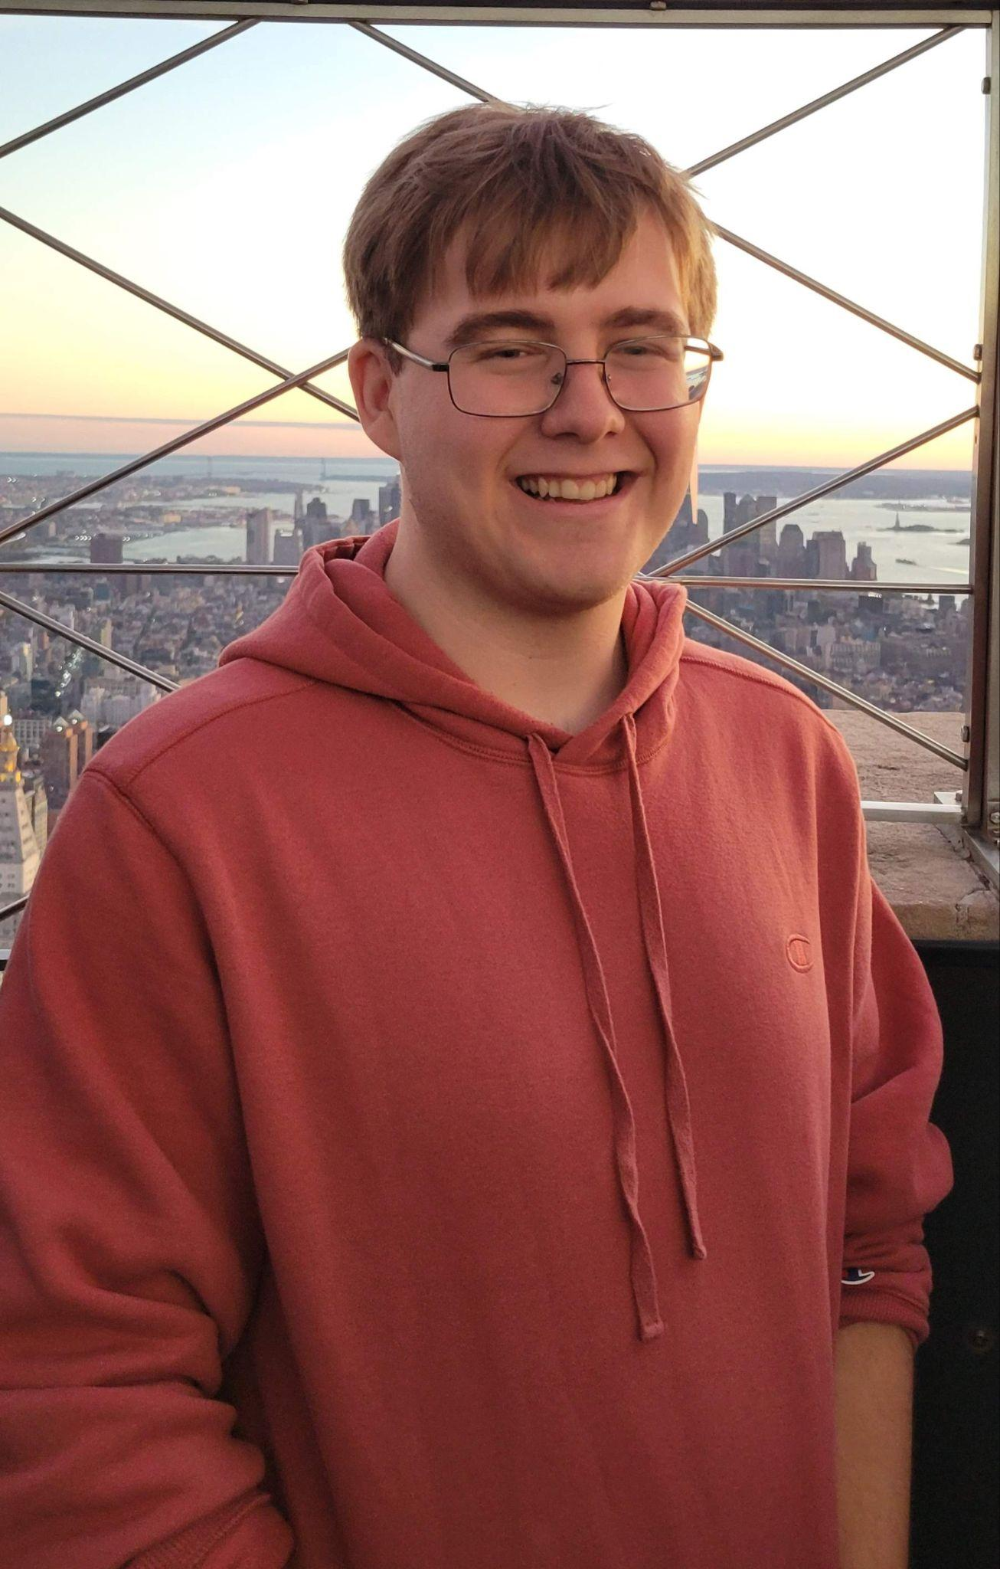
Team Member Introduction: Griffin Newbold
I’m Griffin, a CS major in SEAS graduating Spring 2025.
I came up with the idea for the app, designed the app icon, worked on login and registration, the text to speech feature, the sharing feature, as well as setting up the database and networking checks and UI enhancements.

Slide 4
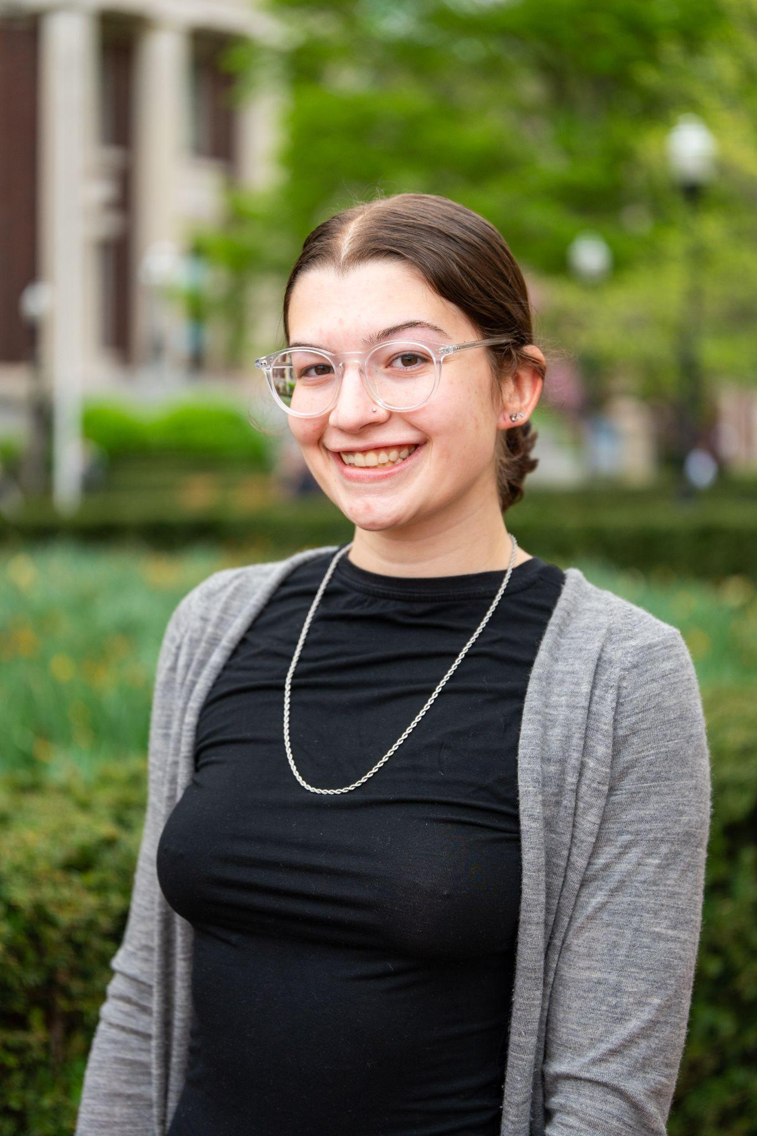
Team Member Introduction: Madeleine Lerner
I’m Madeleine, a senior at Barnard studying CS graduating this semester (and starting full-time SWE work in, like, less than a week).
I implemented the create new deck UI + BE functionality as well as the change card color and notifications features.

Slide 5
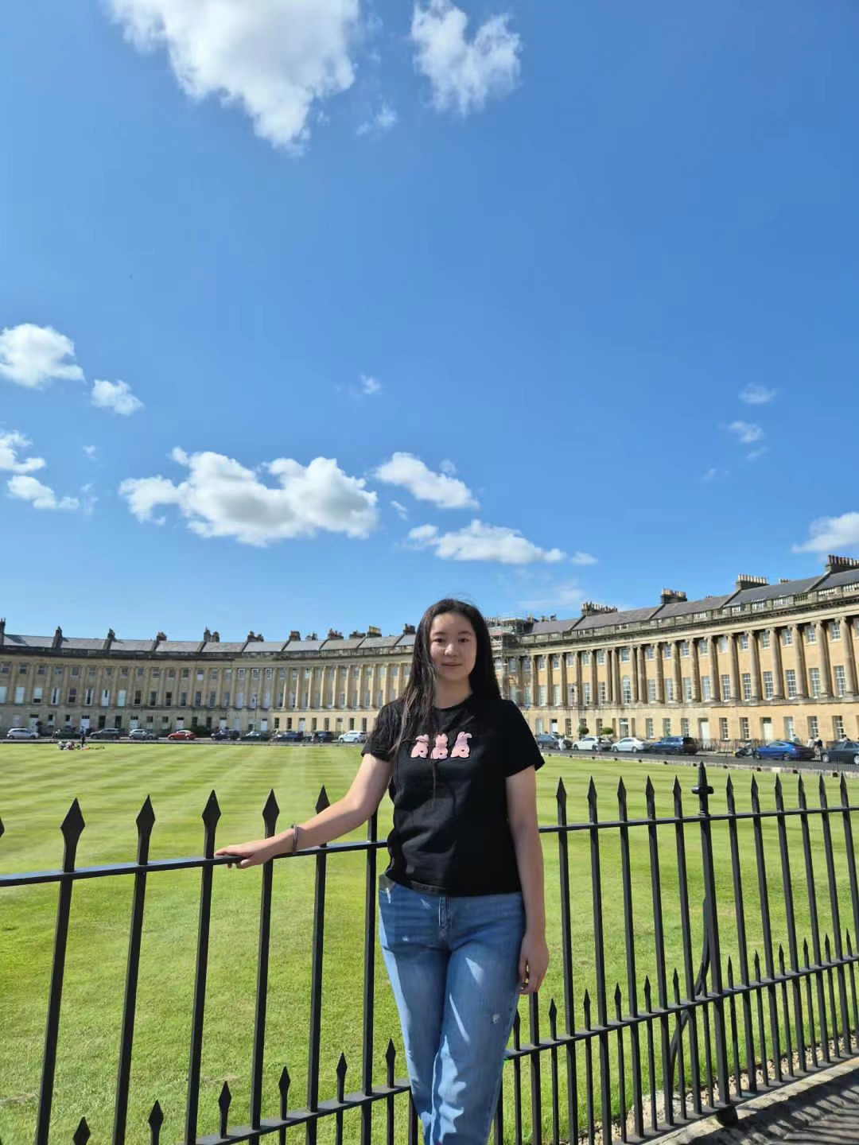
Team Member Introduction: Yuxin Li
I’m Yuxin, a junior at SEAS studying Computer Science.
I implemented the dashboard and the initial user profile UI + the logout/sign-in logic + text-to-speech Backend + user tour guide.

Slide 6
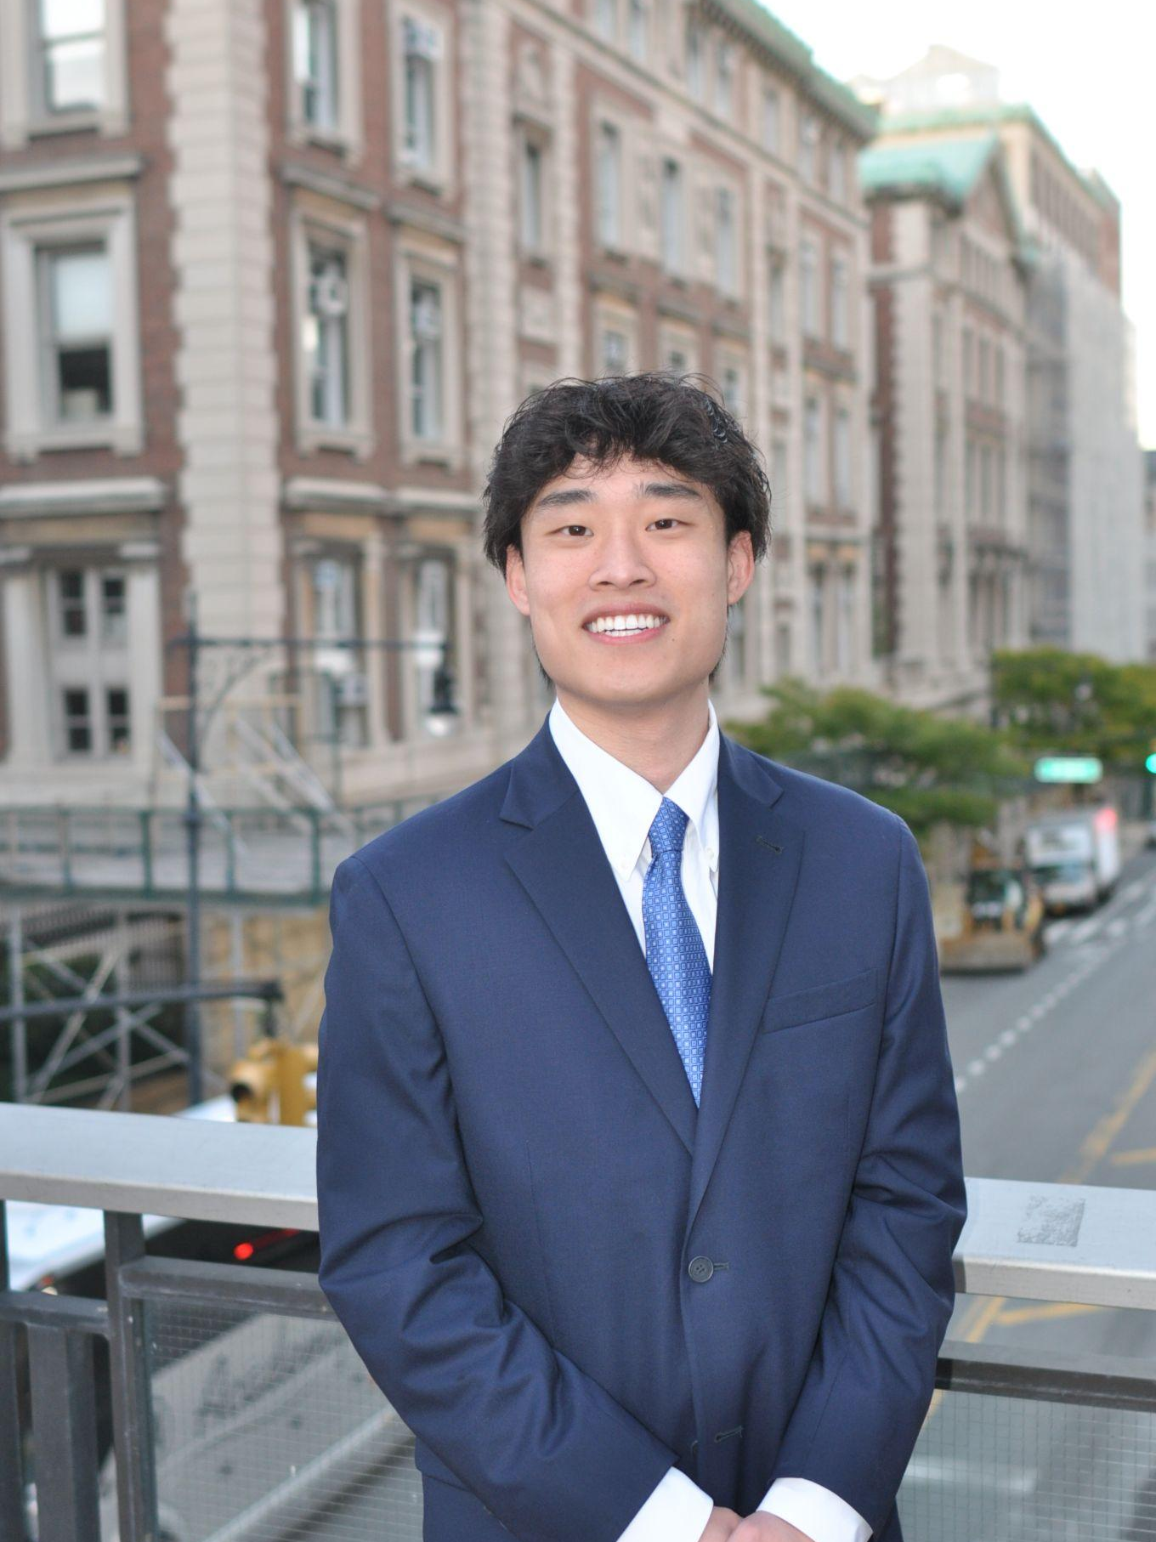
Team Member Introduction: Tommy Lam
I’m Tommy, a junior in CC studying Computer Science.
I implemented the quiz UI and our AI backend implementation for quiz generation using OpenAI’s API.

Slide 7
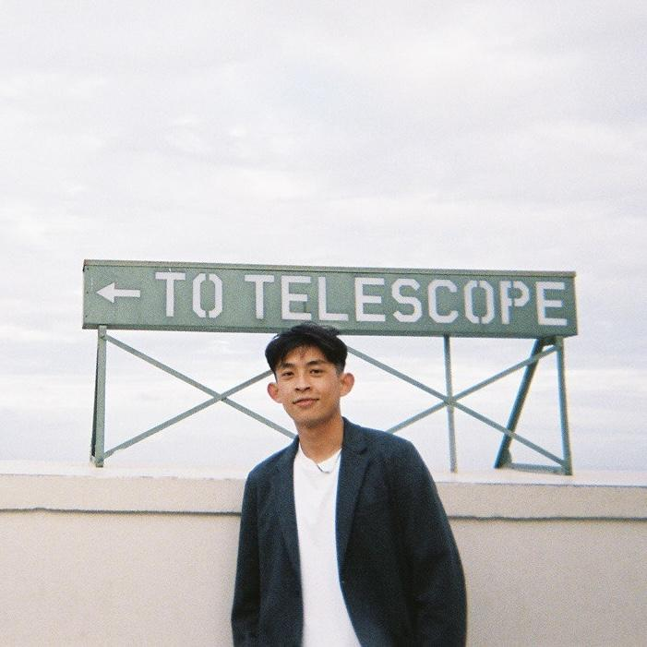
Team Member Introduction: Chia Peng Wu
I’m Chia Peng, a senior in GS studying Computer Science.
I made the existing flashcards view, wire up main functionalities together such as add cards, quiz, and basic edit card functions(edit, save, and delete). Ensuring seamless integration(backend) and a smooth flow between adding new card and existing flashcards deck view for a user-friendly experience.

Slide 8
App Description
QuizzyBee is your one stop shop for AI enhanced studying, making use of in house frameworks like AVFoundation, Network, and the Notifications framework as well as external APIs like OpenAI and ElevenLabs. We also make use of Firebase for user authentication and data store. We ensure that your experience is never dull when using our app.

Slide 9
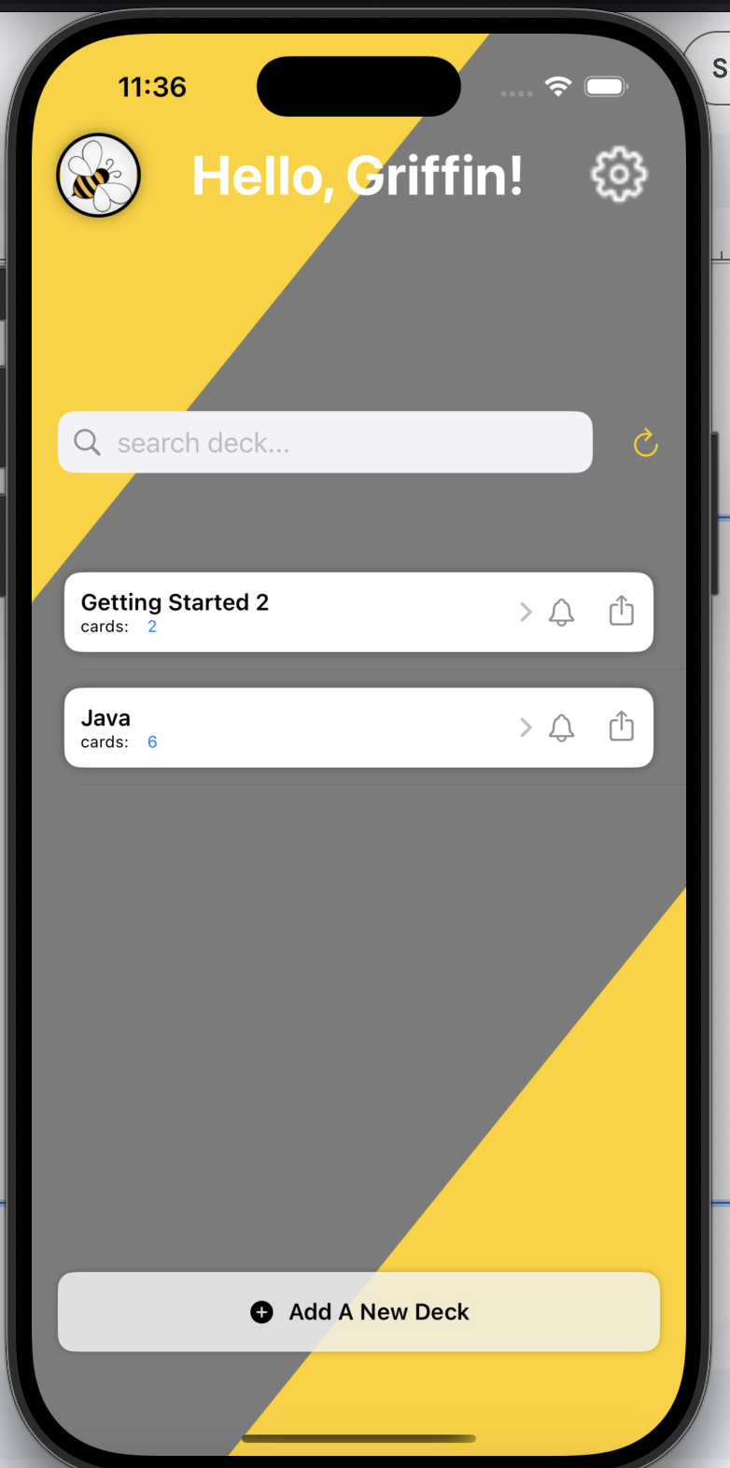
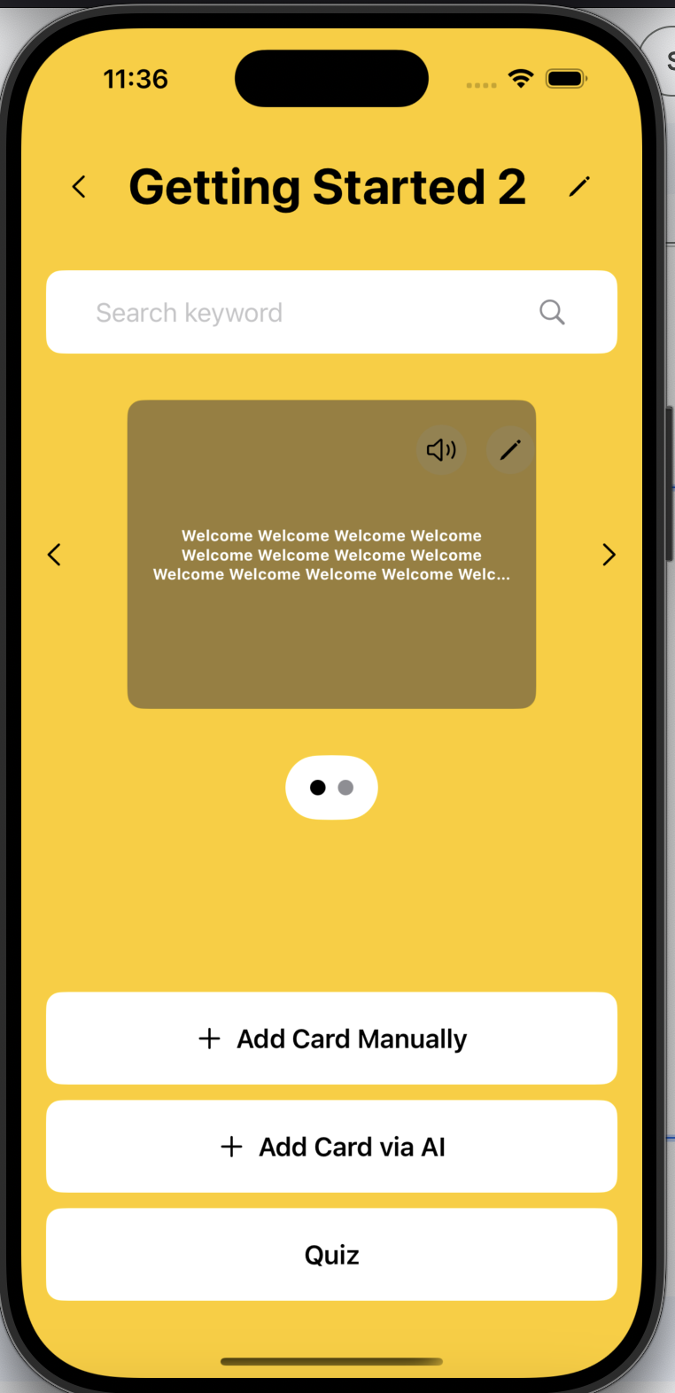
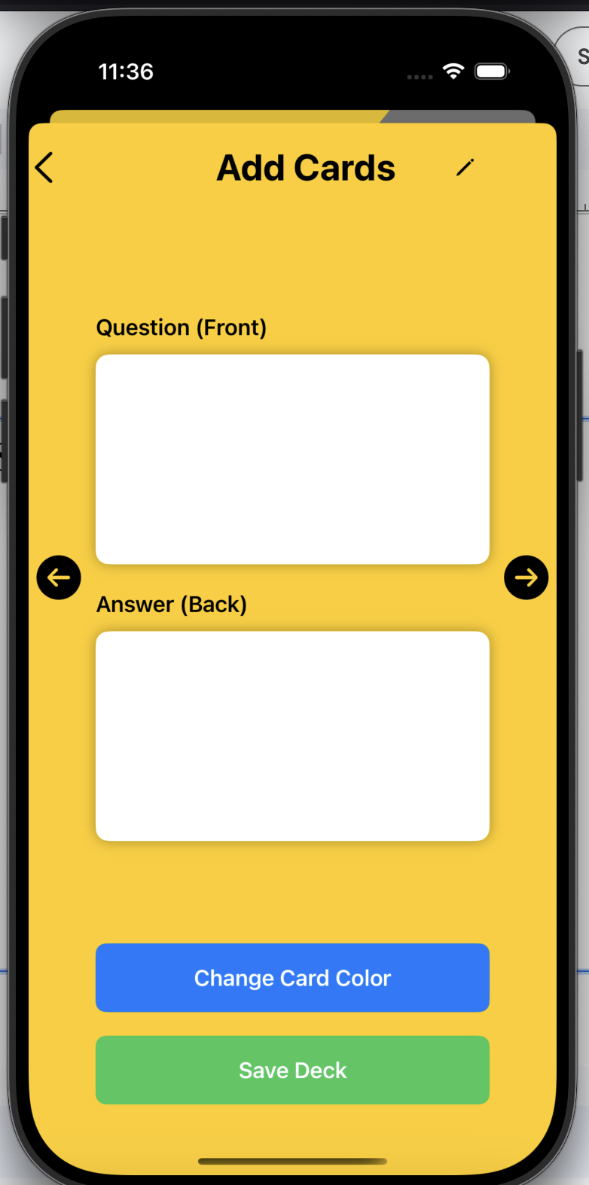
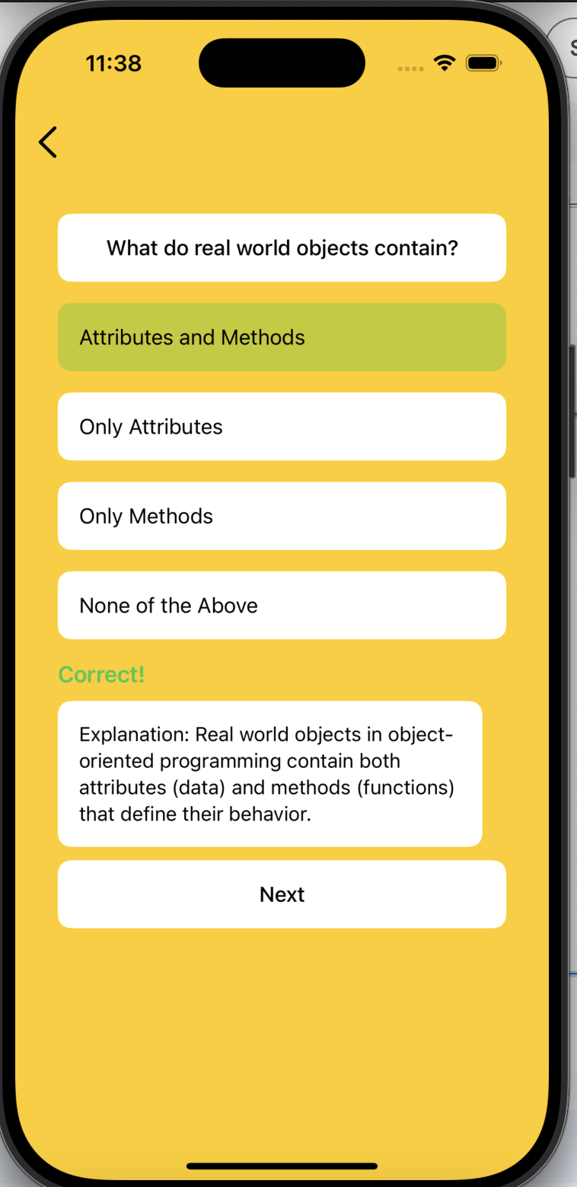
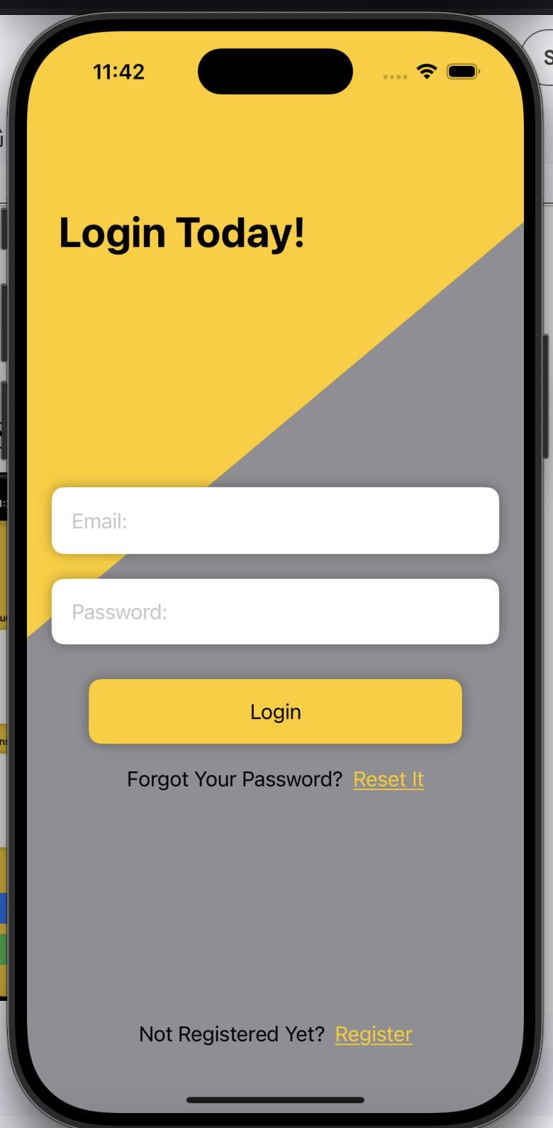
App Demonstration
Now we can see the app in action! See below for select screenshots!

