Slide 1

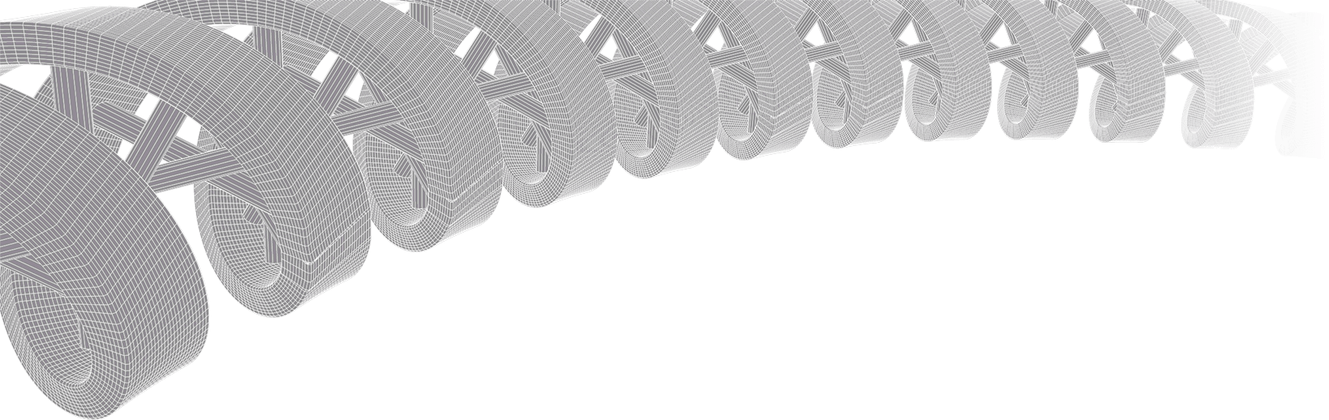
GenViz Module 3: Introduction to GenVisR
Malachi Griffith, Obi Griffith, Zachary Skidmore
Genomic Data Visualization and Interpretation
April 8-12, 2019
Freie Universität Berlin

Slide 2
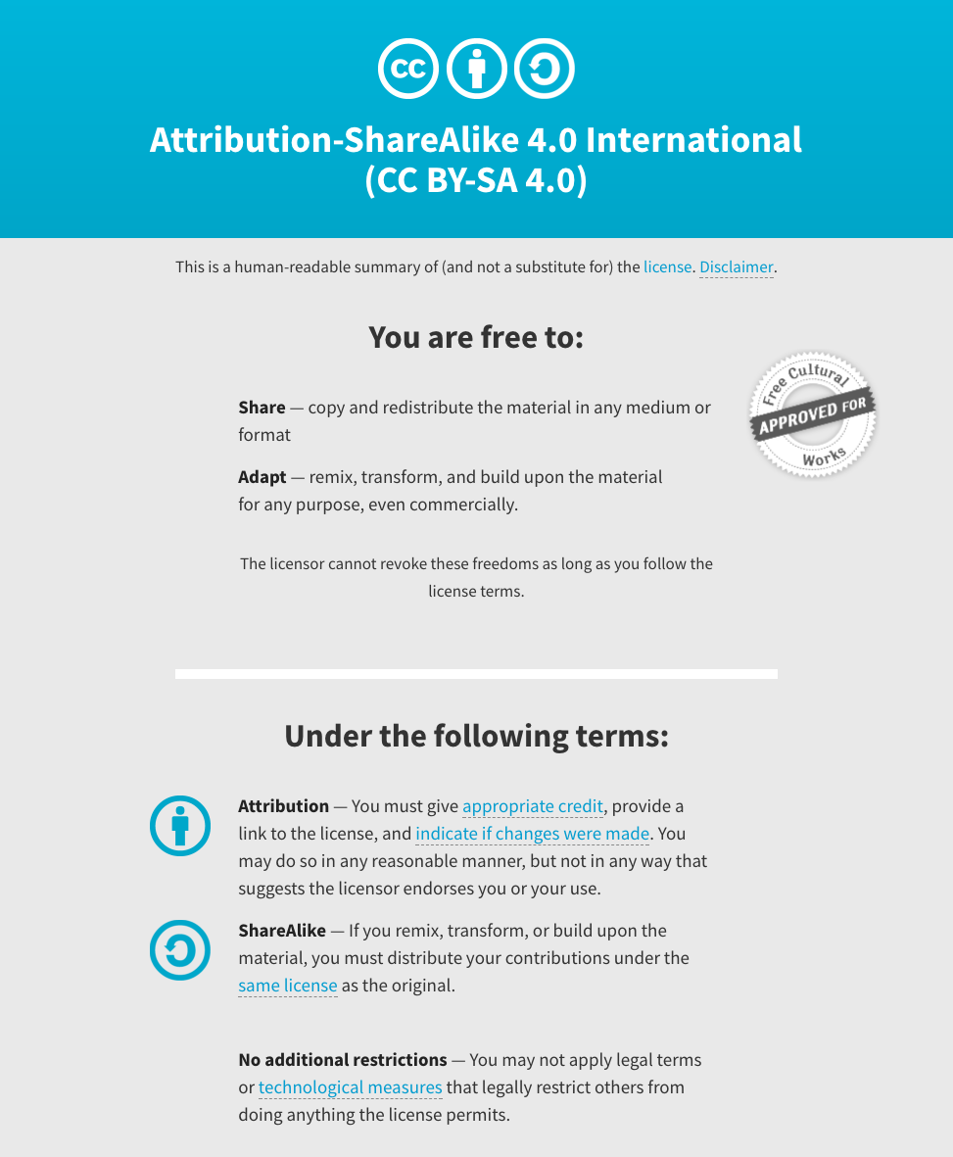
Notes:
Note there are two licenses if effect for this course.
All *content* (lectures, written materials, etc.) are made available under the Creative Commons Attribution-ShareAlike 4.0 International (CC BY-SA 4.0). (https://creativecommons.org/licenses/by-sa/4.0/).
All *code* (R scripts the website code itself) are made available under the MIT License (https://opensource.org/licenses/MIT).

Slide 3
Learning objectives of the course
Module 1: Introduction to genomic data visualization and interpretation
Module 2: Using R for genomic data visualization and interpretation
Module 3: Introduction to GenVisR
Module 4: Expression profiling, visualization, and interpretation
Module 5: Variant annotation and interpretation
Module 6: Q & A, discussion, integrated assignments, and working with your own data
Tutorials
Provide working examples of data visualization and interpretation
Self contained, self explanatory, portable

Slide 4
Learning objectives of module 3
Introduction to GenVisR
Creation and interpretation of GenVisR plots
waterfall()
TvTi()
genCov()
cnFreq()
cnSpec()
lohSpec()
covBars()
Adding plot layers to GenVisR
Arranging viewports with gridExtra
Aligning viewports with gtable

Slide 5
What is GenVisR?
Provides a toolkit for visualizing Genomic data
Implemented in R
Emphasis on producing “publication quality” graphics with a minimal amount of user input.
Part of bioconductor
https://www.bioconductor.org/packages/3.3/bioc/html/GenVisR.html
Active development on github
https://github.com/griffithlab/GenVisR
Functions focused in three areas “Small variants”, “Copy number alterations”, and “Data quality”

Slide 6
Why GenVisR?
The package is built upon ggplot2 and will allow us to leverage information we've learned in previous modules.
The package is intended to be flexible, supporting multiple file types, species, etc.
The package is relatively popular; In the top 20% of bioconductor downloads.
The package is regularly updated with improvements, bug fixes, etc.
The package is maintained by the Griffith lab.

Slide 7
GenVisR::waterfall()
What does it do?
Visualize the types of mutations within a cohort
Visualize the mutation burden in a data set
Visualize the proportion of samples with a mutated gene
Visualize clinical data
Why do we care?
Determine mutually exclusive or co-occurring genomic events
Recognize patterns within clinical data
See if the mutation burden conforms to expectations

Slide 8
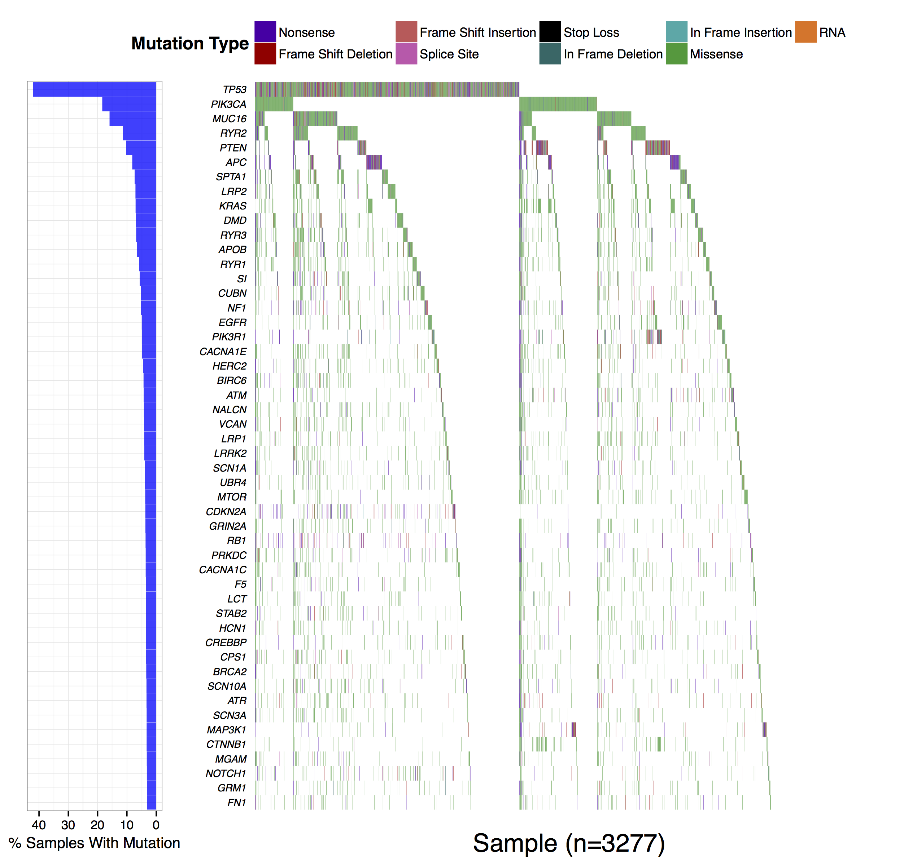
GenVisR::waterfall()
Fig. 2: “DGIdb 2.0: mining clinically relevant drug–gene interactions”

Slide 9
GenVisR::TvTi()
What does it do?
Visualize Transition and Transversion proportions
Visualize Transition and Transversion frequencies
Compare these proportions with expectations
Why do we care?
Visualize mutation profile patterns
Ex. Smoking tends to increase G -> T/C -> A transversions due to oxidative damage
Practical application verify smoking status of patients with lung carcinomas

Slide 10
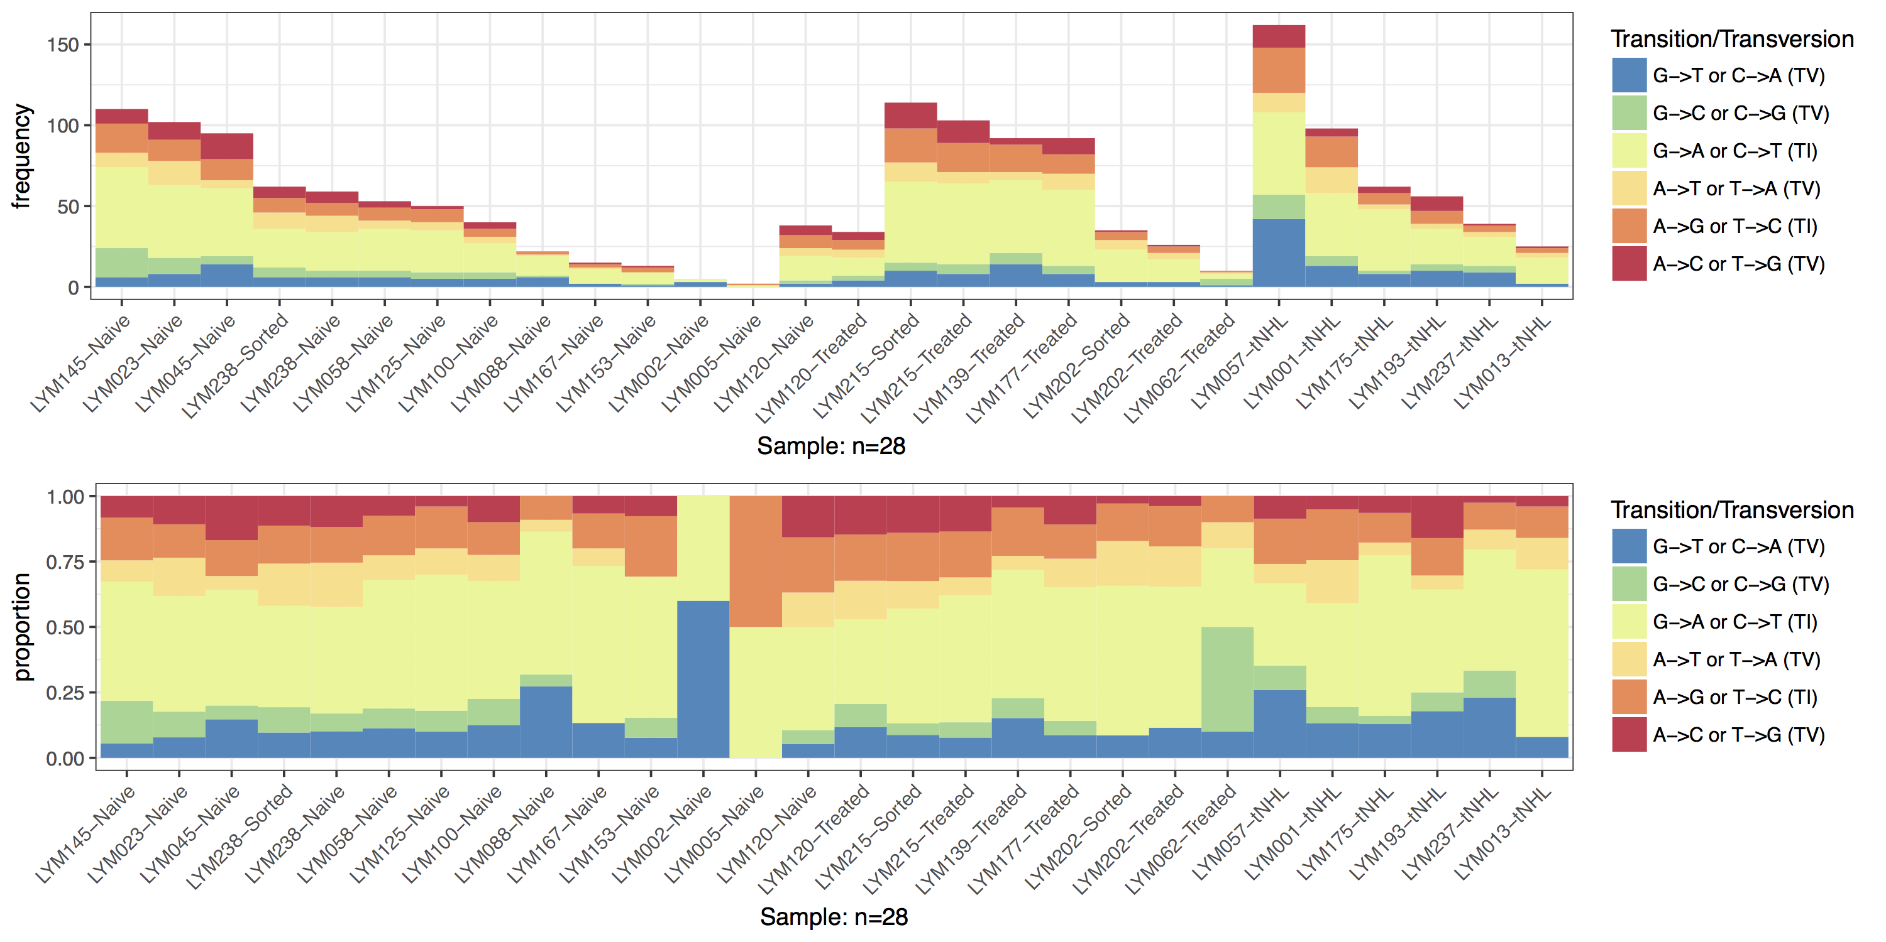
GenVisR::TvTi()
This research was originally published in Blood. Krysiak et al. Blood 2017 129:473-483 by Krysiak et al. licensed under © the American Society of Hematology

Slide 11
GenVisR::cnSpec()
What does it do?
Display recurrent copy number alterations
Why do we care?
Recognize patterns of amplifications and deletions while maintaining sample information

Slide 12
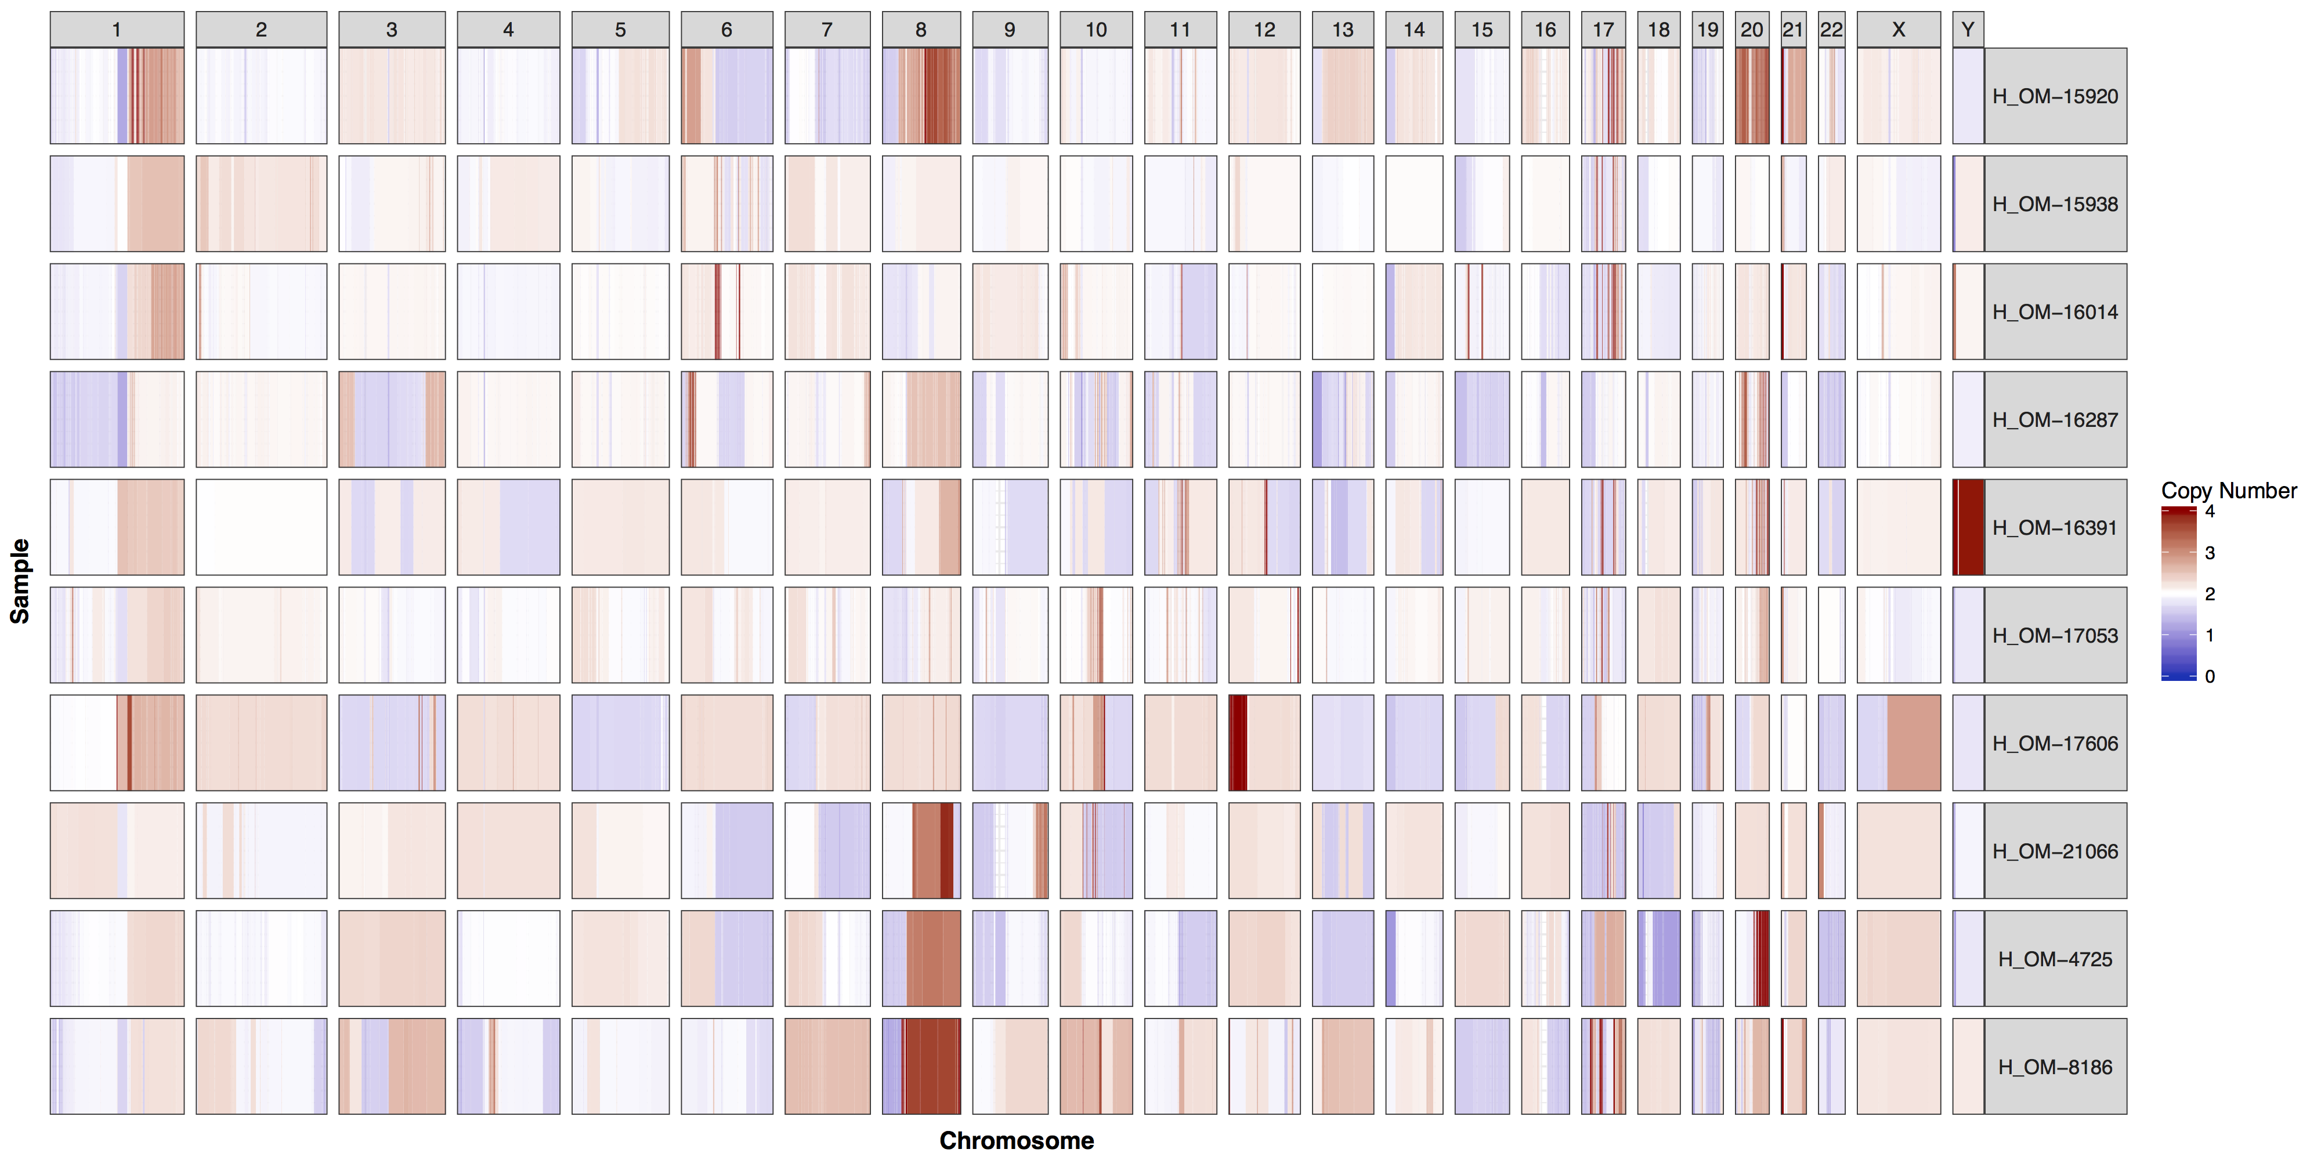
GenVisR::cnSpec()
Data from: "Genomic characterization of HER2-positive breast cancer and response to neoadjuvant trastuzumab and chemotherapy-results from the ACOSOG Z1041 (Alliance) trial."

Slide 13
GenVisR::cnFreq()
What does it do?
Another view displayed from cnSpec
Summarize copy number alterations across a cohort
Plots segmented copy number alterations for a cohort
Why do we care?
Easily view recurrently amplified/deleted regions

Slide 14
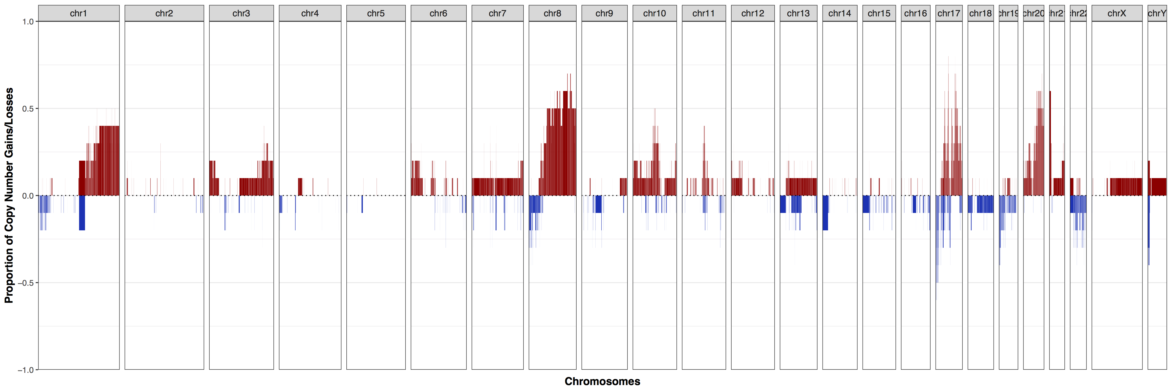
GenVisR::cnFreq()
Data from: "Genomic characterization of HER2-positive breast cancer and response to neoadjuvant trastuzumab and chemotherapy-results from the ACOSOG Z1041 (Alliance) trial."

Slide 15
GenVisR::lohSpec()
What does it do?
Visualize loss of heterozygosity (LOH) for multiple samples
Why we care?
Copy-neutral LOH could be missed with a plot produced with functions such as cnSpec however these events are potentially interesting
lohSpec allows these events to be viewed and summarized for multiple samples allowing viewing of recurrent LOH patterns

Slide 16
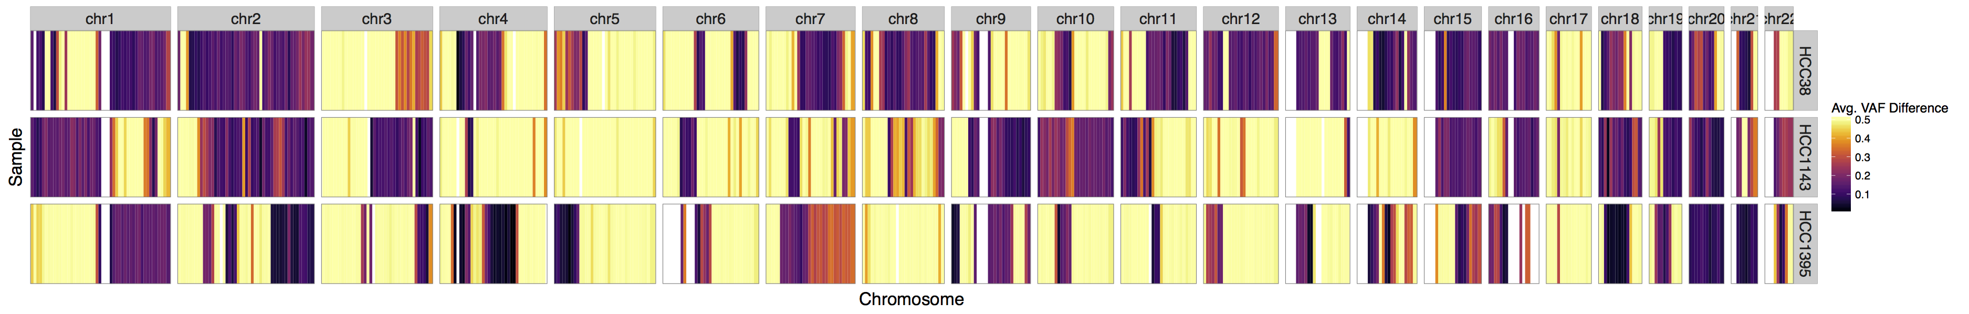
GenVisR::lohSpec() for 3 breast cancer cell lines

Slide 17
GenVisR::genCov()
What does it do?
Visualize coverage in a region of interest
Why do we care?
Infer the impact of a structural deletion
Verify gene knockouts

Slide 18
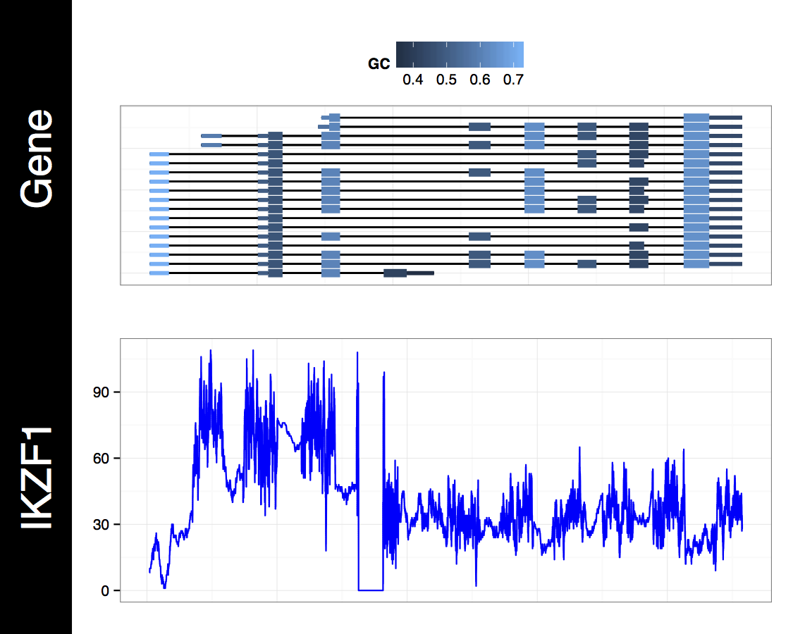
GenVisR::genCov()
Fig. 2: “Comprehensive genomic analysis reveals FLT3 activation and a therapeutic strategy for a patient with relapsed adult B-lymphoblastic leukemia”

Slide 19
GenVisR::covBars()
What does it do?
Visualize sequencing coverage achieved across samples
Why do we care?
Immediately identify if a sample has failed sequencing or has not achieved the expected sequencing depth

Slide 20
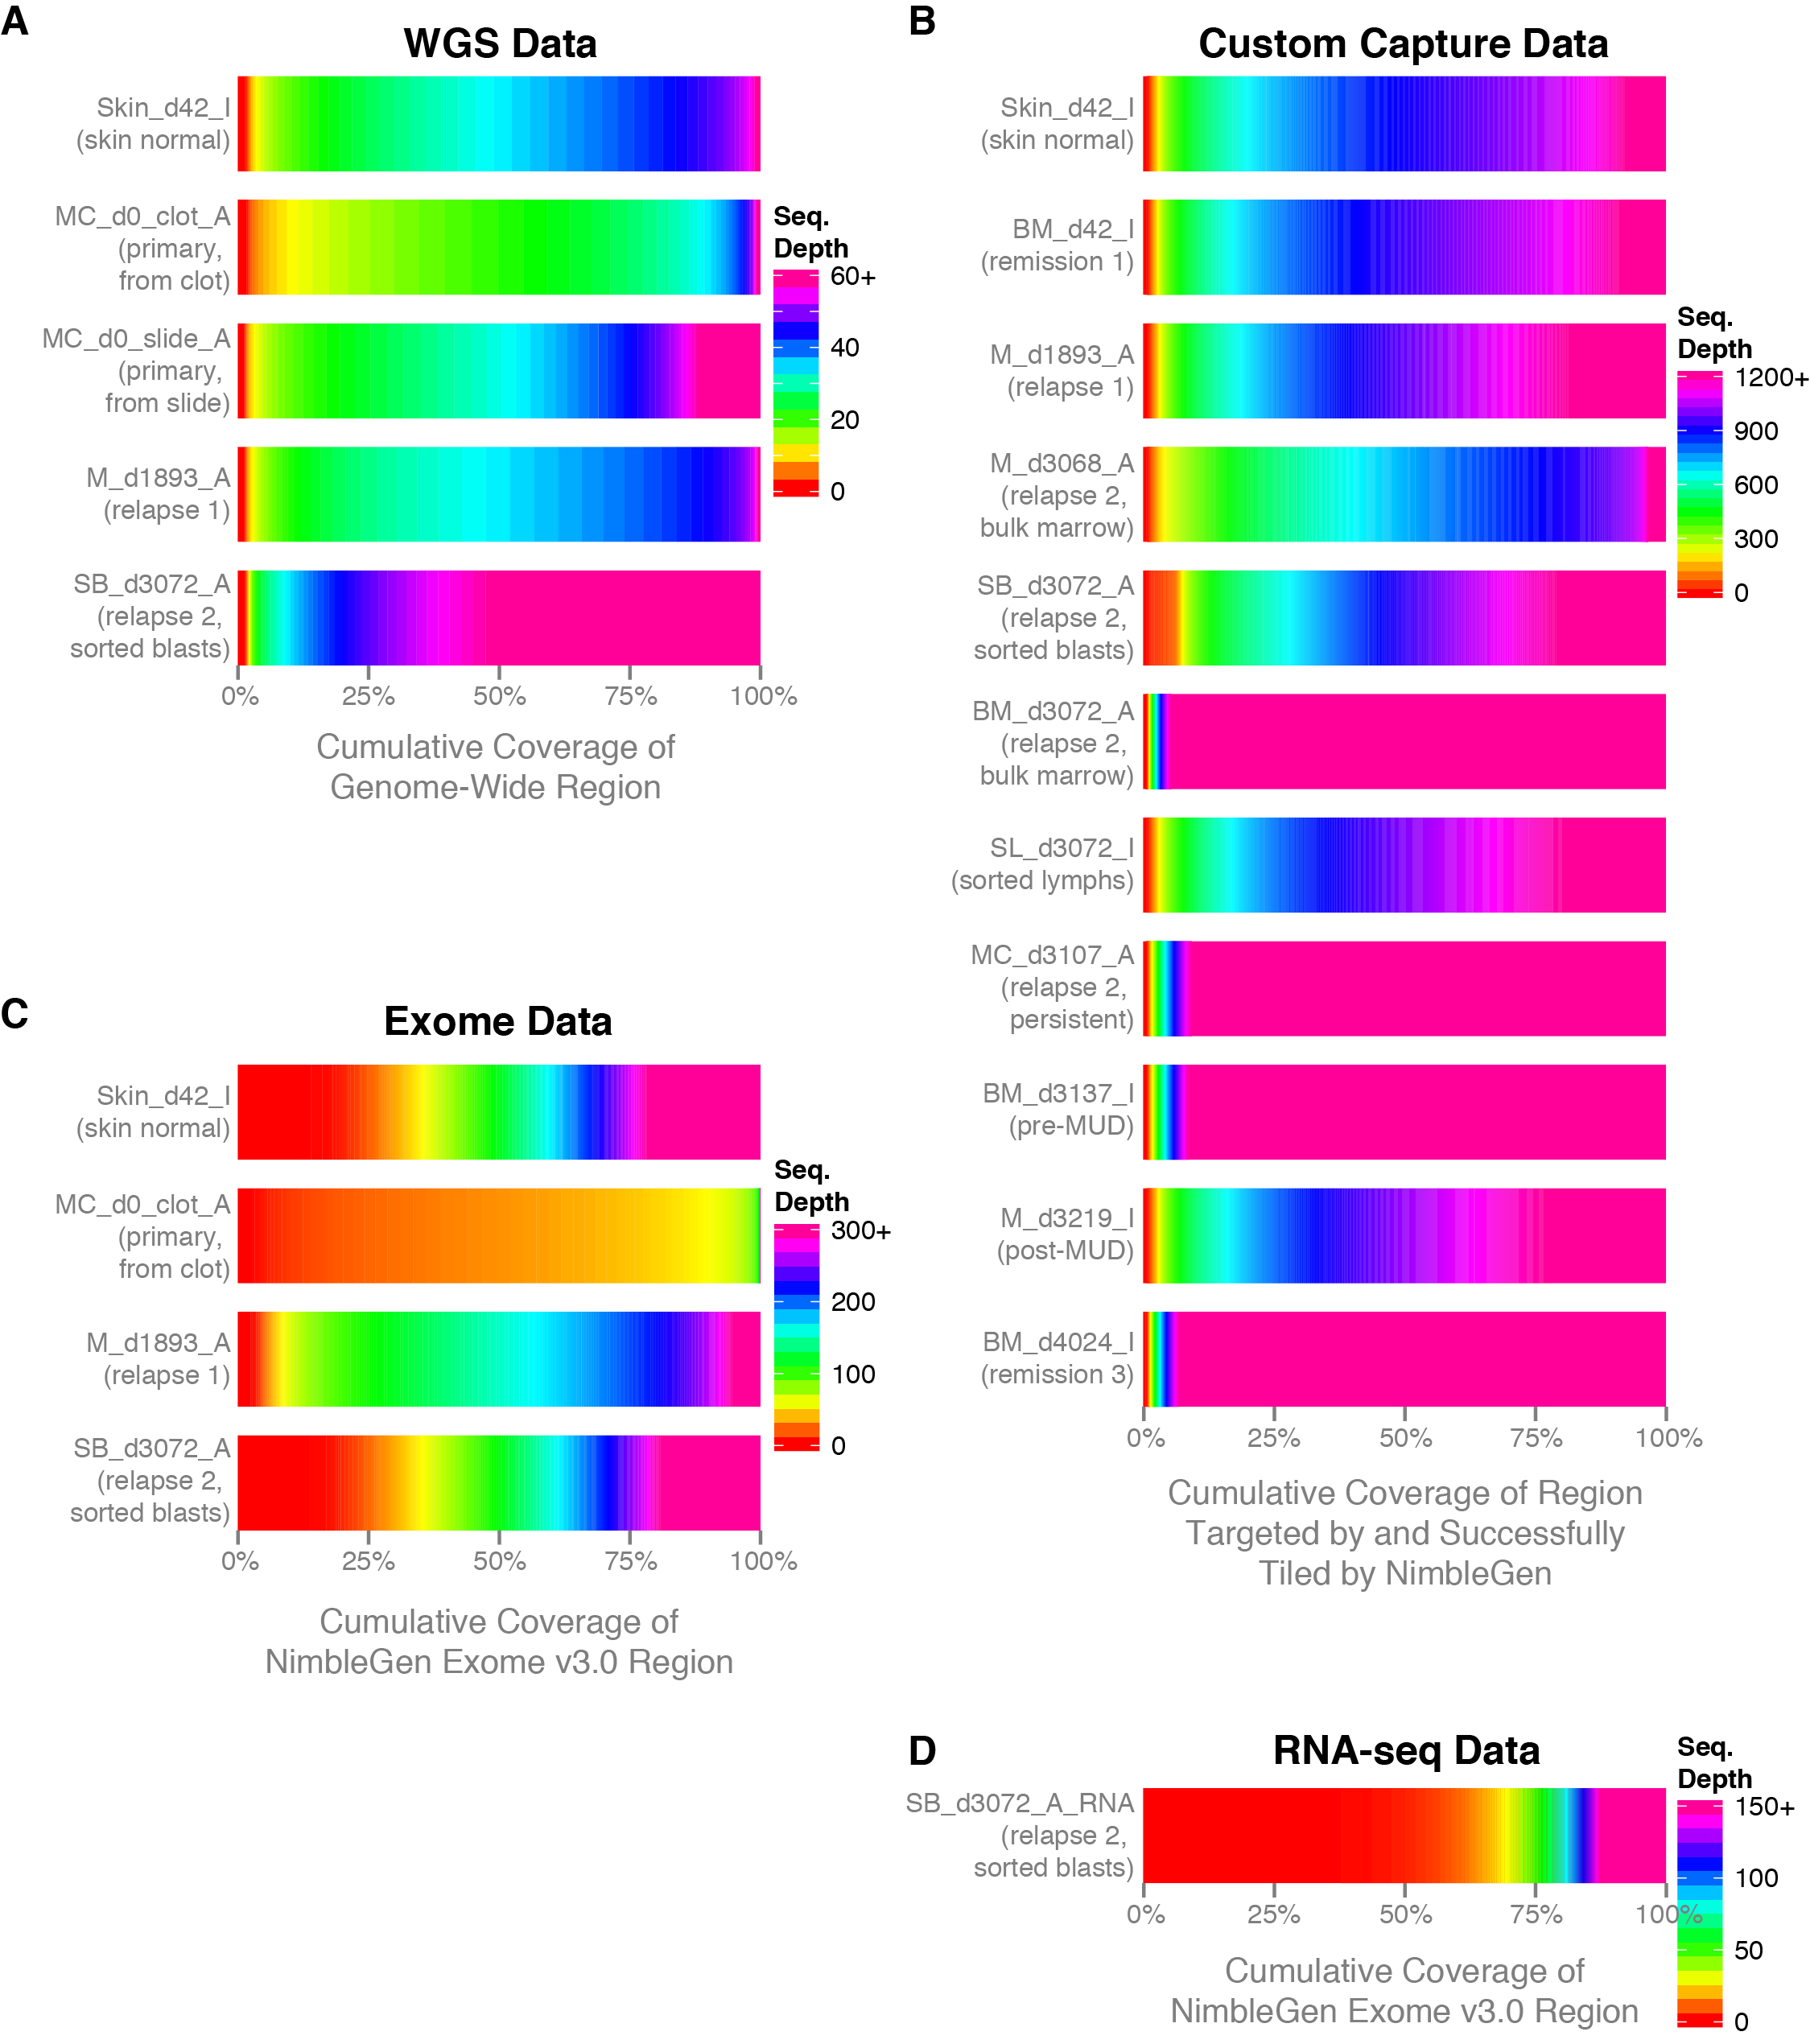
GenVisR::covBars()
Supp. Fig. 3: “Comprehensive genomic analysis reveals FLT3 activation and a therapeutic strategy for a patient with relapsed adult B-lymphoblastic leukemia”

