Slide 1


GenViz Module 2: Using R for genomic data visualization and interpretation
Malachi Griffith, Obi Griffith, Zachary Skidmore
Genomic Data Visualization and Interpretation
September 11-15, 2017
Berlin

Slide 2
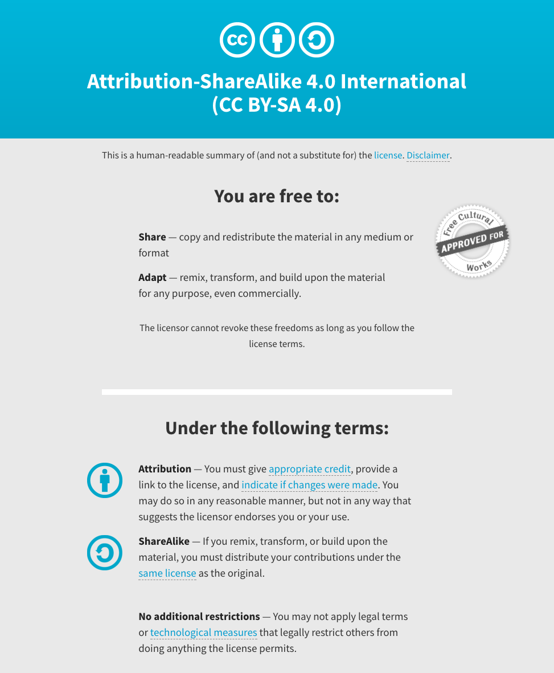
Notes:
Note there are two licenses if effect for this course.
All *content* (lectures, written materials, etc.) are made available under the Creative Commons Attribution-ShareAlike 4.0 International (CC BY-SA 4.0). (https://creativecommons.org/licenses/by-sa/4.0/).
All *code* (R scripts the website code itself) are made available under the MIT License (https://opensource.org/licenses/MIT).

Slide 3
Learning objectives of the course
Module 1: Introduction to genomic data visualization and interpretation
Module 2: Using R for genomic data visualization and interpretation
Module 3: Introduction to GenVisR
Module 4: Expression profiling, visualization, and interpretation
Module 5: Variant annotation and interpretation
Module 6: Q & A, discussion, integrated assignments, and working with your own data
Tutorials
Provide working examples of data visualization and interpretation
Self contained, self explanatory, portable

Slide 4
Learning objectives of module 2
Review basic R usage
Learn to use R for basic data manipulation
Learn to create publication quality graphs to display data
Learn to create interactive graphics

Slide 5
A brief history of R
R is an implementation of the S programming language combined with lexical scoping semantics inspired by Scheme.
S was created by John Chambers while at Bell Labs
There are some important differences, but much of the code written for S runs unaltered.
R was created by Ross Ihaka and Robert Gentleman at the University of Auckland, New Zealand
Currently developed by the R Development Core Team, of which Chambers is a member.
The R project was conceived in 1992, with an initial version released in 1995 and a stable beta version in 2000
https://en.wikipedia.org/wiki/R_(programming_language)

Slide 6


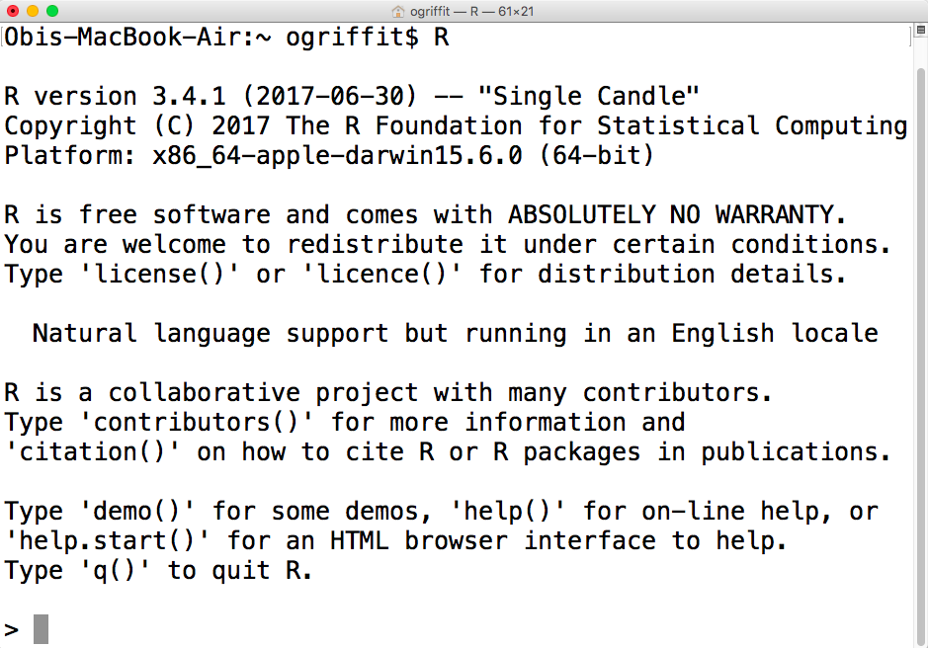
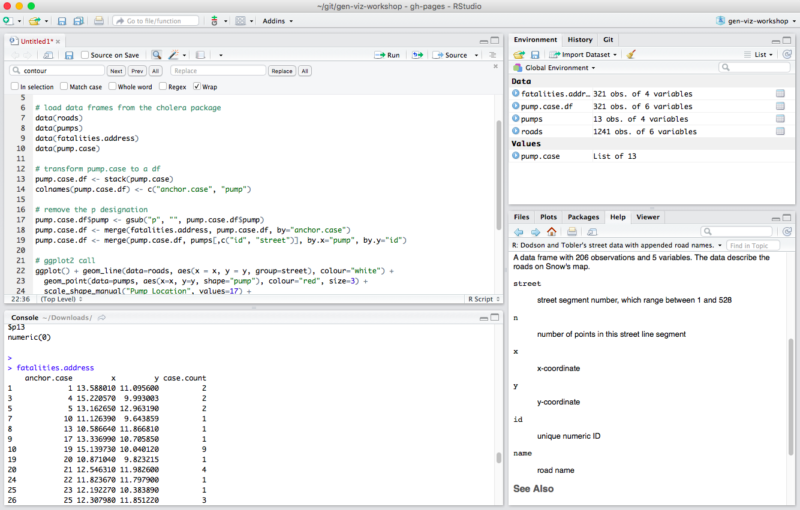
R is available via command-line or a number of integrated development environments (IDE)
R Project
Rstudio
https://cran.r-project.org/
https://www.rstudio.com/
Open-source, non-profit
Open-source, free + commercial

Slide 7
Installation and versions
Shiny installation is very simple
R installation generally only a little more complicated
Pre-compiled binaries exist for most operating systems
Be aware of R versions
Occasionally some packages may be version dependent or interdependent
Less of an issue these days

Slide 8
CRAN and BioConductor

Slide 9
Getting help: ?, vignettes(), and data()

Slide 10
Variables and Data types
As with any programming language, you need to use various variables to store various information. When you create a variable you reserve some space in memory and keep a record of its location for later retrieval and use.
The information you wish to store might be characters (e.g., text), integers, boolean (e.g., True/False) etc.
In contrast to other many programming languages (e.g., C, java, etc) in R, variables are not declared as a specific data type.
The variables are assigned with R-Objects and the data type of the R-object becomes the data type of the variable.
Frequently used R-Objects include: Vectors, Lists, Matrices, Arrays, Factors, Data Frames
The simplest R-object is the atomic vector
There are six data types for atomic vectors, also termed as six classes of vectors: logical, numerical, integer, complex, character, and raw
The other R-Objects are built upon atomic vectors
Lists are also vectors but are not atomic vectors, meaning that they can include multiple data types and can be recursive (contain lists of lists)

Slide 11
<- vs =

Slide 12
Data structures (R objects)

Slide 13
Understanding data and object types with class(), typeof() and is.*()
x | class(x) | typeof(x) | is.*(x)
x <- 1.0 | numeric | double | is.numeric(x)=TRUE is.double(x)=TRUE
x <- 1L | integer | integer | is.integer(x)=TRUE
x <- “a” | character | character | is.character(x)=TRUE
x <- TRUE | logical | logical | is.logical(x)=TRUE
x <- charToRaw(“a”) | raw | raw | is.raw(x)=TRUE
x <- 4 + 4i | complex | complex | is.complex(x)=TRUE
x <- matrix(1:4, nrow=2) | matrix | integer | is.matrix(x)=TRUE Is.integer(x)=TRUE
x <- data.frame(x=1:2, y=c(“a”, “b”)) | data.frame | list | is.data.frame(x)=TRUE is.list(x)=TRUE

Slide 14
Vectors

Slide 15
Factors

Slide 16
Lists

Slide 17
Attributes

Slide 18
Importing and Exporting Data

Slide 19
Dataframes

Slide 20
Apply functions

Slide 21
Custom functions

Slide 22
Introducing ggplot2

Slide 23
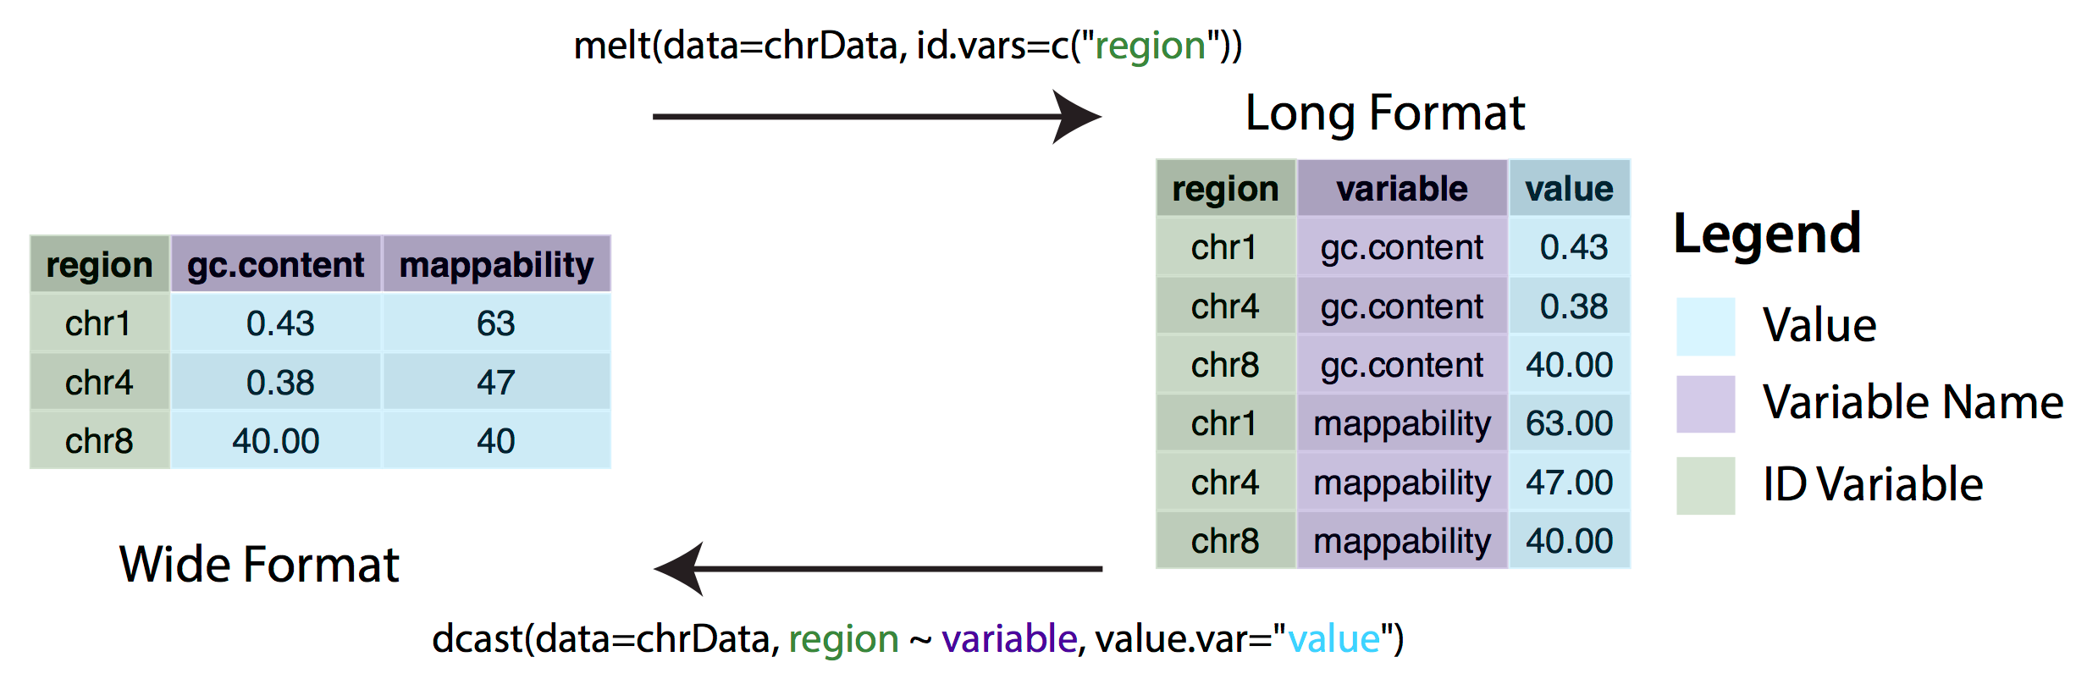
Wide vs long format

Slide 24
Graphics options in R
At least 3 primary graphics options in R
base R graphics
plot(), par(), etc
lattice
ggplot2

Slide 25
Why use ggplot2?
base R
ggplot2

Slide 26
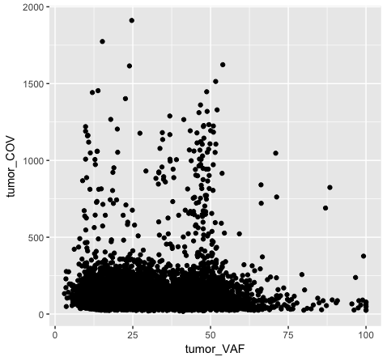
ggplot2 syntax
ggplot(data=variantData, aes(x=tumor_VAF, y=tumor_COV)) + geom_point()
dataframe with data to be plotted
geometric objects specify how data should be plotted
Aesthetic mappings describe how variables in the data are mapped to visual properties (aesthetics) of geometric objects (geoms)

Slide 27
Faceting

Slide 28
Themes

Slide 29
RMarkdown?

Slide 30
Interactive graphics with R shiny
Optimizing a graphic often requires multiple iterative alterations
Analysis and interpretation often benefits from active filtering, variable selection, and parameterization
Interactive graphics allow end-users, especially non-experts, to more effectively explore data
The R shiny package allows you to quickly and easily create sophisticated web-accessible interactive graphics

Slide 31
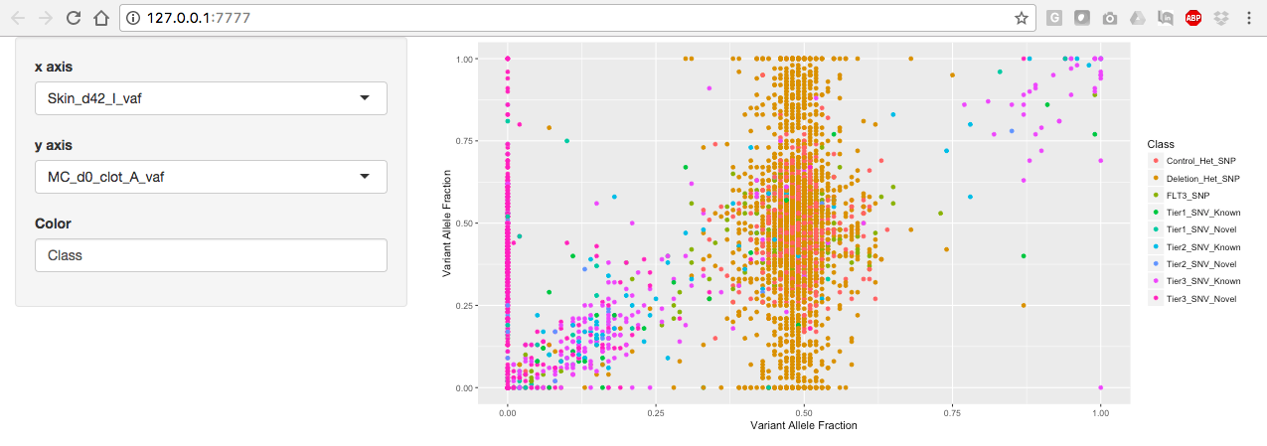
Basic organization of a shiny application
shinyServer
server.R
User input
R output
shinyUI
ui.R
Interactive User Interface (UI) = website

Slide 32
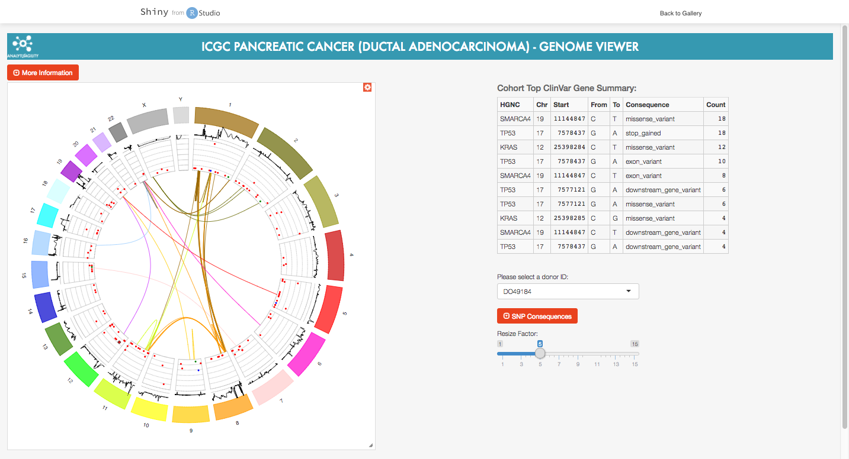
Demo of shiny gallery genomics example
https://shiny.rstudio.com/gallery/

Slide 33
Questions?

