Slide 1

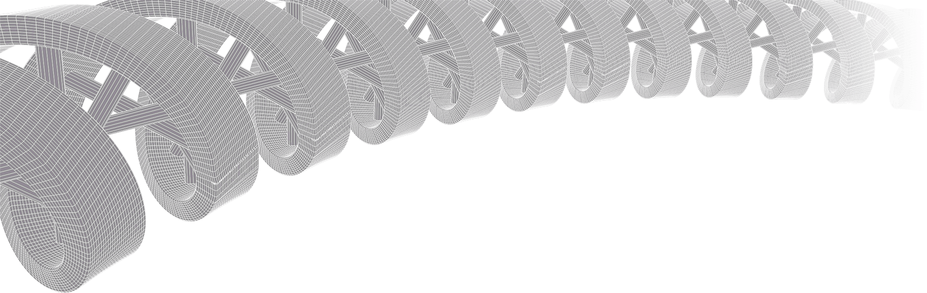
GenViz Module 4: Expression profiling, visualization, and interpretation
Malachi Griffith, Obi Griffith, Zachary Skidmore
Genomic Data Visualization and Interpretation
September 11-15, 2017
Berlin

Slide 2
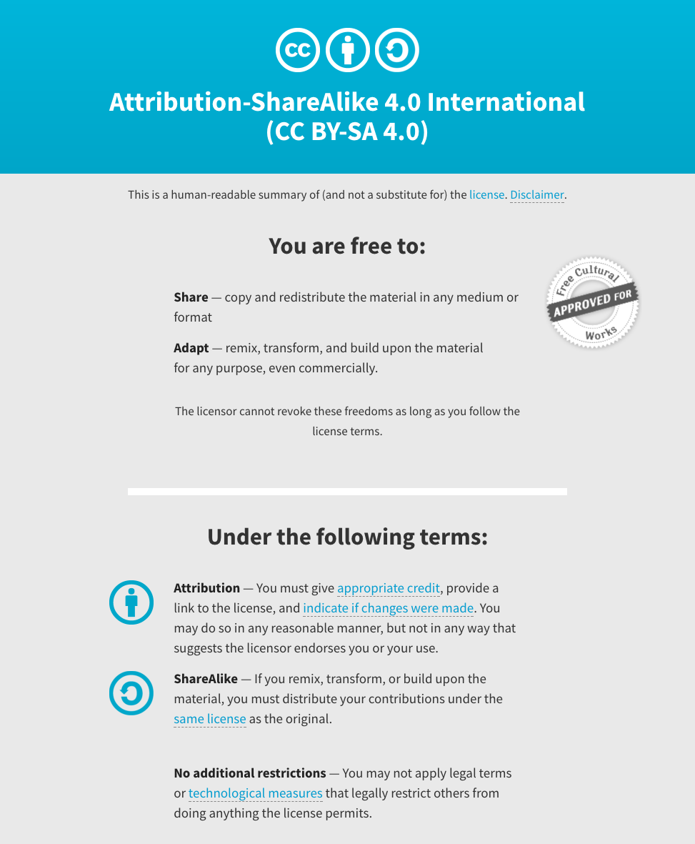
Notes:
Note there are two licenses if effect for this course.
All *content* (lectures, written materials, etc.) are made available under the Creative Commons Attribution-ShareAlike 4.0 International (CC BY-SA 4.0). (https://creativecommons.org/licenses/by-sa/4.0/).
All *code* (R scripts the website code itself) are made available under the MIT License (https://opensource.org/licenses/MIT).

Slide 3
Learning objectives of the course
Module 1: Introduction to genomic data visualization and interpretation
Module 2: Using R for genomic data visualization and interpretation
Module 3: Introduction to GenVisR
Module 4: Expression profiling, visualization, and interpretation
Module 5: Variant annotation and interpretation
Module 6: Q & A, discussion, integrated assignments, and working with your own data
Tutorials
Provide working examples of data visualization and interpretation
Self contained, self explanatory, portable

Slide 4
Learning objectives of module 4
Expression profiling, visualization, and interpretation
Expression estimation for known genes (concepts)
FPKM’ expression estimates vs. ‘raw’ counts
Differential expression methods (DESeq2)
Downstream interpretation of expression and differential estimates

Slide 5
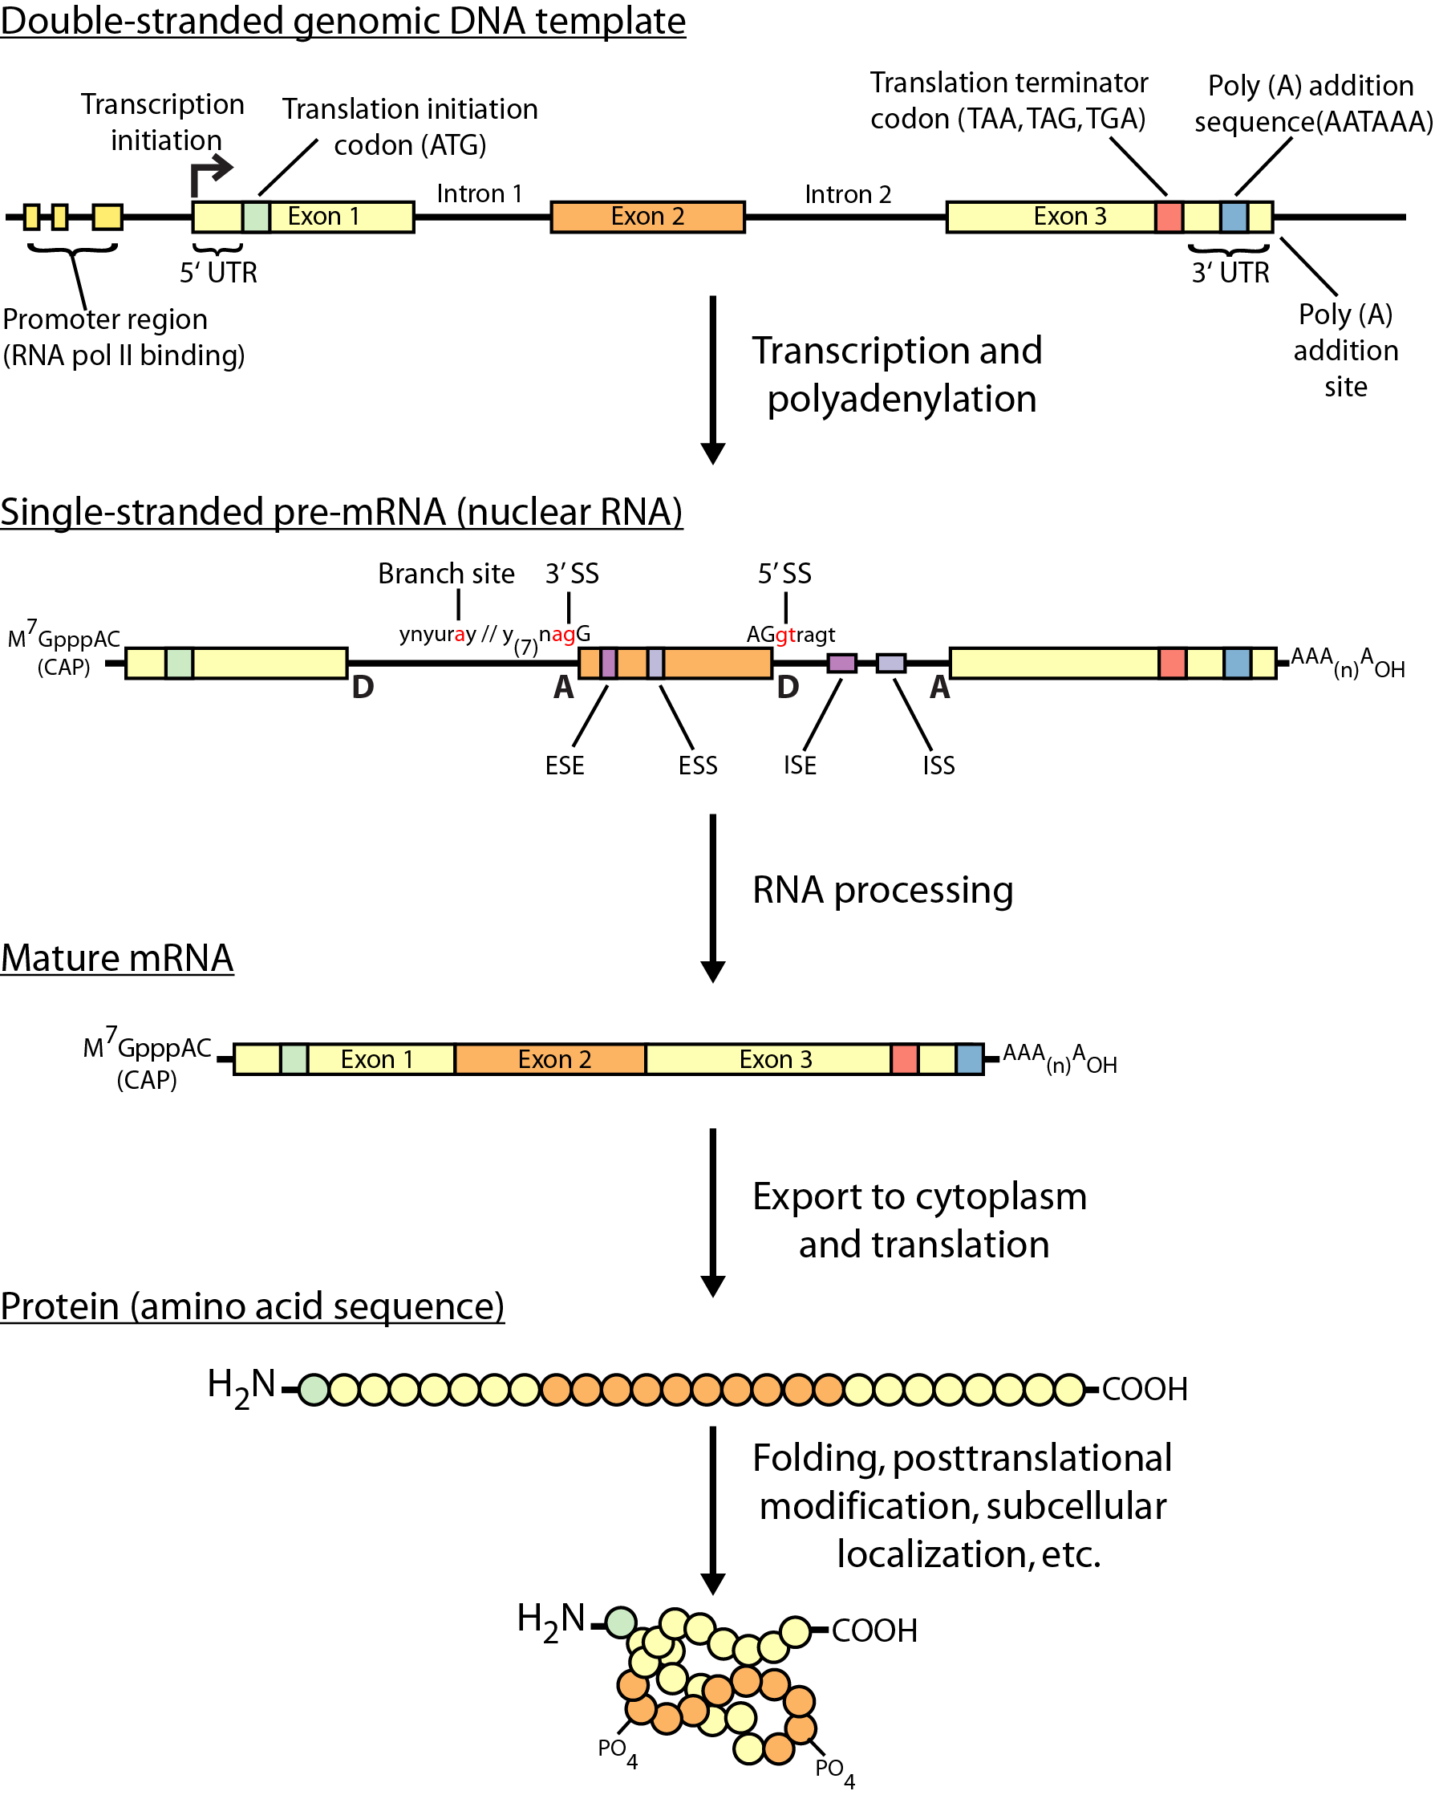
Gene expression

Slide 6
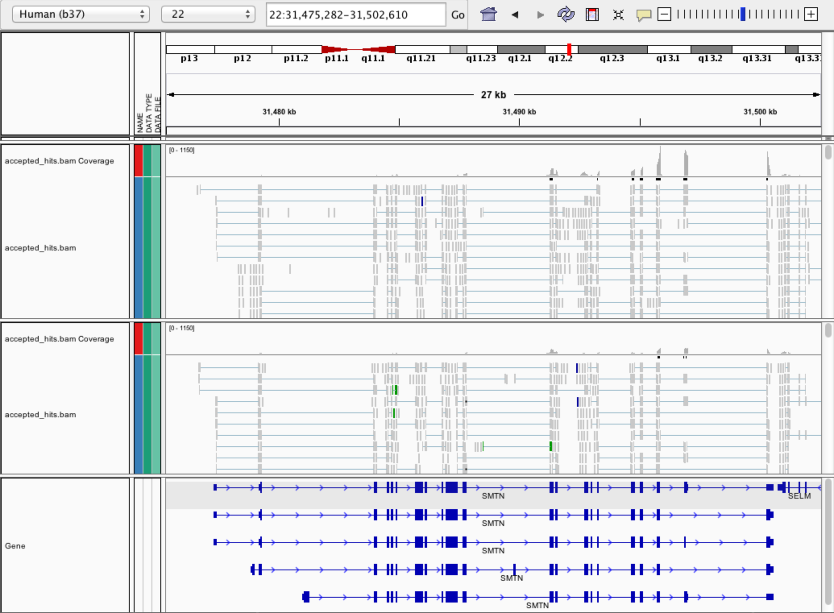
Expression estimation for known genes and transcripts

Slide 7
Abundance/expression estimation methods
Raw Counts
HTSeq-Count
FeatureCounts
StringTie
RPKM/FPKM values
StringTie
TPM values
Kallisto
Salmon
StringTie

Slide 8
What is FPKM (RPKM)
RPKM: Reads Per Kilobase of transcript per Million mapped reads.
FPKM: Fragments Per Kilobase of transcript per Million mapped reads.
In RNA-Seq, the relative expression of a transcript is proportional to the number of cDNA fragments that originate from it. However:
The number of fragments is also biased towards larger genes
The total number of fragments is related to total library depth
FPKM (RPKM) attempt to normalize for gene size and library depth
FPKM (RPKM) = (10^9 * C) / (N * L)
C = number of mappable reads/fragments for a gene/transcript/exon/etc
N = total number of mappable reads/fragments in the library
L = number of base pairs in the gene/transcript/exon/etc
http://www.biostars.org/p/11378/
http://www.biostars.org/p/68126/

Slide 9
What are raw counts?
Raw read counts as an alternate for differential expression analysis
Instead of calculating FPKM, simply assign reads/fragments to a defined set of genes/transcripts and determine “raw counts”
Transcript structures could still be defined by something like cufflinks
HTSeq (htseq-count)
http://www-huber.embl.de/users/anders/HTSeq/doc/count.html
htseq-count --mode intersection-strict --stranded no --minaqual 1 --type exon --idattr transcript_id accepted_hits.sam chr22.gff > transcript_read_counts_table.tsv
Important caveat of ‘transcript’ analysis by htseq-count:
http://seqanswers.com/forums/showthread.php?t=18068
Notes:
--minaqual means we skip all reads with alignment quality lower than 1. The default for this parameter is now 10.

Slide 10
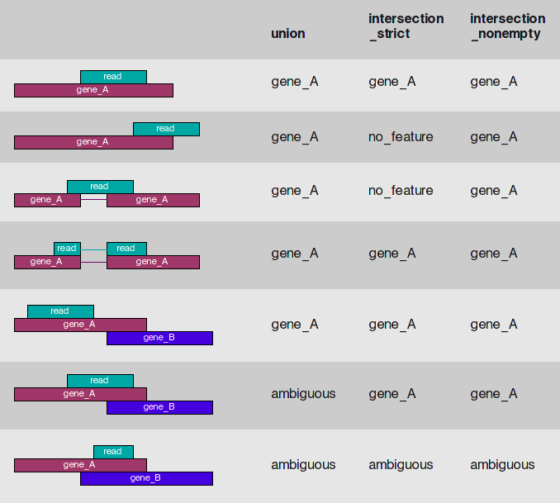
HTSeq-count basically counts reads supporting a feature (exon, gene) by assessing overlapping coordinates
Whether a read is counted depends on the nature of overlap and “mode” selected
Notes:
-m <mode>, --mode=<mode>
Mode to handle reads overlapping more than one feature. Possible values for <mode> are union, intersection-strict and intersection-nonempty (default: union)

Slide 11
Differential expression methods
Raw count approaches (gene level)
DESeq2
edgeR
Many others…
FPKM approaches (for transcript level)
Ballgown
Helpful explanation (PMID: 25748911)
Many others (EBSeq, etc.)
TPM approaches
Kallisto/Sleuth

Slide 12
‘FPKM’ expression estimates vs. ‘raw’ counts
Which should I use?
Long running debate with countless blogs and analyses arguing the advantages of each. The general consensus:
FPKM
Isoform deconvolution
Good for straight visualization (e.g., heatmaps)
Calculating fold changes, etc.
Counts
More robust statistical methods for differential expression
Accommodates more sophisticated experimental designs with appropriate statistical tests

Slide 13
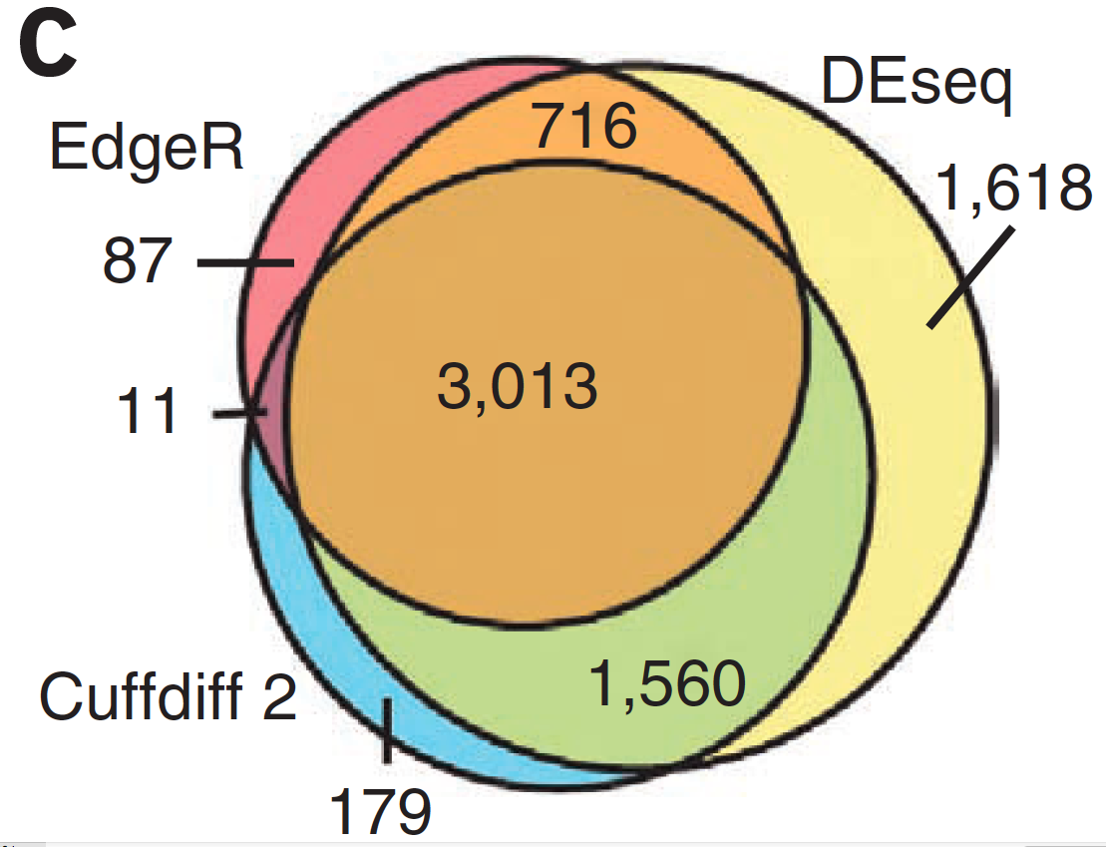
Multiple approaches advisable

Slide 14
Refer to www.rnaseq.wiki for many, many more details, resources and exercises

