Slide 1


GenViz Module 6: Q & A, discussion, integrated assignments, and working with your own data
Malachi Griffith, Obi Griffith, Zachary Skidmore
Genomic Data Visualization and Interpretation
April 8-12, 2019
Freie Universität Berlin

Slide 2
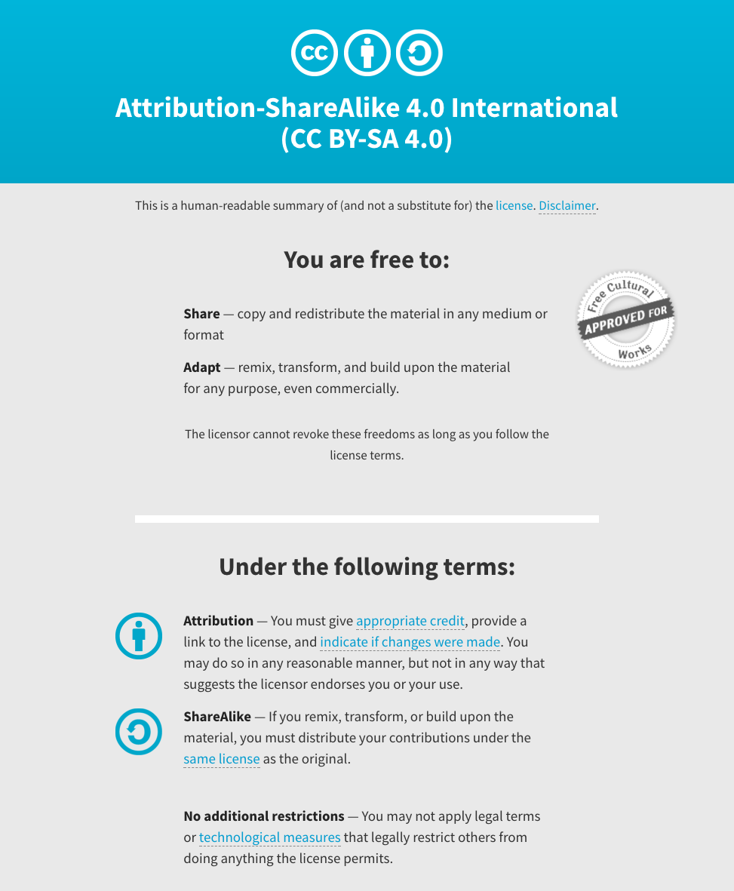
Notes:
Note there are two licenses if effect for this course.
All *content* (lectures, written materials, etc.) are made available under the Creative Commons Attribution-ShareAlike 4.0 International (CC BY-SA 4.0). (https://creativecommons.org/licenses/by-sa/4.0/).
All *code* (R scripts the website code itself) are made available under the MIT License (https://opensource.org/licenses/MIT).

Slide 3
Learning objectives of the course
Module 1: Introduction to genomic data visualization and interpretation
Module 2: Using R for genomic data visualization and interpretation
Module 3: Introduction to GenVisR
Module 4: Expression profiling, visualization, and interpretation
Module 5: Variant annotation and interpretation
Module 6: Q & A, discussion, integrated assignments, and working with your own data
Tutorials
Provide working examples of data visualization and interpretation
Self contained, self explanatory, portable

Slide 4
Learning objectives of module 6
Q & A, discussion, integrated assignments, and working with your own data

Slide 5
Questions and discussion
Before starting with the advanced exercises, are there any questions or topics for discussion?

Slide 6
Integrated assignments and working with your own data
Two general options
If you have your own data. Try to apply something you learned this week to visualize that data
If you don’t have your own data, there are optional integrated exercises in module 6 at www.GenViz.org

