Slide 1


GenViz Module 2: Using R for genomic data visualization and interpretation
Malachi Griffith, Obi Griffith, Zachary Skidmore
Genomic Data Visualization and Interpretation
April 8-12, 2019
Freie Universität Berlin

Slide 2
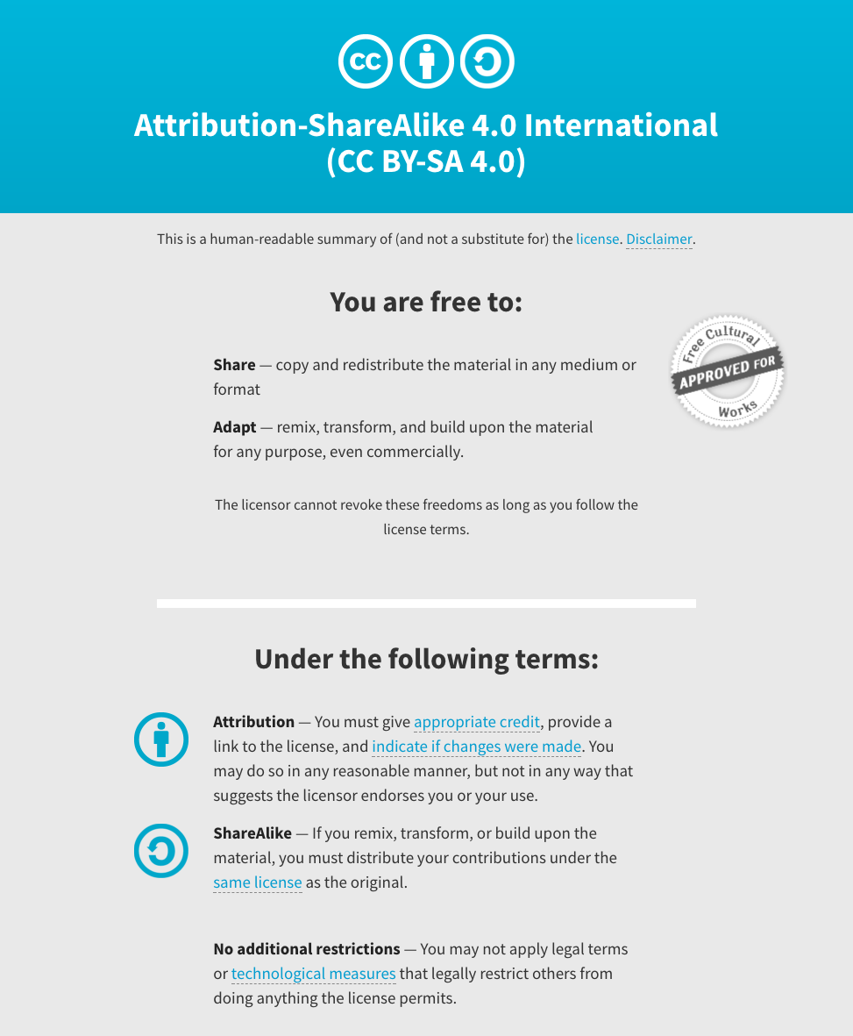
Notes:
Note there are two licenses if effect for this course.
All *content* (lectures, written materials, etc.) are made available under the Creative Commons Attribution-ShareAlike 4.0 International (CC BY-SA 4.0). (https://creativecommons.org/licenses/by-sa/4.0/).
All *code* (R scripts the website code itself) are made available under the MIT License (https://opensource.org/licenses/MIT).

Slide 3
Learning objectives of the course
Module 1: Introduction to genomic data visualization and interpretation
Module 2: Using R for genomic data visualization and interpretation
Module 3: Introduction to GenVisR
Module 4: Expression profiling, visualization, and interpretation
Module 5: Variant annotation and interpretation
Module 6: Q & A, discussion, integrated assignments, and working with your own data
Tutorials
Provide working examples of data visualization and interpretation
Self contained, self explanatory, portable

Slide 4
Learning objectives of module 2
Review basic R usage
Learn to use R for basic data manipulation
Learn to create publication quality graphs to display data
Learn to create interactive graphics

Slide 5
A brief history of R
R is an implementation of the S programming language combined with lexical scoping semantics inspired by Scheme.
S was created by John Chambers while at Bell Labs
There are some important differences, but much of the code written for S runs unaltered.
R was created by Ross Ihaka and Robert Gentleman at the University of Auckland, New Zealand
Currently developed by the R Development Core Team, of which Chambers is a member.
The R project was conceived in 1992, with an initial version released in 1995 and a stable beta version in 2000
https://en.wikipedia.org/wiki/R_(programming_language)

Slide 6


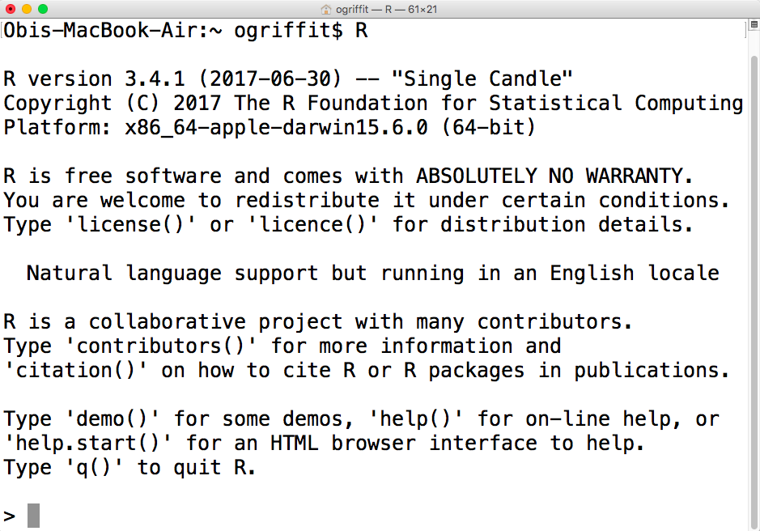
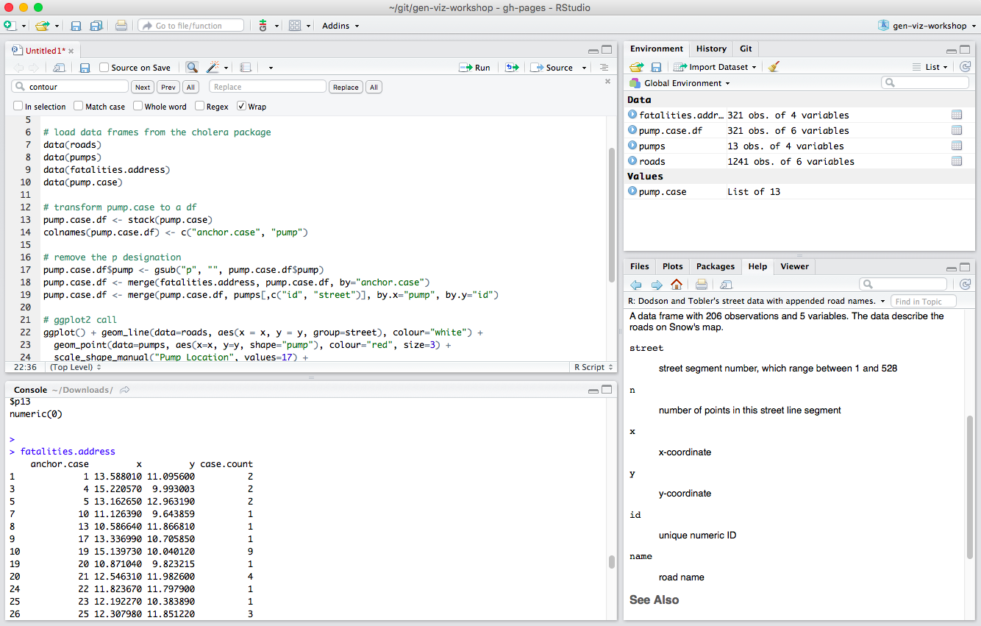
R is available via command-line or a number of integrated development environments (IDE)
R Project
Rstudio
https://cran.r-project.org/
https://www.rstudio.com/
Open-source, non-profit
Open-source, free + commercial

Slide 7
Installation and versions
Rstudio installation is very simple
R installation generally only a little more complicated
Pre-compiled binaries exist for most operating systems
Be aware of R versions
Occasionally some packages may be version dependent or interdependent
Less of an issue these days
Simplest to keep R, Rstudio and BioConductor updated to current/latest version
Rswitch – allows multiple versions of R/Rstudio to be maintained simultaneously

Slide 8
CRAN and BioConductor
11,411 available packages
All applications
ggplot2, cluster, dplyr, reshape2, randomForest, RColorBrewer
https://cran.r-project.org/
install.packages()
1,381 available packages
Genomic applications
AnnotationDBI, GenomicRanges, limma, biomaRt, affy, GEOquery
https://bioconductor.org/
source("https://bioconductor.org/biocLite.R")
biocLite()

Slide 9
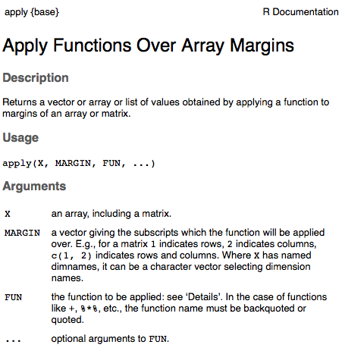
Getting help: ?, vignette(), and data()
Type ‘?’ before any function to get a manual style help page in R or Rstudio
Similarly use vignette() together with a function/package name to get detailed usage vignettes
Type data() to return a list of available demonstration datasets.
> ?apply

Slide 10
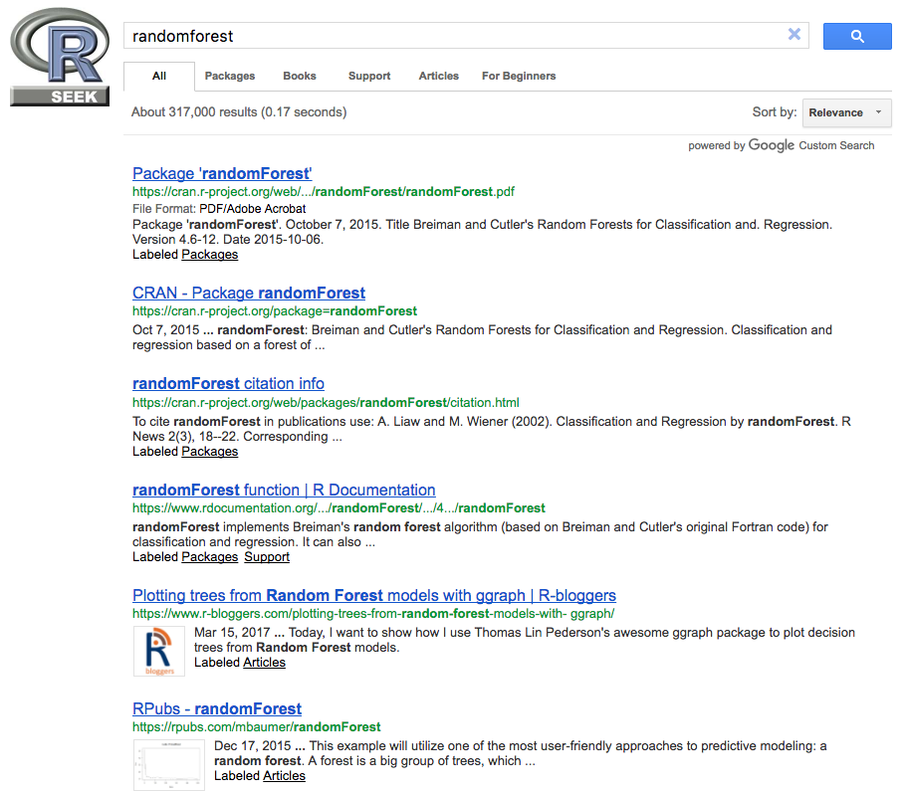
Rseek.org to search CRAN, r-bloggers, support.rstudio.com, rpubs.com, etc

Slide 11
Variables, Data Structure (Object) Types and Data types
As with any programming language, you need to use variables to store information. When you create a variable you reserve some space in memory and keep a record of its location for later retrieval and use.
The information you wish to store might be characters (e.g., text), integers, boolean (e.g., True/False) etc.
In contrast to many other programming languages (e.g., C, java, etc), in R variables are not declared as a specific data type.
The variables are assigned with R-Objects and the data type of the R-object becomes the data type of the variable.
The simplest R-object type is the atomic vector
There are six data types for atomic vectors, also termed as six classes of vectors: logical, numerical, integer, complex, character, and raw
Lists are also vectors but are not atomic vectors, meaning that they can include multiple data types and can be recursive (contain lists of lists)
The other R-Objects are built upon atomic vectors and include: factors, matrices, arrays, data frames,

Slide 12
Understanding object and data types with class(), typeof() and is.*()
x | class(x) | typeof(x) | is.*(x)
x <- 1.0 | numeric | double | is.numeric(x)=TRUE is.double(x)=TRUE
x <- 1L | integer | integer | is.integer(x)=TRUE
x <- “foo” | character | character | is.character(x)=TRUE
x <- TRUE | logical | logical | is.logical(x)=TRUE
x <- charToRaw(“foo”) | raw | raw | is.raw(x)=TRUE
x <- 4 + 4i | complex | complex | is.complex(x)=TRUE
x <- factor(c("foo","bar","bar")) | factor | integer | is.factor(x)=TRUE is.integer(x)=TRUE
x <- matrix(1:4, nrow=2) | matrix | integer | is.matrix(x)=TRUE Is.integer(x)=TRUE
x <- data.frame(x=1:2, y=c(“foo”, “bar”)) | data.frame | list | is.data.frame(x)=TRUE is.list(x)=TRUE

Slide 13
Vectors
Typically defined with c() or extracted from other objects
> myVector <- c(“foo”, “bar”, “baz”)
> myVector2 <- c(2,3,5:10,15,20,25,30)
Subsets of vectors can be extracted by index values
> myVector[3]
[1] “baz”
Conditional statements can be applied to vectors
myVector2 >= 5
[1] FALSE FALSE TRUE TRUE TRUE TRUE TRUE TRUE TRUE TRUE TRUE TRUE

Slide 14
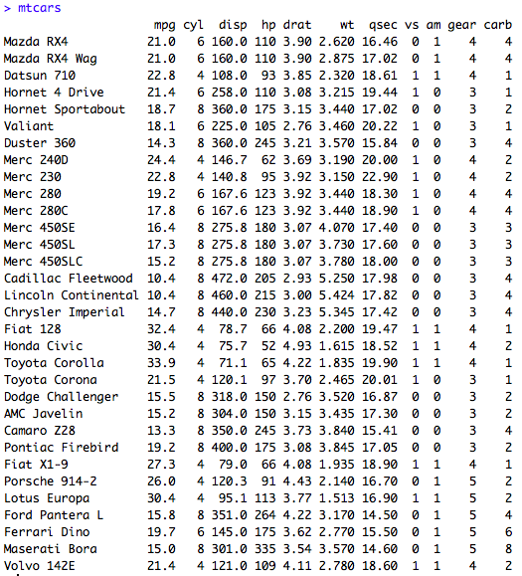
Dataframes
Demo dataframe available in R: “mtcars”
Similar to vectors, you can extract subsets of dataframes using [] but now with two dimensions:
e.g., data[ROW,COL]
You can also extract by row and column name:
e.g., mtcars$mpg

Slide 15
Importing and Exporting Data
R functions exist to import most common file formats
tsv, csv, excel, xml, json, etc
read.table() is particularly useful for simple delimited data files
Read from file or web URL
Tell R how you have encoded missing values
Use as.is to prevent R from converting strings to factors
data <- read.table(file=“my file or URL”, header=TRUE, sep="\t", na.strings = c("NA","N/A","na"), as.is=c(1:27,29:30), row.names=1, …)

Slide 16
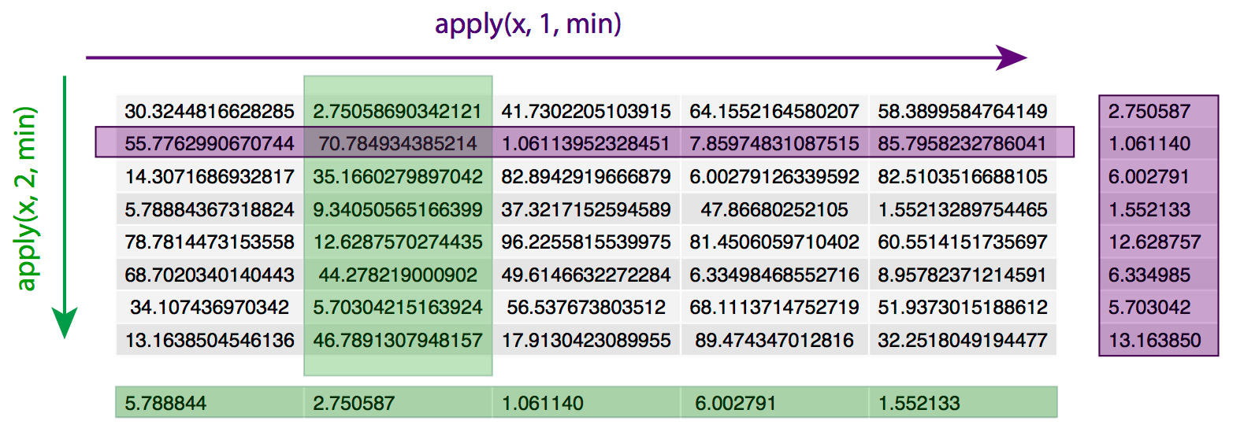
Apply functions
# Create a matrix of 8 rows by 5 columns as above:
x <- matrix(runif(n=40, min=1, max=100), ncol=5)
# Calculate min value for each row with a for loop
for(i in 1:8){
print(min(x[i,]))
}
# use apply function to do same thing
apply(x, 1, min)

Slide 17
Custom functions
Often necessary when an existing R function doesn’t quite do what you need.
Especially powerful in combination with apply() functions
Basic structure:
myfun <- function(input){
output <- do_something(input)
return(output)
}
apply(mydata, 1, myfun)

Slide 18
Assignment – the age old “<-” vs “=” debate
By convention in R, “<-” is used to assign a value to a variable and “=” is used for setting arguments in a function. For R purists, this is the preferred method.
The “=” symbol will also generally work for assignment.
Old keyboards had a “<-” key. Now it is an extra key stroke.
There is a difference in “scope”. Generally you may want values assigned within functions to stay inside the function.
Let’s look at the simple ‘median’ function to illustrate
Usage: median(x, na.rm = FALSE, ...)
> data=c(1:10,NA,NA,3:5)
> median(x=data, na.rm=TRUE)
[1] 5
> x
Error: object 'x' not found
> median(x <- data, na.rm=TRUE)
[1] 5
> x
[1] 1 2 3 4 5 6 7 8 9 10 NA NA 3 4 5

Slide 19
Assignment – the age old “<-” vs “=” debate
With “<-” spacing matters. This drives some programmers crazy who think spacing should be a style matter and not change the way a program works
> x<-3
> x [1] 3
> x <- 3
> x [1] 3
> x < -3
> x FALSE

Slide 20
Assignment – the age old “<-” vs “=” debate
More weirdness having to do with order of interpretation by R
x <- y <- 5 # x and y equal 5
x = y = 5 # x and y equal 5
x = y <- 5 # x and y equal 5
x <- y = 5 # errors!
# Error in (x <- y) = 5 : could not find function "<-<-”
We could keep going …
Use “<-” if you want to be a l33t R geek.
I’ve been writing code for 15 years and use “=” for assignment. Never had a problem.
formatR package (tidy_* functions) can be used to clean your code for publication

Slide 21
Graphics options in R
At least 3 primary graphics options in R
base R graphics
plot(), par(), etc
lattice
ggplot2
ggplot2 consistently one of the top two most popular of all R packages

Slide 22
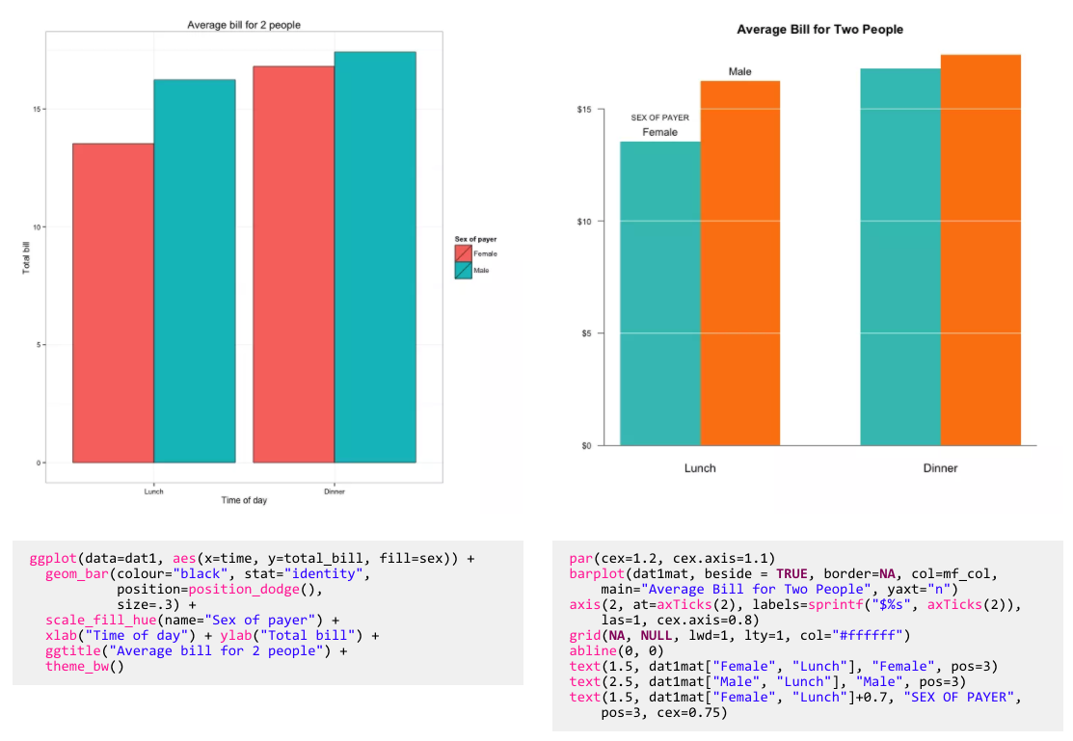
Why use ggplot2? – “prettier” graphics in less lines of code

Slide 23
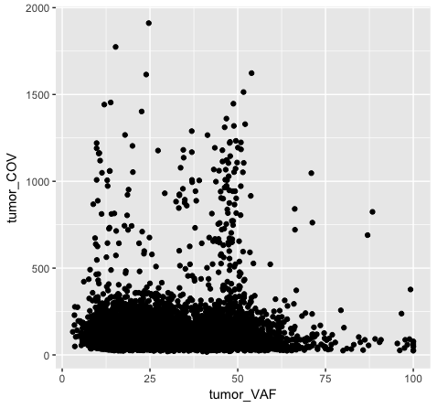
ggplot2 syntax
ggplot(data=variantData, aes(x=tumor_VAF, y=tumor_COV)) + geom_point()
dataframe with data to be plotted
geometric objects specify how data should be plotted
Aesthetic mappings describe how variables in the data are mapped to visual properties (aesthetics) of geometric objects (geoms)

Slide 24
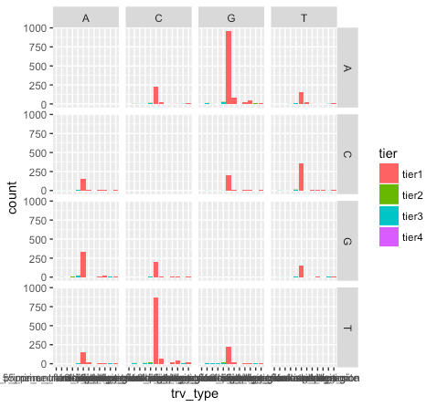
Faceting allows multiple plots in a single page

Slide 25
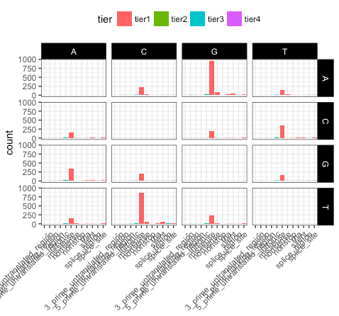
Themes allow stylistic improvements

Slide 26
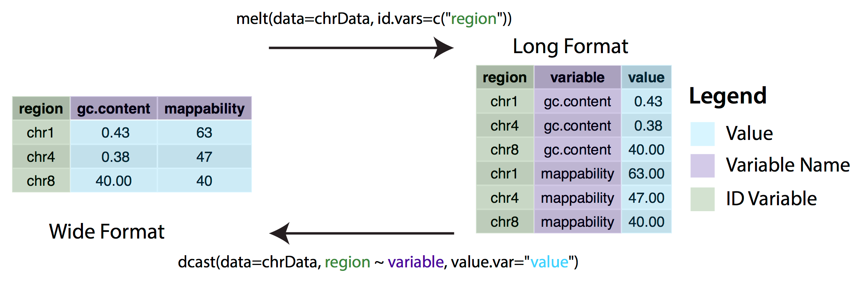
Wide vs long format

Slide 27
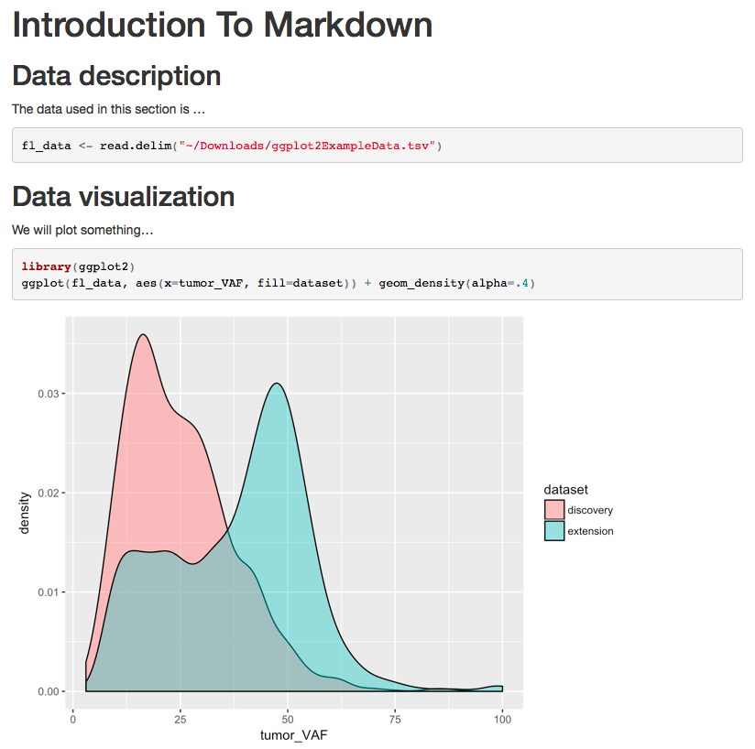
Rmarkdown can be used to create publication ready documents presenting all code (analysis), comments, and results
myRprogram.Rmd
knitr
result.html
---
title: "Introduction To Markdown"
output: html_document
---
```{r setup, include=FALSE}
knitr::opts_chunk$set(echo = TRUE)
```
## Data description
The data used in this section is ...
```{r}
fl_data <- read.delim("~/Downloads/ggplot2ExampleData.tsv")
```
## Data visualization
We will plot something...
```{r}
library(ggplot2)
ggplot(fl_data, aes(x=tumor_VAF, fill=dataset)) + geom_density(alpha=.4)
```

Slide 28
Interactive graphics with R shiny
Optimizing a graphic often requires multiple iterative alterations
Analysis and interpretation often benefits from active filtering, variable selection, and parameterization
Interactive graphics allow end-users, especially non-experts, to more effectively explore data
The R shiny package allows you to quickly and easily create sophisticated web-accessible interactive graphics

Slide 29
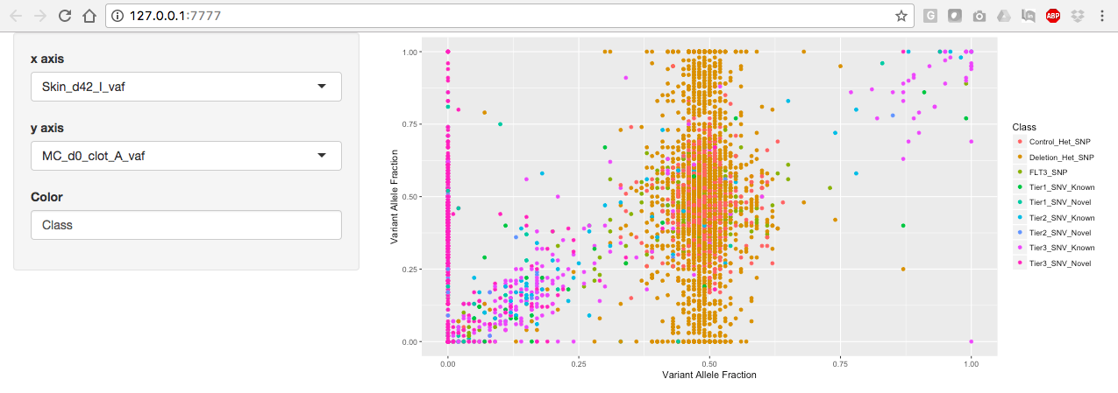
Basic organization of a shiny application
shinyServer
server.R
User input
R output
shinyUI
ui.R
Interactive User Interface (UI) = website

Slide 30
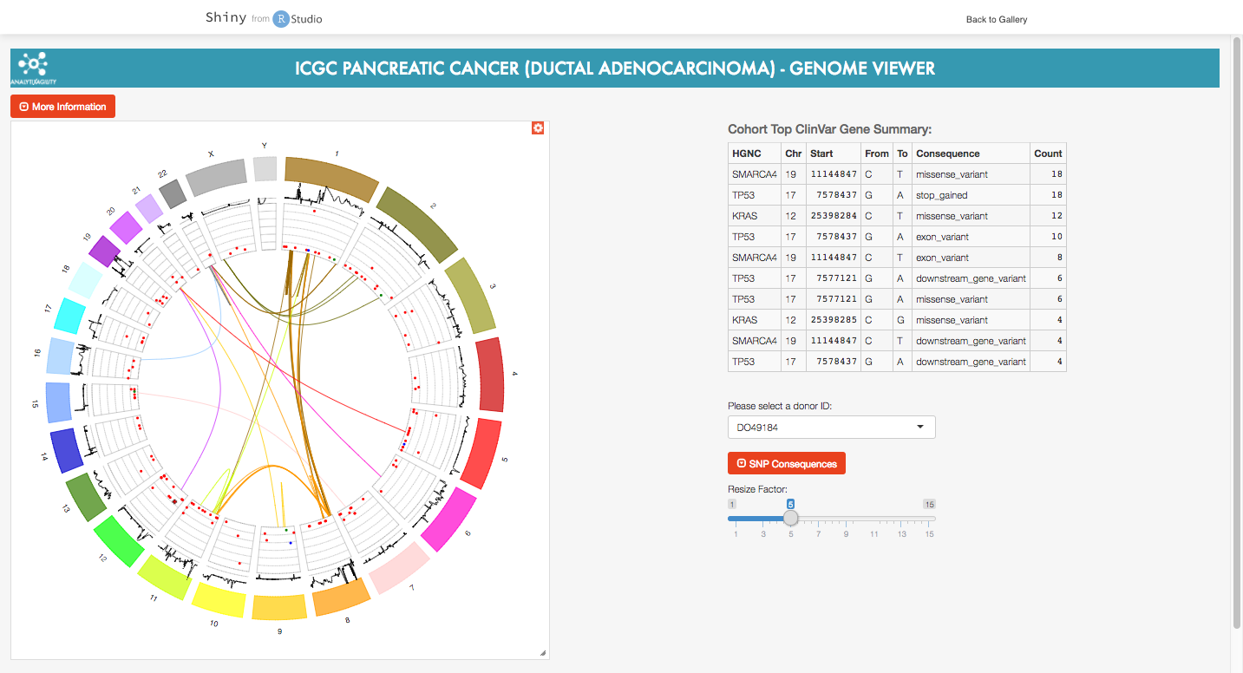
Demo of shiny gallery genomics example
https://shiny.rstudio.com/gallery/

Slide 31
Questions?

