Slide 1
Move to CSHL template

Slide 2
Using AI as a Research Assistant: Successes and Failures

Slide 3
Ideation | Code Enhancements (or writing) | Project Management | Visual Design
Generate frameworks for innovation Identify novel relationships Generate ideas for acronyms or titles for projects | Annotation Refactoring Extra security/ privacy evaluation Translating to new language Understand unfamiliar code Ideas for code validation and testing | Develop templates Task breakdowns Role assignments Meeting agendas and Summaries Document Generation: Code of conduct Mentee agreement Lab handbook | Generate logos or figures

Slide 4
Text Search & Navigation | Communication Adjustment | Content Summarization
Locate specific text within large documents. Retrieve similar info across multiple docs | Transform communication style Shift tone for an email Shift voice for letter of support draft Adjust a presentation for a different audience Review text for clarity and accessibility | Simplify text to fit word count limit (Be cautious about privacy with grant aims.) Convert text into tables or vice versa Create README files

Slide 5
Important Considerations

Slide 6
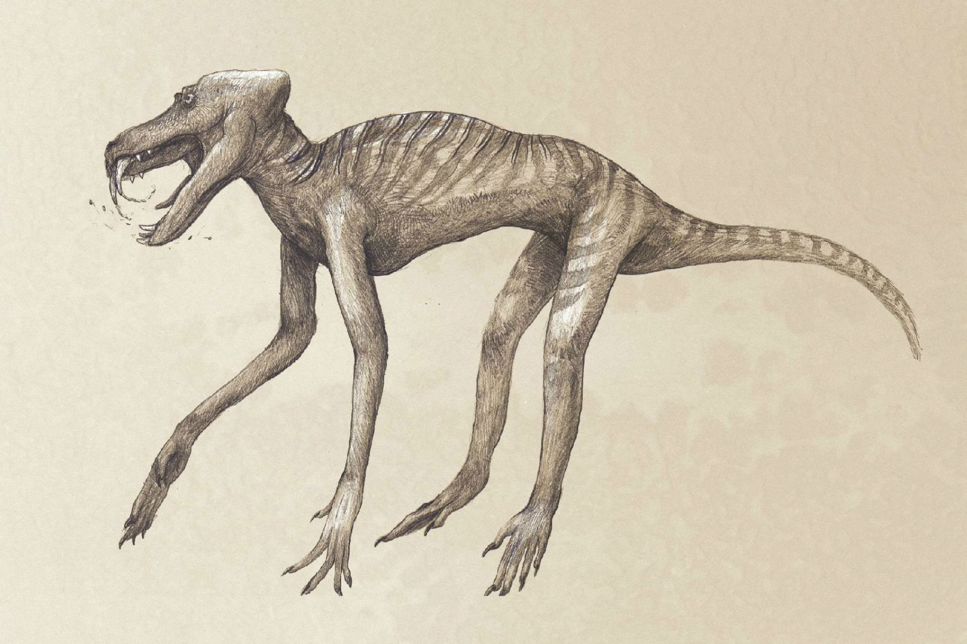
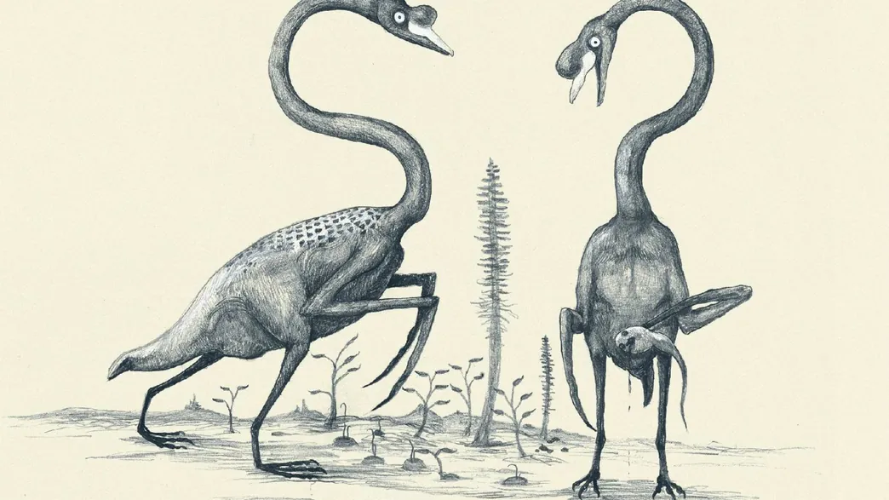
Remember AI is like humans drawing dinosaurs based on bones alone…
https://www.iflscience.com/artist-draws-animals-the-same-way-we-draw-dinosaurs-based-on-bones-alone-and-theyre-terrifying--54399
Notes:
https://www.iflscience.com/artist-draws-animals-the-same-way-we-draw-dinosaurs-based-on-bones-alone-and-theyre-terrifying--54399

Slide 7
Query:
Can you improve the paragraph?
Can you make the paragraph more concise?
Can you make the paragraph more concise and appropriate for a highschool student?
OKAY – but not specific on what improvements are needed
BETTER - we’ve specified a goal
BEST - we’ve specified what goal and an audience or tone

Slide 8
Tips
Be specific & iterate
Where possible, work in a project to use context
Typically asking AI to improve existing work is better than starting something from scratch
Check everything!
The more substance and original thought you provide the more substance and original thought your final product will have!

Slide 9

Asking for a strategy for how to write code may be better than asking for code itself
Example prompts:
  How might I go about doing ______ ?
  How could I structure code that would do ______ ?
  Is it possible to create a package that does ______?
  What packages could I use to make code that does _______ ?

Slide 10




Test and validate EVERYTHING an LLM writes
Test your results (build in checkpoints)
Make sure the code/prompts are secure
Check that you are not violating data restrictions or licensing
Have humans review your code/text
Notes:
It sounds silly, but this probably needs to be stated.

Slide 11
Challenges
Giving credit is hard
Data Privacy is tricky
Environmental Impact is very real
Using AI too much can degrade your trust in your own abilities
  Impact on trainees
Bias - even simple AI requests can generate biased responses

Slide 12
Mitigation
Credit and Privacy: Be transparent and specific about AI use, Choose models that are more transparent about how they were trained. Shop around!
Environmental Impact is very real: Choose AI tools that are transparent about resource usage and attempts to improve efficiency, consider when AI might not be needed.
Loss of trust in yourself: Use in moderation, read the literature, talk to trainees. You are still a spectacular supercomputer!
Bias: consider responses with this lens - ask chatbots to consider bias and challenge them when they fail.

Slide 13

Successful Example Uses!

Slide 14
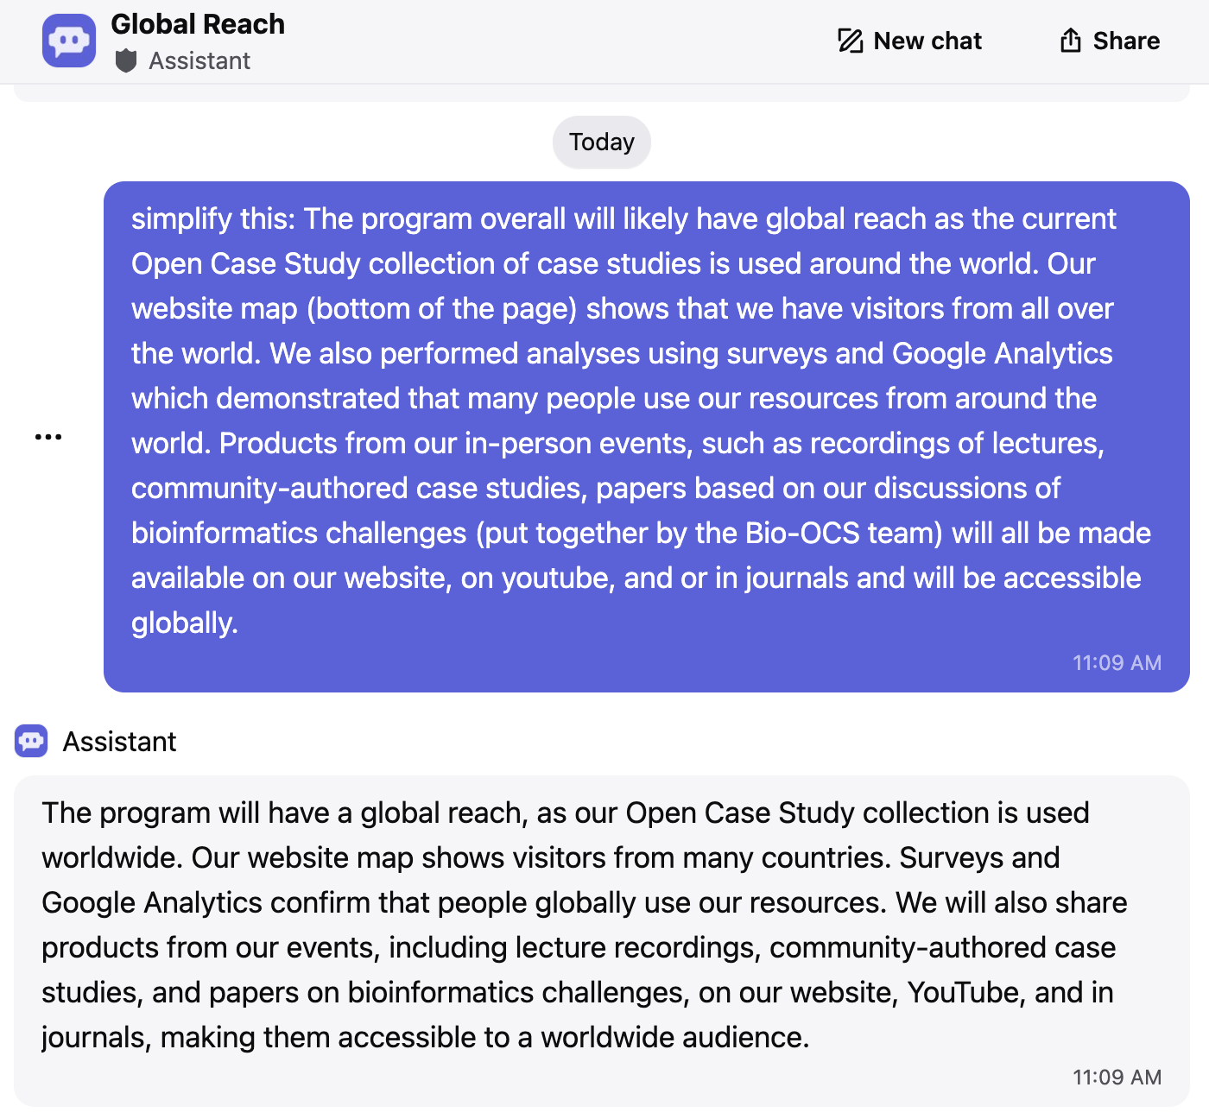
Response to grant reviewers
Task: Making text more concise.
Considerations: Watch out if any content should not be public!

Slide 15
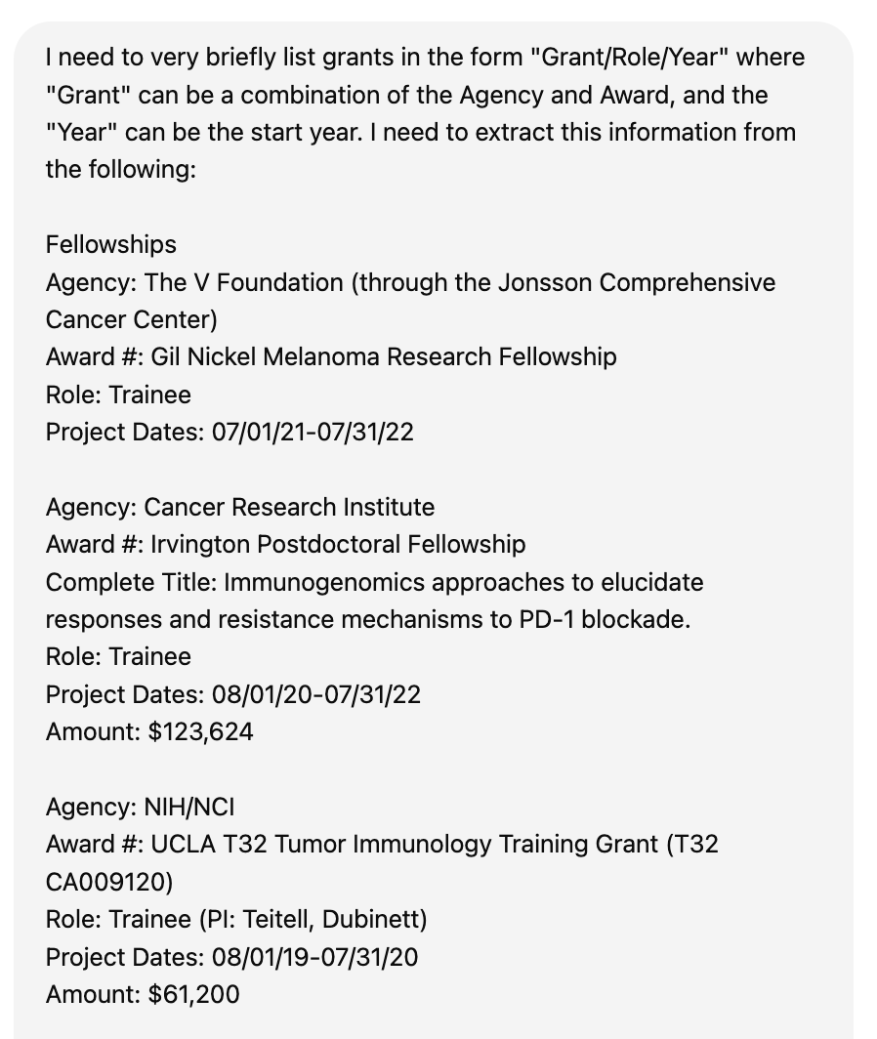
Create trainee grant list summary for a T32 submission
Task: Reformat text for different use.
Considerations: Watch out if any content should not be public!

Slide 16
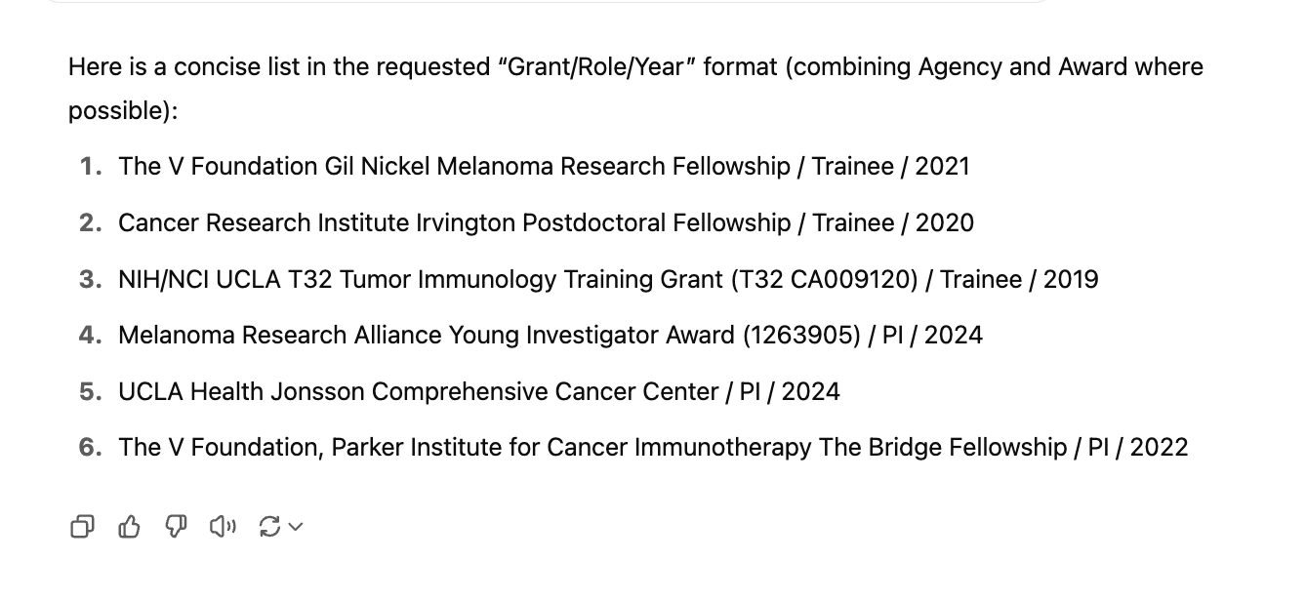
Create trainee grant list summary for a T32 submission
Task: Reformat text for different use.
Considerations: Watch out if any content should not be public!

Slide 17
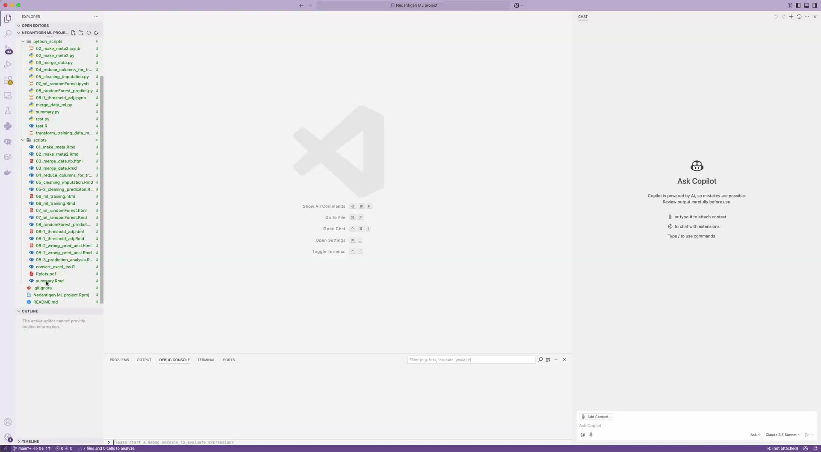
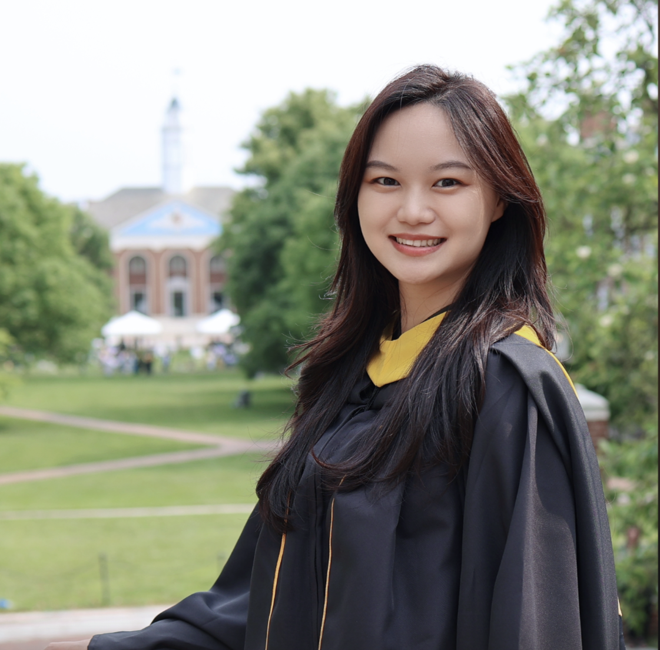
Convert an existing R ML model into Python equivalent
Jennie Yao
Notes:
Copilot in Visual Studio Code (VS Code)

Slide 18
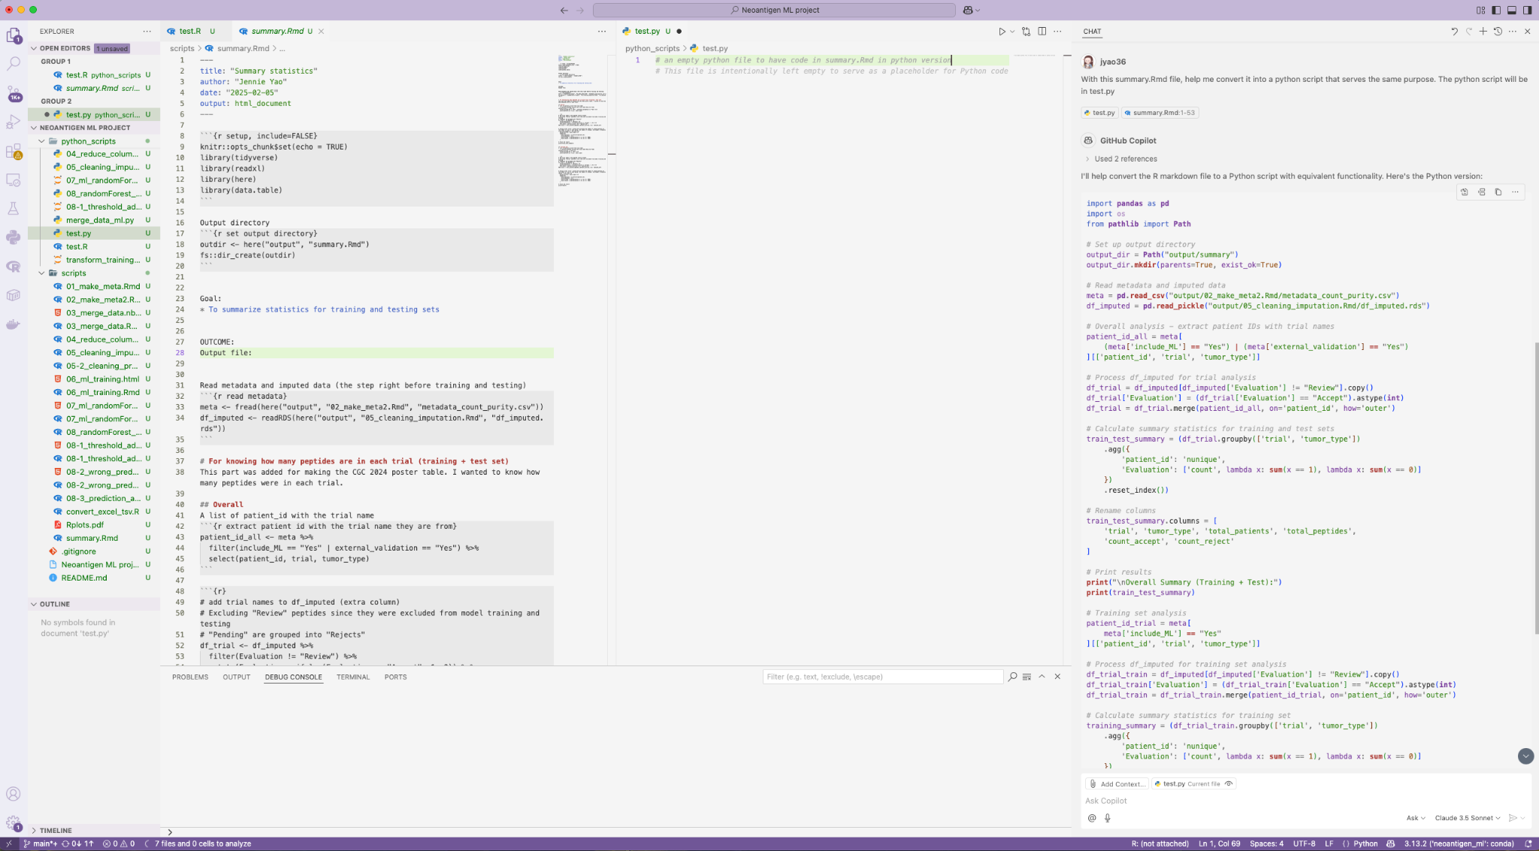
Convert an existing R ML model into Python equivalent
“Convert this Rmd file into a python script that serves the same purpose”

Slide 19
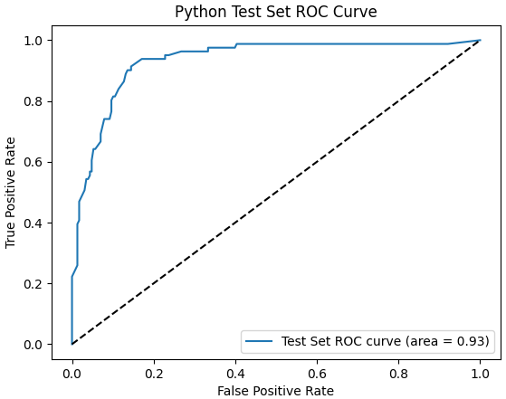
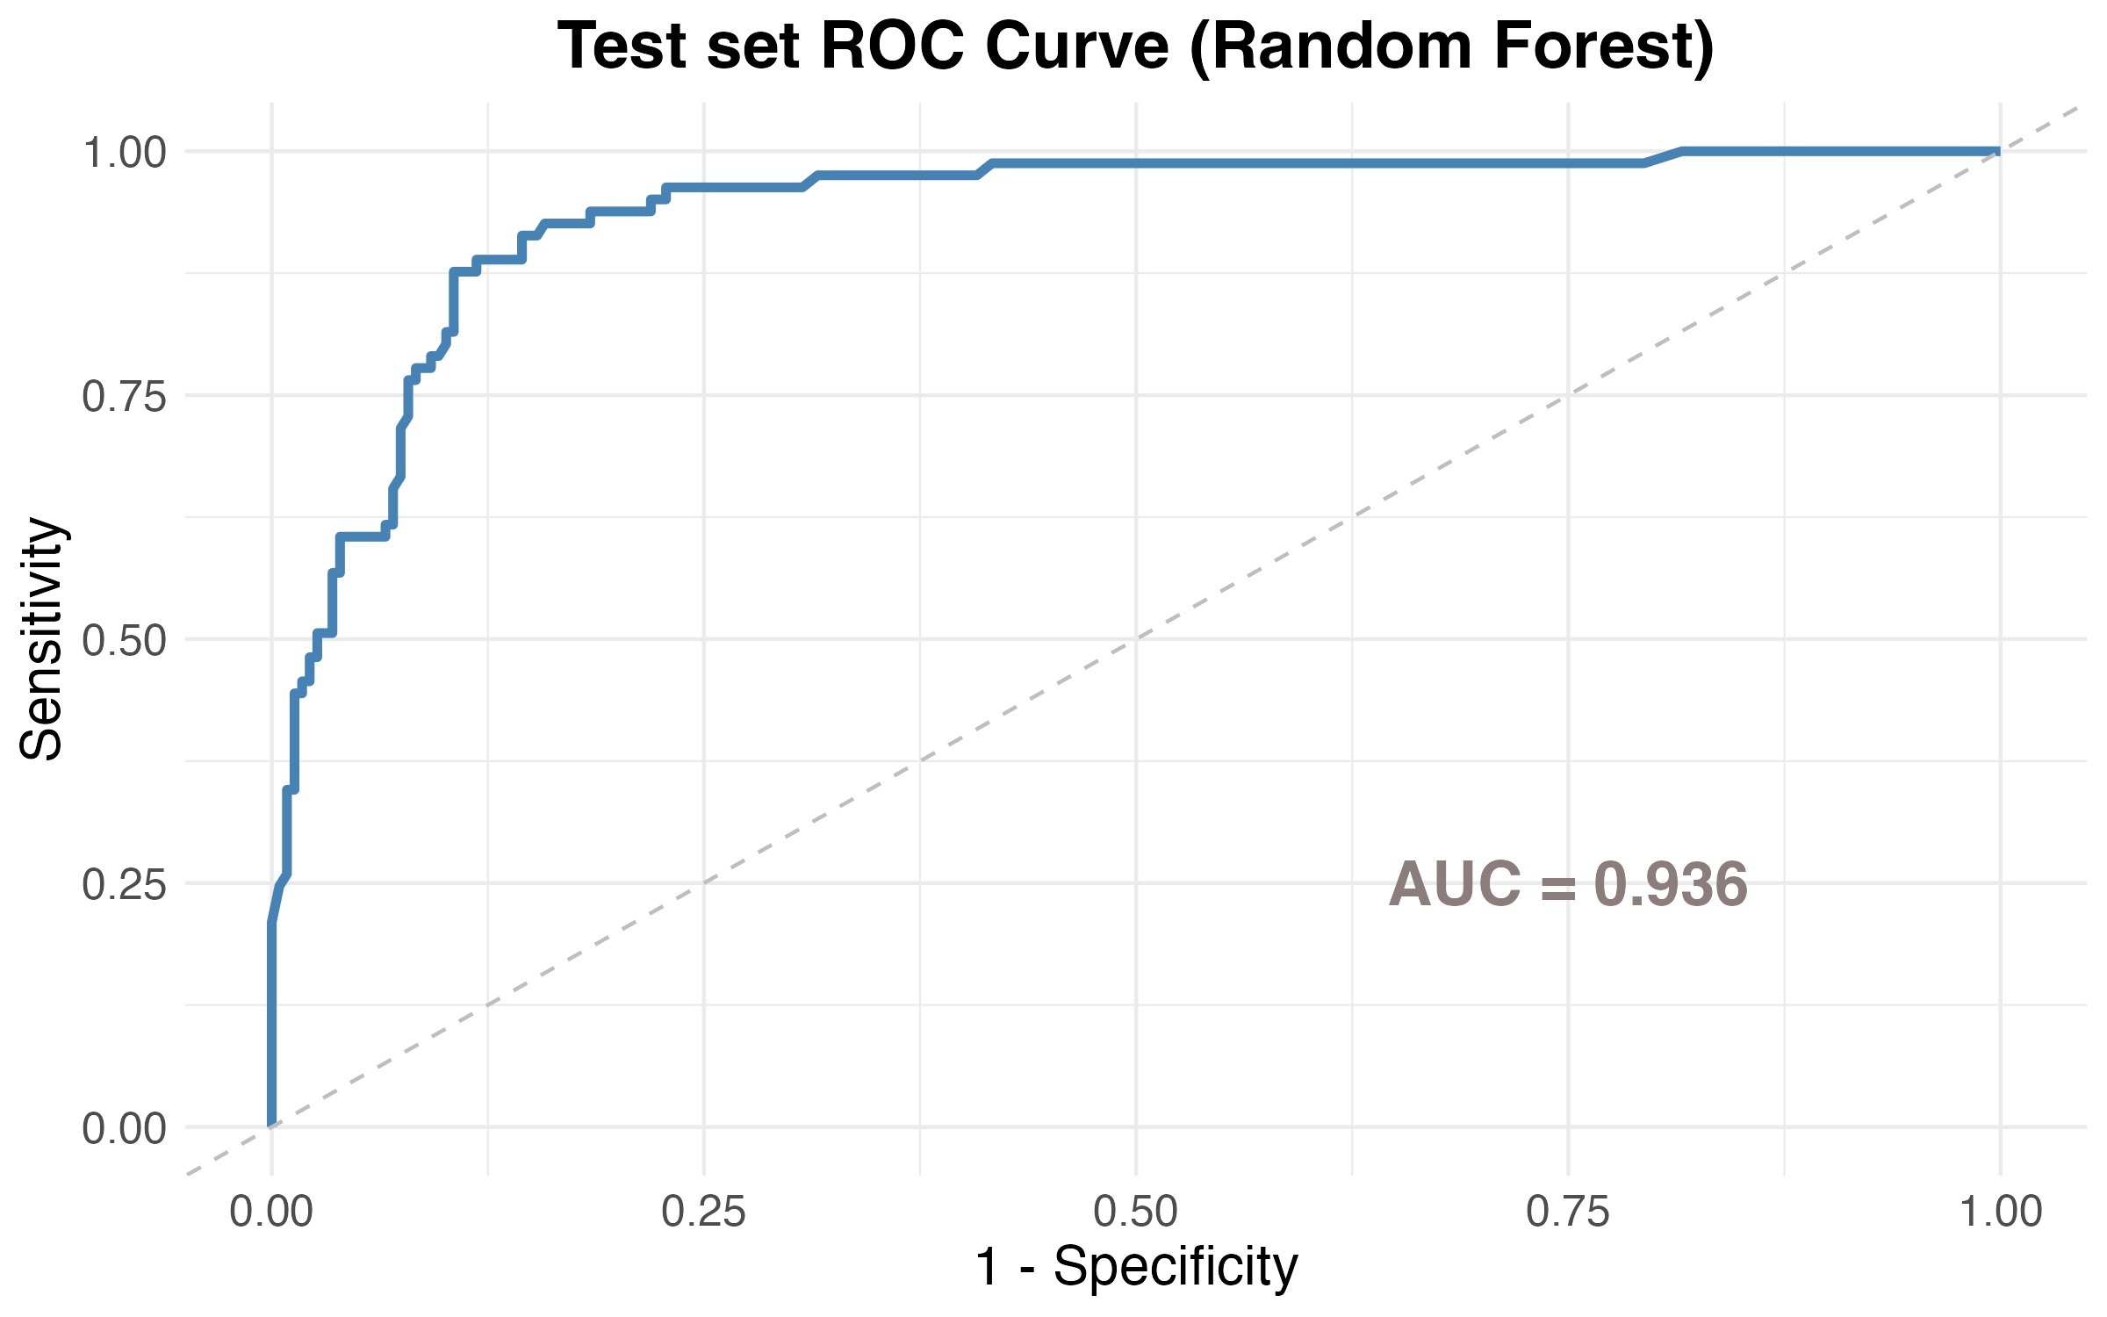
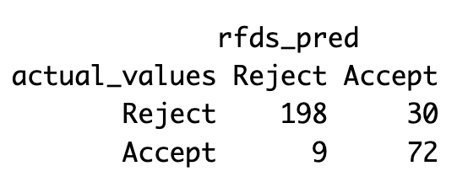
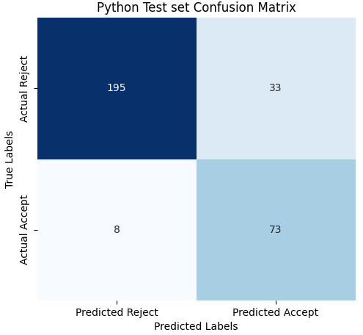
Test set performance concordant
R model performance:
88.89% sensitivity
86.84% specificity
0.936 AUC
Python model test set performance:
90.12% sensitivity
85.52% specificity
0.932 AUC
Notes:
This is the performance of both models on the held-out test set.
The AUC values were very similar at 0.93 for both models.
Both models achieved good sensitivity and specificity.
Check if the same candidates

Slide 20
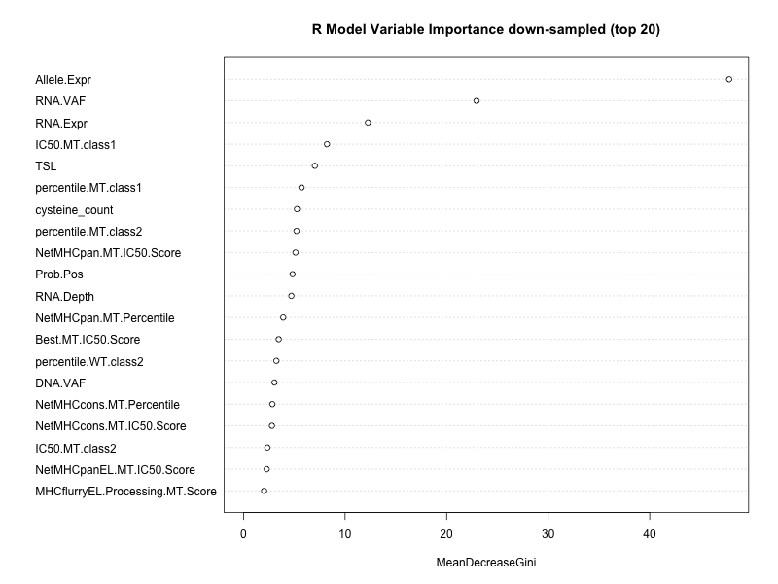
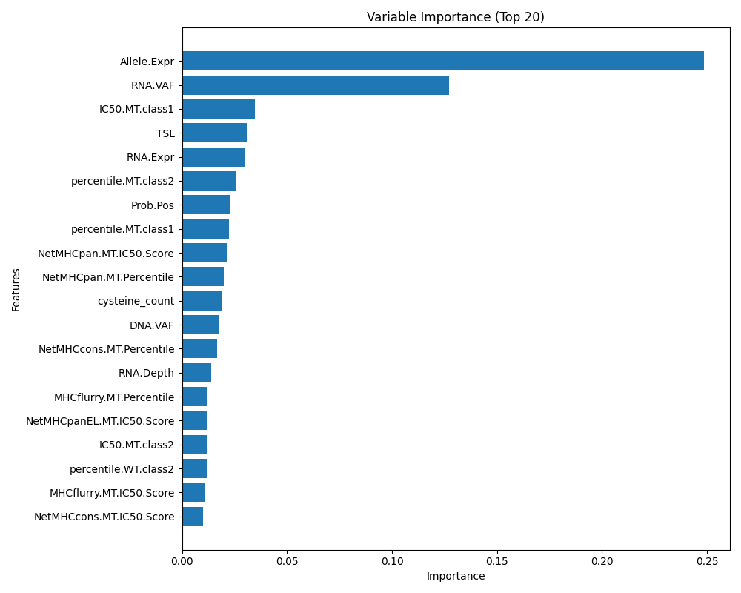
Feature importance (top20) concordant
Mean Decrease in Impurity (MDI) (a.k.a. Gini Importance)
Notes:
the top 20 most important features ranked by each model. This measured by something called the Decrease in Gini impurity.
As we saw, most of these important features make sense and it almost replicates the decision process during the ITB meeting.
When compared between the R and Python model they are also very similar with only two features that are different (I highlighted in boxes)
Gini Importance:
In classification trees, impurity measures how “mixed” the classes are within a node (or a subset of data in a branch of a tree).
• A pure node contains only one class (e.g., all samples are “Positive”).
• A highly impure node has a mix of different classes (e.g., 50% “Positive”, 50% “Negative”).
The goal of the tree is to split the data in ways that reduce impurity — i.e., group similar classes together.
• Each potential split is evaluated by how much it reduces impurity.
• The best split is the one that leads to the largest reduction — i.e., the biggest gain in “purity.”

Slide 21
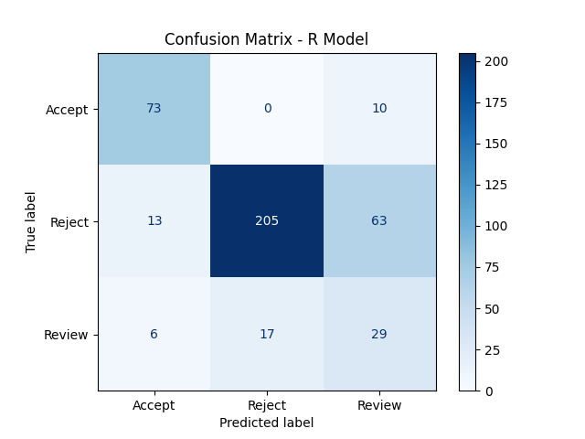
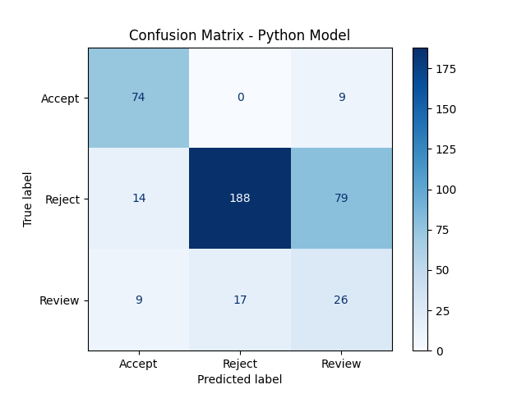
Predictions on external validation concordant
1
73 shared
185 shared
3
16 shared
24 shared
Threshold:
0
0.2
0.6
1
Probability of Accept:
Reject: 0-0.2
Review: 0.2-0.6
Accept: 0.6-1
Notes:
I have also compared the confusion matrix by the Python and the R model.
Overall the numbers are quite similar. We did notice the Python model has a slightly lower specificity.
The arrows and notes here are mostly for my own notes, where I was checking, for each box, how many of these peptides were shared between the two models.
For example, with the 17 candidates that were predicted as Reject, but are actually Review, I verified that 16 of them are shared between both models.
Verify these are the same peptides (e.g. 17)
Integrate to github
Meet with Susanna
Make sure to understand every function in python if publishing it

Slide 22
Lesson: Code generation works well when you have an existing implementation and results to benchmark against

Slide 23
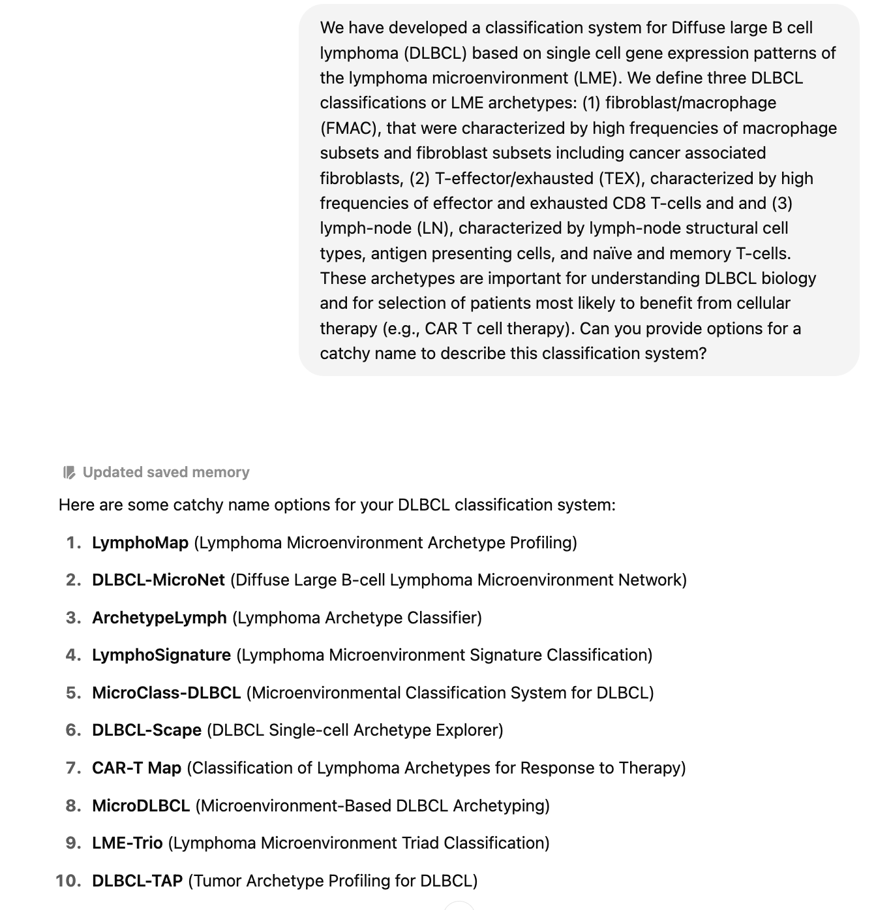
Create an acronym for a DLBCL Classification System

Slide 24
Create an acronym for a DLBCL Classification System
Large B cell lymphoma microenvironment archetype profiles (LymphoMAPs). Cancer Cell. 2025. 43(7):1347-1364

Slide 25
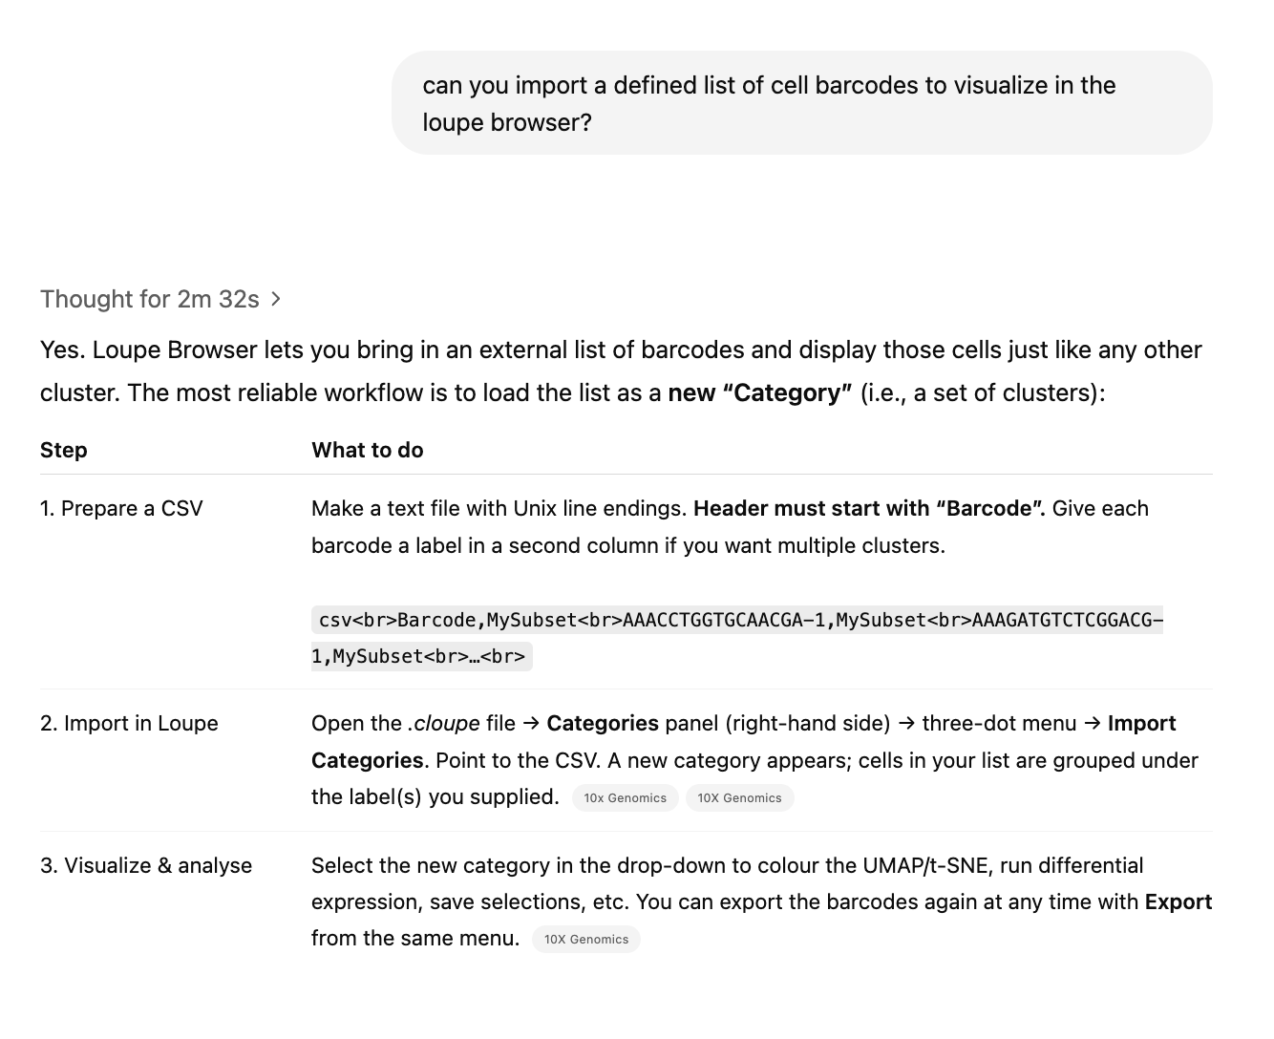
Learn how to use a piece of bioinformatics software

Slide 26
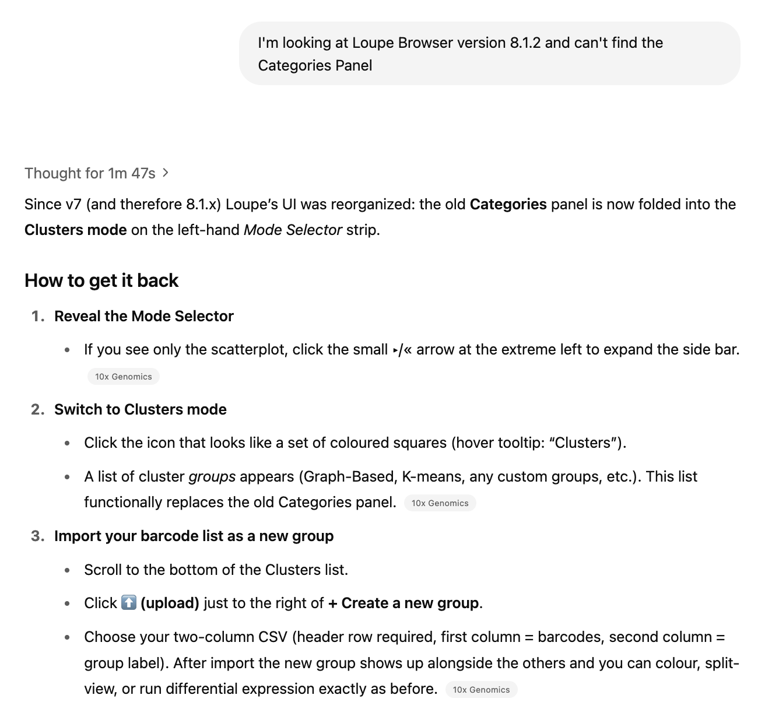
Learn how to use a piece of bioinformatics software

Slide 27
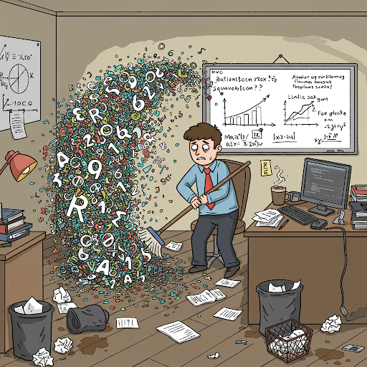
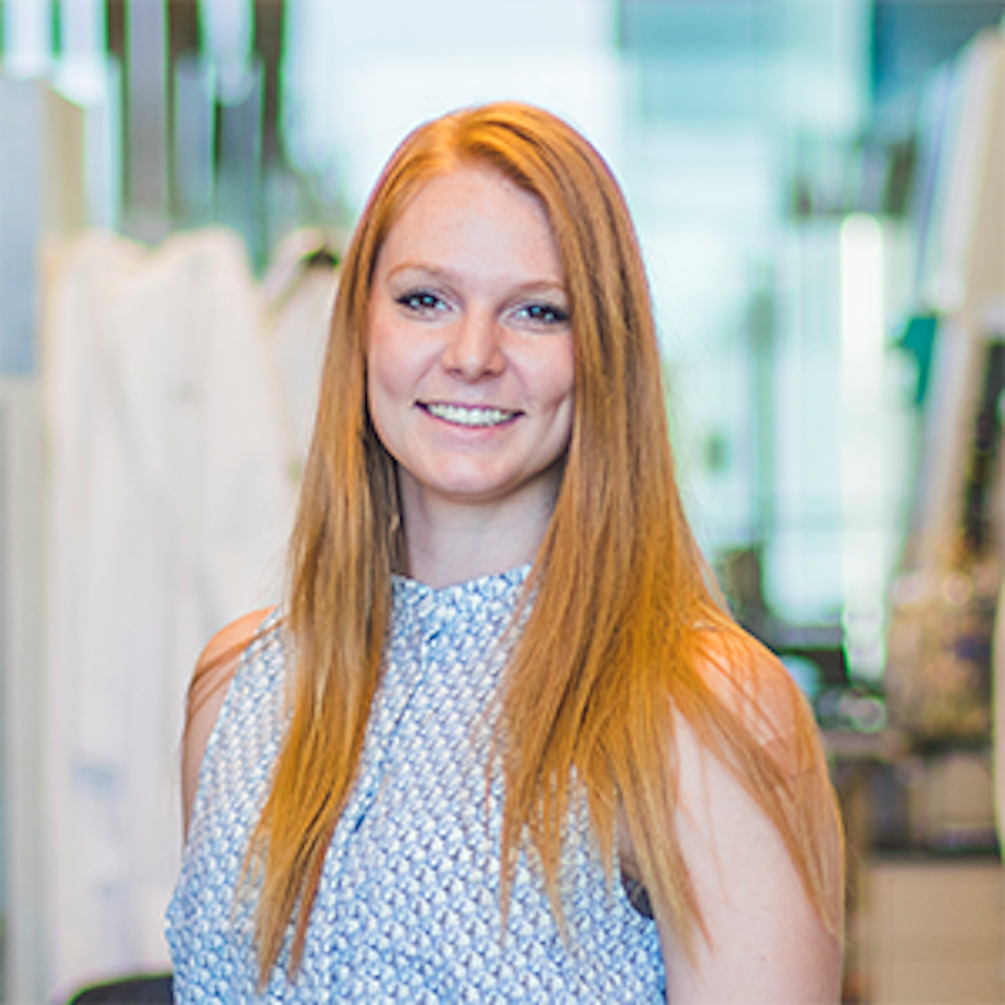
Create an image for a workshop lecture in a bioinformatics bootcamp
Prompt: Make a comic of a graduate student (xkcd style) with a mop and with R scripts:
Katie Campbell

Slide 28
Create a figure from scratch for a review article (Dall-E)
I would like to create a high-level conceptual image to summarize a paper we wrote. The paper is titled "Title: Looking Forward to AI and Medicine: Where Are We, and Where Are We Going?" The key themes of the paper are: …

Slide 29
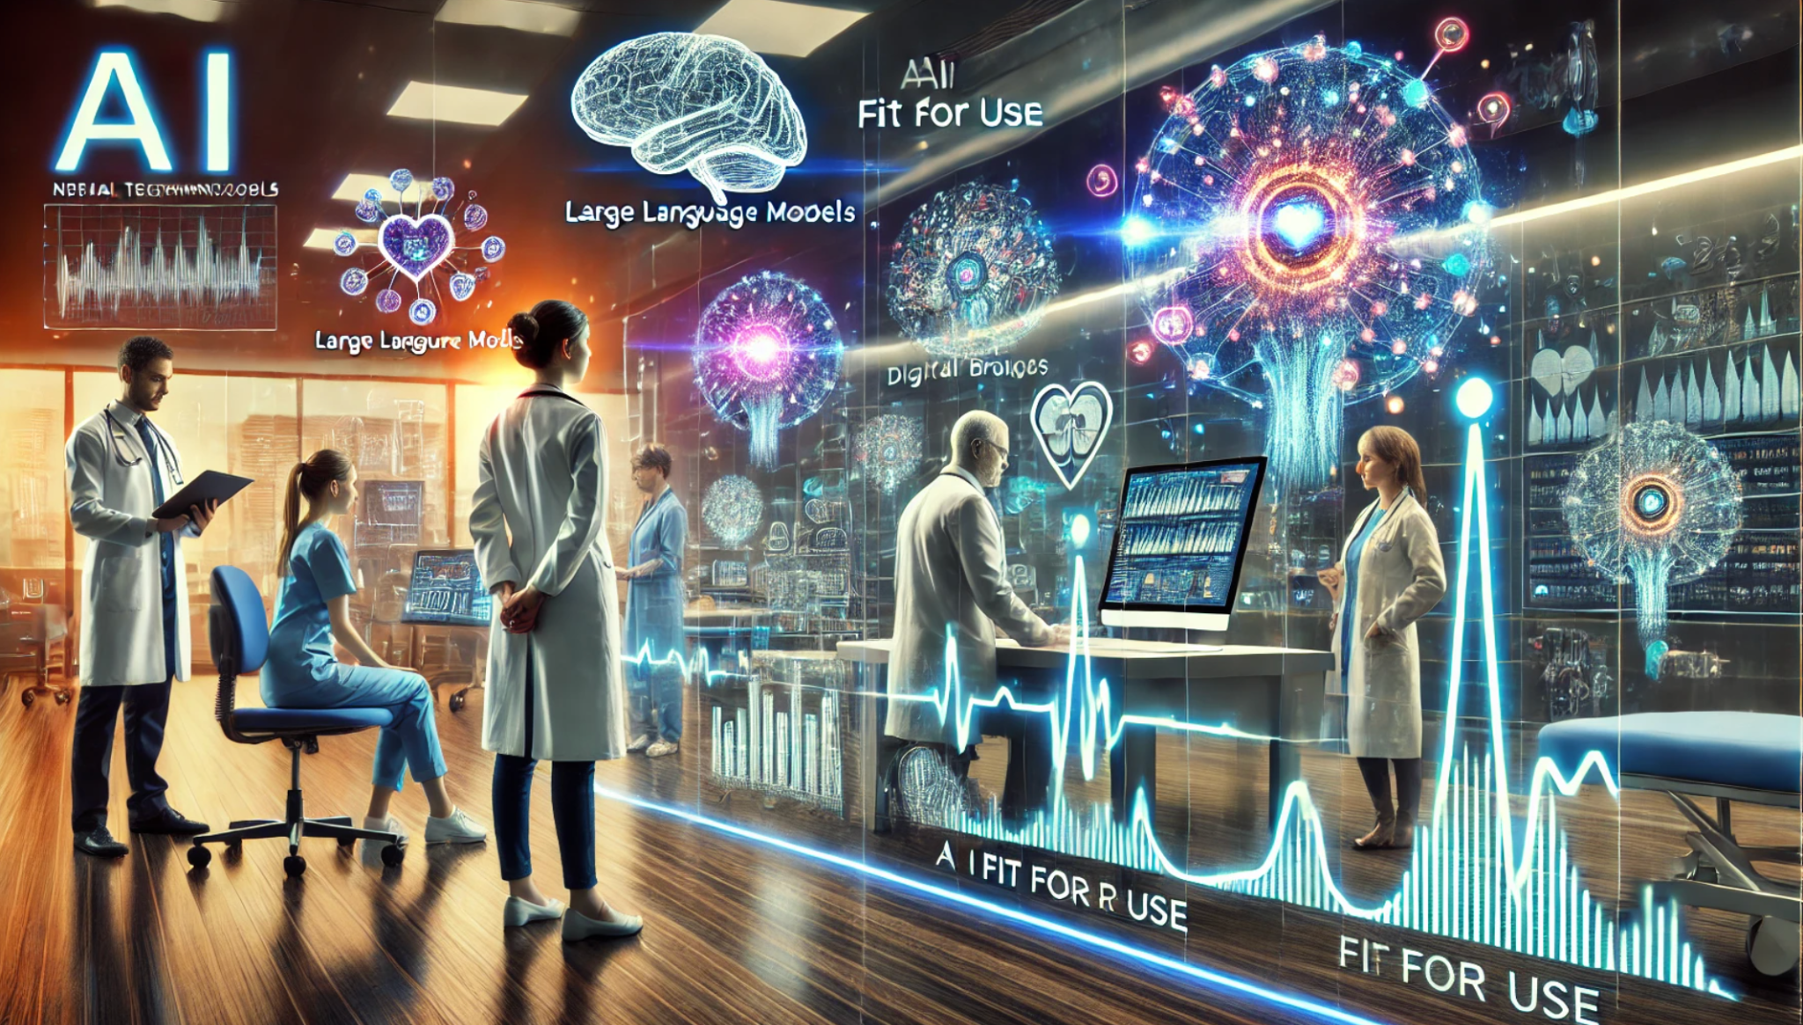
Create a figure from scratch for a review article (Dall-E)

Slide 30
Create a figure from scratch for a review article (Dall-E)
Please create new versions without human figures. Something more conceptual

Slide 31
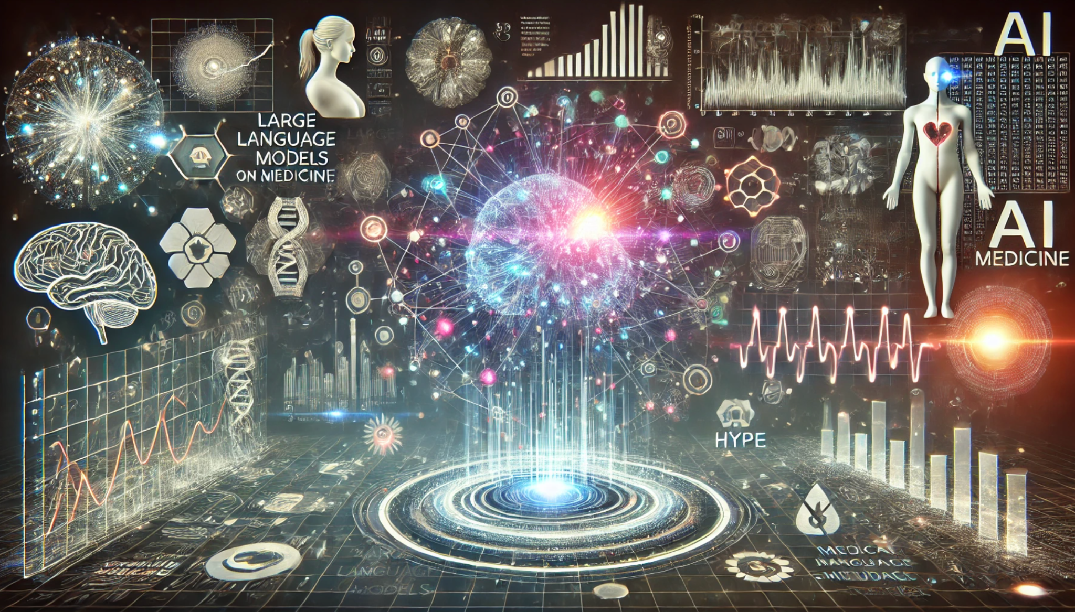
Create a figure from scratch for a review article (Dall-E)

Slide 32
Create a figure from scratch for a review article (Dall-E)
This image is great. However, I don't like the red line going down the person on the right. Also, please remove the word "Hype" from the image

Slide 33
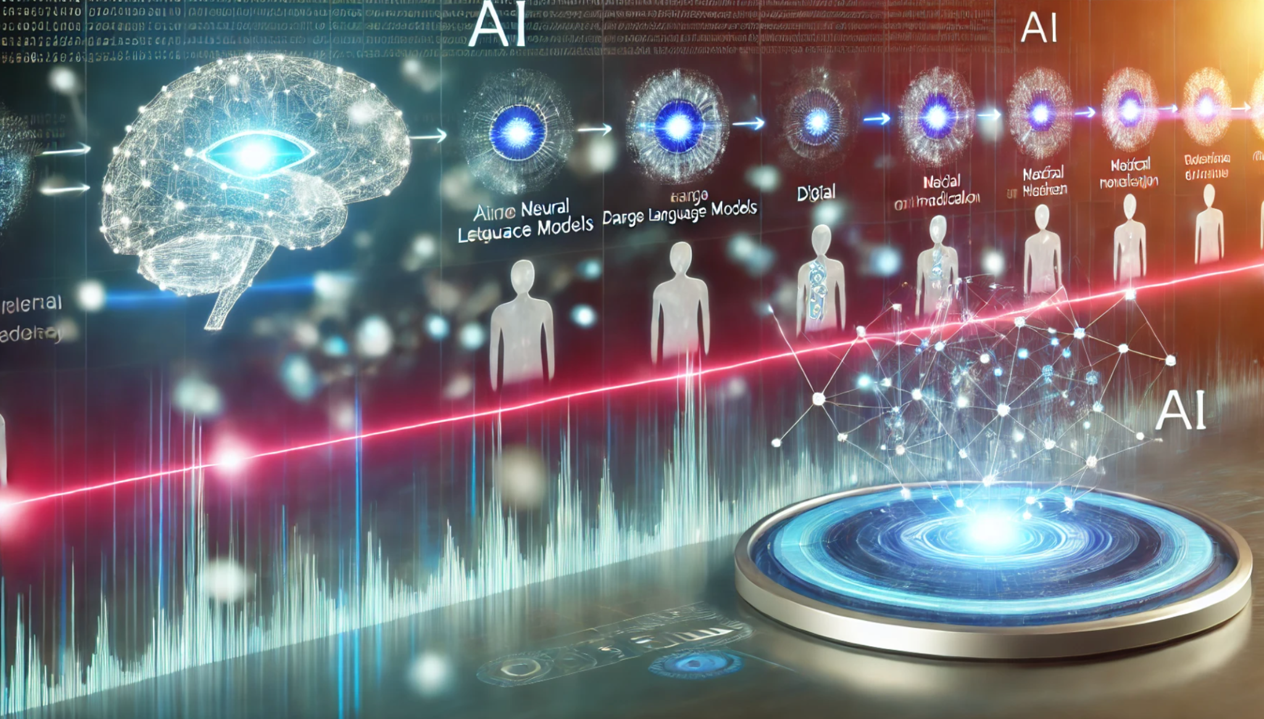
Create a figure from scratch for a review article (Dall-E)

Slide 34
Create a figure from scratch for a review article (Dall-E)
I like these last two versions which include both AI concepts and a timeline.
Create similar figures which graphically depict the evolution from rule-based systems -> machine learning -> deep learning -> generative AI

Slide 35
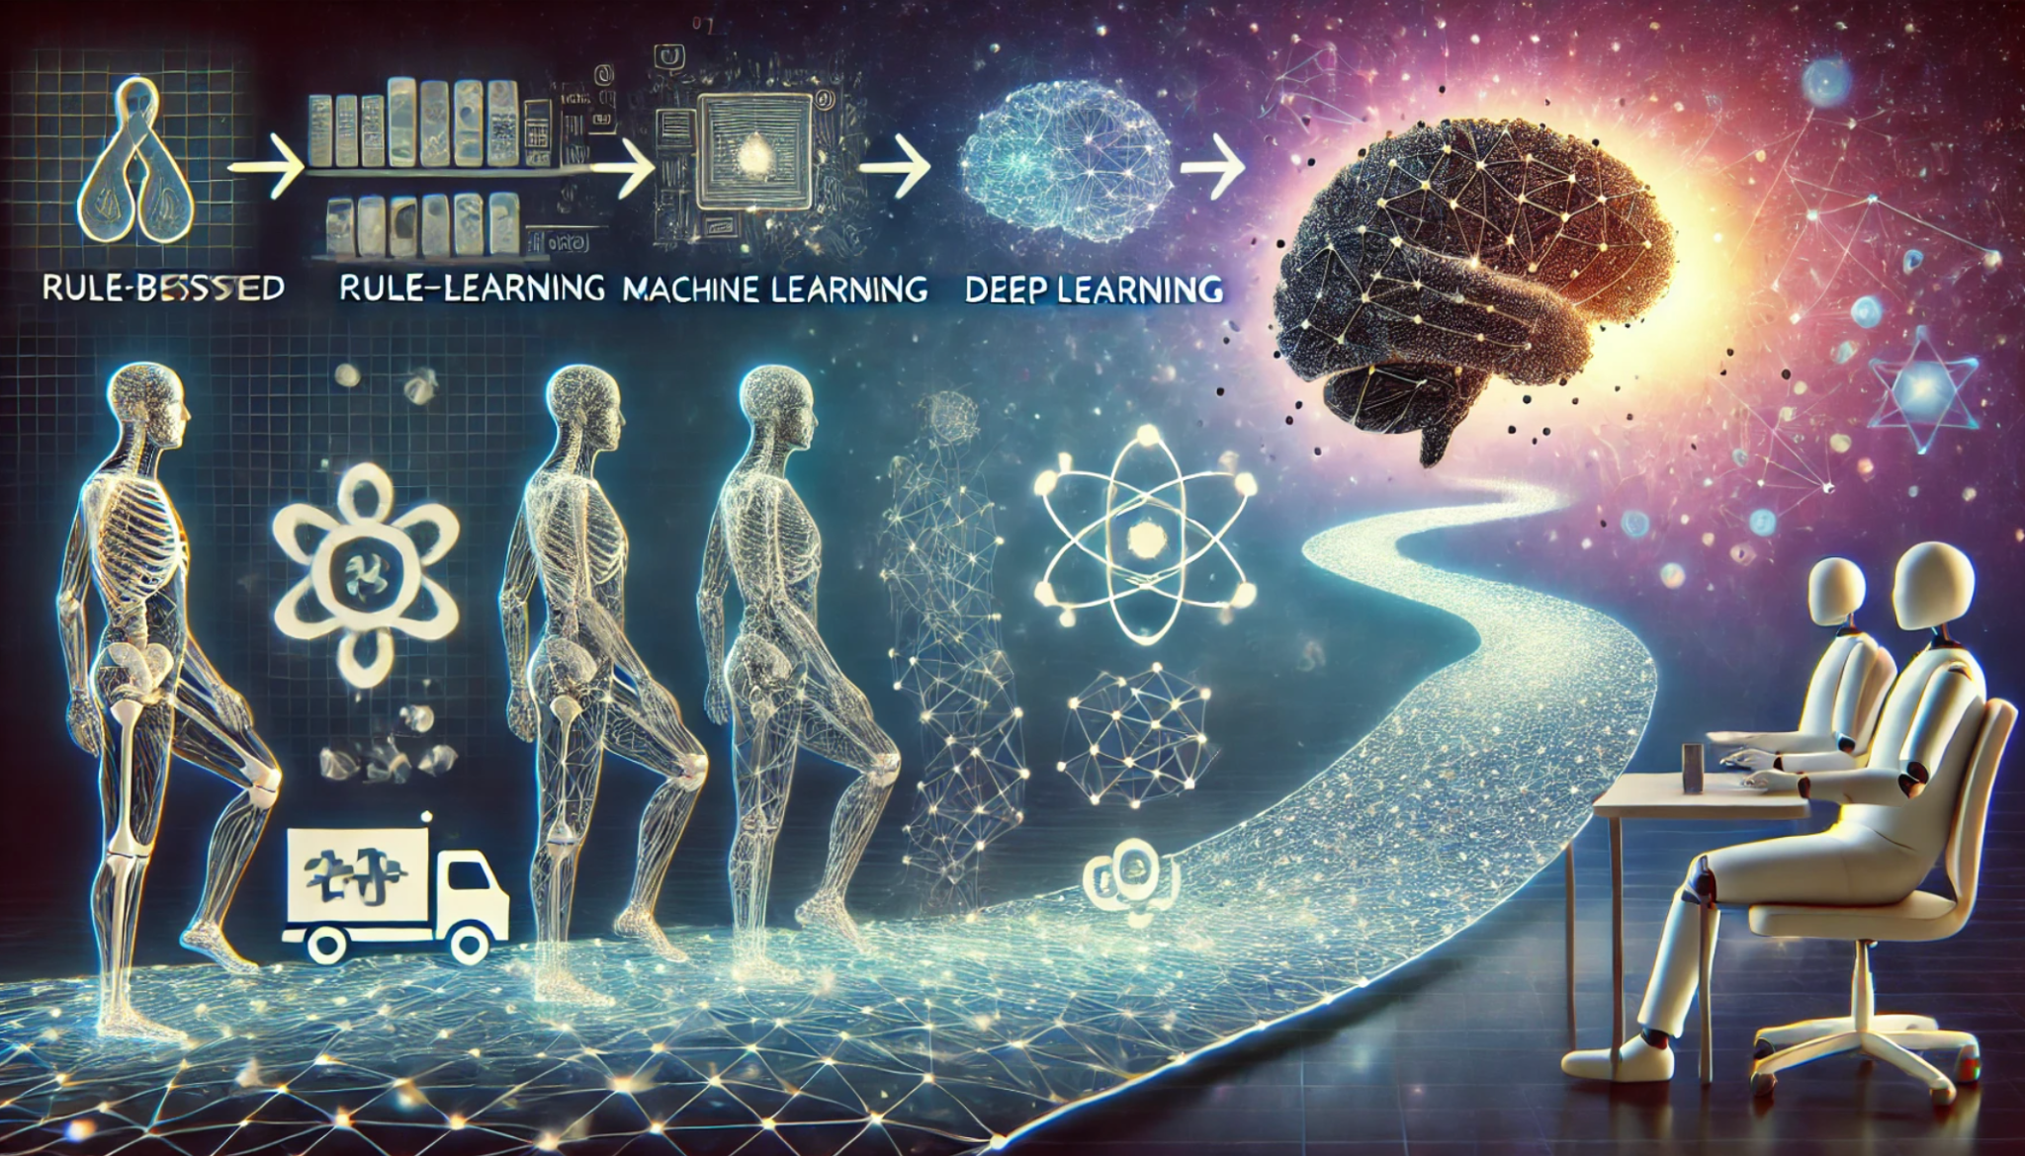
Create a figure from scratch for a review article (Dall-E)

Slide 36
Create a figure from scratch for a review article (Dall-E)
This is OK but please don't include any vehicles, include conceptual elements more like the previous two images, and make sure that the four types of AI are correctly spelled and represented in order: (1) "rule-based systems"; (2) "machine learning"; (3) "deep learning"; (4) "generative AI"

Slide 37
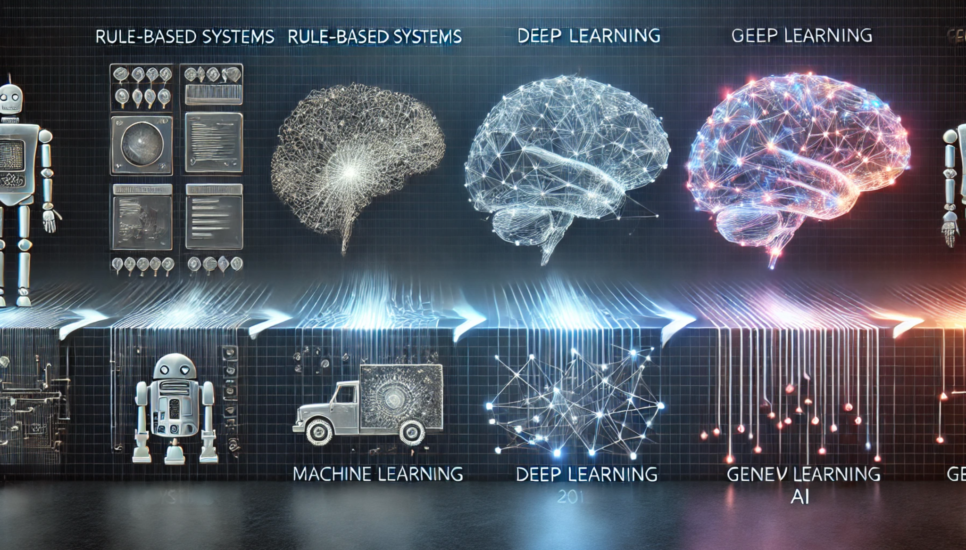
Create a figure from scratch for a review article (Dall-E)

Slide 38
Create a figure from scratch for a review article (Dall-E)
These look great but still don't have the 4 stages, correctly spelled, just appearing once each. Please just depict these four things in order:
(1) "rule-based systems"; (2) "machine learning"; (3) "deep learning"; (4) "generative AI"
… several more prompts

Slide 39
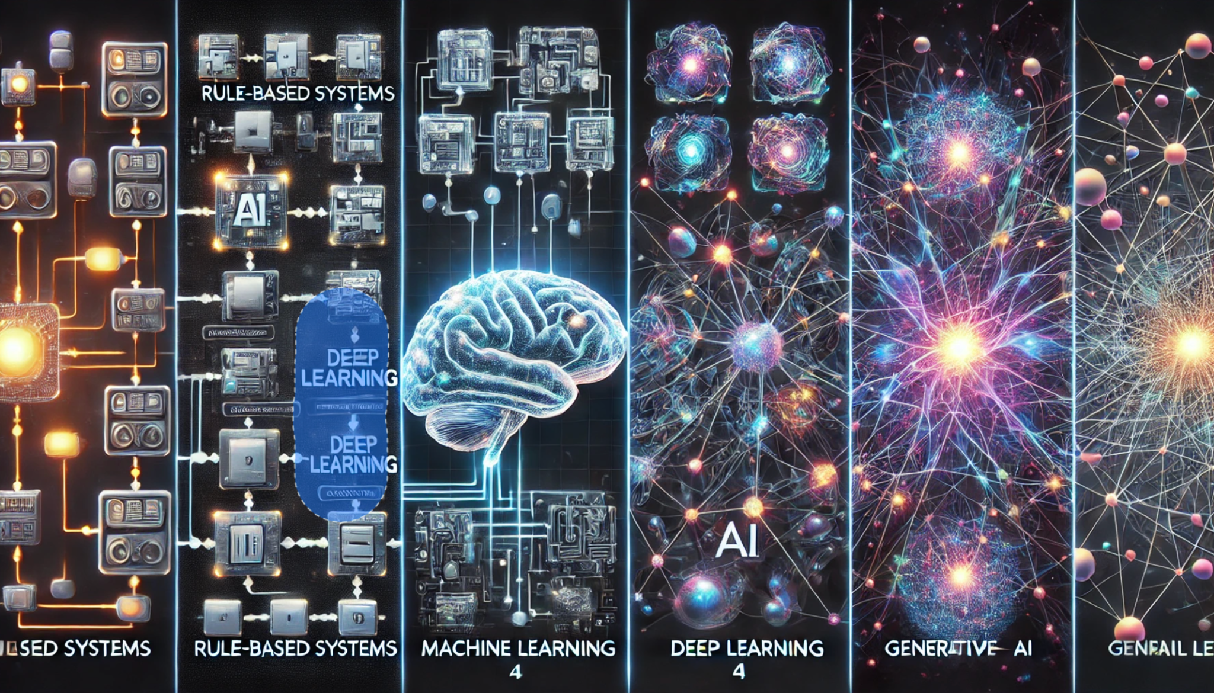
Create a figure from scratch for a review article (Dall-E)

Slide 40

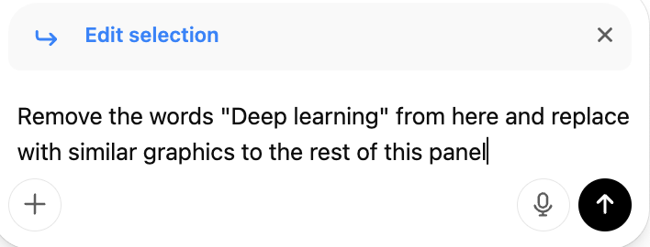
Create a figure from scratch for a review article (Dall-E)
… select and edit is key

Slide 41
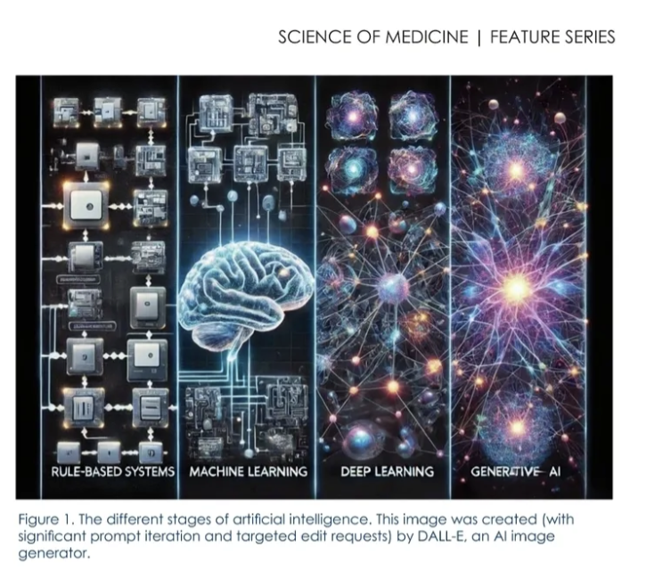
Create a figure from scratch for a review article (Dall-E)
20 prompts later…
Looking Forward to AI and Medicine: Adam Wilcox, Malachi Griffith, Obi Griffith. 2025. Where Are We, and Where Are We Going? Mo Med. 122(1):34–38.

Slide 42
Review consent forms for genomic data sharing language
I need to complete a table which documents whether a large number of informed consent forms (ICF) have language allowing the sharing of genomic/genetic data. This needs to be done for 60+ pdf forms. Specifically, I need to create a spreadsheet with the following four components (columns) for each form:
1. Genomic data sharing allowed? (Y/N)
2. If Genomic Data Sharing was Y, extract text from the ICF; otherwise, indicate N/A
3. Page number(s) in ICF detailing genomic data sharing language, formatted as “page(s) x-x”. Check to make sure only the page or pages from which the text is extracted are listed.
4. Name of consent file PDF
Here is an example of appropriate language: “These studies may include genetic research. Genetic research can look at DNA to look for mutation (changes) that may increase the risk of disease or affect the way a person responds to treatment. This could include the database of Genotypes and Phenotypes (dbGaP), which is a repository that shares genomic data. The data within dbGaP remains anonymous, but de-identification of data cannot eliminate a risk of disclosure, which could affect you and even your family members. … We will share your blood, tissue, and data with other researchers. They may be doing research in areas similar to this research or in other unrelated areas. These researchers may be at Washington University, at other research centers and institutions, or industry sponsors of research. We may also share your research data with large data repositories (a repository is a database of information) for broad sharing with the research community. If your individual research data is placed in one of these repositories only qualified researchers, who have received prior approval from individuals that monitor the use of the data, will be able to look at your information”
The relevant language can be contiguous or spread across multiple parts of the document but must have enough surrounding text or headers to ensure that the meaning is clear and not taken out of context.
The language should be the same or similar to the examples above. The most critical question is whether the consent form made it clear that genetic/genomic data would be shared with other researchers. However, if the consent form provides explanation of the genetic research to be performed, the use of specific genetic data repositories (e.g., dbGaP), access restrictions on such repositories, possible risks associated with sharing genetic data, or other aspects related to genetic research/data then that language can be extracted as well.
Keep the extracted result to a minimum span of text that covers genetic/genomic data and sharing of that data without including much language that more generally covers the sharing of blood, tissue, specimens or other kinds of data unless such language is needed to document implicitly allowing genetic data sharing. If there are multiple spans of text that accomplish the same goal, one good representative is sufficient. It is critically important that the language identified and extracted be quoted verbatim in the table and accurately linked to the page number(s) from which it came.
Create a table in excel format for output.
I will upload batches of PDFs from which to build the table.

Slide 43
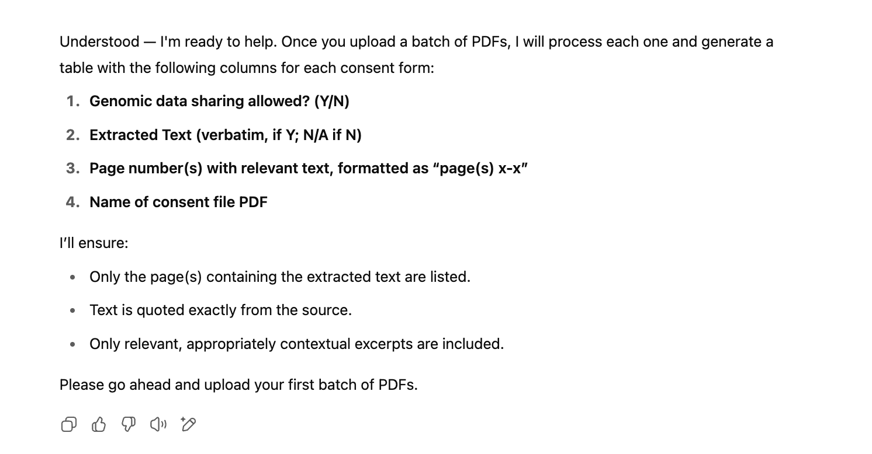
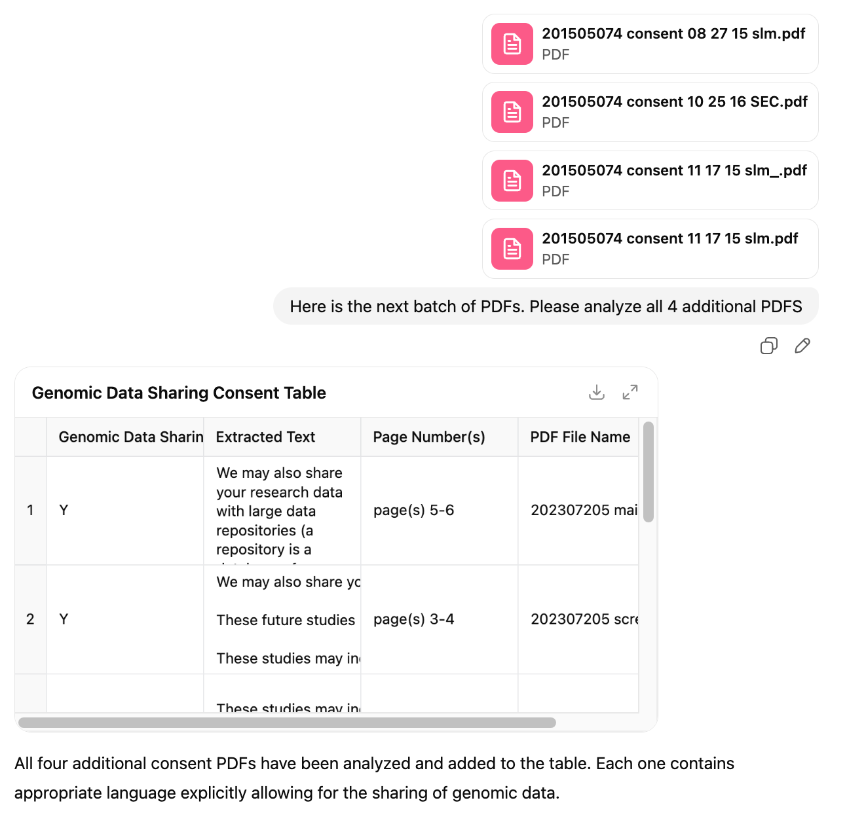
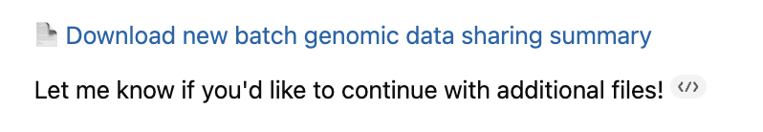
Review consent forms for genomic data sharing language

Slide 44
Lesson: An extended conversation with AI is often needed

Slide 45
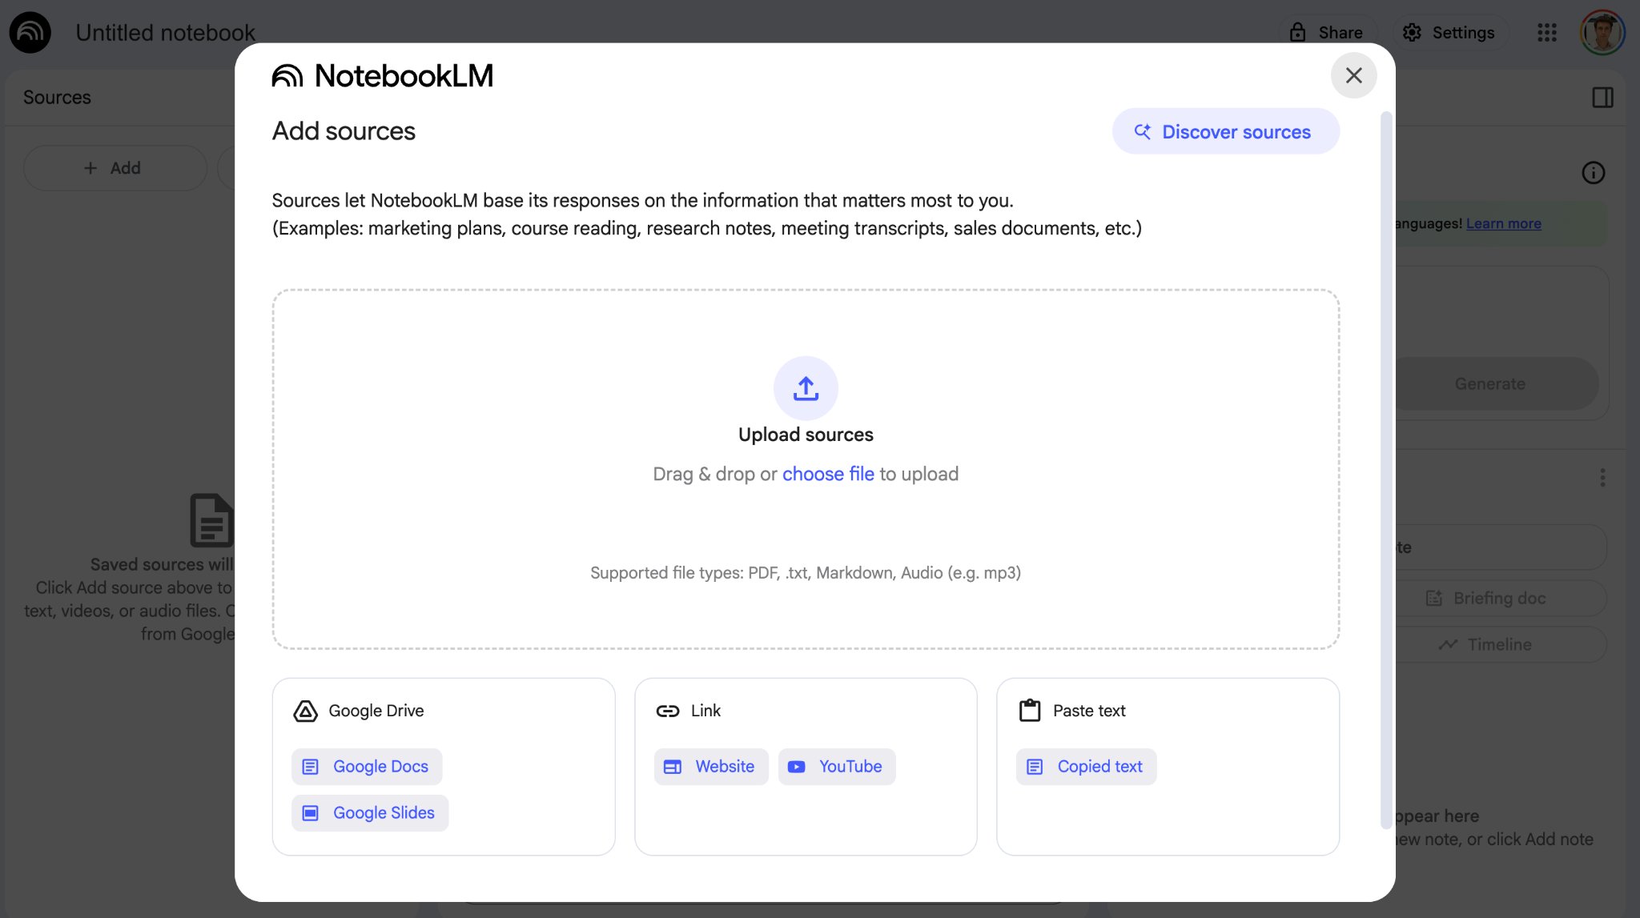
Google NotebookLM allows AI queries of select sources

Slide 46
NotebookLM demo
A colleague has proposed a collaboration using whole-exome-sequencing to investigate the mutational landscape of multiglandular parathyroid disease (MGD)
What is already known about the mutational landscape of this disease?
A google search for “whole exome sequencing parathyroid tumor” identifies 10-20 relevant papers.
Let’s upload the PDFs to Google NotebookLM and ask it some questions.

Slide 47
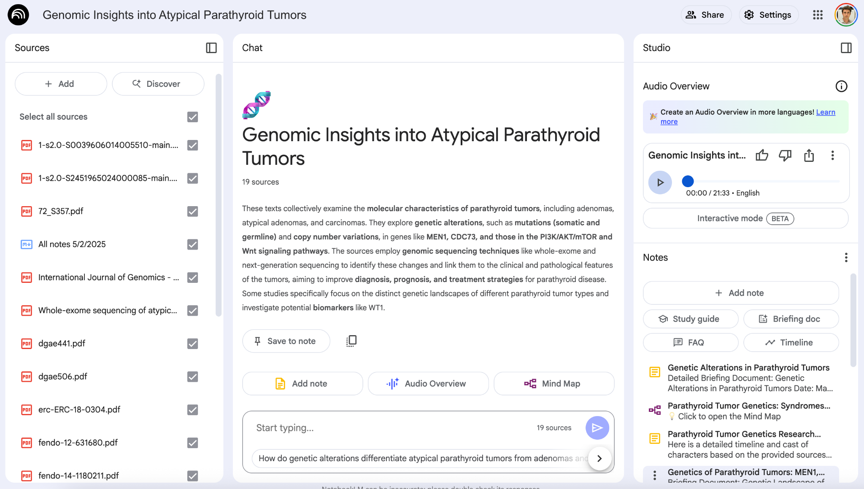
NotebookLM allows queries of source material, and auto-generates audio overview (“podcast”), Study Guide, FAQ and more…

Slide 48
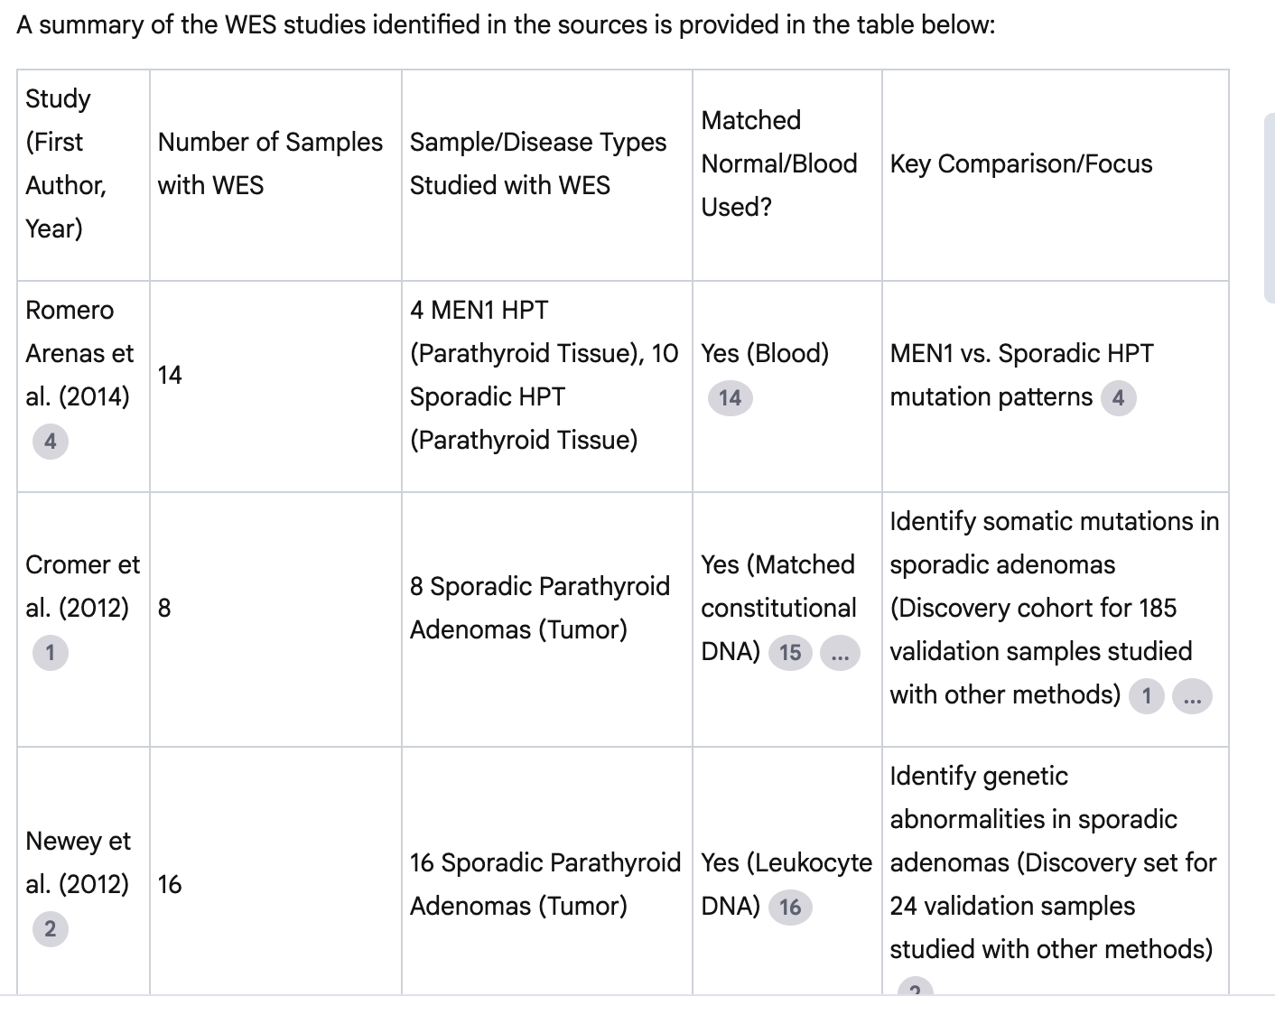
Summarize the exome sequencing studies performed to date
Other questions:
Define the key genetic drivers of parathyroid tumors
Summarize what is known about the genetics of multiglandular parathyroid disease (MGD)

Slide 49
Summarize what is known about the genetics of multiglandular parathyroid disease (MGD)
In summary, sequencing and molecular studies have illuminated the genetic basis of hereditary MGD (primarily MEN1, driven by MEN1 biallelic inactivation and other genes like TP53 and GCM2), and have begun to identify distinct candidate drivers in THPT hyperplasia (PRKDC, TBX20, NOX3, and specific CNVs, notably without MEN1 or CCND1 mutations). However, the specific somatic molecular drivers and genetic landscape of sporadic MGD, particularly sporadic hyperplasia, are less comprehensively defined in the provided sources, which highlight its likely genetic heterogeneity and the limited studies comparing it directly to sporadic single-gland adenomas
The shared interaction using this notebook really helped guide the new collaboration

Slide 50
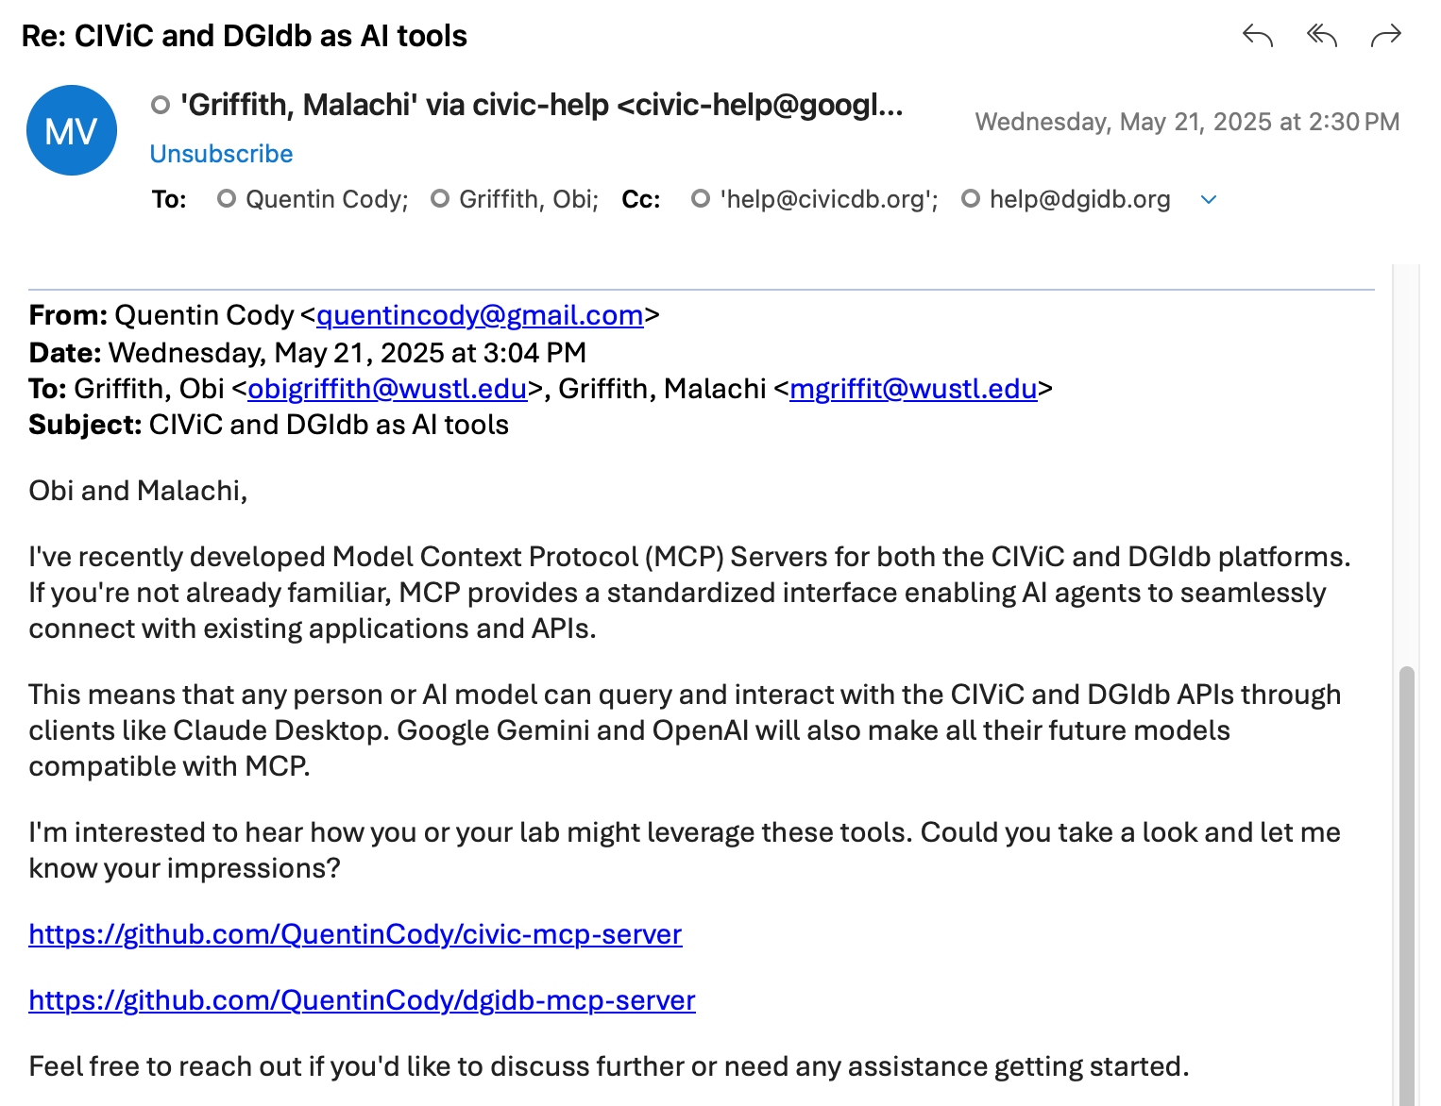
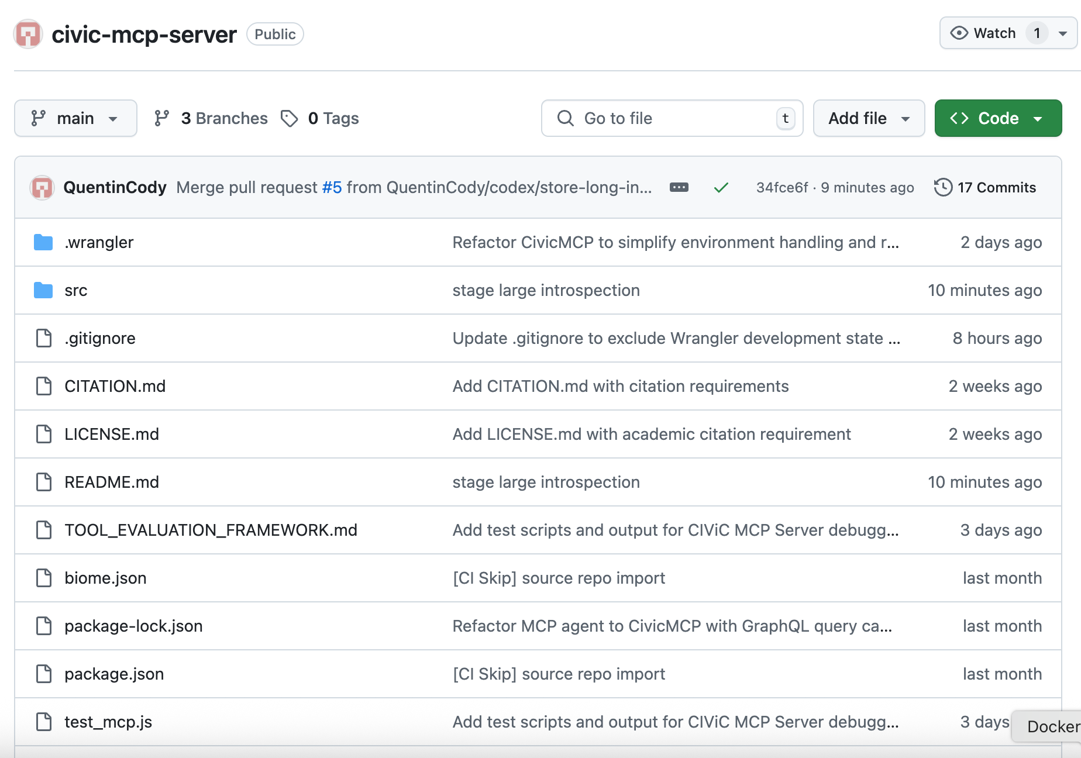
Model Context Protocol (MCP) Server - allows AI agents to connect with existing Applications

Slide 51
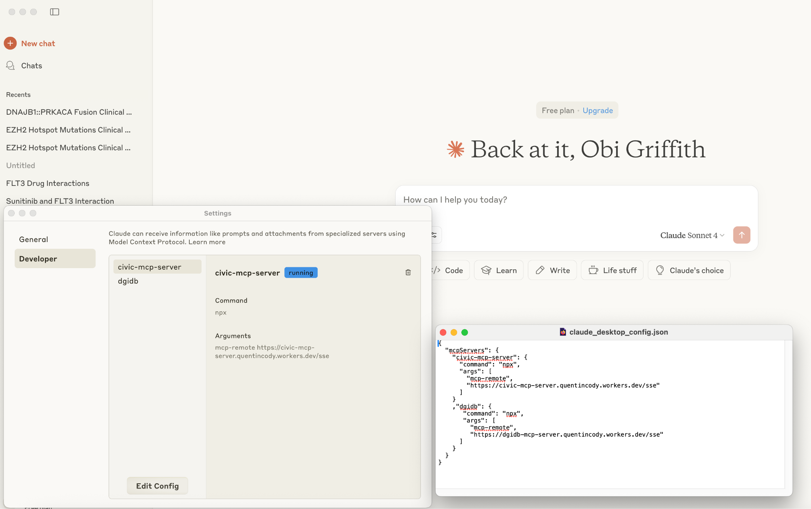
Deploy an MCP server for CIViC and then configure Claude desktop to point to it

Slide 52
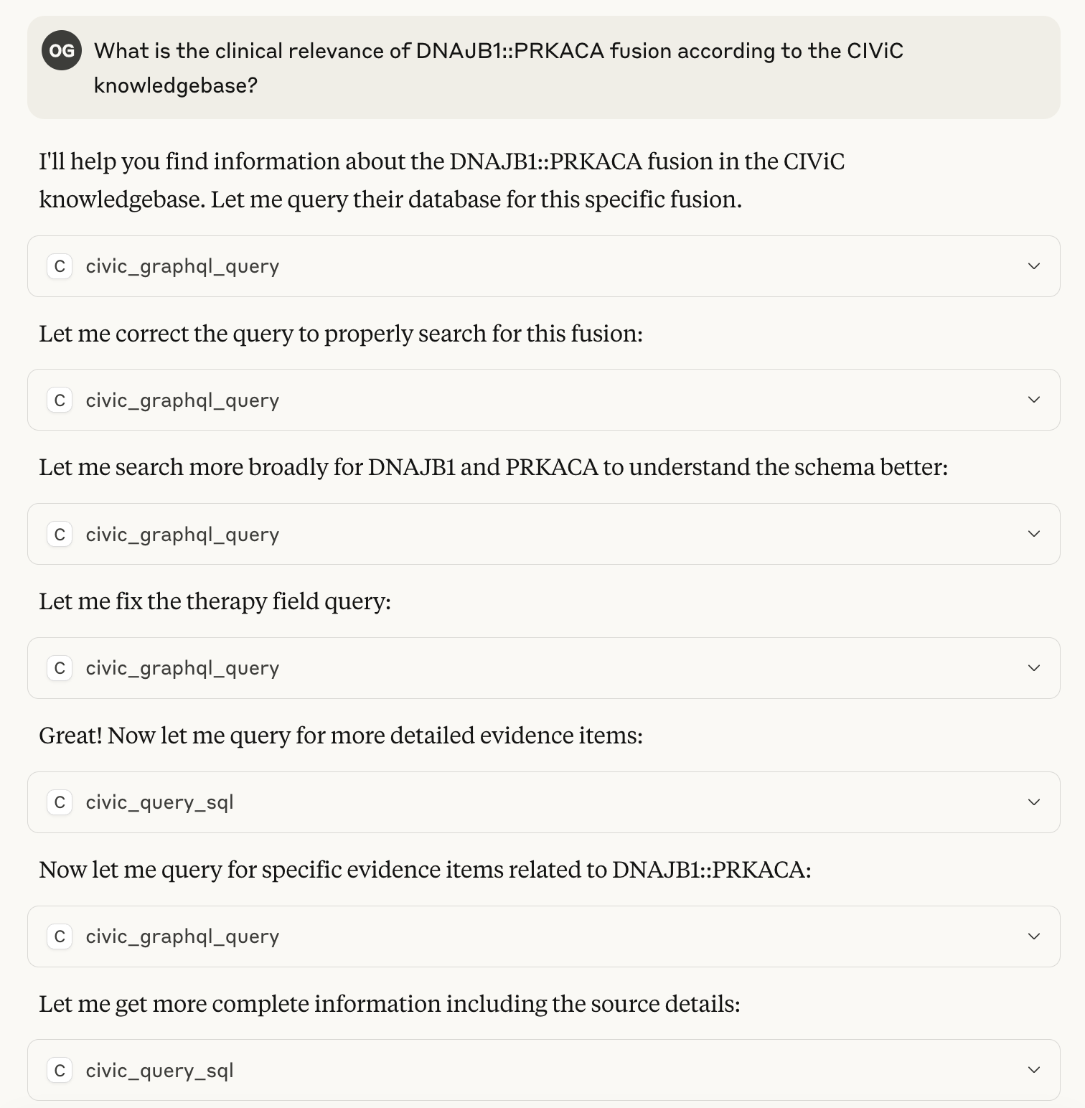
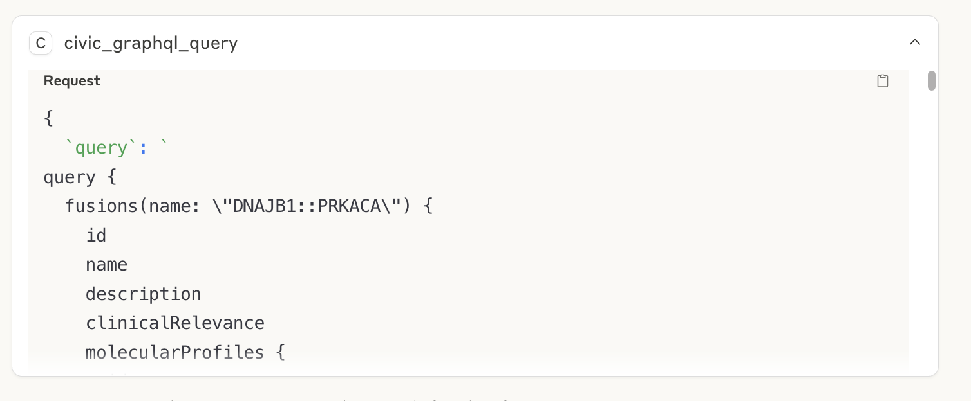
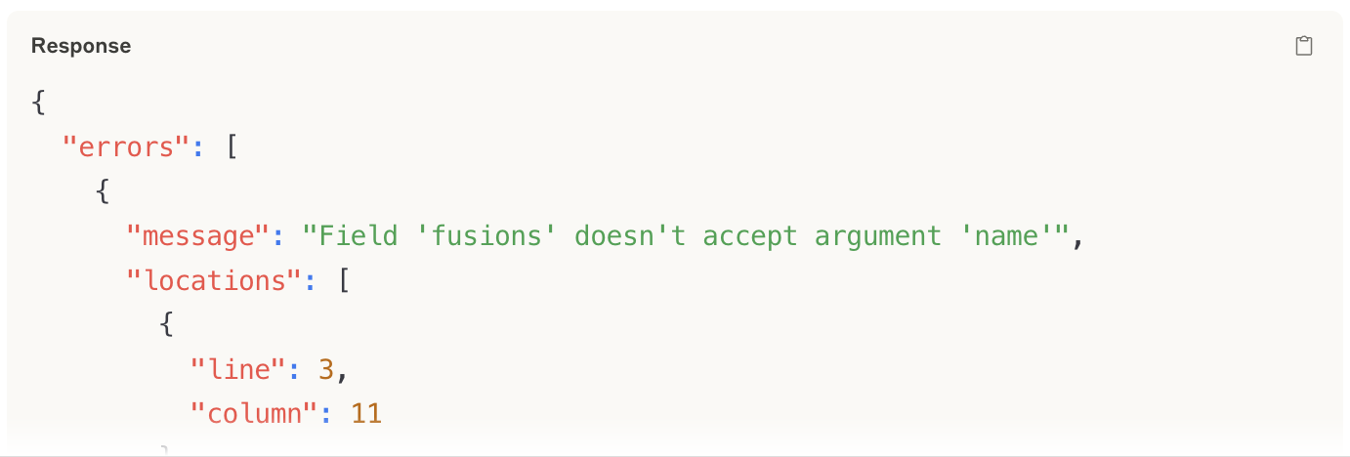
Ask Claude questions and have it directly query CIViC

Slide 53
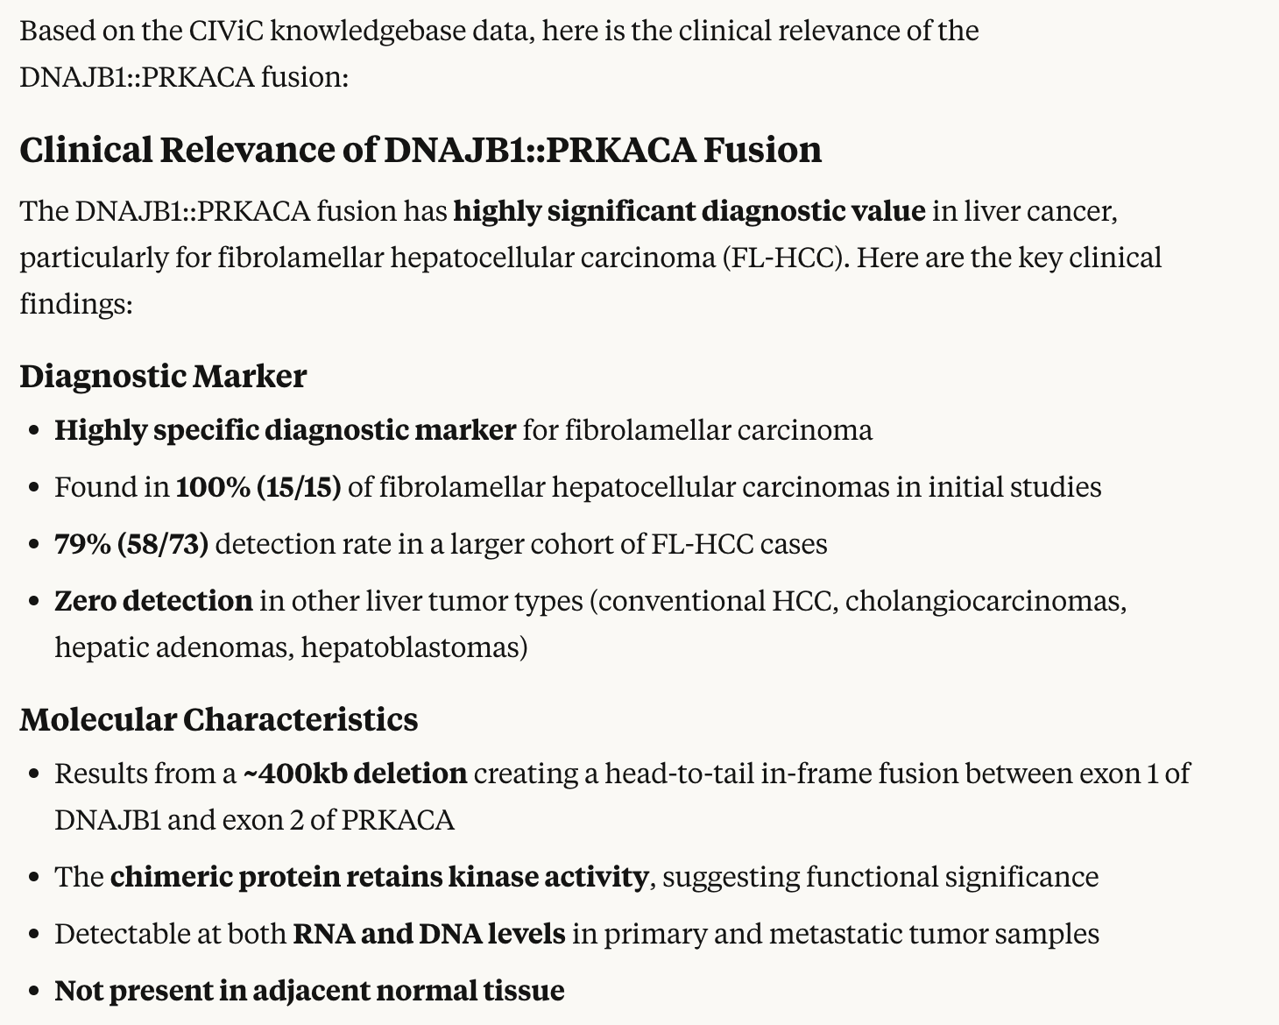
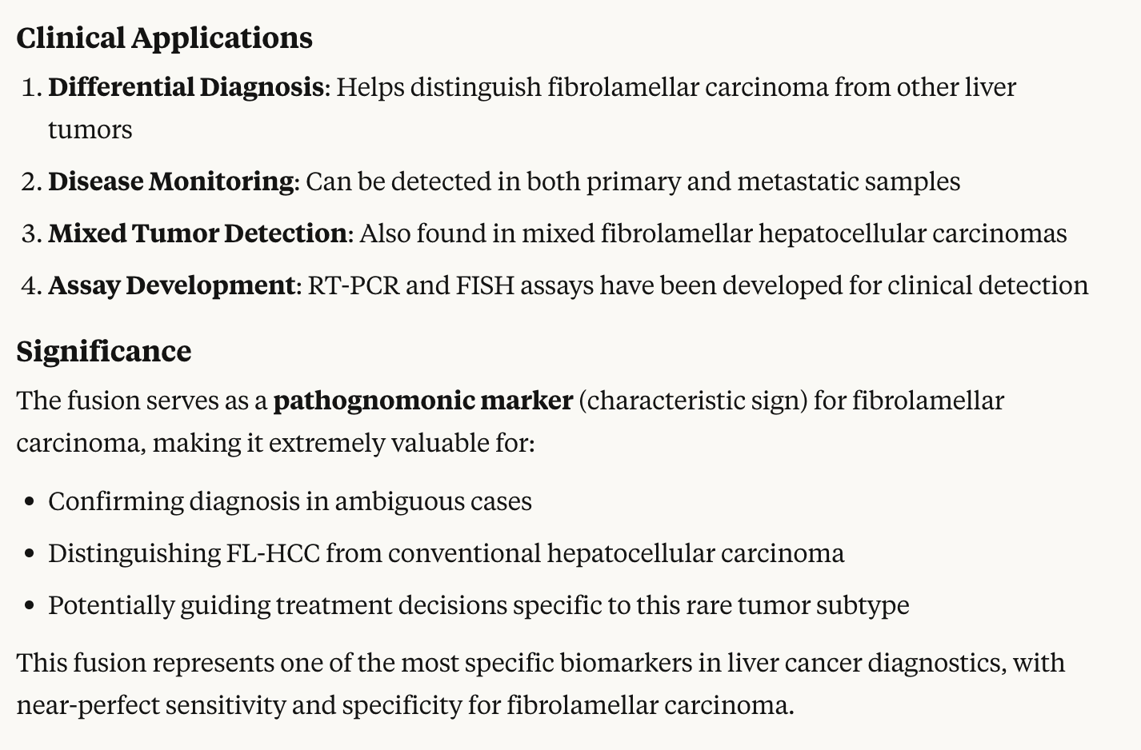
Results are summarized in human readable form

Slide 54
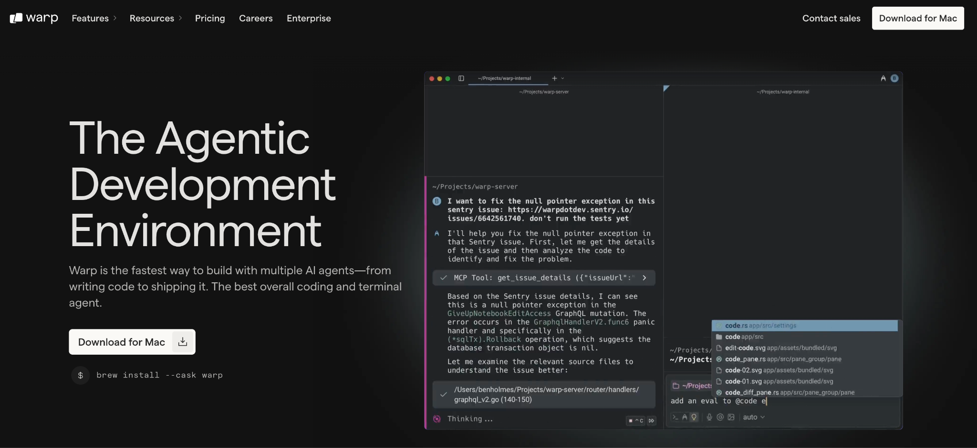
Agentic Coding Environments (Warp, Claude Code) moves development from typing code to coding by prompt

Slide 55
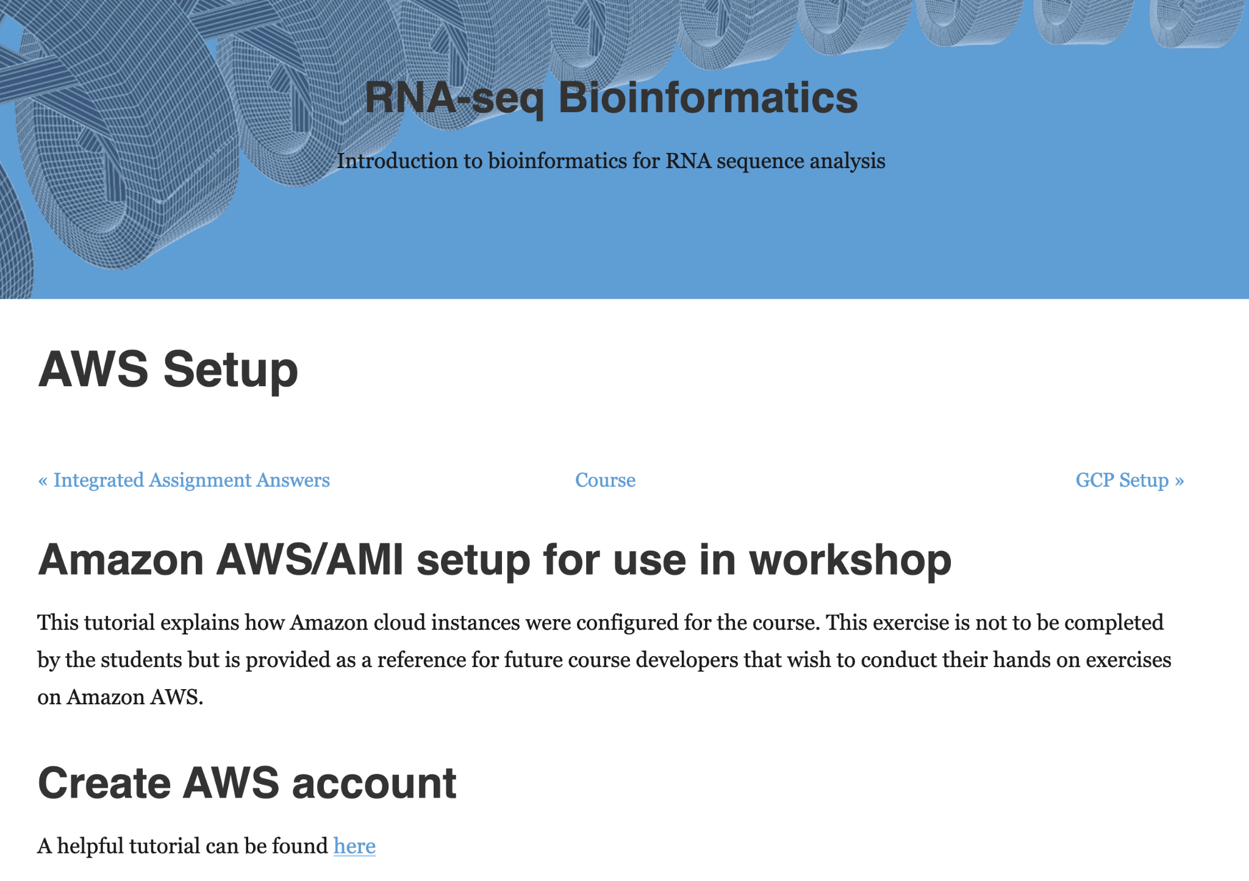
Create a docker environment for hands-on bioinformatics workshop
We host a 3 - 5 day workshop on RNAseq/scRNAseq analysis
AWS AMI allows students to work through exercises in a consistent/robust environment
  Requires AWS account ($$$) and prevents self-organized learning and later review/practice
A docker image with all dependencies would make more broadly accessible year round
  Dozens of tools, linux dependencies, web server, etc
https://rnabio.org/module-09-appendix/0009/09/01/AWS_Setup/

Slide 56
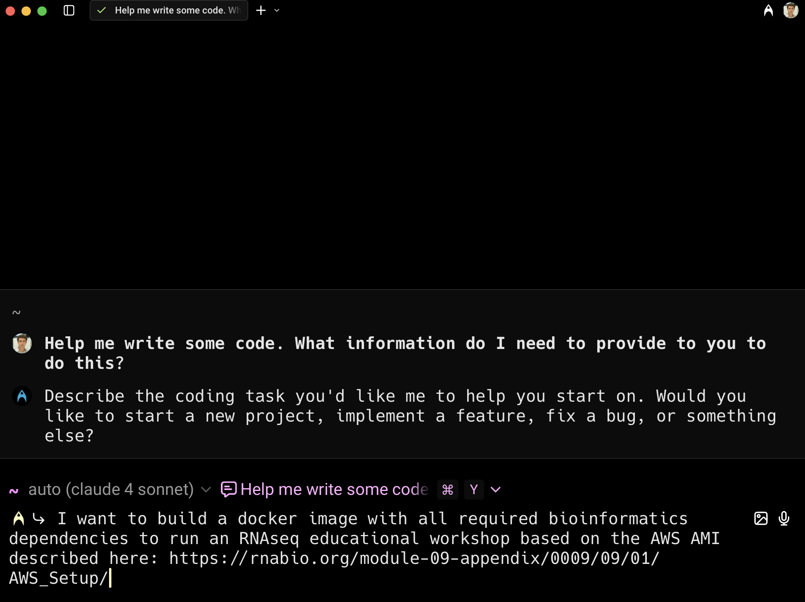
Create a docker environment for hands-on bioinformatics workshop
Point warp to an existing github repo and (very prelim) attempt at a dockerfile
Explain that build time and image size should be optimized
Warp starts building!
  Review each change carefully
  Make corrections advice as needed
  Remind to commit changes along the way
  Ask for versioning
  …
https://github.com/griffithlab/rnabio.org/tree/master/docker/course/dockerfile_approach

Slide 57
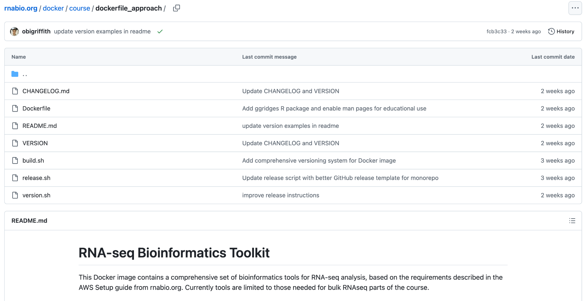
Create a docker environment for hands-on bioinformatics workshop

Slide 58
Even more successes from (small sample) of Obi’s chatGPT history
Get randomforest internal OOB performance from python scikit-learn
Write short, informative figure title for caption text
Find an RIA or CFP who specializes in advising non-profit organization
Explain the concept of "nostalgia" to a kindergartener?
grep for one string OR another string
Difference between a roll and a po’boy?
Write a letter of support for a scientific proposal
Configure Apache2 for HTTPS
Calculate attributable earnings for an HSA excess contribution
Freeze your children’s credit history
Explain cytogenetic nomenclature (e.g., ISCN) to specify a reciprocal translocation?
What is the answer to life, the universe and everything?

Slide 59
Cautionary Example Uses!

Slide 60
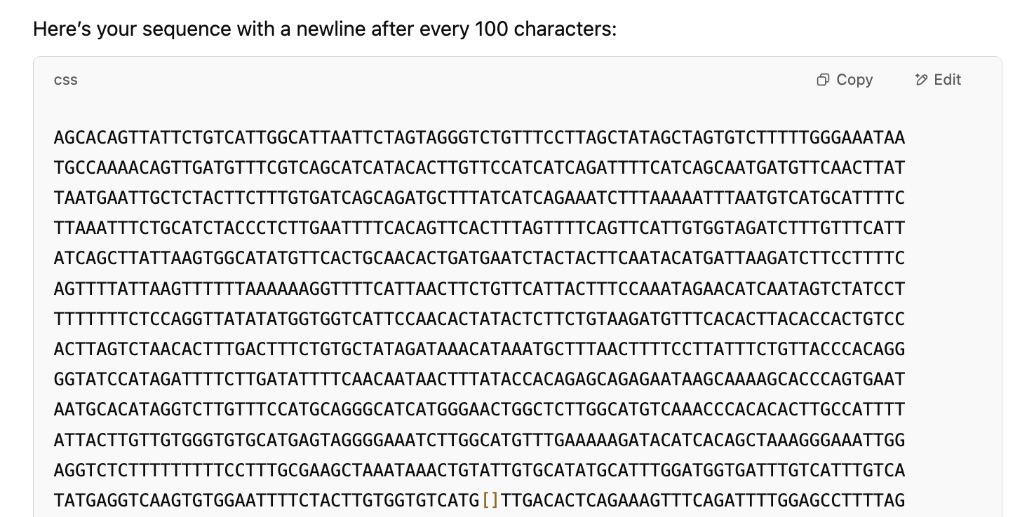
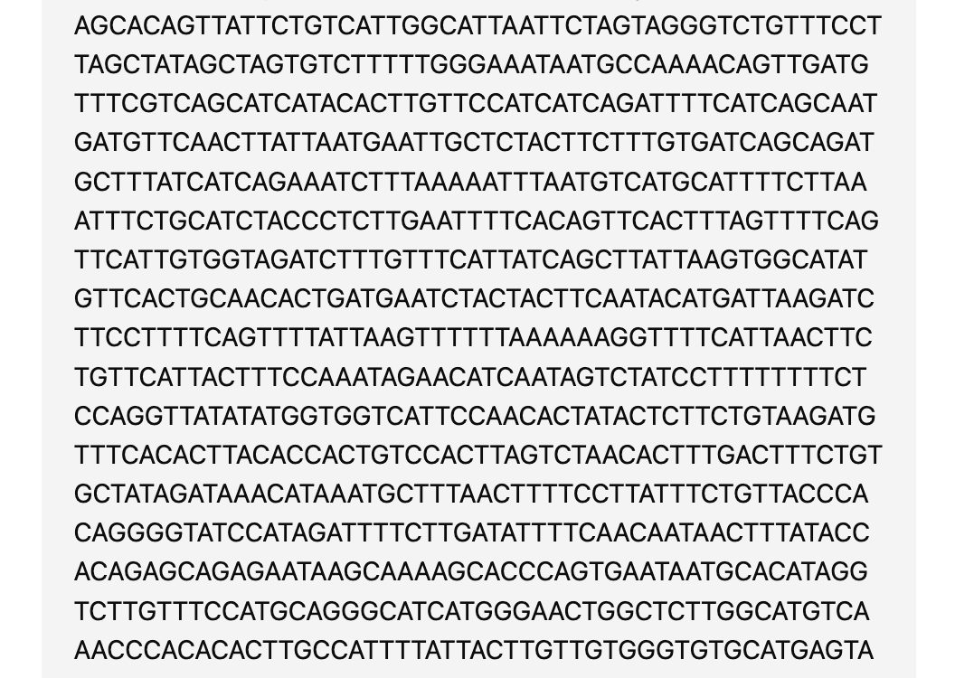
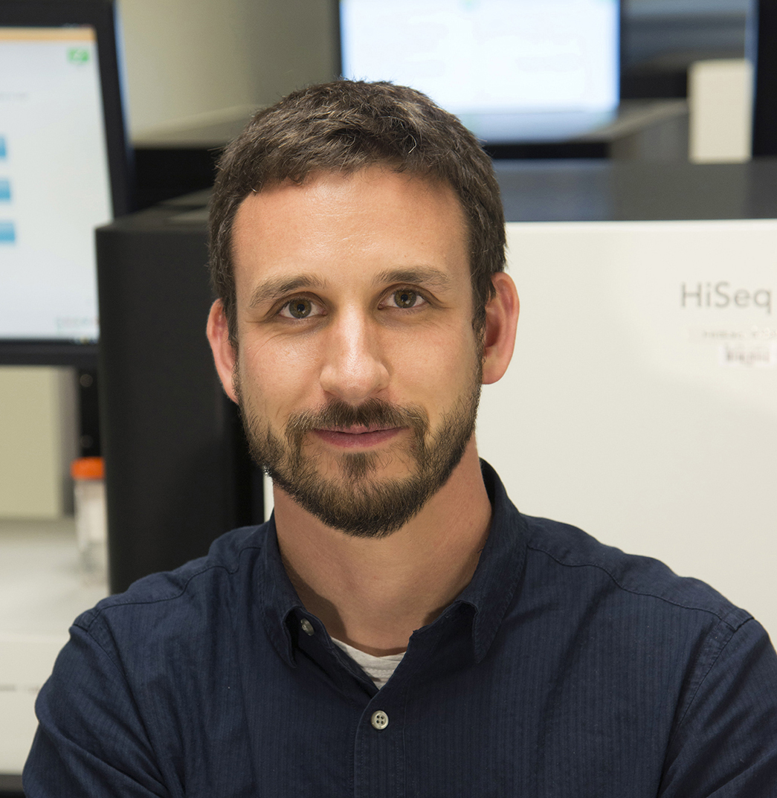
Simple sequence manipulation
Give me this sequence with a newline after every 100 characters
Malachi Griffith

Slide 61

Something a little more complicated…
Give me the reverse complement of this sequence maintaining the "[]":

Slide 62

ChatGPT explains it’s plan and gives a sensible looking result

Slide 63

ChatGPT explains it’s plan and gives a sensible looking result
ChatGPT highlights the brackets in their new position, remembers we like 100 bases per line, and even asks if we’d like it in FASTA format!

Slide 64


There’s just one problem …
As final QC check, let’s just make sure our sequence still matches the original

Slide 65
Lesson: Sometimes maybe AI isn’t the right/best tool…

Slide 66

How does this software parameter work?
Malachi Griffith
Amazing! exactly what I was hoping to learn!
Malachi Griffith (WashU)

Slide 67

When I ask about this made up option --filter_name it doubles down and provides “evidence”.
All three of these points of evidence are demonstrably false

Slide 68
Lesson: Sometimes AI is just telling you what you want to hear

Slide 69

Processing Images into Useful Artifacts
Some LLMs can take images as input.
This can be useful to process an image into a document, code snippet, or data.
The following example uses Google’s Gemini 2.5 Pro Model via Copilot to turn a database schema diagram into database migration files to create the diagrammed tables.
Adam Coffman
Notes:
In addition to producing images, some models can actually take images as inputs. You can use the model to generate useful items from the image like code snippets, documents, or data. I've even pasted in a picture of a schedule flyer and asked it to generate calendar events from it.

Slide 70

Processing Images into Useful Artifacts
Notes:
We maintain a fairly large Ruby on Rails web application in our lab. When developing new features that require additions to the schema, we like to diagram out the new tables and fields as part of the planning process. We then usually write a Rails migration that will add the needed tables and columns. Gemini however is able to take a screenshot of our schema diagram and generate the migration file automatically.

Slide 71


Processing Images into Useful Artifacts
That’s a lot of assumptions and pitfalls!
Notes:
Asking it to document any assumptions it makes or likely places for errors results in a lengthy/thorough looking list which makes it seem like it really reasoned through the problem.

Slide 72
Processing Images into Useful Artifacts
Despite the apparent comprehensiveness of the reasoning. It missed something very basic in its generated code.
We specifically told it that we were using Rails 8, but it generated a migration for Rails 7, despite repeating version 8 back to us.
Notes:
However, despite being explicitly told we were using version 8, it generated a migration file for version 7.1. An error on the very first line of the file! Overall, the rest of the file was mostly correct and we were able to use it with minor adjustments. Definitely a time saver, but more proof you can't just blindly trust what it spits out.

Slide 73
Lesson: Check the bot’s work, very carefully

Slide 74

“Create an image the delicious depicts the difference between peptide mhc binding, processing, presentation and immunogenicity”
Malachi Griffith

Slide 75

“Create an image that depicts the difference between peptide mhc binding, processing, presentation and immunogenicity”

Slide 76

“Okay that's nice but tone down the deliciousness”

Slide 77

“Get rid of the burger aspect”

Slide 78
Lesson: Current AI “remembers” past things you’ve said, in unexpected ways, and doesn’t always understand

Slide 79

Solve my calendar problem!
Meeting Free Week: https://the-tgg.org/news-and-events/meeting-free-weeks

Slide 80


Build your own custom agentic workflows
Really cool
Unfortunately, it doesn’t work
  Constantly tries to schedule meetings on Saturday
  Misses good options
  Times out, etc

Slide 81


Claude with Google Calendar Connector solves this

Slide 82
Lesson: Sometimes its best to leave things to the professionals

Slide 83


Remember … you can’t lick a badger twice!
https://www.cnet.com/tech/services-and-software/googles-ai-overviews-explain-made-up-idioms-with-confident-nonsense/

Slide 84
Take home message
Some CEO (or department chair) maybe looks at this and says “I can fire half my staff and get the same amount of work done”
… maybe a few staff can be saved mundane, unsatisfying work…
But, they should be saying “if we train our staff to use these tools effectively our whole productivity will be like 10x and we will rocket past the competition”

Slide 85

AI for Decision Makers - Avoiding AI Harm
Tips and prompts for AI use and AI development
https://www.itcrtraining.org/courses

Slide 86

AI for Efficient Programming Course
Tips and prompts for using AI to write and refactor code
https://www.itcrtraining.org/courses

