Slide 1
Canadian Bioinformatics Workshops
www.bioinformatics.ca
bioinformaticsdotca.github.io

Slide 2
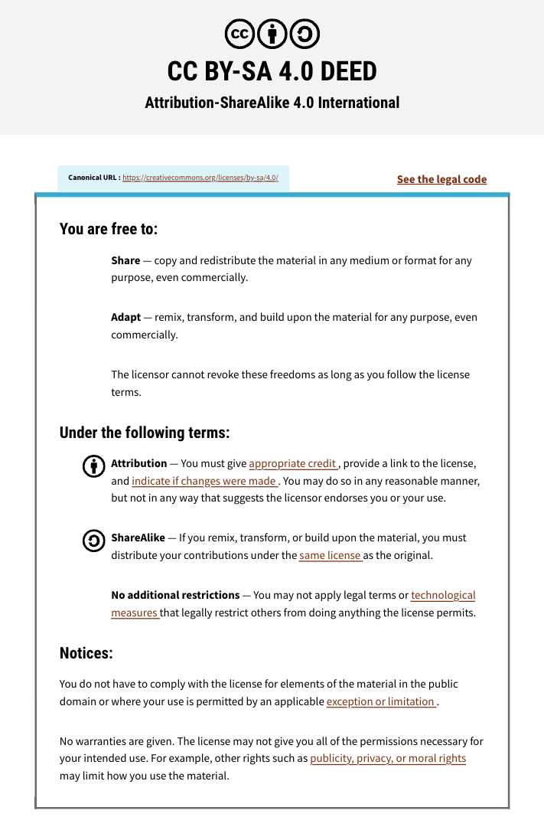

Slide 3
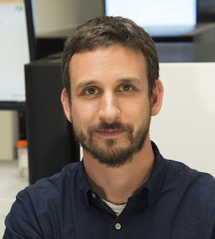
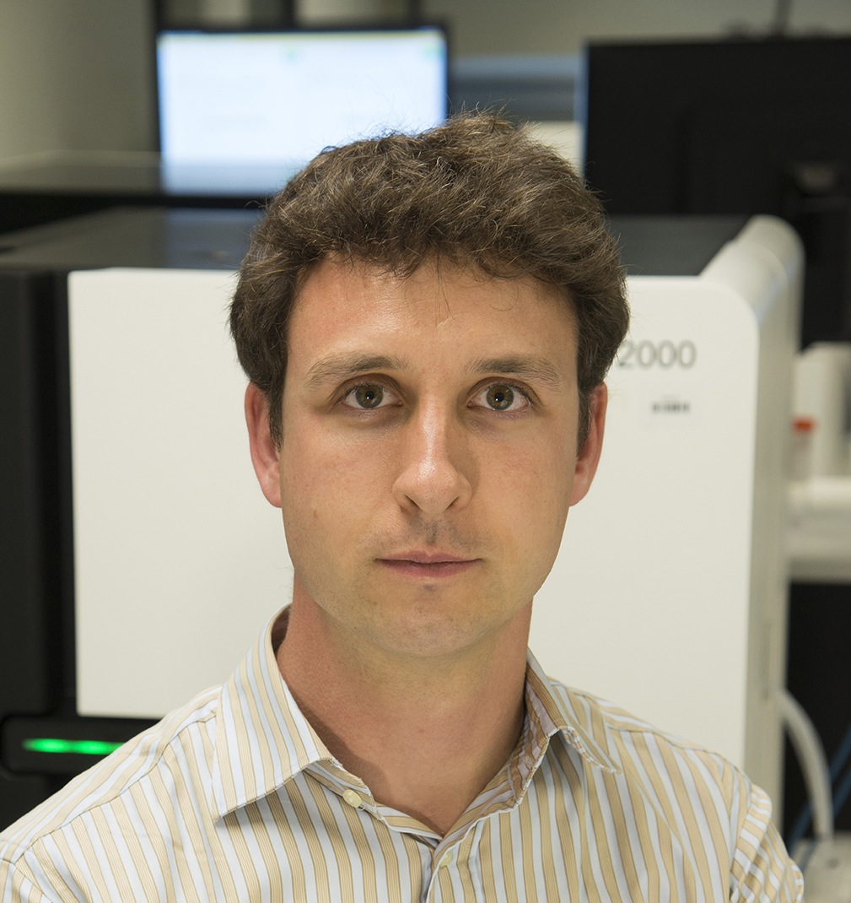
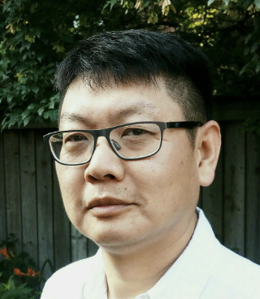
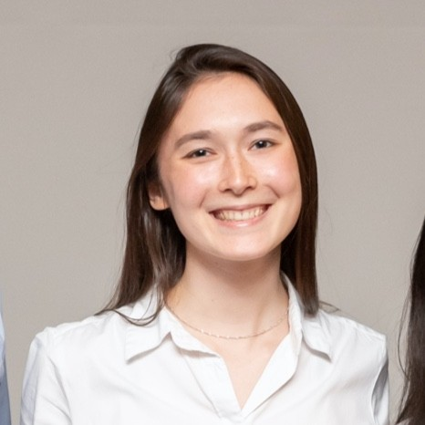

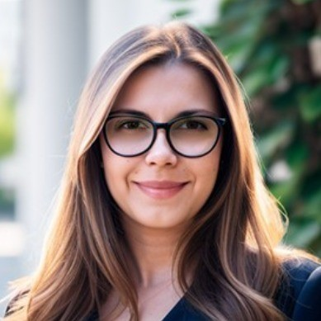

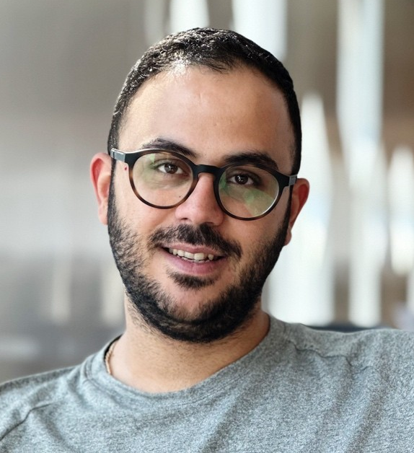



Introductions to Bioinformatics instructors
Malachi Griffith Professor of Medicine Professor of Genetics
Assistant Director, MGI
Obi Griffith
Professor of Medicine Professor of Genetics
Assistant Director, MGI
Nia Hughes
Zhibin Lu
Isabel Risch
griffithlab.org
rnabio.org genviz.org pmbio.org
civicdb.org pvactools.org dgidb.org
regtools.org vatools.org
Nicolas Ho
Melisa Acun
Varinder Verma
Mobin Khoramjoo

Slide 4
Introduction to course – philosophy and goals
Do “the bioinformatics” for someone, and you help them for a day. Teach someone to do bioinformatics, and you help them for a lifetime.
- Ancient Chinese proverb
Course goals
Learn concepts and develop skills for sequence analysis
Build the foundation for tackling your own analysis challenges
Learn to think like a bioinformatician
Have fun

Slide 5
Course format for a typical day
Lecture
BREAK
Practical exercises
Lunch
Practical exercises
BREAK
Practical exercises
Wrap-up and Q&A

Slide 6
Student poll (respond in slack)
Not counting the pre-requisites and materials for this course:
Do you consider yourself a bioinformatician? Computational biologist?
Are you familiar with linux/command line?
Intermediate?
Expert?
Do you sometimes write code?
Are you familiar with R?
Intermediate?
Expert?
Do you use git/github?
What organism do you work with? (Put an animal emoji in slack)
Are you interested in bulk RNAseq, scRNAseq, or both?

Slide 7




We are on a Coffee Break & Networking Session
Workshop Sponsors:

