Slide 1
Canadian Bioinformatics Workshops
www.bioinformatics.ca
bioinformaticsdotca.github.io

Slide 2
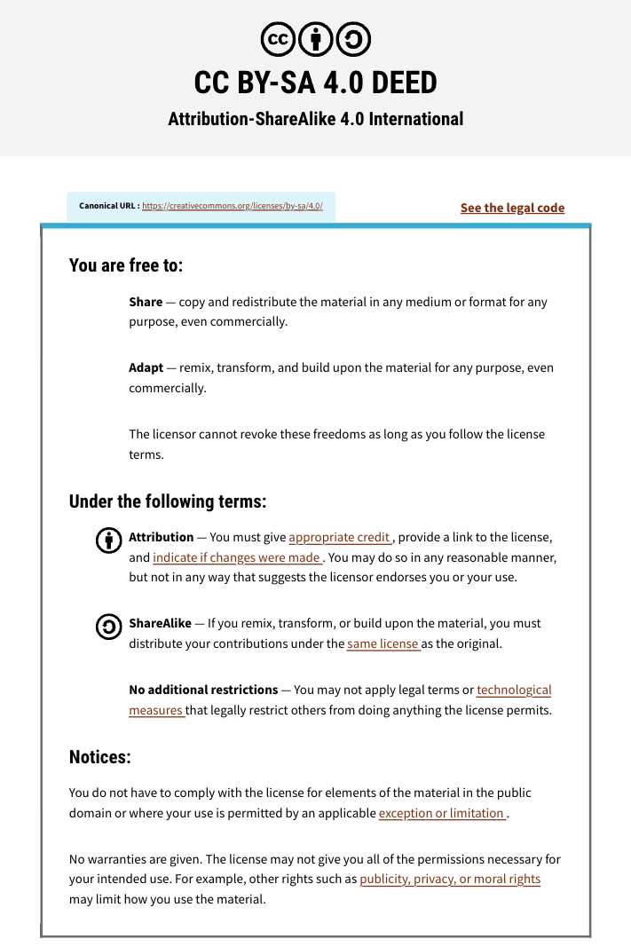

Slide 3
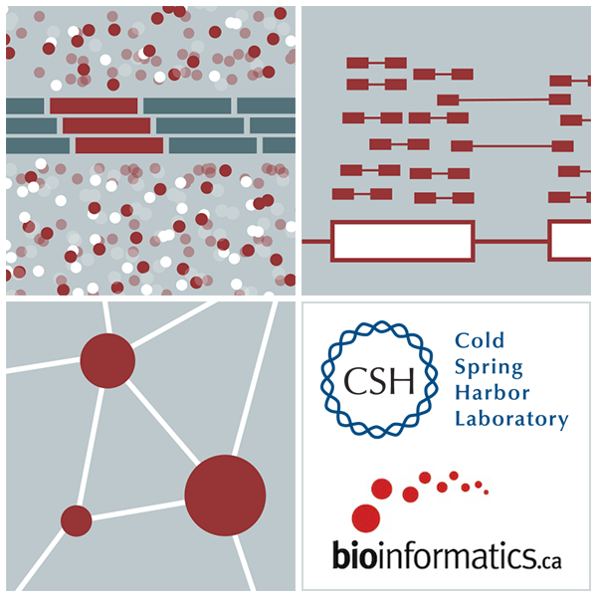
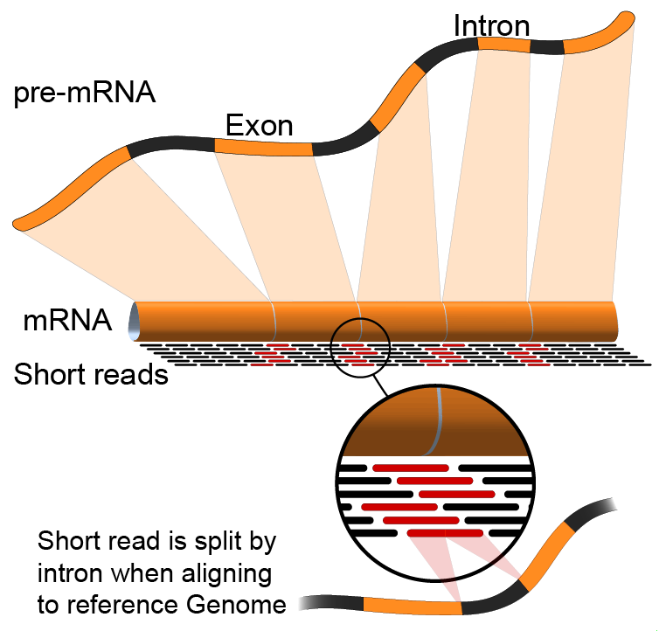

RNA-Seq Module 3 Abundance Estimation and Differential Expression
Malachi Griffith, Obi Griffith, Isabel Risch,
Nicolas Ho, Melisa Acun, Varinder Verma, Mobin Khoramjoo
RNA-seq Analysis 2025. June 7-9, 2025

Slide 4
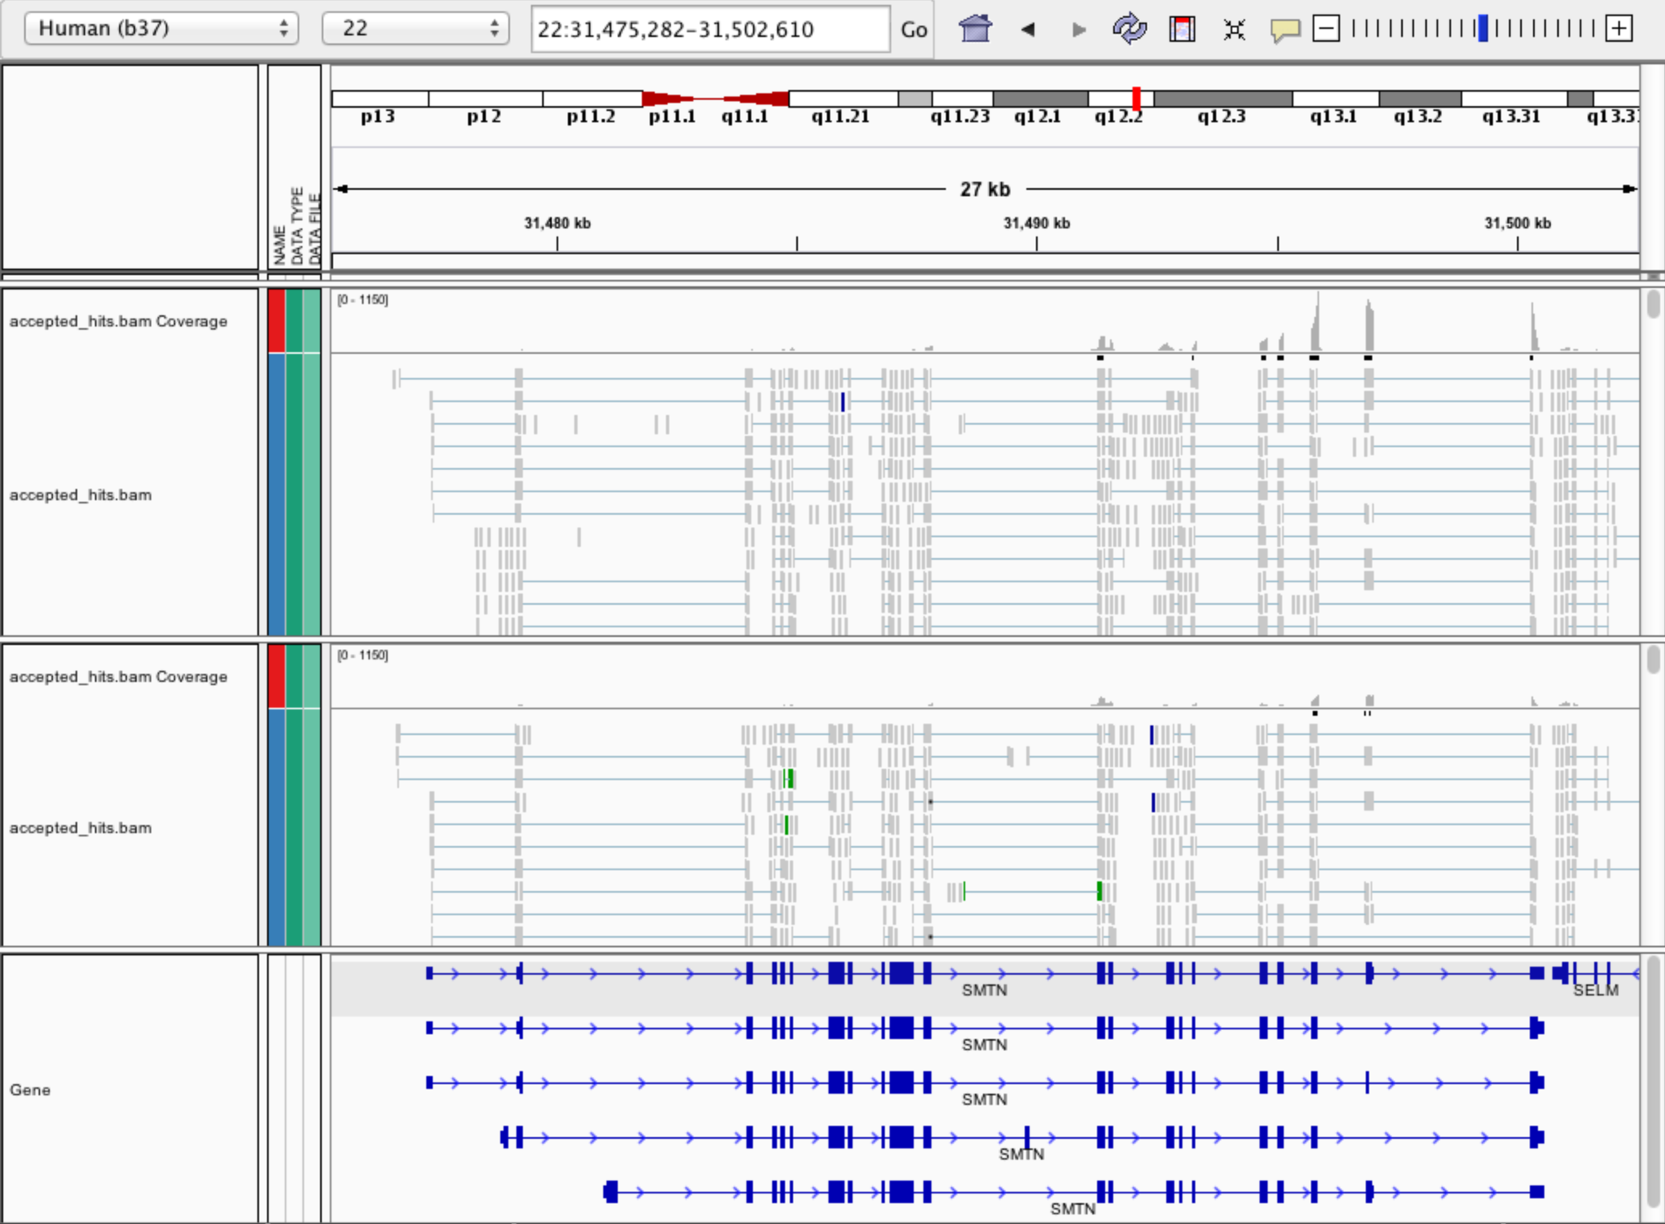
Expression estimation for known genes and transcripts
3’ bias
Down-regulated

Slide 5
What is FPKM (RPKM)?
RPKM: Reads Per Kilobase of transcript per Million mapped reads.
FPKM: Fragments Per Kilobase of transcript per Million mapped reads.
No essential difference - Just a terminology change to better describe paired-end reads!

Slide 6
What is FPKM?
Why not just count reads in my RNAseq data?
The relative expression of a transcript is proportional to the number of cDNA fragments that originate from it. However:
# fragments is biased towards larger genes
# fragments is related to total library depth
Fragments
Per Kilobase of transcript
per Million mapped reads.

Slide 7
What is FPKM?
FPKM attempts to normalize for gene size and library depth
remember – RPKM is essentially the same!
C = number of mappable fragments for a gene (transcript)
N = total number of mappable fragments in the library
L = number of base pairs in the gene (transcript)
FPKM = (C / (N x L) ) x 1,000 x 1,000,000
FPKM = (1,000,000,000 x C) / (N x L)
FPKM = (C / (N / 1,000,000)) / (L/1000)
More reading:
http://www.biostars.org/p/11378/
http://www.biostars.org/p/68126/

Slide 8
How do FPKM and TPM differ?
TPM: Transcript per Kilobase Million
The difference is in the order of operations:
FPKM
1) Determine total fragment count, divide by 1,000,000 (per Million)
2) Divide each gene/transcript fragment count by #1 (Fragments Per Million)
3) Divide each FPM by length of each gene/transcript in kilobases (FPKM)
TPM
1) Divide each gene/transcript fragment count by length of the transcript in kilobases (Fragments Per Kilobase)
2) Sum all FPK values for the sample and divide by 1,000,000 (per Million)
3) Divide #1 by #2 (TPM)
The sum of all TPMs in each sample is the same. Easier to compare across samples!
http://www.rna-seqblog.com/rpkm-fpkm-and-tpm-clearly-explained/
https://www.ncbi.nlm.nih.gov/pubmed/22872506
Notes:
When you use TPM, the sum of all TPMs in each sample are the same. This makes it easier to compare the proportion of reads that mapped to a gene in each sample. In contrast, with RPKM and FPKM, the sum of the normalized reads in each sample may be different, and this makes it harder to compare samples directly.

Slide 9
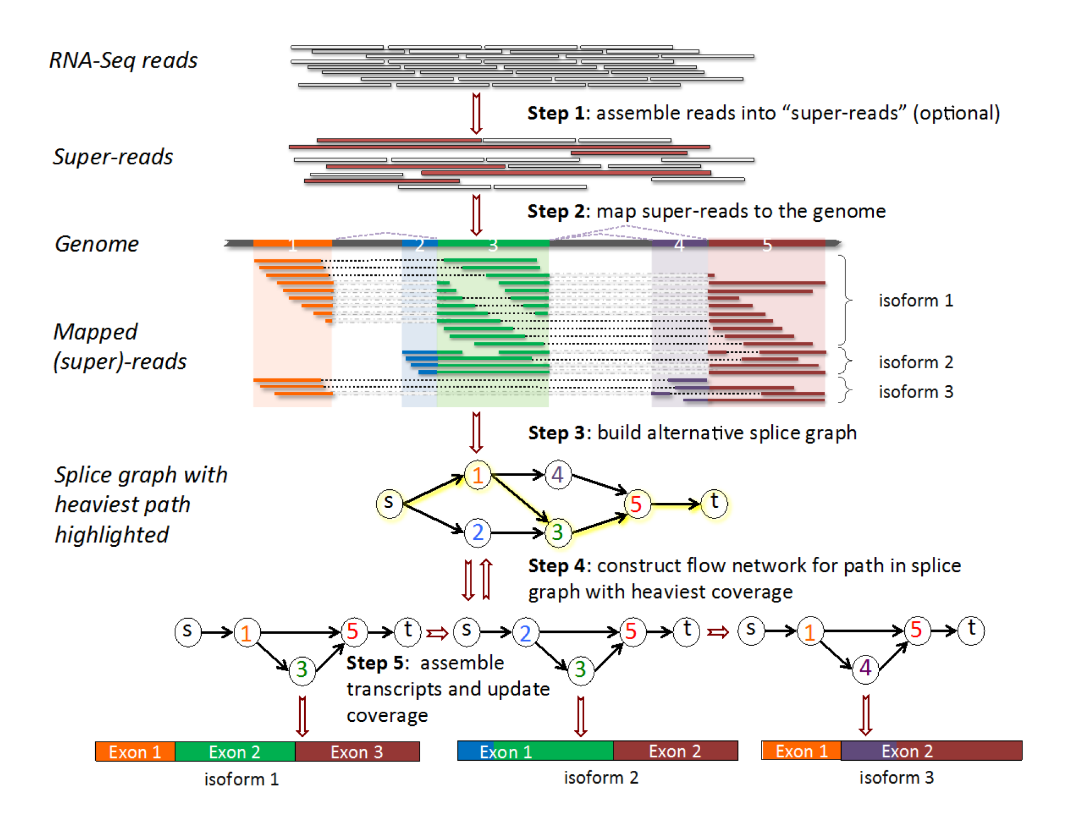
How does StringTie work?
Map reads to the genome
Infer isoforms:
iteratively extract the heaviest path from a splice graph
construct a flow network
compute maximum flow to estimate abundance
update the splice graph by removing reads that were assigned by the flow algorithm
This process repeats until all reads have been assigned.
Pertea et al. Nature Biotechnology, 2015
Notes:
The StringTie algorithm: RNA-seq reads are assembled into super-reads (Step 1) and then super-reads plus un-assembled reads are mapped to the genome (Step 2). In Step 3, mapped reads and super-reads are used to build an alternative splice graph. We use the path from source (s) to sink (t) with the heaviest coverage to build a flow network corresponding to the transcript represented by that path (Step 4). The maximum flow in this network represents the coverage of one assembled transcript, which is removed from the splice graph (Step 5). Steps 4 and 5 are repeated until no more transcripts can be assembled.

Slide 10
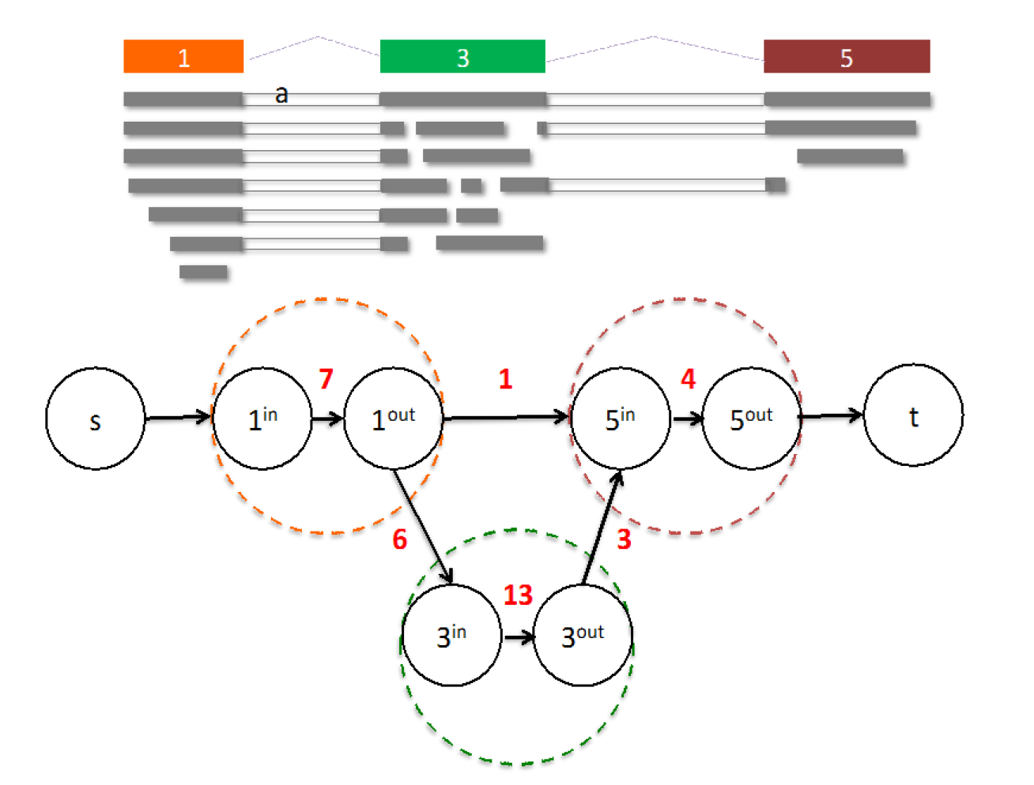
From flow network for each transcript, maximum flow is used to assemble transcript and estimate abundance
StringTie uses basic graph theory (splice graph), custom heuristics (heaviest path), more graph theory (flow network) and optimization theory (maximum flow). See StringTie paper for definitions and math.
Notes:
Flow network associated with a transcript (shown with colored nodes). 15 fragments (shown in grey) align to the transcript. Two nodes in the flow network are connected if a fragment starts and ends at those nodes. E.g., nodes 1 and 5 are connected because fragment (a) starts at node 1 and ends at node 5. For each colored node in the transcript, two nodes are created in the flow network. Capacities on edges (not connecting source or sink) are shown in red.
In the first node (corresponding to exon1) there are 7 fragments. One of these fragments is connected to exon5 (starts at beginning of exon1 and ends at end of exon5), while 6 fragments are connected to exon3. In the second node (corresponding to exon3) there are 13 fragments, of which 3 are connected to exon 5. The final node (corresponding to exon5) has 4 supporting fragments. The maximum flow is clearly 1 – 3 – 5.
StringTie estimates the coverage level of the transcript by solving a maximum-flow problem that determines the maximum number of fragments that can be associated with the chosen transcript.
The maximum flow problem is a well-studied problem in optimization theory.

Slide 11
StringTie -merge
Merge together all gene structures from all samples
Some samples may only partially represent a gene structure
Incorporates known transcripts with assembled, potentially novel transcripts
For de novo or reference guided mode, we will rerun StringTie with the merged transcript assembly.
Pertea et al. Nature Protocols, 2016

Slide 12
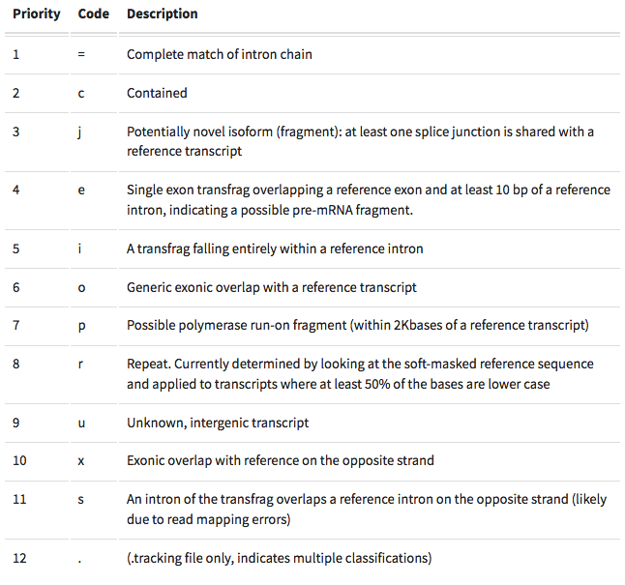
gffcompare
gffcompare will compare a merged transcript GTF with known annotation, also in GTF/GFF3 format
http://cole-trapnell-lab.github.io/cufflinks/cuffcompare/index.html#cuffcompare-output-files

Slide 13
Alternatives to FPKM
Raw read counts for differential expression analysis
Assign reads/fragments to defined genes/transcripts, get “raw counts”
Transcript structures could still be defined by something like Stringtie
HTSeq (htseq-count)
https://htseq.readthedocs.io/
Caveats of ‘transcript’ analysis by htseq-count:
Designed for genes - ambiguous reads from overlapping transcripts may not be handled!
http://seqanswers.com/forums/showthread.php?t=18068
htseq-count --mode intersection-strict --stranded no --minaqual 1 --type exon --idattr transcript_id accepted_hits.sam chr22.gff > transcript_read_counts_table.tsv

Slide 14
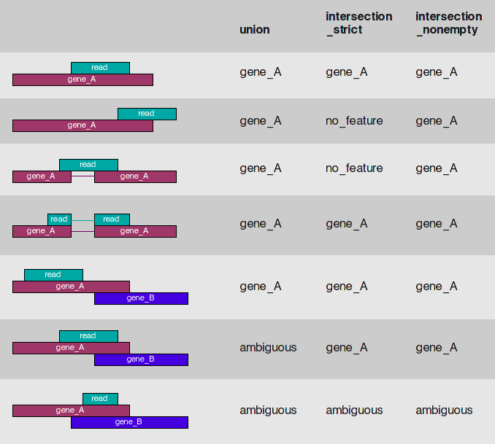
HTSeq-count basically counts reads supporting a feature (exon, gene) by assessing overlapping coordinates
Note, if gene_A and gene_B on opposite strands, sequence data is stranded, and correct HTSeq parameter set then this read may not be ambiguous
Whether a read is counted depends on the nature of overlap and “mode” selected
Notes:
We recommend intersection_strict

Slide 15
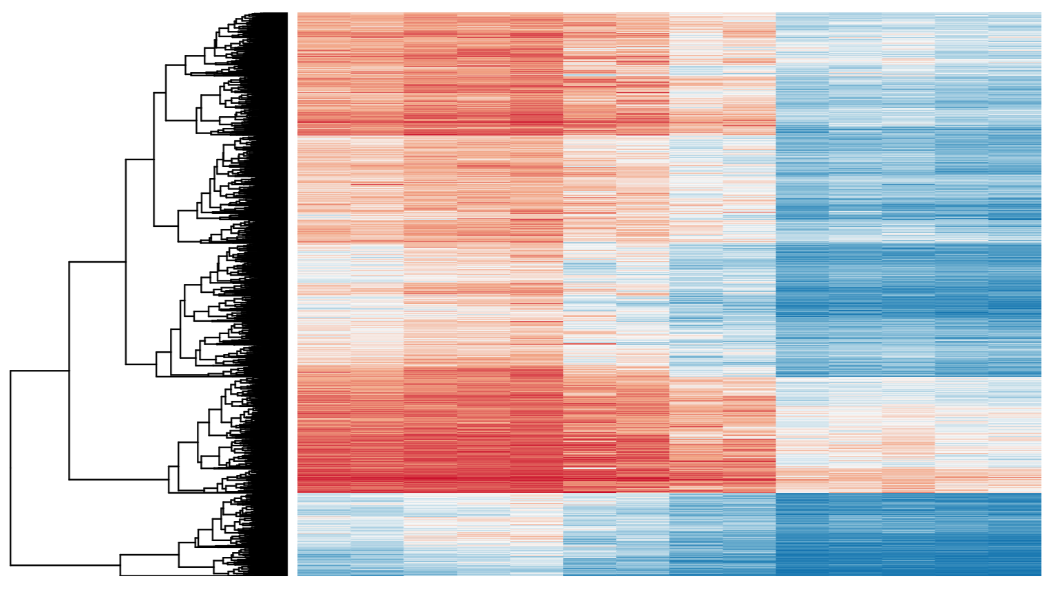
Differential Expression
Tying gene expression back to genotype/phenotype
What genes/transcripts are being expressed at higher/lower levels in different groups of samples?
Are these differences ‘significant’, accounting for variance/noise?
Examples (used in course):
UHR cells vs HBR brain
Tumor vs Normal tissue
Wild-type vs gene KO cells

Slide 16
Differential Expression with Ballgown
Parametric F-test comparing nested linear models
Two models are fit to each feature, using expression as the outcome
one including the covariate of interest (e.g., case/control status or time) and one not including that covariate.
An F statistic and p-value are calculated using the fits of the two models.
A significant p-value means the model including the covariate of interest fits significantly better than the model without that covariate, indicating differential expression.
We adjust for multiple testing by reporting q-values:
q < 0.05 the false discovery rate should be controlled at ~5%.
Frazee et al. (2014)

Slide 17
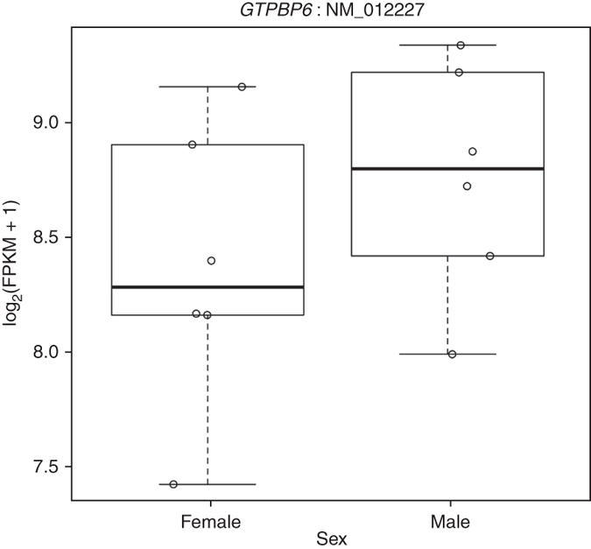
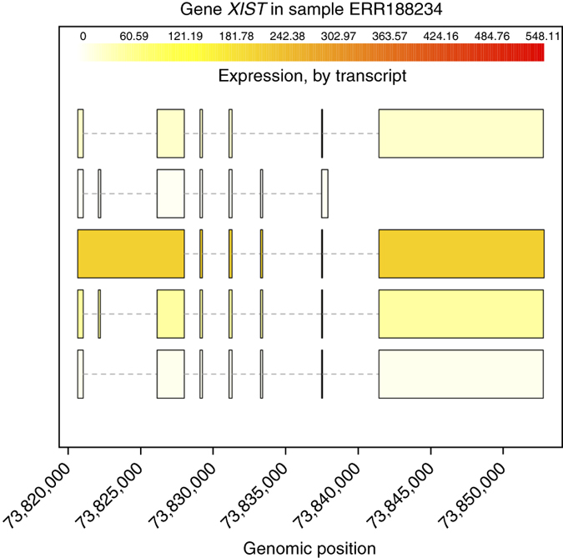
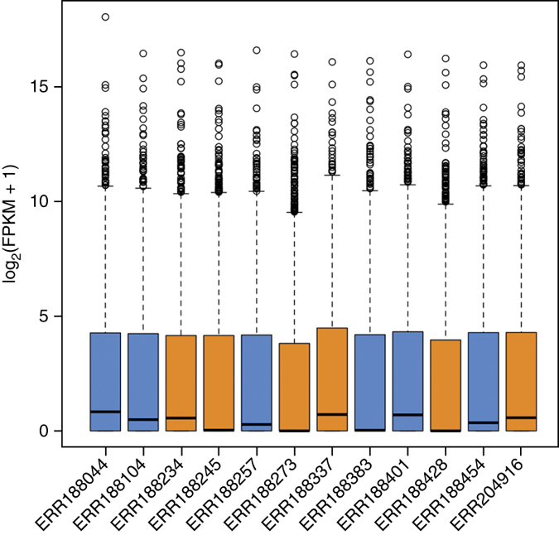
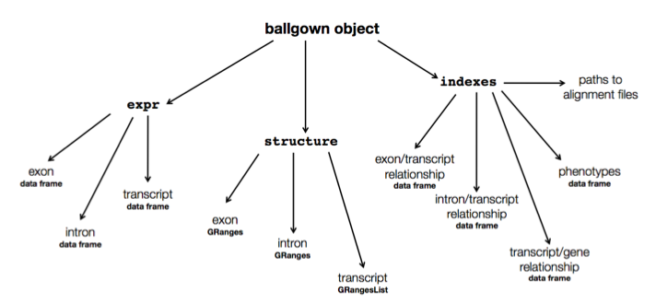
Ballgown for Visualization with R

Slide 18
Alternative differential expression methods
Raw count approaches
DESeq2 - http://www-huber.embl.de/users/anders/DESeq/
edgeR - http://www.bioconductor.org/packages/release/bioc/html/edgeR.html
Others…

Slide 19
‘FPKM/TPM’ expression estimates vs. ‘raw’ counts
Which should I use?
Long running debate, but the general consensus:
FPKM/TPM
When you want to leverage benefits of tuxedo suite
Isoform deconvolution
Good for visualization (e.g., heatmaps)
Calculating fold changes, etc.
Counts
More robust statistical methods for differential expression
Accommodates more sophisticated experimental designs with appropriate statistical tests

Slide 20
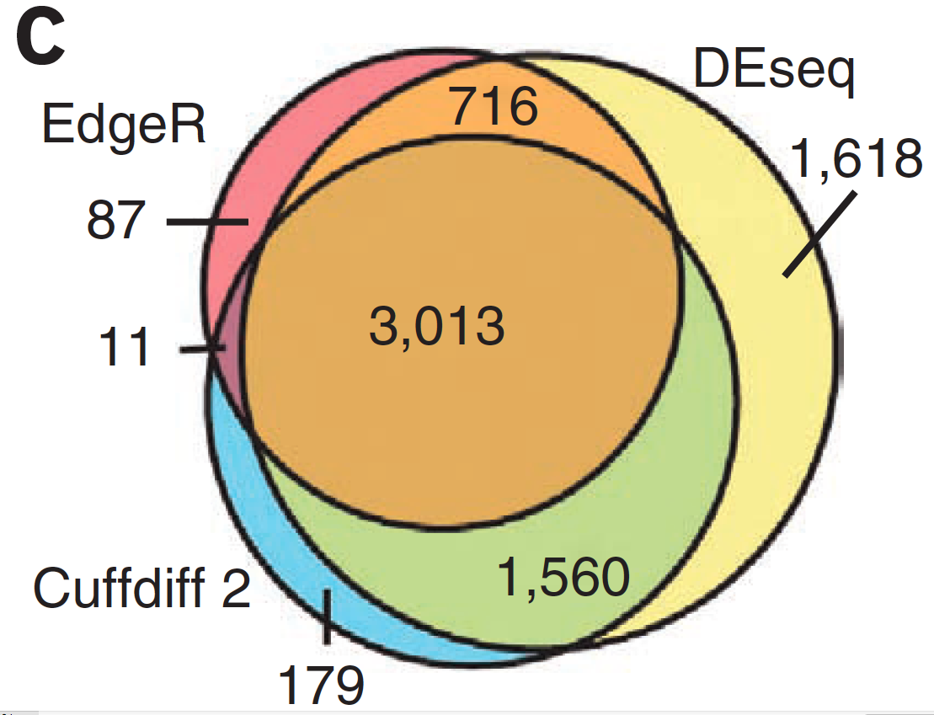
Multiple approaches advisable

Slide 21
Lessons learned from microarray days
Hansen et al. “Sequencing Technology Does Not Eliminate Biological Variability.” Nature Biotechnology 29, no. 7 (2011): 572–573.
Power analysis for RNA-seq experiments
http://scotty.genetics.utah.edu/
RNA-seq need for biological replicates
http://www.biostars.org/p/1161/
RNA-seq study design
http://www.biostars.org/p/68885/

Slide 22
Multiple testing correction
As more attributes are compared, differences due solely to chance become more likely!
Well known from array studies
10,000s genes/transcripts
100,000s exons
With RNA-seq, more of a problem than ever
All the complexity of the transcriptome gives huge numbers of potential features
Genes, transcripts, exons, junctions, retained introns, microRNAs, lncRNAs, etc
Bioconductor multtest
http://www.bioconductor.org/packages/release/bioc/html/multtest.html

Slide 23
Downstream interpretation of expression analysis
Topic for an entire course
Expression estimates and differential expression lists from StringTie, Ballgown or other alternatives can be fed into many analysis pipelines
See supplemental R tutorial for how to format expression data and start manipulating in R
Clustering/Heatmaps
Provided by Ballgown
For more customized analysis various R packages exist:
hclust, heatmap.2, plotrix, ggplot2, etc.
Classification
Weka is a good learning tool
Pathway analysis
GSEA, IPA, Cytoscape, many R/BioConductor packages: http://www.bioconductor.org/help/search/index.html?q=pathway
https://genviz.org/module-04-expression/0004/01/01/Expression_Profiling_and_Visualization/

Slide 24
HISAT2/StringTie/Ballgown RNA-seq Pipeline
Sequencing
Read alignment
Transcript compilation
Expression estimation
Differential expression
RNA-seq reads (2 x 100 bp)
HISAT2
StringTie
StringTie
Ballgown
Raw sequence data
(.fastq files)
Reference genome
(.fa file)
Gene annotation
(.gtf file)
Ballgown & R
Inputs
Visualization
Module 3

Slide 25
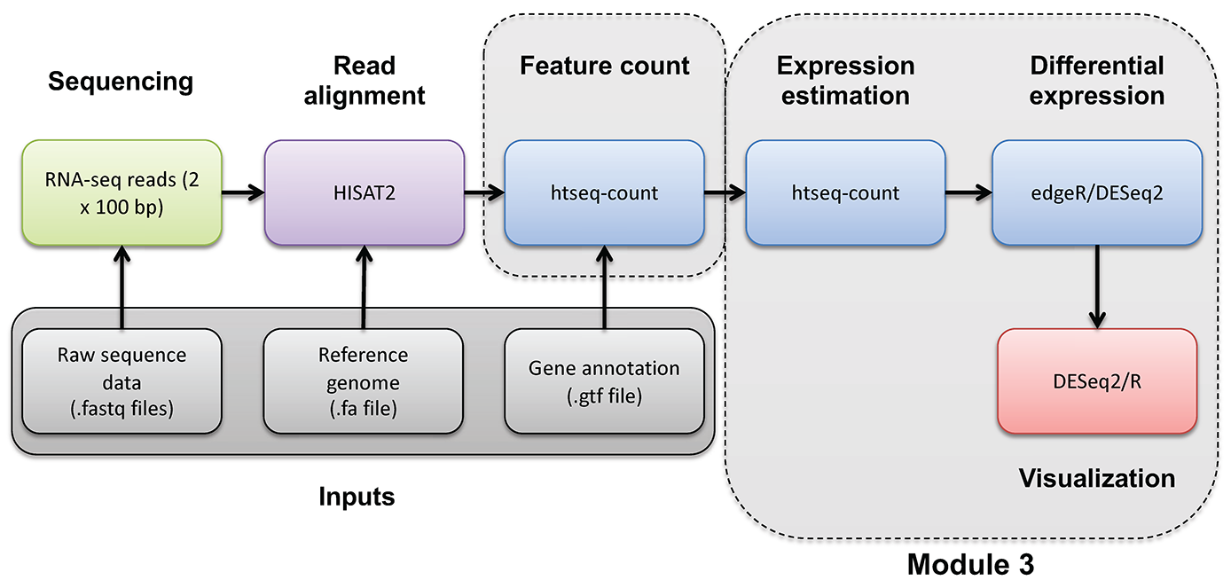
HISAT2/htseq/DESeq2 RNA-seq Pipeline

Slide 26





We are on a Coffee Break & Networking Session
Workshop Sponsors:

