Slide 1
Canadian Bioinformatics Workshops
www.bioinformatics.ca
bioinformaticsdotca.github.io

Slide 2
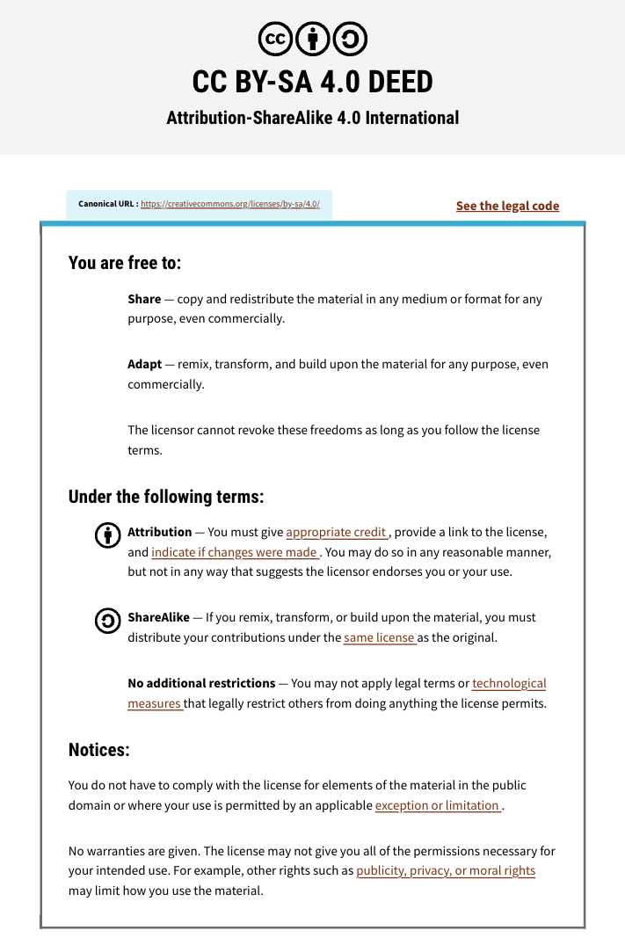

Slide 3
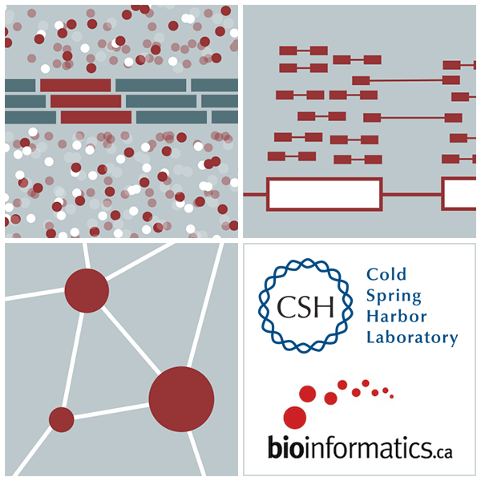
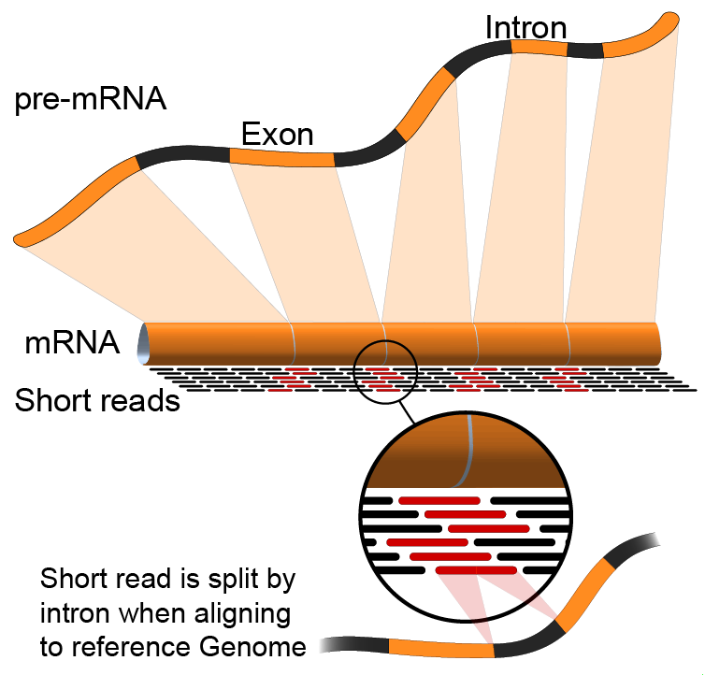

RNA-Seq Module 2: Alignment
Malachi Griffith, Obi Griffith, Isabel Risch,
Nicolas Ho, Melisa Acun, Varinder Verma, Mobin Khoramjoo
RNA-seq Analysis 2025. July 7-9, 2025

Slide 4
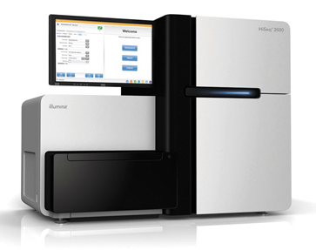


Alignment is central to most genomic research
Find peaks
Align
to
genome
Quantify transcripts
FASTQ
format
Quality control
Find SVs
Analysis,
Interpretation,
Discovery
.
.
.
etc.
Phase 0
Phase1
Phase 2-100
Slide courtesy of Andrew Farrell, Obi and Malachi Griffith

Slide 5

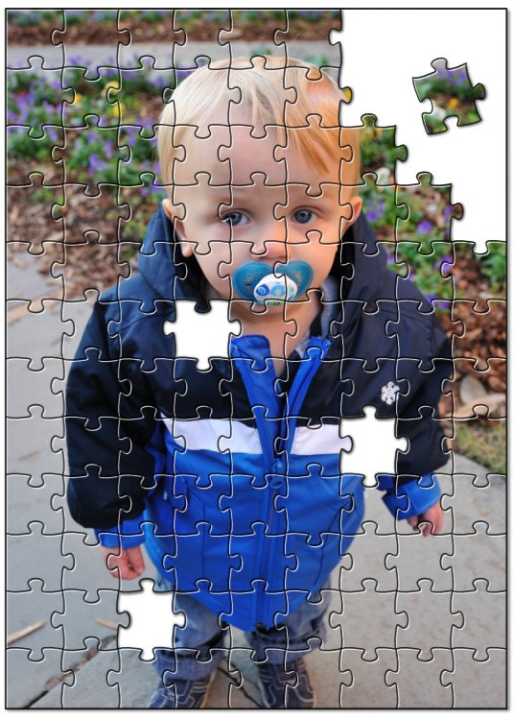
Alignment - How does it work?
Alignment is about fitting individual pieces (reads) into the correct part of the puzzle
The human genome project gave us the picture on the box cover (the reference genome)
Imperfections in how the pieces fit can indicate changes to a copy of the picture
AGCCTGAGACCGTAAAAAAGTCAAG
|||||||||||||||||
GAGACCGTAAAAACGTC
Reference:
A read sequence:
A variant!

Slide 6
RNA-seq alignment challenges
Computational cost
100’s of millions of reads
Introns!
Align to a transcriptome or align to a genome?
Spliced vs. unspliced alignments
Can I just align my data once using one approach and be done with it?
Unfortunately, probably not

Slide 7
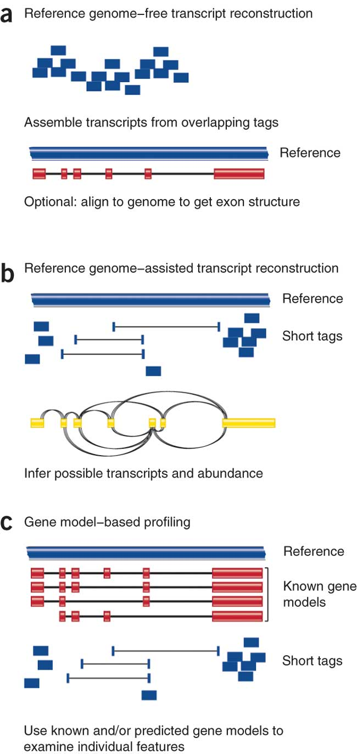
Three RNA-seq mapping strategies
De novo assembly
Align to transcriptome
Align to reference genome
Diagrams from Cloonan & Grimmond, Nature Methods 2010

Slide 8
Which alignment strategy is best?
De novo assembly
If a reference genome does not exist for the species being studied
If complex polymorphisms/mutations/haplotypes might be missed by comparing to the reference genome
Align to transcriptome
If you have short reads (< 50bp)
Relies on known transcripts
Align to reference genome
All other cases
Does not rely on known transcripts – allows for discovery
Each strategy involves different alignment/assembly tools

Slide 9
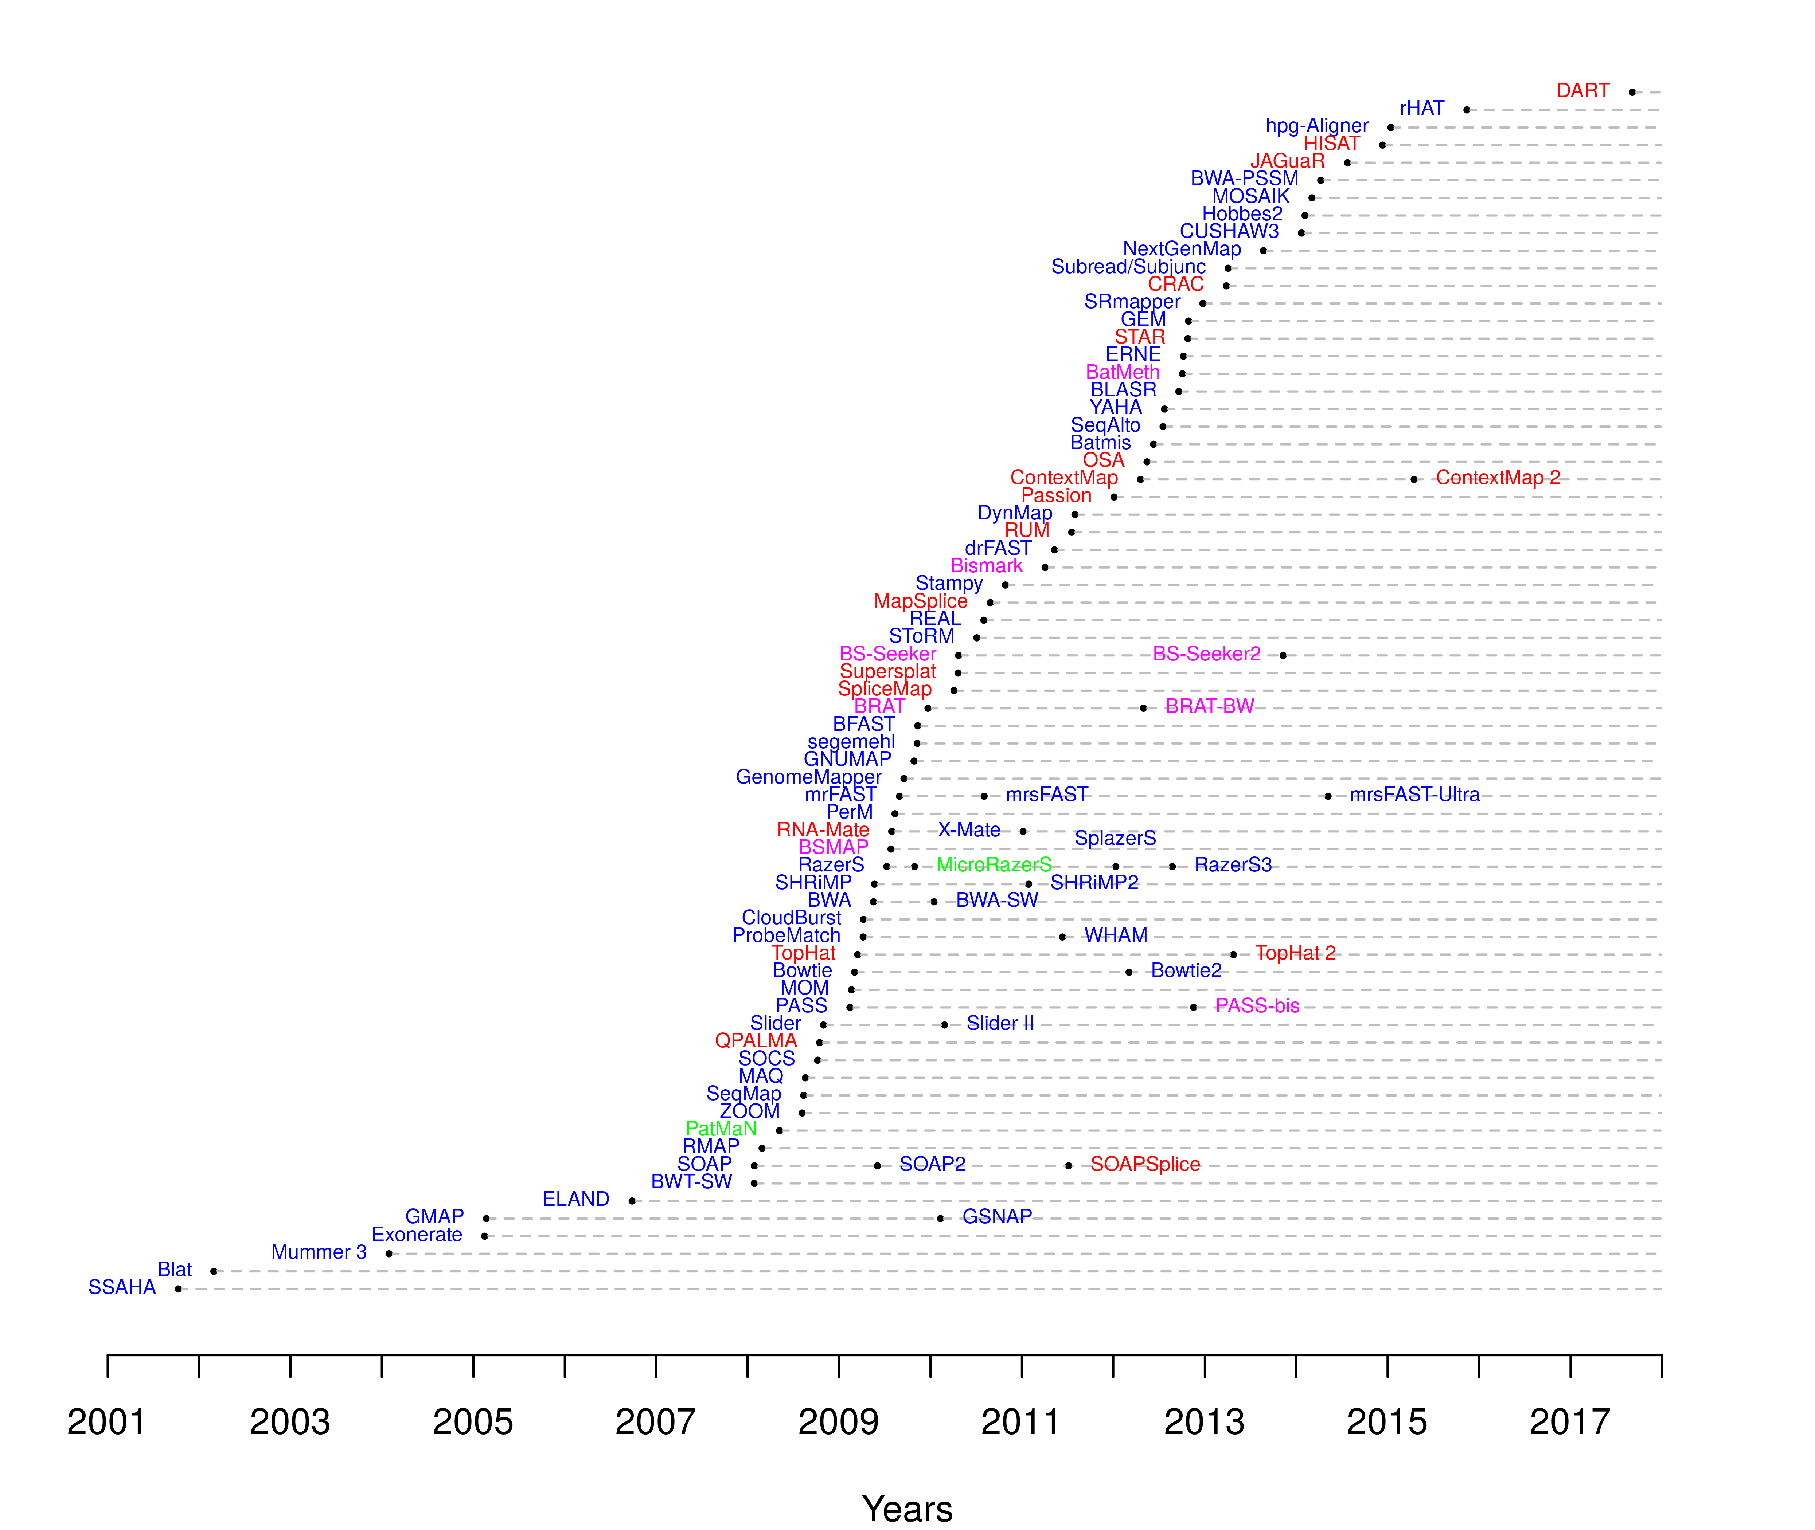
Which read aligner should I use?
RNA
Bisulfite
DNA
microRNA
http://wwwdev.ebi.ac.uk/fg/hts_mappers/

Slide 10
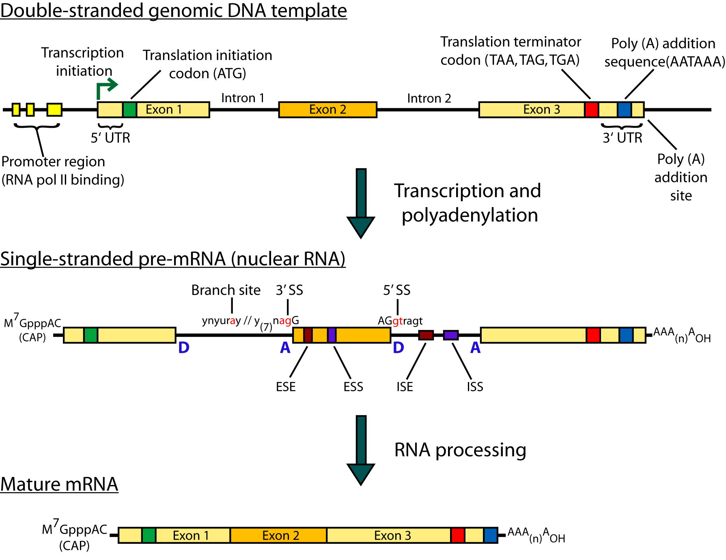
Should I use a splice-aware or unspliced mapper?
The fragments being sequenced in RNA-seq represent mRNA - introns are removed
But we are usually aligning these reads back to the reference genome
Unless your reads are short (<50bp) you should use a splice-aware aligner
HISAT2, STAR, MapSplice, etc.

Slide 11
HISAT/HISAT2
HISAT is a ‘splice-aware’ RNA-seq read aligner
HISAT = Hierarchical Indexing for Spliced Alignments of Transcripts
Requires a reference genome
Very fast
Uses an indexing scheme based on the Burrows-Wheeler transform and the Ferragina-Manzini (FM) index
Multiple types of indexes for alignment
a whole-genome FM index to anchor each alignment
numerous local FM indexes for very rapid extensions of these alignments.
Whole-genome indices with SNPs and known transcript structures accounted for
Kim et al. 2015. Nat Methods 12:357–360
Notes:
HISAT's hierarchical index for the human genome contains 48,000 local FM indexes, each representing a genomic region of ~64,000 bp.

Slide 12
HISAT/HISAT2 algorithm
Uses a hierarchical indexing algorithm + several adaptive strategies
based on the position of a read with respect to splice sites
1) Find candidate locations across the whole genome first
mapping part of each read using the global FM index
Generally identifies one or a small number of candidates.
2) Do local alignment
selects one of ~48,000 local indexes for each candidate
uses it to align the remainder of the read.
For paired reads, each mate is separately aligned
If a read fails to align, then the alignments of its mate are used as anchors to map the unaligned mate
Notes:
HISAT's hierarchical index for the human genome contains 48,000 local FM indexes, each representing a genomic region of ~64,000 bp.

Slide 13
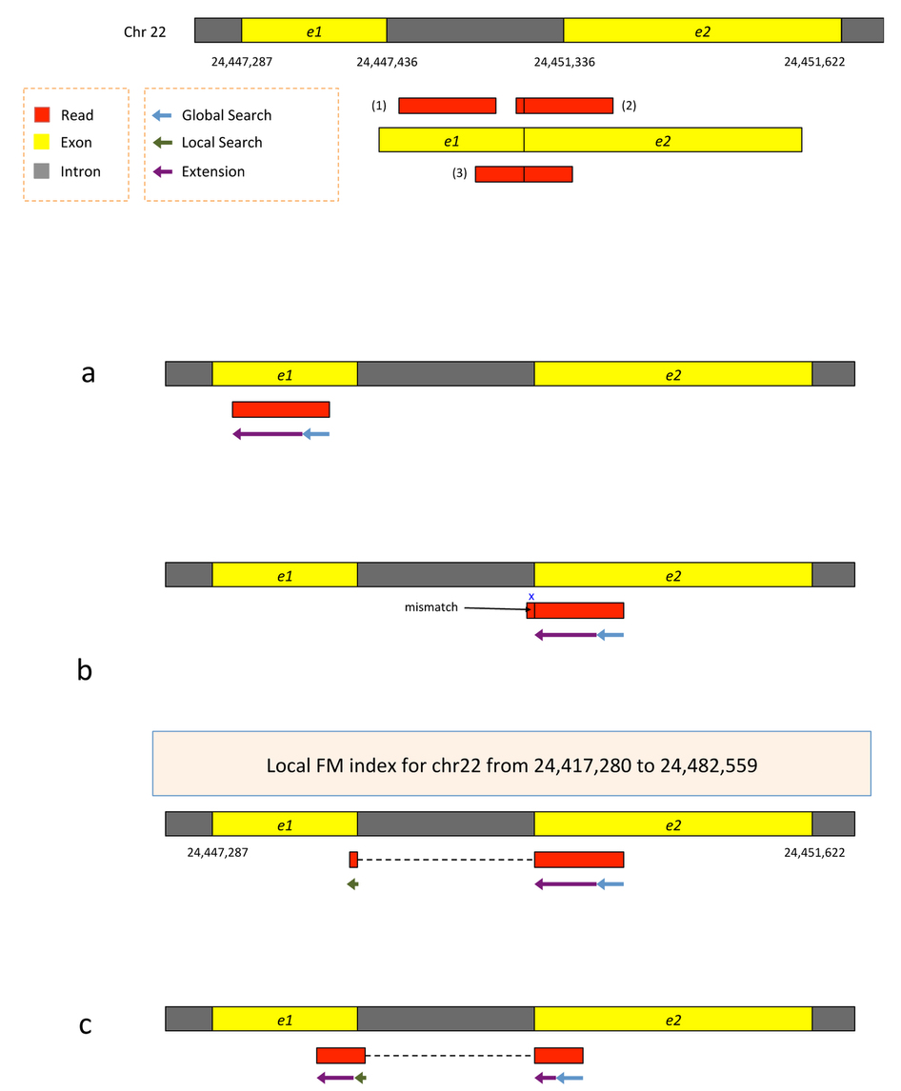
HISAT2 Alignment
Two exons from chr22
Three reads
Kim et al. 2015. Nat Methods 12:357–360
Notes:
Alignment of exonic reads and long- and intermediate-anchored reads.
Given two exons from a gene on human chromosome 22, separated by a 3,899-bp intron, suppose the genomic region is transcribed and spliced and we have three reads sequenced from the resulting transcript: (i) an exonic read, (ii) a read spanning two exons with an 8-bp anchor in one exon and (iii) a read spanning two exons with 50 bp in each exon (Supplementary Fig. 8). All the reads are assumed to be error free and 100 bp long. We can apply hierarchical indexing to align each of these reads rapidly and correctly.

Slide 14
HISAT2 Alignment
1) Search for read position with global FM index (slower)
2) Once at least 28bp and exactly one location switch to extension mode against reference genome (faster)
Kim et al. 2015. Nat Methods 12:357–360
Notes:
We align the first read using the global FM-index (Supplementary Fig. 8a). Because global search is relatively time consuming, we change strategies when the partial alignment meets two conditions: (i) it is at least 28 bp long and (ii) it maps onto exactly one location. For the read shown in the figure, the 28-bp sequence on its right end maps uniquely, allowing us to stop the global search operation at that point. From there, we extend the partial alignment by directly comparing the remaining sequence and the corresponding genomic sequence, which we can extract directly from the genome using the mapped location as an index. Because the read is error free and contained within one exon, the extension operation sweeps across the remaining 72 bp, completing the alignment for the read. Note that we could perform this alignment using the global FM index, as TopHat2 does, but the combination of global search and local extension is faster.

Slide 15
HISAT2 Alignment
1) Search for read position with global FM index (slower)
2) Extend until mismatch at 93bp (faster)
3) Switch to local FM index to align remaining 8bp
index covers only a small region, so we find just one match
4) Check for compatibility and combine into single spliced alignment
Kim et al. 2015. Nat Methods 12:357–360
Notes:
For the second read, which has a very short 8-bp anchor on the left side, we first try to map the read using global search, moving right to left (Supplementary Fig. 8b). The first 28 bp on the right end of the read maps uniquely, allowing us to anchor the alignment and halt the global search. We then extend the alignment until we encounter a mismatch at the 93rd base. This mismatch occurs when the alignment extension reaches the intron. At this point we pause the search, retrieve the local FM index that contains this location and align the remaining 8 bp using this index. Because the index covers only a small region, in this case we find just one match for the 8-bp segment. Finally, we check whether the two partial alignments (8 bp and 92 bp) are compatible with each other (for example, in the correct orientation) and then combine them to produce a spliced alignment of the original read.
Note that if we searched for an 8-bp sequence in the global index, we would expect to find an average of ~48,000 matching locations in the human genome (and sometimes many more). Instead of examining 48,000 possible locations, we use one of the local FM indexes, which is expected to contain just one copy of a given 8-bp sequence, on average. This two-stage hierarchical indexing allows us to avoid examining tens of thousands of candidate locations for short anchors, which in turn dramatically speeds up the overall alignment algorithm.

Slide 16
HISAT2 Alignment
1) global search until exactly one match of at least 28bp (slower)
2) Extend until mismatch at 51bp (faster)
3) switch to local FM index to align first 8bp of remaining read
- If too many matches increase prefix size
4) Extend again
5) Check for compatibility and combine into single spliced alignment
Kim et al. 2015. Nat Methods 12:357–360
Notes:
The third read has long anchors (50 bp each) in each exon. We first align the read beginning on the right, using global search as we did before. After the first 28 bp is uniquely mapped, we switch to the extension operation, which further aligns 22 bp and stops after a mismatch at the 51st base. We then choose a local FM index and perform a local search using the first 8 bp of the remaining part of the read. Once this 8 bp is found, HISAT again uses the extension operation to align the rest of the read (Supplementary Fig. 8c). Note that if the 8-bp prefix mapped to too many locations, HISAT would use a longer prefix to reduce the number of potential locations to 5 or fewer.
As we can see from these examples, we can combine global search, local search and directed read extension to achieve rapid yet sensitive alignment. Note that when a read has multiple spliced alignments, HISAT prefers to report alignments that use the canonical GT and AG dinucleotides on the ends of the intron. From any remaining alignments after this filter, it reports the one with the shortest intron length. HISAT provides several parameters with which users can customize its alignment strategy, including adjustable penalties for mismatches, indels and noncanonical splice sites (Supplementary Note).

Slide 17
Should I allow ‘multi-mapped’ reads?
Depends on the application
In *DNA* analysis it is common to use a mapper to randomly select alignments from a series of equally good alignments
In *RNA* analysis this is less common
Perhaps disallow multi-mapped reads if you are variant calling
Definitely should allow multi-mapped reads for expression analysis with Cufflinks (and StringTie?)
Definitely should allow multi-mapped reads for gene fusion discovery

Slide 18
What is the output of HISAT2?
A SAM/BAM file
SAM stands for Sequence Alignment/Map format
BAM is the binary version of a SAM file
Remember, compressed files require special handling compared to plain text files
How can I convert BAM to SAM?
http://www.biostars.org/p/1701/
Is HISAT2 the only mapper to consider for RNA-seq data?
http://www.biostars.org/p/60478/

Slide 19





We are on a Coffee Break & Networking Session
Workshop Sponsors:

