Slide 1
Canadian Bioinformatics Workshops
www.bioinformatics.ca
bioinformaticsdotca.github.io

Slide 2
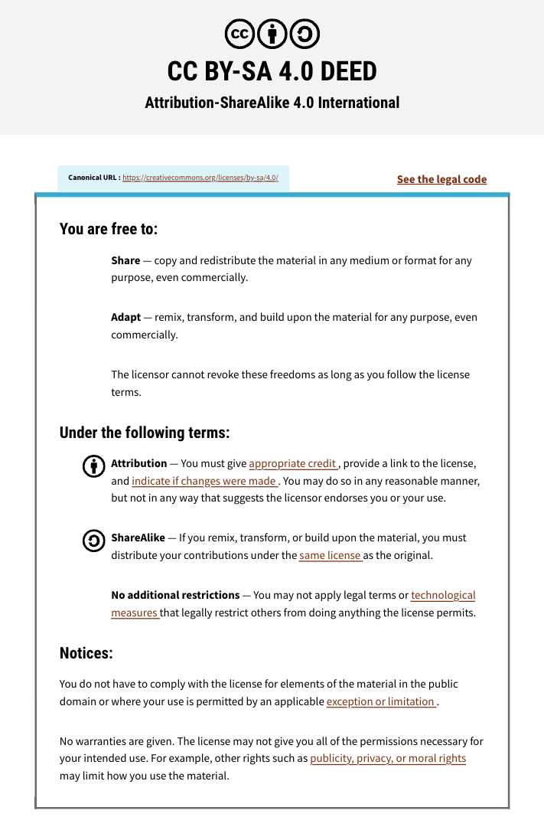

Slide 3
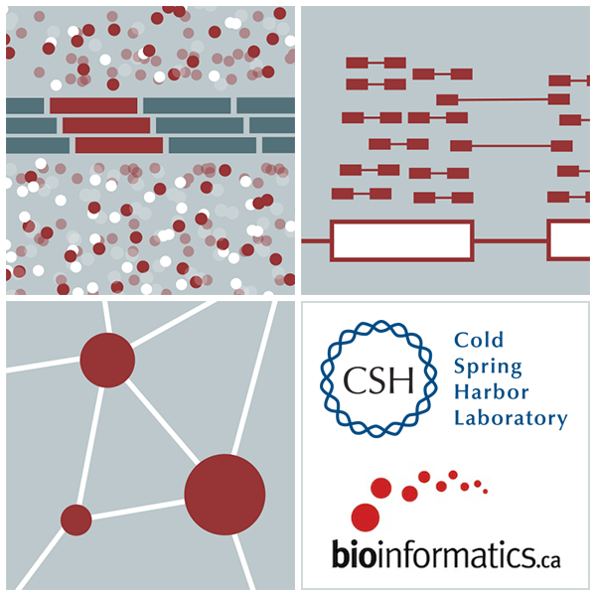
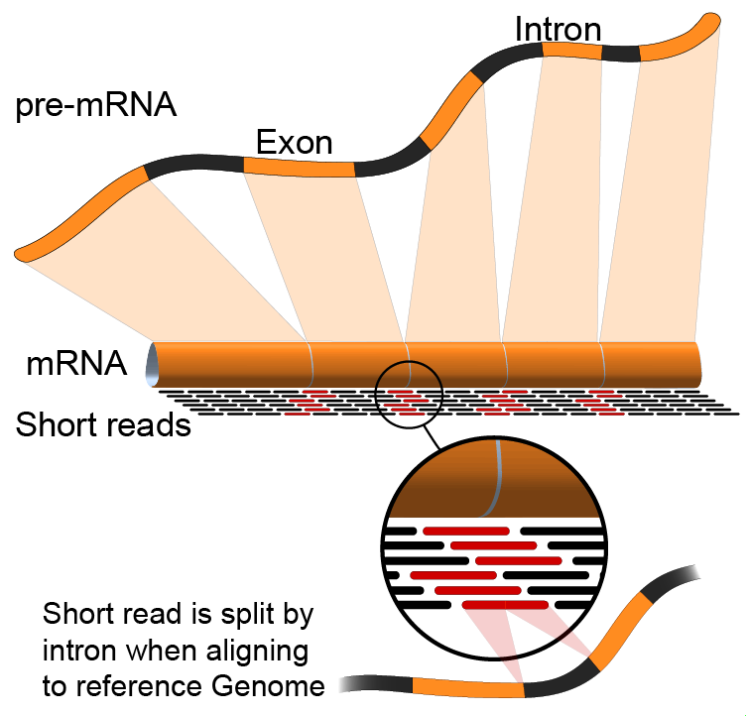

RNA-Seq Module 2: SAM/BAM/BED file formats
Malachi Griffith, Obi Griffith, Isabel Risch,
Nicolas Ho, Melisa Acun, Varinder Verma, Mobin Khoramjoo
RNA-seq Analysis 2025. July 7-9, 2025

Slide 4
Introduction to the SAM/BAM format
The specification
http://samtools.sourceforge.net/SAM1.pdf
SAM is uncompressed text data
BAM is a compressed version of SAM
lossless BGZF format
BAM files are usually ‘indexed’
A ‘.bai’ file will be found beside the ‘.bam’ file
Indexing provides fast retrieval of alignments overlapping a specified region without going through all alignments.
BAM must be sorted by the reference ID and then the leftmost coordinate before indexing

Slide 5
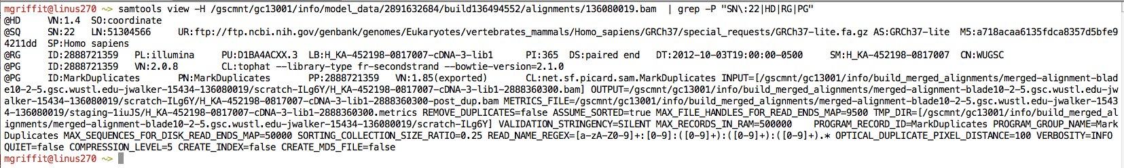
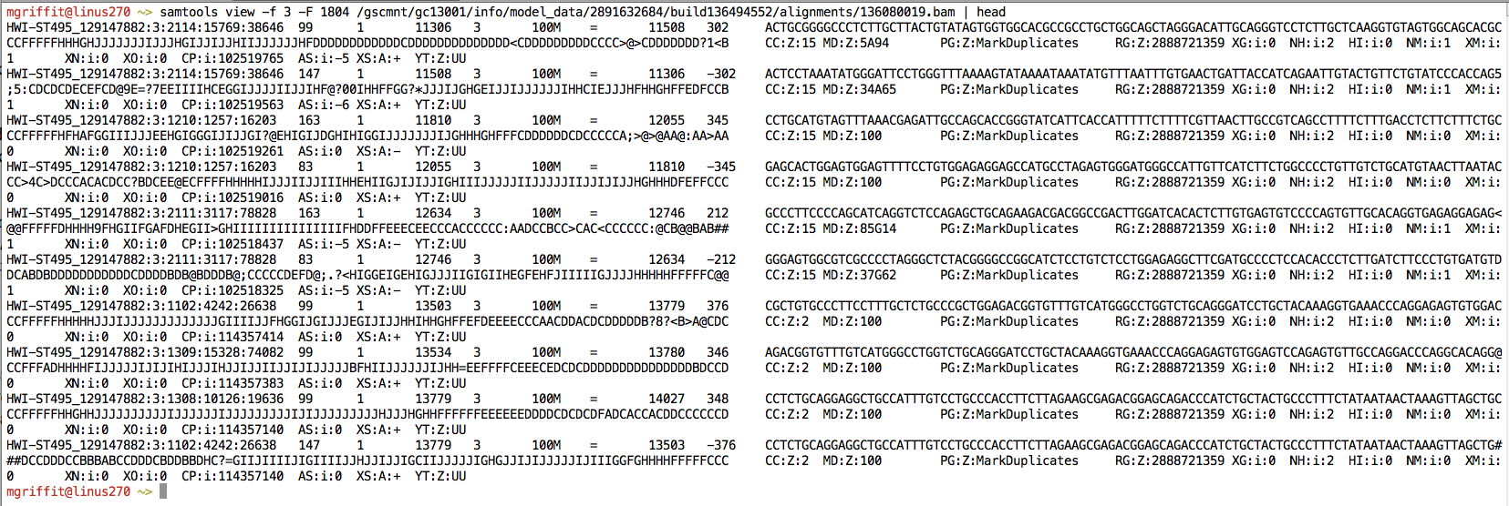
Example of SAM/BAM file format
Example SAM/BAM/CRAM header section (abbreviated)
Example SAM/BAM/CRAM alignment section (only 10 alignments shown)

Slide 6
SAM/BAM header section
Used to describe source of data, reference sequence, method of alignment, etc.
Each section begins with character ‘@’ followed by a two-letter record type code. These are followed by two-letter tags and values:
@HD The header line
VN: format version
SO: Sorting order of alignments
@SQ Reference sequence dictionary
SN: reference sequence name
LN: reference sequence length
SP: species
@RG Read group
ID: read group identifier
CN: name of sequencing center
SM: sample name
@PG Program
PN: program name
VN: program version

Slide 7
A BAM file is divided into header and alignment sections
Example SAM/BAM header section
Version (VN) and sort order (SO) - Important!
Reference sequence (SQ)
and sequence length (LN)
Read group (RG) and sample (SM)
Programs (PG) that have been run on the data

Slide 8
A BAM file is divided into header and alignment sections
Example SAM/BAM alignment section

Slide 9
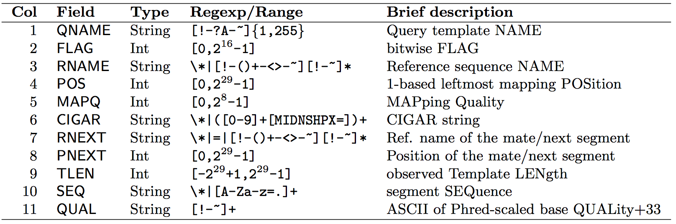
SAM/BAM alignment section
Example values
QNAME e.g. HWI-ST495_129147882:1:2302:10269:12362
FLAG e.g. 99
RNAME e.g. 1
POS e.g. 11623
MAPQ e.g. 3
CIGAR e.g. 100M
RNEXT e.g. =
PNEXT e.g. 11740
TLEN e.g. 217
SEQ e.g. CCTGTTTCTCCACAAAGTGTTTACTTTTGGATTTTTGCCAGTCTAACAGGTGAAGCCCTGGAGATTCTTATTAGTGATTTGGGCTGGGGCCTGGCCATGT
QUAL e.g. CCCFFFFFHHHHHJJIJFIJJJJJJJJJJJHIJJJJJJJIJJJJJGGHIJHIJJJJJJJJJGHGGIJJJJJJIJEEHHHHFFFFCDCDDDDDDDB@ACDD

Slide 10
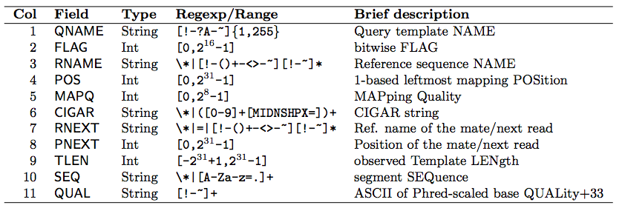

SAM Format – Information Fields
1
2
3
4
5
6
7
8
9
10
Slide courtesy of Andrew Farrell

Slide 11
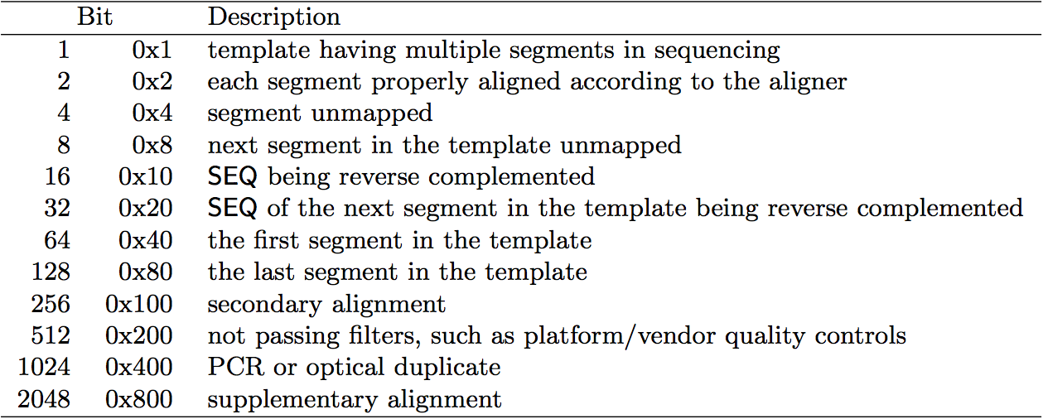
SAM/BAM flags explained
12 bitwise flags describing the alignment
Stored as a binary string of length 12 instead of 12 columns of data
Value of ‘1’ indicates the flag is set. e.g. 001000000000
All combinations can be represented as a number from 0 to 4095 (i.e. 2¹²). This number is used in the BAM/SAM file.
You can specify ‘required’ or ‘filter’ flags in samtools view using the ‘-f’ and ‘-F’ options respectively
Note that to maximize confusion, each bit is described in the SAM specification using its hexadecimal representation (i.e., '0x10' = 16 and '0x40' = 64).
http://broadinstitute.github.io/picard/explain-flags.html

Slide 12
SAM Format – Information Fields
1
2
3
4
5
6
7
8
9
10
Slide courtesy of Andrew Farrell

Slide 13
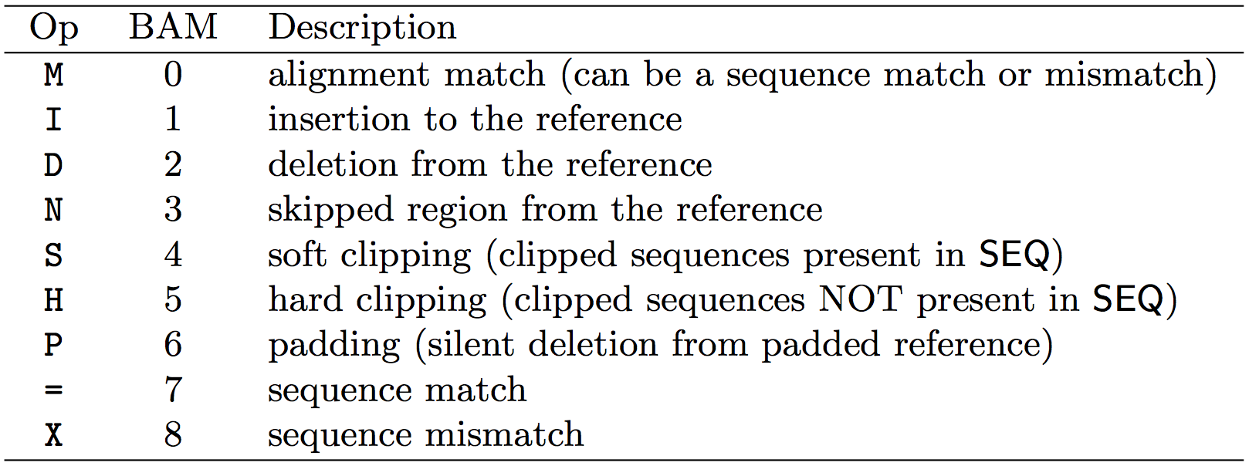
CIGAR strings explained
The ‘CIGAR’ (Compact Idiosyncratic Gapped Alignment Report)
The CIGAR string is a sequence of base lengths and associated ‘operations’ indicating which bases align to the reference (either a match or mismatch), are deleted, are inserted, represent introns, etc.
e.g. 81M859N19M
A 100 bp read consists of: 81 bases of alignment to reference, 859 bases skipped (an intron), 19 bases of alignment

Slide 14
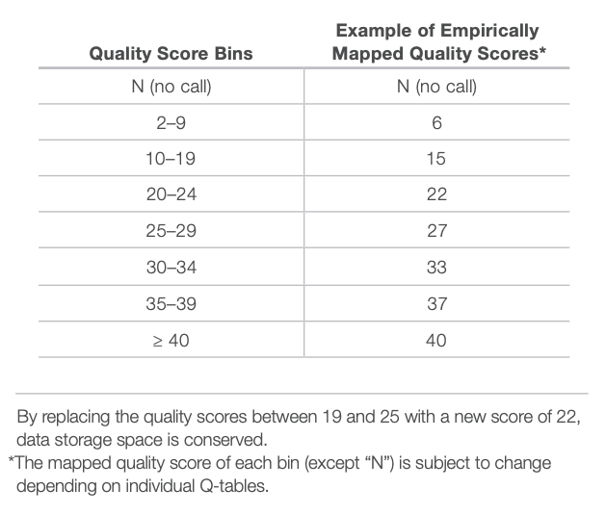
CRAM files
CRAM is an ultra-compressed version of a BAM file
Usually between 30-60% smaller than the corresponding BAM
Stores “diffs” from the reference genome
requires the matching reference genome to restore original data!
Base quality binning may be used as well
Some tools still require conversion back to bam

Slide 15
How should I sort my SAM/BAM file?
Generally BAM files are sorted by position
This is for performance reasons
When sorted and indexed, arbitrary positions in a massive BAM file can be accessed rapidly
Certain tools require a BAM sorted by read name
Usually this is when we need to easily identify both reads of a pair
The insert size between two reads may be large
In fusion detection we are interested in read pairs that map to different chromosomes

Slide 16
Introduction to the BED format
When working with BAM files, it is very common to want to examine a focused subset of the reference genome
e.g. the exons of a gene
These subsets are commonly specified in ‘BED’ files
https://genome.ucsc.edu/FAQ/FAQformat.html#format1
Many BAM manipulation tools accept regions of interest in BED format
Basic BED format (tab separated):
Chromosome name, start position, end position (BED3)
Coordinates in BED format are 0 based

Slide 17
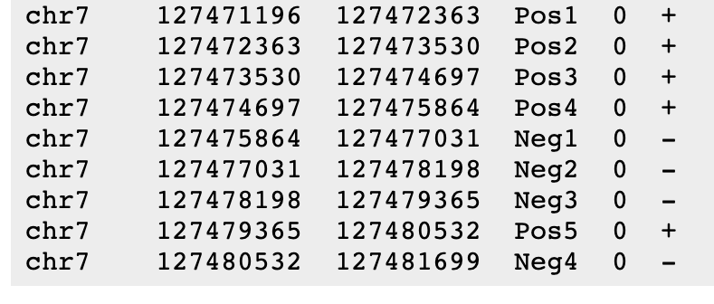
Introduction to the BED format
There are several flavors of BED format: BED3, BED4, BED6, BED8, etc
First 3 fields always required: chr, start, stop
Followed by up to 9 additional optional fields: name, score, strand, thickStart, thickEnd, itemRGB, blockCount, blockSizes, blockStarts

Slide 18

Manipulation of SAM/BAM and BED files
Several tools are used ubiquitously in sequence analysis to manipulate these files
SAM/BAM files
samtools
bamtools
Picard
BED files
bedtools
bedops

Slide 19
Common sources of confusion
Genomic coordinate systems
Genome builds
Variant representation

Slide 20
Genomic coordinates – 1 vs 0 based
chr1 |  | T |  | A |  | C |  | G |  | T |  | C |  | A
1-based |  | 1 |  | 2 |  | 3 |  | 4 |  | 5 |  | 6 |  | 7
0-based | 0 |  | 1 |  | 2 |  | 3 |  | 4 |  | 5 |  | 6 |  | 7
 | 1-based | 0-based
Indicate a single nucleotide | chr1:4-4 G | chr1:3-4 G
Indicate a range of nucleotides | chr1:2-4 ACG | chr1:1-4 ACG
Indicate a single nucleotide variant | chr1:5-5 T/A | chr1:4-5 T/A
1-based : Single nucleotides, variant positions, or ranges are specified directly by their corresponding nucleotide numbers
GFF, SAM, VCF, Ensembl browser, …
0-based: Single nucleotides, variant positions, or ranges are specified by the coordinates that flank them
BED, BAM, UCSC browser, …

Slide 21
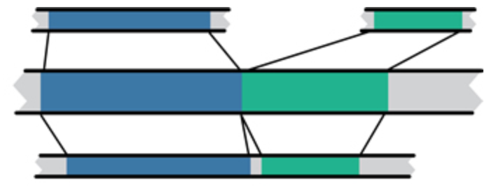
Genome builds
Reference Genome builds
Current human: GRCh38, hg38, b38
alternates: GRCh38v2_ccdg, GRCh38_full_analysis_set_plus_decoy_hla Previous human: GRCh37, hg19, b37 Current mouse: GRCm38, mm10
Lift-over
Mouse mm10
Human hg19
Human GRCh37
For a detailed discussion of various human reference genome flavors refer here:
https://pmbio.org/module-02-inputs/0002/02/01/Reference_Genome/

Slide 22
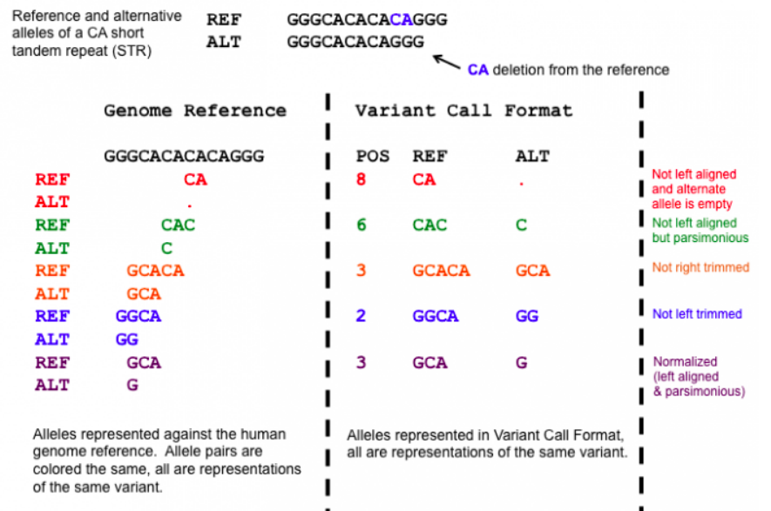
Variant shifting (alignment) and parsimony/trimming
Parsimony: representing variant in as few nucleotides as possible without reducing the length of any allele to 0
Left (right) aligning = shifting the start position of a variant as far to the left (right) as possible
Notes:
https://genome.sph.umich.edu/wiki/Variant_Normalization
Parsimony means representing a variant in as few nucleotides as possible without reducing the length of any allele to 0.
Left aligning a variant means shifting the start position of that variant to the left till it is no longer possible to do so.
The representation of variants in a VCF file requires that no alleles in the REF and ALT field are represented with an empty string (empty allele). The red indel has an illegal VCF representation.
The green variant is not left aligned as you can prefix an A nucleotide on the left side of the variant's alleles and truncate the C on the right side of the variant's alleles. It is however parsimonious.
The orange variant is left aligned but is not right parsimonious.
The blue variant is left aligned but not left parsimonious.
The maroon variant is left aligned and parsimonious.

Slide 23





We are on a Coffee Break & Networking Session
Workshop Sponsors:

