Slide 1
Canadian Bioinformatics Workshops
www.bioinformatics.ca
bioinformaticsdotca.github.io

Slide 2
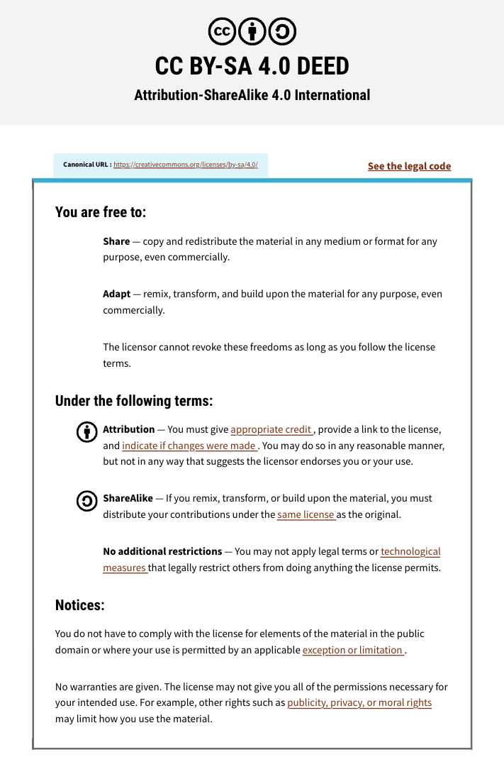

Slide 3

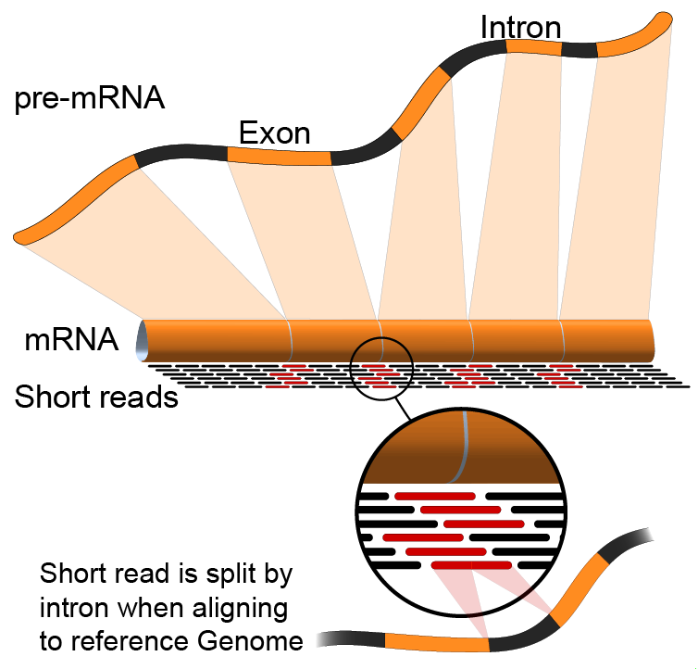

RNA-Seq Module 3: HTSeq
Malachi Griffith, Obi Griffith, Isabel Risch,
Nicolas Ho, Melisa Acun, Varinder Verma, Mobin Khoramjoo
RNA-seq Analysis 2025. July 7-9, 2025

Slide 4
Alternatives to FPKM
Raw read counts for differential expression analysis
Assign reads/fragments to defined genes/transcripts, get “raw counts”
Transcript structures could still be defined by something like Stringtie
HTSeq (htseq-count)
https://htseq.readthedocs.io/
Caveats of ‘transcript’ analysis by htseq-count:
Designed for genes - ambiguous reads from overlapping transcripts may not be handled!
http://seqanswers.com/forums/showthread.php?t=18068
htseq-count --mode intersection-strict --stranded no --minaqual 1 --type exon --idattr transcript_id accepted_hits.sam chr22.gff > transcript_read_counts_table.tsv

Slide 5
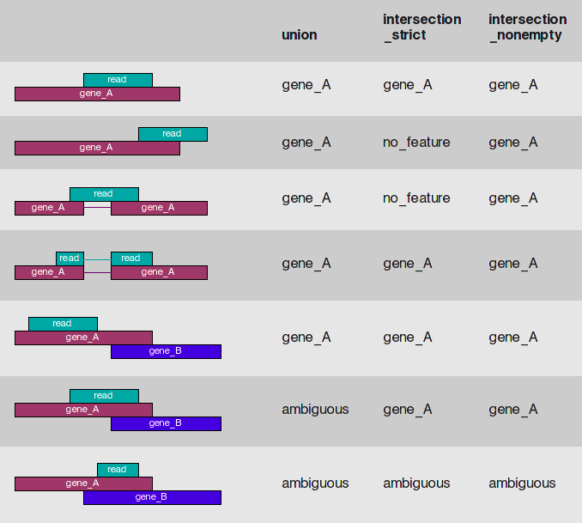
HTSeq-count basically counts reads supporting a feature (exon, gene) by assessing overlapping coordinates
Note, if gene_A and gene_B on opposite strands, sequence data is stranded, and correct HTSeq parameter set then this read may not be ambiguous
Whether a read is counted depends on the nature of overlap and “mode” selected
Notes:
We recommend intersection_strict

Slide 6





We are on a Coffee Break & Networking Session
Workshop Sponsors:

