Slide 1
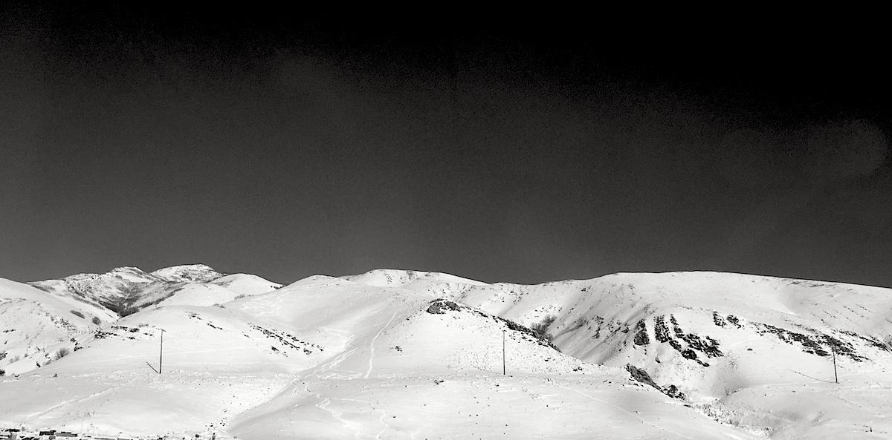
More advanced command line lab and exercises
WashU’s Bioinformatics Workshop
Applied Computational Genomics, Lecture 1-4
Jason Kunisaki
Quinlan Lab
University of Utah

Slide 2
We’ve gone through many essential commands
ls
wc
pwd
cd
mkdir
man
rm
touch
mv
echo
less
cat
>> vs >
grep
sort
Pipe |
vim
Notes:
Learned about navigating through your computer’s filesystem from the command line
pwd
Mkdir, rmdr
ls
cat
How to manipulate and parse through files from the command line.

Slide 3
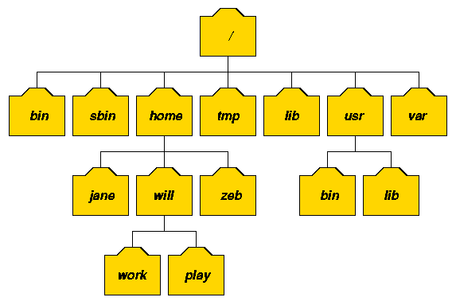
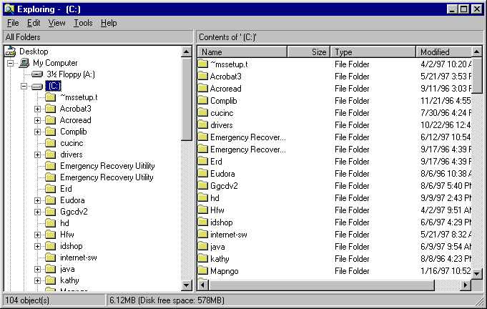
Navigating filesystems via the command line is essential
Notes:
Learned about navigating through your computer’s filesystem from the command line
pwd
Mkdir, rmdr
ls
cat
How to manipulate and parse through files from the command line.

Slide 4

Navigating filesystems via the command line is essential
Conceptual recap: You are in “home”
How would you verify that?
How do you move to a directory above/below home?
How do you list the contents in the “data” folder
How do you create a file called “my_file.txt” in data? How do you remove it?
Example Unix file system (a “tree”)
root
home
bin
vol
luke
leia
ls
head
cat
hi.txt
proj1
data1.txt
data2.txt
data
frost.txt

Slide 5
Commands we will use/reinforce in this session
ls
wc
pwd
cd
mkdir
man
rm
touch
mv
echo
less
cat
>> vs >
grep
sort
Pipe |
vim
Objectives:
Go through the command line anatomy
Combining sort + uniq
More advanced grep usage
Using the cut command
Notes:
Learned about navigating through your computer’s filesystem from the command line
pwd
Mkdir, rmdr
ls
cat
How to manipulate and parse through files from the command line.

Slide 6

Anatomy of the command line
ls -l --color=auto ~
command_name -flag --argument value positional_argument
command
parameters
Notes:
Flags are like on/off switches, they tell a command that it should or shouldn’t do something
Arguments are like the slidey part of the light switch, where there are many values a command could take in to perform a specific function.
And then positional arguments are those that are required to run a function in the first place. So for example, it could be a file or a directory or anything you could imagine being as input

Slide 7
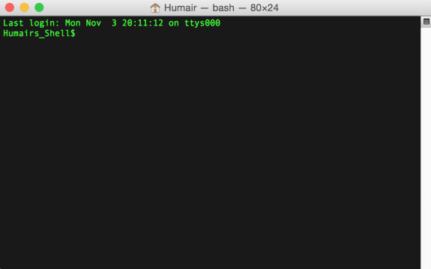
Piping Unix commands together with "|"
The sum is greater than its parts.
## Alphabetically sort the words file and output the first 20
cat /usr/share/dict/words | sort | head -n 20
command 1
command 2
command 3
"stdout"
Notes:
Just emphasize how cool piping is
2nd command takes the output of the first command as input, and the third command takes the output of the second command as output and so on

Slide 8
“Show me the output of your command”
stdout = “the path your data taks”
your_fav_command
stderr = “the path your errors and warnings take”
Notes:
Each time you run a command, the information can take two different paths

Slide 9
Let’s see this in action with the date command
mkdir ~/command_line_lab
## Get the date
date
Notes:
Important notes:
When you redirect the output of stderr, stdout still goes to the screen

Slide 10
Let’s see this in action with the date command
mkdir ~/command_line_lab
## Get the date
date
## Use invalid parameter
date -asdf #error to stderr
## Store date in text file
date > file.txt
Notes:
Important notes:
When you redirect the output of stderr, stdout still goes to the screen

Slide 11
Let’s see this in action with the date command
mkdir ~/command_line_lab
## Get the date
date
## Use invalid parameter
date -asdf #error to stderr
## Store date in text file
date > file.txt
## Show date from text file
cat file.txt
Notes:
Important notes:
When you redirect the output of stderr, stdout still goes to the screen

Slide 12
Let’s see this in action with the date command
mkdir ~/command_line_lab
## Get the date
date
## Use invalid parameter
date -asdf #error to stderr
## Store date in text file
date > file.txt
## Show date from text file
cat file.txt
## Store the error/warning messages in a text file
date --asdf 2> err.log
cat err.log
## What happens if we run this?
date 2> err.log
## And what about this?
date >file.txt
date >>file.txt
date >>file.txt
cat file.txt
Notes:
Important notes:
When you redirect the output of stderr, stdout still goes to the screen

Slide 13
Learning the sort | uniq dynamic duo

Slide 14
First, let’s download some files
## Download slack files to your desktop
## Move into the directory from earlier
cd ~/workspace
## Move files from Desktop to command_line_lab directory
mv ~/Desktop/command_line_tutorial/* ~/workspace
https://github.com/genome/bfx-workshop
Notes:
Questions to ask:
What does the tilda mean?
How can we see where we are in the file system?
How to list files in this directory? (ls and ls -l)

Slide 15
Let’s go through the files
genes1.txt = genes highly expressed in a tumor
genes2.txt = genes highly expressed in matching normal tissue
What do you notice about genes1.txt and genes2.txt?
Notes:
Step 1: we need to remove duplicate genes in each dataset
sort genes1.txt | uniq >genes1.uniq.txt
sort genes2.txt | uniq >genes2.uniq.txt
Step 2: Combine the two lists --> we know that a gene appearing twice would be found in both datasets
cat genes1.uniq.txt genes2.uniq.txt | sort | uniq -d

Slide 16
Working with sort | uniq
Genes are sorted alphabetically, great!
## Sorts genes in genes1.txt
cat genes1.txt | sort
## ... is equivalent to ...
sort genes1.txt
CEBPA
CEBPA
DNMT3A
FLT3
IDH1
IDH2
IDH2
NPM1
NRAS
RUNX1
TET2
TP53
Notes:
Sort does what we expect...
The two commands are the same

Slide 17
Working with sort | uniq
## Sorts genes in genes1.txt
cat genes1.txt | sort
## ... is equivalent to ...
sort genes1.txt
## Get the unique genes... right?
cat genes1.txt | uniq
DNMT3A
FLT3
NPM1
TET2
IDH2
RUNX1
TP53
IDH2
IDH1
CEBPA
NRAS
CEBPA
Why are IDH2 and CEBPA repeated?
Notes:
And so uniq should give us what we expect right?

Slide 18
Working with sort | uniq
(uniq identifies matching values when they are immediately next to one another)
## Sorts genes in genes1.txt
cat genes1.txt | sort
## ... is equivalent to ...
sort genes1.txt
## Sort, unique, then count
cat genes1.txt | sort | uniq
CEBPA
DNMT3A
FLT3
IDH1
IDH2
NPM1
NRAS
RUNX1
TET2
TP53
This is the way!
Notes:
Uniq requires the data be sorted first to work properly...

Slide 19
More sort | uniq combinations
Unsorted data:
DNMT3A
FLT3
NPM1
TET2
IDH2
RUNX1
TP53
IDH2
IDH1
CEBPA
NRAS
CEBPA
## Report only duplicate values (uniq -d flag)
cat genes1.txt | sort | uniq -d
## Report values that are in the file a single time (uniq -u)
cat genes1.txt | sort | uniq -u
## Count the number of occurrences for each value (uniq -c)
cat genes1.txt | sort | uniq -c
Try it out: what happens when you don’t sort the genes.txt file?

Slide 20
Performing set operations with sort | uniq
Question 1: how to find if a gene is present in both genes1.txt and genes2.txt?
## Let’s first talk about the “pseudocode” AKA conceptual code
## Without creating intermediate files:
cat <(cat genes1.txt | sort | uniq) <(cat genes2.txt | sort | uniq) | sort | uniq -d
Notes:
Step 1: we need to remove duplicate genes in each dataset
sort genes1.txt | uniq >genes1.uniq.txt
sort genes2.txt | uniq >genes2.uniq.txt
Step 2: Combine the two lists --> we know that a gene appearing twice would be found in both datasets
cat genes1.uniq.txt genes2.uniq.txt | sort | uniq -d

Slide 21
Performing set operations with sort | uniq
Question 1: how to find if a gene is present in both genes1.txt and genes2.txt?
## Let’s first talk about the “pseudocode” AKA conceptual code
Question 2: how do we find genes only found in genes1.txt and not in genes2.txt?
## Hint: you will need to “manually” duplicate something. This can be done by concatenating multiple files. Below is an example, where we combine genes1.txt and genes2.txt files.
cat genes1.txt genes2.txt

Slide 22
Performing set operations with sort and uniq
Question 1: how to find if a gene is present in both datasets?
sort genes1.txt | uniq >genes1.uniq.txt
sort genes2.txt | uniq >genes2.uniq.txt
cat genes1.uniq.txt genes2.uniq.txt | sort | uniq -d
Question 2: how do we find genes only found in genes1.txt?
Hint: you will need to “manually” duplicate something.
cat genes1.uniq.txt genes2.uniq.txt genes2.uniq.txt | sort | uniq -u
Notes:
Step 1: we need to remove duplicate genes in each dataset
sort genes1.txt | uniq >genes1.uniq.txt
sort genes2.txt | uniq >genes2.uniq.txt
Step 2: Combine the two lists --> we know that a gene appearing twice would be found in both datasets
cat genes1.uniq.txt genes2.uniq.txt | sort | uniq -d
Question 2: by including genes2.txt twice, we guarantee that each gene in the 2nd dataset is duplicated and thus removed by the -u option
cat genes1.uniq.txt genes2.uniq.txt genes2.uniq.txt | sort | uniq -u

Slide 23
How do we sort a file with multiple columns?

Slide 24
More practical sorting practice with a tab-delimited file
## View the file with the less command. To increase width of tabs, type -x20 and enter. You can press “q” to exit to file viewer.
less tcga.tsv
## Get rid of horrible wrapping behavior
less -S tcga.tsv
UPN chromosome_name start stop reference variant type gene_name
104 MT 13059 13059 C - DEL MT-ND5
104 MT 14767 14767 T C SNP MT-CYB
104 1 119270684 119270684 T A SNP TBX15
104 1 150324146 150324146 T C SNP TCHHL1
104 2 25310747 25310747 G A SNP DNMT3A
104 2 208821357 208821357 C T SNP IDH1
104 3 7478316 7478316 T A SNP GRM7
104 5 170767341 170767342 - GAGGAGG INS NPM1
104 5 170767342 170767343 - T INS NPM1
Just run
“sort tcga.tsv”, right?
Notes:
Within less you can scroll left and right, just press the arrow keys.
Go through -S flag
The dataset has mutations from multiple different chromosomes. And often when we want to process datasets such as these, we need to sort the data based on the genomic coordinates.

Slide 25
More practical sorting practice with a tab-delimited file
## Better to sort on a specific column of interest (chr)
sort -k 2,2 tcga.tsv | head
We sorted by the chromosome column, great!
But the coordinates are still out of order...
100232 1 158984926 158984926 A G SNP SLAMF7
100232 1 170692206 170692206 T - DEL C1orf105
100232 1 26974278 26974278 G A SNP ARID1A
103342 1 115058052 115058052 T G SNP NRAS
103342 1 56934311 56934311 C T SNP PRKAA2
104 1 119270684 119270684 T A SNP TBX15
104 1 150324146 150324146 T C SNP TCHHL1
110 1 199321250 199321250 G A SNP CACNA1S
110 1 200181928 200181928 G A SNP LMOD1
113971 1 180882643 180882643 C T SNP RGS8
Notes:
Sort by the 2nd column (chromosome_name)

Slide 26
Need to sort start coordinate numerically
## Or event multiple columns of interest (chr, start)
sort -k 2,2 -k 3,3n tcga.tsv | head
Treat chromosome values as text --> sort alphabetically
Treat start coordinate as numeric (hence “n”) --> sort numerically
Much better!
180168 1 5347 5347 G A SNP LOC100134101
852559 1 7692 7692 G A SNP LOC727882
303818 1 1561654 1561654 G A SNP CDC2L2
203 1 1737088 1737088 T G SNP GNB1
225373 1 2408210 2408210 C T SNP PLCH2
721214 1 3318383 3318383 G A SNP PRDM16
426980 1 3628599 3628599 C T SNP TP73
775109 1 3690478 3690478 G A SNP LRRC47
128392 1 6453706 6453706 C T SNP PLEKHG5
869922 1 6559262 6559262 A G SNP TAS1R1
Notes:
Add another -k argument to the sort command so that we first sort by chromosome, and then sort by the 3rd column (start).
This will be important for tomorrow’s lesson working with genomic coordinate and interval files.

Slide 27
Understanding sort’s field options
sort -k2 tcga.tsv | head
Sorts by columns including + after the 2nd column
Looks like a fully sorted dataset
sort -k2,2 tcga.tsv | head
Sorts by only the 2nd column
The genomic coordinates are still unsorted

Slide 28
Getting fancy with grep using a GFF/GTF file
Notes:
We are going to work with a fasta file
And in working through this, we are going to encounter a number of gotchas or common mistakes that we will subsequently correct
We might not get through it all but that’s okay since I just want to convey the overall utility of the command line to perform genomic analyses

Slide 29
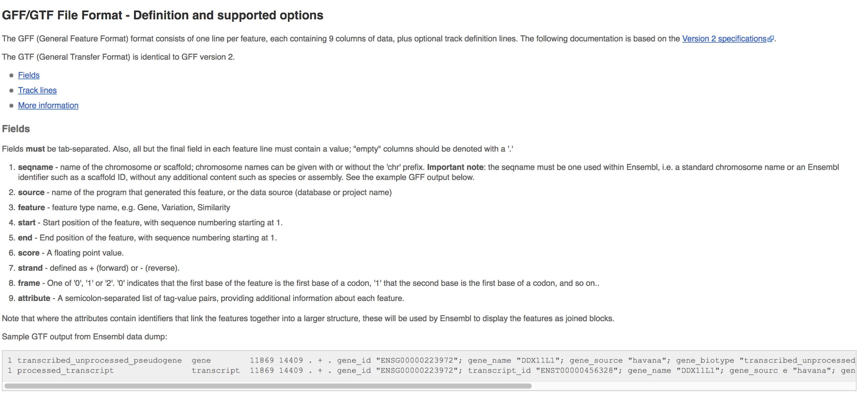
The GFF Format
Notes:
Go through cat genes.gtf

Slide 30
The grep command is VERY useful
grep "gene" genes.gtf
#!genebuild-last-updated 2019-06
22 ensembl gene 10736171 10736283 . - . gene_id "ENSG00000277248"; gene_version "1"; gene_name "U2"; gene_source "ensembl"; gene_biotype "snRNA";
22 ensembl transcript 10736171 10736283 . - . gene_id "ENSG00000277248"; gene_version "1"; transcript_id "ENST00000615943"; transcript_version "1"; gene_name "U2"; gene_source "ensembl"; gene_biotype "snRNA"; transcript_name "U2.14-201"; transcript_source "ensembl"; transcript_biotype "snRNA"; tag "basic"; transcript_support_level "NA";
22 ensembl exon 10736171 10736283 . - . gene_id "ENSG00000277248"; gene_version "1"; transcript_id "ENST00000615943"; transcript_version "1"; exon_number "1"; gene_name "U2"; gene_source "ensembl"; gene_biotype "snRNA"; transcript_name "U2.14-201"; transcript_source "ensembl"; transcript_biotype "snRNA"; exon_id "ENSE00003736336"; exon_version "1"; tag "basic"; transcript_support_level "NA";
22 havana gene 10939388 10961338 . - . gene_id "ENSG00000283047"; gene_version "1"; gene_name "FRG1FP"; gene_source "havana"; gene_biotype "unprocessed_pseudogene";
...
Result:
Only lines that contain the text "gene" anywhere in the line will be returned.

Slide 31
See grep matches with --color
grep --color "gene" genes.gtf
#!genebuild-last-updated 2019-06
22 ensembl gene 10736171 10736283 . - . gene_id "ENSG00000277248"; gene_version "1"; gene_name "U2"; gene_source "ensembl"; gene_biotype "snRNA";
22 ensembl transcript 10736171 10736283 . - . gene_id "ENSG00000277248"; gene_version "1"; transcript_id "ENST00000615943"; transcript_version "1"; gene_name "U2"; gene_source "ensembl"; gene_biotype "snRNA"; transcript_name "U2.14-201"; transcript_source "ensembl"; transcript_biotype "snRNA"; tag "basic"; transcript_support_level "NA";
22 ensembl exon 10736171 10736283 . - . gene_id "ENSG00000277248"; gene_version "1"; transcript_id "ENST00000615943"; transcript_version "1"; exon_number "1"; gene_name "U2"; gene_source "ensembl"; gene_biotype "snRNA"; transcript_name "U2.14-201"; transcript_source "ensembl"; transcript_biotype "snRNA"; exon_id "ENSE00003736336"; exon_version "1"; tag "basic"; transcript_support_level "NA";
22 havana gene 10939388 10961338 . - . gene_id "ENSG00000283047"; gene_version "1"; gene_name "FRG1FP"; gene_source "havana"; gene_biotype "unprocessed_pseudogene";
Result:
Only lines that contain the text "gene" anywhere in the line will be returned.
What if we want to match "gene" but not things like "gene_name"?
Notes:
--color helps see where the matches are in your file
Gene is everywhere, even in the header

Slide 32
Get “whole word” matches with -w
grep --color "gene" -w genes.gtf
22 ensembl gene 10736171 10736283 . - . gene_id "ENSG00000277248"; gene_version "1"; gene_name "U2"; gene_source "ensembl"; gene_biotype "snRNA";
22 havana gene 10939388 10961338 . - . gene_id "ENSG00000283047"; gene_version "1"; gene_name "FRG1FP"; gene_source "havana"; gene_biotype "unprocessed_pseudogene";
22 havana gene 11066418 11068174 . + . gene_id "ENSG00000279973"; gene_version "2"; gene_name "CU104787.1"; gene_source "havana"; gene_biotype "lncRNA";
22 havana gene 11124337 11125705 . + . gene_id "ENSG00000226444"; gene_version "2"; gene_name "ACTR3BP6"; gene_source "havana"; gene_biotype "processed_pseudogene";
By default, grep reports a pattern match anywhere it find it on the line.
What if we want to match "gene" but not things like "gene_name"?

Slide 33
Report lines that lack a pattern with -v
grep "gene" -v genes.gtf
#!genome-build GRCh38.p13
#!genome-version GRCh38
#!genome-date 2013-12
#!genome-build-accession NCBI:GCA_000001405.28
Why are these the only lines that are reported?
Notes:
Removes all rows that contain “gene” in the row, but “gene” is in every row.

Slide 34
Report lines that lack a pattern with -v and -w
grep "gene" -v -w genes.gtf
#!genome-build GRCh38.p13
#!genome-version GRCh38
#!genome-date 2013-12
#!genome-build-accession NCBI:GCA_000001405.28
#!genebuild-last-updated 2019-06
22 ensembl transcript 10736171 10736283 . - . gene_id "ENSG00000277248"; gene_version "1"; transcript_id "ENST00000615943"; transcript_version "1"; gene_name "U2"; gene_source "ensembl"; gene_biotype "snRNA"; transcript_name "U2.14-201"; transcript_source "ensembl"; transcript_biotype "snRNA"; tag "basic"; transcript_support_level "NA";
22 ensembl exon 10736171 10736283 . - . gene_id "ENSG00000277248"; gene_version "1"; transcript_id "ENST00000615943"; transcript_version "1"; exon_number "1"; gene_name "U2"; gene_source "ensembl"; gene_biotype "snRNA"; transcript_name "U2.14-201"; transcript_source "ensembl"; transcript_biotype "snRNA"; exon_id "ENSE00003736336"; exon_version "1"; tag "basic"; transcript_support_level "NA";
...
Notes:
We can combine multiple grep options:
Remove rows with “gene” with -v
Require that the row has “gene” entered as a whole word with -w

Slide 35
Matching patterns that include quotes
grep --color “PTPN22” genes.gtf
1 ensembl_havana gene 113813811 113871753 . - . gene_id "ENSG00000134242"; gene_version "16"; gene_name "PTPN22"; gene_source "ensembl_havana"; gene_biotype "protein_coding";
1 havana transcript 113813811 113871712 . - . gene_id "ENSG00000134242"; gene_version "16"; transcript_id "ENST00000460620"; transcript_version "5"; gene_name "PTPN22"; gene_source "ensembl_havana"; gene_biotype "protein_coding"; transcript_name "PTPN22-203"; transcript_source "havana"; transcript_biotype "protein_coding"; tag "basic"; transcript_support_level "1";
1 havana exon 113871537 113871712 . - . gene_id "ENSG00000134242"; gene_version "16"; transcript_id "ENST00000460620"; transcript_version "5"; exon_number "1"; gene_name "PTPN22"; gene_source "ensembl_havana"; gene_biotype "protein_coding"; transcript_name "PTPN22-203"; transcript_source "havana"; transcript_biotype "protein_coding"; exon_id "ENSE00001835701"; exon_version "1"; tag "basic"; transcript_support_level "1";
What if we want to find lines with a specific gene name (note that the GFF has gene names in quotes). We need to tell grep to treat quote characters literally!
Notes:
One horrible thing about GTF files is that some of the information we are interested in is surrounded by quotes...
This is because grep matches based on patterns within the quotes... It does not treat the quotes as part of the pattern...

Slide 36
Matching patterns that include quotes
grep --color \“PTPN22\” genes.gtf
ensembl_havana gene 113813811 113871753 . - . gene_id "ENSG00000134242"; gene_version "16"; gene_name "PTPN22"; gene_source "ensembl_havana"; gene_biotype "protein_coding";
1 havana transcript 113813811 113871712 . - . gene_id "ENSG00000134242"; gene_version "16"; transcript_id "ENST00000460620"; transcript_version "5"; gene_name "PTPN22"; gene_source "ensembl_havana"; gene_biotype "protein_coding"; transcript_name "PTPN22-203"; transcript_source "havana"; transcript_biotype "protein_coding"; tag "basic"; transcript_support_level "1";
1 havana exon 113871537 113871712 . - . gene_id "ENSG00000134242"; gene_version "16"; transcript_id "ENST00000460620"; transcript_version "5"; exon_number "1"; gene_name "PTPN22"; gene_source "ensembl_havana"; gene_biotype "protein_coding"; transcript_name "PTPN22-203"; transcript_source "havana"; transcript_biotype "protein_coding"; exon_id "ENSE00001835701"; exon_version "1"; tag "basic"; transcript_support_level "1";
What if we want to find lines with a specific gene name (note that the GFF has gene names in quotes). We need to tell grep to treat quote characters literally!
To do so, we must "escape" them.
Note these matches from our last attempt disappeared. Why?
Notes:
So to grep for situations where quotes are part of the pattern we want to match against, wee need to “escape” them by using a backslash.
This tells grep to search for cases where PTPN22 is surrounded by quotes.

Slide 37
How many lines contain PTPN22
grep --color \"PTPN22\" genes.gtf | wc -l
316
Notes:
You can pipe grep commands and outputs to perform more specific analyses

Slide 38
How many exon records are there for PTPN22?
grep \“PTPN22\” genes.gtf | grep -w exon | wc -l
148
Notes:
You can pipe grep commands and outputs to perform more specific analyses

Slide 39
The cut command
(cut out specific columns/fields from a file or input stream)
So far, we have been working with entire lines of files. Many times we want to just explore specific subsets of information in a file. The grep command helps to isolate specific lines. The cut command helps us to extract specific columns from lines.
The cut command assumes that your file or input stream (in the case of a pipe) is tab-delimited.

Slide 40
The cut command identifies columns by number
less -S genes.gtf
The long strings of text at the end of each line are treated as a single column. Why?
Because the text within is separated by spaces, not tabs.
#!genome-build GRCh38.p7
#!genome-version GRCh38
#!genome-date 2013-12
#!genome-build-accession NCBI:GCA_000001405.22
#!genebuild-last-updated 2016-06
1 havana gene 11869 14409 . + . gene_id "ENSG00000223972"; gene_version "5"; gene_name "DDX11L1"; gene_source "havana";
1 havana transcript 11869 14409 . + . gene_id "ENSG00000223972"; gene_version "5"; transcript_id "ENST00000456328"; tr
1 havana exon 11869 12227 . + . gene_id "ENSG00000223972"; gene_version "5"; transcript_id "ENST00000456328"; transcript
1 havana exon 12613 12721 . + . gene_id "ENSG00000223972"; gene_version "5"; transcript_id "ENST00000456328"; transcript
1 havana exon 13221 14409 . + . gene_id "ENSG00000223972"; gene_version "5"; transcript_id "ENST00000456328"; transcript
1 havana transcript 12010 13670 . + . gene_id "ENSG00000223972"; gene_version "5"; transcript_id "ENST00000450305"; tr
1 havana exon 12010 12057 . + . gene_id "ENSG00000223972"; gene_version "5"; transcript_id "ENST00000450305"; transcript
1 havana exon 12179 12227 . + . gene_id "ENSG00000223972"; gene_version "5"; transcript_id "ENST00000450305"; transcript
1 havana exon 12613 12697 . + . gene_id "ENSG00000223972"; gene_version "5"; transcript_id "ENST00000450305"; transcript
1 havana exon 12975 13052 . + . gene_id "ENSG00000223972"; gene_version "5"; transcript_id "ENST00000450305"; transcript
1 havana exon 13221 13374 . + . gene_id "ENSG00000223972"; gene_version "5"; transcript_id "ENST00000450305"; transcript
1 havana exon 13453 13670 . + . gene_id "ENSG00000223972"; gene_version "5"; transcript_id "ENST00000450305"; transcript
1 havana gene 14404 29570 . - . gene_id "ENSG00000227232"; gene_version "5"; gene_name "WASH7P"; gene_source "havana"; g
1 havana transcript 14404 29570 . - . gene_id "ENSG00000227232"; gene_version "5"; transcript_id "ENST00000488147"; tr
1 havana exon 29534 29570 . - . gene_id "ENSG00000227232"; gene_version "5"; transcript_id "ENST00000488147"; transcript
1 havana exon 24738 24891 . - . gene_id "ENSG00000227232"; gene_version "5"; transcript_id "ENST00000488147"; transcript
1 havana exon 18268 18366 . - . gene_id "ENSG00000227232"; gene_version "5"; transcript_id "ENST00000488147"; transcript
1 havana exon 17915 18061 . - . gene_id "ENSG00000227232"; gene_version "5"; transcript_id "ENST00000488147"; transcript
1 havana exon 17606 17742 . - . gene_id "ENSG00000227232"; gene_version "5"; transcript_id "ENST00000488147"; transcript
1
2
3
4
5
6
7
8
9

Slide 41
Use cut to extract from solely the 2nd column
cut -f2 genes.gtf | head -n 20
#!genome-build GRCh38.p13
#!genome-version GRCh38
#!genome-date 2013-12
#!genome-build-accession NCBI:GCA_000001405.28
#!genebuild-last-updated 2019-06
ensembl
ensembl
ensembl
havana
havana
havana
havana
havana
havana
havana
havana
havana
havana
havana
havana
Why were the first 5 lines reported?
How could we prevent that?
Notes:
If there are no tabs in a row, cut will report the entire row...

Slide 42
Use cut to extract from solely the 2nd column
grep -v “#” genes.gtf | cut -f 2 | head -n 20
ensembl
ensembl
ensembl
havana
havana
havana
havana
havana
havana
havana
havana
havana
havana
havana
havana
havana
havana
havana
havana
havana
Notes:
If there are no tabs in a row, cut will report the entire row...

Slide 43
We can also extract information from multiple columns
grep -v “#” genes.gtf | cut -f 1,4-5 | head -n 20
22 10736171 10736283
22 10736171 10736283
22 10736171 10736283
22 10939388 10961338
22 10939388 10961338
22 10961283 10961338
22 10959067 10959136
22 10950049 10950174
22 10949212 10949269
22 10947304 10947418
22 10944967 10945053
22 10941691 10941780
22 10940597 10940707
22 10939388 10939423
22 11066418 11068174
22 11066418 11068174
22 11066418 11066515
22 11067985 11068174
22 11124337 11125705
22 11124337 11125705
Note: make sure there are no spaces between column numbers you are wanting to cut
Notes:
Remove rows with # via grep -v

Slide 44
Saving grep results to files with >
grep -v “#” genes.gtf | cut -f 1,4-5 | head -n 20 > gtf_coordinates.txt
cat gtf_coordinates.txt
22 10736171 10736283
22 10736171 10736283
22 10736171 10736283
22 10939388 10961338
22 10939388 10961338
22 10961283 10961338
22 10959067 10959136
22 10950049 10950174
22 10949212 10949269
22 10947304 10947418
22 10944967 10945053
22 10941691 10941780
22 10940597 10940707
22 10939388 10939423
22 11066418 11068174
22 11066418 11068174
22 11066418 11066515
22 11067985 11068174
22 11124337 11125705
22 11124337 11125705

Slide 45
Mini recap
## This is a command we discussed previously.
grep "exon" -v -w genes.gtf
Question 1: What should it do?
Question 2: How can we verify it is doing what we want it to do? (hint: use the grep, cut, sort, and uniq commands)
Notes:
Question 1: remove all rows with exon as a whole word
Question 2:
grep "exon" -v -w genes.gtf | cut -f 3 | sort | uniq -c

Slide 46
Command Line Lab

Slide 47
grep command line lab
1) How many GTF data lines are in this file? Note that the first few lines in the file beginning with "#" are so-called "header" lines describing thing like the creation date, the genome version (more on that later in the course), etc. Header lines should not be counted as data lines.
2) How many GTF data lines are in this file for protein coding genes? Note that entries (lines in the file for protein coding genes will contain the following text: gene_biotype "protein_coding"). Use the string above with a command you have learned to find such lines. Hint: the UNIX pipe may come in handy here...
3) How many GTF data lines are in this file for exons from protein coding genes?
4) How many CDS exons ("CDS" in column 3) from protein coding genes exist on per each chromosome (column 1 in the GTF file)? That is, the count per chromsome.

Slide 48
grep command line lab solutions
1) How many GTF data lines are in this file? Note that the first few lines in the file beginning with "#" are so-called "header" lines describing thing like the creation date, the genome version (more on that later in the course), etc. Header lines should not be counted as data lines.
cat genes.gtf | grep -v "#" | wc -l
2) How many GTF data lines are in this file for protein coding genes? Note that entries (lines in the file for protein coding genes will contain the following text: gene_biotype "protein_coding"). Use the string above with a command you have learned to find such lines. Hint: the UNIX pipe may come in handy here...
cat genes.gtf | grep -v "#" | grep "gene_biotype \"protein_coding\"" | wc -l
3) How many GTF data lines are in this file for exons from protein coding genes?
cat genes.gtf | grep -w "exon" | grep "gene_biotype \"protein_coding\"" | wc -l
4) How many CDS exons ("CDS" in column 3) from protein coding genes exist on per each chromosome (column 1 in the GTF file)? That is, the count per chromsome.
grep -w "gene_biotype \"protein_coding"\" genes.gtf | grep -w "CDS" | cut -f 1 | sort | uniq –c

Slide 49
More examples with grep using genomic data
Pattern searching in the human genome slides: https://docs.google.com/presentation/d/1W7bwMLAqCIB9unbv4Kswc8P7cE5ATkMhHYJfwBa64L0/edit#slide=id.g1a75711018_0_253
Lecture: https://www.youtube.com/watch?v=ngpwuFh7H5M

Slide 50
Let’s download the fasta file
## Make new directory and change directory
cd ~/command_line_lab/workshop/bfx-workshop/lectures/week_02
## Download fasta file
curl http://hgdownload.cse.ucsc.edu/goldenPath/hg38/chromosomes/chr22.fa.gz > chr22.fa.gz
## Try to cat/less the fa.gz file
cat chr22.fa.gz
## Uncompress the gzipped file and rename
gzip -d chr22.fa.gz
mv chr22.fa hg.b38.chr22.fa
Notes:
Try to cat gzipped file
One workaround is to use zcat/zless to look at the file
Chr22 should be 51 MB, but we download it as a compressed file which is 11.6M\
mv just renames the file
Get the head of the

Slide 51
Searching for and counting patterns in genomes with grep
First line is a header line to indicate which chromosome we are looking at
cat hg.b38.chr22.fa | head -n 10
>chr22
NNNNNNNNNNNNNNNNNNNNNNNNNNNNNNNNNNNNNNNNNNNNNNNNNN
NNNNNNNNNNNNNNNNNNNNNNNNNNNNNNNNNNNNNNNNNNNNNNNNNN
NNNNNNNNNNNNNNNNNNNNNNNNNNNNNNNNNNNNNNNNNNNNNNNNNN
NNNNNNNNNNNNNNNNNNNNNNNNNNNNNNNNNNNNNNNNNNNNNNNNNN
NNNNNNNNNNNNNNNNNNNNNNNNNNNNNNNNNNNNNNNNNNNNNNNNNN
NNNNNNNNNNNNNNNNNNNNNNNNNNNNNNNNNNNNNNNNNNNNNNNNNN
NNNNNNNNNNNNNNNNNNNNNNNNNNNNNNNNNNNNNNNNNNNNNNNNNN
NNNNNNNNNNNNNNNNNNNNNNNNNNNNNNNNNNNNNNNNNNNNNNNNNN
NNNNNNNNNNNNNNNNNNNNNNNNNNNNNNNNNNNNNNNNNNNNNNNNNN
Notes:
We see that the first line is a header

Slide 52
Searching for and counting patterns in genomes with grep
First line is a header line to indicate which chromosome we are looking at
## Find line with the “>”
grep “>” hg.b38.chr22.fa
cat hg.b38.chr22.fa | head -n 10
>chr22
NNNNNNNNNNNNNNNNNNNNNNNNNNNNNNNNNNNNNNNNNNNNNNNNNN
NNNNNNNNNNNNNNNNNNNNNNNNNNNNNNNNNNNNNNNNNNNNNNNNNN
NNNNNNNNNNNNNNNNNNNNNNNNNNNNNNNNNNNNNNNNNNNNNNNNNN
NNNNNNNNNNNNNNNNNNNNNNNNNNNNNNNNNNNNNNNNNNNNNNNNNN
NNNNNNNNNNNNNNNNNNNNNNNNNNNNNNNNNNNNNNNNNNNNNNNNNN
NNNNNNNNNNNNNNNNNNNNNNNNNNNNNNNNNNNNNNNNNNNNNNNNNN
NNNNNNNNNNNNNNNNNNNNNNNNNNNNNNNNNNNNNNNNNNNNNNNNNN
NNNNNNNNNNNNNNNNNNNNNNNNNNNNNNNNNNNNNNNNNNNNNNNNNN
NNNNNNNNNNNNNNNNNNNNNNNNNNNNNNNNNNNNNNNNNNNNNNNNNN
Notes:
We can grep for the header row, since it will always have “>”

Slide 53
Searching for and counting patterns in genomes with grep
First line is a header line to indicate which chromosome we are looking at
## Find line with the “>”
grep “>” hg.b38.chr22.fa
## What will this do?
grep > hg.b38.chr22.fa
cat hg.b38.chr22.fa | head -n 10
>chr22
NNNNNNNNNNNNNNNNNNNNNNNNNNNNNNNNNNNNNNNNNNNNNNNNNN
NNNNNNNNNNNNNNNNNNNNNNNNNNNNNNNNNNNNNNNNNNNNNNNNNN
NNNNNNNNNNNNNNNNNNNNNNNNNNNNNNNNNNNNNNNNNNNNNNNNNN
NNNNNNNNNNNNNNNNNNNNNNNNNNNNNNNNNNNNNNNNNNNNNNNNNN
NNNNNNNNNNNNNNNNNNNNNNNNNNNNNNNNNNNNNNNNNNNNNNNNNN
NNNNNNNNNNNNNNNNNNNNNNNNNNNNNNNNNNNNNNNNNNNNNNNNNN
NNNNNNNNNNNNNNNNNNNNNNNNNNNNNNNNNNNNNNNNNNNNNNNNNN
NNNNNNNNNNNNNNNNNNNNNNNNNNNNNNNNNNNNNNNNNNNNNNNNNN
NNNNNNNNNNNNNNNNNNNNNNNNNNNNNNNNNNNNNNNNNNNNNNNNNN
Notes:
It will overwrite the fasta file and set it as an empty file

Slide 54
Searching for and counting patterns in genomes with grep
First line is a header line to indicate which chromosome we are looking at
## Find line with the “>”
grep “>” hg.b38.chr22.fa
## What will this do?
grep > hg.b38.chr22.fa
## Why does this return nothing?
grep -w “A” hg.b38.chr22.fa
cat hg.b38.chr22.fa | head -n 10
>chr22
NNNNNNNNNNNNNNNNNNNNNNNNNNNNNNNNNNNNNNNNNNNNNNNNNN
NNNNNNNNNNNNNNNNNNNNNNNNNNNNNNNNNNNNNNNNNNNNNNNNNN
NNNNNNNNNNNNNNNNNNNNNNNNNNNNNNNNNNNNNNNNNNNNNNNNNN
NNNNNNNNNNNNNNNNNNNNNNNNNNNNNNNNNNNNNNNNNNNNNNNNNN
NNNNNNNNNNNNNNNNNNNNNNNNNNNNNNNNNNNNNNNNNNNNNNNNNN
NNNNNNNNNNNNNNNNNNNNNNNNNNNNNNNNNNNNNNNNNNNNNNNNNN
NNNNNNNNNNNNNNNNNNNNNNNNNNNNNNNNNNNNNNNNNNNNNNNNNN
NNNNNNNNNNNNNNNNNNNNNNNNNNNNNNNNNNNNNNNNNNNNNNNNNN
NNNNNNNNNNNNNNNNNNNNNNNNNNNNNNNNNNNNNNNNNNNNNNNNNN
Notes:
There is no row with A as a whole word in the file

Slide 55
How could we determine how many nucleotides are in chr22?
cat hg.b38.chr22.fa | head -n 10
>chr22
NNNNNNNNNNNNNNNNNNNNNNNNNNNNNNNNNNNNNNNNNNNNNNNNNN
NNNNNNNNNNNNNNNNNNNNNNNNNNNNNNNNNNNNNNNNNNNNNNNNNN
NNNNNNNNNNNNNNNNNNNNNNNNNNNNNNNNNNNNNNNNNNNNNNNNNN
NNNNNNNNNNNNNNNNNNNNNNNNNNNNNNNNNNNNNNNNNNNNNNNNNN
NNNNNNNNNNNNNNNNNNNNNNNNNNNNNNNNNNNNNNNNNNNNNNNNNN
NNNNNNNNNNNNNNNNNNNNNNNNNNNNNNNNNNNNNNNNNNNNNNNNNN
NNNNNNNNNNNNNNNNNNNNNNNNNNNNNNNNNNNNNNNNNNNNNNNNNN
NNNNNNNNNNNNNNNNNNNNNNNNNNNNNNNNNNNNNNNNNNNNNNNNNN
NNNNNNNNNNNNNNNNNNNNNNNNNNNNNNNNNNNNNNNNNNNNNNNNNN
Need to remove the >chr22 line... How?
grep -v “>” hg.b38.chr22.fa
Notes:
Step 1: grep -v returns all lines in the file that do not have the “>” sign
Step 2: wc -c counts the number of characters in the file

Slide 56
How could we determine how many nucleotides are in chr22?
cat hg.b38.chr22.fa | head -n 10
>chr22
NNNNNNNNNNNNNNNNNNNNNNNNNNNNNNNNNNNNNNNNNNNNNNNNNN
NNNNNNNNNNNNNNNNNNNNNNNNNNNNNNNNNNNNNNNNNNNNNNNNNN
NNNNNNNNNNNNNNNNNNNNNNNNNNNNNNNNNNNNNNNNNNNNNNNNNN
NNNNNNNNNNNNNNNNNNNNNNNNNNNNNNNNNNNNNNNNNNNNNNNNNN
NNNNNNNNNNNNNNNNNNNNNNNNNNNNNNNNNNNNNNNNNNNNNNNNNN
NNNNNNNNNNNNNNNNNNNNNNNNNNNNNNNNNNNNNNNNNNNNNNNNNN
NNNNNNNNNNNNNNNNNNNNNNNNNNNNNNNNNNNNNNNNNNNNNNNNNN
NNNNNNNNNNNNNNNNNNNNNNNNNNNNNNNNNNNNNNNNNNNNNNNNNN
NNNNNNNNNNNNNNNNNNNNNNNNNNNNNNNNNNNNNNNNNNNNNNNNNN
Need to remove the >chr22 line... How?
grep -v “>” hg.b38.chr22.fa
## What does this do?
grep -v “>” hg.b38.chr22.fa | wc -l
Notes:
Counts the number of non-header rows in the fasta file

Slide 57
How could we determine how many nucleotides are in chr22?
Count characters with `wc -c`
grep -v ">" hg.b38.chr22.fa | wc -c
51834838
Wait - this is wrong... why? Because of hidden characters, which in this case, indicate a newline
Notes:
Step 1: grep -v returns all lines in the file that do not have the “>” sign
Step 2: wc -c counts the number of characters in the file

Slide 58
What are hidden characters?
cat -e hg.b38.chr22.fa | head
>chr22$
NNNNNNNNNNNNNNNNNNNNNNNNNNNNNNNNNNNNNNNNNNNNNNNNNN$
NNNNNNNNNNNNNNNNNNNNNNNNNNNNNNNNNNNNNNNNNNNNNNNNNN$
NNNNNNNNNNNNNNNNNNNNNNNNNNNNNNNNNNNNNNNNNNNNNNNNNN$
NNNNNNNNNNNNNNNNNNNNNNNNNNNNNNNNNNNNNNNNNNNNNNNNNN$
NNNNNNNNNNNNNNNNNNNNNNNNNNNNNNNNNNNNNNNNNNNNNNNNNN$
Notes:
Hidden characters is just a character that is not normally printed but tels a computer how a specific file is formatted. For example:
How does a computer distinguish a tab from a bunch of spaces?
How does a computer know when to print the new line?

Slide 59
How could we determine how many nucleotides are in chr22?
## Counts all characters (hidden + nucleotide) in file
$ grep -v ">" hg.b38.chr22.fa | wc -c
51834838
Notes:
wc -c counts all the characters in the file, including newline and hidden characters
We can then subtract from that value the number of newline characters in that file by counting up the number of newlines in the file
There are 50 million nucleotides in the total file, which includes your ATCGs and N’s where a nucleotide was not called for one reason or another

Slide 60
How could we determine how many nucleotides are in chr22?
## Counts all characters (hidden + nucleotide) in file
$ grep -v ">" hg.b38.chr22.fa | wc -c
51834838
## Why do we perform this calculation?
$ grep -v ">" hg.b38.chr22.fa | wc -l
1016370
51834838 - 1016370 = 50818468
Notes:
wc -c counts all the characters in the file, including newline and hidden characters
We can then subtract from that value the number of newline characters in that file by counting up the number of newlines in the file
There are 50 million nucleotides in the total file, which includes your ATCGs and N’s where a nucleotide was not called for one reason or another

Slide 61
How many adenosines are there on chr22?
## Find A nucleotides in the file
grep -v ">" hg.b38.chr22.fa | grep "A"
## “Count” A nucleotides in the file
grep -v ">" hg.b38.chr22.fa | grep -c "A"
410249
Notes:
What command could we use to find the A nucleotides in the file?
There are 50 million nucleotides in the file, but there are only 410,000 A’s. This doesn’t seem right...
grep --color highlights the matches
There are a lot of A’s per line but the way we are using grep -c, it is only counting the number of lines with an A in it.

Slide 62
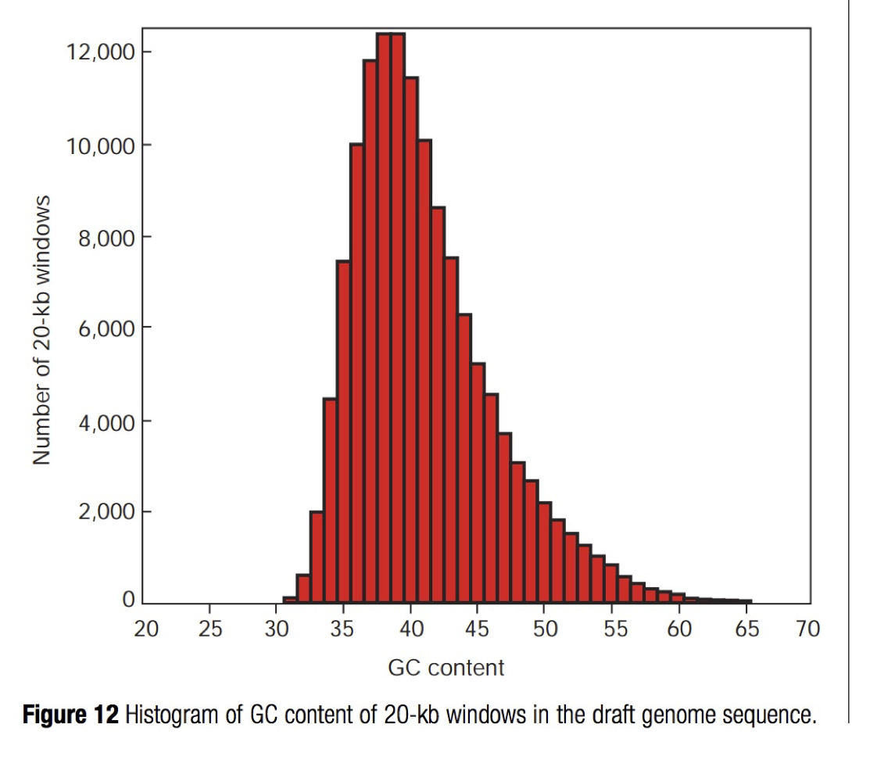
Let's sanity check our work.
We know that ~42% of the human genome is GC.
Therefore the AT content is ~58%
Thus we expect the A content to be ~58% / 2
= 14.5 million A nucleotides
But we see 410249 / 50818468 = 0.8%
Fishy! What is going on here?

Slide 63
Man page entry for grep -c
-c, --count
Suppress normal output; instead print a count of matching lines for each input file.
Notes:
We thought grep -c might do what we wanted
But if we look at the man page for grep, -c only prints the number of lines with at least one iinstance of for the value of interest, in this case we wanted the A nucleotide.
Problem because each row could have multiple A nucleotides
So we gotta do better

Slide 64
The -o option
-o, --only-matching
Print only the matched (non-empty) parts of a matching line, with each such part on a separate output line.
grep -v ">" hg.b38.chr22.fa | grep -o "A"
Notes:
We’re going to build up to a solution but this might be a little confusing at first. But what we want is to use an option called -o which prints only the matched parts of a line and outputs it onto its own line. So if there are 10 A nucleotides in the first line, it will rip that apart and output an A onto 10 separate lines. So let’s try that here.
And then we could use wc -l to count the number of lines to count the number of nucleotides

Slide 65
The -n option
-n, --line-number
Prefix each line of output with the 1-based line number within its input file.
grep -v ">" hg.b38.chr22.fa | grep -o -n "A"
Notes:
And we can use grep to report the line number in which those matching A’s were found in the file
So that file had about 1 million lines, meaning values from 1 to a million will be stored in that output

Slide 66
How many adenosines are there on chr22?
$ grep -v ">" hg.b38.chr22.fa | grep -o -n "A" | head -n 16
210201:A
210201:A
210201:A
210201:A
210201:A
210201:A
210201:A
210201:A
210201:A
210201:A
210201:A
210201:A
210201:A
210201:A
210201:A
210202:A
Line number:match
grep -v ">" hg.b38.chr22.fa | grep -o -n "A" | wc -l
4,583,339
Expected 14.5 million A’s so we are still missing something
Notes:
Walk through output
Calculated number is better but still pretty weak, why might this be?
Grep is only looking for uppercase A’s
The remaining nucleotides may be lowercase
Why lowercase: most of the genome is repetitive and lowercase regions are part of a repeat

Slide 67
We need to search for "A" or "a"
The name "grep" stands for "global regular expression print".
$ grep -v ">" hg.b38.chr22.fa | grep -o -n "[A|a]" | less
Our first regular expression.
Match "A" or (|) "a"
Notes:
One way we can do this is by using this weird bracket thing.
Pipe indicates A or a and
Brackets tell us pattern of things we want to match against
Very arbitrary and could get very complicated
Called regular expression - just computer science jargon for pattern matching

Slide 68
How many adenosines are there on chr22?
$ grep -v ">" hg.b37.chr22.fa | grep -o -n "[A|a]" | wc -l
10382214
Why is our calculation still off?
We know 29% of nucleotides are A’s
We said there are 50818468 nucleotides on chr22
Includes A, T, G, C, and Ns
We need to exclude N’s
Notes:
So we are closer but there is still one remaining flaw.
Hint: how did we get our estimate for the total number of nucleotides?

Slide 69
Exercises
Question 1: What is the nucleotide sequence for the 542,560th line in the chr22 fasta file?
Question 2: How many G/g/C/c nucleotides are there on chr22?
Question 3: What is the GC content (% nucleotides that are G/g/C/g in the file)?
Question 4: How many lines in the chr22 fasta file have exactly 15 cytosines?
Bonus: Identify lines in the chr22 file that have ≥ 15 cytosines (hint: may need to look up additional cut options to isolate the counts per line)
Notes:
Question 1:
head -n 542560 chr22.fa
Question 2:
grep -v ">" chr22.fa | grep -o -n "[G|g|C|c]" | wc -l
Question 3:
Total_nuc = (grep -v ">" chr22.fa | wc -c) - (grep -v “>” chr22.fa | wc -l) - (grep -o -n “N” | wc -l)
Q2 / total_nuc
Question 4:
grep -v ">" chr22.fa | grep -o -n "[C|c]" | sort | uniq -c | grep -w "15" |wc -l
Bonus:
grep -v ">" chr22.fa | grep -o -n "[C|c]" | cut -f1 -d”:” | sort | uniq -c | sort -nr
--> look for first line with 14 (grep -n -w 14 c.counts.ordered.txt) --> identify the row number and then

