Slide 1
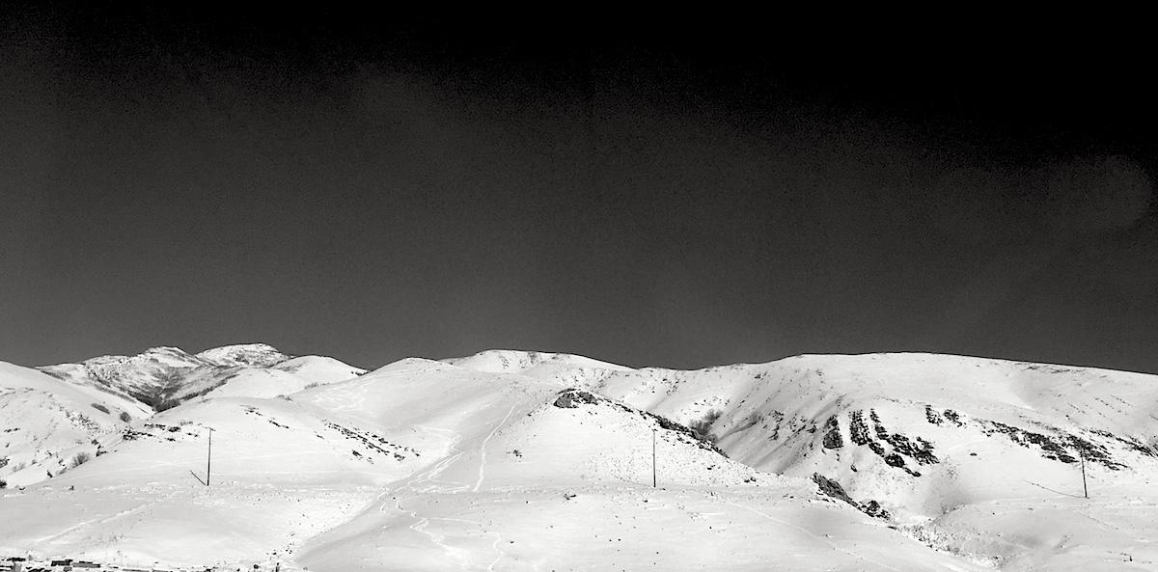
Using bedtools to perform genome arithmetic
Adapted from Aaron Quinlan’s
Applied Computational Genomics, Lecture 16 - 18
Jason Kunisaki
Quinlan Lab
University of Utah

Slide 2
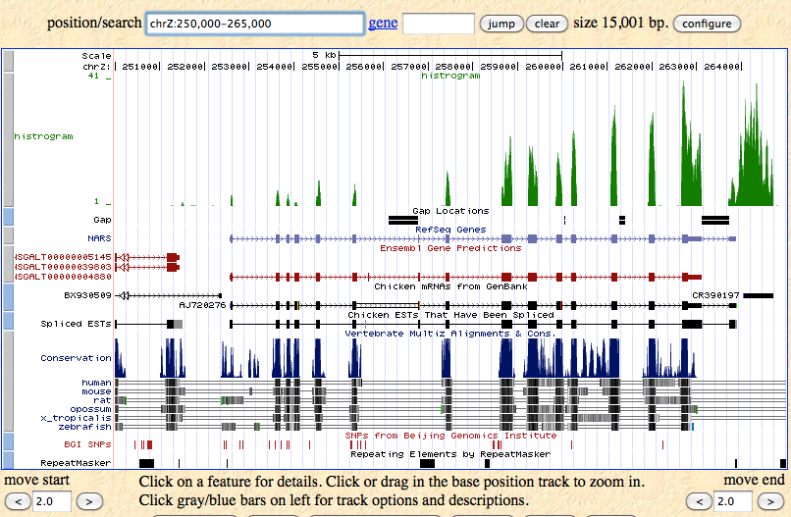
What is a genome interval?
Genes: exons, introns, UTRs, promoters (BED, GFF, GTF
Conservation (BEDGRAPH)
Genetic variation (VCF)
Sequence alignments (BAM)
Transcription factor binding sites (BED, BEDGRAPH)
CpG islands (BED)
Segmental duplications (BED)
Chromatin annotations (BED)
Gene expression data (WIG, BIGWIG, BEDGRAPH)
Your own observations: put them in context
Notes:
So the question is how to we gain biological insights from many genomic intervals, many of which have different encodings for genomic intervals.

Slide 3
At a high level, what are some analyses we could pursue with these intervals?
Exons
Genomic variants
Chip-seq Peaks
RNA seq coverage
Notes:
Intersection:
Merge intervals
Count overlapping intervals

Slide 4
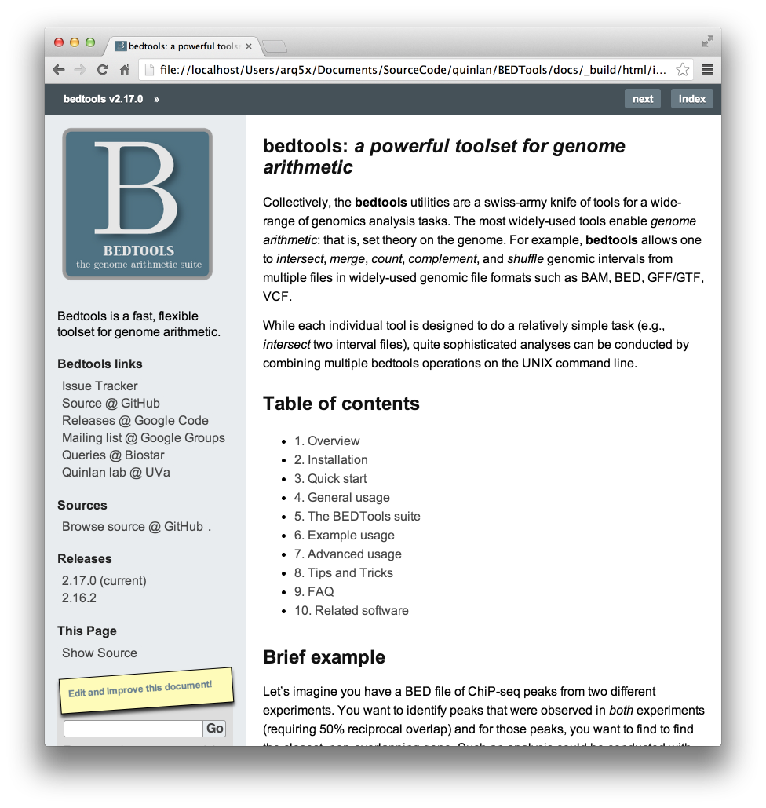
Bedtools: example analyses
Closest gene to a ChIP-seq peak.
How many genes does this mutation affect?
Where did I fail to collect sequence coverage?
Is my favorite feature significantly correlated with some other feature?
What is the density of variants in "windows" along the genome?
http://bedtools.readthedocs.io/en/latest/

Slide 5


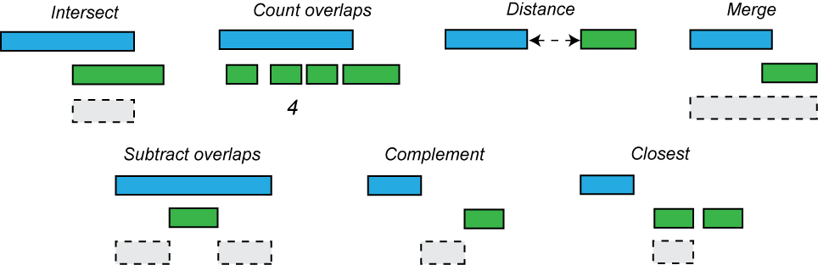
Supports most interval formats & handles diff. coordinate systems
BED
BAM
GFF
SAM
VCF
GTF
http://bedtools.readthedocs.io/en/latest/
Notes:
Can also take in interval files that use different coordinate systems to automatically account for those differences and handle it accordingly
Intersect bed file (0-based) with gff file (1-based)
It is essential that we sort files when comparing across intervals, especially with large files

Slide 6
Important recap
How do we sort a BED file by chromosome (column 1) and start position (column 2)?
sort -k 1,1 -k 2,2n my_file.bed
Treat chromosome values as text --> sort alphabetically
Treat start coordinate as numeric (hence “n”) --> sort numerically

Slide 7
Download the data
## Download files from slack to ~/Desktop + unzip
## Log into your instance
## cd into the folder with the pem file
scp -r -i cshl_2024_student.pem ~/Desktop/bedtools_tutorial ubuntu@[public-ip-address]:~/workspace/

Slide 8
Description of the files
cpg.bed --> Genome coordinates + annotations for CpG islands or genomic intervals enriched for C and G nucleotides
exons.bed --> genome coordinates + transcript + strand information for exons in the human
gwas.bed --> genome coordinates + ID for disease-associated single nucleotide polymorphisms
hesc.chromHmm.bed --> genome coordinates + function in the genome (e.g., promoter, enhancer, etc.)

Slide 9
Let’s work through the bedtools subcommands

Slide 10
bedtools intersect
## Run this command:
$ bedtools
## Run bedtools with a subcommand (e.g., intersect)
$ bedtools intersect
## Note what inputs are required (scroll to the top of the output)
Usage: bedtools intersect [OPTIONS] -a <bed/gff/vcf/bam> -b <bed/gff/vcf/bam>

Slide 11
bedtools intersect
$ cat intersect_A.bed
chr1 10 20
chr1 30 40
$ cat intersect_B.bed
chr1 15 20
A
B
Where is the intersection taking place?
$ bedtools intersect -a intersect_A.bed -b intersect_B.bed
Output

Slide 12
Stepping through bedtools intersect output
$ cat intersect_A.bed
chr1 10 20
chr1 30 40
$ cat intersect_B.bed
chr1 15 20
$ bedtools intersect -a intersect_A.bed -b intersect_B.bed
chr1 15 20
These are the portions of A intervals that overlap B intervals.
Note: These do not represent the original A intervals!!!
How can we report the original interval with bedtools?

Slide 13
bedtools intersect -wa (write A)
-wa option will return the original A interval(s) that are being overlapped
$ bedtools intersect -a intersect_A.bed -b intersect_B.bed -wa
chr1 10 20
chr1 15 20
From interval file A
From interval file B
Let’s add another column value to intersect_B.bed to convince ourselves

Slide 14
bedtools intersect -wb (write B)
-wb option will return the original B interval(s) that are being overlapped
$ bedtools intersect -a intersect_A.bed -b intersect_B.bed -wb
chr1 10 20
chr1 15 20
From interval file A
From interval file B
Let’s add another column value to intersect_B.bed to convince ourselves

Slide 15
Mini review
Exercise 1: Identify the overlapping coordinates between CpG Islands (cpg.bed) and exons (exons.bed)
Exercise 2: Report the original exon coordinates that have ≥1 gwas snp (gwas.bed). Use cut to get the exon columns.
Exercise 3: Using the same datasets for exercise 2, how can you report the original intervals from both A and B?
Notes:
Exercise 1:
bedtools intersect -a cpg.bed -b exons.bed
Exercise 2:
bedtools intersect -a exons.bed -b gwas.bed -wa | cut -f 1-3 | head
bedtools intersect -a gwas.bed -b exons.bed -wb | cut -f 5-7 | head
Exercise 3:
bedtools intersect -a gwas.bed -b exons.bed -wa -wb | head

Slide 16
What if an A interval has multiple overlapping B intervals?
$ cat intersect_A.bed
chr1 10 20
chr1 30 40
$ cat intersect_B.bed
chr1 15 20
chr1 17 23
Let’s add this file in to our intersect_B.bed file
Notes:
The chr1:10-20 interval overlaps with 2 intervals from B, so both overlapping intervals are outputted

Slide 17
What if an A interval has multiple overlapping B intervals?
$ cat intersect_A.bed
chr1 10 20
chr1 30 40
$ cat intersect_B.bed
chr1 15 20
chr1 17 23
$ bedtools intersect -a intersect_A.bed -b intersect_B.bed
chr1 15 20
chr1 17 20
Why are these two rows being outputted?
Did the original A interval overlap with any interval in B?
Notes:
The chr1:10-20 interval overlaps with 2 intervals from B, so both overlapping intervals are outputted
What if we don’t care if interval A has multiple overlaps, we just care that it overlaps with intervals in B?

Slide 18
bedtools intersect -u (uniq intervals)
$ cat intersect_A.bed
chr1 10 20
chr1 30 40
$ cat intersect_B.bed
chr1 15 20
chr1 17 23
$ bedtools intersect -a intersect_A.bed -b intersect_B.bed
chr1 15 20
chr1 17 20
$ bedtools intersect -a intersect_A.bed -b intersect_B.bed -u
chr1 10 20
Notice that -u returns the original intervals from the A.bed file!!
Notes:
The chr1:10-20 interval overlaps with 2 intervals from B, so both overlapping intervals are outputted

Slide 19
Quick review:
Exercise 4: Use bedtools to identify GWAS SNPs (gwas.bed) that are within exons (exons.bed)
Exercise 5: How many unique GWAS SNPs features overlap an exon?
Notes:
Exercise 4:
bedtools intersect -a gwas.bed -b exons.bed | head
Exercise 5:
bedtools intersect -a gwas.bed -b exons.bed -u | wc -l

Slide 20
Quick pop quiz!
What do each of the bedtools intersect options do?
Command | Purpose | Return original A interval? | Return original B interval?
bedtools intersect | Report overlapping regions of A and B intervals | No | No
bedtools intersect -wa | Identify A itnervals overlapping B | Yes | No
bedtools intersect -wb | Identify B intervals overlapping A | No | Yes
bedtools intersect -u | Unique A intervals overlapping ≥1 B interval | Yes | No (even with -wb)

Slide 21
bedtools intersect -c (count overlapping features)
B
A
Output
2
0
2
How many B intervals overlap with the original A intervals?
$ bedtools intersect -a intersect_A.bed -b intersect_B.bed -c

Slide 22
bedtools intersect -c (count overlapping features)
$ cat intersect_A.bed
chr1 10 20
chr1 30 40
$ cat intersect_B.bed
chr1 15 20
chr1 17 23
What is the expected output when running:
$ bedtools intersect -a intersect_A.bed -b intersect_B.bed -c
chr1 10 20 2
chr1 30 40 0
Number of overlapping intervals in -b bed file is reported as a new tab-separated column

Slide 23
bedtools intersect -c (count overlapping features)
$ cat intersect_A.bed
chr1 10 20
chr1 30 40
$ cat intersect_B.bed
chr1 15 20
chr1 17 23
What is the expected output when running:
$ bedtools intersect -a intersect_A.bed -b intersect_B.bed -c
chr1 10 20 2
chr1 30 40 0
$ bedtools intersect -a intersect_B.bed -b intersect_A.bed -c
chr1 15 20 1
chr1 17 23 1
Notice that -c returns the original intervals from the -a bed file!!

Slide 24
The directionality of the intersection is specified by the -a and -b files!
Everything is in reference to the -a file!

Slide 25
bedtools intersect -v (no overlap)
A
B
Output
Which intervals in A do not overlap any intervals in B?
$ bedtools intersect -a intersect_A.bed -b intersect_B.bed -v

Slide 26
bedtools intersect -v (no overlap)
$ cat intersect_A.bed
chr1 10 20
chr1 30 40
$ cat intersect_B.bed
chr1 15 20
chr1 17 23
What is the expected output when running:
$ bedtools intersect -a intersect_A.bed -b intersect_B.bed -v
$ bedtools intersect -a intersect_B.bed -b intersect_A.bed -v

Slide 27
bedtools intersect -v (no overlap)
$ cat intersect_A.bed
chr1 10 20
chr1 30 40
$ cat intersect_B.bed
chr1 15 20
chr1 17 23
What is the expected output when running:
$ bedtools intersect -a intersect_A.bed -b intersect_B.bed -v chr1 30 40
original intervals from the -a bed file!!

Slide 28
bedtools intersect -v (no overlap)
$ cat intersect_A.bed
chr1 10 20
chr1 30 40
$ cat intersect_B.bed
chr1 15 20
chr1 17 23
What is the expected output when running:
$ bedtools intersect -a intersect_A.bed -b intersect_B.bed -v chr1 30 40
$ bedtools intersect -a intersect_B.bed -b intersect_A.bed -v ...
original intervals from the -a bed file!!

Slide 29
One final bedtools intersect -f (fraction)
A
B
100% Overlap
50% Overlap
20% Overlap
-f requires ≥x% of interval A overlapped by interval B (0 < x ≤ 1)
$ bedtools intersect -a intersect_A.bed -b intersect_B.bed -f 0.50
Notes:
Output will vary depending on the -f value and optional flags used

Slide 30
bedtools intersect -f (fraction)
$ cat intersect_A.bed
chr1 10 20
chr1 30 40
$ cat intersect_B.bed
chr1 15 20
chr1 17 23
$ bedtools intersect -a intersect_A.bed -b intersect_B.bed -f 0.50
chr1 15 20
$ bedtools intersect -a intersect_A.bed -b intersect_B.bed -f 0.50 -wa -wb
chr1 10 20 chr1 15 20
Notes:
Previously, the first command outputted two rows, corresponding to intersections with both the B intervals...
The intervals reported when using -f depend on if -wa, -wb, or other flags are provided.

Slide 31
Quick pop quiz!
What do each of the bedtools intersect options do?
Command | Purpose | Return original A interval? | Return original B interval?
bedtools intersect | Report overlapping regions of A and B intervals | No | No
bedtools intersect -wa | Identify A itnervals overlapping B | Yes | No
bedtools intersect -wb | Identify B intervals overlapping A | No | Yes
bedtools intersect -u | Unique A intervals overlapping ≥1 B interval | Yes | No
bedtools intersect -c | Counts overlapping intervals from B with A | Yes | No
bedtools intersect -v | A intervals without B overlap | Yes | No
Bedtools intersect -f | Filters intervals to overlap ≥ -f value | No (without -wa) | No (without -wb)

Slide 32
bedtools intersect exercises
Identify overlapping intervals between the exons and CpG islands
Report the original exon interval that overlaps the most CpG islands (Hint: look up sort -nr)
Identify the original cpg island that overlaps the most exons, requiring that ≥10% of the CpG island is overlapped by an exon (Hint: look up sort -nr)
What fraction of the GWAS SNPs are exonic? (Hint: what should be the denominator for calculating this fraction)
What fraction of GWAS SNPs are non-exonic? (use bedtools, not answer to Q3)
What fraction of GWAS SNPs are either in enhancers/promoters from the hESC data? (any row with “Promoter” or “Enhancer”)?
Rank in descending order original exon intervals with the most GWAS SNPs (Hint: cut may help you identify columns of interest)
Notes:
Question 1:
bedtools intersect -a exons.bed -b cpg.bed | head
Question 2:
bedtools intersect -a exons.bed -b cpg.bed -c -wa | sort -k7,7nr | head
Question 3:
bedtools intersect -a cpg.bed -b exons.bed -c -f 0.10 -wa | sort -k5,5nr | head
Question 4:
bedtools intersect -a gwas.bed -b exons.bed -u - wa | wc -l
Check and verify: bedtools intersect -a gwas.bed -b exons.bed -c | grep -v -w "0" | wc -l
1013
wc -l gwas.bed
13702
1013 / 13702
Question 5:
bedtools intersect -a gwas.bed -b exons.bed -v -wa | wc -l
16055
16055 / 17680
Question 6:
cat hesc.chromHmm.bed | grep -i "promoter\|enhancer" | cut -f 4 | sort | uniq
bedtools intersect -a gwas.bed -b <(cat hesc.chromHmm.bed | grep -i "promoter\|enhancer") -wa | wc -l
1014
What would happen if you bracket “[promoter\|enhancer]”
Question 7:
bedtools intersect -a exons.bed -b gwas.bed -c -wa | cut -f 1-3,7 | sort -k4,4nr | head

Slide 33
intersect is the workhorse of the bedtools suite of tools...
What about other useful subcommands?

Slide 34
bedtools merge
Input (I)
Merge I
Why didn’t the below command work?
$ bedtools merge merge_file.bed
Notes:
The merge subcommand requires the -i (input file) argument be specified, it does not take a file as a positional argument

Slide 35
bedtools merge
Input (I)
Merge I
All fixed!
$ bedtools merge -i exons.bed
Notes:
The merge subcommand requires the -i (input file) argument be specified, it does not take a file as a positional argument

Slide 36
bedtools merge
$ cat merge_file.bed
chr1 100 200
chr1 180 250
chr1 250 500
chr1 501 1000
Why was the 3rd row merged?
0-based coordinates!
But not 4th row?
$ bedtools merge -i merge_file.bed
chr1 100 500
chr1 501 1000

Slide 37
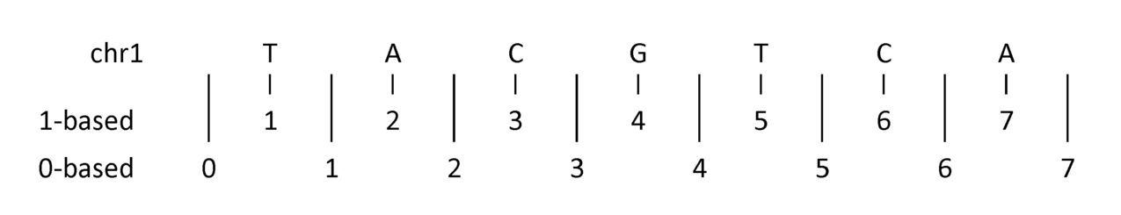
bedtools merge
$ cat merge_file.bed
chr1 100 200
chr1 180 250
chr1 250 500
chr1 501 1000
Why was the 3rd row merged?
0-based coordinates!
But not 4th row?
Notes:
Say we look at ACG (chr1:1-4 in 0-base). The T (chr1:4-5 in 0-base) is immediately adjacent, and gets merged into the larger merged interval.
However, the CA (chr1:5-7 in 0-base) is one nucleotide away from the ACG so it won’t get merged.

Slide 38
bedtools merge -c (column) and -o (operation)
Input (I)
Merge I
3
1
1
1
Can also record information about merged intervals:
Names (e.g., exon IDs or gene name)
Peak means for ChIP seq
etc...
Notes:
The merge subcommand requires the -i (input file) argument be specified, it does not take a file as a positional argument

Slide 39
bedtools merge -c (column) and -o (operation)
$ cat exons.bed | head -n 4
chr1 11873 12227 NR_046018_exon_0_0_chr1_11874_f 0 +
chr1 12612 12721 NR_046018_exon_1_0_chr1_12613_f 0 +
chr1 13220 14409 NR_046018_exon_2_0_chr1_13221_f 0 +
chr1 14361 14829 NR_024540_exon_0_0_chr1_14362_r 0 -
## Count number of intervals included in each merge
$ bedtools merge -i exons.bed -c 1 -o count | head -n 3
chr1 11873 12227 1
chr1 12612 12721 1
chr1 13220 14829 2

Slide 40
bedtools merge -c (column) and -o (operation)
$ cat exons.bed | head -n 4
chr1 11873 12227 NR_046018_exon_0_0_chr1_11874_f 0 +
chr1 12612 12721 NR_046018_exon_1_0_chr1_12613_f 0 +
chr1 13220 14409 NR_046018_exon_2_0_chr1_13221_f 0 +
chr1 14361 14829 NR_024540_exon_0_0_chr1_14362_r 0 -
## Count number of intervals and exon ids used for each merge
$ bedtools merge -i exons.bed -c 1,4 -o count,collapse | head -n 3
chr1 11873 12227 1 NR_046018_exon_0_0_chr1_11874_f
chr1 12612 12721 1 NR_046018_exon_1_0_chr1_12613_f
chr1 13220 14829 2 NR_046018_exon_2_0_chr1_13221_f,NR_024540_exon_0_0_chr1_14362_r

Slide 41
bedtools merge questions
Question 1: Merge the intervals from the exons.bed file
Question 2: Merge exon intervals and record the following:
The number of intervals included in each merge
The average start position for each exon that was included in a merge (hint: look at the other -o options)
Notes:
Question 1:
bedtools merge -i exons.bed | head
Question 2:
bedtools merge -i exons.bed -c 1,2,2 -o count,mean,collapse | head

Slide 42
And finally... bedtools closest
A
B
$ bedtools closest -a gwas.bed -b exons.bed | head -n 5
chr1 1005805 1005806 rs3934834 chr1 1007125 1007955 NM_001205252_exon_0_0_chr1_1007126_r 0 -
chr1 1079197 1079198 rs11260603 chr1 1078118 1079434 NR_038869_exon_2_0_chr1_1078119_f 0 +
chr1 1247493 1247494 rs12103 chr1 1247397 1247527 NM_001256456_exon_1_0_chr1_1247398_r 0 -
chr1 1247493 1247494 rs12103 chr1 1247397 1247527 NM_001256460_exon_1_0_chr1_1247398_r 0 -
chr1 1247493 1247494 rs12103 chr1 1247397 1247527 NM_001256462_exon_1_0_chr1_1247398_r 0 -
GWAS SNPs
Closest exon(s)
Notes:
By default, all ties are reported.

Slide 43
bedtools closest -D ref
10bp
10bp
3bp
0bp
A
B
$ bedtools closest -a gwas.bed -b exons.bed -D ref | head -n 5
chr1 1005805 1005806 rs3934834 chr1 1007125 1007955 NM_001205252_exon_0_0_chr1_1007126_r 0 - 1320
chr1 1079197 1079198 rs11260603 chr1 1078118 1079434 NR_038869_exon_2_0_chr1_1078119_f 0 + 0
chr1 1247493 1247494 rs12103 chr1 1247397 1247527 NM_001256456_exon_1_0_chr1_1247398_r 0 - 0
chr1 1247493 1247494 rs12103 chr1 1247397 1247527 NM_001256460_exon_1_0_chr1_1247398_r 0 - 0
chr1 1247493 1247494 rs12103 chr1 1247397 1247527 NM_001256462_exon_1_0_chr1_1247398_r 0 - 0
GWAS SNPs
Closest exon(s)

Slide 44
bedtools closest -D ref -t first
10bp
10bp
3bp
0bp
A
B
$ bedtools closest -a gwas.bed -b exons.bed -D ref -t first | head -n 3
chr1 1005805 1005806 rs3934834 chr1 1007125 1007955 NM_001205252_exon_0_0_chr1_1007126_r 0 - 1320
chr1 1079197 1079198 rs11260603 chr1 1078118 1079434 NR_038869_exon_2_0_chr1_1078119_f 0 + 0
chr1 1247493 1247494 rs12103 chr1 1247397 1247527 NM_001256456_exon_1_0_chr1_1247398_r 0 - 0
GWAS SNPs
Closest exon(s)
Notes:
Setting the -t argument to first will report the first tie that occured in the B file

Slide 45
bedtools merge/closest questions
Merge the intervals from the exons.bed file
Record the closest exon for each GWAS SNP (exclude ties)
Based on the above bedtools closest output, how many SNPs entries the gwas.bed file are within an exon?
What is a bedtools intersect command that can verify the value from question 2?
Notes:
Question 1:
Bedtools merge -i exons.bed
Question 2:
bedtools closest -a gwas.bed -b exons.bed -t first | head
Question 3:
bedtools closest -a gwas.bed -b exons.bed -D ref -t first | cut -f 1-3,11 | grep -w “0” | wc -l
Question 4:
bedtools intersect -a gwas.bed -b exons.bed -wa -u | wc -l

Slide 46
BED
BAM
GFF
SAM
VCF
GTF
http://bedtools.readthedocs.io/en/latest/
Notes:
Can also take in interval files that use different coordinate systems to automatically account for those differences and handle it accordingly
Intersect bed file (0-based) with gff file (1-based)
It is essential that we sort files when comparing across intervals, especially with large files

Slide 47
Visualize your bedtools output
$ bedtools intersect -a cpg.bed -b exons.bed -v > nonexons_cpgs.txt
$ cat nonexons_cpgs.txt | head -n 5
chr1 437151 438164 CpG:_84
chr1 449273 450544 CpG:_99
chr1 533219 534114 CpG:_94
chr1 544738 546649 CpG:_171
chr1 801975 802338 CpG:_24
Conceptually, how could we verify that these CpG islands do not overlap any exon?

Slide 48
Using “basic” awk to process intervals from the command line

Slide 49
Questions we can ask with awk
Questions we can ask:
How many nucleotides are in this interval?
What is the sum of all intervals on chromosome 1?
https://www.biostars.org/p/84686/
Notes:
Go over reason for the use of 0-based: look at length of an interval of interest easily (end - start)

Slide 50

Now to learn some more UNIX. awk is your dear friend.

Slide 51
Now to learn some more UNIX. awk is your dear friend.
Awk is a programming language that is specifically designed for quickly manipulating space delimited data.
-Heng Li (http://lh3lh3.users.sourceforge.net/biounix.shtml)
Only report annotations in cpg.bed that are for chr1
Each column is referred to by number.
awk '$1 == "chr1"' cpg.bed
Every awk program begins and ends with single quotes.

Slide 52
Now to learn some more UNIX. awk is your dear friend.
awk '$1 == "chr1"' cpg.bed
$0 refers to the entire input line
awk '{ if ($1 == "chr1") print $0 }' cpg.bed
If using a print statement, you must add curly brackets between the single quotes describing the program.

Slide 53
Now to learn some more UNIX. awk is your dear friend.
awk '$1 == "chr1"' cpg.bed
awk '{ if ($1 == "chr1") print $0 }' cpg.bed
awk '{ if ($1 == "chr1" || $1 == “chr22”) print $0 }' cpg.bed
What happens if you replace || with &&?

Slide 54
We can also compare values across columns using some critera
Only report annotations in cpg.bed where the end coordinate is less than or equal to the start coordinate. How many such records do we expect?
Sanity check your bed file.
What’s another way to do this?
awk '$3 <= $2' cpg.bed
## 0-based BED file
chr1 2 3 C
chr1 4 7 TCA
What would these coordinates indicate in 1-base?
chr1 2 3
chr1 4 7

Slide 55
Do some computation and report the results
chr1 2 3 C
chr1 4 7 TCA
Print the BED record followed by the length (end - start) of the record
$0 refers to the entire input line
awk '{print $0, $3-$2}' cpg.bed
If using a print statement, you must add curly brackets between the single quotes describing the program.

Slide 56
However, there is something wrong with this file...
## Store stdout in a file
awk '{print $0, $3-$2}' cpg.bed > cpg_length.bed
## Look at hidden characters
cat -t -e cpg_length.bed
What do you see?

Slide 57
How to resolve the lack of a tab-delimited file
There are many approaches to resolve this issue, but this is probably the most intuitive one:
awk -v OFS="\t" '{print $0, $3-$2}' cpg.bed
OFS stands for output field separator
Default behavior is to use a space
We can specify how our output should be separated
How to use these values to quantify the total length of all intervals

Slide 58
By default, output is separated by a space. Prefer tabs
BEGIN: before anything else happens, execute what is in the BEGIN statement. Then start processing the input.
Print the BED record followed by the length (end - start) of the record. Separated by a TAB, the OFS (output field separator)
awk 'BEGIN{OFS="\t"}{print $0, $3-$2}' cpg.bed
or
awk -v OFS="\t" '{print $0, $3-$2}' cpg.bed
or
awk '{len=($3-$2); print $0"\t"len}' cpg.bed
or
awk -v OFS="\t" '{len=($3-$2); print $0, len}' cpg.bed

Slide 59
Compute the total number of base pairs represented by CpG islands
Create a variable named "sum" whose value starts at 0, but is increased by the length ($3-$2)
of each CpG island.
END: after all the processing of each line in the file occurs, print the final value of sum.
awk '{sum += $3-$2} END{print sum}' cpg.bed
However, this is “lazy”
We are not initializing the variable sum

Slide 60
Or more formally...
awk 'BEGIN {sum=0} {sum += $3-$2} END {print sum}' cpg.bed
## Combining above with an if statement
awk 'BEGIN {sum=0} { if ($1 == "chr1") sum += $3-$2} END {print sum}' cpg.bed

Slide 61
How many (whitespace-separated) columns are on each line?
NF: The number of "fields" (that is, the number of whitespace-separated values) detected for the line
awk '{print NF}' cpg.bed

Slide 62
Using awk to perform genome arithmetic could get complicated
0
5
10
15
20
25
Notes:
Blue = intervals for introns
Green = enhancers
Intersect = subinterval shared between the two
Reminder: this calculation is performed only using the coordinates, we don’t care about the underlying nucleotide sequence of these features when performing this intersection. If we did care about the nucleotide sequence, we could use the intersecting interval to find the exact sequence.
Count: count number of green intervals that overlap a blue interval
Discuss directionality of this calculation
Merge: combine intervals into a larger one
Subtract: identify intervals not covered by another interval
Complement: portions of the genome not covered by any intervals

Slide 63
Bedtools exercises
Create a BED file representing all of the intervals in the genome that are NOT exonic and are not Promoters (based on the promoters in the hESC file).
What is the average distance from GWAS SNPs to the closest exon? (Hint - have a look at the closest tool.)
Count how many exons occur in each 500kb interval (“window”) in the human genome. (Hint - have a look at the makewindows tool.)
Are there any exons that are completely overlapped by an enhancer? If so, how many?
What fraction of the GWAS SNPs are exonic? Hint: should you worry about double counting?

Slide 64
Let’s revisit the bedtools intersect output...
bedtools intersect -a cpg.bed -b exons.bed | head -5
chr1 29320 29370 CpG:_116
chr1 135124 135563 CpG:_30
chr1 327790 328229 CpG:_29
chr1 327790 328229 CpG:_29
chr1 327790 328229 CpG:_29
What’s up with this?
This entry only occurs once in the cpg.bed file...
Any ideas?

Slide 65
The same CpG island overlaps with multiple exons
CpG Interval
CpG island interval (A file)
chr1 327790 328229 CpG:_29
Exon intervals
Exon intervals (B file)
chr1 324438 328581 NR_028322_exon_2_0_chr1_324439_f 0 +
chr1 324438 328581 NR_028325_exon_2_0_chr1_324439_f 0 +
chr1 327035 328581 NR_028327_exon_3_0_chr1_327036_f 0 +
How do we get the unique CpG intervals without duplicates?

Slide 66
bedtools intersect -u (unique intervals)
See what -u refers to in the bedtools intersect information
bedtools intersect -a cpg.bed -b exons.bed -u | head -5
chr1 28735 29810 CpG:_116
chr1 135124 135563 CpG:_30
chr1 327790 328229 CpG:_29
chr1 713984 714547 CpG:_60
chr1 762416 763445 CpG:_115
Now there is only one entry for this CpG island. Nice!
-u option: Reports unique intervals in A that have any overlap with an interval in B.
Notes:
Write original A entry once if any overlaps found in B. In other words, just report the fact at least one overlap was found in B.
Identifies unique intervals in A that have any overlap with an interval in B.

Slide 67
bedtools intersect -wb (write B)
What are the intervals in B that are being overlapped???
bedtools intersect -a cpg.bed -b exons.bed -wb | head -5
chr1 29320 29370 CpG:_116
chr1 135124 135563 CpG:_30
chr1 327790 328229 CpG:_29
chr1 327790 328229 CpG:_29
chr1 327790 328229 CpG:_29

Slide 68
bedtools intersect -wb (write B)
What are the original intervals in B that are being overlapped???
bedtools intersect -a cpg.bed -b exons.bed -wb | head -5
Ah ha! This exon is encompassed entirely by the CpG island!
chr1 29320 29370 CpG:_116 chr1 29320 29370 NR_024540_exon_10_0_chr1_29321_r 0 -
chr1 135124 135563 CpG:_30 chr1 134772 139696 NR_039983_exon_0_0_chr1_134773_r 0 -
chr1 327790 328229 CpG:_29 chr1 324438 328581 NR_028322_exon_2_0_chr1_324439_f 0 +
chr1 327790 328229 CpG:_29 chr1 324438 328581 NR_028325_exon_2_0_chr1_324439_f 0 +
chr1 327790 328229 CpG:_29 chr1 327035 328581 NR_028327_exon_3_0_chr1_327036_f 0 +
Remember: these do not represent the original A intervals!!!

Slide 69
bedtools intersect -wa (write A)
Use -wa to return the original intervals from A that overlap with B
bedtools intersect -a cpg.bed -b exons.bed -wa | head -5
chr1 28735 29810 CpG:_116
chr1 135124 135563 CpG:_30
chr1 327790 328229 CpG:_29
chr1 327790 328229 CpG:_29
chr1 327790 328229 CpG:_29
These are the original CpG island intervals from file A

Slide 70
bedtools intersect -c (count)
bedtools intersect -a cpg.bed -b exons.bed -c | head -5
chr1 28735 29810 CpG:_116 1
chr1 135124 135563 CpG:_30 1
chr1 327790 328229 CpG:_29 3
chr1 437151 438164 CpG:_84 0
chr1 449273 450544 CpG:_99 0
This is the CpG island from before that was encompassed by 3 unique exon interval entries!
These are the original A intervals!!!

Slide 71
bedtools intersect -v (no overlap)
bedtools intersect -a cpg.bed -b exons.bed -v | head -5
chr1 437151 438164 CpG:_84
chr1 449273 450544 CpG:_99
chr1 533219 534114 CpG:_94
chr1 544738 546649 CpG:_171
chr1 801975 802338 CpG:_24
Conceptually, how could we verify that these CpG islands do not overlap any exon?

