Slide 1
Canadian Bioinformatics Workshops
www.bioinformatics.ca
bioinformaticsdotca.github.io

Slide 2
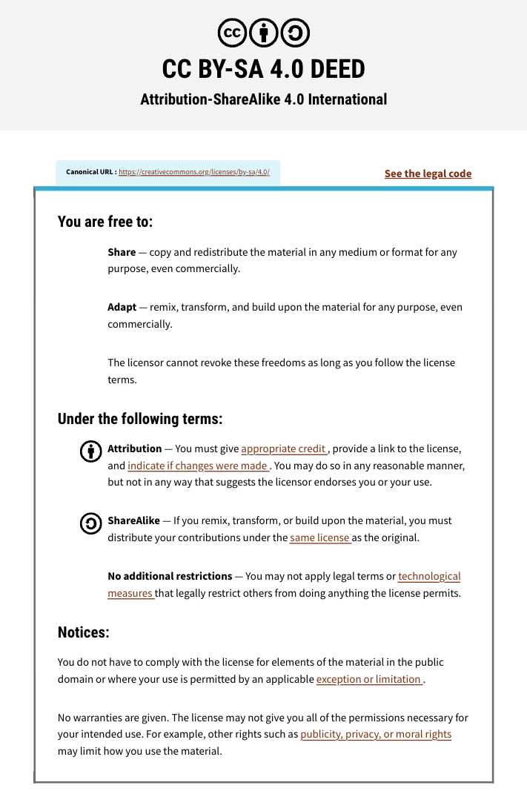

Slide 3
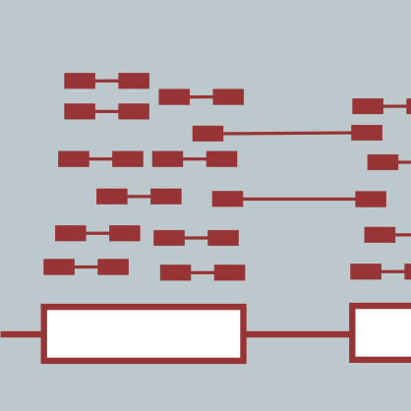
Module #X: Title
<INSTRUCTOR NAME>
RNA-seq Analysis
<WORKSHOP DATES>
Instructor affiliation logos

Slide 4
Learning Objectives
By the end of this lecture, you will:
Understand…
Be able to define…
Know…

Slide 6





We are on a Coffee Break & Networking Session
Workshop Sponsors:

