Slide 1



RNA-Seq Module 3
Abundance Estimation and Differential Expression
Felicia Gomez, Charlz Jerold, Obi Griffith, Malachi Griffith,
My Hoang, Mariam Khanfar, Chris Miller, Kartik Singhal, Jennie Yao
Advanced Sequencing Technologies & Bioinformatics Analysis November 10-21, 2025

Slide 2
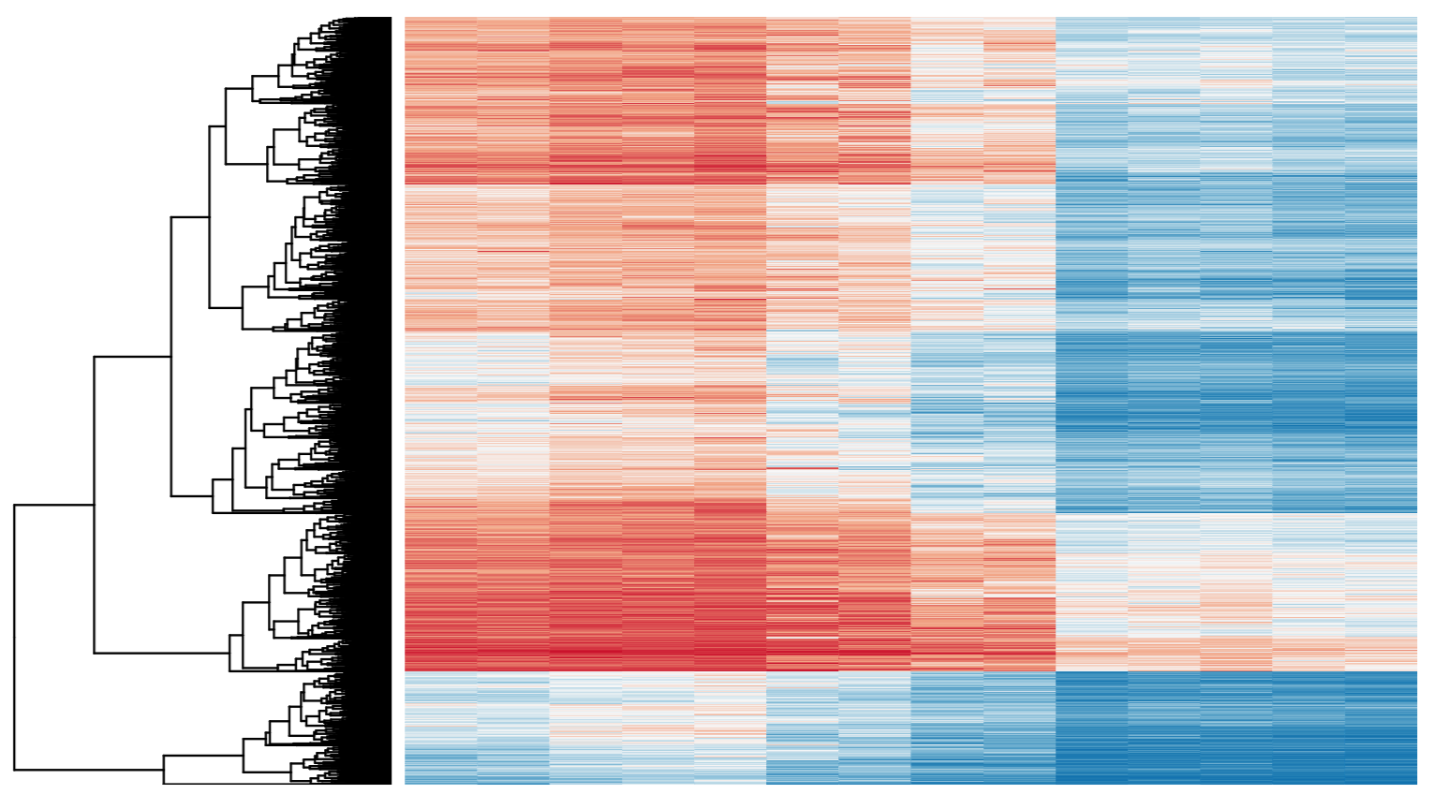
Differential Expression
Tying gene expression back to genotype/phenotype
What genes/transcripts are being expressed at higher/lower levels in different groups of samples?
  Are these differences ‘significant’, accounting for variance/noise?
Examples (used in course):
  UHR cells vs HBR brain
  Tumor vs Normal tissue
  Wild-type vs gene KO cells

Slide 3
Differential Expression with Ballgown
Parametric F-test comparing nested linear models
Two models are fit to each feature, using expression as the outcome
  one including the covariate of interest (e.g., case/control status or time) and one not including that covariate.
An F statistic and p-value are calculated using the fits of the two models.
  A significant p-value means the model including the covariate of interest fits significantly better than the model without that covariate, indicating differential expression.
Adjust for multiple testing by reporting q-values:
  q < 0.05 the false discovery rate should be controlled at ~5%.
Frazee et al. (2014)

Slide 4
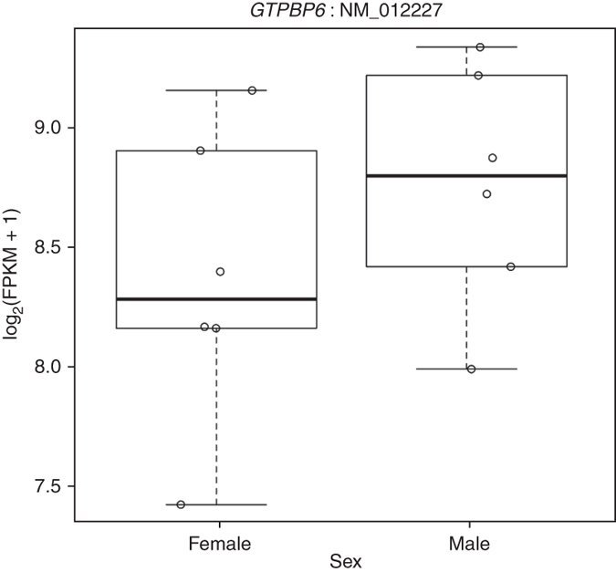
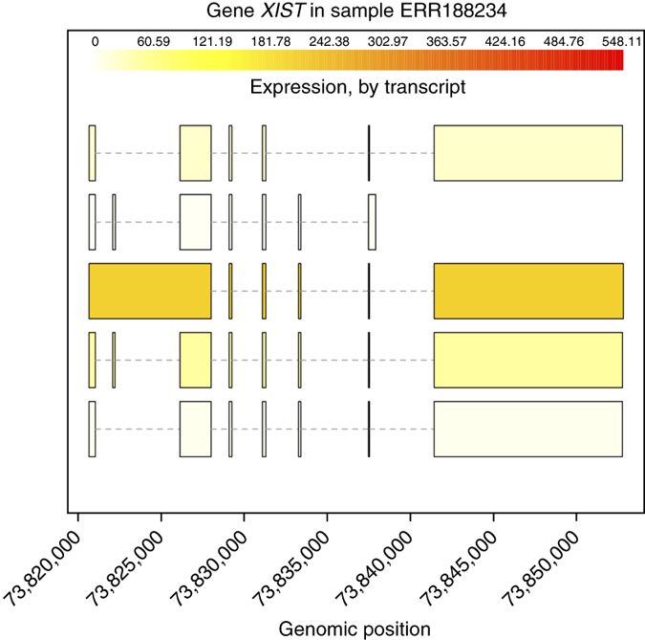
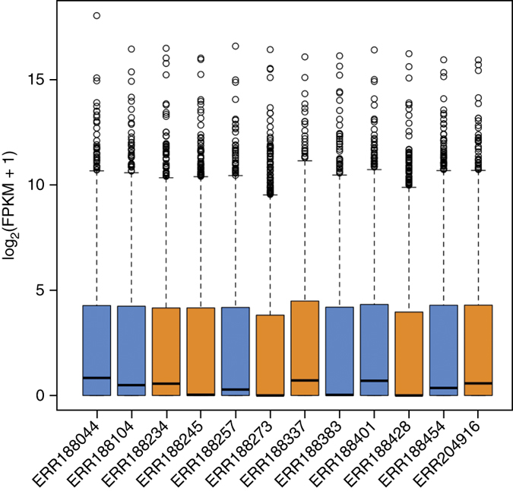
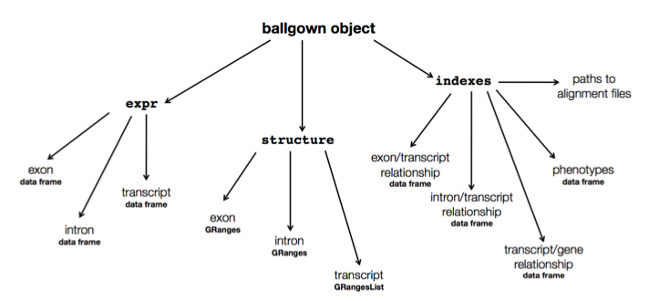
Ballgown for Visualization with R

Slide 5
Alternative differential expression methods
Raw count approaches
  DESeq2 - http://www-huber.embl.de/users/anders/DESeq/
  edgeR - http://www.bioconductor.org/packages/release/bioc/html/edgeR.html
  Others…

Slide 6
‘FPKM/TPM’ expression estimates vs. ‘raw’ counts
Which should I use?
  Long running debate, but the general consensus:
FPKM/TPM
  When you want to leverage benefits of tuxedo suite
    Isoform deconvolution
  Good for visualization (e.g., heatmaps)
  Calculating fold changes, etc.
Counts
  “More robust" statistical methods for differential expression
    Stringtie/Ballgown approach is also robust
  Accommodates more sophisticated experimental designs with appropriate statistical tests

Slide 7
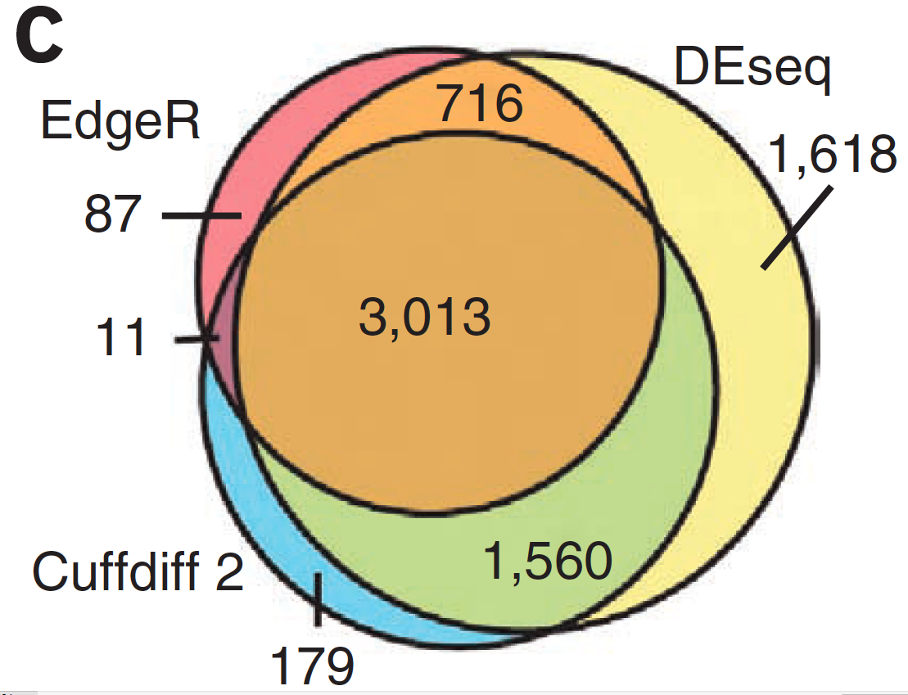
Multiple approaches advisable

Slide 8
Lessons learned from microarray days
Hansen et al. “Sequencing Technology Does Not Eliminate Biological Variability.” Nature Biotechnology 29, no. 7 (2011): 572–573.
Power analysis for RNA-seq experiments
  http://scotty.genetics.utah.edu/
RNA-seq need for biological replicates
  http://www.biostars.org/p/1161/
RNA-seq study design
  http://www.biostars.org/p/68885/

Slide 9
Multiple testing correction
As more attributes are compared, differences due solely to chance become more likely!
Well known from array studies
  10,000s genes/transcripts
  100,000s exons
  With RNA-seq, more of a problem than ever
  All the complexity of the transcriptome gives huge numbers of potential features
    Genes, transcripts, exons, junctions, retained introns, microRNAs, lncRNAs, etc
Bioconductor multtest
  http://www.bioconductor.org/packages/release/bioc/html/multtest.html

Slide 10
Downstream interpretation of expression analysis
Topic for an entire course
Expression estimates and differential expression lists from StringTie, Ballgown or other alternatives can be fed into many analysis pipelines
See supplemental R tutorial for how to format expression data and start manipulating in R
Clustering/Heatmaps
  Provided by Ballgown
  For more customized analysis various R packages exist:
    hclust, heatmap.2, plotrix, ggplot2, etc.
Classification
  For RNA-seq data we still rarely have sufficient sample size and clinical details but this is changing
    Weka is a good learning tool
    RandomForests R package (biostar tutorial being developed)
Pathway analysis
  GSEA, IPA, Cytoscape, many R/BioConductor packages:
  http://www.bioconductor.org/help/search/index.html?q=pathway
https://genviz.org/module-04-expression/0004/01/01/Expression_Profiling_and_Visualization/

Slide 11
HISAT2/StringTie/Ballgown
RNA-seq Pipeline
Sequencing
Read alignment
Transcript compilation
Expression estimation
Differential expression
RNA-seq reads (2 x 100 bp)
HISAT2
StringTie
StringTie
Ballgown
Raw sequence data
(.fastq files)
Reference genome
(.fa file)
Gene annotation
(.gtf file)
Ballgown & R
Inputs
Visualization
Module 3

Slide 12
We are on a Coffee Break & Networking Session

