Slide 1



RNA-Seq Module 4
Alignment Free Expression Estimation (Kallisto)
Felicia Gomez, Charlz Jerold, Obi Griffith, Malachi Griffith,
My Hoang, Mariam Khanfar, Chris Miller, Kartik Singhal, Jennie Yao
Advanced Sequencing Technologies & Bioinformatics Analysis November 10-21, 2025

Slide 2
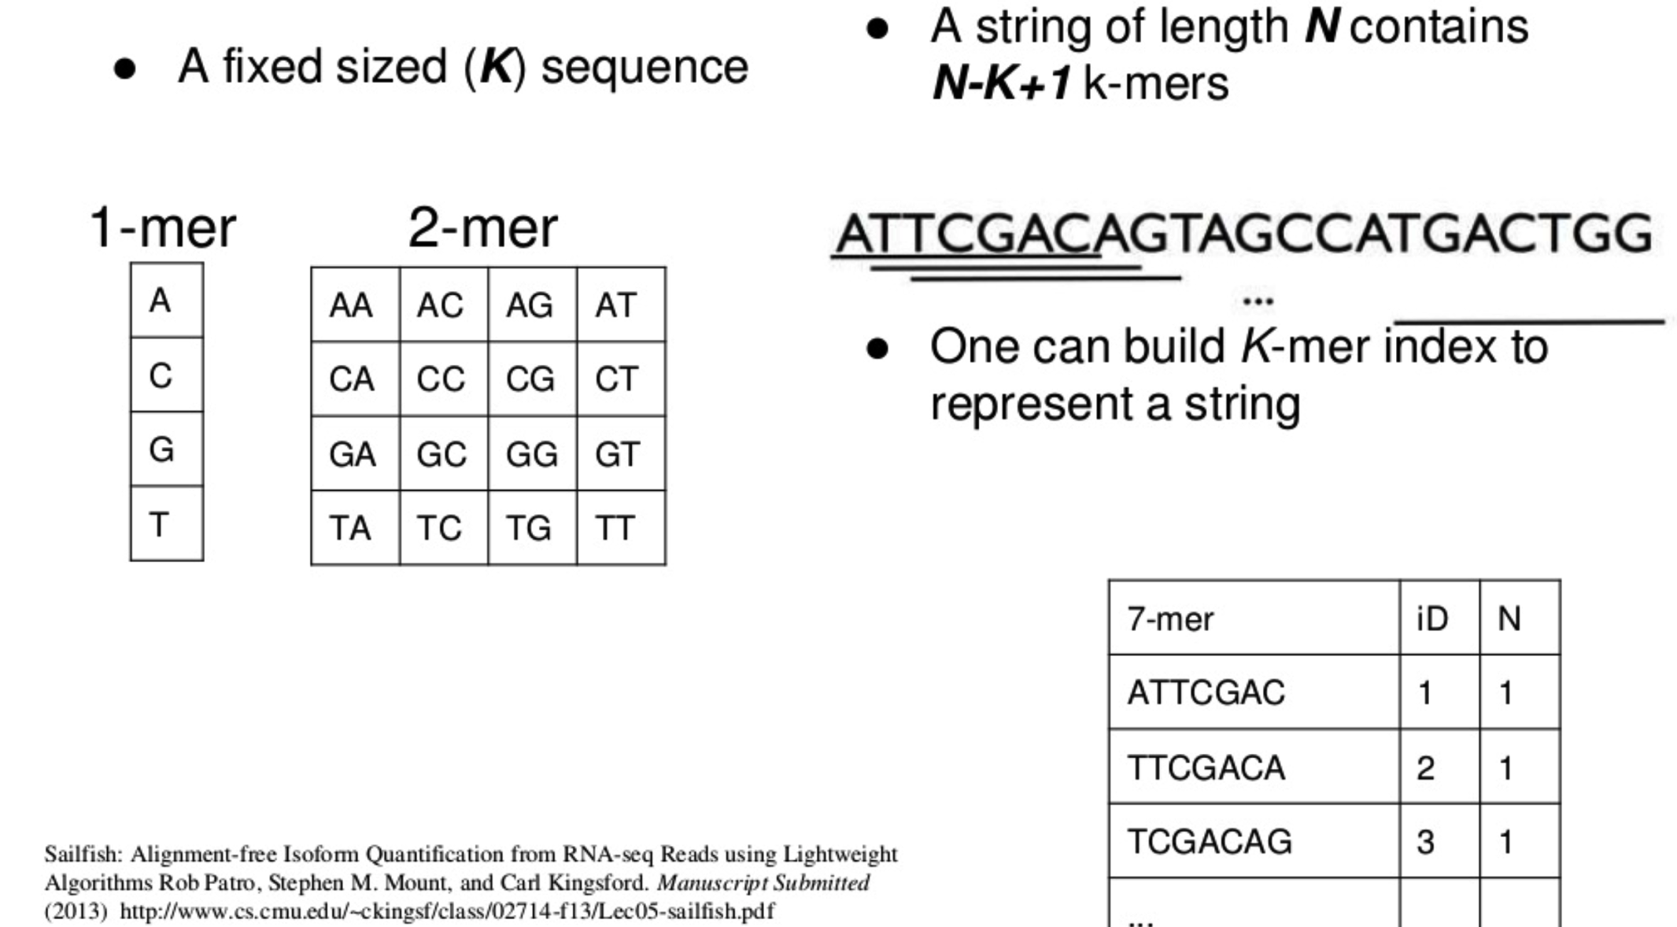
What is a k-mer?
https://www.slideshare.net/duruofei/cmsc702-project-final-presentation
Notes:
As k-mers get longer, there are more possible unique combinations. For k-mers representing strings of DNA sequence there are 4^k possible unique k-mers where k is the length of the k-mer.
Alignment free transcript abundance estimation methods obtain fast performance in part by keeping an index of k-mers in memory. Longer k-mers require more memory.
K-mer length must be shorter than read and transcript lengths to be useful
Default k-mer length for Kallisto is 31

Slide 3
Alignment free approaches for transcript abundance
Obtain reference transcript sequences
  - e.g. Ensembl, Refseq, or GENCODE
Build a k-mer index of all of the k-mers in each transcript sequence
  - Store each k-mer and its position within the transcript. “hashing”

Slide 4
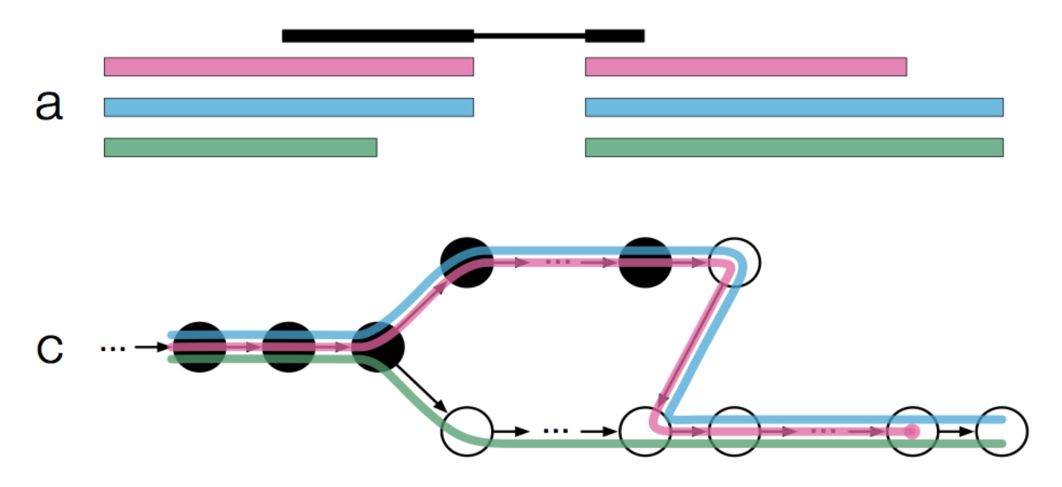
Alignment free approaches for transcript abundance
3. Count number of times each k-mer occurs within each RNAseq read
  Model relationship between RNA-seq read k-mers and the transcript k-mer index.
  What transcript is the most likely source for each read?
  Called “pseudoalignment” , “quasi-mapping”, etc.
4. Handle sequencing errors, isoforms, ambiguity, and determine abundance estimates
  Transcriptome de Bruijn graphs, likelihood function, expectation maximization, etc.
Bray, 2016 doi:10.1038/nbt.3519
https://tinyheero.github.io/2015/09/02/pseudoalignments-kallisto.html

Slide 5
Advantages/disadvantages of alignment free approaches
Advantages
  Very fast and efficient
    Similar accuracy to alignment based approach but with much, much shorter run time.
  Do not need a reference genome, only a reference transcriptome
Disadvantages
  You don’t get a proper BAM file (though a pseudo-bam can be created)
  Information in reads with sequence errors may be ignored
  Limited potential for transcript discovery, variant calling, fusion detection, etc.

Slide 6
Common alignment free tools
Sailfish
  “Sailfish enables alignment-free isoform quantification from RNA-seq reads using lightweight algorithms.” 2014
  https://www.ncbi.nlm.nih.gov/pubmed/24752080
RNA-Skim
  “RNA-Skim: a rapid method for RNA-Seq quantification at transcript level.” 2014
  https://www.ncbi.nlm.nih.gov/pubmed/24931995
Kallisto
  “Near-optimal probabilistic RNA-seq quantification.” 2016
  https://www.ncbi.nlm.nih.gov/pubmed/27043002
Salmon
  “Salmon provides fast and bias-aware quantification of transcript expression.” 2017
  https://www.ncbi.nlm.nih.gov/pubmed/28263959

Slide 7
Which is best?
Somewhat controversial …
https://liorpachter.wordpress.com/2017/08/02/how-not-to-perform-a-differential-expression-analysis-or-science/
Various sources suggest that Salmon, Kallisto, and Sailfish results are quite comparable
Usability, documentation, and supporting downstream tools could be used to decide

Slide 8
We are on a Coffee Break & Networking Session

