Slide 1



RNA-Seq Module 5:
Alternative Splicing Analysis
Felicia Gomez, Charlz Jerold, Obi Griffith, Malachi Griffith,
My Hoang, Mariam Khanfar, Chris Miller, Kartik Singhal, Jennie Yao
Advanced Sequencing Technologies & Bioinformatics Analysis November 10-21, 2025

Slide 2
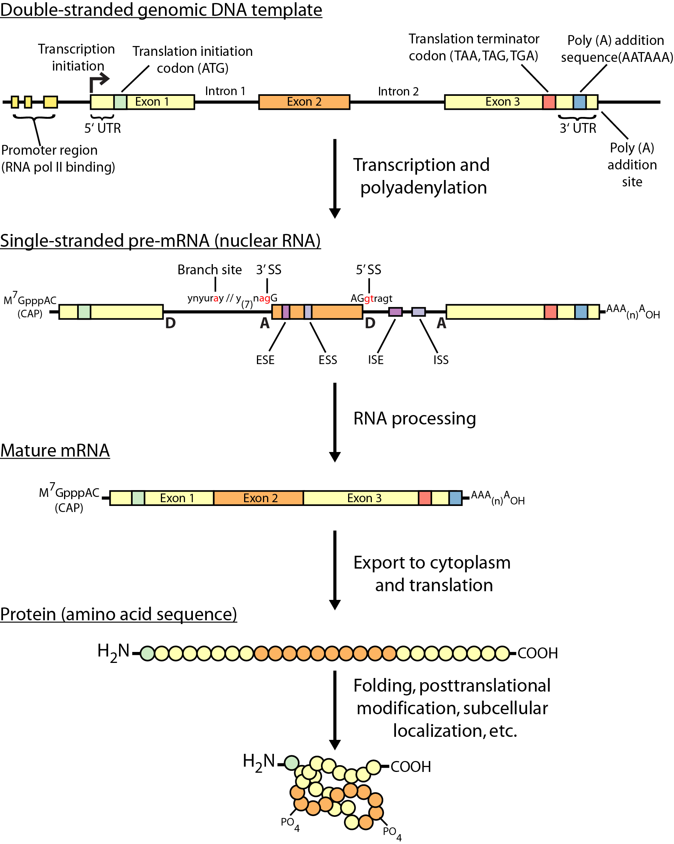
Review of gene expression

Slide 3
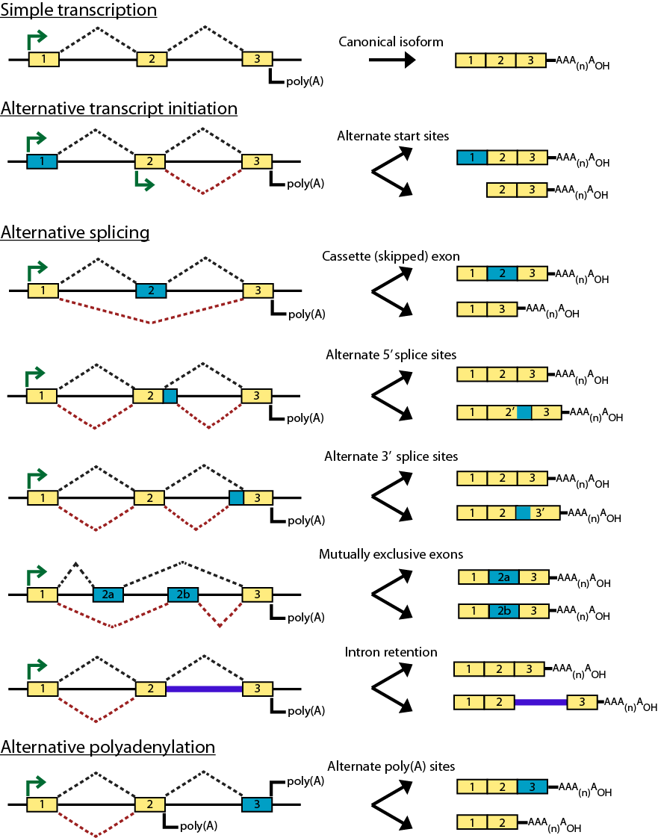
Types of alternative expression - part 1

Slide 4
Types of alternative expression – part 2

Slide 5
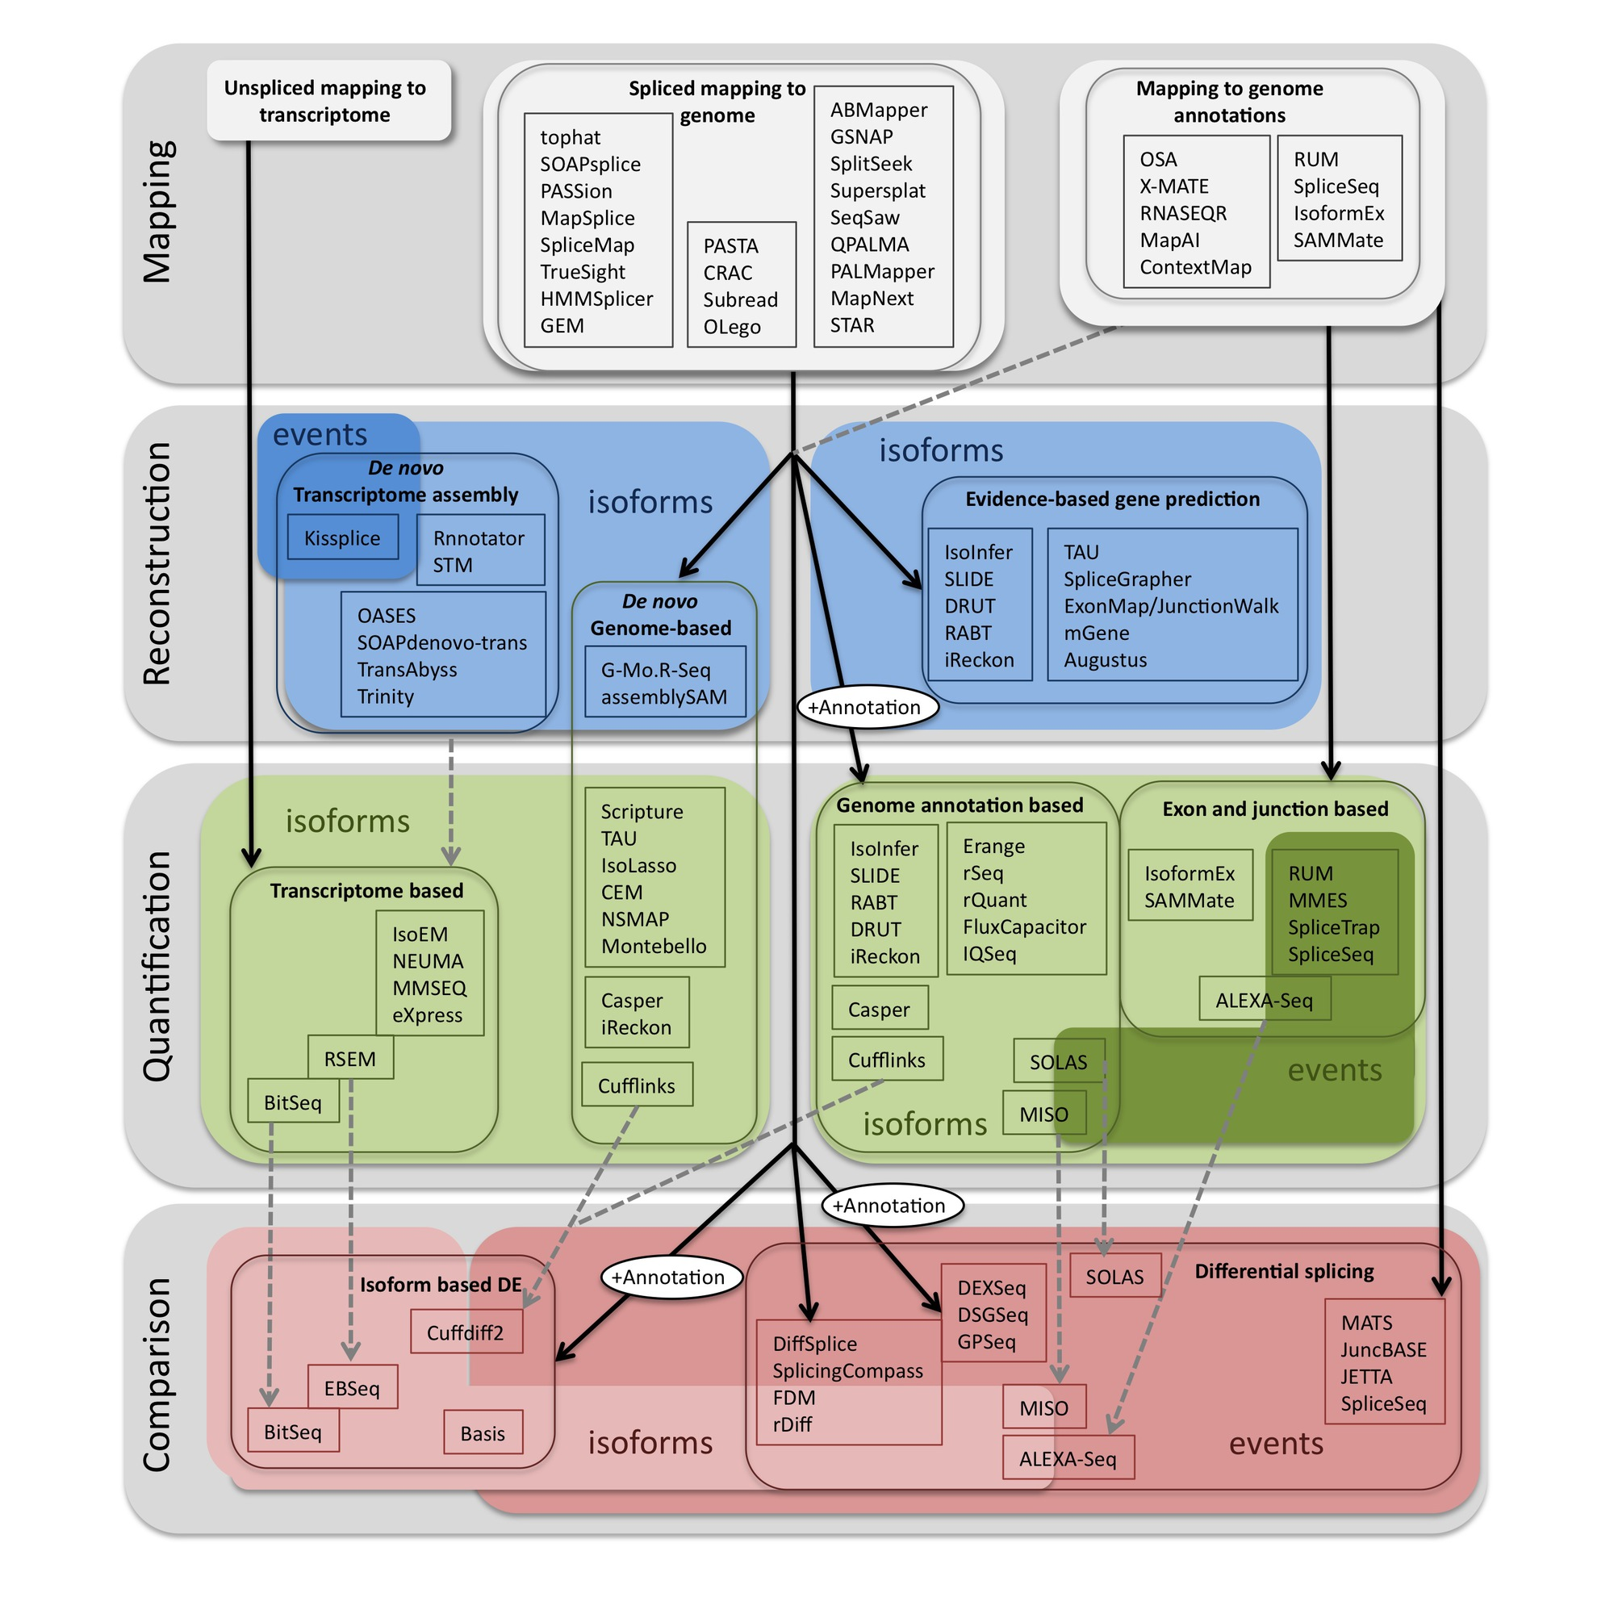
Methods to study splicing by RNA-seq
http://www.rna-seqblog.com/data-analysis/splicing-junction/methods-to-study-splicing-from-rna-seq/
http://arxiv.org/ftp/arxiv/papers/1304/1304.5952.pdf

Slide 6
Methods to study splicing by RNA-seq
http://www.rna-seqblog.com/data-analysis/splicing-junction/methods-to-study-splicing-from-rna-seq/
http://arxiv.org/ftp/arxiv/papers/1304/1304.5952.pdf

Slide 7
Useful resources and discussion
Best approach to predict novel and alternative splicing events from RNA-seq data
  http://www.biostars.org/p/68966/
  http://www.biostars.org/p/62728/
Alternative splicing detection
  http://www.biostars.org/p/65617/
  http://www.biostars.org/p/11695/
Identifying genes that express different isoforms in cancer vs normal RNA-seq data
  http://www.biostars.org/p/50365/
Cufflinks / Cuffdiff Output - How are tests different?
  http://www.biostars.org/p/13525/
Visualization of alternative splicing events using RNA-seq data
  http://www.biostars.org/p/8979/

Slide 8
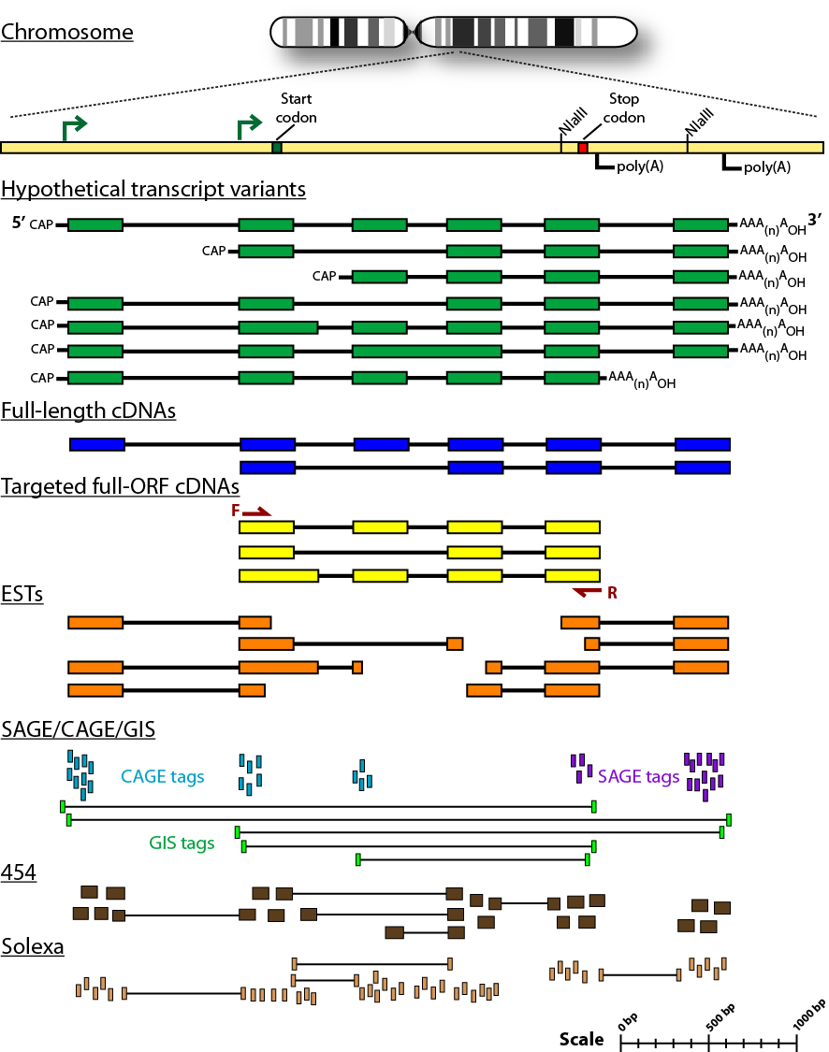
Sequencing methods for studying alternative isoforms

Slide 9
We are on a Coffee Break & Networking Session

