Slide 1

Canadian Bioinformatics Workshops
www.bioinformatics.ca

Slide 2


In collaboration with
Cold Spring Harbor Laboratory
&
New York Genome Center

Slide 3
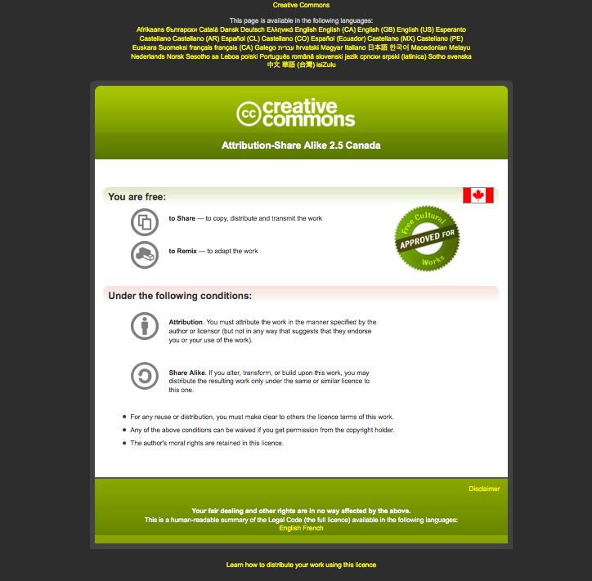
Module #: Title of Module

Slide 4
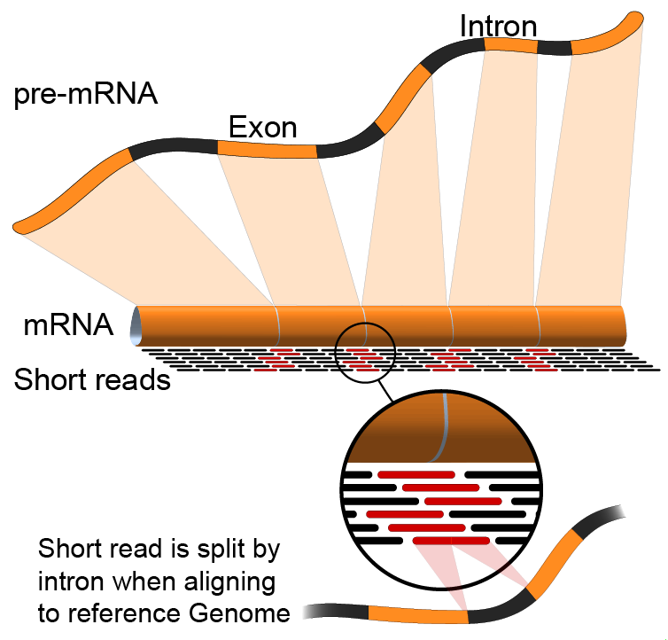

Module 2
RNA-seq alignment and visualization (lecture)
Malachi Griffith & Obi Griffith & Fouad Yousif
High-throughput Biology: From Sequence to Networks
April 27-May 3, 2015

Slide 5
Learning objectives of the course
Module 0: Introduction to cloud computing
Module 1: Introduction to RNA sequencing
Module 2: RNA-seq alignment and visualization
Module 3: Expression and Differential Expression
Module 4: Isoform discovery and alternative expression
Tutorials
  Provide a working example of an RNA-seq analysis pipeline
  Run in a ‘reasonable’ amount of time with modest computer resources
  Self contained, self explanatory, portable

Slide 6
Learning Objectives of Module
RNA-seq alignment challenges and common questions
Alignment strategies
Bowtie/TopHat
Introduction to the BAM and BED formats
Basic manipulation of BAMs
Visualization of RNA-seq alignments in IGV
Alignment QC Assessment
BAM read counting and determination of variant allele expression status

Slide 7
RNA-seq alignment challenges
Computational cost
  100’s of millions of reads
Introns!
  Spliced vs. unspliced alignments
Can I just align my data once using one approach and be done with it?
  Unfortunately probably not
Is TopHat the only mapper to consider for RNA-seq data?
  http://www.biostars.org/p/60478/

Slide 8
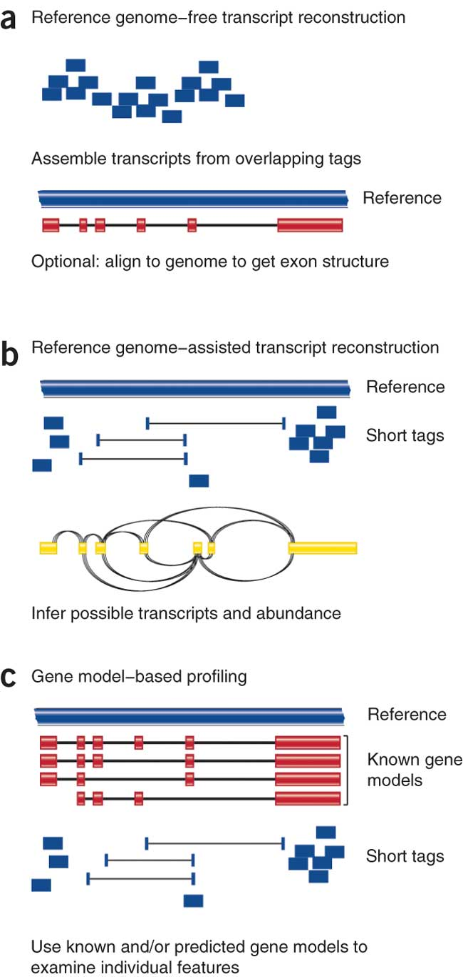
Three RNA-seq mapping strategies
De novo assembly
Align to transcriptome
Align to reference genome
Diagrams from Cloonan & Grimmond, Nature Methods 2010

Slide 9
Which alignment strategy is best?
De novo assembly
  If a reference genome does not exist for the species being studied
  If complex polymorphisms/mutations/haplotypes might be missed by comparing to the reference genome
Align to transcriptome
  If you have short reads (< 50bp)
Align to reference genome
  All other cases
Each strategy involves different alignment/assembly tools

Slide 10
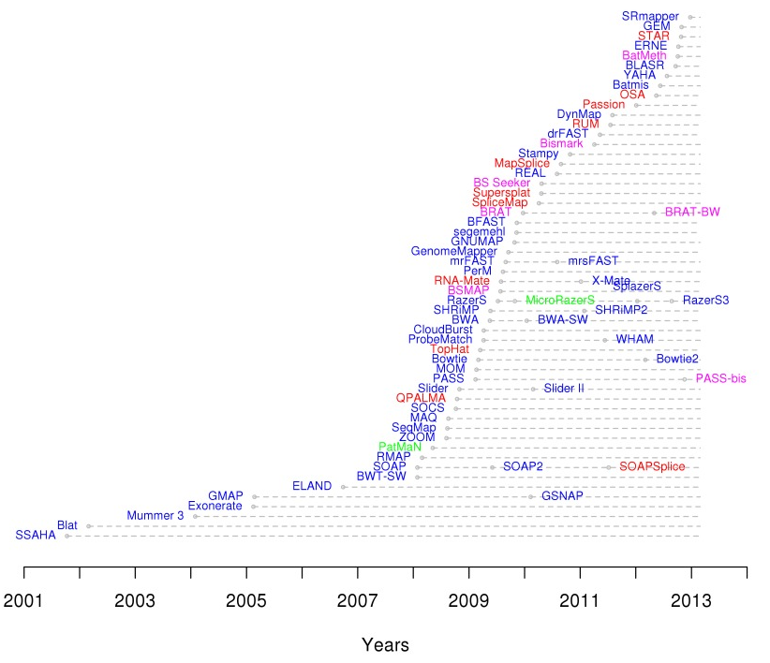
Which read aligner should I use?
RNA
Bisulfite
DNA
microRNA

Slide 11
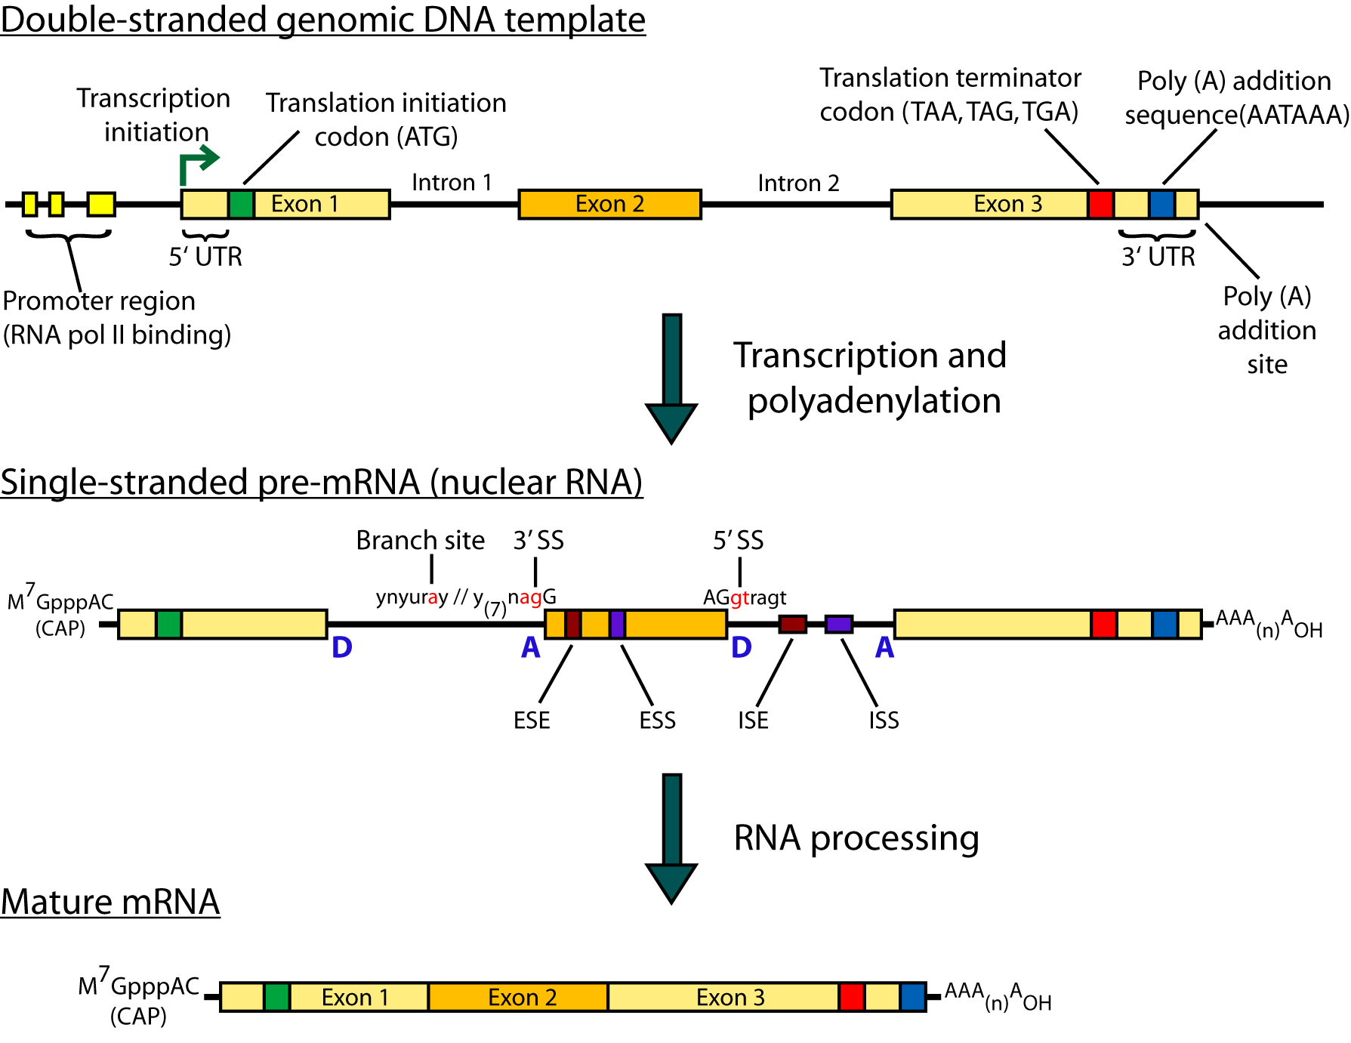
Should I use a splice-aware or unspliced mapper
RNA-seq reads may span large introns
The fragments being sequenced in RNA-seq represent mRNA and therefore the introns are removed
But we are usually aligning these reads back to the reference genome
Unless your reads are short (<50bp) you should use a splice-aware aligner
  TopHat, STAR, MapSplice, etc.

Slide 12
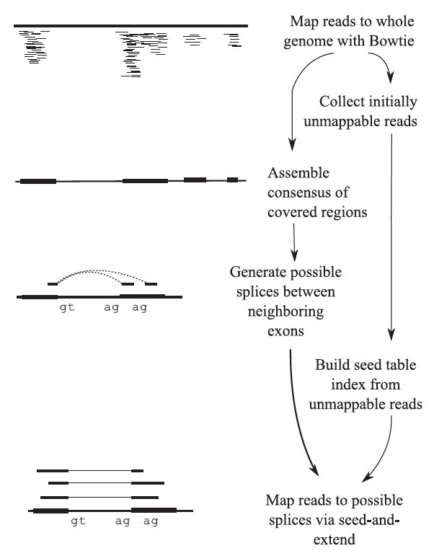
Bowtie/TopHat
TopHat is a ‘splice-aware’ RNA-seq read aligner
Requires a reference genome
Breaks reads into pieces, uses ‘bowtie’ aligner to first align these pieces
Then extends alignments from these seeds and resolves exon edges (splice junctions)
Trapnell et al. 2009

Slide 13
Bowtie/TopHat
Read X
Read Y
Exon 1
Exon 2
Reference

Slide 14
Bowtie/TopHat
?
Read X
Map with Bowtie
Read Y
Exon 1
Reference
Exon 2
Read Y
Read X
Aligned Bin
Unaligned Bin

Slide 15
Bowtie/TopHat
X1
X2
X3
Read X
Read X
Unaligned Reads
X2
?
X1
X3
Exon 1
Reference
Exon 2
Collect Mapping Information for X1 and X3
Construct a Splice Library

Slide 16
Should I allow ‘multi-mapped’ reads?
Depends on the application
In *DNA* analysis it is common to use a mapper to randomly select alignments from a series of equally good alignments
In *RNA* analysis this is less common
  Perhaps disallow multi-mapped reads if you are variant calling
  Definitely should allow multi-mapped reads for expression analysis with TopHat/Cufflinks
  Definitely should allow multi-mapped reads for gene fusion discovery

Slide 17
What is the output of bowtie/tophat?
A SAM/BAM file
  SAM stands for Sequence Alignment/Map format
  BAM is the binary version of a SAM file
  Remember, compressed files require special handling compared to plain text files
How can I convert BAM to SAM?
  http://www.biostars.org/p/1701/

Slide 18
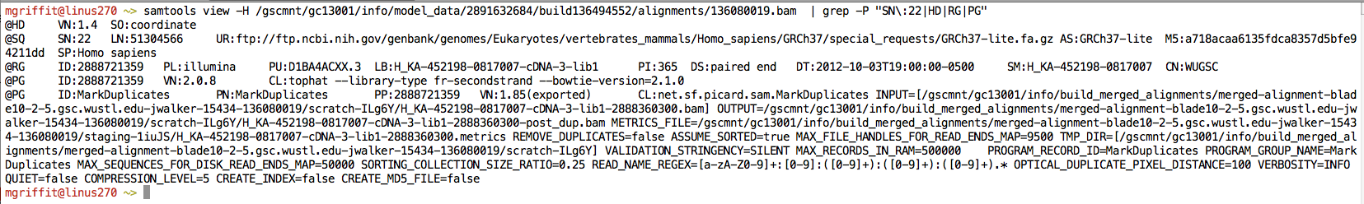
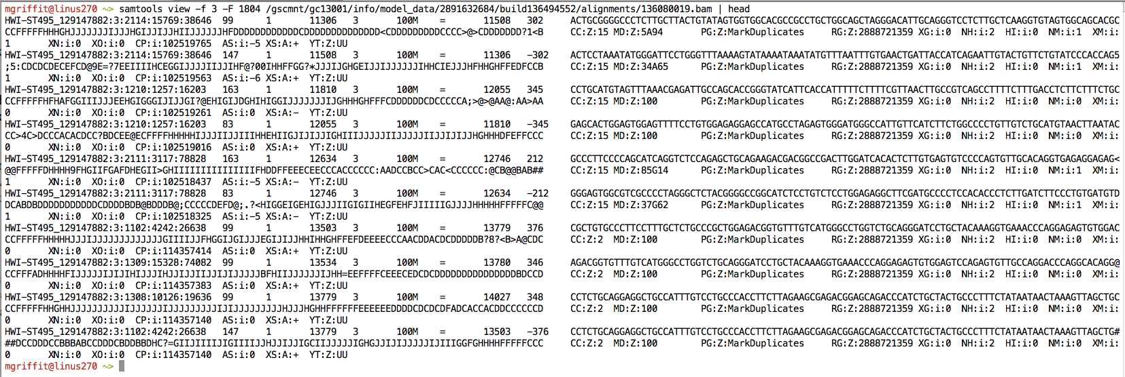
Example of SAM/BAM file format
Example SAM/BAM header section (abbreviated)
Example SAM/BAM alignment section (only 10 alignments shown)

Slide 19
Introduction to the SAM/BAM format
The specification
  http://samtools.sourceforge.net/SAM1.pdf
The SAM format consists of two sections:
  Header section
    Used to describe source of data, reference sequence, method of alignment, etc.
  Alignment section
    Used to describe the read, quality of the read, and nature alignment of the read to a region of the genome
BAM is a compressed version of SAM
  Compressed using lossless BGZF format
  Other BAM compression strategies are a subject of research. See ‘CRAM’ format for example
BAM files are usually ‘indexed’
  A ‘.bai’ file will be found beside the ‘.bam’ file
  Indexing aims to achieve fast retrieval of alignments overlapping a specified region without going through the whole alignments. BAM must be sorted by the reference ID and then the leftmost coordinate before indexing

Slide 20
SAM/BAM header section
Used to describe source of data, reference sequence, method of alignment, etc.
Each section begins with character ‘@’ followed by a two-letter record type code. These are followed by two-letter tags and values
  @HD The header line
    VN: format version
    SO: Sorting order of alignments
  @SQ Reference sequence dictionary
    SN: reference sequence name
    LN: reference sequence length
    SP: species
  @RG Read group
    ID: read group identifier
    CN: name of sequencing center
    SM: sample name
  @PG Program
    PN: program name
    VN: program version

Slide 21
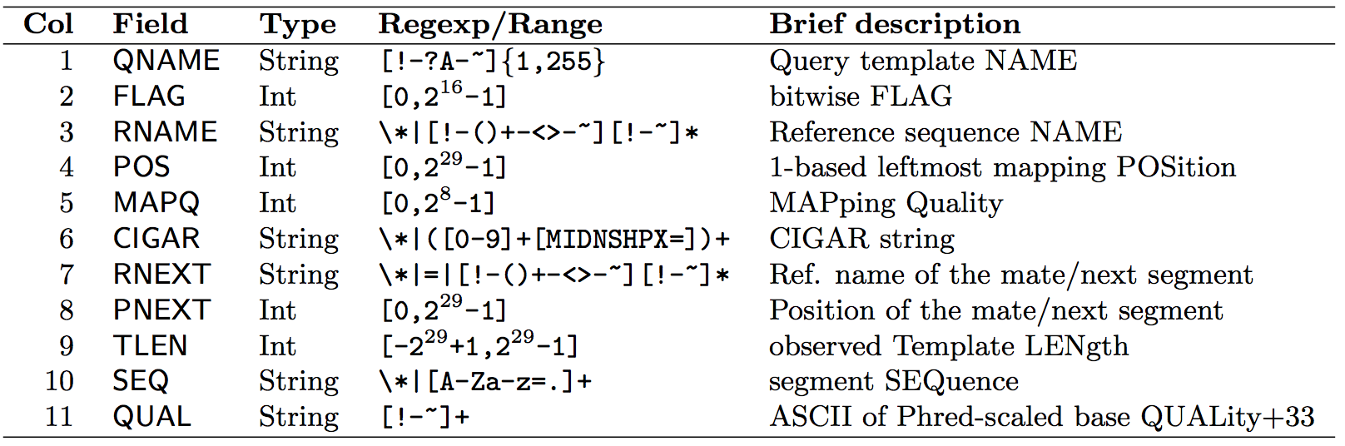
SAM/BAM alignment section
Example values
QNAME e.g. HWI-ST495_129147882:1:2302:10269:12362 (QNAME)
FLAG e.g. 99
RNAME e.g. 1
POS e.g. 11623
MAPQ e.g. 3
CIGAR e.g. 100M
RNEXT e.g. =
PNEXT e.g. 11740
TLEN e.g. 217
SEQ e.g. CCTGTTTCTCCACAAAGTGTTTACTTTTGGATTTTTGCCAGTCTAACAGGTGAAGCCCTGGAGATTCTTATTAGTGATTTGGGCTGGGGCCTGGCCATGT
QUAL e.g. CCCFFFFFHHHHHJJIJFIJJJJJJJJJJJHIJJJJJJJIJJJJJGGHIJHIJJJJJJJJJGHGGIJJJJJJIJEEHHHHFFFFCDCDDDDDDDB@ACDD

Slide 22
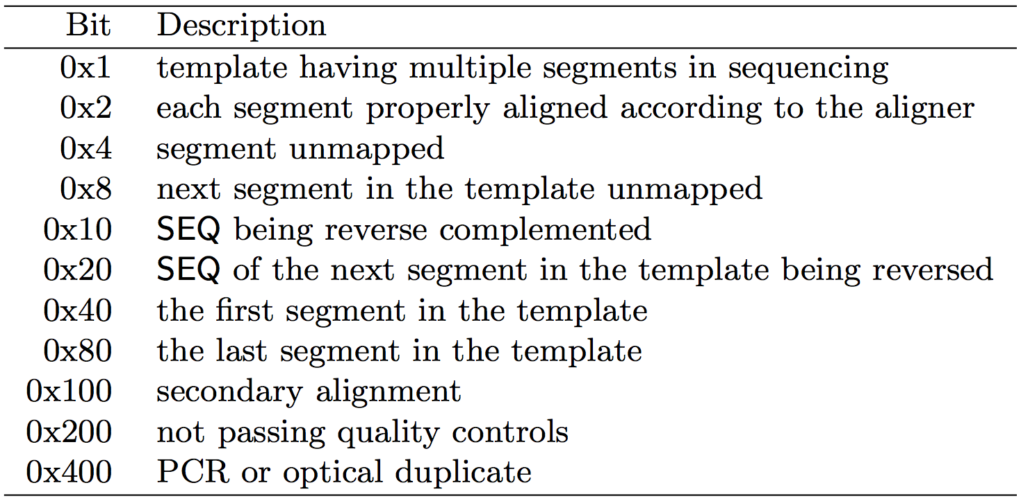
SAM/BAM flags explained
http://broadinstitute.github.io/picard/explain-flags.html
11 bitwise flags describing the alignment
These flags are stored as a binary string of length 11 instead of 11 columns of data
Value of ‘1’ indicates the flag is set. e.g. 00100000000
All combinations can be represented as a number from 0 to 2047 (i.e. 211-1). This number is used in the BAM/SAM file. You can specify ‘required’ or ‘filter’ flags in samtools view using the ‘-f’ and ‘-F’ options respectively
Note that to maximize confusion, each bit is described in the SAM specification using its hexadecimal representation (i.e., '0x10' = 16 and '0x40' = 64).

Slide 23
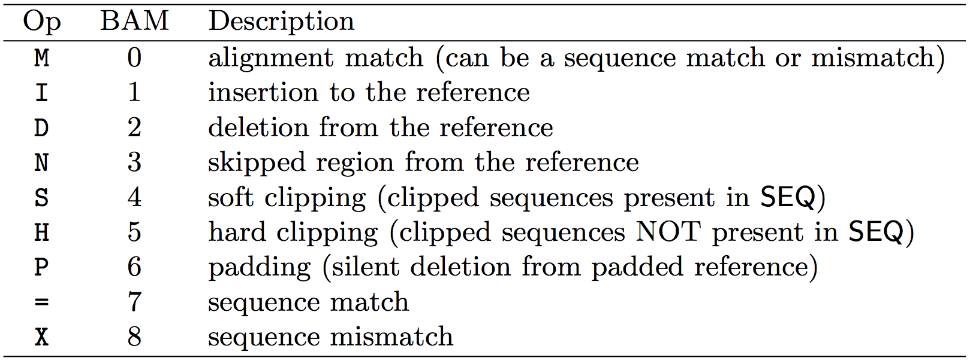
CIGAR strings explained
The CIGAR string is a sequence of base lengths and associated ‘operations’ that are used to indicate which bases align to the reference (either a match or mismatch), are deleted, are inserted, represent introns, etc.
e.g. 81M859N19M
  A 100 bp read consists of: 81 bases of alignment to reference, 859 bases skipped (an intron), 19 bases of alignment

Slide 24
Introduction to the BED format
When working with BAM files, it is very common to want to examine a focused subset of the reference genome
  e.g. the exons of a gene
These subsets are commonly specified in ‘BED’ files
  https://genome.ucsc.edu/FAQ/FAQformat.html#format1
Many BAM manipulation tools accept regions of interest in BED format
Basic BED format (tab separated):
  Chromosome name, start position, end position
  Coordinates in BED format are 0 based

Slide 25
Manipulation of SAM/BAM and BED files
Several tools are used ubiquitously in sequence analysis to manipulate these files
SAM/BAM files
  samtools
  bamtools
  picard
BED files
  bedtools
  bedops

Slide 26
How should I sort my SAM/BAM file?
Generally BAM files are sorted by position
  This is for performance reasons
    When sorted and indexed, arbitrary positions in a massive BAM file can be accessed rapidly
Certain tools require a BAM sorted by read name
  Usually this is when we need to easily identify both reads of a pair
    The insert size between two reads may be large
    In fusion detection we are interested in read pairs that map to different chromosomes…

Slide 27
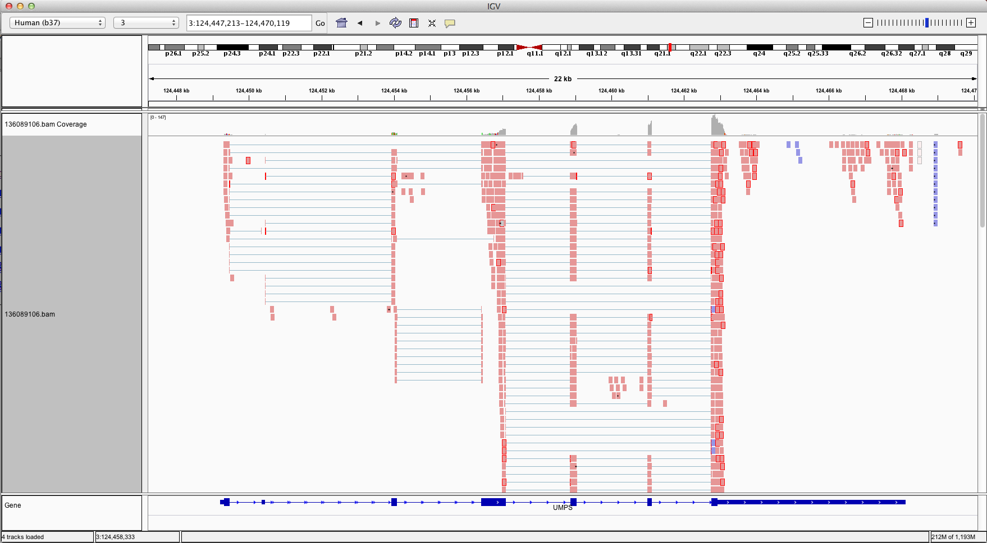
Visualization of RNA-seq alignments in IGV browser
Ideogram
Coverage
pileup
Control pop-up info
Viewer position
Coverage
track
Coverage
scale
Single reads, not spliced
+ve
strand
-ve
strand
Reads track
Single reads, spliced
Gene track

Slide 28
Alternative viewers to IGV
Alternative viewers to IGV
  http://www.biostars.org/p/12752/
  http://www.biostars.org/p/71300/
Artemis, BamView, Chipster, gbrowse2, GenoViewer, MagicViewer, Savant, Tablet, tview

Slide 29
Alignment QC Assessment
3' and 5' Bias
Nucleotide Content
Base/Read Quality
PCR Artifact
Sequencing Depth
Base Distribution
Insert Size Distribution

Slide 30
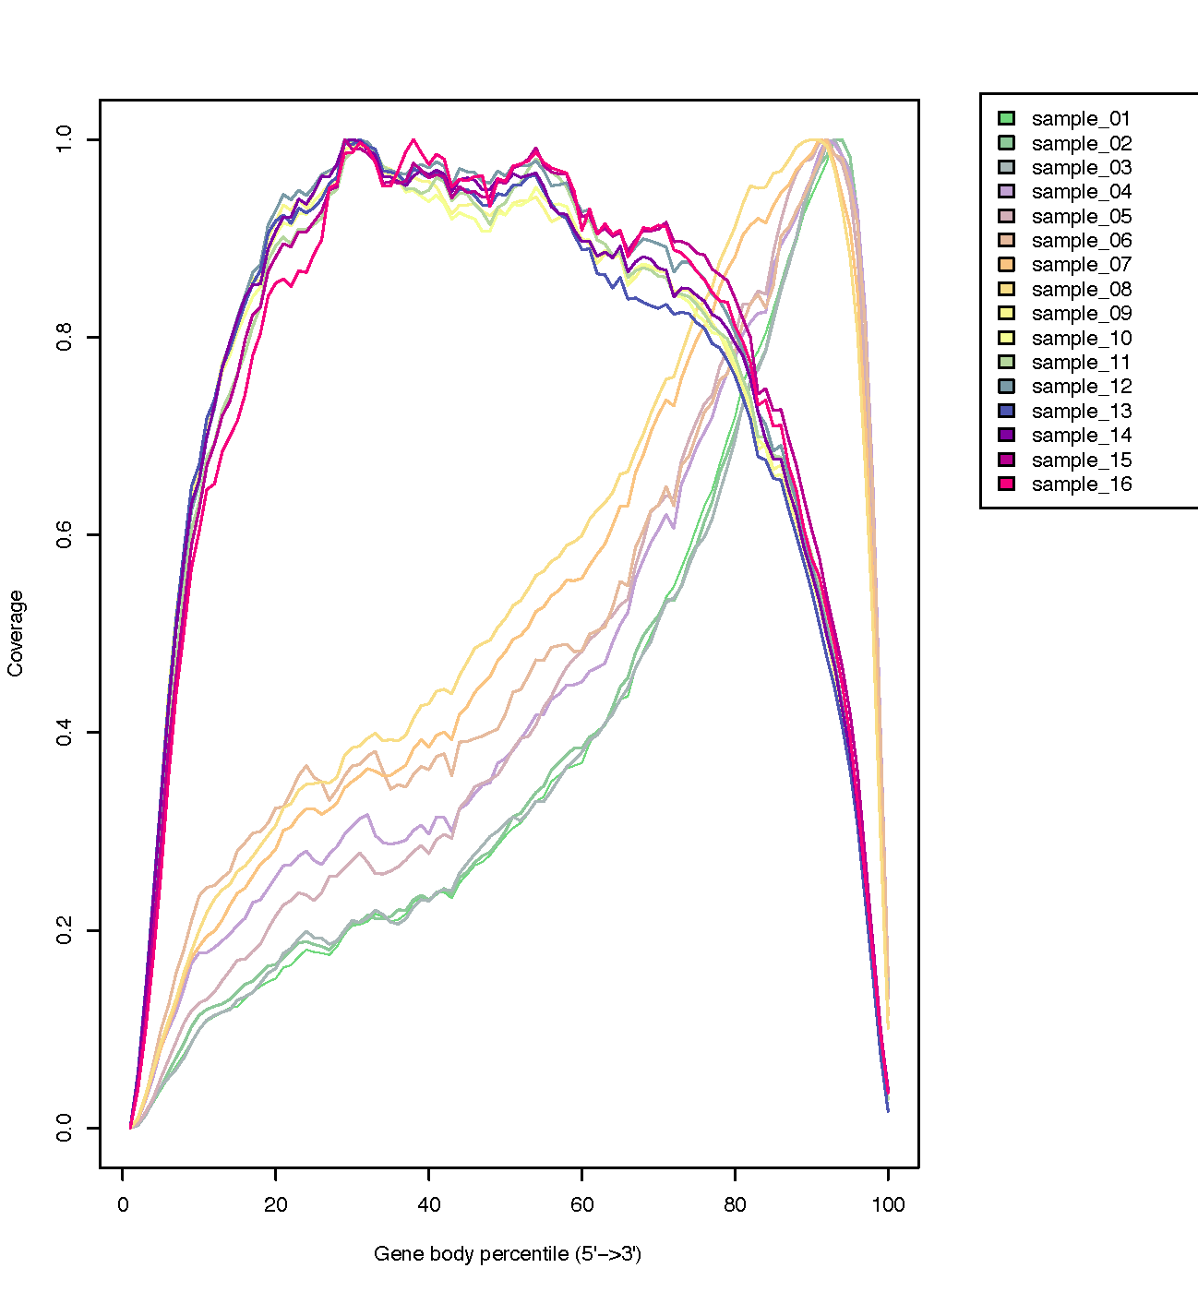
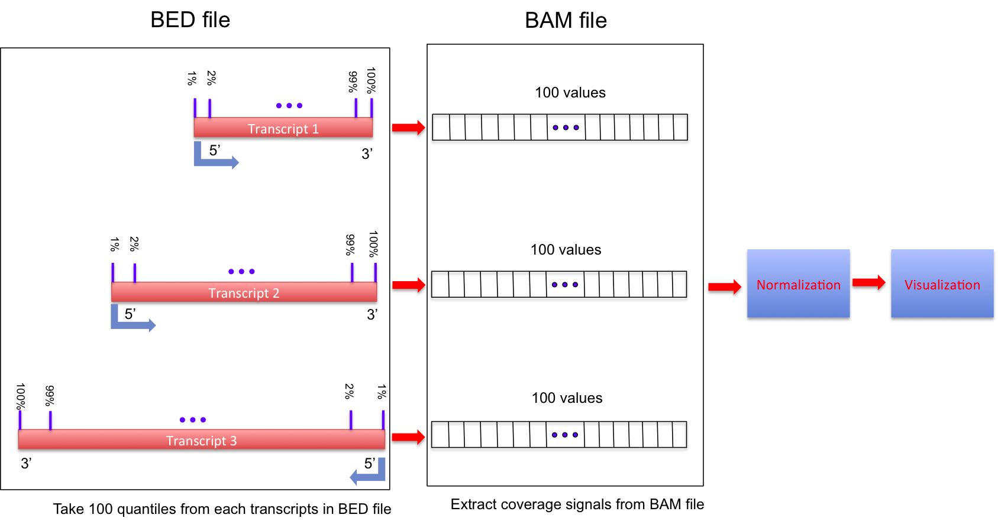
Alignment QC: 3' & 5' Bias
http://rseqc.sourceforge.net/

Slide 31
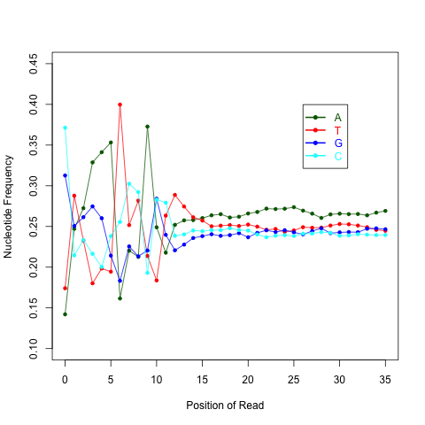
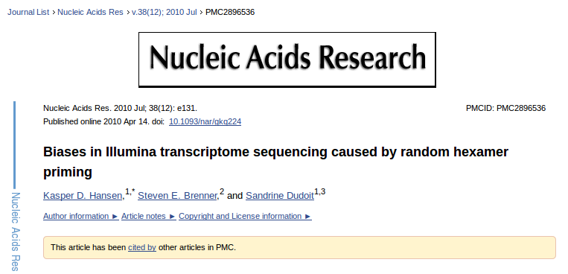
Alignment QC: Nucleotide Content
Random primers are used to reverse transcribe RNA fragments into double-stranded complementary DNA (dscDNA)
Causes certain patterns to be over represented at the beginning (5’end) of reads
Deviation from expected A%=C%=G%=T%=25%
http://rseqc.sourceforge.net/

Slide 32
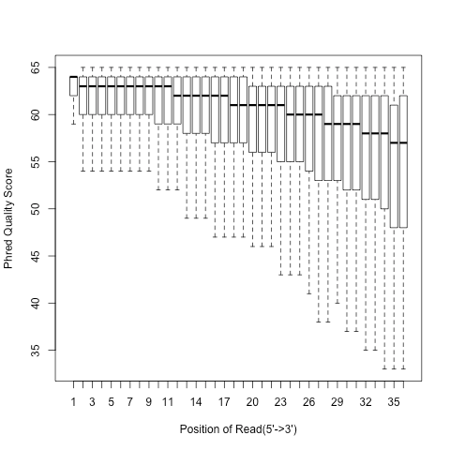
Alignment QC: Quality Distribution
Phred quality score is widely used to characterize the quality of base-calling
Phred quality score = -10xlog(10)P, here P is probability that base-calling is wrong
Phred score of 30 means there is 1/1000 chance that the base-calling is wrong
The quality of the bases tend to drop at the end of the read, a pattern observed in sequencing by synthesis techniques
http://rseqc.sourceforge.net/

Slide 33
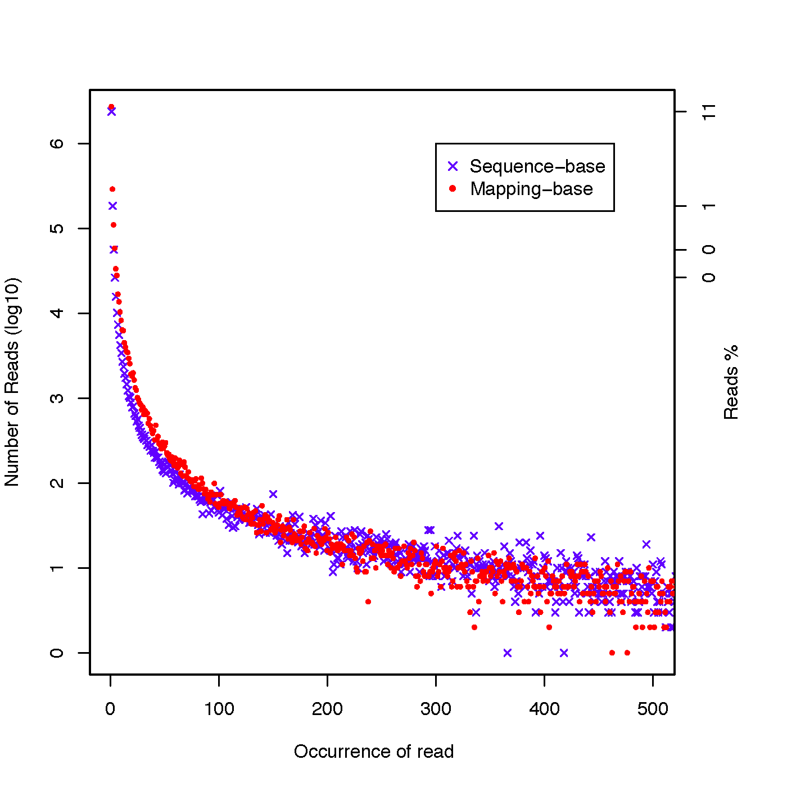
Alignment QC: PCR Duplication
Duplicate reads are reads that have the same start/end positions and same exact sequence
In DNA-seq, reads/start point is used as a metric to assess PCR duplication rate
In DNA-seq, duplicate reads are collapsed using tools such as picard
How is RNA-seq different from DNA-seq?
http://rseqc.sourceforge.net/

Slide 34
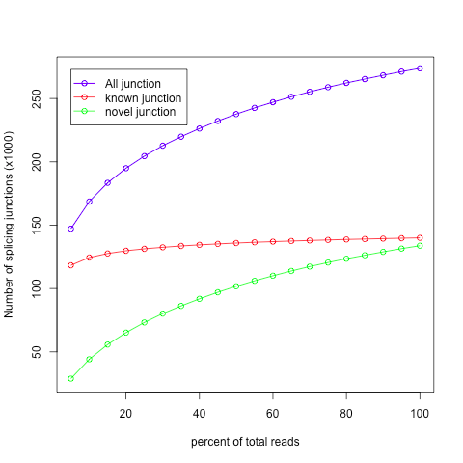
Alignment QC: Sequencing Depth
Have we sequenced deep enough?
In DNA-seq, we can determine this by looking at the average coverage over the sequenced region. Is it above a certain threshold?
In RNA-seq, this is a challenge due to the variability in gene abundance
Use splice junctions detection rate as a way to identify desired sequencing depth
Check for saturation by resampling 5%, 10%, 15%, ..., 95% of total alignments from aligned file, and then detect splice junctions from each subset and compare to reference gene model.
This method ensures that you have sufficient coverage to perform alternative splicing analyses
http://rseqc.sourceforge.net/

Slide 35
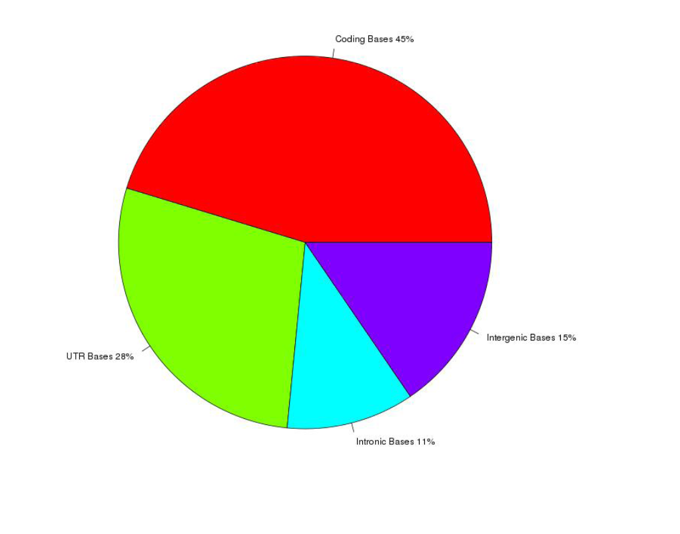
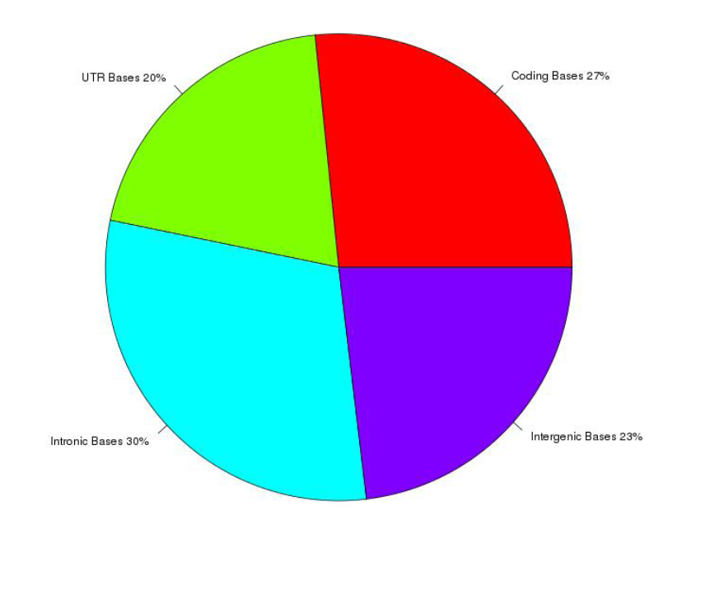
Alignment QC: Base Distribution
Whole Transcriptome Library
PolyA mRNA library
Your sequenced bases distribution will depend on the library preperation protocol selected

Slide 36
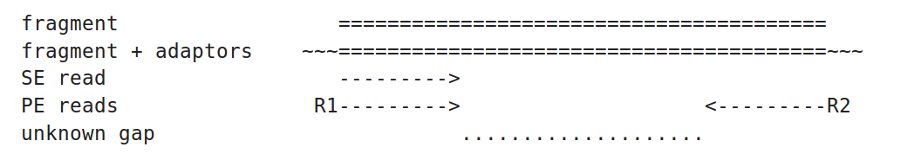
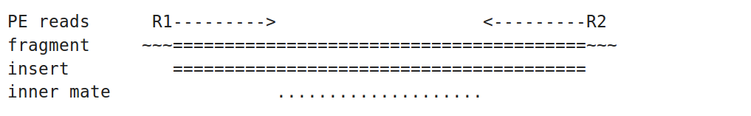
Alignment QC: Insert Size
http://thegenomefactory.blogspot.ca/2013/08/paired-end-read-confusion-library.html

Slide 37
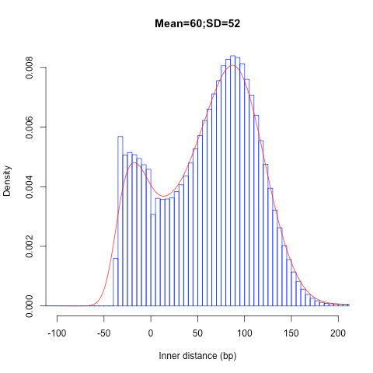
Alignment QC: Insert Size
Consistent with library size selection?
http://rseqc.sourceforge.net/

Slide 38
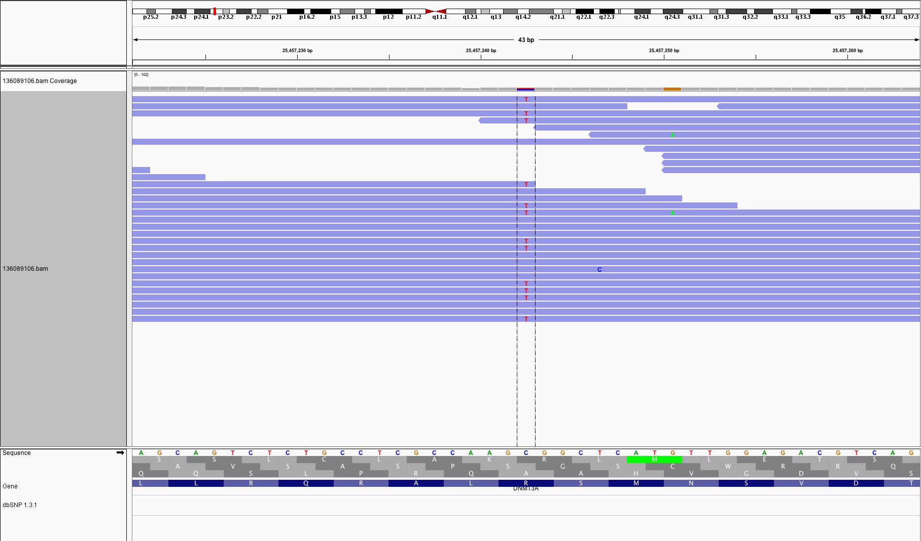
BAM read counting and variant allele expression status
A variant C->T is observed in 12 of 25 reads covering this position. Variant allele frequency (VAF) 12/25 = 48%.
Both alleles appear to be expressed equally (not always the case) -> heterozygous, no allele specific expression
How can we determine variant read counts, depth of coverage, and VAF without manually viewing in IGV?

Slide 39
Introduction to tutorial
(Module 3)

Slide 40
Bowtie/Tophat/Cufflinks/Cuffdiff
RNA-seq Pipeline
Module 3
Sequencing
Read alignment
Transcript compilation
Gene identification
Differential expression
RNA-seq reads (2 x 100 bp)
Bowtie/TopHat alignment (genome)
Cufflinks
Cufflinks (cuffmerge)
Cuffdiff
(A:B comparison)
Raw sequence data
(.fastq files)
Reference genome
(.fa file)
Gene annotation
(.gtf file)
CummRbund
Inputs
Visualization

Slide 41
We are on a Coffee Break & Networking Session

