Slide 1
Genome Arithmetic and Bedtools
Felicia Gomez
11/13/2025
Cold Spring Harbor Sequencing Technologies Course
Slides generously provided by Chris Miller
some slides adapted from:
Aaron Quinlan's Applied Computational Geno
mics course https://github.com/quinlan-lab/applied-computational-genomics
The Griffith Lab's RNAbio course: https://rnabio.org/

Slide 2
A common class of problems:
I have a list of SNPs in this patient. Which ones hit known enhancers?
Did my sequencing run give good coverage over the genes I care about?
My experiment returned 300 ChIP-seq peaks. Which ones are near cancer-related genes?

Slide 3
What is a genome interval?
At minimum defined by chromosome, start, and stop
may also have strand, name, other fields
chr1:12345-98765
chrX 12345
chr17 7661779
98765
-
7687550 ENSG00000141510
TP53
-

Slide 4
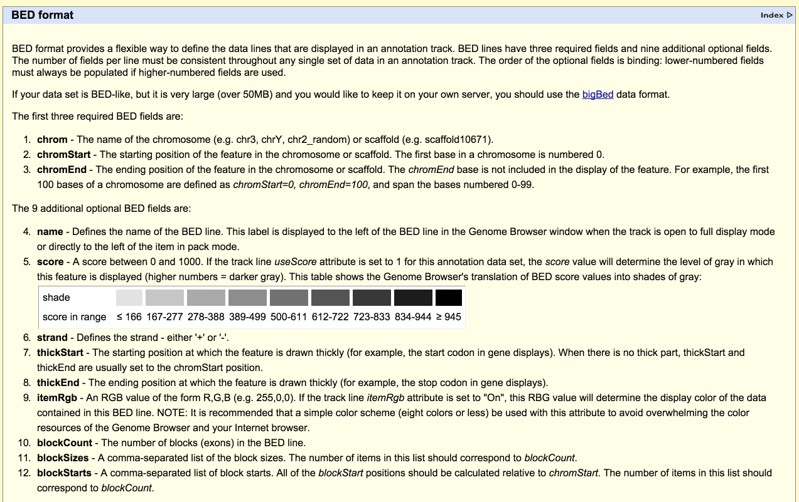
BED (browser extensible data) format
Notes:
BED format has 3 important columns, arguably 4

Slide 5
BED annotations also support "names" or "labels" (4th column)
CAGTCGACATAGACTGATATGACACCACACTGAG...
chr3
0
5
10
15
20
25
30
Annotations
chr3 0 7 exon_gene1
chr3 4 10 exon_gene2
Notes:
So in addition to storing information about an interval’s location, we can record additional information about the interval. For example, we can say that this
We could have an annotation indicated where a gene is transcribed on the strand corresponding to the reference genome or whether it is transcribed from the complementary strand.

Slide 6
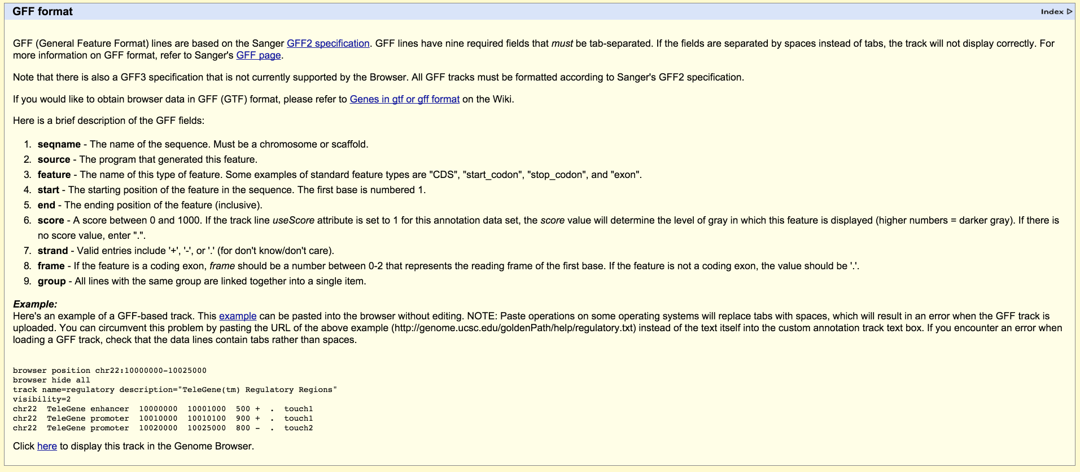
GFF/GTF format
chr22 TeleGene enhancer 10000000 10001000 500 + . touch1
chr22 TeleGene promoter 10010000 10010100 900 + . touch1
chr22 TeleGene promoter 10020000 10025000 800 - . touch2
Note that the start and end coordinates are in different columns versus BED format
Notes:
Problems:
Start and end coordinates are in the 4th and 5th column
Even worse, they use a 1-based coordinate system
How to convert to 0-based coordinate system?

Slide 7
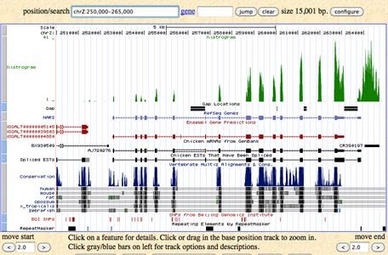
Examples of genome intervals
Genes: exons, introns, UTRs, promoters (BED, GFF, GTF)
Conservation (BEDGRAPH)
Genetic variation (VCF)
Sequence alignments (BAM)
Transcription factor binding sites (BED, BEDGRAPH)
CpG islands (BED)
Segmental duplications (BED)
Chromatin annotations (BED)
Gene expression data (WIG, BIGWIG, BEDGRAPH)
Your own observations: put them in context

Slide 8
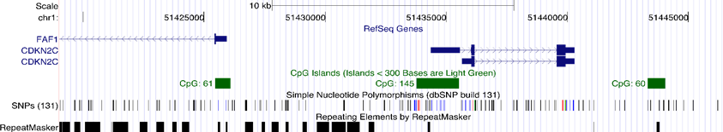
Genome arithmetic
the method of comparing, contrasting,
and gaining insight using multiple genome interval files

Slide 9
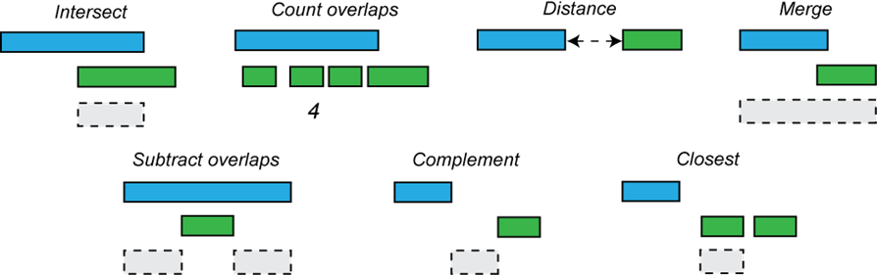
Genome arithmetic operations
0
5
10
15
20
25

Slide 10
Genome arithmetic operations
0
5
10
15
20
25

Slide 11
Genome arithmetic operations
0
5
10
15
20
25

Slide 12
Genome arithmetic operations
0
5
10
15
20
25

Slide 13
Genome arithmetic operations
0
5
10
15
20
25

Slide 14
Genome arithmetic operations
0
5
10
15
20
25

Slide 15
Genome arithmetic operations
0
5
10
15
20
25

Slide 16
Do two intervals intersect (overlap)?
10 20
17
27
Seq a
17
27
10
20
Seq b
10
20
13
16
13
16
10
20
if ((a.start <= b.start and a.end (b.start <= a.start and b.end (a.start <= b.start and a.end (b.start <= a.start and b.end
{
INTERSECTION!!!
}
else NADA!!!
>= b.start) or
>= a.start) or
>= b.end) or
>= a.end))

Slide 17
Do two intervals intersect (overlap)? A simpler way
10
20 17
27
Seq a
17
27
10
20
Seq b
10
20
13
16
13
16
10
20
I = min(a.end, b.end) - max(a.start, b.start)
if I > 0, intersection,
if I <= 0, distance between the intervals
= min(20, 27) - max(10, 17)
= 20-17 = 3
Positive! Intersection!

Slide 18
Do two intervals intersect (overlap)? A simpler way
20 17
25 27
27
10
Seq a
Seq b
10
20
10
20
13
16
13
16
10
20
I = min(a.end, b.end) - max(a.start, b.start)
if I > 0, intersection,
if I <= 0, distance between the intervals
= min(20, 27) - max(10, 25)
= 20-25 = -5
Negative – No intersection!

Slide 19

Manipulation of SAM/BAM and BED files
Several tools are used ubiquitously in sequence analysis to manipulate these files
SAM/BAM files
  samtools
  bamtools
  Picard
BED files
  bedtools
  bedops

Slide 20
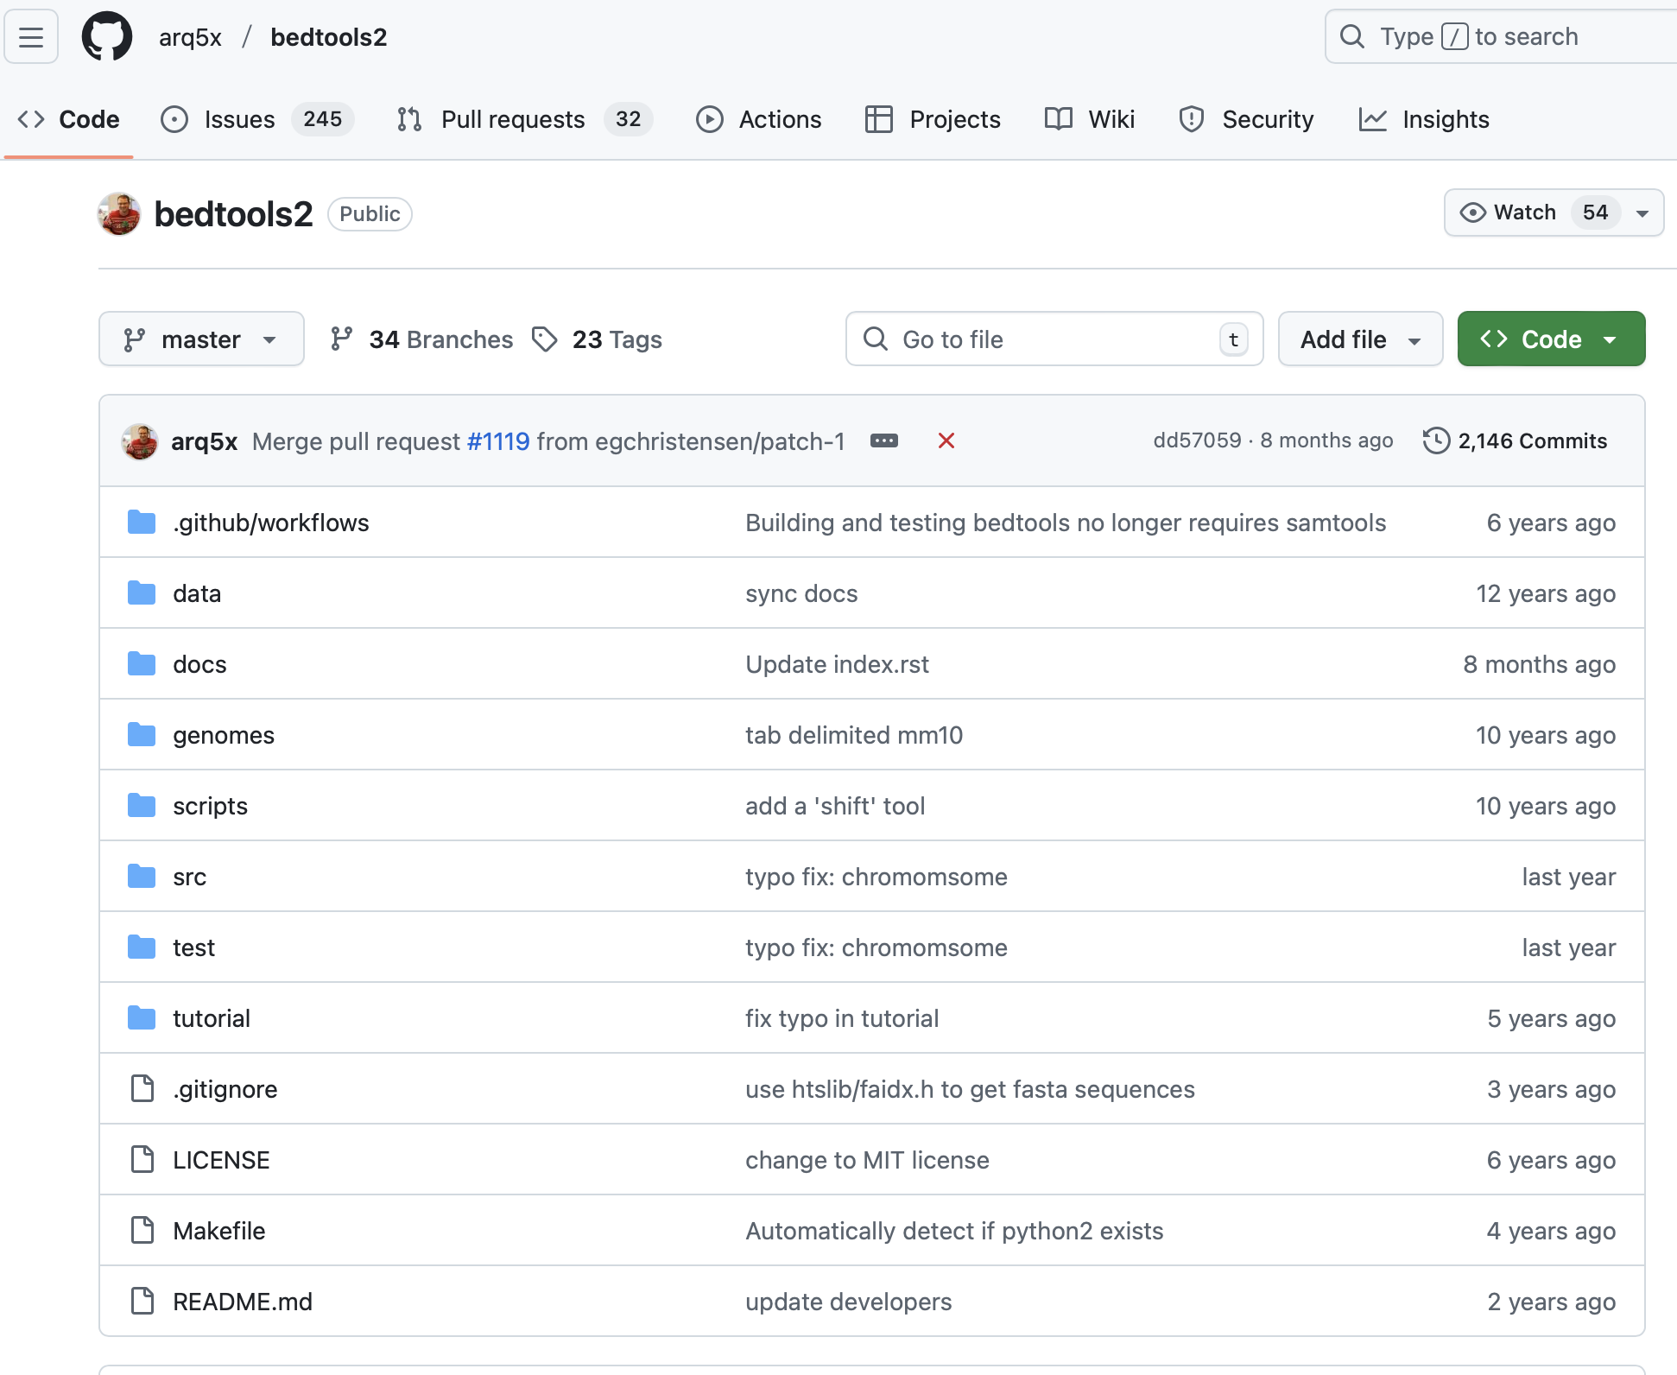
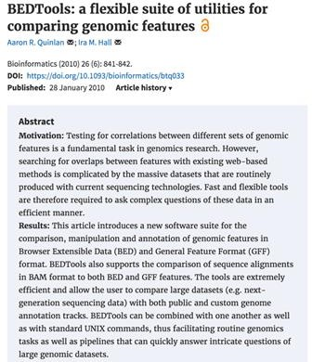

Bedtools: a swiss army knife for genome analysis
Papers:
https://doi.org/10.1093/bioinformatics/btq033 DOI: 10.1002/0471250953.bi1112s47
Documentation:
http://bedtools.readthedocs.io/en/latest/

Slide 21



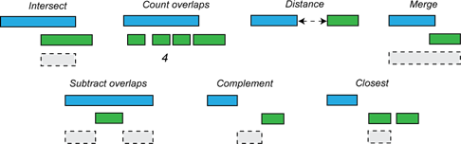


Supports most interval formats & handles diff. coordinate systems
BED
BEDGRAP
H
GFF
SAM
VCF
GTF
http://bedtools.readthedocs.io/en/latest/

Slide 22
Unsorted data is slow!
Many bedtools functions require the data to be sorted. Why?
chr8 | 94925972 | 94949411 | chr11 | 128934731 | 128943399
chr2 | 24077433 | 24085861 | chr20 | 45372563 | 45407889
chr20 | 46684365 | 46689779 | chr1 | 223779899 | 223845972
chr20 | 45372563 | 45407889 | chr15 | 43403061 | 43510728
chr20 | 34704290 | 34713439 | chr20 | 46684365 | 46689779
chr17 | 7661779 |  | chr2 | 24077433 | 24085861
7687550 |  |  | chr20 | 34704290 | 34713439
chr17 | 29566052 | 29573157 | chr17 | 7661779 | 7687550
chr15 | 43403061 | 43510728 | chr17 | 29566052 | 29573157
chr1 | 223779899 | 223845972 | chr8 | 94925972 | 94949411
chr11 | 44885903 | 44951306 | chr11 | 44885903 | 44951306
chr11 | 128934731 | 128943399

Slide 23
Unsorted data is slow!
chr8 | 94925972 | 94949411 | chr11 | 128934731 | 128943399
chr2 | 24077433 | 24085861 | chr20 | 45372563 | 45407889
chr20 | 46684365 | 46689779 | chr1 | 223779899 | 223845972
chr20 | 45372563 | 45407889 | chr15 | 43403061 | 43510728
chr20 | 34704290 | 34713439 | chr20 | 46684365 | 46689779
chr17 | 7661779 |  | chr2 | 24077433 | 24085861
7687550 |  |  | chr20 | 34704290 | 34713439
chr17 | 29566052 | 29573157 | chr17 | 7661779 | 7687550
chr15 | 43403061 | 43510728 | chr17 | 29566052 | 29573157
chr1 | 223779899 | 223845972 | chr8 | 94925972 | 94949411
chr11 | 44885903 | 44951306 | chr11 | 44885903 | 44951306
chr11 | 128934731 | 128943399

Slide 24
Unsorted data is slow!
chr8 | 94925972 | 94949411 | chr11 | 128934731 | 128943399
chr2 | 24077433 | 24085861 | chr20 | 45372563 | 45407889
chr20 | 46684365 | 46689779 | chr1 | 223779899 | 223845972
chr20 | 45372563 | 45407889 | chr15 | 43403061 | 43510728
chr20 | 34704290 | 34713439 | chr20 | 46684365 | 46689779
chr17 | 7661779 |  | chr2 | 24077433 | 24085861
7687550 |  |  | chr20 | 34704290 | 34713439
chr17 | 29566052 | 29573157 | chr17 | 7661779 | 7687550
chr15 | 43403061 | 43510728 | chr17 | 29566052 | 29573157
chr1 | 223779899 | 223845972 | chr8 | 94925972 | 94949411
chr11 | 44885903 | 44951306 | chr11 | 44885903 | 44951306
chr11 | 128934731 | 128943399

Slide 25
Unsorted data is slow!
chr8 | 94925972 | 94949411 | chr11 | 128934731 | 128943399
chr2 | 24077433 | 24085861 | chr20 | 45372563 | 45407889
chr20 | 46684365 | 46689779 | chr1 | 223779899 | 223845972
chr20 | 45372563 | 45407889 | chr15 | 43403061 | 43510728
chr20 | 34704290 | 34713439 | chr20 | 46684365 | 46689779
chr17 | 7661779 |  | chr2 | 24077433 | 24085861
7687550 |  |  | chr20 | 34704290 | 34713439
chr17 | 29566052 | 29573157 | chr17 | 7661779 | 7687550
chr15 | 43403061 | 43510728 | chr17 | 29566052 | 29573157
chr1 | 223779899 | 223845972 | chr8 | 94925972 | 94949411
chr11 | 44885903 | 44951306 | chr11 | 44885903 | 44951306
chr11 | 128934731 | 128943399

Slide 26
Unsorted data is slow!
chr8 | 94925972 | 94949411 | chr11 | 128934731 | 128943399
chr2 | 24077433 | 24085861 | chr20 | 45372563 | 45407889
chr20 | 46684365 | 46689779 | chr1 | 223779899 | 223845972
chr20 | 45372563 | 45407889 | chr15 | 43403061 | 43510728
chr20 | 34704290 | 34713439 | chr20 | 46684365 | 46689779
chr17 | 7661779 |  | chr2 | 24077433 | 24085861
7687550 |  |  | chr20 | 34704290 | 34713439
chr17 | 29566052 | 29573157 | chr17 | 7661779 | 7687550
chr15 | 43403061 | 43510728 | chr17 | 29566052 | 29573157
chr1 | 223779899 | 223845972 | chr8 | 94925972 | 94949411
chr11 | 44885903 | 44951306 | chr11 | 44885903 | 44951306
chr11 | 128934731 | 128943399

Slide 27
Unsorted data is slow!
chr8 | 94925972 | 94949411 | chr11 | 128934731 | 128943399
chr2 | 24077433 | 24085861 | chr20 | 45372563 | 45407889
chr20 | 46684365 | 46689779 | chr1 | 223779899 | 223845972
chr20 | 45372563 | 45407889 | chr15 | 43403061 | 43510728
chr20 | 34704290 | 34713439 | chr20 | 46684365 | 46689779
chr17 | 7661779 |  | chr2 | 24077433 | 24085861
7687550 |  |  | chr20 | 34704290 | 34713439
chr17 | 29566052 | 29573157 | chr17 | 7661779 | 7687550
chr15 | 43403061 | 43510728 | chr17 | 29566052 | 29573157
chr1 | 223779899 | 223845972 | chr8 | 94925972 | 94949411
chr11 | 44885903 | 44951306 | chr11 | 44885903 | 44951306
chr11 | 128934731 | 128943399

Slide 28
Unsorted data is slow!
chr8 | 94925972 | 94949411 | chr11 | 128934731 | 128943399
chr2 | 24077433 | 24085861 | chr20 | 45372563 | 45407889
chr20 | 46684365 | 46689779 | chr1 | 223779899 | 223845972
chr20 | 45372563 | 45407889 | chr15 | 43403061 | 43510728
chr20 | 34704290 | 34713439 | chr20 | 46684365 | 46689779
chr17 | 7661779 |  | chr2 | 24077433 | 24085861
7687550 |  |  | chr20 | 34704290 | 34713439
chr17 | 29566052 | 29573157 | chr17 | 7661779 | 7687550
chr15 | 43403061 | 43510728 | chr17 | 29566052 | 29573157
chr1 | 223779899 | 223845972 | chr8 | 94925972 | 94949411
chr11 | 44885903 | 44951306 | chr11 | 44885903 | 44951306
chr11 | 128934731 | 128943399

Slide 29
Unsorted data is slow!
chr8 | 94925972 | 94949411 | chr11 | 128934731 | 128943399
chr2 | 24077433 | 24085861 | chr20 | 45372563 | 45407889
chr20 | 46684365 | 46689779 | chr1 | 223779899 | 223845972
chr20 | 45372563 | 45407889 | chr15 | 43403061 | 43510728
chr20 | 34704290 | 34713439 | chr20 | 46684365 | 46689779
chr17 | 7661779 |  | chr2 | 24077433 | 24085861
7687550 |  |  | chr20 | 34704290 | 34713439
chr17 | 29566052 | 29573157 | chr17 | 7661779 | 7687550
chr15 | 43403061 | 43510728 | chr17 | 29566052 | 29573157
chr1 | 223779899 | 223845972 | chr8 | 94925972 | 94949411
chr11 | 44885903 | 44951306 | chr11 | 44885903 | 44951306
chr11 | 128934731 | 128943399

Slide 30
Sorting the files helps!
chr1 | 223779899 | 223845972 | chr1 | 223779899 | 223845972
chr11 | 44885903 | 44951306 | chr11 | 44885903 | 44951306
chr11 | 128934731 | 128943399 | chr11 | 128934731 | 128943399
chr15 | 43403061 | 43510728 | chr15 | 43403061 | 43510728
chr17 | 7661779 |  | chr17 | 7661779
7687550 |  |  | 7687550
chr17 | 29566052 | 29573157 | chr17 | 29566052 | 29573157
chr2 | 24077433 | 24085861 | chr2 | 24077433 | 24085861
chr20 | 34704290 | 34713439 | chr20 | 34704290 | 34713439
chr20 | 45372563 | 45407889 | chr20 | 45372563 | 45407889
chr20 | 46684365 | 46689779 | chr20 | 46684365 | 46689779
chr8 | 94925972 | 94949411 | chr8 | 94925972 | 94949411

Slide 31
Sorting the files helps!
chr1 | 223779899 | 223845972 | chr1 | 223779899 | 223845972
chr11 | 44885903 | 44951306 | chr11 | 44885903 | 44951306
chr11 | 128934731 | 128943399 | chr11 | 128934731 | 128943399
chr15 | 43403061 | 43510728 | chr15 | 43403061 | 43510728
chr17 | 7661779 |  | chr17 | 7661779
7687550 |  |  | 7687550
chr17 | 29566052 | 29573157 | chr17 | 29566052 | 29573157
chr2 | 24077433 | 24085861 | chr2 | 24077433 | 24085861
chr20 | 34704290 | 34713439 | chr20 | 34704290 | 34713439
chr20 | 45372563 | 45407889 | chr20 | 45372563 | 45407889
chr20 | 46684365 | 46689779 | chr20 | 46684365 | 46689779
chr8 | 94925972 | 94949411 | chr8 | 94925972 | 94949411

Slide 32
Sorting the files helps!
chr1 | 223779899 | 223845972 | chr1 | 223779899 | 223845972
chr11 | 44885903 | 44951306 | chr11 | 44885903 | 44951306
chr11 | 128934731 | 128943399 | chr11 | 128934731 | 128943399
chr15 | 43403061 | 43510728 | chr15 | 43403061 | 43510728
chr17 | 7661779 |  | chr17 | 7661779
7687550 |  |  | 7687550
chr17 | 29566052 | 29573157 | chr17 | 29566052 | 29573157
chr2 | 24077433 | 24085861 | chr2 | 24077433 | 24085861
chr20 | 34704290 | 34713439 | chr20 | 34704290 | 34713439
chr20 | 45372563 | 45407889 | chr20 | 45372563 | 45407889
chr20 | 46684365 | 46689779 | chr20 | 46684365 | 46689779
chr8 | 94925972 | 94949411 | chr8 | 94925972 | 94949411

Slide 33
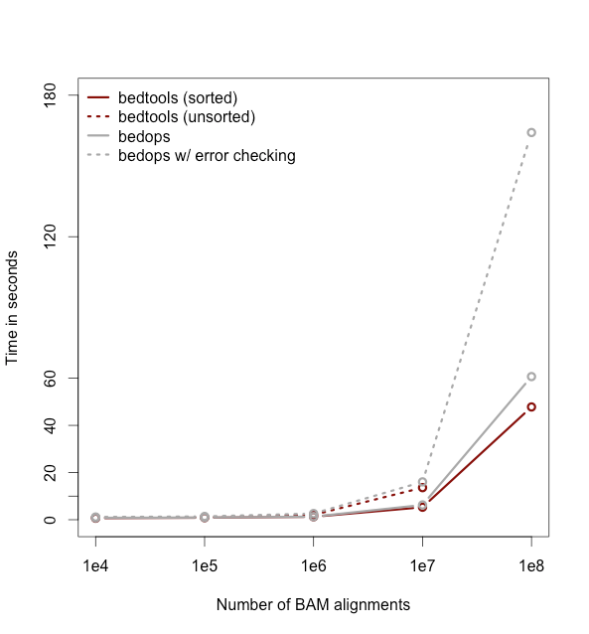
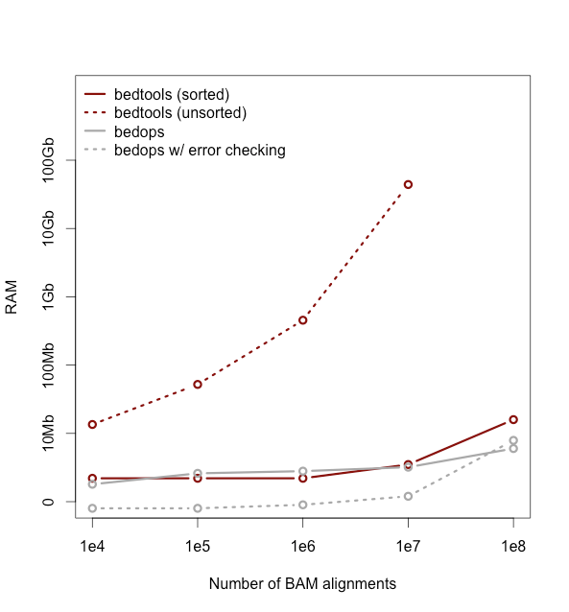
Data….

Slide 34
Genome arithmetic depends upon the genome and the coordinate system
0
7
4
10
CAGTCGACATAGACTGATATGACACCACACTGAG...
0 5 10 15 20 25
chr3
chr3 | 0 | 7
chr3 | 4 | 10

Slide 35
Genomic coordinates – 1 vs 0 based
chr1 | T | A | C | G | T | C | A
1-based | 1 | 2 | 3 | 4 | 5 | 6 | 7
0-based | 0 | 1 | 2 | 3 | 4 | 5 | 6 | 7
 | 1-based | 0-based
Indicate a single nucleotide | chr1:4-4 G | chr1:3-4 G
Indicate a range of nucleotides | chr1:2-4 ACG | chr1:1-4 ACG
Indicate a single nucleotide variant | chr1:5-5 T/A | chr1:4-5 T/A
1-based : Single nucleotides, variant positions, or ranges are specified directly by their corresponding nucleotide numbers
  GFF, SAM, VCF, Ensembl browser, …
0-based: Single nucleotides, variant positions, or ranges are specified by the coordinates that flank them
  BED, BAM, UCSC browser, …

Slide 36
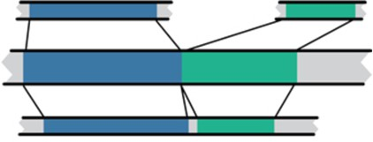
Genome builds
Lift-over
Reference Genome builds
Current human: GRCh38, hg38, b38
Mouse mm10
alternates: GRCh38v2_ccdg,
GRCh38_full_analysis_set_plus_decoy_hla
Human hg19
Previous human: GRCh37, hg19, b37
Human GRCh38
Current mouse: GRCm39, mm39
Previous mouse: GRCm38, mm10
build 38
17 7565256 7590863 TP53 build 37
17 7661779 7687550 TP53
New human assembly: T2T-CHM13, pan-genomes

Slide 37
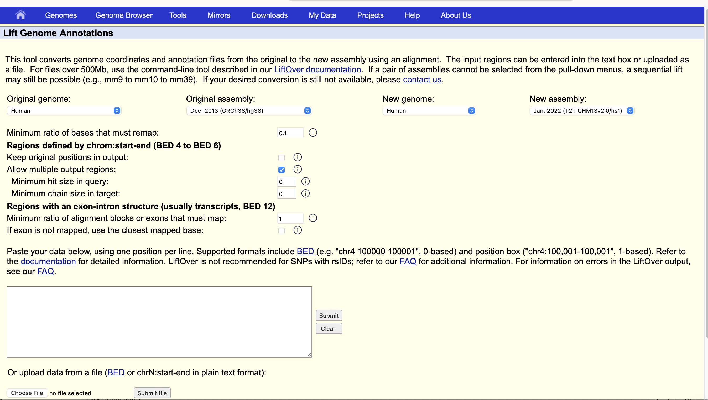

Slide 38
Bedtools: example analyses
Closest gene to a ChIP-seq peak.
Is my latest discovery novel?
Is there strand bias in my data?
How many genes does this mutation affect?
Where did I fail to collect sequence coverage?
Is my favorite feature significantly correlated with some other feature?
What is the density of variants in "windows" along the genome?
http://bedtools.readthedocs.io/en/latest/

Slide 39
Assignment: work through the bedtools tutorial.
https://sandbox.bio/tutorials/bedtools-intro
Non-interactive version: http://quinlanlab.org/tutorials/bedtools.html

