Slide 1

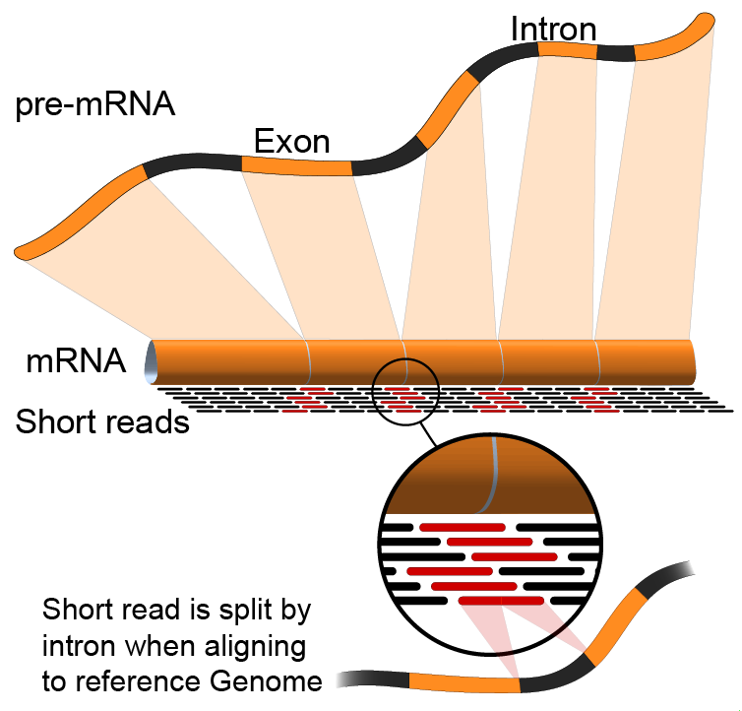

Module 1:
FASTA/FASTQ/GTF
Arpad Danos, Felicia Gomez, Obi Griffith, Malachi Griffith,
My Hoang, Mariam Khanfar, Chris Miller, Kartik Singhal
Advanced Sequencing Technologies & Bioinformatics Analysis November 5-19, 2023

Slide 3
We are on a Coffee Break & Networking Session

