Slide 1


Canadian Bioinformatics Workshops
www.bioinformatics.ca
bioinformaticsdotca.github.io
Supported by

Slide 2


Slide 3

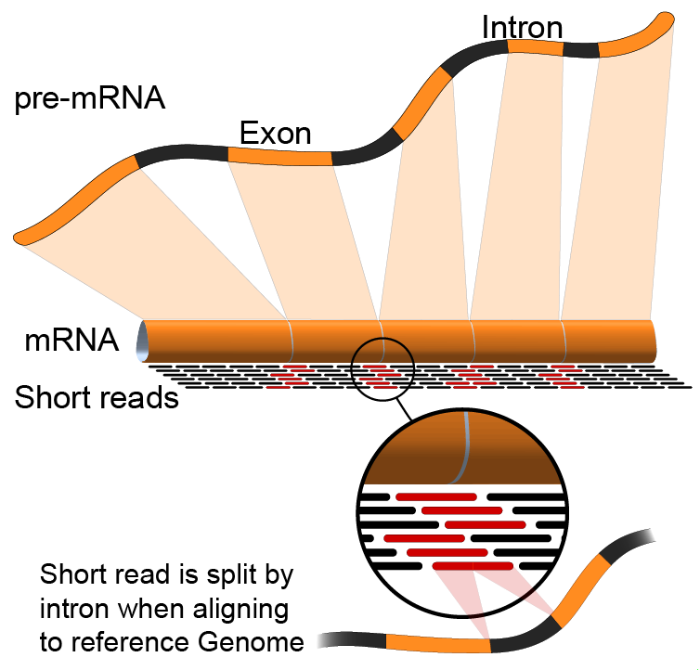

FASTA/FASTQ/GTF
Emma Bell, Felicia Gomez, Obi Griffith, Malachi Griffith, Huiming Xia
RNA-Seq Analysis
Sep 8th-10th, 2021

Slide 4
Fasta – format for representing nucleic acid or amino acid sequences
First line starts with “>” header or ”Comment”; used as a summary/description, often starting with unique accession/identifier
>AY274119.3 Severe acute respiratory syndrome-related coronavirus isolate Tor2, complete genome
ATATTAGGTTTTTACCTACCCAGGAAAAGCCAACCAACCTCGATCTCTTGTAGATCTGTTCTCTAAACGA
ACTTTAAAATCTGTGTAGCTGTCGCTCGGCTGCATGCCTAGTGCACCTACGCAGTATAAACAATAATAAA
TTTTACTGTCGTTGACAAGAAACGAGTAACTCGTCCCTCTTCTGCAGACTGCTTACGGTTTCGTCCGTGT
TGCAGTCGATCATCAGCATACCTAGGTTTCGTCCGGGTGTGACCGAAAGGTAAGATGGAGAGCCTTGTTC
TTGGTGTCAACGAGAAAACACACGTCCAACTCAGTTTGCCTGTCCTTCAGGTTAGAGACGTGCTAGTGCG
TGGCTTCGGGGACTCTGTGGAAGAGGCCCTATCGGAGGCACGTGAACACCTCAAAAATGGCACTTGTGGT
…
>FJ882960.1 SARS coronavirus ExoN1 isolate P3pp34, complete genome
CGATCTCTTGTAGATCTGTTCTCTAAACGAACTTTAAAATCTGTGTAGCTGTCGCTCGGCTGCATGCCTA
GTGCACCTACGCAGTATAAACAATAATAAATTTTACTGTCGTTGACAAGAAACGAGTAACTCGTCCCTCT
TCTGCAGACTGCTTACGGTTTCGTCCGTGTTGCAGTCGATCATCAGCATACCTAGGTTTCGTCCGGGTGT
…
Subsequent lines contain sequence
Interleaved: sequence broken into multiple lines of characters
Sequential: entire sequence on a single line
Multiple sequence FASTA obtained by simply concatenating multiple FASTA records together

Slide 5
Fastq – format for representing raw sequence – base calls and quality values
First line starts with “@” header or ”Comment”; followed by sequence identifier and optional description
@HWUSI-EAS100R:6:73:941:1973#0/1
CTTTTTTATTTTTGTCTGACTGGGTTGATTCAAAA
+
CCCFFFFFHHHHGJHIIJHIHIIIFHIJJJJIJJGIBBFGE
@HWUSI-EAS100R:6:2303:11793:37095#0/1
ATGAATTATAGGGCTGTATTTTAATTTTGCATTTTAA
+
@@??BDDFFF<FHEGFFGGIEBGHIIIIIBEHIIGIH<FHE
Sequence line
Spacer line
Quality values
Next sequence record

Slide 6
Read naming conventions
@HWUSI-EAS100R:6:73:941:1973#0/1
Instrument ID
Tile
Index
Lane
X/Y coords
Pair
Filter status
@EAS139:136:FC706VJ:2:2104:15343:197393:GATTACT+GTCTTAAC 1:Y:0:ATCACG
Instrument ID
Flowcell
tile
UMI
Control #
Run
lane
x/y coords
Pair
Index

Slide 7
Quality values - Phred scores and ASCII glyphs
Phred Q | Probability (P) of Wrong Base | Base Call Accuracy | Sanger “Q + 33” Shift | Sanger “Q + 33” Shift ASCII glyph
0 | 1 | 0 | 33 | !
1 | 0.794 | 0.206 | 34 | “
2 | 0.631 | 0.369 | 35 | #
10 | 0.1 | 0.9 | 43 | +
20 | 0.01 | 0.99 | 53 | 5
30 | 0.001 | 0.999 | 63 | ?
Encoding History:
Sanger Format (shown above): Q of 0 to 93 using ASCII 33 to 126
Sanger data, SAM format, Illumina 1.8+
Solexa/Illumina 1.0: Q of -5 to 62 using ASCII 59 to 126
Illumina 1.3 to 1.8: Q of 0 to 62 using ASCII 64 to 126
Illumina 1.5 to 1.7: Phred scores 0 to 2 have a slightly different meaning
Illumina 1.8+ -> Sanger Format
Notes:
http://www.somewhereville.com/2011/12/16/sanger-and-illumina-1-3-and-solexa-phred-score-q-ascii-glyph-base-error-conversion-tables/
https://en.wikipedia.org/wiki/FASTQ_format#Quality

Slide 8
GFF/GTF - representing sequence features
GFF – General/Generic Feature Format; Gene Finding Format
Two versions in wide use
GFF2 (see also GTF)
GFF3
Added formal support for multiple levels (and direction) of hierarchy (e.g., gene -> transcript -> exon)
GTF – Gene Transfer Format
An extension of GFF2
GFF2, GFF3 and GTF are all tab-separate files with 9 fields
Differing content in 9th column

Slide 9
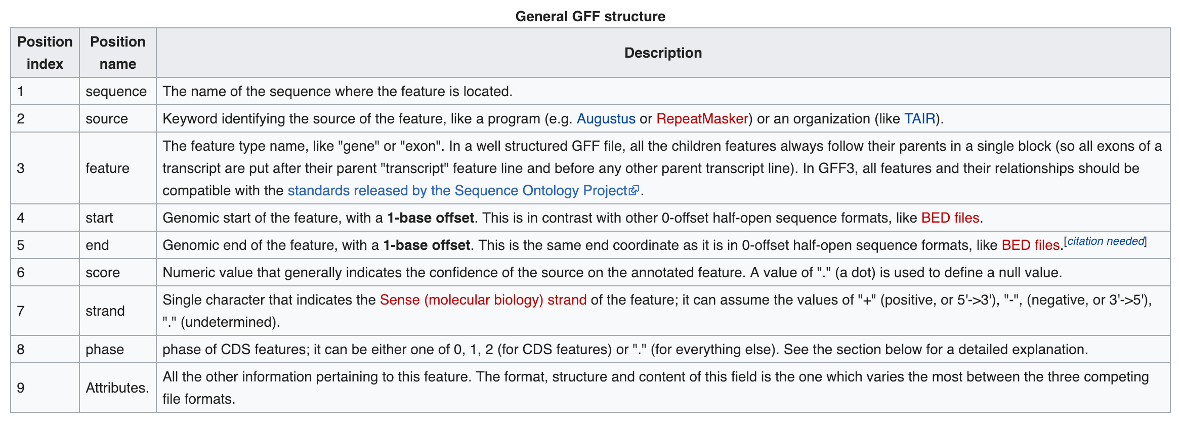
GFF/GTF – general structure
https://en.wikipedia.org/wiki/General_feature_format
Notes:
https://en.wikipedia.org/wiki/General_feature_format

Slide 10
Ensembl GTF example record
22 ensembl start_codon 11066501 11066503 . + 0 gene_id "ENSG00000279973”; …
Sequence Name
Feature
End
Strand
Attributes
Source
Start
Score
Phase/Frame
Example of attributes string:
gene_id "ENSG00000279973”; gene_version "1"; transcript_id "ENST00000624155"; transcript_version "1"; exon_number "1"; gene_name "BAGE5"; gene_source "ensembl"; gene_biotype "protein_coding"; transcript_name "BAGE5-201"; transcript_source "ensembl"; transcript_biotype "protein_coding"; tag "basic"; transcript_support_level "1";
Note: there will be many GTF records/rows per transcript per gene (UTRs, start_codon, exons, etc)
Notes:
gene_id "ENSG00000279973”; gene_version "1"; transcript_id "ENST00000624155"; transcript_version "1"; exon_number "1"; gene_name "BAGE5"; gene_source "ensembl"; gene_biotype "protein_coding"; transcript_name "BAGE5-201"; transcript_source "ensembl"; transcript_biotype "protein_coding"; tag "basic"; transcript_support_level "1";

Slide 11






We are on a Coffee Break & Networking Session
Workshop Sponsors:

