Slide 1


Canadian Bioinformatics Workshops
www.bioinformatics.ca
bioinformaticsdotca.github.io
Supported by

Slide 2


Slide 3
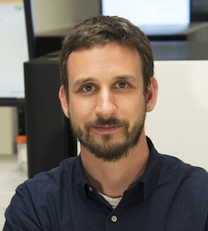
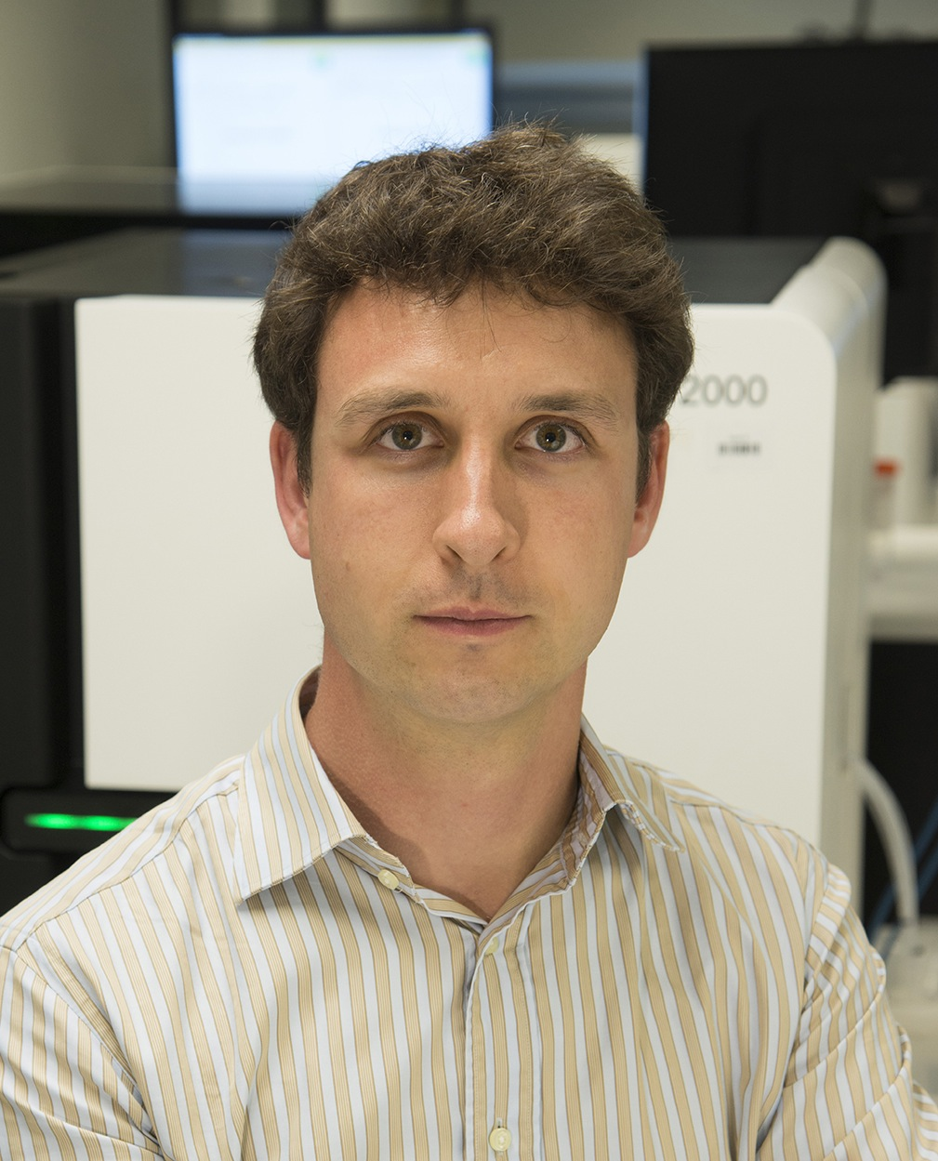
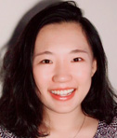
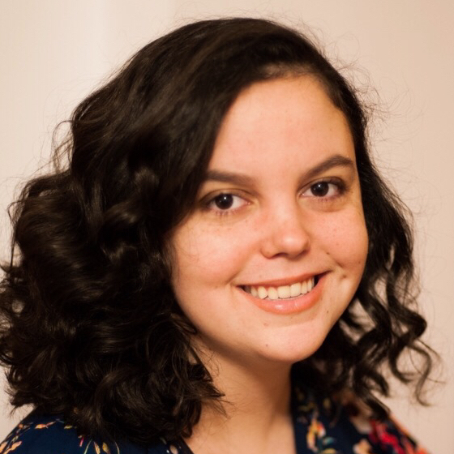
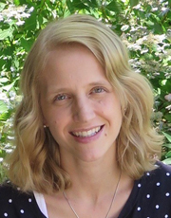
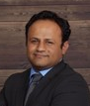


Introductions to Washington University instructors
Kelsy Cotto
PhD candidate
Allegra Petti
Assistant Professor of Medicine
Saad Khan
Bioinformatics Scientist
Malachi Griffith Assistant Professor of Medicine Assistant Professor of Genetics
Assistant Director, MGI
Obi Griffith
Associate Professor of Medicine Associate Professor of Genetics
Assistant Director, MGI
Huiming Xia
PhD candidate
PETTI LAB
griffithlab.org
rnabio.org genviz.org pmbio.org
This will be our first virtual workshop!

Slide 4
Student poll
Not counting the pre-requisites and materials for this course:
Do you consider yourself a bioinformatician?
Are you familiar with linux/command line?
Intermediate?
Expert?
Do you sometimes write code?
Are you familiar with R?
Intermediate?
Expert?
Do you use git/github?
What organism do you work with?
Are you interested in bulk RNAseq (Yes), scRNAseq (No), or both (hand)?
Who has a dual monitor setup?

Slide 5




We are on a Coffee Break & Networking Session
Workshop Sponsors:

