Slide 1

Meeting #13. The Central Limit Theorem and Error Bars
Aaron Quinlan
October 14, 2019
bit.ly//sllobs
Notes:
Open up RStudio, you can find the lecture as usual on the github site

Slide 2

The Central Limit Theorem
Applied Computational Genomics
https://github.com/quinlan-lab/applied-computational-genomics
Aaron Quinlan
Departments of Human Genetics and Biomedical Informatics
University of Utah
quinlanlab.org

Slide 3
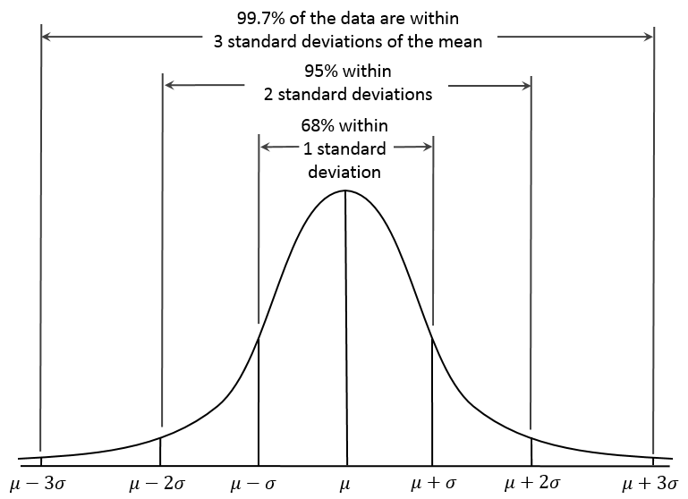
Recall: Gaussian (Normal) distributions
Two parameters: mean (𝜇) and standard deviation (𝜎)

Slide 4
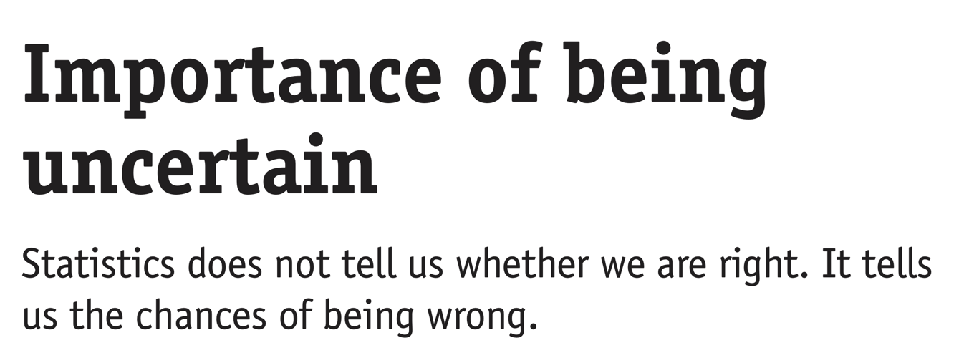
https://www.nature.com/articles/nmeth.2613.pdf

Slide 5
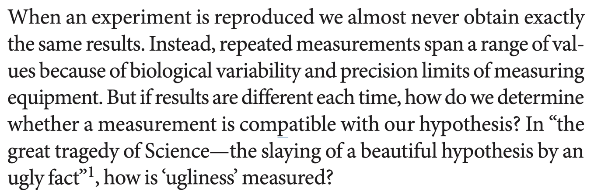
https://www.nature.com/articles/nmeth.2613.pdf

Slide 6
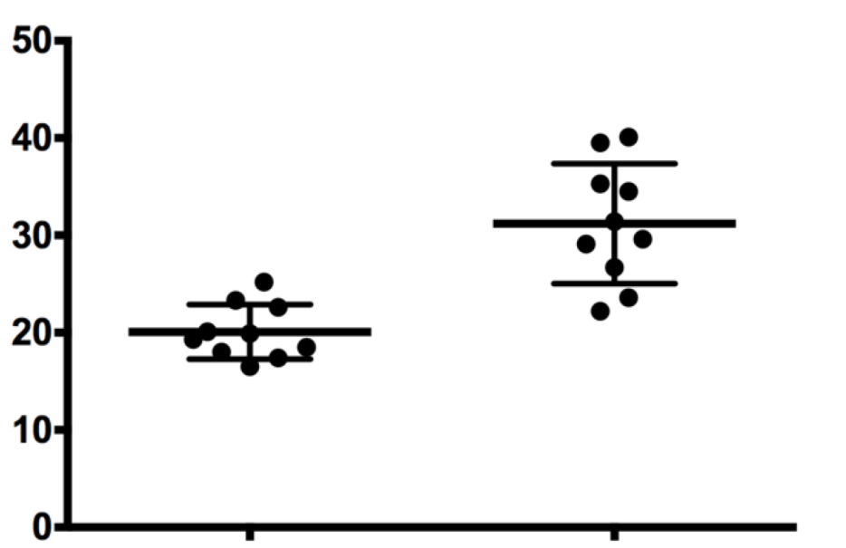
We are rarely able to observe an entire population. Instead, we take (ideally) random samples.
Measure of interest
Untreated
Treated

Slide 7
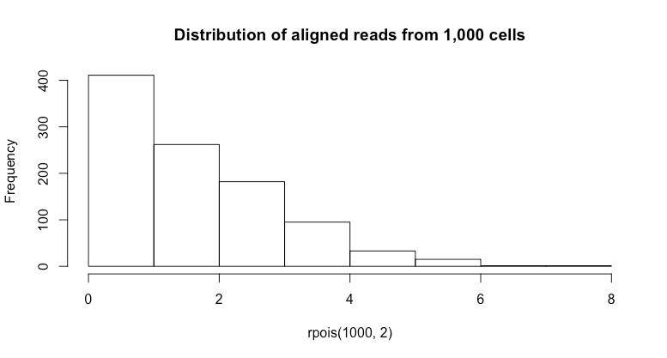
Example: observed read alignments at TP53 from all single cells
hist(rpois(1000,2), main="Distribution of TP53 transcript counts from 1,000 single cells")

Slide 8
This is a "population distribution" of our random variable:
(i.e., TP53 expression in single cells)

Slide 9
Single cell sequencing is expensive:
What if we can only count reads at TP53 from 4 cells at a time? This is a size 4 sample to estimate the population
# sample 1
> rpois(4,2)
[1] 4 1 4 1
# sample 2
> rpois(4,2)
[1] 2 2 1 3
# sample 3
> rpois(4,2)
[1] 0 0 3 0
# sample 4
> rpois(4,2)
[1] 1 4 1 1
# sample 5
> rpois(4,2)
[1] 0 1 0 2
# sample 1 mean
2.5
# sample 2 mean
2.0
# sample 3 mean
0.75
# sample 4 mean
1.75
# sample 5 mean
0.75
0 1 2 3 4 5 6

Slide 10
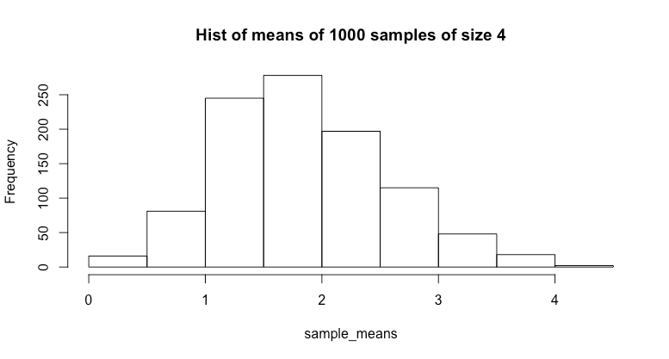
Let's repeat this 1000 times using
a sample of 4 cells.
What does this distribution look like?
# sample 1
> rpois(4,2)
[1] 2 2 2 0
# sample 2
> rpois(4,2)
[1] 2 2 1 3
...
# sample 1000
> rpois(4,2)
[1] 0 1 0 2
# sample 1 mean
1.5
# sample 2 mean
1.0
# sample 1000 mean
1.75

Slide 11
Central Limit Theorem:
As the sample size increases, the means of samples will become increasingly close to a normal distribution with a mean (𝞵) equal to the mean of the population!
Population mean = 2
Mean of the sample means = 1.97

Slide 12
Sampling distribution simulator
https://onlinestatbook.com/stat_sim/sampling_dist/

Slide 13
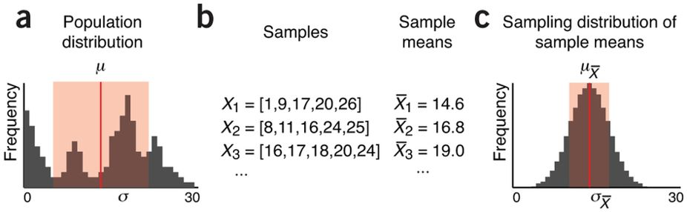
Central Limit Theorem holds true for any distribution
"Just like the population, the sampling distribution [of sample means] is not directly measurable because we do not have access to all possible samples. However, it turns out to be an extremely useful concept in the process of estimating population statistics."
https://www.nature.com/articles/nmeth.2613/figures/2

Slide 14
Why do we care?
Knowing that the sample means will always be normally- distributed means (ha!) that we don't need to know the properties of underlying population distribution.
This allows us to compute confidence interval
Run t-tests between samples of two different populations
Run ANOVAs between samples of three or more different populations
https://www.nature.com/articles/nmeth.2613/figures/2

Slide 15
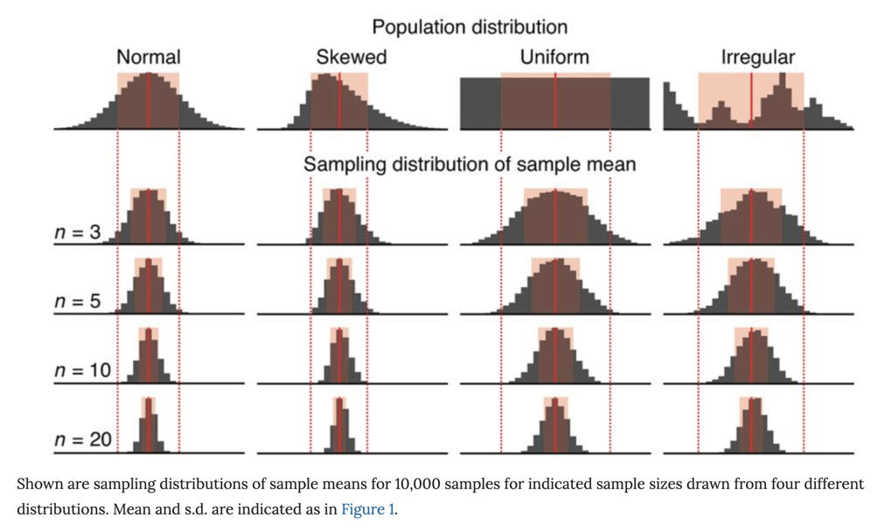
With larger sample sizes (n), the standard deviation of the sample means decreases
Standard deviation of the sample means
σX̅ = σ/√n
Standard deviation of the
population
As n increases, σX̅ decreases. That is, the samples will have more similar means. Most importantly, when using a larger n, your sample mean is much more likely to be close to the true population mean. This is important in biology because we typically do one sample of size n (i.e., n replicates).
https://www.nature.com/articles/nmeth.2613/figures/3

Slide 16
Be wary of small sample sizes. They can cause many of the sample means to vary substantially from the true population mean
"It is still possible for a sample mean to fall far from the population mean, especially for small n. For example, in ten iterations of drawing 10,000 samples of size n = 3 from the irregular distribution, the number of times the sample mean fell outside μ ± σ (indicated by vertical dotted lines) ranged from 7.6% to 8.6%.
Thus, use caution when interpreting means of small samples."

Slide 17
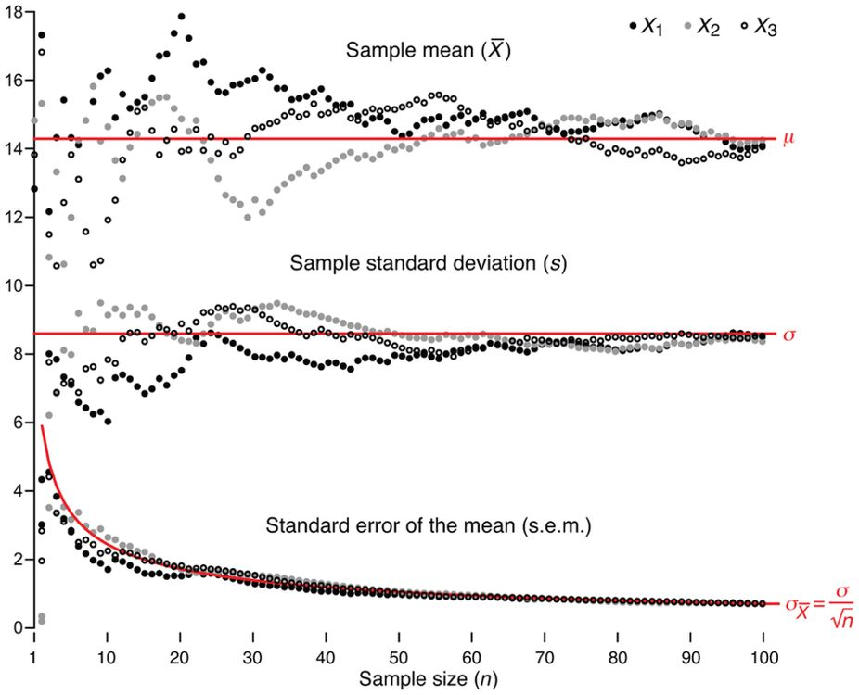
Samples better approximate population as n increases.
A sample size of 30 is often recommended.
The measured spread of sample means is also known as the standard error of the mean (s.e.m., SEX̅) and is used to estimate σX̅, which we cannot know because we cannot collect all possible samples.

Slide 18
Estimates from samples have uncertainty.
How can we quantify the degree to which a (random) sample's mean and standard deviation is a good representation of the true population's mean and standard deviation?

Slide 19
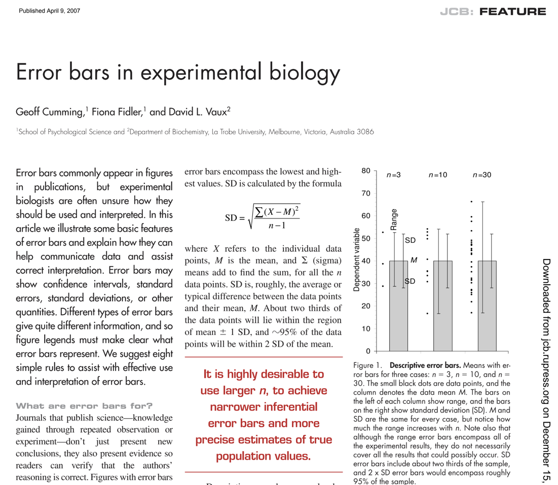
Error bars are commonly used, misused, and misunderstood

Slide 20
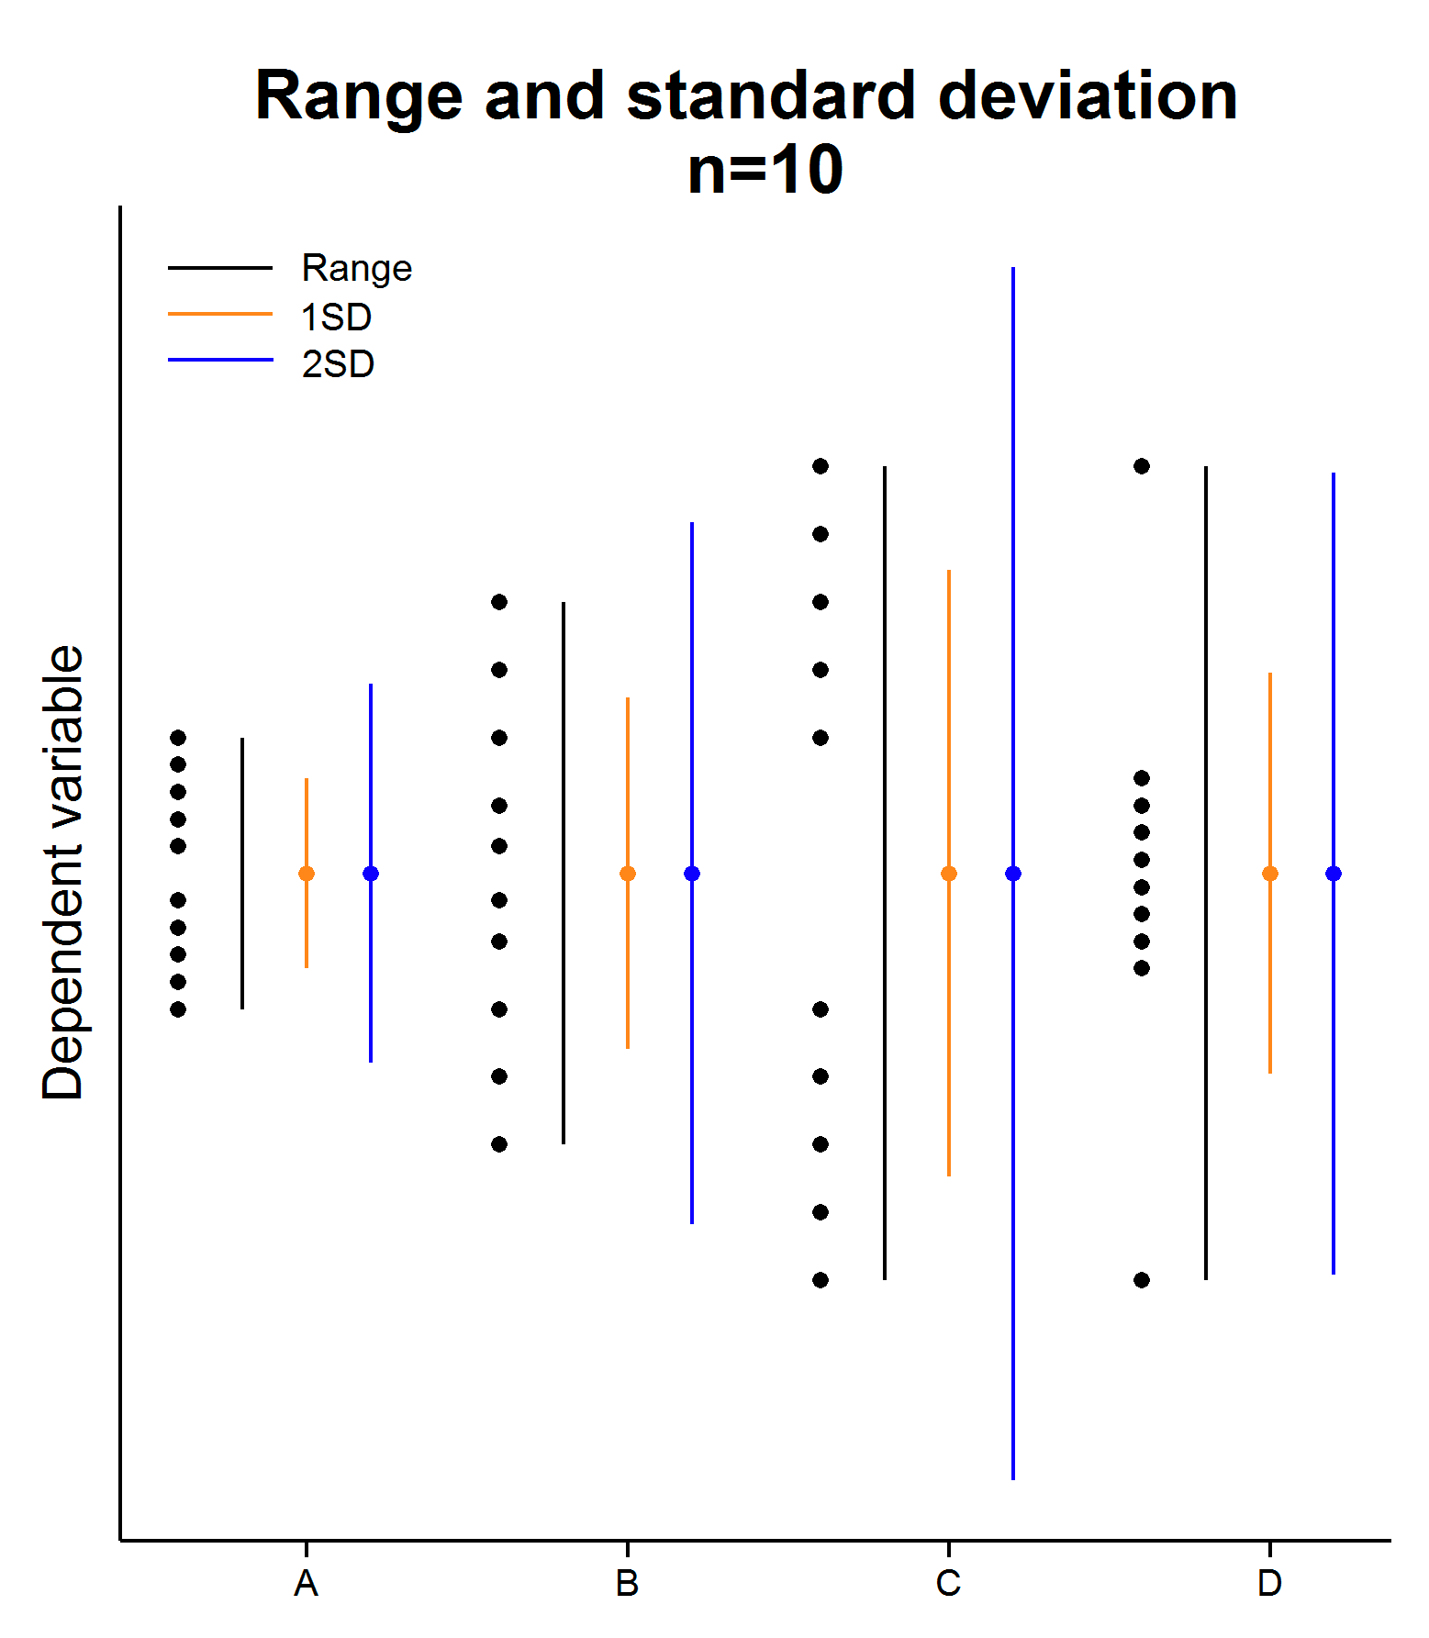
Two types of error bars: descriptive and inferential
Descriptive error bars
Meant to give show the “spread” of the data
Range (min to max value)
Standard deviation (SD)
Useful for asking whether a single result fits within a normal range (e.g., cholesterol levels)
Not useful for comparison of conditions or groups

Slide 21
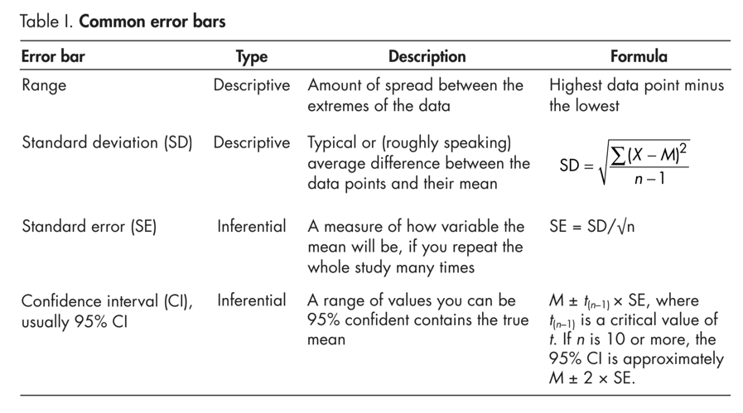
Two types of error bars: descriptive and inferential
In biology, we typically want to compare samples from different groups or experimental conditions (e.g., wild-type to mutant, experimental versus control). In order to make inferences and convey whether the groups are significantly different beyond what could be expected by random chance, we should use inferential error bars
SE and CI give a sense of where the mean of the complete population should lie

Slide 22
Rule #1: Legends must state type of error bar
Because error bars can be descriptive or inferential, and could be any of the bars below or even something else, they are meaningless, or misleading, if the legend does not state what kind they are.

Slide 23
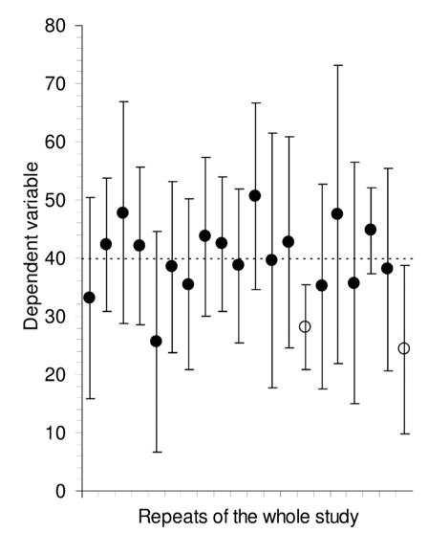
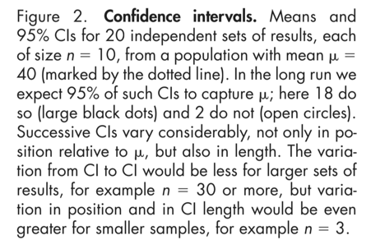
Confidence Intervals as error bars
In 20 repetitions of the study, the true population mean (dashed line)
fell outside of the 95% CI twice. In the long run (that is, if we did this hundreds or thousands of times, it should fall outside of the CI 5% of the time
A big advantage of inferential error bars is that their length gives a graphic signal of how much uncertainty there is in the data: We are asserting that the 95% of the intervals we make will cover the true population mean (μ). Wide inferential bars indicate large error; short inferential bars indicate high precision.

Slide 24

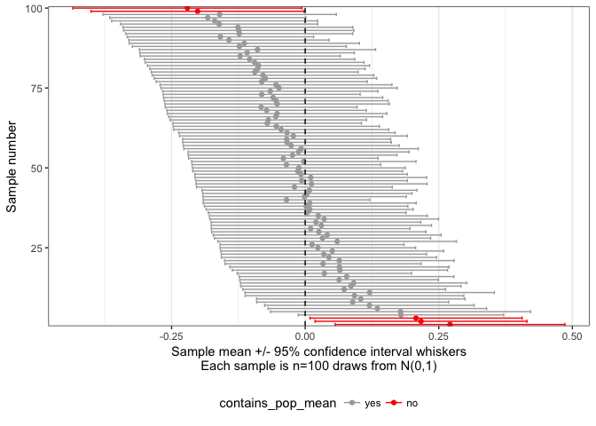
Confidence Intervals as error bars
Code to generate CI simulation: https://github.com/leonjessen/confidence_intervals_visualised
Hat tip to Brent Pedersen: https://twitter.com/LucyStats/status/1181542102779531264

Slide 25
Rule #2: The value of n (i.e., the sample size, or the number of independently performed experiments) must be stated in the figure legend.
What is n?
N is the number of independent experiments, not the number of replicates
Example: you select one mutant and one wild type mouse and perform 10 experiments in replicate on each of their tails.
The mean and SD of the replicates is not sufficient for a figure, as n=1 for each mouse genotype. This design does not measure natural variation from animal to animal.
“If an experiment involves triplicate cultures, and is repeated four independent times, then n = 4, not 3 or 12. The variation within each set of triplicates is related to the fidelity with which the replicates were created, and is irrelevant to the hypothesis being tested.”

Slide 26
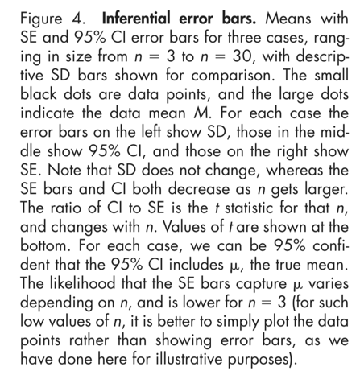
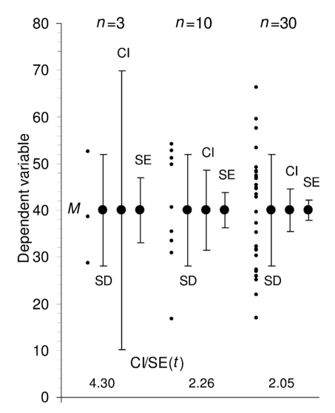
Inferential error bars shrink with larger n
Rule #3: error bars and statistics should only be shown for independently repeated experiments, and never for replicates. If a “representative” experiment is shown, it should not have error bars or P values, because in such an experiment, n = 1

Slide 27
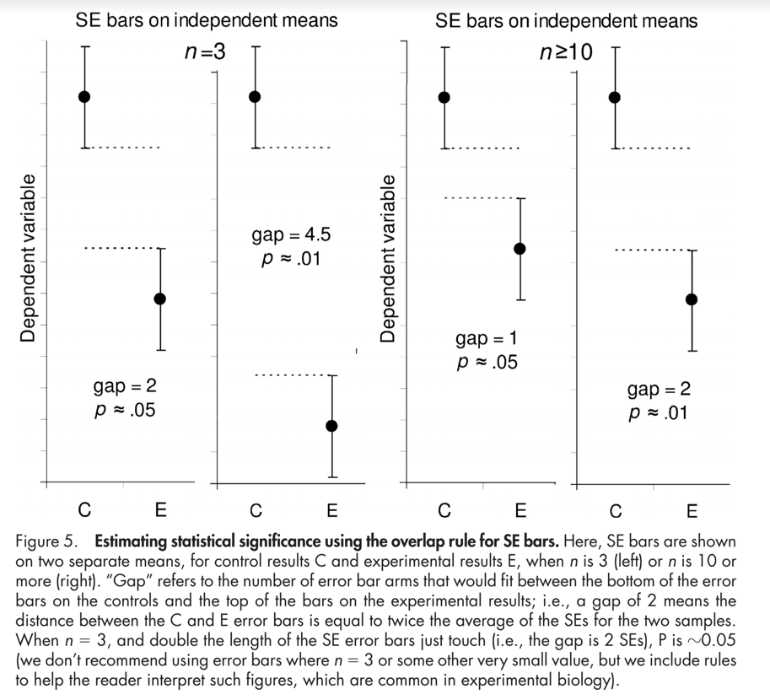
Estimating significance with inferential SE error bars
The “Gap” refers to the number of error bar lengths that separate the two conditions.
When N=3 and Gap between the control and experimental SE error bars is >= 2, then P~0.05.
However, when N>=10, a gap of >=2 yields P~0.01.

Slide 28
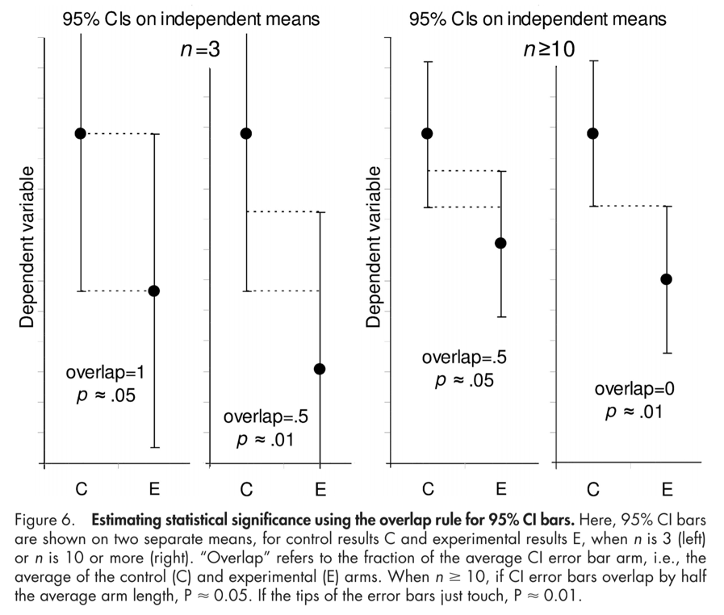
Estimating significance with inferential CI error bars
When n=3 and overlap between the control and experimental SE error bars is 1, then P~0.05.
However, when n>=10, an overlap of 0.5 yields P~0.05.
When using CI and n>=10, error bars that touch (overlap = 0), p~0.01.
Know the type of error bar to know how to interpret the error bar overlap.

Slide 29
Overall recommendation for comparison / inference. Use confidence intervals for error bars.
“Determining CIs requires slightly more calculating by the authors of a paper, but for people reading it, CIs make things easier to understand, as they mean
the same thing regardless of n. For this reason, in medicine, CIs have been recommended for more than 20 years, and are required by many journals.”

