Slide 1

SNP and INDEL discovery
CSHL Advanced Sequencing Technologies 2022
11/17/2022
Joshua Mincer, Jason Kunisaki
Notes:
Today, we’ll be going over the technical and statistical ways in which we can confidently call a mutation seen in the genome as a true variant!

Slide 2

Goal: find all inherited variants in an individual's diploid genome.
Notes:
Let’s start off with an example. Say we have an individual, and our goal is to find all of the inherited variants in an individual’s diploid genome. That is, all variants that can be traced back to either their mom or dad.

Slide 3
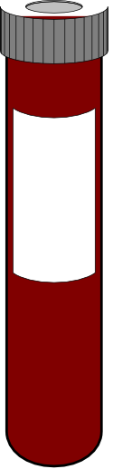
Find inherited genetic variation by sequencing DNA
from millions of cells
A
G
A
G
A
G
A
G
A
G
A
G
A
G
A
G
A
G
x millions
Notes:
The way that we would do this is taking a biospecimen, most commonly a blood sample, and sequencing some million chromosomes from some million cells from the sample.
We usually wouldn’t know this information before-hand, but for this example, let’s assume that we can trace all information back these colored haploids; one haploid of the genome is pink and the other haploid is purple, representing the two parental haploids.

Slide 4
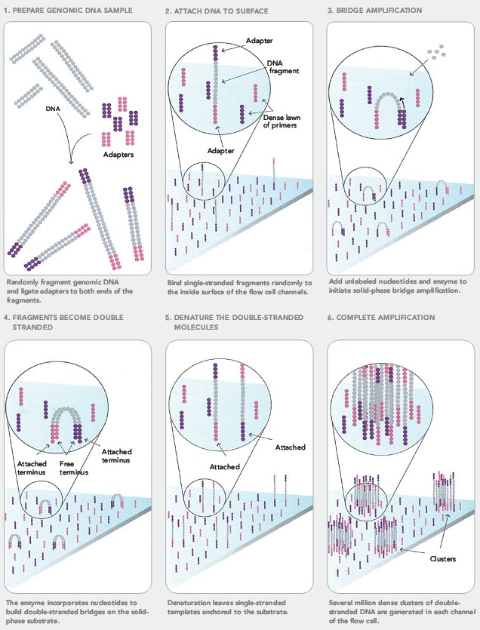
Each DNA cluster is amplified from a single strand from a single haploid chromosome from a single cell.
A
G
@seq1
@seq1
ACCTTCGAACGGCGGGGGGTTACAA
+
!''*((((***+))%%%++).1***
@seq2
TGGAACCGAACGGCCCCGGTTACAT
+
!''*!!!!***+))+++++).1***
@seq3
ACCTTCGAACGGCGGGGGGTTACAA
+
!''*((((***+))%%%++).1***
@seq4
TGGAACCGAACGGCCCCGGTTACAT
+
!''*!!!!***+))+++++).1***
@seq2
A
G
@seq3
@seq4
Notes:
Has everyone gone through sequencing before?
When we sequence the genomes, we typically PCR-amplify these haploids.
In the case of bridge amplification, each cluster of DNA is amplified from a single haploid.
The amplification allows us to get (hopefully) confident reads for the DNA fragment that was amplified.
When sequenced, we’ll generate FASTQ-format files, which have a sequence read followed by a ASCII symbols that correspond to a quality score for each base.
These sequences are then aligned to a reference genome of your choosing, and in the case of whole genome sequencing, each position in the genome should have some amount of reads aligned to that position.
Using this information as a baseline, let’s look at a couple of examples of what these reads aligned to a genome can look like.

Slide 5
Scenario 1: An individual is homozygous for the "reference" allele.
♂
♀
Ref
ATCGGGTACCATCCAATCATTACC
♂
ATCGGGTACCATCCAATCATTACC
♀
ATCGGGTACCATCCAATCATTACC
Notes:
For the first example, let’s look an individual that is homozygous for the “reference” allele, or both haploids of their genome contains the same base as the reference genome.
In this case, that’s a T.

Slide 6
Scenario 1: An individual is homozygous for the "reference" allele.
T
T
@seq1
@seq1
ACCTTCGAACGGCGGGGGGTTACAA
+
!''*((((***+))%%%++).1***
@seq2
TGGAACCGAACGGCCCCGGTTACAT
+
!''*!!!!***+))+++++).1***
@seq3
ACCTTCGAACGGCGGGGGGTTACAA
+
!''*((((***+))%%%++).1***
@seq4
TGGAACCGAACGGCCCCGGTTACAT
+
!''*!!!!***+))+++++).1***
@seq2
T
T
@seq3
@seq4
Notes:
We follow this same process: amplifying our haploids via PCR, using our sequencer to get some reads, and aligning these reads back to the reference genome.

Slide 7
Scenario 1: An individual is homozygous for the "reference" allele.
Ref
ATCGGGTACCATCCAATCATTACC
GGTACCATCCAAT
T
T
ATCGGGTACCAT
GGGTACCATCCAA
TCGGGTACCATC
T
T
CGGGTACCATCC
GGGTACCATCCA
CGGGTACCATCCA
Notes:
In an ideal world, this is what we would see.
In the image, the top sequence is our reference genome, the purple sequences are reads generated from the purple haploid, and the pink sequences are reads generated from the pink haploid. We would not necessarily know this information in isolation, but this helps illustrate our variant calling concept.
For the homozygous reference allele, we would expect all of our reads to have the T allele at the same position as the reference genome, since the individual is homozygous reference and all of the reads are amplified from these haploids.

Slide 8
Scenario 2: An individual is homozygous for an "alternate" allele.
♂
♀
Ref
ATCGGGTACCATCCAATCATTACC
♂
ATCGGGCACCATCCAATCATTACC
♀
ATCGGGCACCATCCAATCATTACC
Notes:
Now let’s take a look at an individual that is homozygous for the alternate allele, which differs from the reference genome.

Slide 9
Scenario 2: An individual is homozygous for an "alternate" allele.
C
C
@seq1
@seq1
ACCTTCGAACGGCGGGGGGTTACAA
+
!''*((((***+))%%%++).1***
@seq2
TGGAACCGAACGGCCCCGGTTACAT
+
!''*!!!!***+))+++++).1***
@seq3
ACCTTCGAACGGCGGGGGGTTACAA
+
!''*((((***+))%%%++).1***
@seq4
TGGAACCGAACGGCCCCGGTTACAT
+
!''*!!!!***+))+++++).1***
@seq2
C
C
@seq3
@seq4
Notes:
Both of the haploids of the genome will have this mutation at the position of interest. Let’s go through the same annealing and sequencing pipeline…

Slide 10
Scenario 2: An individual is homozygous for an "alternate" allele.
Ref
ATCGGGTACCATCCAATCATTACC
GGCACCATCCAAT
C
C
ATCGGGCACCAT
GGGCACCATCCAA
TCGGGCACCATC
C
C
CGGGCACCATCC
GGGCACCATCCA
CGGGCACCATCCA
Notes:
And our reads should all theoretically have this alternate allele at this position in the genome. In our example, the reference genome has a T base, but all of the reads for the diploid of the individual have the C allele.

Slide 11
Scenario 3: An individual is heterozygous for an "alternate" allele.
♂
♀
Ref
ATCGGGTACCATCCAATCATTACC
♂
ATCGGGCACCATCCAATCATTACC
♀
ATCGGGTACCATCCAATCATTACC
Notes:
Lastly, let’s look at a little more of a complicated case. In scenario 3, our individual is heterozygous for the position in a gene of interest.

Slide 12
Scenario 3: An individual is heterozygous for an "alternate" allele.
C
T
@seq1
@seq1
ACCTTCGAACGGCGGGGGGTTACAA
+
!''*((((***+))%%%++).1***
@seq2
TGGAACCGAACGGCCCCGGTTACAT
+
!''*!!!!***+))+++++).1***
@seq3
ACCTTCGAACGGCGGGGGGTTACAA
+
!''*((((***+))%%%++).1***
@seq4
TGGAACCGAACGGCCCCGGTTACAT
+
!''*!!!!***+))+++++).1***
@seq2
C
T
@seq3
@seq4
Notes:
In this instance, one of the haploids has the reference allele of T and the other haploid has an alternate allele of C. This information should be propagated through our sequencing pipeline and will be represented in our reads.

Slide 13
Scenario 3: An individual is heterozygous for an "alternate" allele.
Ref
ATCGGGTACCATCCAATCATTACC
GGTACCATCCAAT
C
T
ATCGGGCACCAT
GGGTACCATCCAA
TCGGGCACCATC
C
T
CGGGCACCATCC
GGGCACCATCCA
CGGGTACCATCCA
Notes:
This is what these reads could potentially look like, where our purple reads from our purple haploid has the reference allele and our pink reads has the alternate C allele. Theoretically, we would think that about 50% of our reads will have the reference allele and 50% of the reads will have the alternate allele.

Slide 14
Why might finding heterozygous variants be harder?
Notes:
Can anyone tell me why it might be a little more difficult to identify heterozygous variants?
When we’re sequencing an individual, we’re randomly sampling the reads that were generated from an individual’s diploid. If the haploids aren’t the same, then there is the potential that one haploid is sampled more than the other when we read our data.
Take the previous example. We have 7 reads, 4 containing the alternate allele and 3 containing the reference allele; about a 57% to 43% split.
So, this begs the question. How much sampling and how much data do we need to be confident in our genotyping calls?

Slide 15
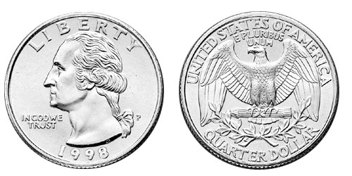
The binomial distribution: adventures in coin flipping
P(heads) = 0.5
P(tails) = 0.5
Notes:
To answer this question, we can look towards binomial distribution statistics. A binomial distribution is the probability of seeing one of two outcomes, such as flipping a coin or calling a genotype in a heterozygous individual.

Slide 16
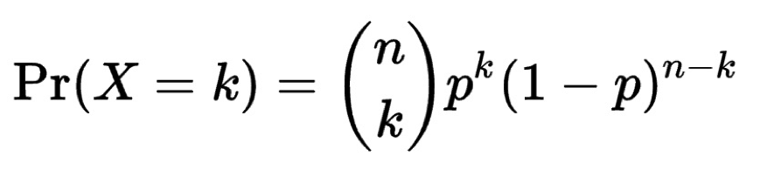
Thinking about allele sampling with the binomial distribution
The binomial distribution with parameters n and p is the discrete probability distribution of the number of successes in a sequence of n independent yes (e.g., "heads" or "reference allele") or no (e.g., "tails", or "alternate allele") experiments, each of which yields success with probability p.
The probability of getting exactly k successes in n trials is given by the probability mass function:
What is the probability of seeing k=1 tails in n=3 flips of a fair coin with the probability of a tail (p) = 0.5?
3 choose 1 = 3; 0.5¹ = 0.5; (1-0.5)⁽³⁻¹⁾ = 0.25. So…. 3*0.5*0.25 = 0.375
In R, the function would be: dbinom(1, size=3, prob=0.5)
Notes:
Statistically speaking, the binomial distribution with parameters n for number of p for probability is the discrete probability distribution of the number of successes in a sequence of n independent yes or no experiments, each of which yields with probability p.
In human terms, it’s the probability that you’ll see some number of yeses and some number of no’s in some number of flips of a coin.
The notation below means:
The probability of some number of successes, k, is equal to successes in a number of attempts multiplied by the probability of the event k times multiplied by 1 minus the probability raised to the number of trials minus the number of successes. I won’t be able to explain why any of this was decided this way, because statisticians way smarter than me figured this out a while ago and it turns out to work pretty well.
Let’s look at an example to solidify it. Say we want k=1 successes with n=3 flights with a fair coin, meaning the probability of either heads or tails is 0.5.
The 3 choose 1 evaluates to 3, the probability 0.5 raised to the first power is 0.5, and 1-0.5 raised to the 3-1 is equal to 0.25. This simplifies to 3 times 0.5 times 0.25, which evaluates to 0.375.
Luckily, you don’t have to solve these calculations yourself! R has a function called dbinom that can take inputs n, k, and the probability of success occurring that will calculate this value for you.

Slide 17
What is the distribution of tails (alternate alleles) do we expect to see after 5 tosses (sequence reads)?
Notes:
Let’s return to our allele thought experiment. If we have 5 reads generated from a heterozygous diploid genome, how many alternate alleles do we expect to see?

Slide 18
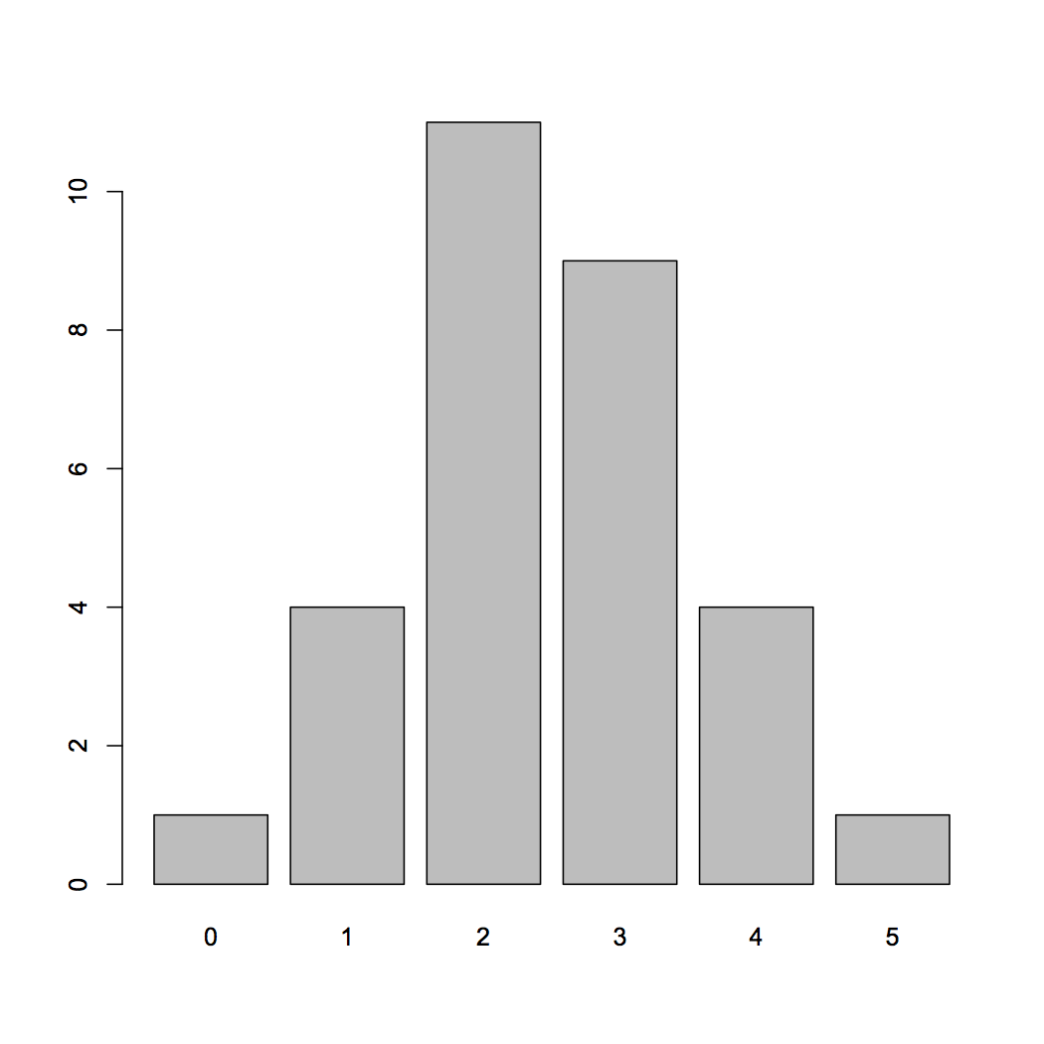
What is the distribution of tails (alternate alleles) do we expect to see after 5 tosses (sequence reads)?
R code:
barplot(table(rbinom(30, 5, 0.5)))
Number of experiments
30 experiments (students tossing coins)
5 tosses each
Probability of Tails
Number of "tails"
Notes:
We can simulate this with a function called “rbinom” in R, which generates a specified number of random values of given probability from a given sample in some number of experiments.
In other terms, we flip a coin five times, record that number of tails, and repeat that 30 times. This creates a simplistic binomial distribution.
If we look at our distribution, the results are not too surprising. Most of the experiments are finding 2 or 3 tails in 5 flips, which checks out with what we expect with a fair coin.
However, there are a couple of experiments where we saw either 5 tails or 0 tails. If we think of these experiments as alleles, then we have some instances where we might be fooled into thinking that the individual is homozygous reference or homozygous alternative for the allele, even though they are heterozygous in truth.

Slide 19
What is the distribution of tails (alternate alleles) do we expect to see after 15 tosses (sequence reads)?
Notes:
Let’s now expand this example and use 15 tosses for each of the experiments.

Slide 20
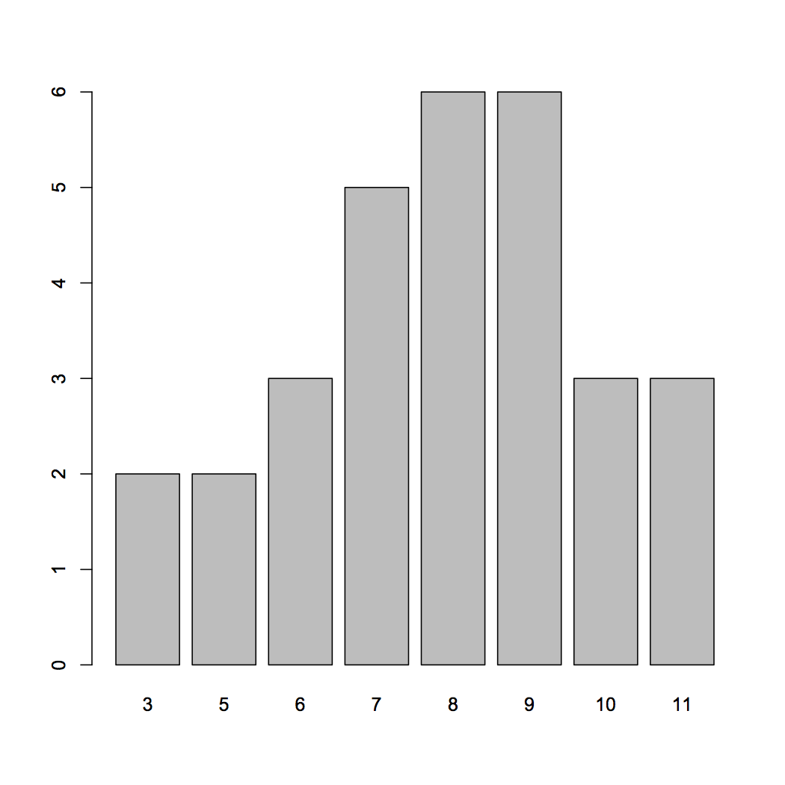
What is the distribution of tails (alternate alleles) do we expect to see after 15 tosses (sequence reads)?
R code:
barplot(table(rbinom(30, 15, 0.5)))
Number of experiments
30 experiments (students tossing coins)
15 tosses each
Probability of Tails
Number of "tails"
Notes:
So, in 30 experiments each with 15 coin tosses, there is an average of 7-9 tails. These results are a little better, but if we got back our sequencing reads and we found 3 alternate alleles and 12 reference alleles, would we have a lot of confidence in this site being a true heterozygote? Probably not.

Slide 21
What is the distribution of tails (alternate alleles) do we expect to see after 30 tosses (sequence reads)?
Record your result in the following spreadsheet:
https://docs.google.com/spreadsheets/d/1i8sA1KMeYc9UhWTnCg0tLFjCy8x5LlsBITcXrz5La94/edit?usp=sharing
Notes:
Lastly, let’s increase to 30 tosses.

Slide 22
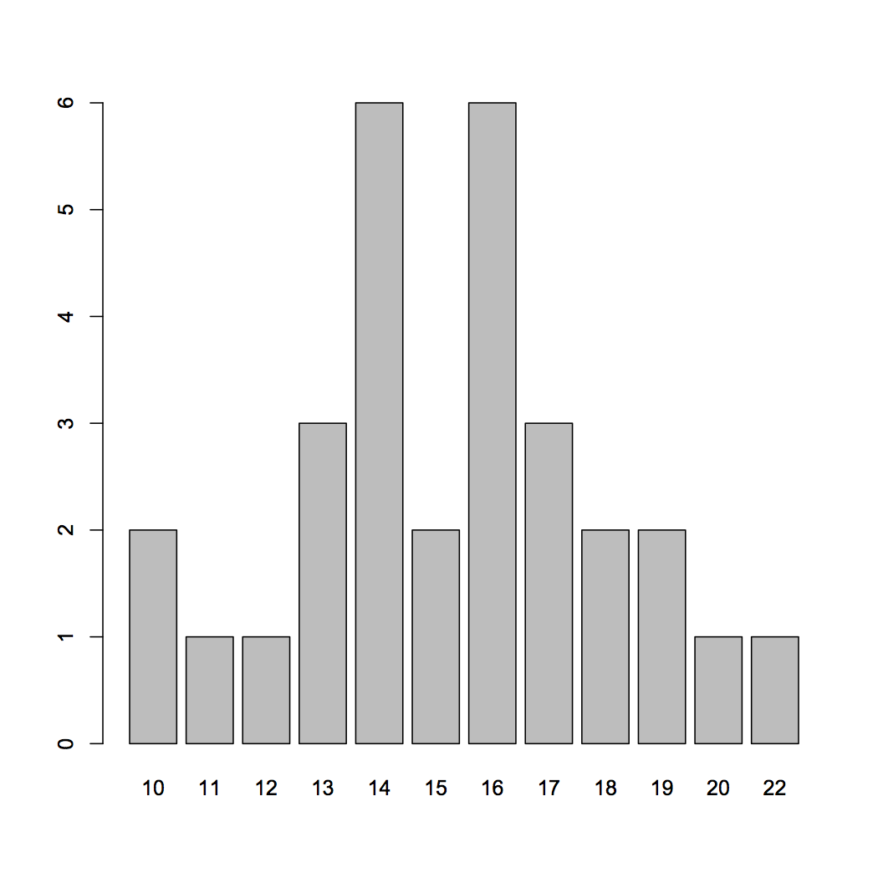
What is the distribution of tails (alternate alleles) do we expect to see after 30 tosses (sequence reads)?
R code:
barplot(table(rbinom(30, 30, 0.5)))
Number of experiments
30 experiments (students tossing coins)
30 tosses each
Probability of Tails
Number of "tails"
Notes:
In this last example. We’re likely to see somewhere between 10-22 successes, or an alternate allele. In this instance, we might be a little more confident that 10 theoretically independent sequencing reads showing an alternate allele points towards a true heterozygote.

Slide 23
So, with 30 tosses (reads), we are much more likely to see an even mix of alternate and reference alleles at a heterozygous locus in a genome
This is why at least a "30X" (30 fold sequence coverage) genome is recommended: it confers sufficient power to find the majority of heterozygous alleles
Number of experiments
Number of "alternate alleles"
Notes:
This probability distribution exercise really illustrates why sequencing depth is important when needing to genotype an individual. With a 30X genome coverage, we have enough power to confidently determine if a genotype is heterozygous or homozygous without sequencing at such a depth that will increase the price of sequencing substantially. This reasoning is typically why datasets are sequenced to 30X coverage.

Slide 24
Depth tackles the allele sampling issue and lower quality scores
Phred Quality Score of 30
Phred Quality Score of 10
Ref
ATCGGGTACCATCCAATCATTACC
GGTACCATCCAAT
ATCGGGCACCAT
GGGTACCATCCAA
TCGGGcACCATC
CGGGcACCATCC
GGGcACCATCCA
CGGGTACCATCCA
Notes:
Furthermore, sequencing to a greater depth can help mitigate some issues that you might encounter with lower quality reads. In this instance, some of our reads might have a low quality, so in isolation we might not be too confident that this site is heterozygous, however with sufficient sequencing depth, we have a greater probability of getting reads that have sufficient quality to make confident calls.

Slide 25
Some real examples of SNPs in IGV: validating variants via manual review
Notes:
And with that, I’ll hand it over to Jason Kunisaki to run y’all through real life examples of this in IGV.

Slide 26
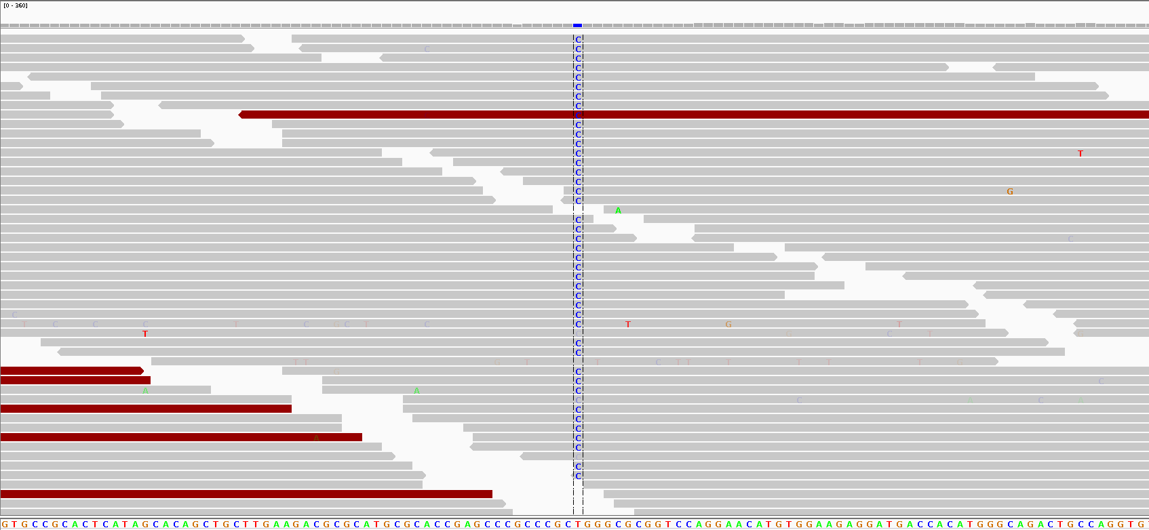
Homozygous for the "C" allele
Notes:
Things to point out:
T>C homozygous variant
There are some reads that don’t have the C allele
Red reads suggests that there is some weird alignment - indicates that the distance between paired end sequencing reads is not normal
Notice the lighter blue C allele
Looking at read with T allele --> has a lot of mismatches suggesting that the alignment quality of the read is suspect

Slide 27
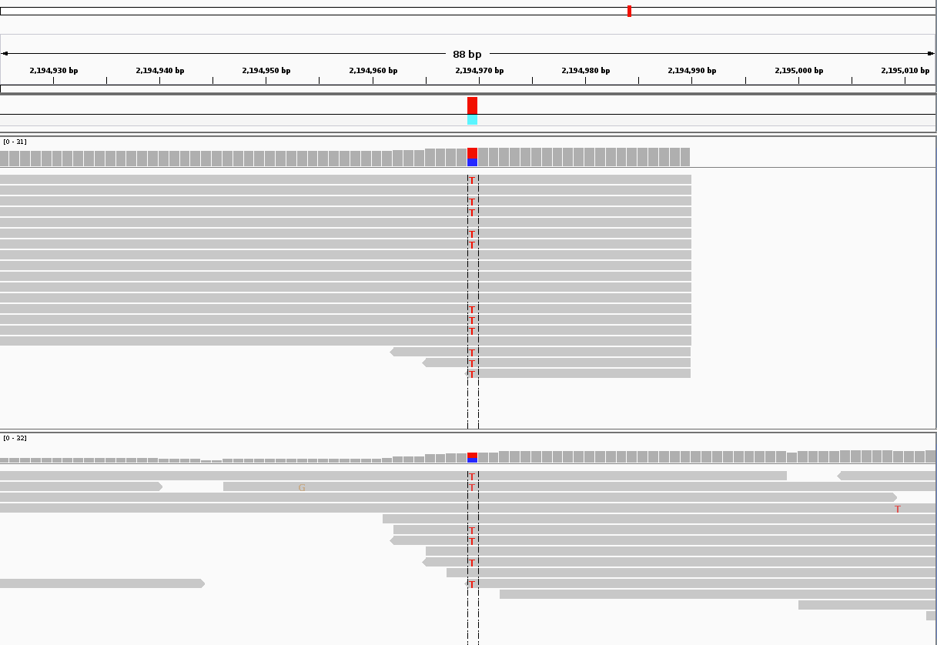
Heterozygous for the alternate allele
Individual 1
Individual 2
Which genotype prediction would you have more confidence in?
Notes:
Two individuals heterozygous at the same site
More confident in the top one
There is more data, more binomial sampling, more coin flips to get the true frequency of the alternate T allele
Less likely to be random chance, true biology

Slide 28
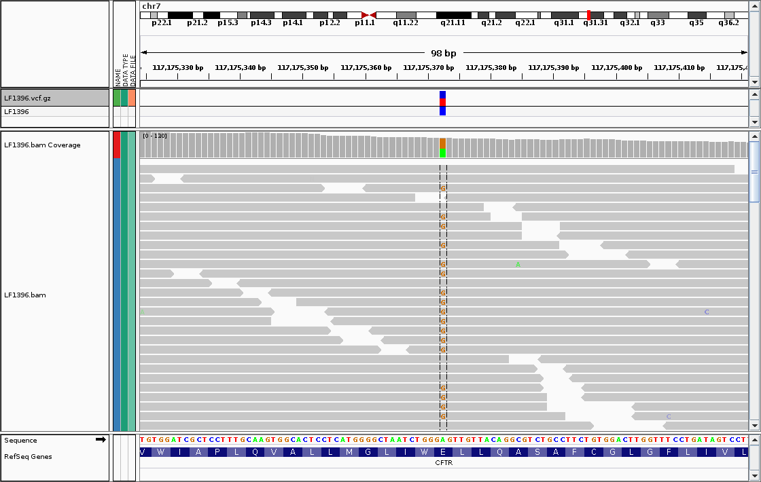
Sequencing errors fall out as noise (most of the time)
Sequencing errors
https://jchoigt.files.wordpress.com/2012/07/igv_e217g_snapshot.png
Notes:
Signal to noise:
Signal = true mutation like G
Noise = sequencing error
98 bp window --> 50 sequencing reads = 98 * 50 nuleotides being sampled
2 errors
Error rate = 2 / (98 * 50)

Slide 29
It is not always so easy

Slide 30
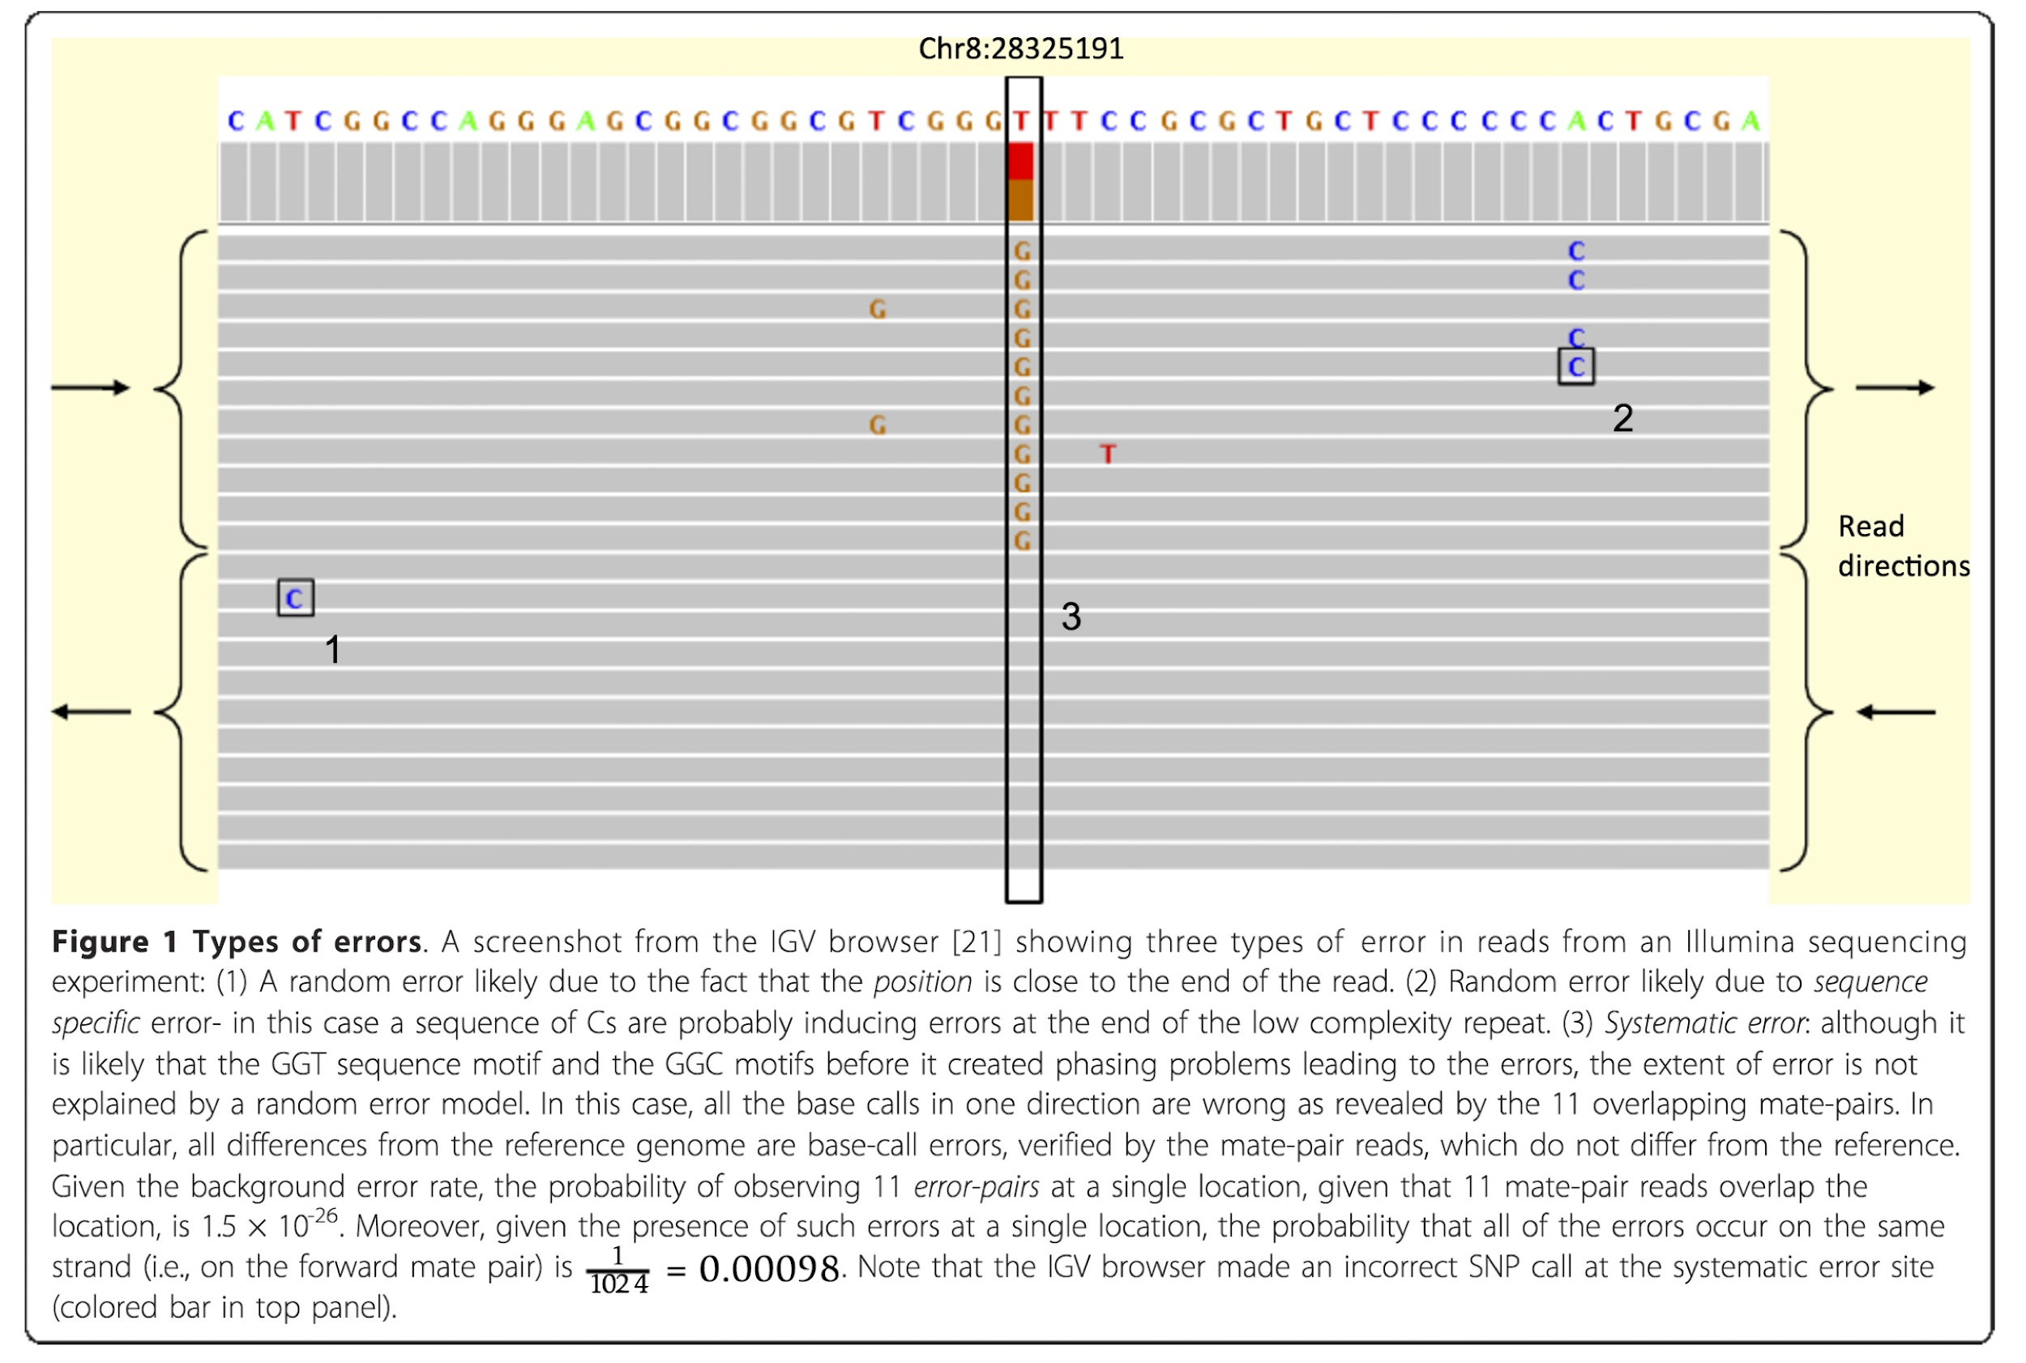
Random versus systematic error
https://www.researchgate.net/publication/51814240_Identification_and_correction_of_systematic_error_in_high-throughput_sequence_data
Notes:
Random error - much simpler to tease apart signal from noise by increasing sequencing coverage
Error due to sequence context - C allele is bleed through from the homopolymer of C’s upstream
Systematic error (not random error):
The binomial probability of the same random error occurring at the exact same site is extremely low
We see 11 C>G variants --> analogous to flipping a coin 11 times and seeing the same G allele --> this is very improbable if this was from random error --> it is either a true variant or a systematic error
This is likely a systematic error - where the aligner makes the same mistake --> pileup seuqences with the error --> masquerade as true mutation when it is a systematic error
Additional sequencing will not resolve systematic errors

Slide 31
Random versus systematic error
https://www.researchgate.net/publication/51814240_Identification_and_correction_of_systematic_error_in_high-throughput_sequence_data

Slide 32
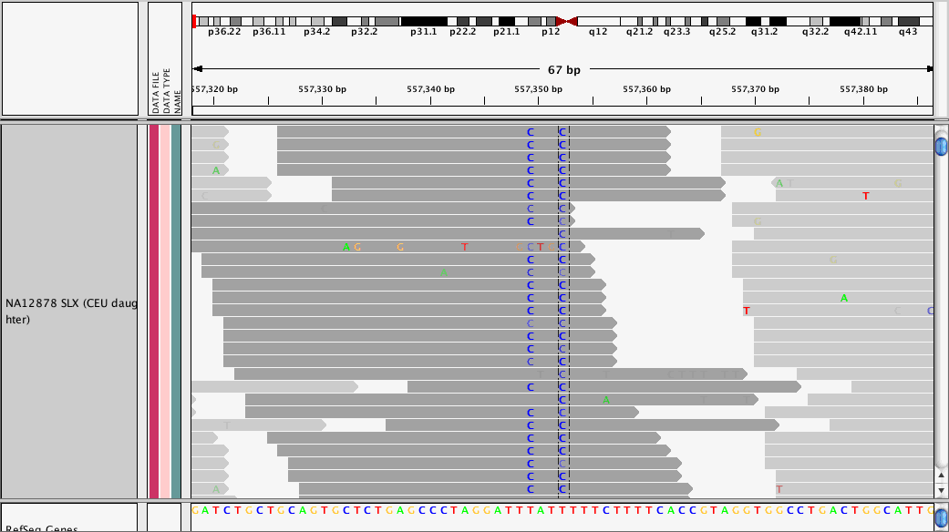
Strand bias from PCR
http://gatkforums.broadinstitute.org/gatk/discussion/49/using-variant-annotator
Notes:
Systematic error:
PCR libraries (exome, targeted seq, maybe chip seq?)
Pileup of reads at this site
All sequences with the C are from the same strand --> this is unexpected
We are sampling reads randomly from both strands of a DNA molecule --> we expect a true variant to be reflected in both directions
This could be caused by PCR bias where an error occurred only on the top strand

Slide 33
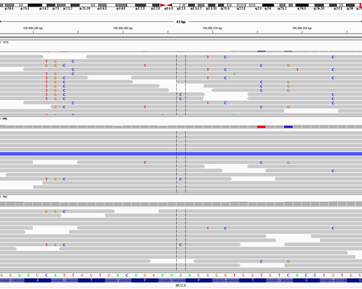

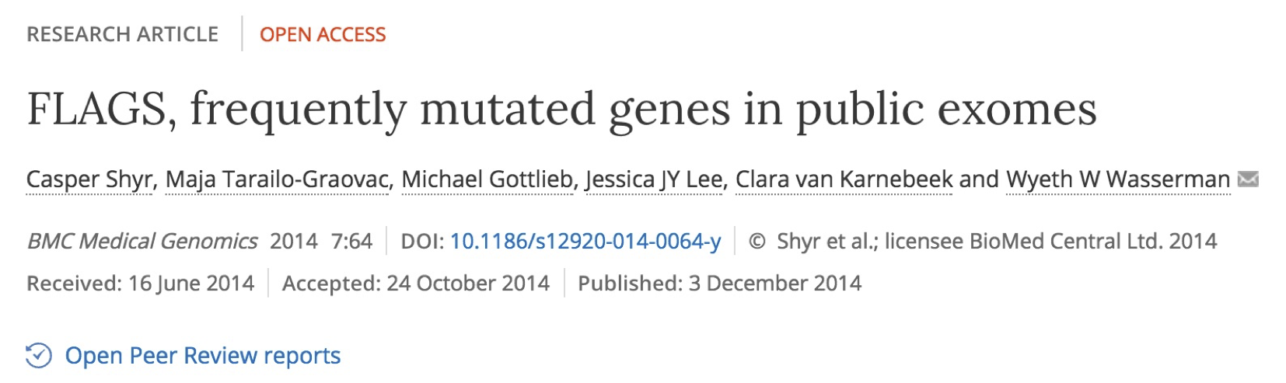
Pileups of many differences from paralogy
http://massgenomics.org/2013/06/ngs-false-positives.html
Notes:
3 panels are BAMs from 3 different individuals
Systematic error:
Reads with lots of differences in them --> higher than the polymorphism and error rate than we would expect
Two humans differ at 1/700 bp
41 base pair window has ~10 “variants”
Why does this happen?
Due to paralogy
There are incredibly repetitive throughout the genome
When we get a read that belongs at one of the two loci, the aligner will put the reads at one locus
Reference genome is depleted for paralogous regions
Paralogous gene families

Slide 34
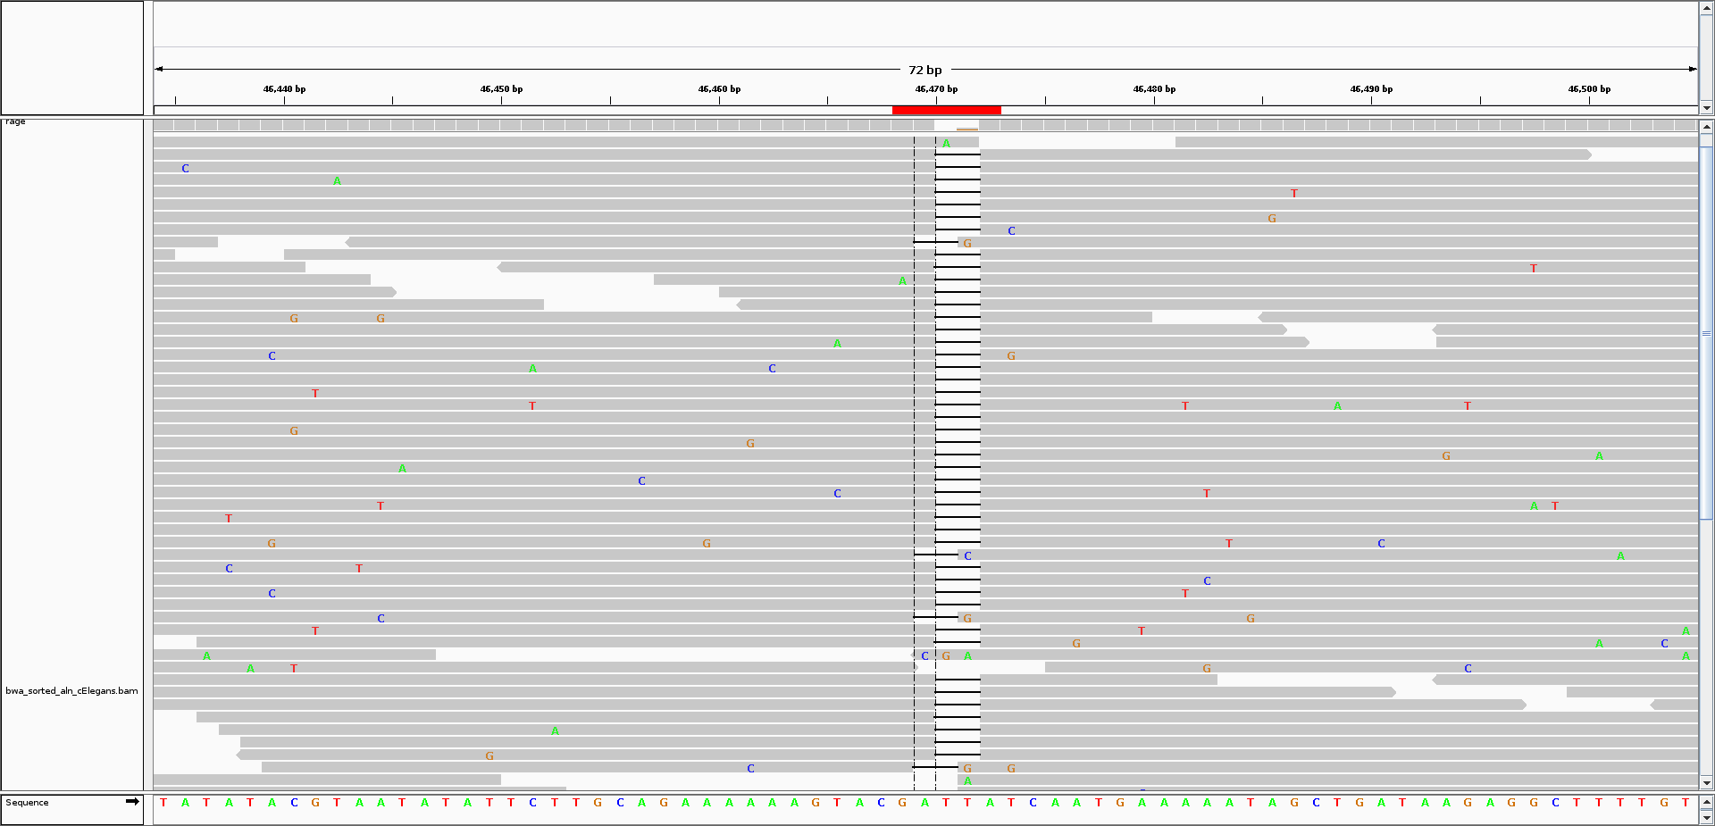
Calling INDELs is _much_ harder than SNPs
Notes:
Shifting to indels, identifying the true start and stop position of INDELs is difficult
Behaves similar to SNPs in terms of the binomial sampling theory --> we need lots of coverage to determine if it is a true variant or not
700-800K indel polymorphisms are in the human genome
Smith-watermann algorithm --> deletions + adjacent nucleotide mismatches leads to inconsistencies about the true start position

Slide 35
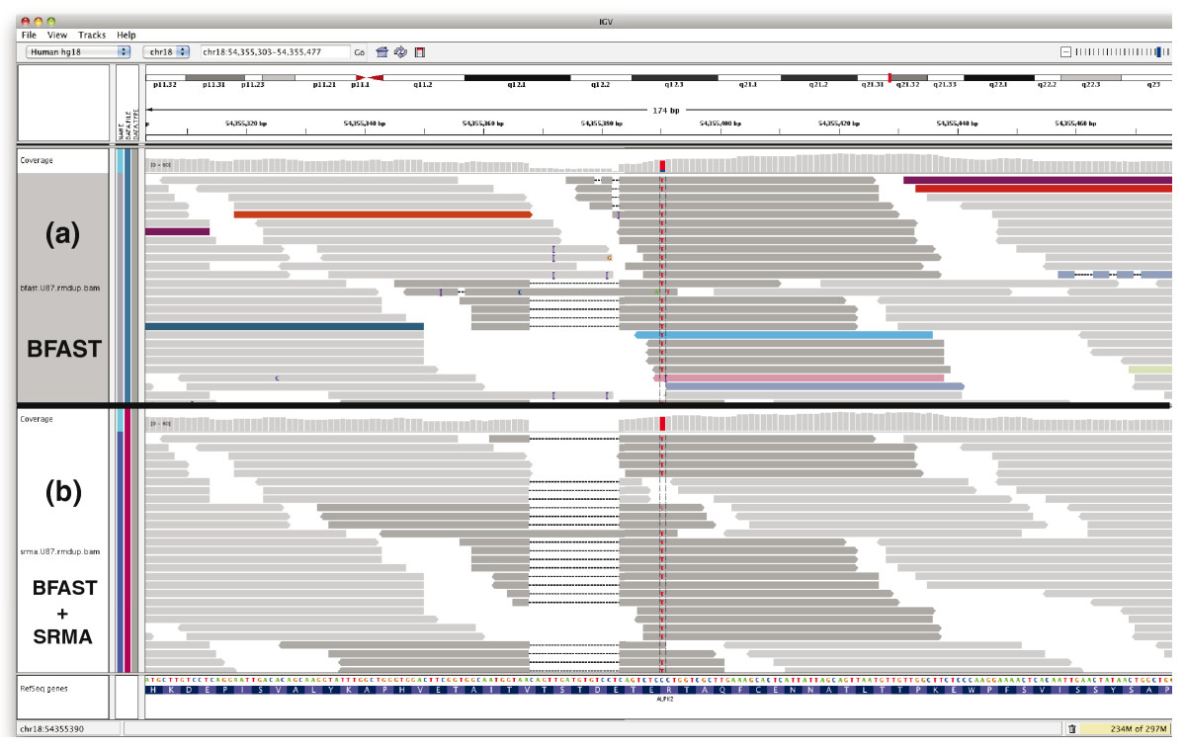
INDEL "realignment"
https://genomebiology.biomedcentral.com/articles/10.1186/gb-2010-11-10-r99
Notes:
GATK does this
Multiple sequence alignment of DNA sequencing reads (similar to protein sequence homology) --> clean up reads with indels to get consistent start and positions
SRMA

Slide 36
Some excellent resources to learn about manual review
Griffith Lab guides to manual review in IGV:
https://rnabio.org/module-02-alignment/0002/04/01/IGV/
Standard operating procedure for somatic variant refinement of sequencing data with paired tumor and normal samples

