Slide 1

bioinformatics.ca
bioinformaticsdotca.github.io

Slide 2
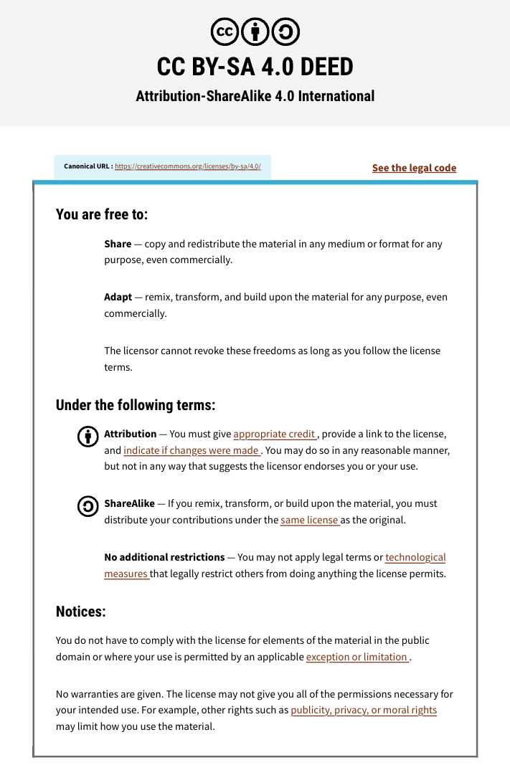

Slide 3

Module #: Title
<INSTRUCTOR NAME>
<WORKSHOP>
<DATES>
Instructor affiliation logos go here

Slide 4
Learning Objectives

Slide 6




Coffee Break & Networking Session
Workshop Sponsors

