Slide 1



Introduction to cloud computing
Obi Griffith, Malachi Griffith,
Charlz Jerold, Allen Li, Jennie Yao, Isabel Risch
Advanced Sequencing Technologies & Bioinformatics Analysis November 8-20, 2026

Slide 2
Learning Objectives
Introduction to cloud computing concepts
Introduction to cloud computing providers
Use the Amazon EC2 console to create an instance for each student
  Will be used for many hands-on tutorials throughout the course
How to log into your cloud instance

Slide 3
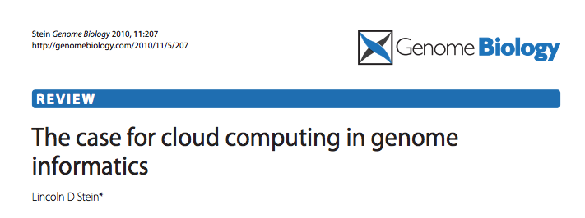
Disk Capacity vs Sequencing Capacity, 1990-2012
Disk Storage
(Mbytes/$)
DNA
Sequencing (bp/$)
1,000,000
1,000,000,000
100,000
100,000,000
10,000,000
10,000
Hard disk storage (MB/$)
Doubling time=14 mo
1,000,000
1,000
100,000
100
10,000
Nextgen sequencing (bp/$)
Doubling time=4 mo
1,000
10
100
Pre-nextgen sequencing (bp/$)
Doubling time=19 mo
1
10
0
1990
1992
1996
1998
2000
2002
2004
2006
2008
2010
1
1994
2012

Slide 4
About DNA and computers
We hit the $1000 genome* in ~2016
  Need to think about the $100 genome
The doubling time of sequencing has been ~5-6 months.
The doubling time of storage and network bandwidth is ~12 months.
The doubling time of CPU speed is ~18 months.
The cost of sequencing a base pair will eventually equal the cost of storing a base pair

Slide 5
What is the general biomedical scientist to do?
Lots of data
Poor IT infrastructure in many labs
Where do they go?
Get bigger hardware?
Write more grants?

Slide 6
Cloud computing providers
Amazon AWS
  https://aws.amazon.com/
Google cloud
  https://cloud.google.com/
Microsoft Azure
  https://azure.microsoft.com/en-us/
More…

Slide 7

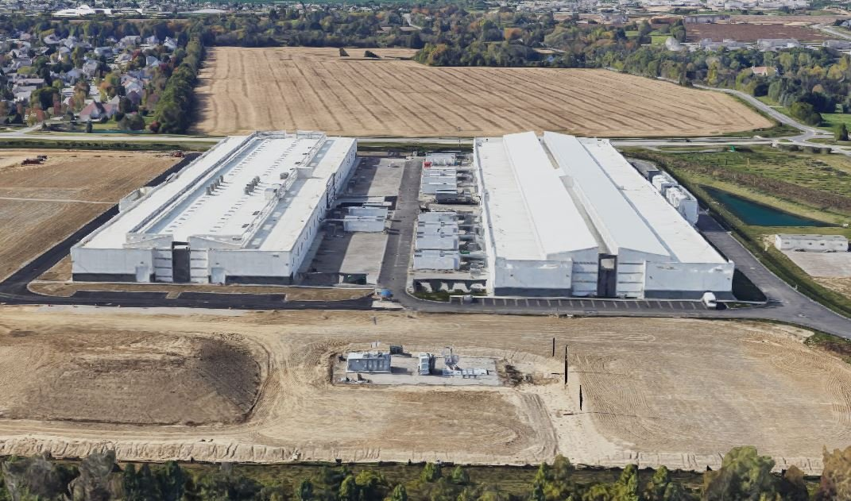
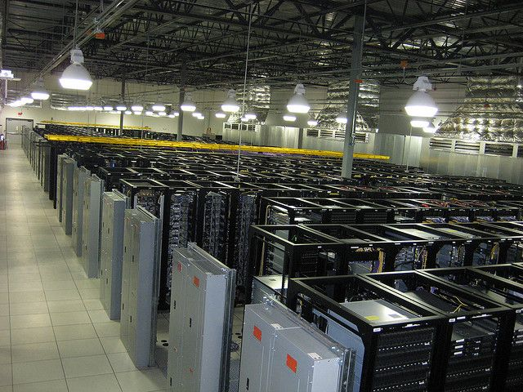
Amazon Web Services (AWS)
Infinite storage (scalable): S3 (simple storage service)
Compute per hour: EC2 (elastic cloud computing)
Ready when you are High Performance Computing
Multiple football fields of HPC throughout the world

Slide 8
Some of the challenges of cloud computing:
Not cheap
Getting files to and from there
Standardization can be a challenge if you don’t control hardware
PHI: personal health information & security concerns
  In the USA: HIPAA act, PSQIA act, HITECH act, Patriot act, CLIA and CAP programs, etc.
  http://www.biostars.org/p/70204/

Slide 9
Some of the advantages of cloud computing:
There are better ways of transferring large files, and now AWS makes it free to upload files.
A number of datasets exist on AWS (e.g. 1000 genome data, TCGA).
Many useful bioinformatics AMI’s (Amazon Machine Images) exist on AWS: e.g. cloudbiolinux & CloudMan (Galaxy) – now one for this course!
Many flavors of cloud available, not just AWS

Slide 10
Key AWS concepts and terminology
AWS - Amazon Web Services. A collection of cloud computing services provided by Amazon.
EC2 - Elastic Compute. An AWS service that allows you to configure and rent computers to meet your compute needs on an as needed basis.
EBS - Elastic Block Storage. A data storage solution that allows you to rent disk storage and associate that storage with your compute resources. EBS volumes are generally backed by SSD devices.

Slide 11
Key AWS concepts and terminology
S3 - Simple storage service. Cheaper than EBS and allows for storage of larger amounts of data with some drawbacks compared to EBS. S3 volumes store data as objects that are accessed by an API or command line interface or other application designed to work with S3. EBS volumes on the other hand can be mounted as if they were a local disk drive associated with the Instance.
SSD - Solid state drive. A particular type of storage hardware that is generally faster and more expensive than traditional hard drives.

Slide 12
What is difference between the 'Start', 'Stop', 'Reboot', and 'Terminate' (Instance States)?
Start – turn on an EC2 instance that you have previously created
Stop – turn off an EC2 instance that you have previously created
Reboot – restart an EC2 instance
Terminate – permanently stop and destroy an EC2 instance. Any associated EBS volumes may also be destroyed at this time depending on configuration

Slide 13
What is an AMI/snapshot?
AMI (Amazon Machine Image) – a template that specifies how to launch EC2 instances
  Root volume with operating system (OS), pre-installed applications, etc
  Launch permissions the determine who can use the AMI
  Specification of (data) volumes to attach when launched
You can create an AMI for any instance you have created/configured
AMI can be made public for sharing (region-specific)
Creating an AMI involves creating a snapshot of the root and any attached volumes. You will be charged to store this snapshot.

Slide 14
I can not log into my EC2 instance, what might have gone wrong?
Is your instance running?
Are you providing the correct path to your key file?
Is it the correct key file?
Have you set the permissions for your key file correctly?
Did you specify a valid user for your AMI (e.g., ubuntu)?
Did you specify the correct IP address?
Does the Security Group for the instance allow access for your connection protocol (e.g., SSH) and location?

Slide 15
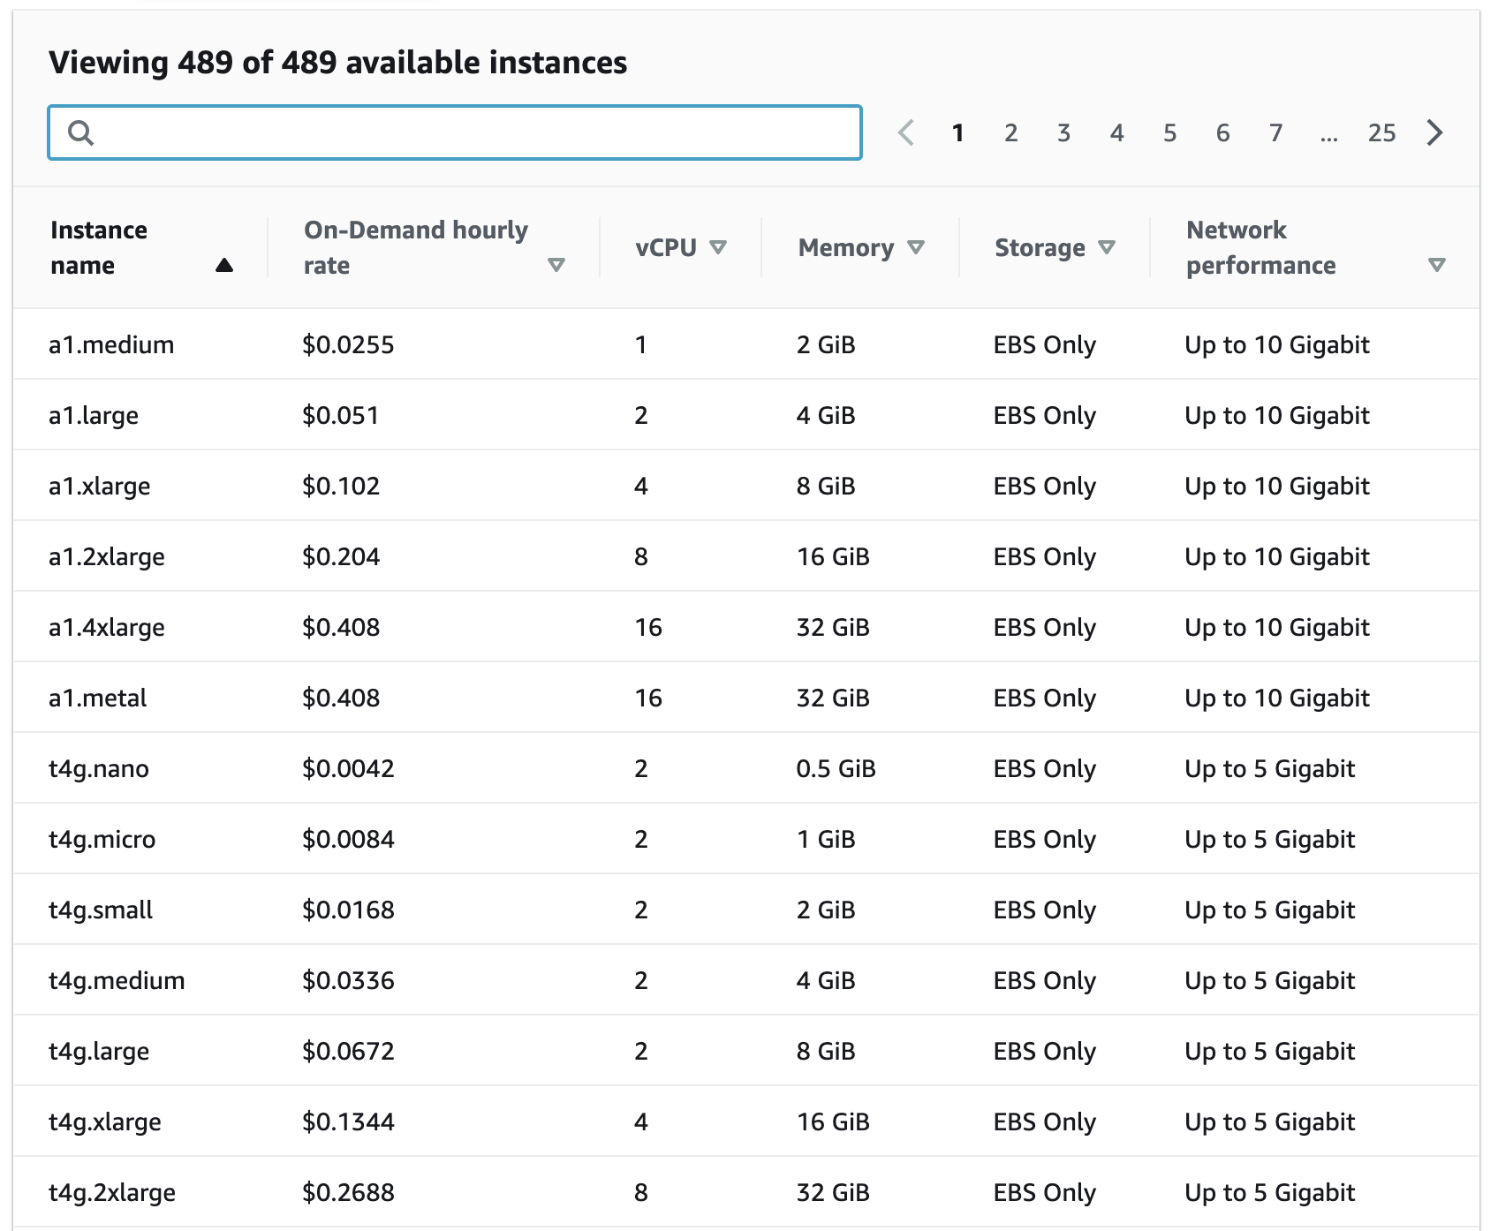
How much does it cost to use AWS EC2 resources?
Data transfer (GB): In: free; Out: first 100 GB free, $0.05-0.09 per GB depending on amount
EBS storage (GB/Month): $0.08
S3 storage (GB/Month): $0.023 standard, $0.0125 infrequent access, or $0.004 glacier

Slide 16
Why am I still getting a monthly bill?
Generally you get an accounting of usage and cost on a 30 day cycle
  Pricing is per instance-seond consumed for each instance type.
  Also charges for storage, transfers, etc
Be aware of regions!
Even when an instance is stopped, storage for root or other EBS volumes persist
Creating AMIs/snapshots requires storage
Explore the billing and cost management tools of AWS to track your spending, set warnings, etc

Slide 17
Amazon AWS documentation
https://rnabio.org/module-00-setup/0000/06/01/Intro_to_AWS/
http://aws.amazon.com/console/

Slide 18
In this workshop:
Some tools (data) are
  on your computer
  on the web
  on the cloud.
You will become efficient at traversing these various spaces, and finding resources you need, and using what is best for you.
There are different ways of using the cloud:
  Command line (like your own very powerful Unix box)
  With a web-browser (e.g. Galaxy): not in this workshop

Slide 19
Things we have set up:
Loaded data files to a web server (genomedata.org)
We started with a base Ubuntu 20.04 (Linux) instance and loaded a whole bunch of software for NGS analysis.
We will copy this and create separate instances for everybody in the class.
We’ve simplified the security: you basically all have the same login and file access, and opened ports. In your own world, you would be more secure to protect your data.

Slide 20
Logging into Amazon AWS

Slide 21
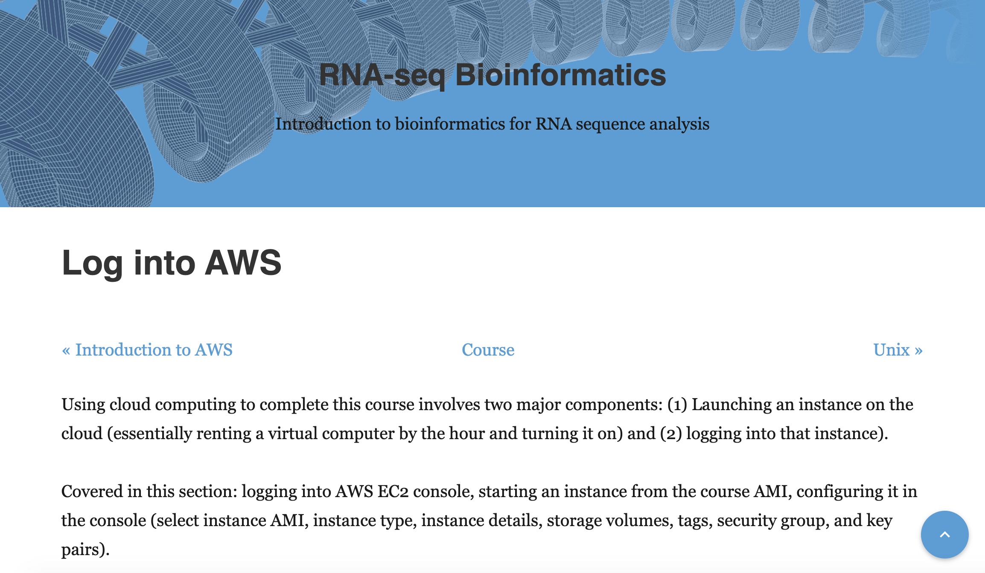
Go to course wiki, “Log into AWS” page
https://rnabio.org/module-00-setup/0000/07/01/Log_into_AWS/

Slide 22
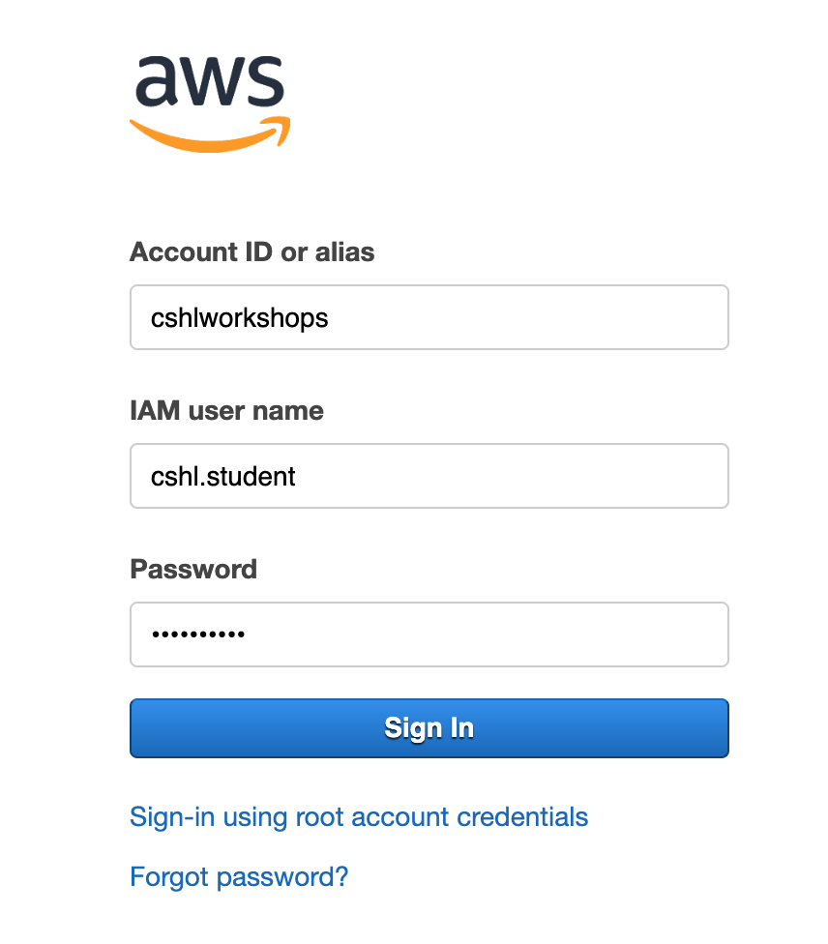
Login to AWS console
https://cshlworkshops.signin.aws.amazon.com/console

Slide 23
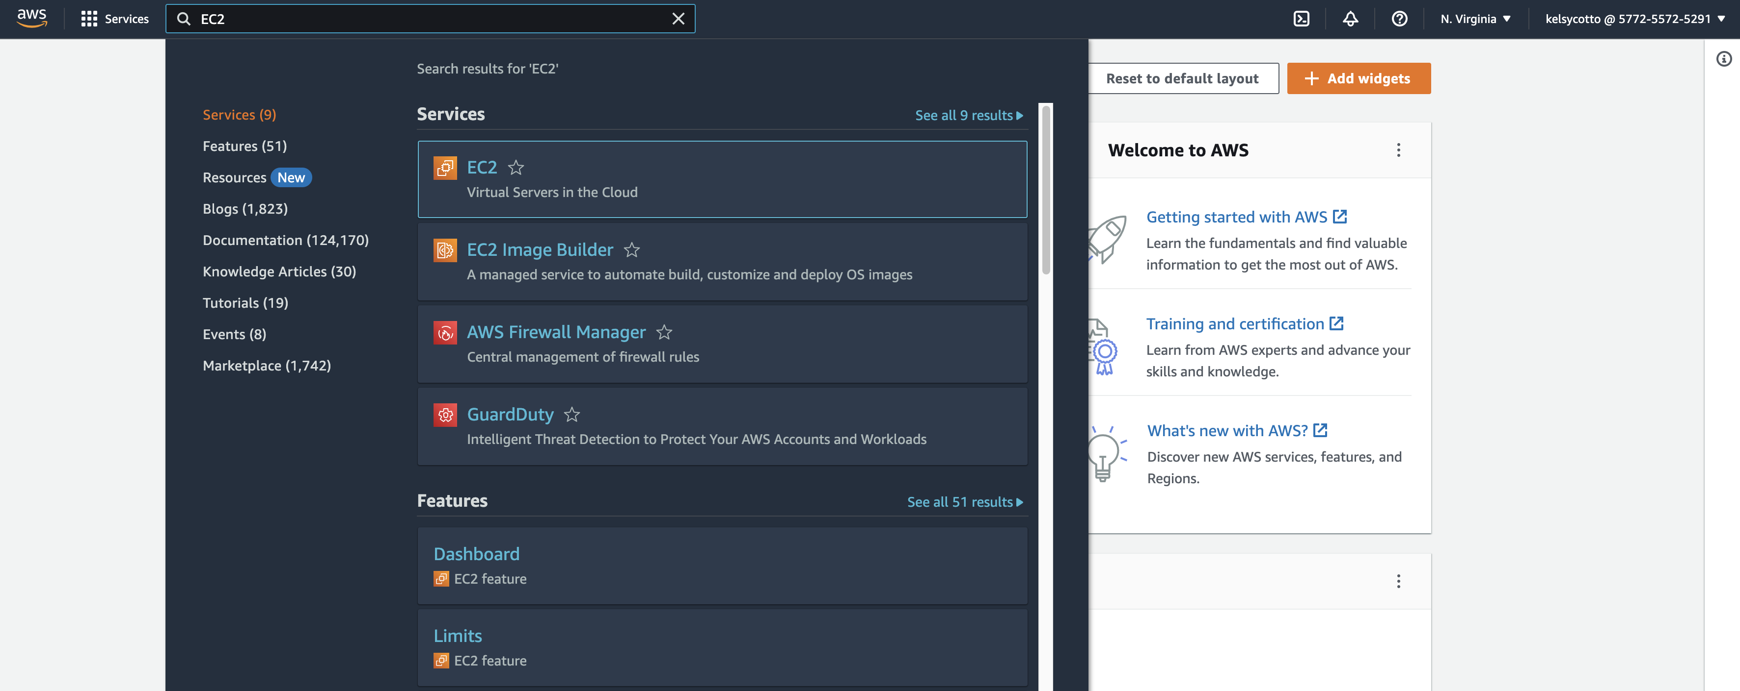
Select "EC2" service
Search for EC2
Make sure you are in N. Virginia region

Slide 24
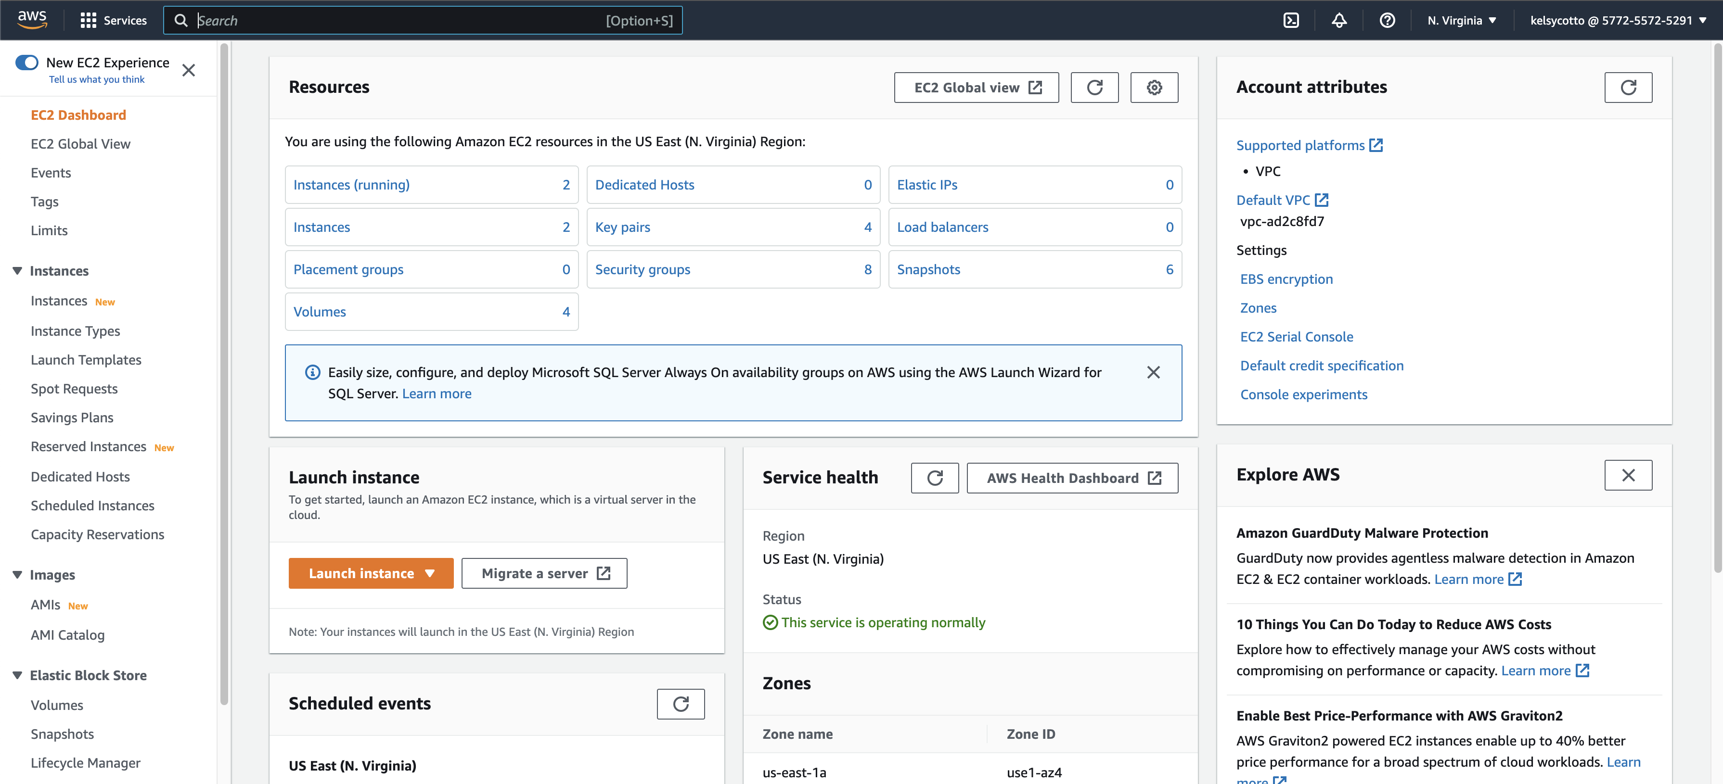
From EC2 Dashboard, launch a new Instance

Slide 25
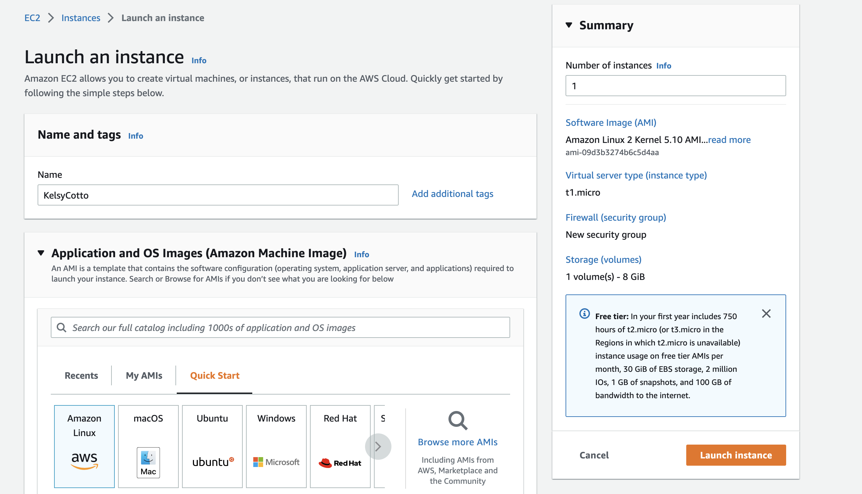
Name your instance “FirstnameLastname” (e.g. KelsyCotto)
Important: Don’t forget to name your instance!
(FirstnameLastname)

Slide 26
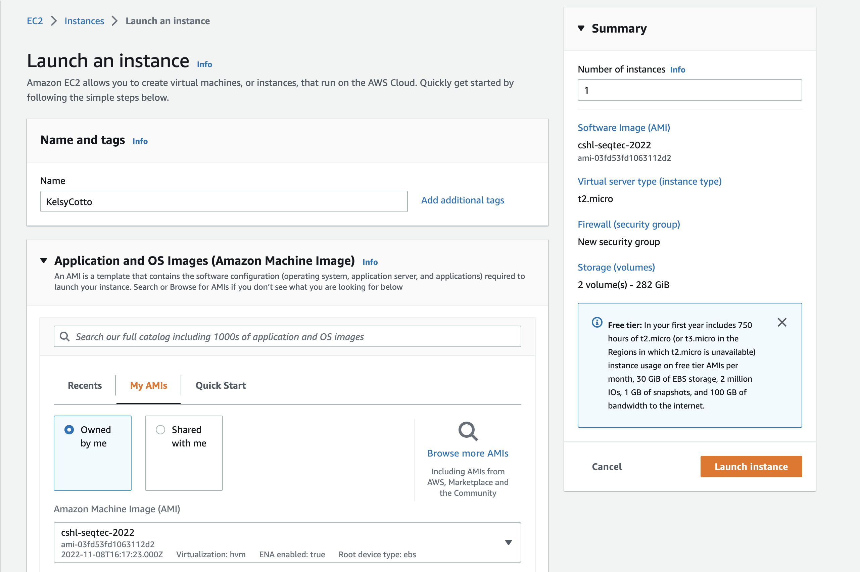
Choose an AMI – Find the CSHL SEQTEC 2022 AMI in the My AMIs

Slide 27
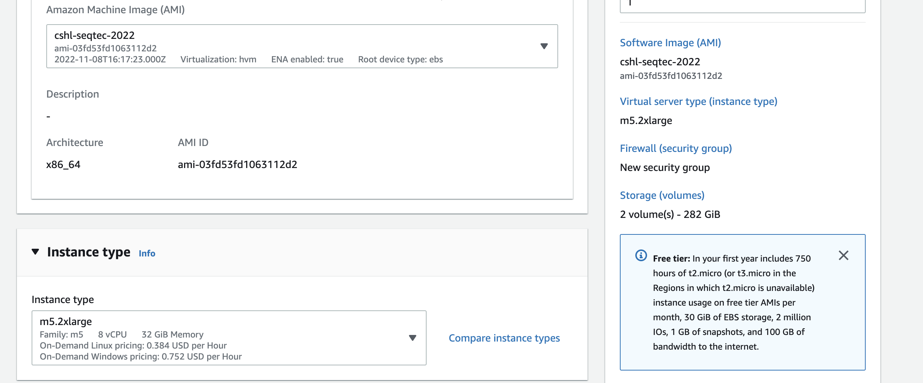
Choose “m5.2xlarge” instance type, then "Next: Configure Instance Details".

Slide 28
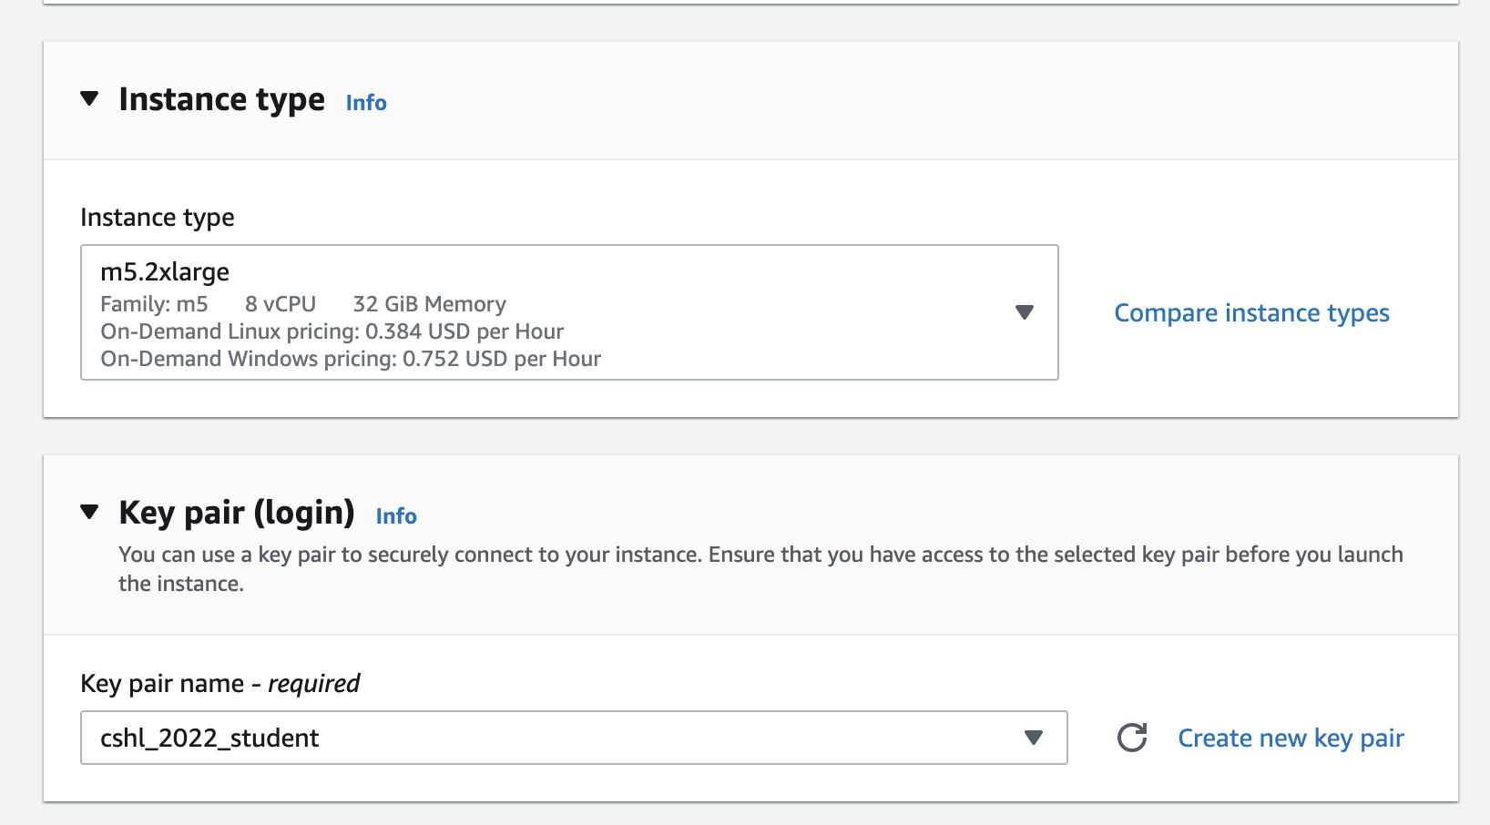
Choose an existing key pair: ”cshl_2022_student"

Slide 29
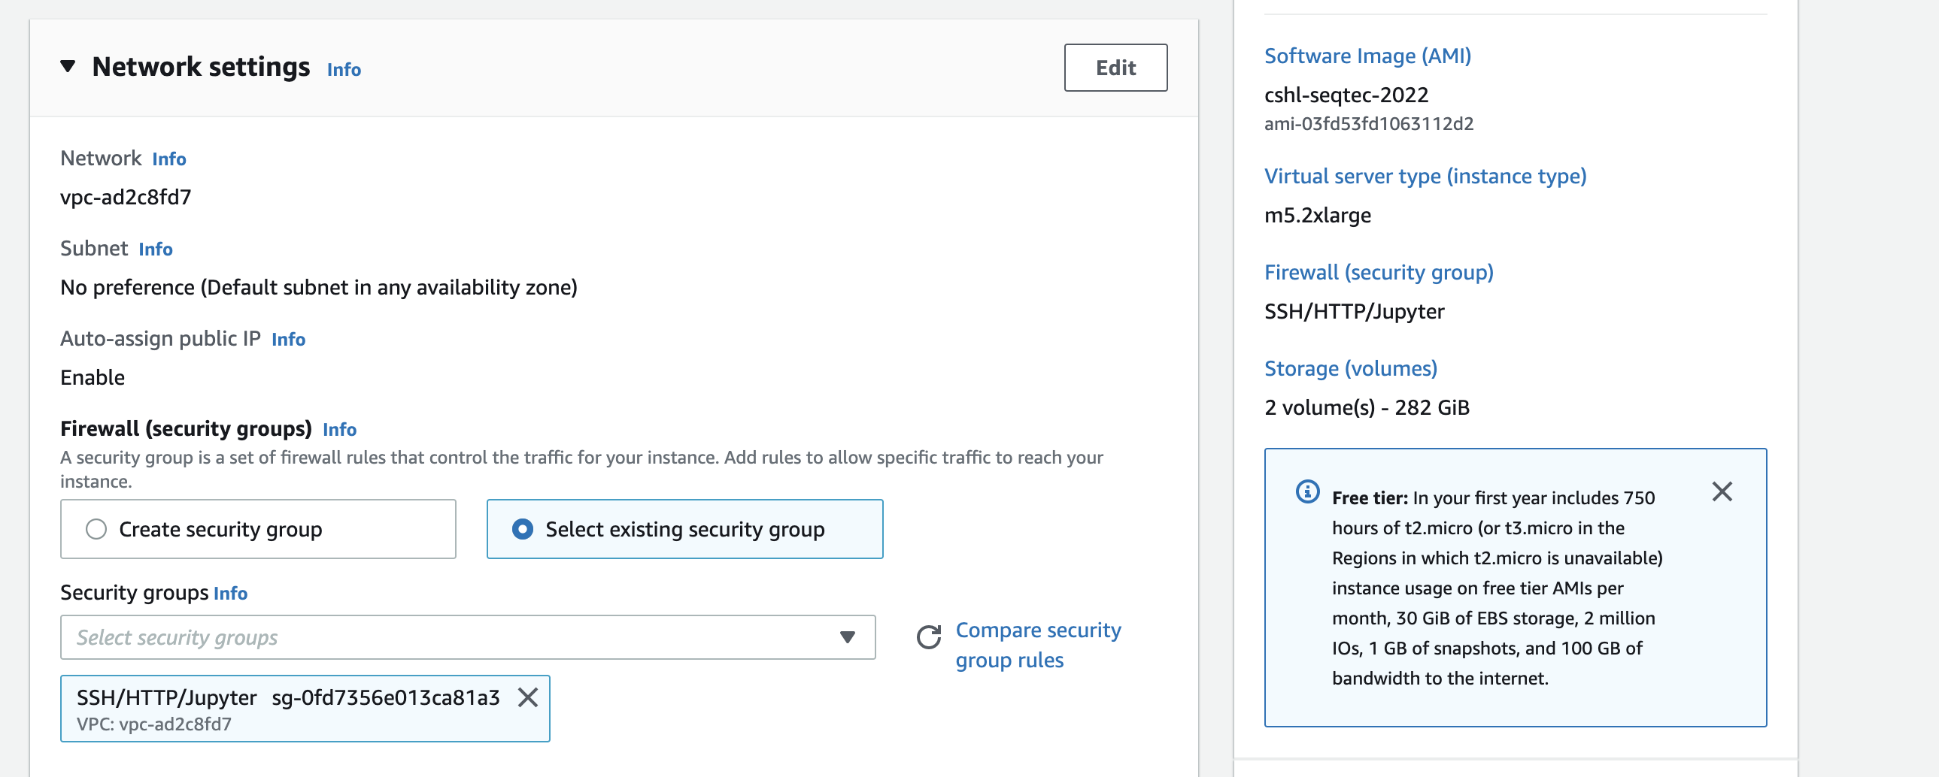
Select an Existing Security Group, choose "SSH_HTTP". Then hit "Review and Launch".

Slide 30
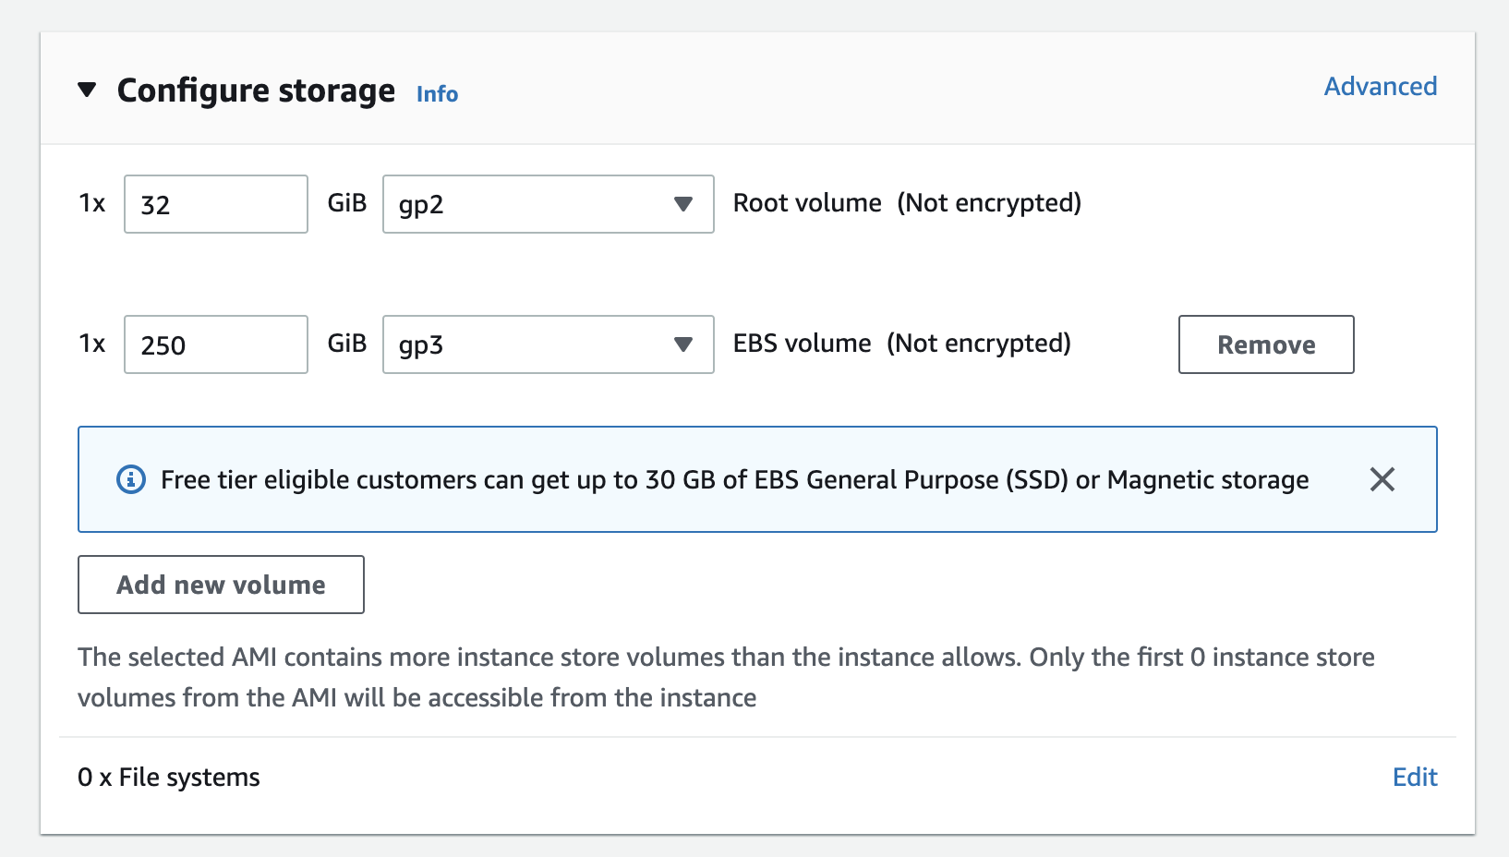
You should see 1 32 GiB root volume and 1 250 GiB EBS volume as the two storage volumes.

Slide 31
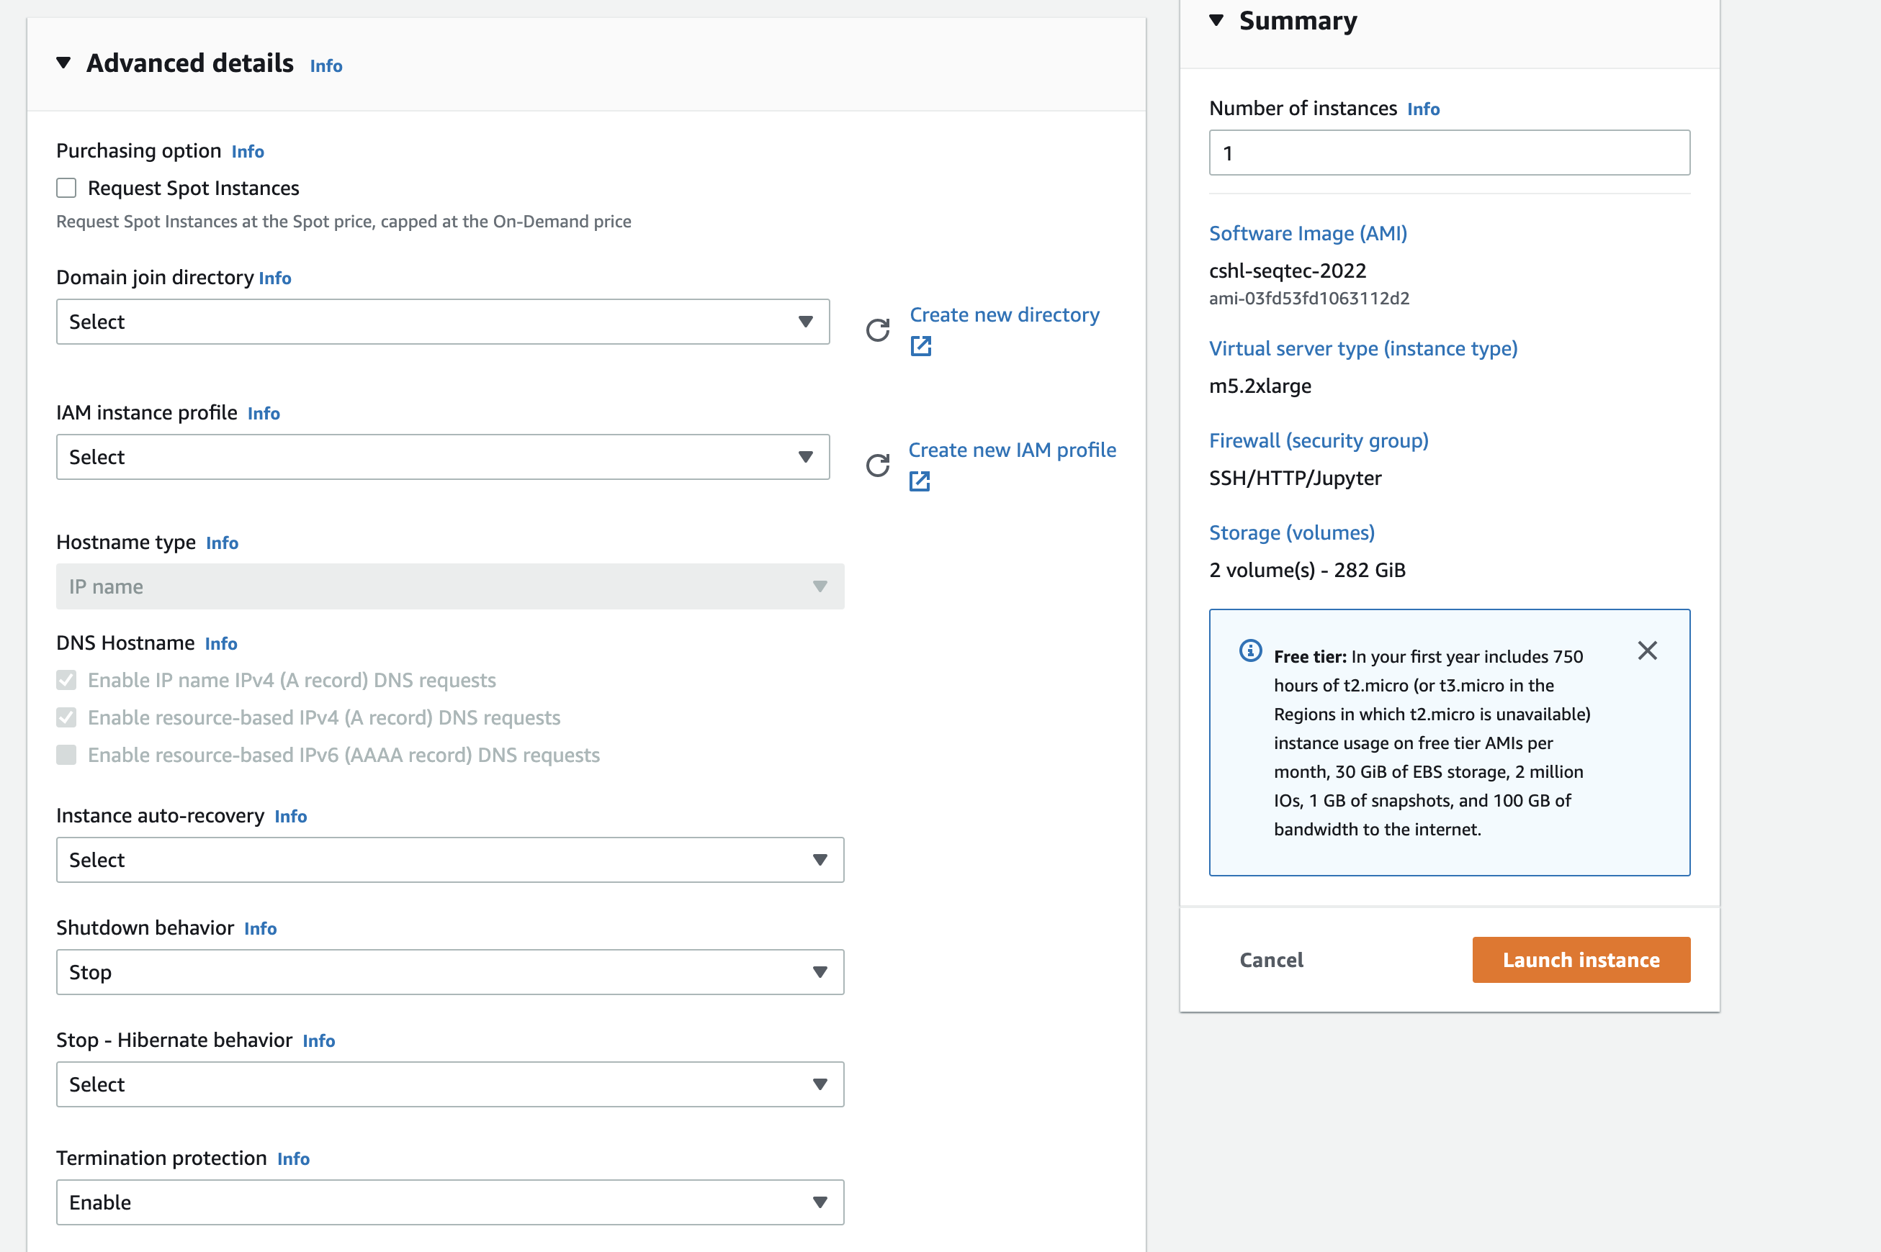
Select “Enable” for termination protection.

Slide 32
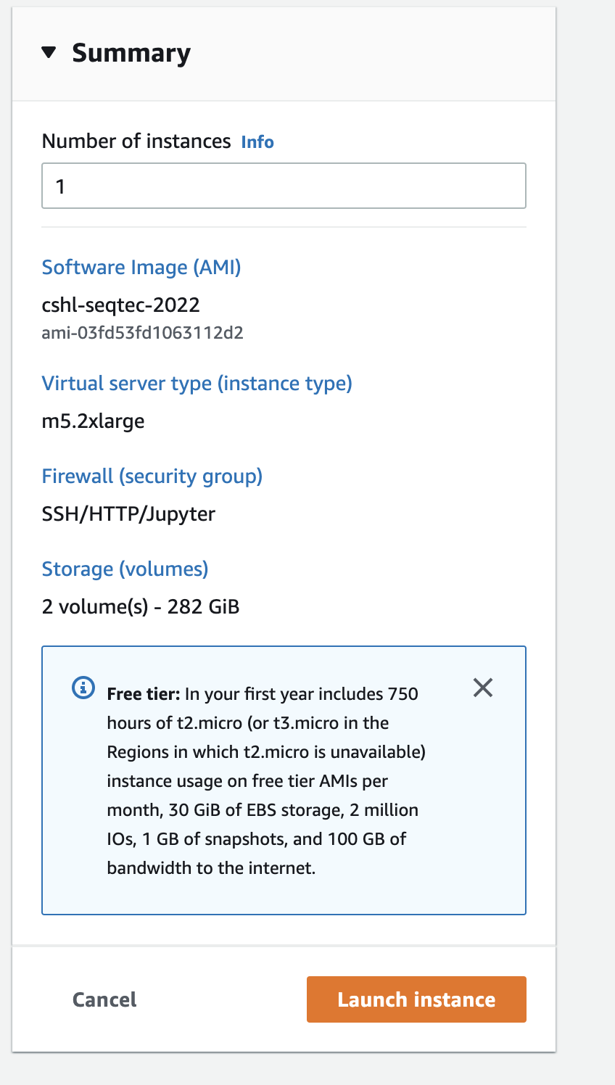
Review the details of your instance and hit Launch

Slide 33
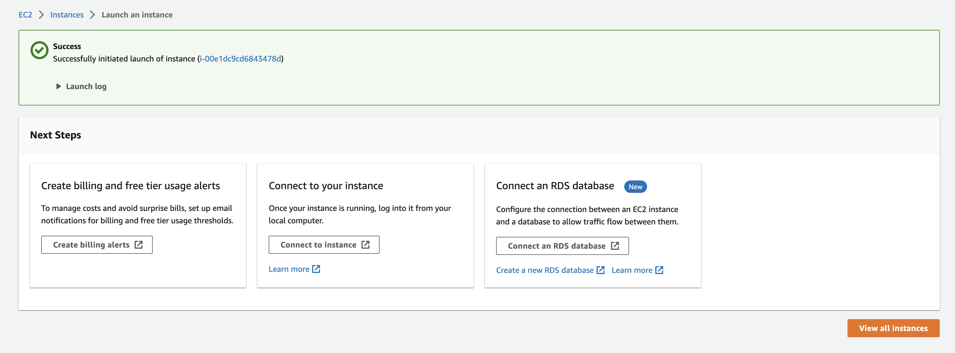
View Instances to see your new instance spinning up!

Slide 34
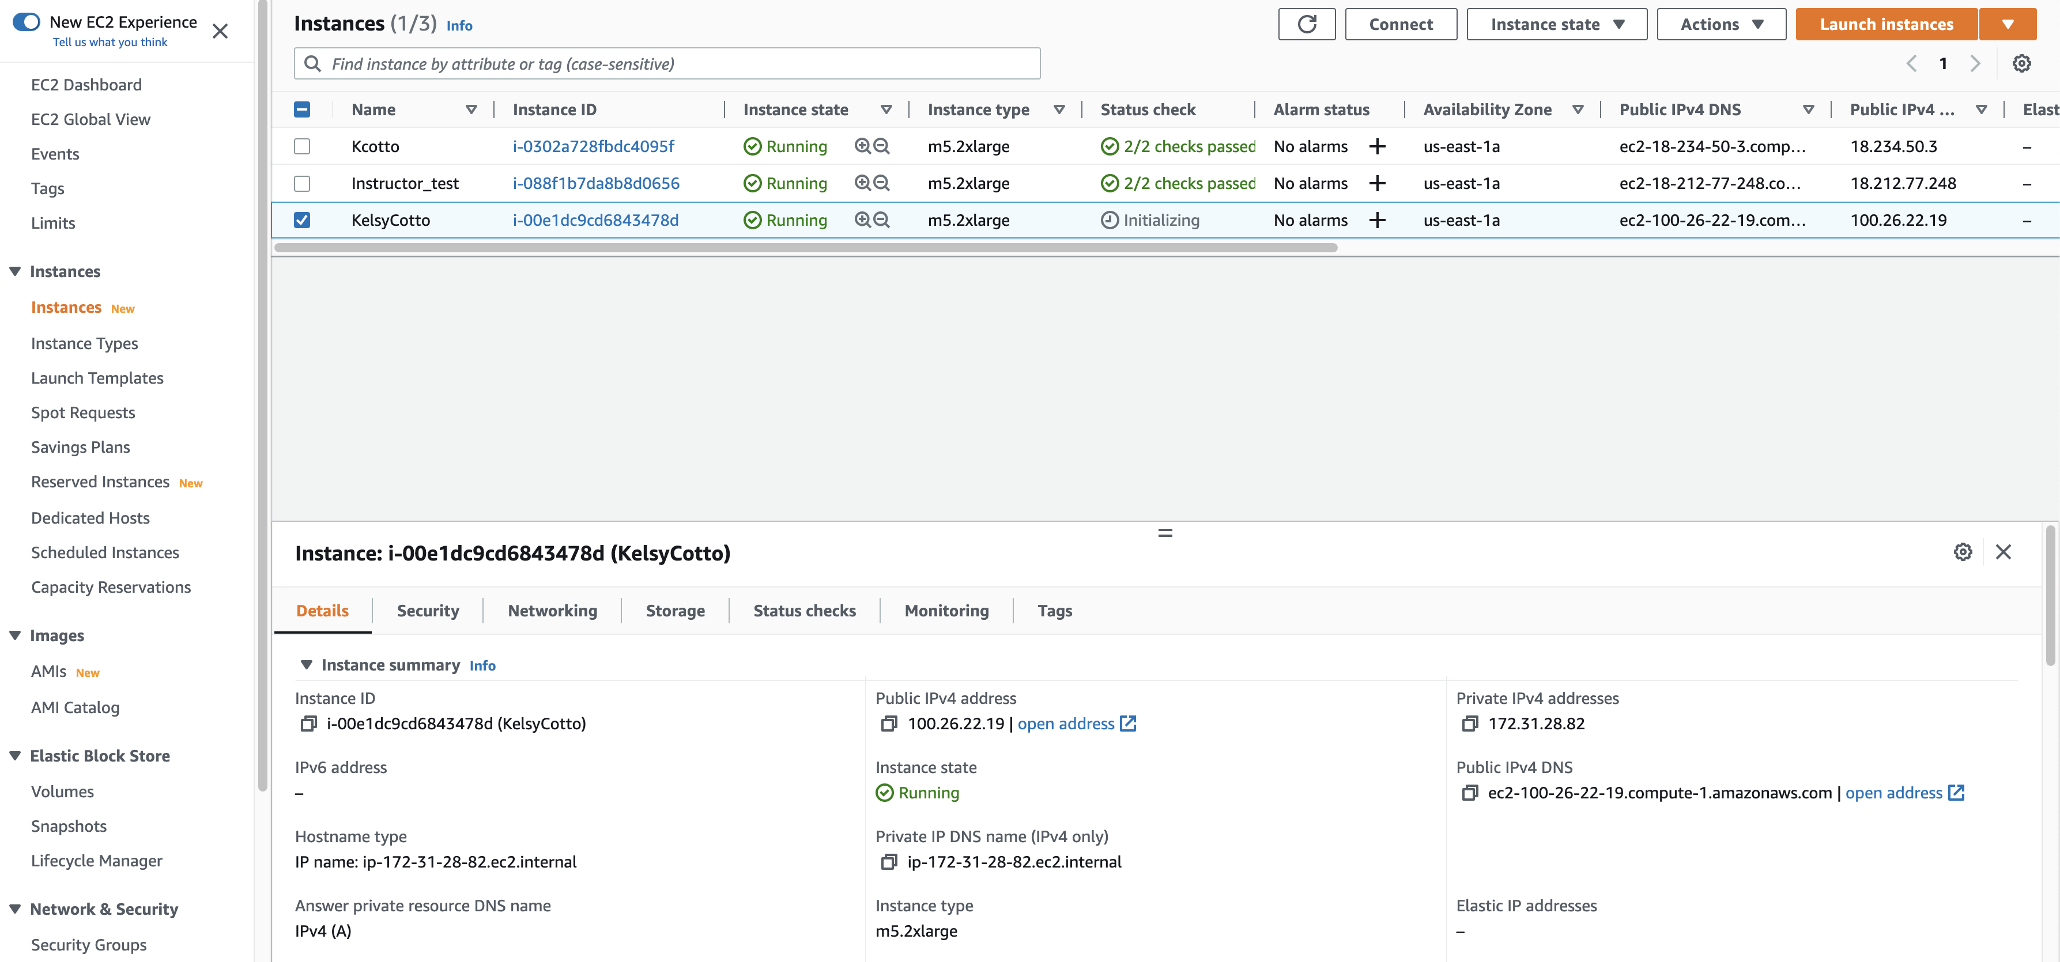
Find YOUR instance, select it, and then hit connect for instructions on how to connect (It may take some time for your instance to be ready)

Slide 35
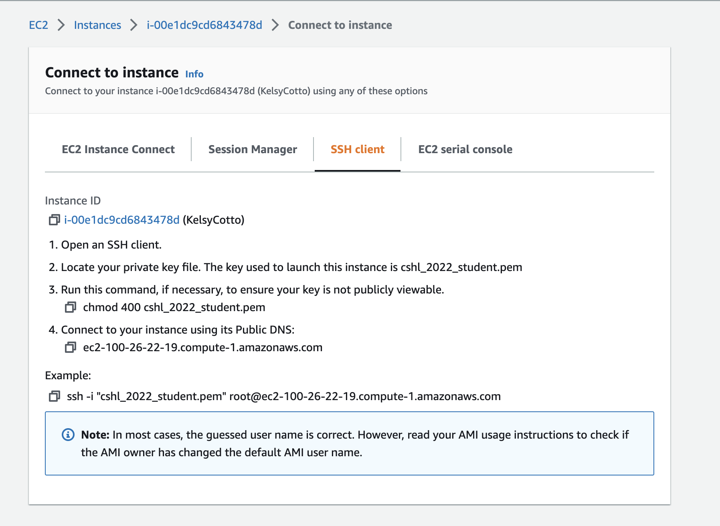
Take note of your Public DNS/IP and the instructions on changing permissions for the key file (Note, we will login as ubuntu NOT root)

Slide 36
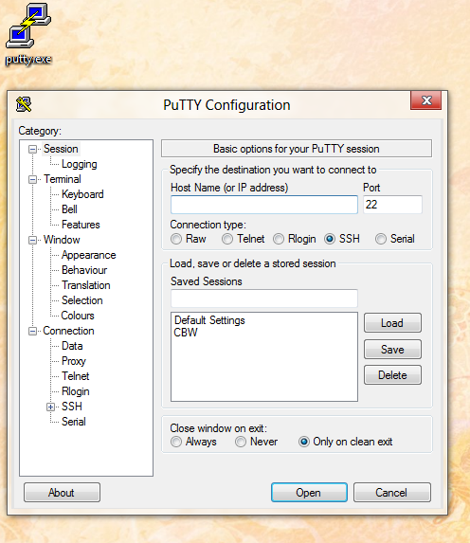
Logging into your instance (Windows)
Enter the Host Name (IP address)
Open PuTTY

Slide 37
Logging into your instance (Windows)
Choose Connection -> Data
Enter the username ‘ubuntu’
Choose SSH -> Auth
Browse to Private key (ppk) file

Slide 38
Logging into your instance (Windows)
Choose Session
Save your session as ”Amazon Node”
Double-click saved “Amazon Node” session OR
Select ”Amazon Node” session and click Open

Slide 39
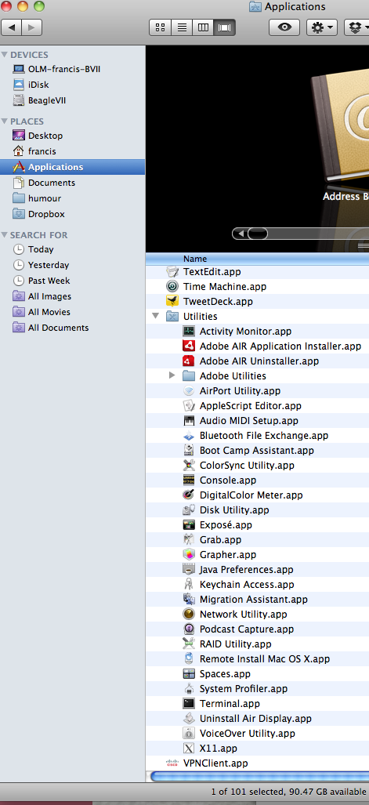
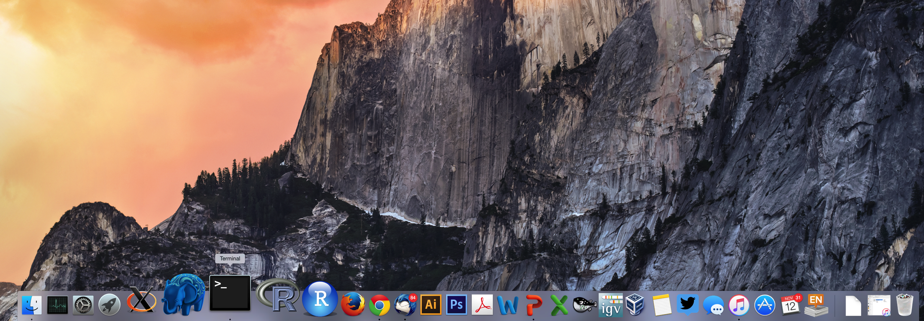
Logging into your instance (Mac)
In a Finder window
‘Applications’ -> ‘Utilities’ -> ‘Terminal’
Or on your dock

Slide 40
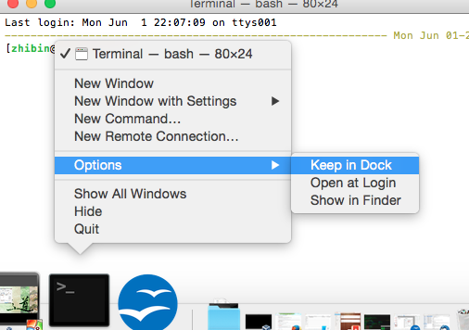
Add the terminal App to your dock

Slide 41
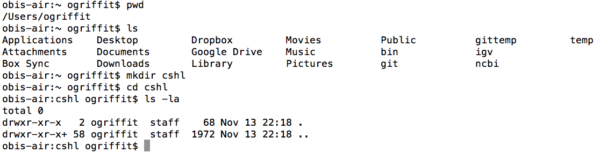
Creating a working directory on your Mac called ‘cshl’
mkdir cshl
cd cshl

Slide 42
Obtain the course SSH key file
NOTE for Mac users. You will need to use a “.pem” file
NOTE for Windows Users. You will need to use a “.ppk” file instead.
  This is created from the “.pem” file.
  https://aws.amazon.com/premiumsupport/knowledge-center/convert-pem-file-into-ppk/
The SSH key file will be used to securely login to your student instance on the cloud
Save the pem/ppk file you received via email/slack to your new cshl folder

Slide 43
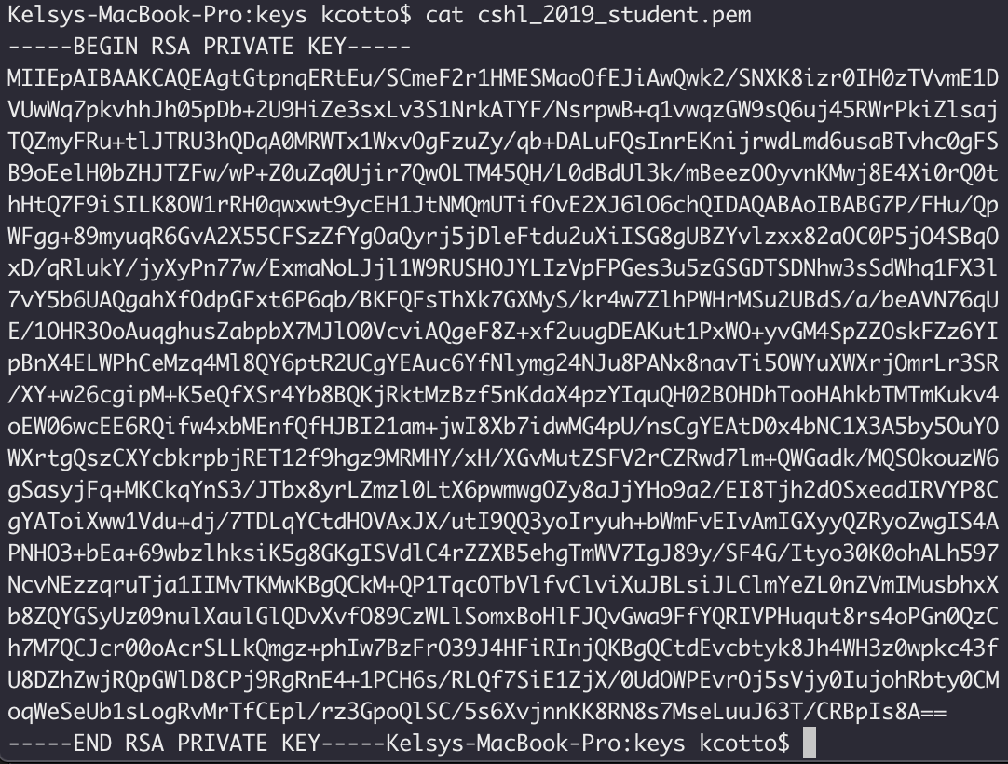
Viewing the ‘key’ file once downloaded
cat cshl_2021_student.pem

Slide 44
Changing file permissions of your ‘key’ file
(Mac/Linux)
ls -l (long listing)
-rw-r--r--@ 1 kcotto staff 1696 Nov 9 09:19 cshl_2022_student.pem
rwx : owner
rwx : group
rwx: world
r read (4)
w write (2)
x execute (1)
Which ever way you add these 3 numbers, you know which integers
were used (6 is always 4+2, 5 is 4+1, 4 is by itself, 0 is none of them etc …)
So, when you have:
chmod 400 <file name>
It is “r” for the the file owner only

Slide 45
Logging into your instance
Mac/Linux
cd ~/cshl
chmod 400 cshl_2022_student.pem
ssh -i cshl_2022_student.pem ubuntu@[YOUR PUBLIC IP]

Slide 46
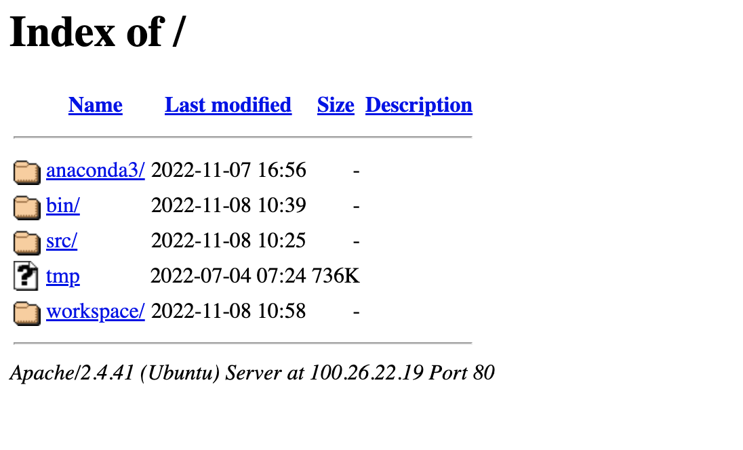
Copying files from AWS to your computer
(using a web browser)
http://[YOUR PUBLIC DNS OR IP]/

Slide 47
Logging out of your instance
Mac/Linux – simply type exit
exit
Note, this disconnects the terminal session (ssh connection) to your cloud instance. But, your cloud instance is still running! See next slide for how to stop your instance.

Slide 48
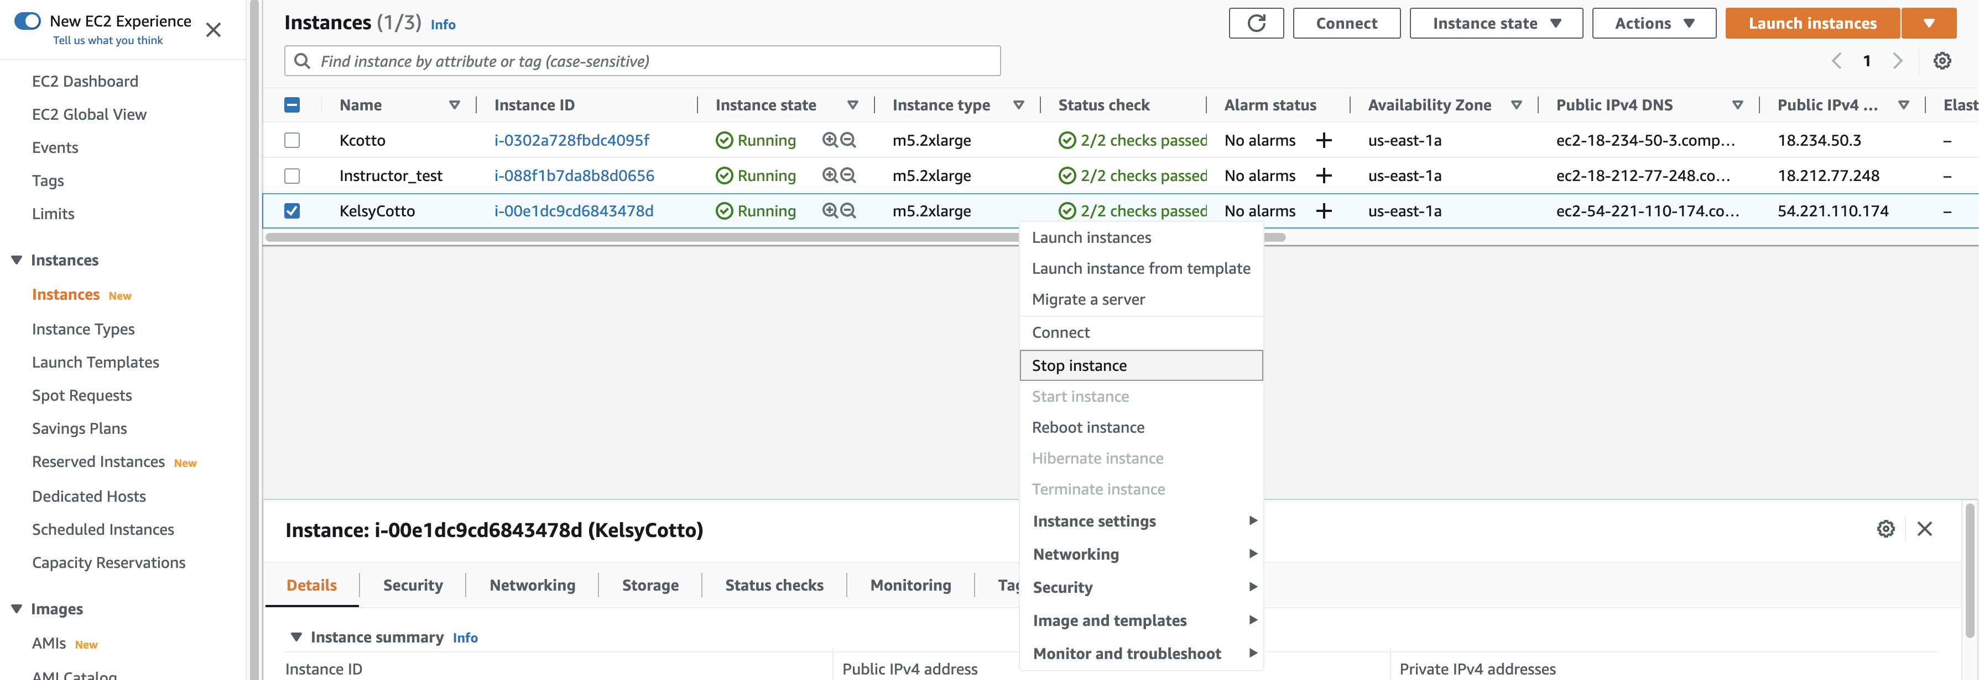
When you are done for the day you can “Stop” your instance – Don’t Terminate!
Go to AWS EC2 Dashboard, select “Instances” tab, then find your instance. Right-click and chose ‘Stop instance’

Slide 49
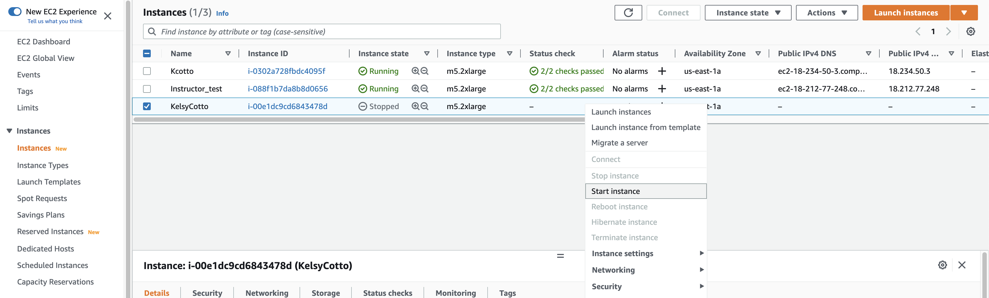
Next morning, you can “Start” your instance again
Go to AWS EC2 Dashboard, select “Instances” tab, then find your instance. Right-click and chose ‘Start Instance’

Slide 50
When you restart your instance you will need to find your new Public DNS or IP address. Select your instance and “Connect” or look in Description tab. Then go back to instructions for “Logging into your instance”

Slide 51
So, at this point:
Your laptop/pc is ready for the workshop
If it is not, you know where to get the information you need
You know how to login to AWS
The next step is to login to your linux machine on AWS and learn the basics of a linux command line

Slide 52
Key AWS concepts and terminology
HDD - Hard disk drive. A particular type of storage hardware that is generally cheaper and larger but slower than SSD. HDD drives are traditional hard drives that access data on a spinning magnetic disk.
Ephemeral storage - Also known as Instance Store storage. Data storage associated with an EC2 instance that is local to the host computer. This storage does not persist when the instance is stopped or terminated. In other words, anything you store in this way will be lost if the system is stopped or terminated. Instance store volumes may be backed by SSD or HDD devices.

Slide 53
What is a Region?
An AWS Region is set of compute resources that Amazon maintains (like the Data Center image shown before)
Each Region corresponds to a physical warehouse of compute hardware (computers, storage, networking, etc.).
At the time of writing there are 27 regions with more planned to come online soon: (US East (N.Virginia), US East (Ohio), US West (Oregon), US West (N. California), GovCloud (US-West), GovCloud (US-East), Canada (Central), EU (Ireland), EU (Frankfurt), EU (London), EU (Paris), EU (Milan), EU (Stockholm), Middle East (Bahrain), Middle East (UAE), Africa (Cape Town), Asia Pacific (Singapore), Asia Pacific (Sydney), Asia Pacific (Seoul), Asia Pacific (Tokyo), Asia Pacific (Mumbai), Asia Pacific (Hong Kong), Asia Pacific (Beijing), Asia Pacific (Osaka), Asia Pacific (Jakarta), Asia Pacific (Ningxia), and South America (Sao Paulo).
When you are logged into the AWS EC2 console, you are always operating in one of these regions.

Slide 54
What is a Region?
Current region shown in the upper right corner of console
It is important to pay attention to what region you are using for several reasons.
  When you create an EC2 instance (EBS volume, etc) in one region you won’t see it in another region.
  The cost to use many AWS resources varies by region.
  The region may influence network performance when you are accessing the instance, especially if you need to transfer large amounts of data in or out.
  Billing is tracked separately for each region
  Generally you should choose a region that is close to you or your users. But cost is also a consideration.

