Slide 1



RNA-Seq Module 2:
RNA Alignment and File Formats
Obi Griffith, Malachi Griffith,
Charlz Jerold, Allen Li, Jennie Yao, Isabel Risch
Advanced Sequencing Technologies & Bioinformatics Analysis November 8-20, 2026

Slide 2
Learning objectives of module 2
RNA-seq alignment challenges and common questions
Alignment strategies
HISAT2
Introduction to the BAM and BED formats
Basic manipulation of BAMs
Visualization of RNA-seq alignments in IGV
Alignment QC Assessment
BAM read counting and determination of variant allele expression status

Slide 3
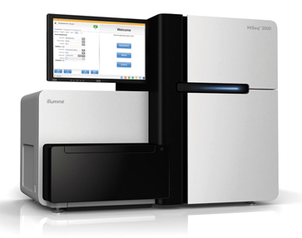


Alignment is central to most genomic research
Find peaks
Align
to
genome
Quantify transcripts
FASTQ
format
Quality control
Find SVs
Analysis,
Interpretation,
Discovery
.
.
.
etc.
Phase 0
Phase1
Phase 2-100

Slide 4

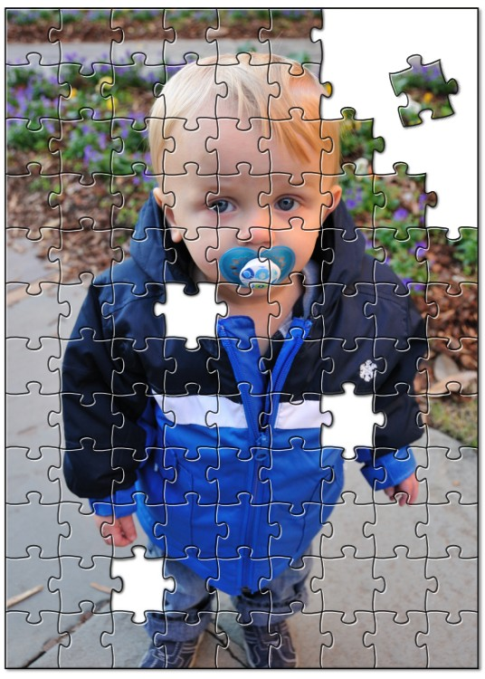
Alignment - How does it work?
Alignment is about fitting individual pieces (reads) into the correct part of the puzzle
The human genome project gave us the picture on the box cover (the reference genome)
Imperfections in how the pieces fit can indicate changes to a copy of the picture
Reference:
AGCCTGAGACCGTAAAAAAGTCAAG
|||||||||||||||||
GAGACCGTAAAAACGTC
A read sequence:
A variant!

Slide 5
RNA-seq alignment challenges
Computational cost
  100’s of millions of reads
Introns!
  Align to a transcriptome or align to a genome?
    Spliced vs. unspliced alignments
Can I just align my data once using one approach and be done with it?
  Unfortunately, probably not

Slide 6
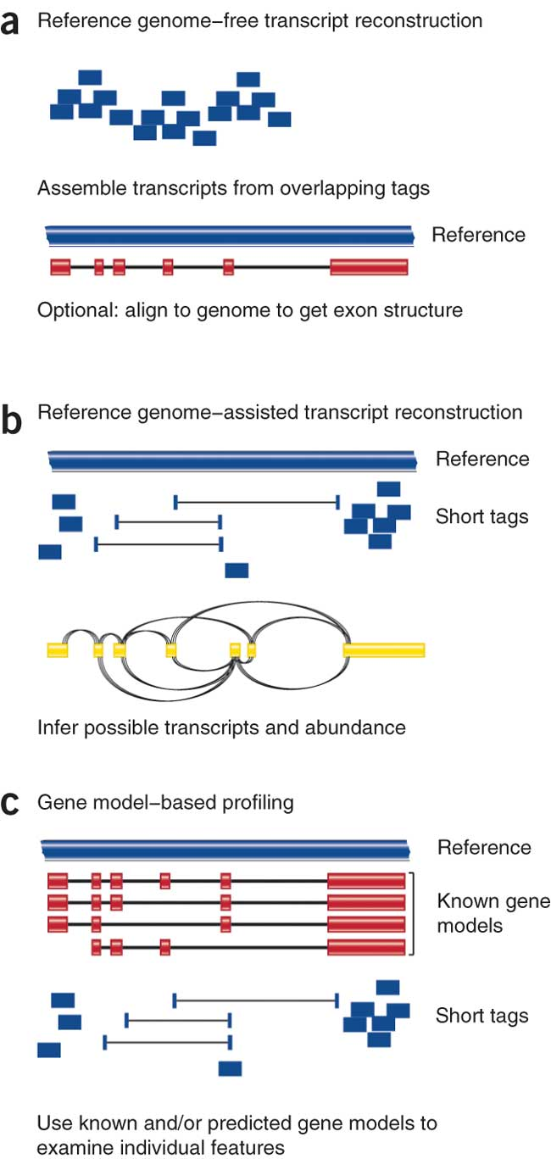
Three RNA-seq mapping strategies
De novo assembly
Align to transcriptome
Align to reference genome
Diagrams from Cloonan & Grimmond, Nature Methods 2010

Slide 7
Which alignment strategy is best?
De novo assembly
  If a reference genome does not exist for the species being studied
  If complex polymorphisms/mutations/haplotypes might be missed by comparing to the reference genome
Align to transcriptome
  If you have short reads (< 50bp)
  Relies on known transcripts
Align to reference genome
  All other cases
  Does not rely on known transcripts – allows for discovery
Each strategy involves different alignment/assembly tools

Slide 8
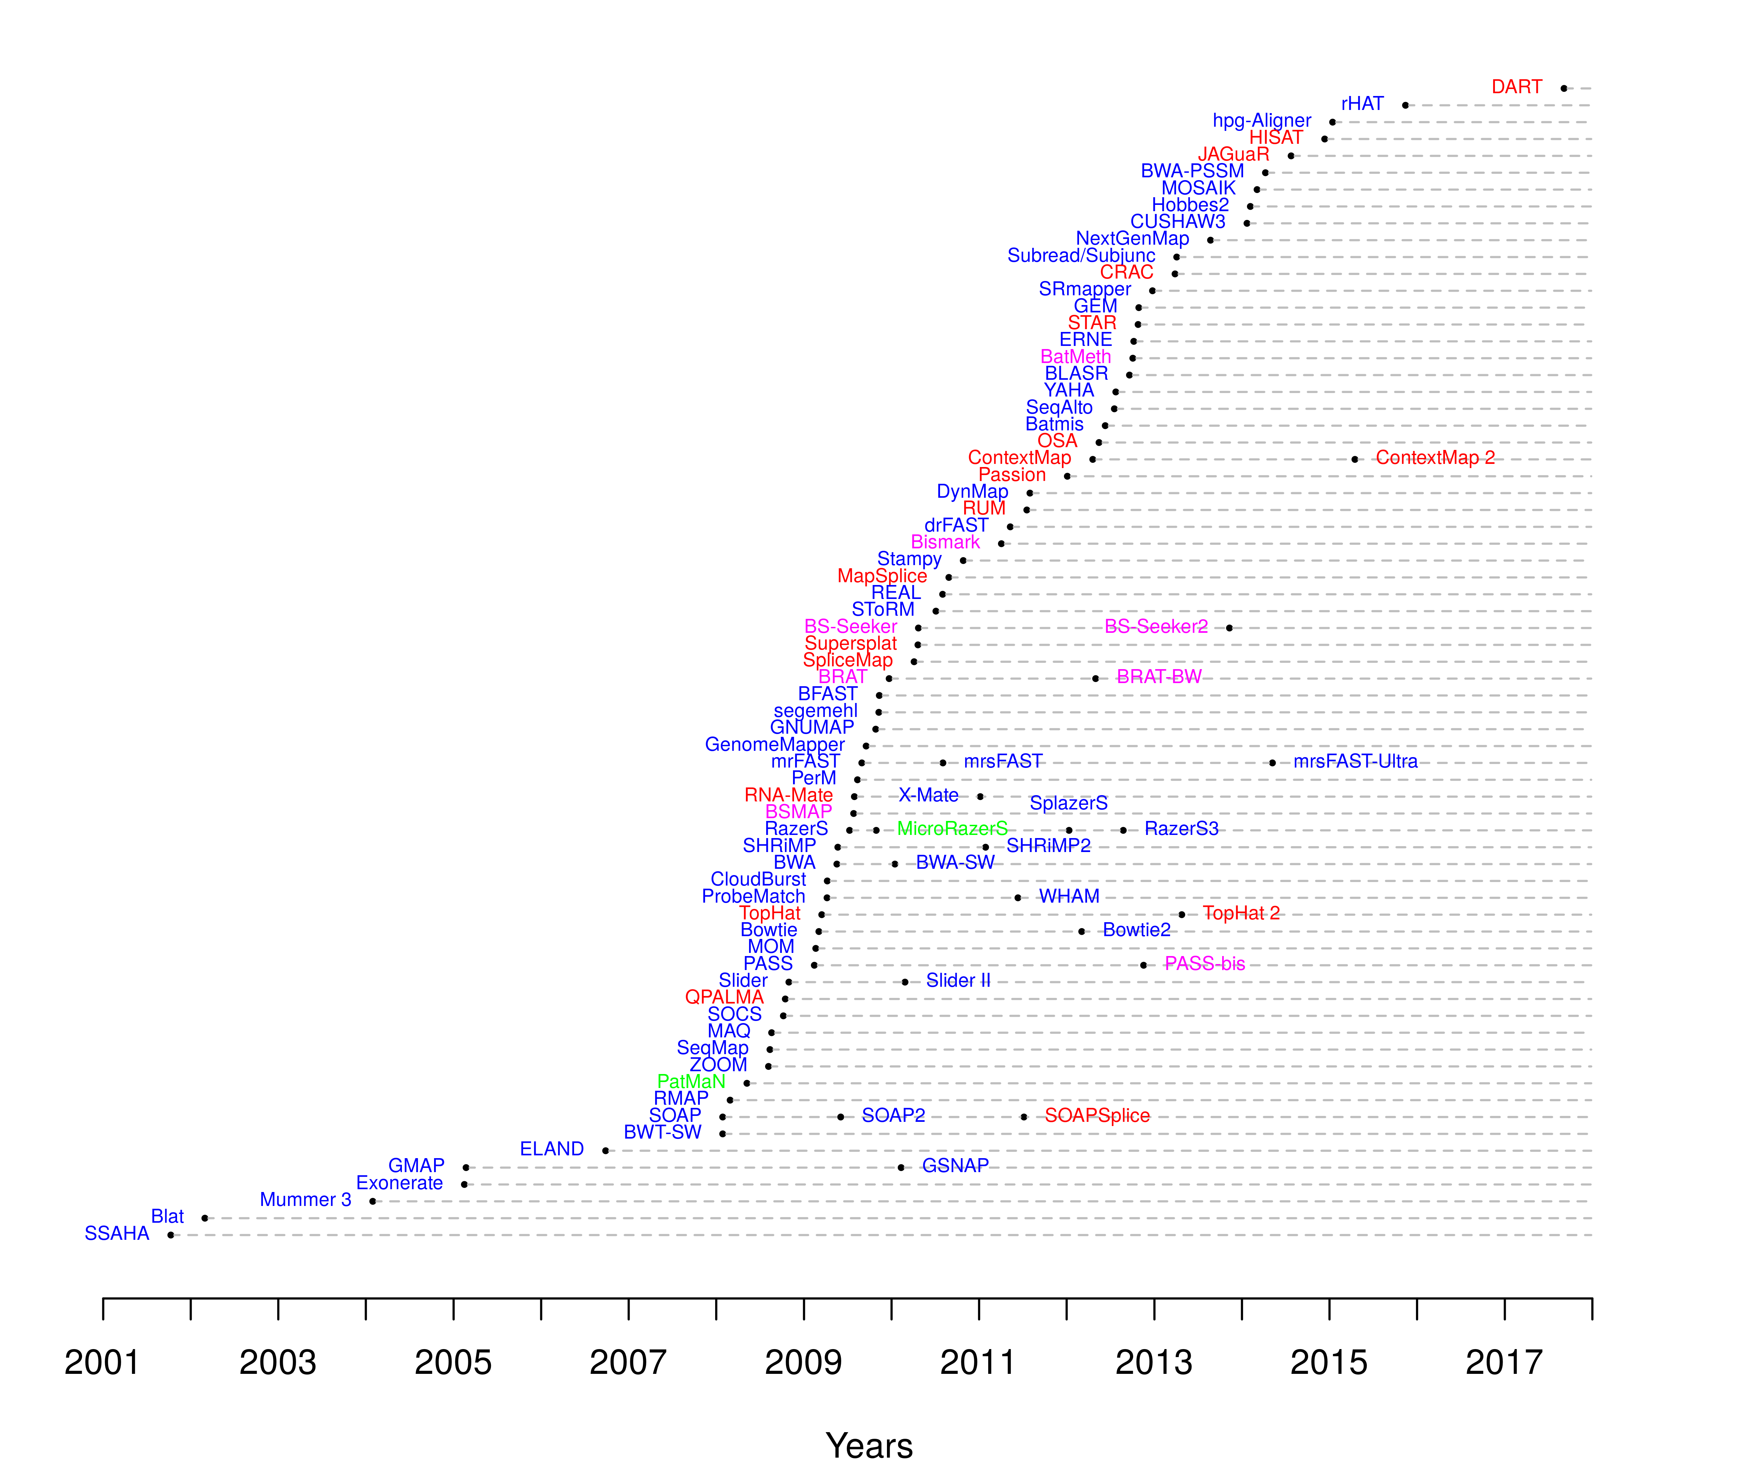
Which read aligner should I use?
RNA
Bisulfite
DNA
microRNA
http://wwwdev.ebi.ac.uk/fg/hts_mappers/

Slide 9
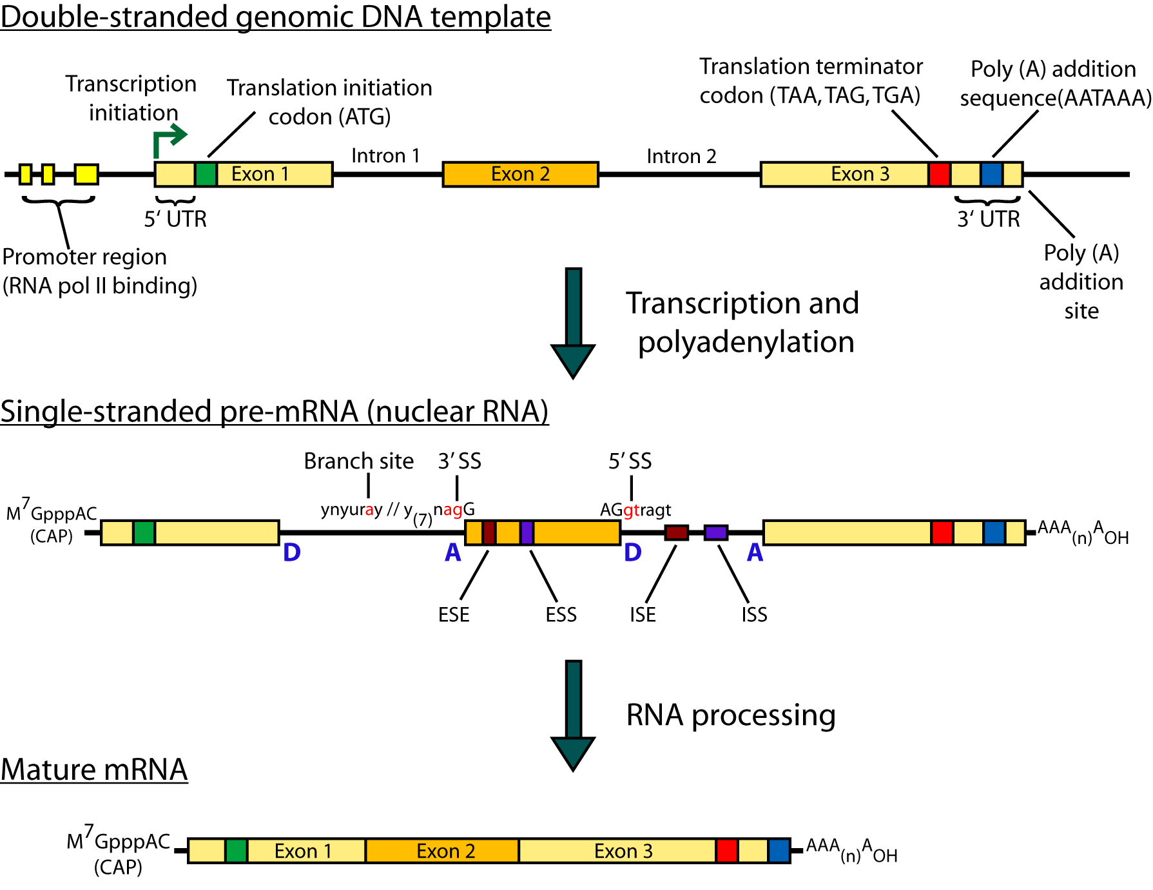
Should I use a splice-aware or unspliced mapper?
The fragments being sequenced in RNA-seq represent mRNA - introns are removed
But we are usually aligning these reads back to the reference genome
Unless your reads are short (<50bp) you should use a splice-aware aligner
  HISAT2, STAR, MapSplice, etc.

Slide 10
HISAT/HISAT2
HISAT is a ‘splice-aware’ RNA-seq read aligner
  HISAT = Hierarchical Indexing for Spliced Alignments of Transcripts
Requires a reference genome
Very fast
Uses an indexing scheme based on the Burrows-Wheeler transform and the Ferragina-Manzini (FM) index
Multiple types of indexes for alignment
  a whole-genome FM index to anchor each alignment
  numerous local FM indexes for very rapid extensions of these alignments.
  Whole-genome indices with SNPs and known transcript structures accounted for
Kim et al. 2015. Nat Methods 12:357–360
Notes:
HISAT's hierarchical index for the human genome contains 48,000 local FM indexes, each representing a genomic region of ~64,000 bp.

Slide 11
HISAT/HISAT2 algorithm
Uses a hierarchical indexing algorithm + several adaptive strategies
  based on the position of a read with respect to splice sites
1) Find candidate locations across the whole genome first
  mapping part of each read using the global FM index
  Generally identifies one or a small number of candidates.
2) Do local alignment
  selects one of ~48,000 local indexes for each candidate
  uses it to align the remainder of the read.
For paired reads, each mate is separately aligned
  If a read fails to align, then the alignments of its mate are used as anchors to map the unaligned mate
Notes:
HISAT's hierarchical index for the human genome contains 48,000 local FM indexes, each representing a genomic region of ~64,000 bp.

Slide 12
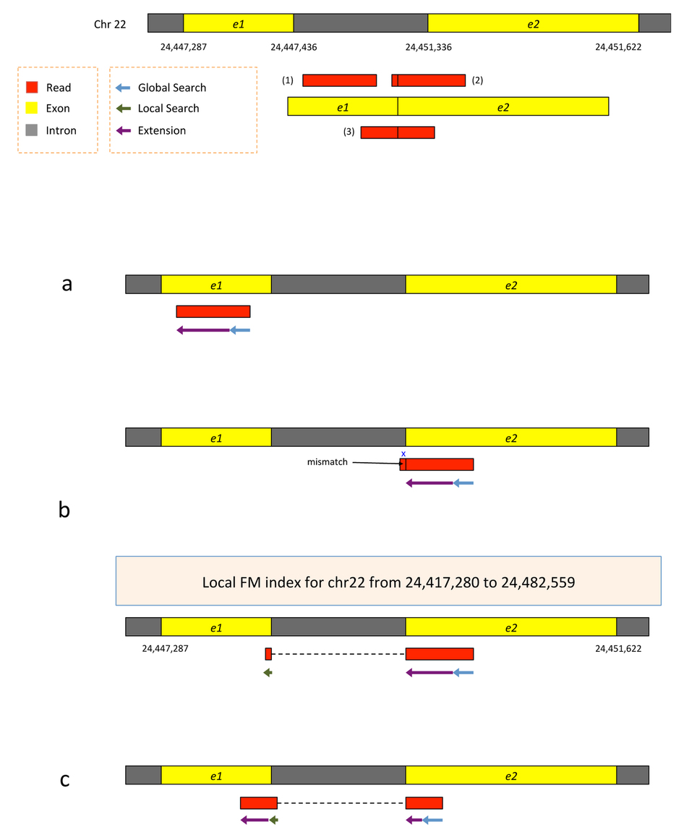
HISAT2 Alignment
Two exons from chr22
Three reads
Kim et al. 2015. Nat Methods 12:357–360
Notes:
Alignment of exonic reads and long- and intermediate-anchored reads.
Given two exons from a gene on human chromosome 22, separated by a 3,899-bp intron, suppose the genomic region is transcribed and spliced and we have three reads sequenced from the resulting transcript: (i) an exonic read, (ii) a read spanning two exons with an 8-bp anchor in one exon and (iii) a read spanning two exons with 50 bp in each exon (Supplementary Fig. 8). All the reads are assumed to be error free and 100 bp long. We can apply hierarchical indexing to align each of these reads rapidly and correctly.

Slide 13
HISAT2 Alignment
1) Search for read position with global FM index (slower)
2) Once at least 28bp and exactly one location switch to extension mode against reference genome (faster)
Kim et al. 2015. Nat Methods 12:357–360
Notes:
We align the first read using the global FM-index (Supplementary Fig. 8a). Because global search is relatively time consuming, we change strategies when the partial alignment meets two conditions: (i) it is at least 28 bp long and (ii) it maps onto exactly one location. For the read shown in the figure, the 28-bp sequence on its right end maps uniquely, allowing us to stop the global search operation at that point. From there, we extend the partial alignment by directly comparing the remaining sequence and the corresponding genomic sequence, which we can extract directly from the genome using the mapped location as an index. Because the read is error free and contained within one exon, the extension operation sweeps across the remaining 72 bp, completing the alignment for the read. Note that we could perform this alignment using the global FM index, as TopHat2 does, but the combination of global search and local extension is faster.

Slide 14
HISAT2 Alignment
1) Search for read position with global FM index (slower)
2) Extend until mismatch at 93bp (faster)
3) Switch to local FM index to align remaining 8bp
  index covers only a small region, so we find just one match
4) Check for compatibility and combine into single spliced alignment
Kim et al. 2015. Nat Methods 12:357–360
Notes:
For the second read, which has a very short 8-bp anchor on the left side, we first try to map the read using global search, moving right to left (Supplementary Fig. 8b). The first 28 bp on the right end of the read maps uniquely, allowing us to anchor the alignment and halt the global search. We then extend the alignment until we encounter a mismatch at the 93rd base. This mismatch occurs when the alignment extension reaches the intron. At this point we pause the search, retrieve the local FM index that contains this location and align the remaining 8 bp using this index. Because the index covers only a small region, in this case we find just one match for the 8-bp segment. Finally, we check whether the two partial alignments (8 bp and 92 bp) are compatible with each other (for example, in the correct orientation) and then combine them to produce a spliced alignment of the original read.
Note that if we searched for an 8-bp sequence in the global index, we would expect to find an average of ~48,000 matching locations in the human genome (and sometimes many more). Instead of examining 48,000 possible locations, we use one of the local FM indexes, which is expected to contain just one copy of a given 8-bp sequence, on average. This two-stage hierarchical indexing allows us to avoid examining tens of thousands of candidate locations for short anchors, which in turn dramatically speeds up the overall alignment algorithm.

Slide 15
HISAT2 Alignment
1) global search until exactly one match of at least 28bp (slower)
2) Extend until mismatch at 51bp (faster)
3) switch to local FM index to align first 8bp of remaining read
- If too many matches increase prefix size
4) Extend again
5) Check for compatibility and combine into single spliced alignment
Kim et al. 2015. Nat Methods 12:357–360
Notes:
The third read has long anchors (50 bp each) in each exon. We first align the read beginning on the right, using global search as we did before. After the first 28 bp is uniquely mapped, we switch to the extension operation, which further aligns 22 bp and stops after a mismatch at the 51st base. We then choose a local FM index and perform a local search using the first 8 bp of the remaining part of the read. Once this 8 bp is found, HISAT again uses the extension operation to align the rest of the read (Supplementary Fig. 8c). Note that if the 8-bp prefix mapped to too many locations, HISAT would use a longer prefix to reduce the number of potential locations to 5 or fewer.
As we can see from these examples, we can combine global search, local search and directed read extension to achieve rapid yet sensitive alignment. Note that when a read has multiple spliced alignments, HISAT prefers to report alignments that use the canonical GT and AG dinucleotides on the ends of the intron. From any remaining alignments after this filter, it reports the one with the shortest intron length. HISAT provides several parameters with which users can customize its alignment strategy, including adjustable penalties for mismatches, indels and noncanonical splice sites (Supplementary Note).

Slide 16
Should I allow ‘multi-mapped’ reads?
Depends on the application
In *DNA* analysis it is common to use a mapper to randomly select alignments from a series of equally good alignments
In *RNA* analysis this is less common
  Perhaps disallow multi-mapped reads if you are variant calling
  Definitely should allow multi-mapped reads for expression analysis with Cufflinks (and StringTie?)
  Definitely should allow multi-mapped reads for gene fusion discovery

Slide 17
What is the output of HISAT2?
A SAM/BAM file
  SAM stands for Sequence Alignment/Map format
  BAM is the binary version of a SAM file
  Remember, compressed files require special handling compared to plain text files
How can I convert BAM to SAM?
  http://www.biostars.org/p/1701/
Is HISAT2 the only mapper to consider for RNA-seq data?
  http://www.biostars.org/p/60478/

Slide 18
Introduction to the SAM/BAM format
The specification
  http://samtools.sourceforge.net/SAM1.pdf
SAM is uncompressed text data
BAM is a compressed version of SAM
  lossless BGZF format
BAM files are usually ‘indexed’
  A ‘.bai’ file will be found beside the ‘.bam’ file
  Indexing provides fast retrieval of alignments overlapping a specified region without going through all alignments.
  BAM must be sorted by the reference ID and then the leftmost coordinate before indexing

Slide 19
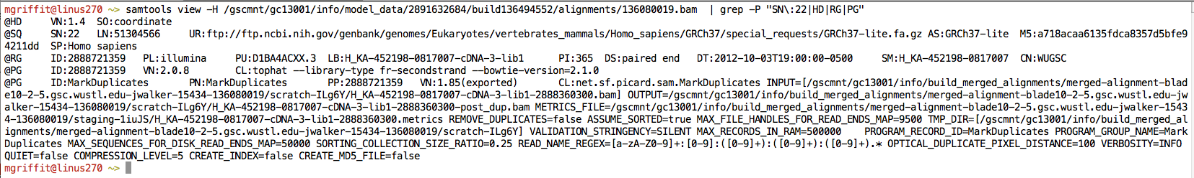
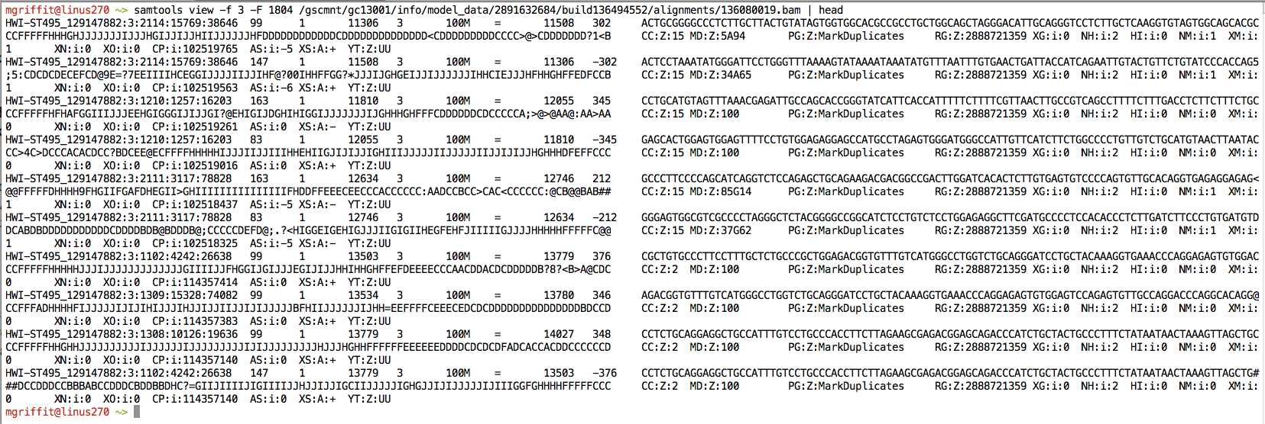
Example of SAM/BAM file format
Example SAM/BAM/CRAM header section (abbreviated)
Example SAM/BAM/CRAM alignment section (only 10 alignments shown)

Slide 20
SAM/BAM header section
Used to describe source of data, reference sequence, method of alignment, etc.
Each section begins with character ‘@’ followed by a two-letter record type code. These are followed by two-letter tags and values:
  @HD The header line
    VN: format version
    SO: Sorting order of alignments
  @SQ Reference sequence dictionary
    SN: reference sequence name
    LN: reference sequence length
    SP: species
  @RG Read group
    ID: read group identifier
    CN: name of sequencing center
    SM: sample name
  @PG Program
    PN: program name
    VN: program version

Slide 21
A BAM file is divided into header and alignment sections
Example SAM/BAM header section
Version (VN) and sort order (SO) - Important!
Reference sequence (SQ)
and sequence length (LN)
Read group (RG) and sample (SM)
Programs (PG) that have been run on the data

Slide 22
A BAM file is divided into header and alignment sections
Example SAM/BAM alignment section

Slide 23
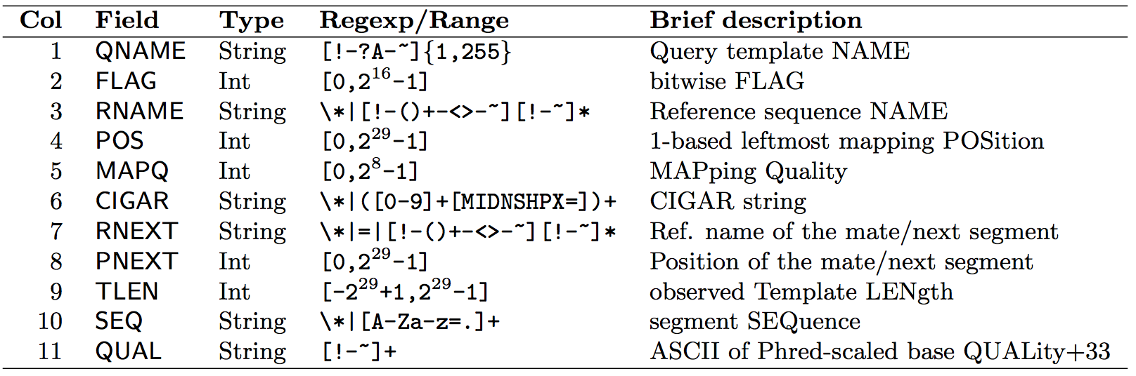
SAM/BAM alignment section
Example values
QNAME e.g. HWI-ST495_129147882:1:2302:10269:12362
FLAG e.g. 99
RNAME e.g. 1
POS e.g. 11623
MAPQ e.g. 3
CIGAR e.g. 100M
RNEXT e.g. =
PNEXT e.g. 11740
TLEN e.g. 217
SEQ e.g. CCTGTTTCTCCACAAAGTGTTTACTTTTGGATTTTTGCCAGTCTAACAGGTGAAGCCCTGGAGATTCTTATTAGTGATTTGGGCTGGGGCCTGGCCATGT
QUAL e.g. CCCFFFFFHHHHHJJIJFIJJJJJJJJJJJHIJJJJJJJIJJJJJGGHIJHIJJJJJJJJJGHGGIJJJJJJIJEEHHHHFFFFCDCDDDDDDDB@ACDD

Slide 24
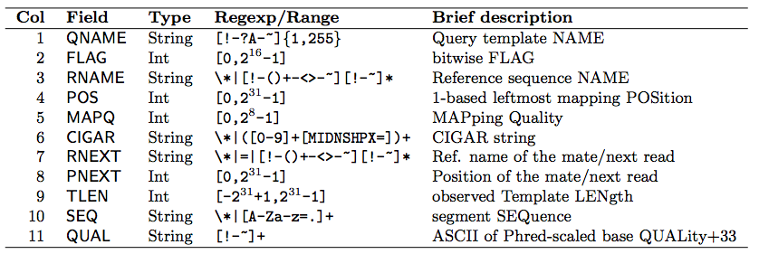

SAM Format – Information Fields
1
2
3
4
5
6
7
8
9
10
Slide courtesy of Andrew Farrell

Slide 25
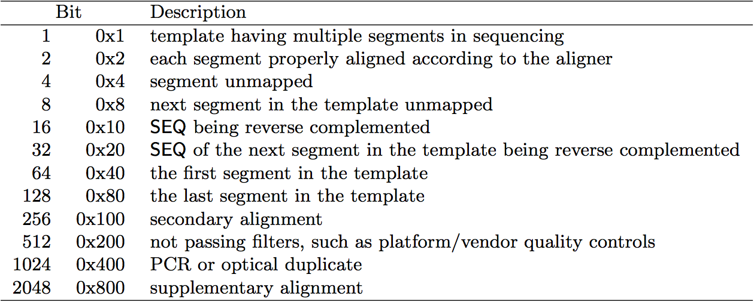
SAM/BAM flags explained
12 bitwise flags describing the alignment
Stored as a binary string of length 12 instead of 12 columns of data
Value of ‘1’ indicates the flag is set. e.g. 001000000000
All combinations can be represented as a number from 0 to 4095 (i.e. 2¹²). This number is used in the BAM/SAM file.
You can specify ‘required’ or ‘filter’ flags in samtools view using the ‘-f’ and ‘-F’ options respectively
Note that to maximize confusion, each bit is described in the SAM specification using its hexadecimal representation (i.e., '0x10' = 16 and '0x40' = 64).
http://broadinstitute.github.io/picard/explain-flags.html

Slide 26
SAM Format – Information Fields
1
2
3
4
5
6
7
8
9
10
Slide courtesy of Andrew Farrell

Slide 27
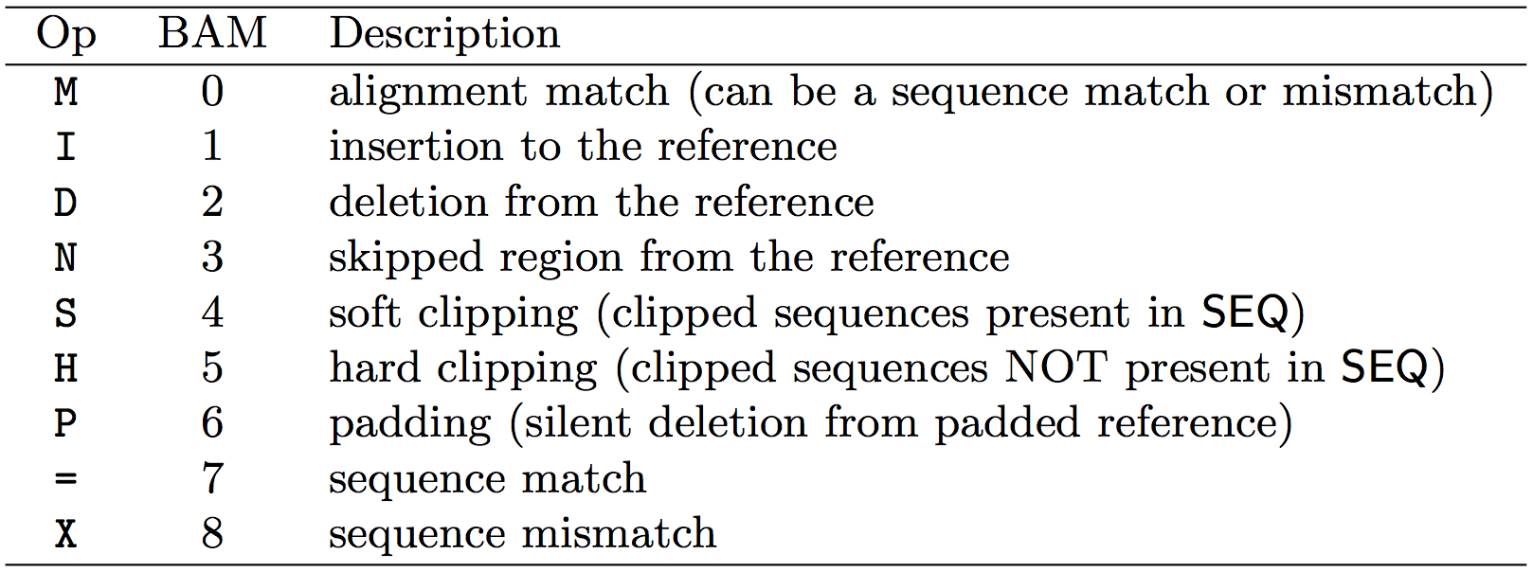
CIGAR strings explained
The ‘CIGAR’ (Compact Idiosyncratic Gapped Alignment Report)
The CIGAR string is a sequence of base lengths and associated ‘operations’ indicating which bases align to the reference (either a match or mismatch), are deleted, are inserted, represent introns, etc.
e.g. 81M859N19M
  A 100 bp read consists of: 81 bases of alignment to reference, 859 bases skipped (an intron), 19 bases of alignment

Slide 28
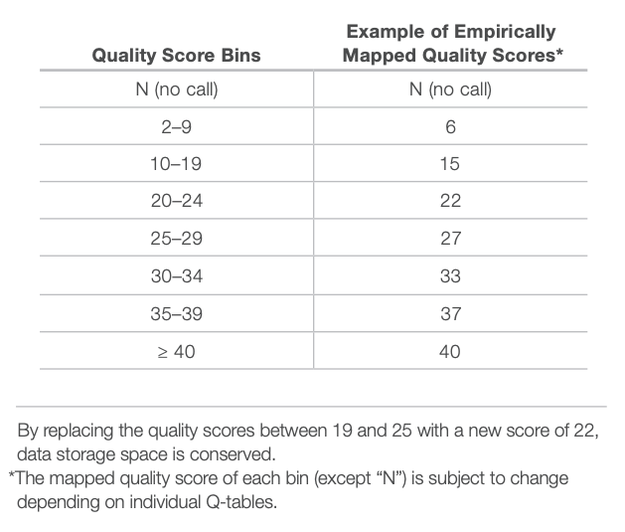
CRAM files
CRAM is an ultra-compressed version of a BAM file
  Usually between 30-60% smaller than the corresponding BAM
Stores “diffs” from the reference genome
  requires the matching reference genome to restore original data!
Base quality binning may be used as well
Some tools still require conversion back to bam

Slide 29
How should I sort my SAM/BAM file?
Generally BAM files are sorted by position
  This is for performance reasons
    When sorted and indexed, arbitrary positions in a massive BAM file can be accessed rapidly
Certain tools require a BAM sorted by read name
  Usually this is when we need to easily identify both reads of a pair
    The insert size between two reads may be large
    In fusion detection we are interested in read pairs that map to different chromosomes

Slide 30
Introduction to the BED format
When working with BAM files, it is very common to want to examine a focused subset of the reference genome
  e.g. the exons of a gene
These subsets are commonly specified in ‘BED’ files
  https://genome.ucsc.edu/FAQ/FAQformat.html#format1
Many BAM manipulation tools accept regions of interest in BED format
Basic BED format (tab separated):
  Chromosome name, start position, end position (BED3)
  Coordinates in BED format are 0 based

Slide 31
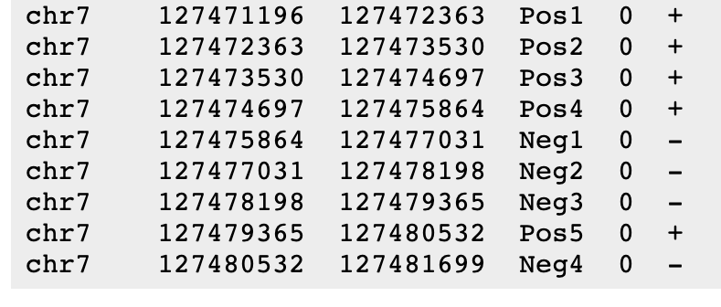
Introduction to the BED format
There are several flavors of BED format: BED3, BED4, BED6, BED8, etc
First 3 fields always required: chr, start, stop
Followed by up to 9 additional optional fields: name, score, strand, thickStart, thickEnd, itemRGB, blockCount, blockSizes, blockStarts

Slide 32

Manipulation of SAM/BAM and BED files
Several tools are used ubiquitously in sequence analysis to manipulate these files
SAM/BAM files
  samtools
  bamtools
  Picard
BED files
  bedtools
  bedops

Slide 33
Common sources of confusion
Genomic coordinate systems
Genome builds
Variant representation

Slide 34
Genomic coordinates – 1 vs 0 based
chr1 |  | T |  | A |  | C |  | G |  | T |  | C |  | A
1-based |  | 1 |  | 2 |  | 3 |  | 4 |  | 5 |  | 6 |  | 7
0-based | 0 |  | 1 |  | 2 |  | 3 |  | 4 |  | 5 |  | 6 |  | 7
 | 1-based | 0-based
Indicate a single nucleotide | chr1:4-4 G | chr1:3-4 G
Indicate a range of nucleotides | chr1:2-4 ACG | chr1:1-4 ACG
Indicate a single nucleotide variant | chr1:5-5 T/A | chr1:4-5 T/A
1-based : Single nucleotides, variant positions, or ranges are specified directly by their corresponding nucleotide numbers
  GFF, SAM, VCF, Ensembl browser, …
0-based: Single nucleotides, variant positions, or ranges are specified by the coordinates that flank them
  BED, BAM, UCSC browser, …

Slide 35
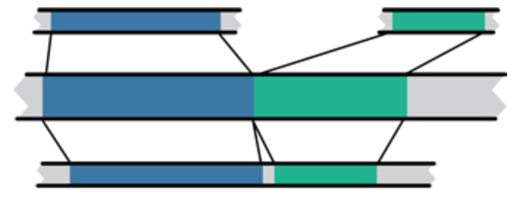
Genome builds
Reference Genome builds
Current human: GRCh38, hg38, b38
alternates: GRCh38v2_ccdg, GRCh38_full_analysis_set_plus_decoy_hla
Previous human: GRCh37, hg19, b37
Current mouse: GRCm38, mm10
Lift-over
Mouse mm10
Human hg19
Human GRCh37
For a detailed discussion of various human reference genome flavors refer here:
https://pmbio.org/module-02-inputs/0002/02/01/Reference_Genome/

Slide 36
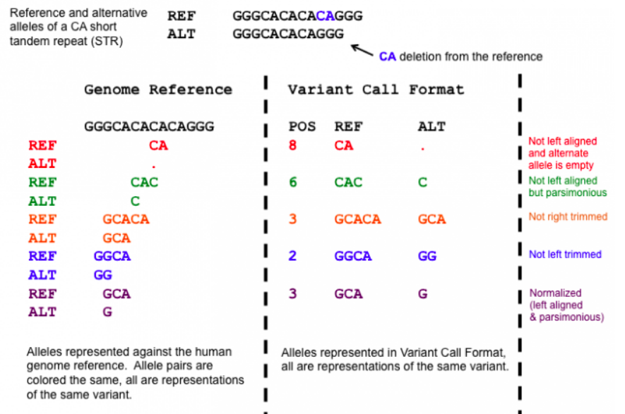
Variant shifting (alignment) and parsimony/trimming
Parsimony: representing variant in as few nucleotides as possible without reducing the length of any allele to 0
Left (right) aligning = shifting the start position of a variant as far to the left (right) as possible
Notes:
https://genome.sph.umich.edu/wiki/Variant_Normalization
Parsimony means representing a variant in as few nucleotides as possible without reducing the length of any allele to 0.
Left aligning a variant means shifting the start position of that variant to the left till it is no longer possible to do so.
The representation of variants in a VCF file requires that no alleles in the REF and ALT field are represented with an empty string (empty allele). The red indel has an illegal VCF representation.
The green variant is not left aligned as you can prefix an A nucleotide on the left side of the variant's alleles and truncate the C on the right side of the variant's alleles. It is however parsimonious.
The orange variant is left aligned but is not right parsimonious.
The blue variant is left aligned but not left parsimonious.
The maroon variant is left aligned and parsimonious.

Slide 37
Coffee Break & Networking Session

