Slide 1



RNA-Seq Module 3
Abundance Estimation and Differential Expression
Obi Griffith, Malachi Griffith,
Charlz Jerold, Allen Li, Jennie Yao, Isabel Risch
Advanced Sequencing Technologies & Bioinformatics Analysis November 8-20, 2026

Slide 2
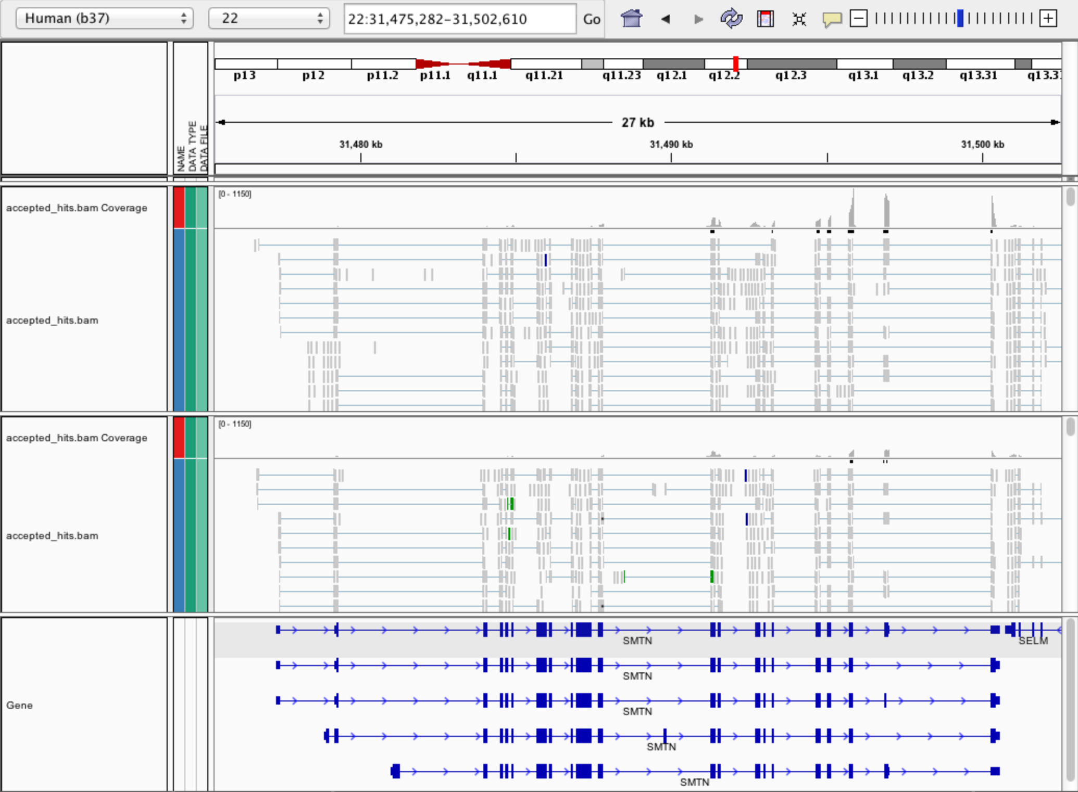
Expression estimation for known genes and transcripts
3’ bias
Down-regulated

Slide 3
What is FPKM (RPKM)?
RPKM: Reads Per Kilobase of transcript per Million mapped reads.
FPKM: Fragments Per Kilobase of transcript per Million mapped reads.
No essential difference - Just a terminology change to better describe paired-end reads!

Slide 4
What is FPKM?
Why not just count reads in my RNAseq data?
The relative expression of a transcript is proportional to the number of cDNA fragments that originate from it. However:
  # fragments is biased towards larger genes
  # fragments is related to total library depth
Fragments
Per Kilobase of transcript
per Million mapped reads.

Slide 5
What is FPKM?
FPKM attempts to normalize for gene size and library depth
    remember – RPKM is essentially the same!
C = number of mappable fragments for a gene (transcript)
N = total number of mappable fragments in the library
L = number of base pairs in the gene (transcript)
  FPKM = (C / (N x L) ) x 1,000 x 1,000,000
  FPKM = (1,000,000,000 x C) / (N x L)
  FPKM = (C / (N / 1,000,000)) / (L/1000)
More reading:
  http://www.biostars.org/p/11378/
  http://www.biostars.org/p/68126/

Slide 6
How do FPKM and TPM differ?
TPM: Transcript per Kilobase Million
The difference is in the order of operations:
FPKM
1) Determine total fragment count, divide by 1,000,000 (per Million)
2) Divide each gene/transcript fragment count by #1 (Fragments Per Million)
3) Divide each FPM by length of each gene/transcript in kilobases (FPKM)
TPM
1) Divide each gene/transcript fragment count by length of the transcript in kilobases (Fragments Per Kilobase)
2) Sum all FPK values for the sample and divide by 1,000,000 (per Million)
3) Divide #1 by #2 (TPM)
The sum of all TPMs in each sample is the same. Easier to compare across samples!
http://www.rna-seqblog.com/rpkm-fpkm-and-tpm-clearly-explained/
https://www.ncbi.nlm.nih.gov/pubmed/22872506
Notes:
When you use TPM, the sum of all TPMs in each sample are the same. This makes it easier to compare the proportion of reads that mapped to a gene in each sample. In contrast, with RPKM and FPKM, the sum of the normalized reads in each sample may be different, and this makes it harder to compare samples directly.

Slide 7
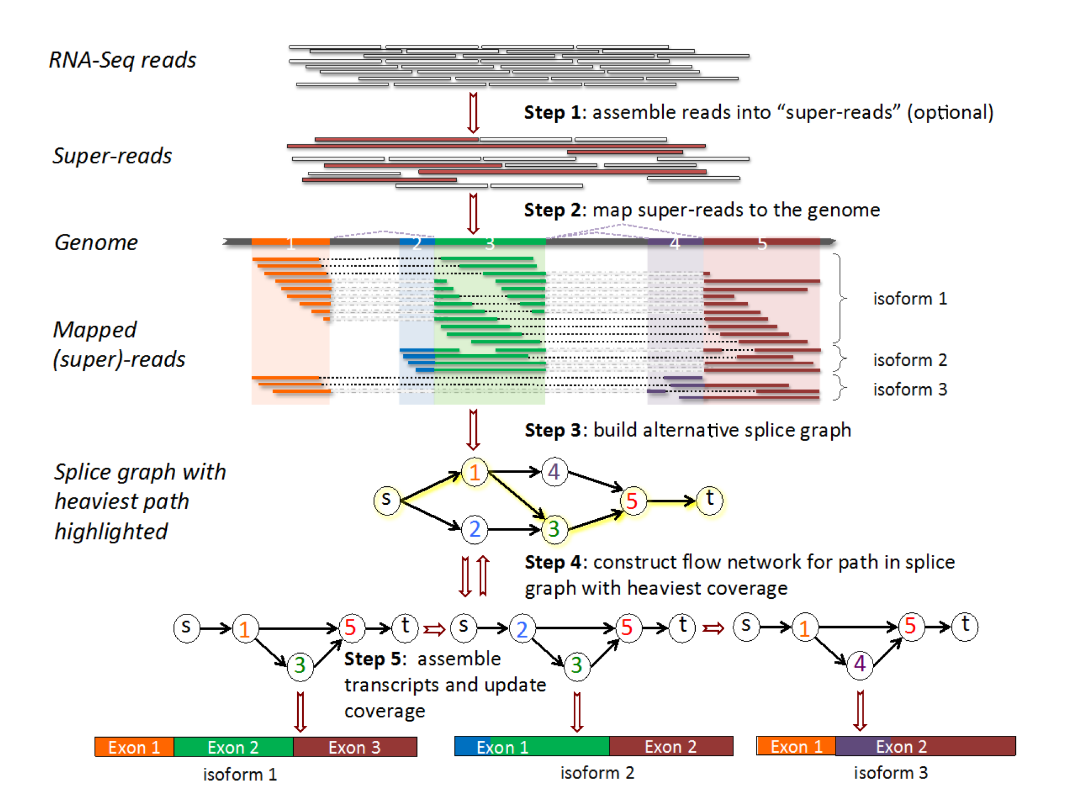
How does StringTie work?
Align reads to the genome, optionally assemble super-reads and re-align
Group reads into clusters
Infer isoforms:
Build alternative splice graph (ASG)
Iteratively extract the heaviest path from a splice graph
construct a flow network
compute maximum flow to estimate abundance
update the splice graph by removing reads that were assigned by the flow algorithm
This process repeats until all reads have been assigned.
Pertea et al. Nature Biotechnology, 2015
Notes:
The StringTie algorithm optionally accepts RNA-seq reads that are assembled into super-reads (Step 1).
Super-reads plus un-assembled reads or just un-assembled reads (if skipping super-read assembly step) are mapped to the genome (Step 2).
In Step 3, mapped reads (and super-reads) are grouped into clusters. Basically, any reads aligned within some minimum distance (configurable) are grouped together. Each cluster is used to build an alternative splice graph (ASG). The ASG captures all possible transcripts that are consistent with the mapped reads, where nodes in the graph correspond to contiguous regions of the genome that are uninterrupted by any spliced read alignment, and directed edges correspond to reads that align across two such nodes in the correct 5′ to 3′ order.
The path from source (s) to sink (t) with the heaviest coverage is used to build a flow network corresponding to the transcript represented by that path (Step 4).
The maximum flow in this network represents the coverage of one assembled transcript, which is removed from the splice graph (Step 5). Steps 4 and 5 are repeated until no more transcripts can be assembled.

Slide 8
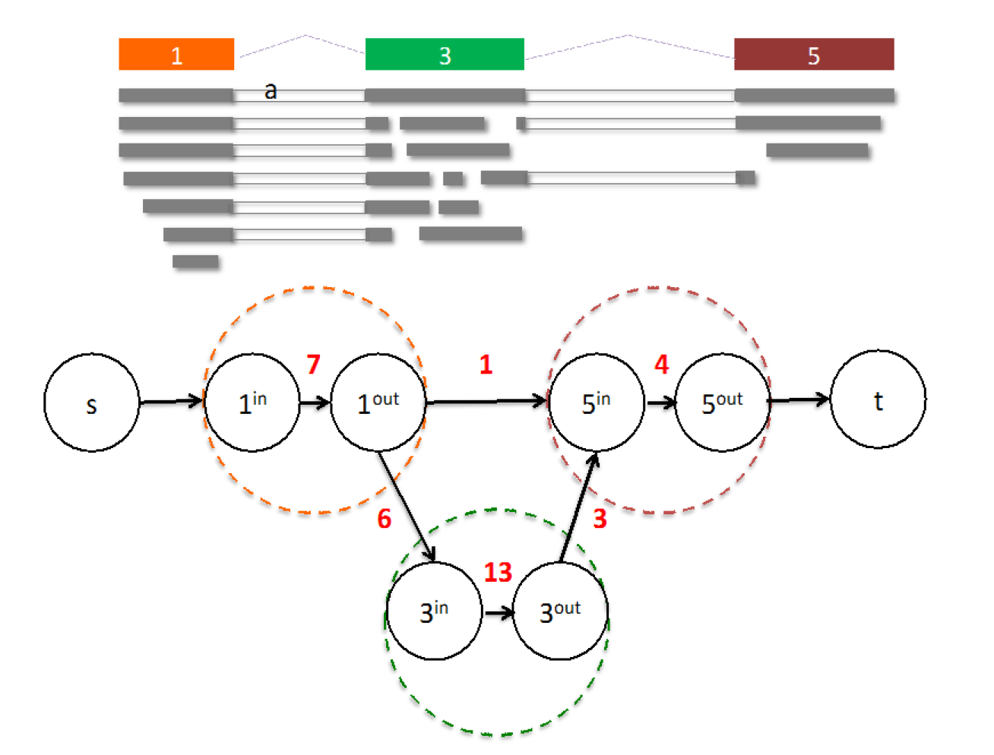
From flow network for each transcript, maximum flow is used to assemble transcript and estimate abundance
StringTie uses basic graph theory (splice graph), custom heuristics (heaviest path), more graph theory (flow network) and optimization theory (maximum flow). See StringTie paper for definitions and math.
Notes:
Flow network associated with a transcript (shown with colored nodes). 15 fragments (shown in grey) align to the transcript. Two nodes in the flow network are connected if a fragment starts and ends at those nodes. E.g., nodes 1 and 5 are connected because fragment (a) starts at node 1 and ends at node 5. For each colored node in the transcript, two nodes are created in the flow network. Capacities on edges (not connecting source or sink) are shown in red.
In the first node (corresponding to exon1) there are 7 fragments. One of these fragments is connected to exon5 (starts at beginning of exon1 and ends at end of exon5), while 6 fragments are connected to exon3. In the second node (corresponding to exon3) there are 13 fragments, of which 3 are connected to exon 5. The final node (corresponding to exon5) has 4 supporting fragments. The maximum flow is clearly 1 – 3 – 5.
StringTie estimates the coverage level of the transcript by solving a maximum-flow problem that determines the maximum number of fragments that can be associated with the chosen transcript.
The maximum flow problem is a well-studied problem in optimization theory.

Slide 9
StringTie Modes
Expression estimation mode (“Reference Only”)
  “–G $GTF_File” AND “–e” option
  no "novel" transcript assemblies (isoforms)
  read alignments not overlapping reference transcripts ignored
  Faster, especially when given limited set of reference transcripts
    Avoids complicated steps of clustering and building alternative splice graph from scratch, skipping straight to abundance estimation
“Reference guided mode”
  “–G $GTF_File” WITHOUT “–e” option
  Both known and novel transcript assemblies
“De novo” mode
  NEITHER “–G $GTF_File” NOR “–e” option
  Novel transcript assemblies only
Pertea et al. Nature Protocols, 2016

Slide 10
StringTie -merge
Merge together all gene structures from all samples
  Some samples may only partially represent a gene structure
Incorporates known transcripts with assembled, potentially novel transcripts
For de novo or reference guided mode, we will rerun StringTie with the merged transcript assembly.
Pertea et al. Nature Protocols, 2016

Slide 11
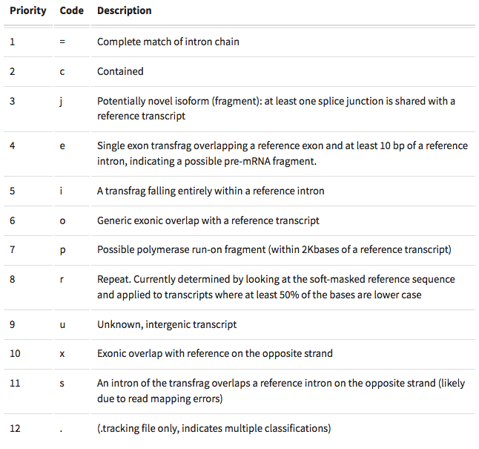
gffcompare
gffcompare will compare a merged transcript GTF with known annotation, also in GTF/GFF3 format
http://cole-trapnell-lab.github.io/cufflinks/cuffcompare/index.html#cuffcompare-output-files

Slide 12
We are on a Coffee Break & Networking Session

