Slide 1
Canadian Bioinformatics Workshops
www.bioinformatics.ca
bioinformaticsdotca.github.io

Slide 2


Slide 3
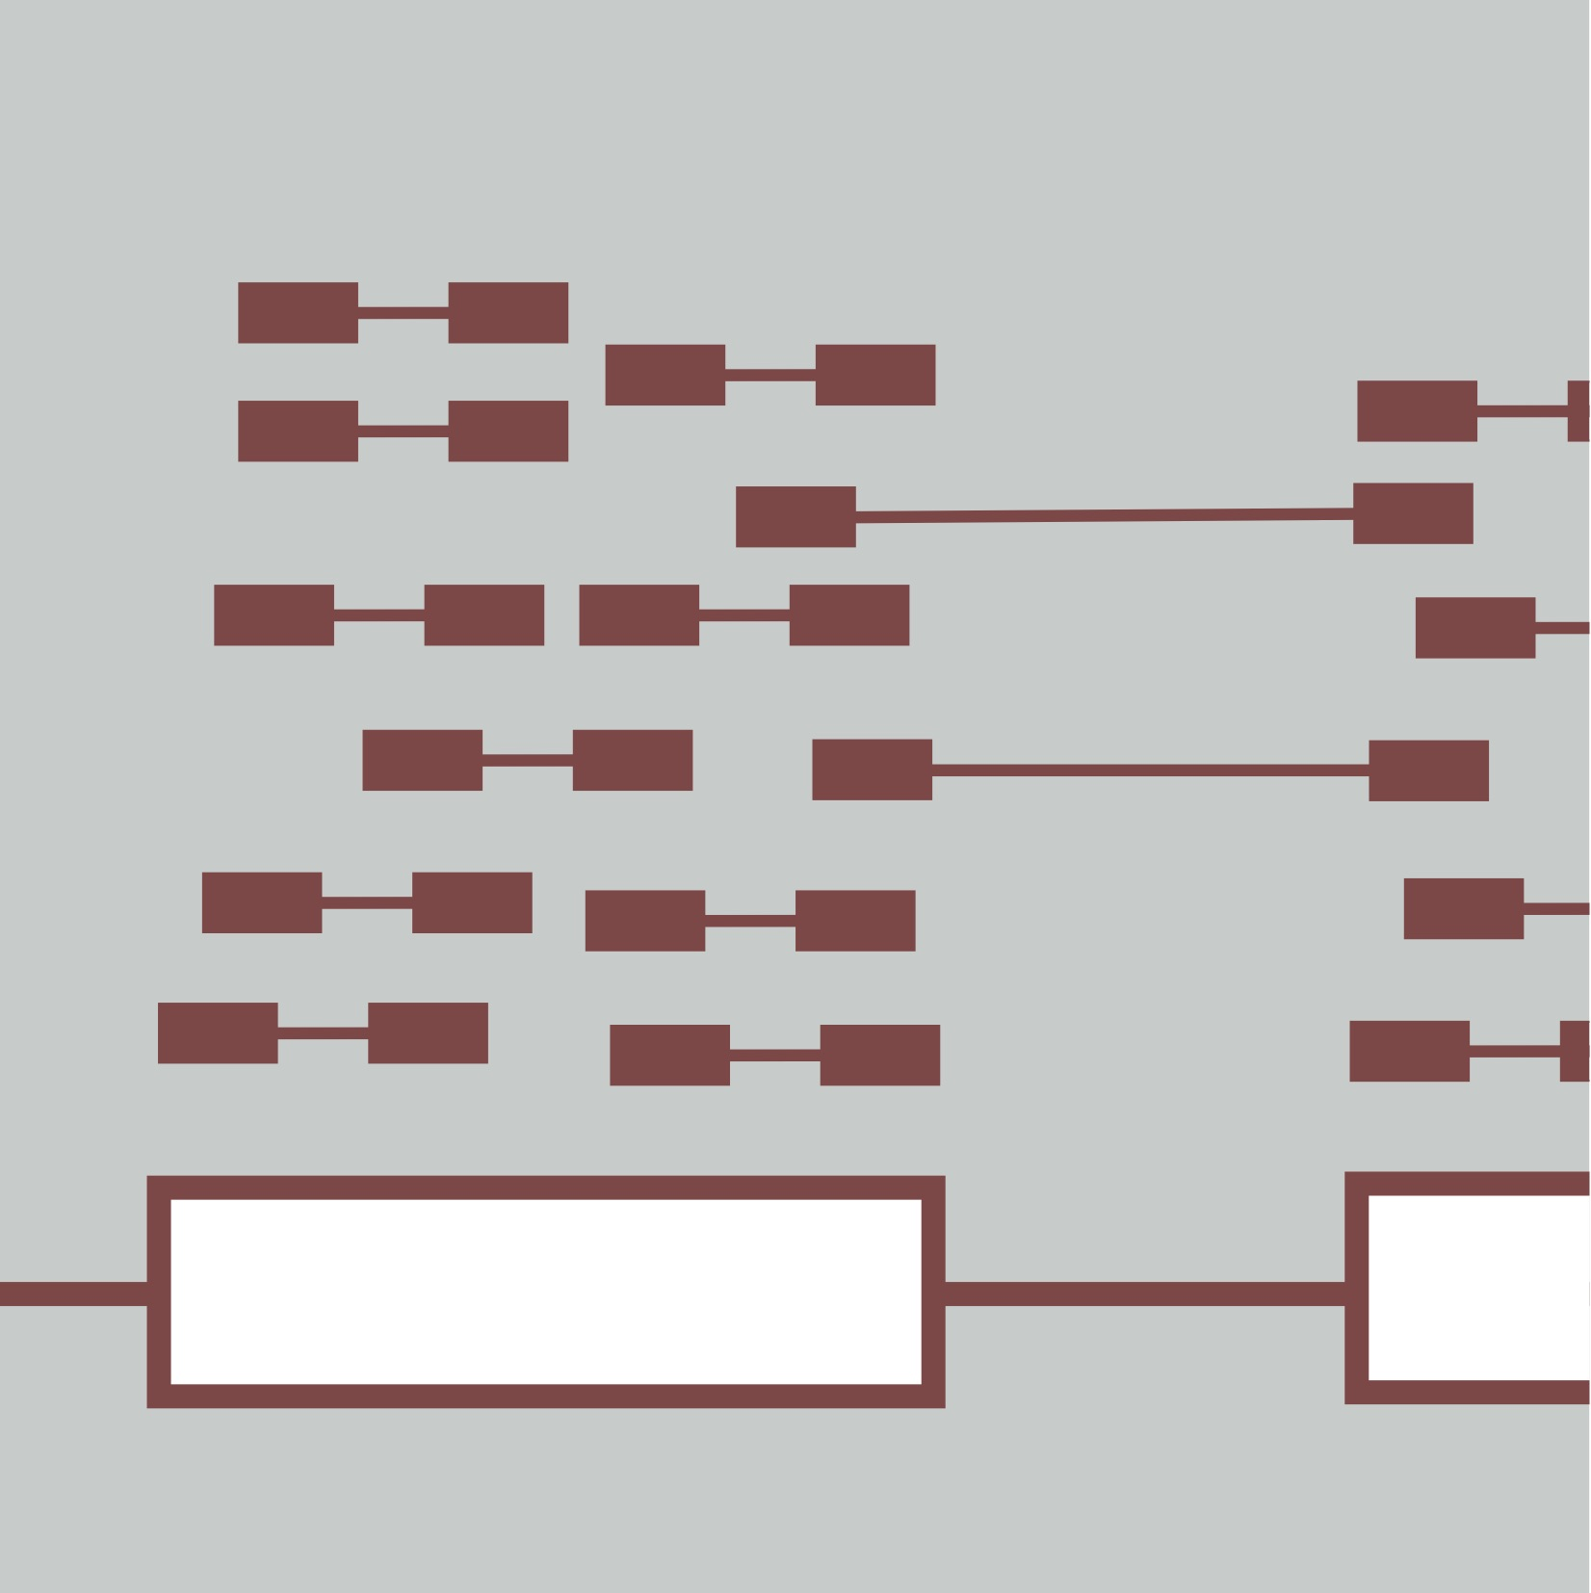
Module Title
Instructor name
RNA-seq Analysis
July 17-19, 2023
Instructor affiliation logos

Slide 4
Learning Objectives
By the end of this lecture, you will:
Understand…
Be able to define…
Know…

Slide 5




We are on a Coffee Break & Networking Session
Workshop Sponsors:

