Slide 1


Canadian Bioinformatics Workshops
www.bioinformatics.ca
bioinformaticsdotca.github.io
Supported by

Slide 2
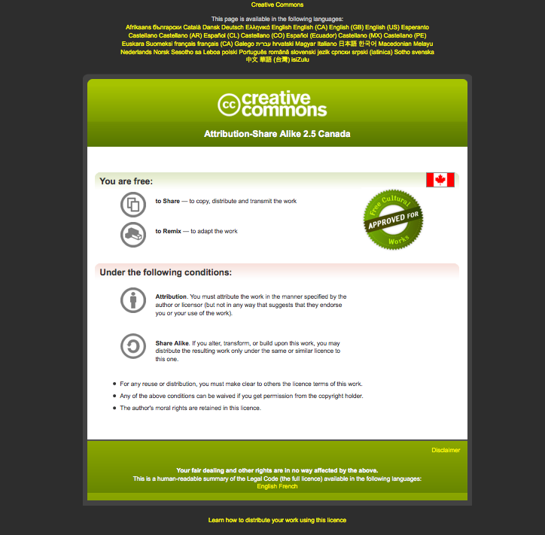

Slide 3
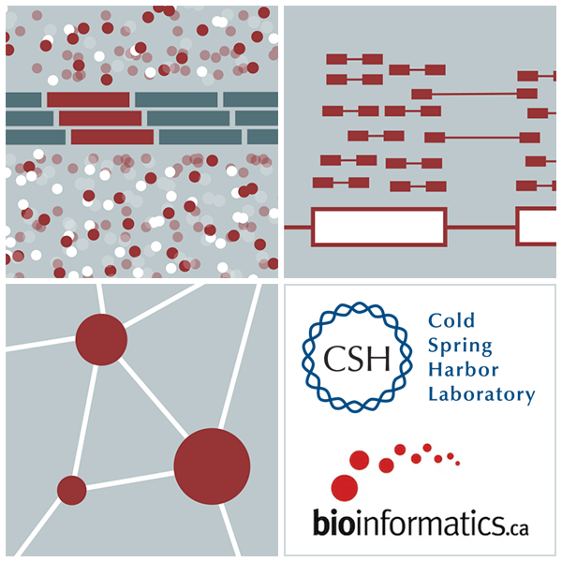
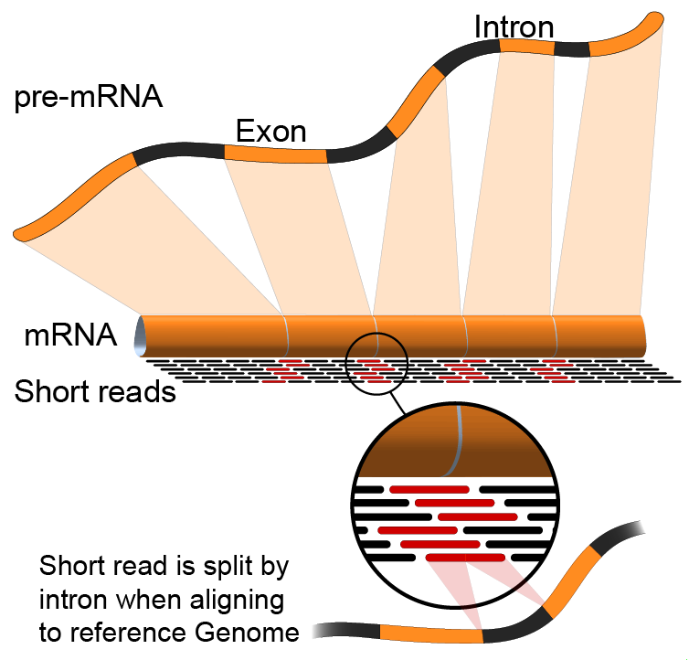

Introduction to RNA sequencing
Emma Bell, Felicia Gomez, Obi Griffith, Malachi Griffith, Huiming Xia
RNA-Seq Analysis
Sep 8th-10th, 2021

Slide 4
Learning objectives of the course
Module 1: Introduction to RNA Sequencing
Module 2: Alignment and Visualization
Module 3: Expression and Differential Expression
Module 4: Alignment Free Expression Estimation
Tutorials
Provide a working example of an RNA-seq analysis pipeline
Run in a ‘reasonable’ amount of time with modest computer resources
Self contained, self explanatory, portable

Slide 5
Learning objectives of module 1
Introduction to the theory and practice of RNA sequencing (RNA-seq) analysis
Rationale for sequencing RNA
Challenges specific to RNA-seq
General goals and themes of RNA-seq analysis work flows
Common technical questions related to RNA-seq analysis
Introduction to the RNA-seq hands on tutorial

Slide 6
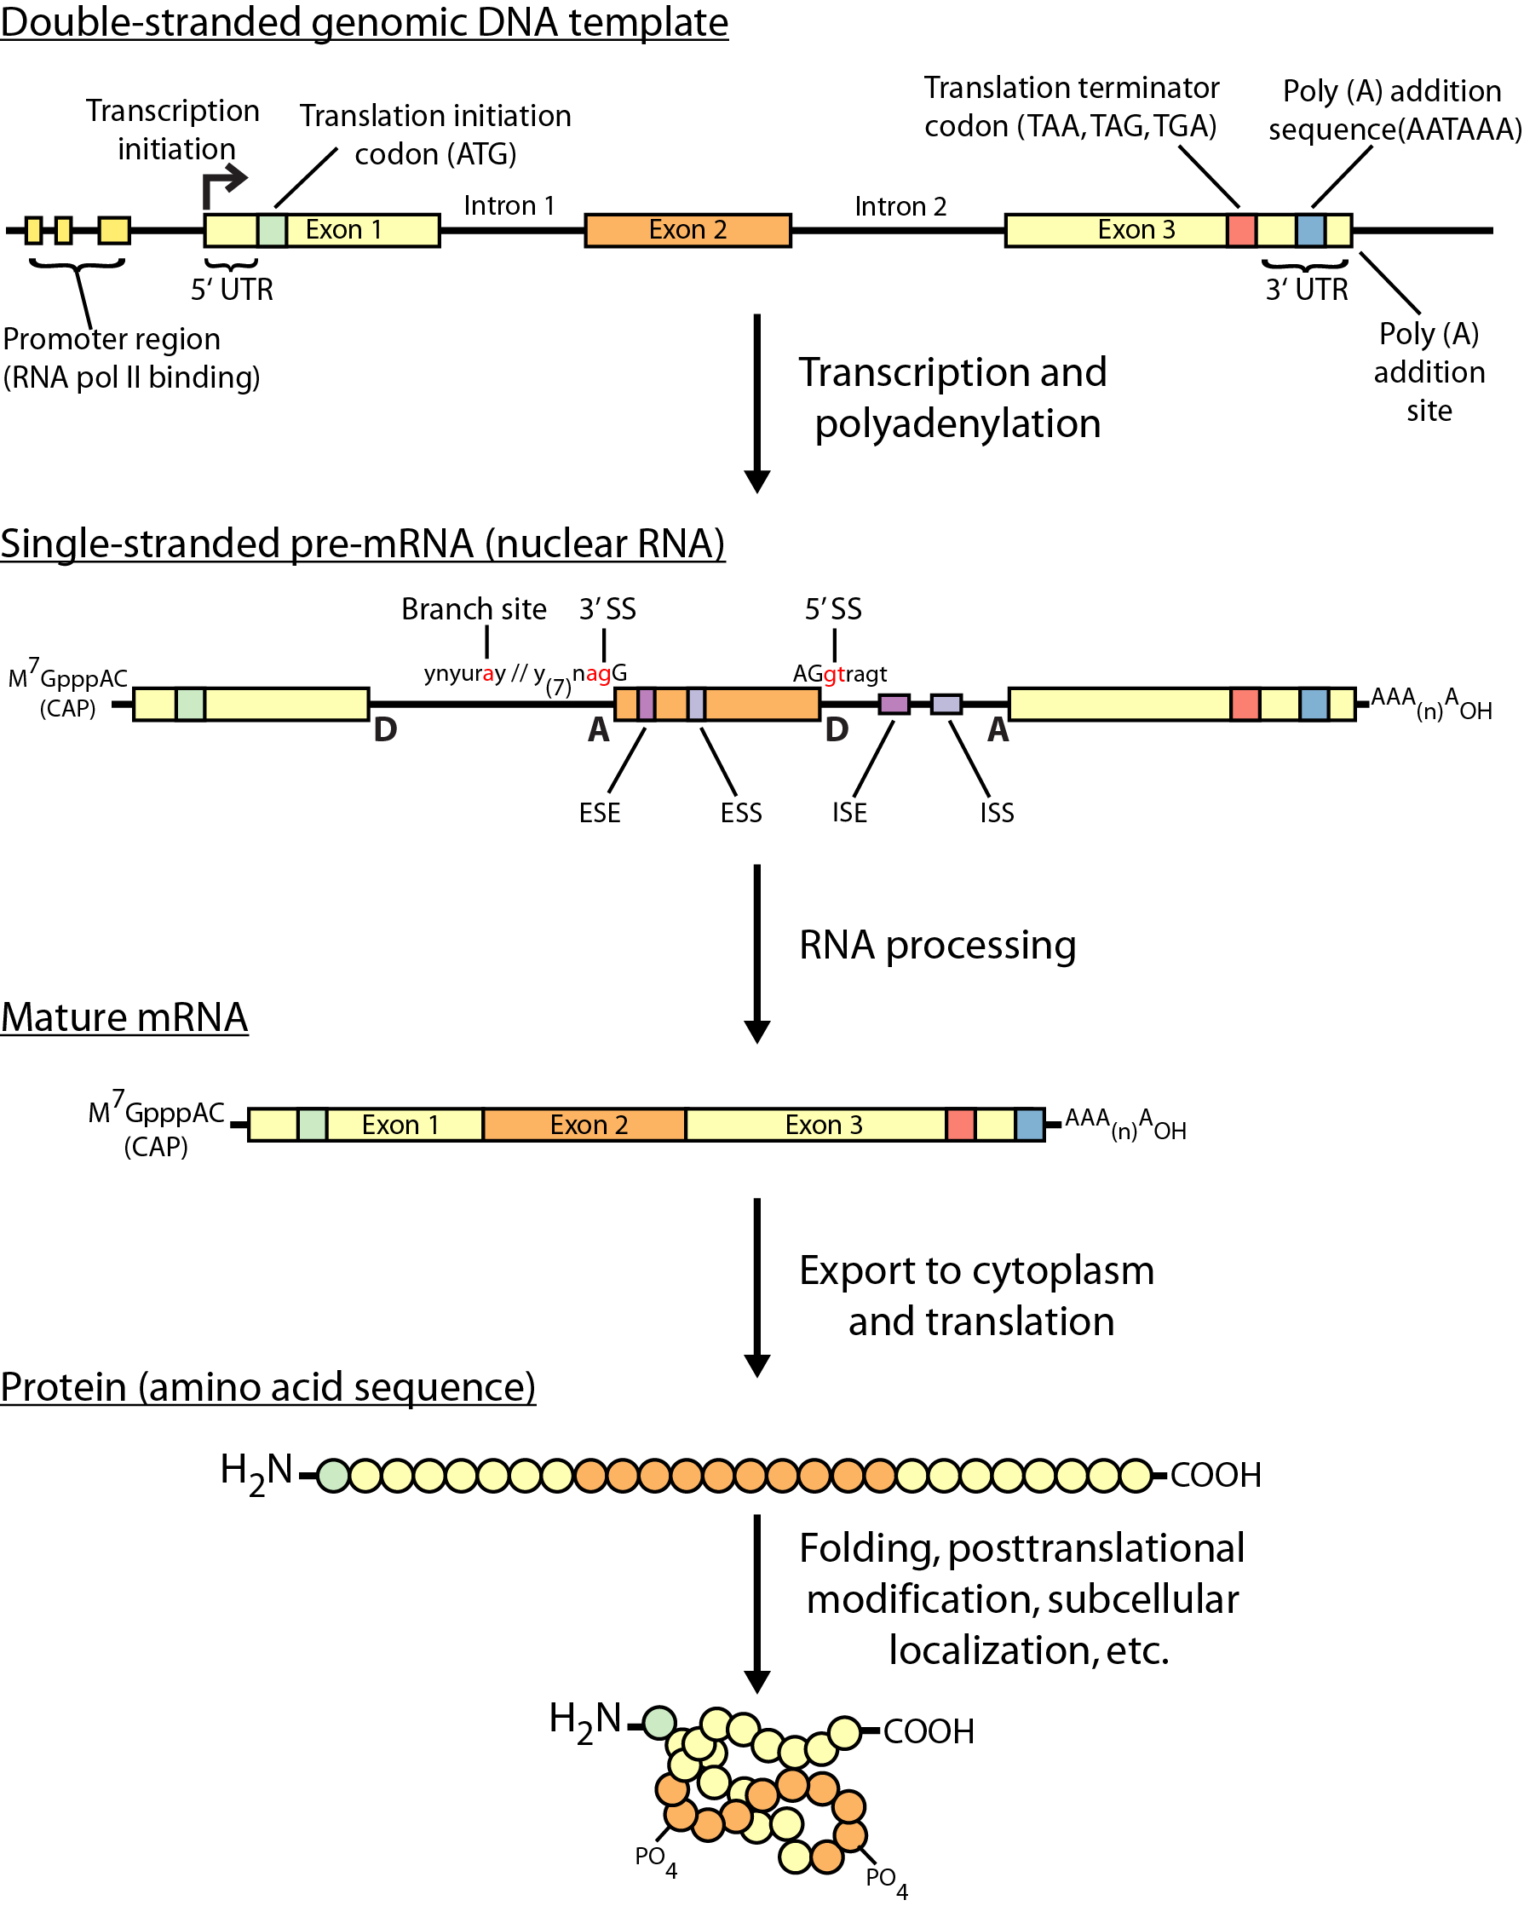
Gene expression

Slide 7
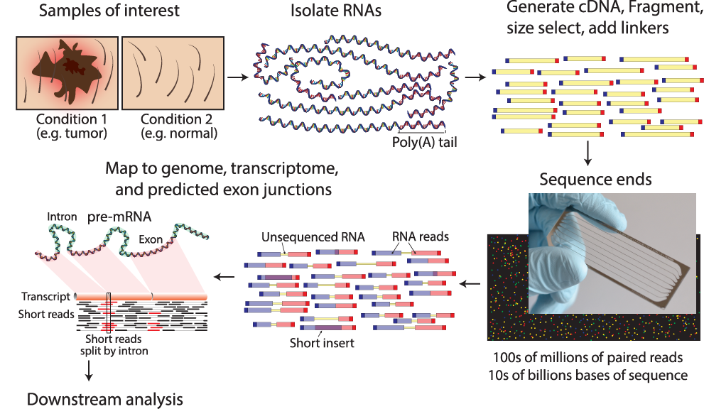
RNA sequencing
Notes:
Notes on paired end read depiction:
Each line depicts a sequenced fragment. These consist of adapters, and portions sequenced from each end
Blue is being used to indicated read 1, and red for read 2
If the fragment is long enough relative to the read sequence length, there will be a portion in the middle that is not sequenced
Read1 and Read2 can also overlap
Note the portion

Slide 8
Why sequence RNA (versus DNA)?
Functional studies
Genome may be constant but an experimental condition has a pronounced effect on gene expression
e.g. Drug treated vs. untreated cell line
e.g. Wild type versus knock out mice
Predicting transcript sequence from genome sequence is difficult
Gene annotation is revolutionized by RNA-seq
Some molecular features can only be observed at the RNA level
Alternative isoforms, fusion transcripts, RNA editing

Slide 9
Why sequence RNA (versus DNA)?
Interpreting mutations that do not have an obvious effect on protein sequence
‘Regulatory’ mutations that affect what mRNA isoform is expressed and how much
Prioritizing protein coding somatic mutations (often heterozygous)
If the gene is not expressed, a mutation in that gene would be less interesting
If the gene is expressed but only from the wild type allele, this might suggest loss-of-function (haploinsufficiency)
If the mutant allele itself is expressed, this might suggest a candidate drug target

Slide 10
Challenges
Sample
Purity?, quantity?, quality?
RNAs consist of small exons that may be separated by large introns
Mapping reads to genome is challenging
The relative abundance of RNAs vary wildly
10⁵ – 10⁷ orders of magnitude
Since RNA sequencing works by random sampling, a small fraction of highly expressed genes may consume the majority of reads
Ribosomal and mitochondrial genes
RNAs come in a wide range of sizes
Small RNAs must be captured separately
PolyA selection of large RNAs may result in 3’ end bias
RNA is fragile compared to DNA (easily degraded)

Slide 11
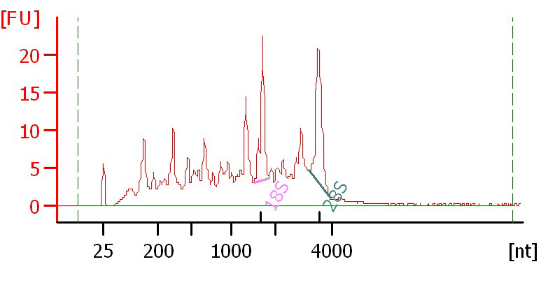
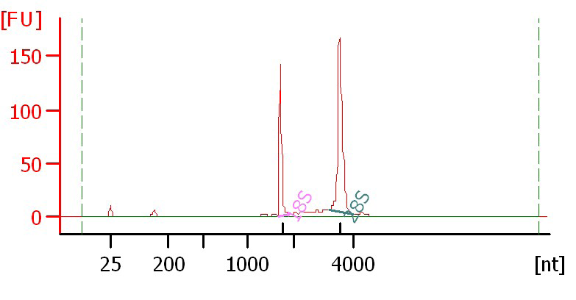
Agilent example / interpretation
https://goo.gl/uC5a3C
‘RIN’ = RNA integrity number
0 (bad) to 10 (good)
RIN = 6.0
RIN = 10

Slide 12
Design considerations
Standards, Guidelines and Best Practices for RNA-seq
The ENCODE Consortium
Download from the Course Wiki
Meta data to supply, replicates, sequencing depth, control experiments, reporting standards, etc.
https://goo.gl/6LePBW
Several additional initiatives are underway to develop standards and best practices that cover many of these concepts. These include: the Sequencing Quality Control (SEQC) consortium, the Roadmap Epigenomics Mapping Consortium (REMC), and the Beta Cell Biology Consortium (BCBC).

Slide 13
There are many RNA-seq library construction strategies
Total RNA versus polyA+ RNA?
Ribo-reduction?
Size selection (before and/or after cDNA synthesis)
Small RNAs (microRNAs) vs. large RNAs?
A narrow fragment size distribution vs. a broad one?
Linear amplification?
Stranded vs. un-stranded libraries
Exome captured vs. un-captured
Library normalization?
These details can affect analysis strategy
Especially comparisons between libraries

Slide 14
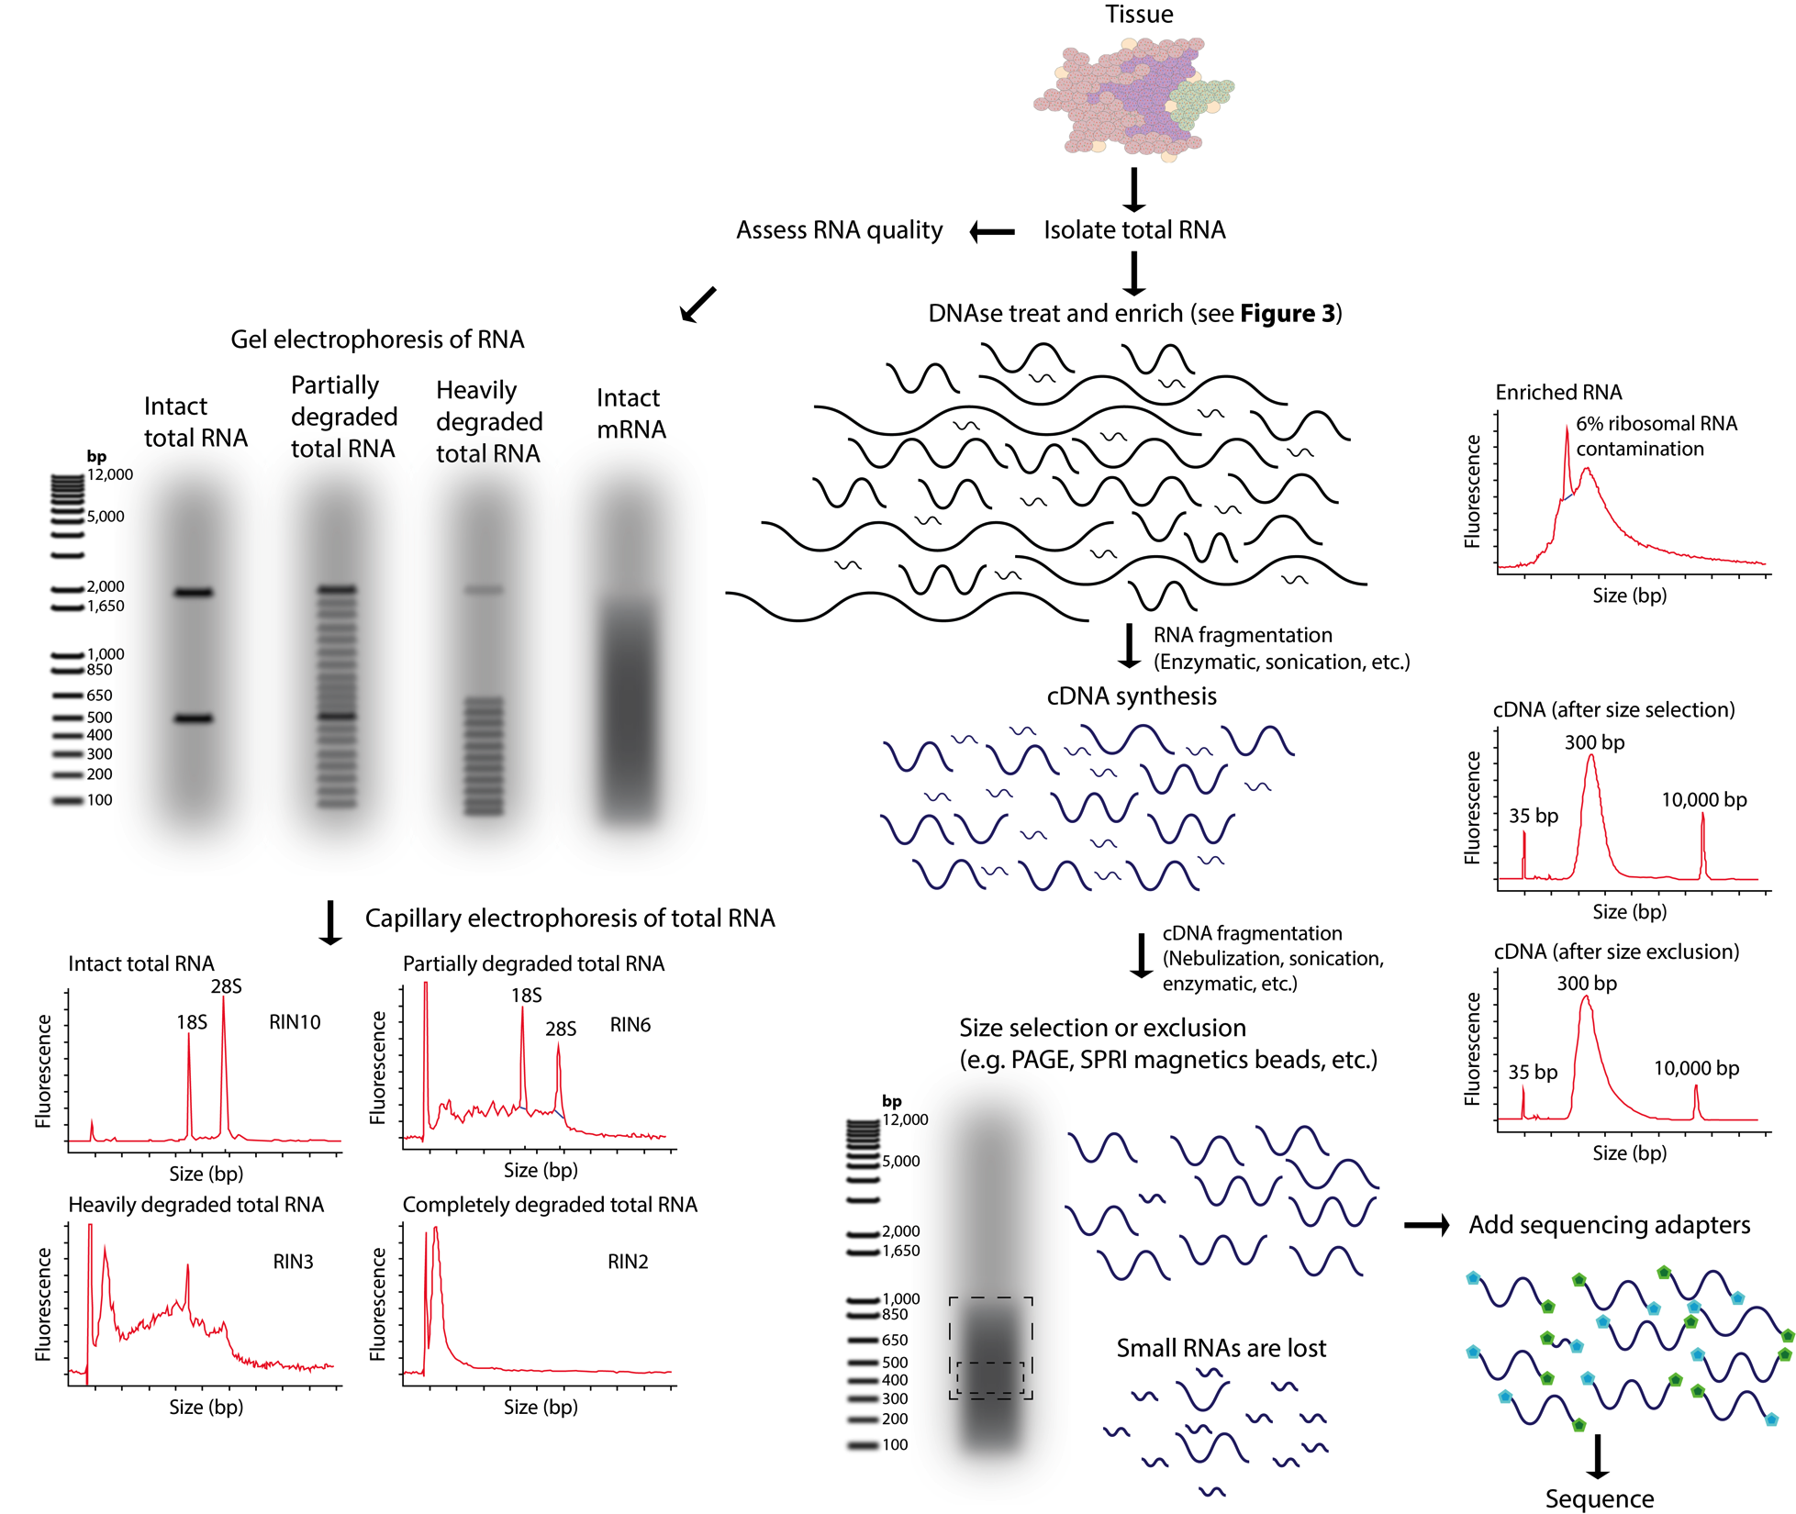
Fragmentation and size selection
Notes:
- RNA-seq library construction may involve both fragmentation and size selection. These procedures may be modified according to the integrity and amount of starting total RNA. The distributions of RNA molecule sizes are depicted for input total RNA and at various stages during the process of RNA/cDNA fragmentation and size selection. Commonly used methods for fragmentation and size selection are depicted along with the expected output of a quality-control assay at each stage (in the form of a capillary electrophoresis trace). Note that in the final library, it is typical that the majority of RNAs below a certain size (typically <150–200 bp) are underrepresented. Refer to S3 Table and S7 Table for more details on many of the concepts depicted in this figure.

Slide 15
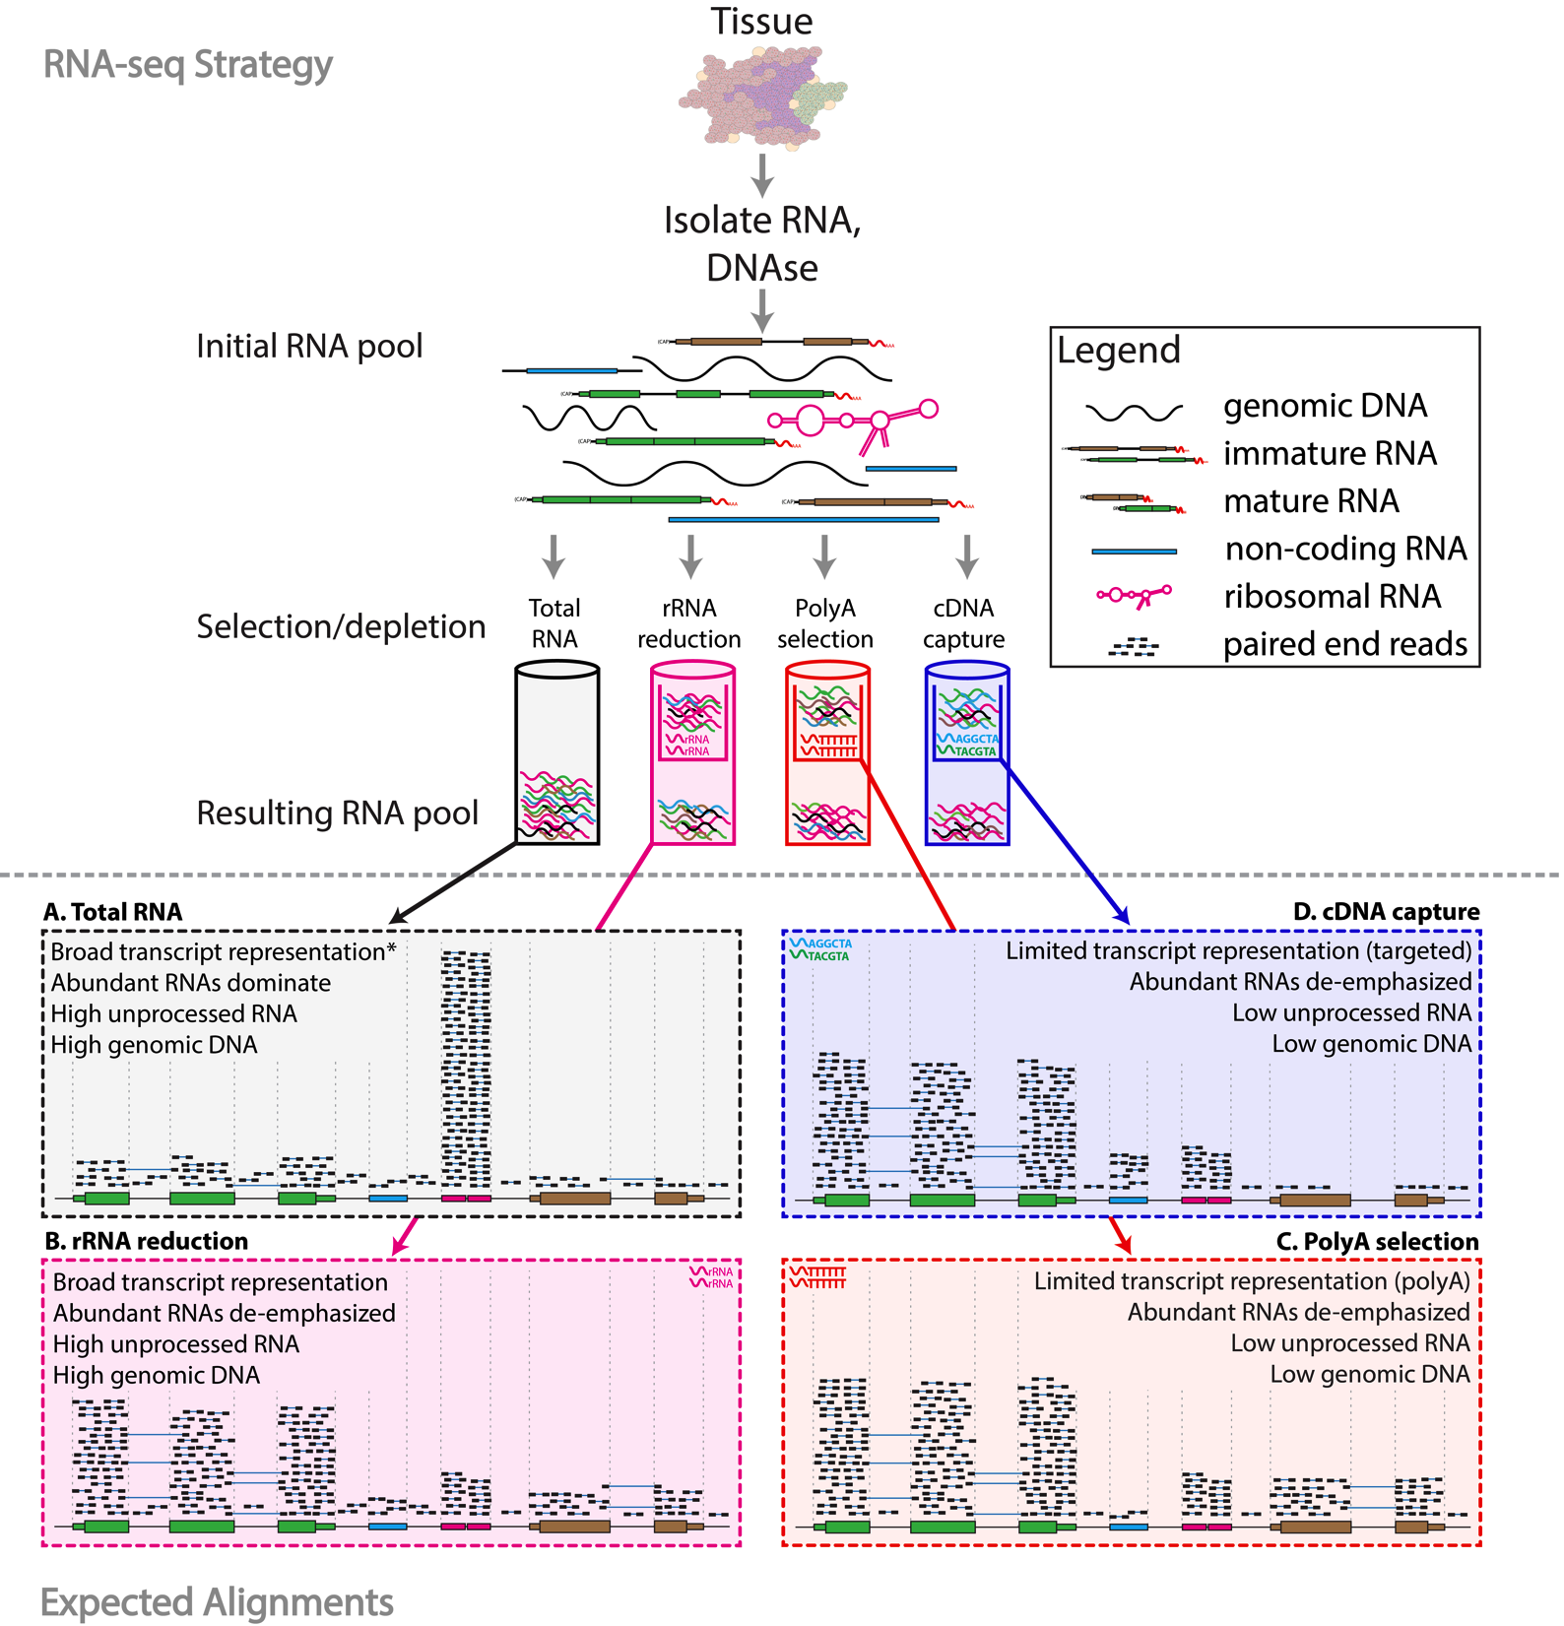
RNA sequence selection/depletion
Notes:
RNA-seq library enrichment strategies that influence interpretation and analysis. RNA-seq library construction protocols differ widely, and these differences have significant consequences for data interpretation and analysis. The figure above illustrates representative alignment results for either total RNA or one of three commonly used enrichment strategies at a hypothetical genomic locus with very highly expressed ribosomal RNA (pink), highly expressed protein coding (green), lowly expressed protein coding (brown) and lowly expressed noncoding RNA (blue) genes. (A) If total RNA is sequenced without enrichment, the vast majority of reads correspond to a small number of very highly expressed RNA species such as ribosomal RNAs (rRNAs). In humans, ~95%–98% of all RNA molecules may be rRNAs. A significant amount of genomic DNA (gDNA) and unprocessed heteronuclear RNA (hnRNA, also known as pre-mRNA) contamination may also remain after typical RNA isolation procedures. As a result, most reads will align to intronic, intergenic, and especially to ribosomal gene regions. Since analysis of these molecules is rarely the target of RNA-seq, various enrichment strategies are commonly employed. The amount of gDNA contamination in total RNA can be reduced, but not entirely eliminated, by use of a deoxyribonuclease (DNase) treatment. The amount of unprocessed RNA can be reduced, but not entirely eliminated, by employing an RNA isolation method that attempts to keep nuclei intact and removing these to enrich for mature mRNAs present in the cytoplasmic compartment. Additional strategies are discussed in S3 Table.
* When sequencing total RNA, a complete representation of the transcriptome is theoretically present, but in practical terms, insufficient sequence reads are obtained to sufficiently sample all transcripts of all types, and some enrichment strategy is required to reduce extremely abundant rRNA species. (B) Selective rRNA reduction kits use oligonucleotides complementary to ribosomal sequences to specifically reduce the abundance of rRNAs while maintaining a broad representation of transcript species. Since the oligonucleotide probes used in these kits are only designed to bind to and deplete rRNA sequences, a significant amount of unprocessed RNA and gDNA contamination may remain. (C) Poly(A) selection and (D) cDNA capture methods specifically enrich for (primarily) mature polyadenylated RNA species or specific targets (e.g., all known transcript exons), respectively. Since poly(A) selection specifically targets RNAs that have been polyadenylated—a modification that happens at the end of the transcription process—poly(A) selection results in an enrichment for mature, completely processed RNAs. Poly(A) selection and cDNA capture methods sacrifice some transcriptome representation for increased signal to noise for transcripts of greater interest. Poly(A) methods will fail to represent most noncoding and other nonpolyadenylated RNAs. Capture methods on the other hand will under-represent any loci not specifically included in the capture design. For example, in this case the brown gene was not included in the design, and therefore, expression of this gene would be underestimated. Each of the methods depicted here has advantages and disadvantages (S3 Table and S7 Table). Furthermore, the relative amounts of each class of RNA depicted in each panel are hypothetical examples meant to demonstrate the goals and principles of each enrichment strategy and should not be interpreted quantitatively. Refer to S4 Table for additional information on the effect of each enrichment strategy.

Slide 16
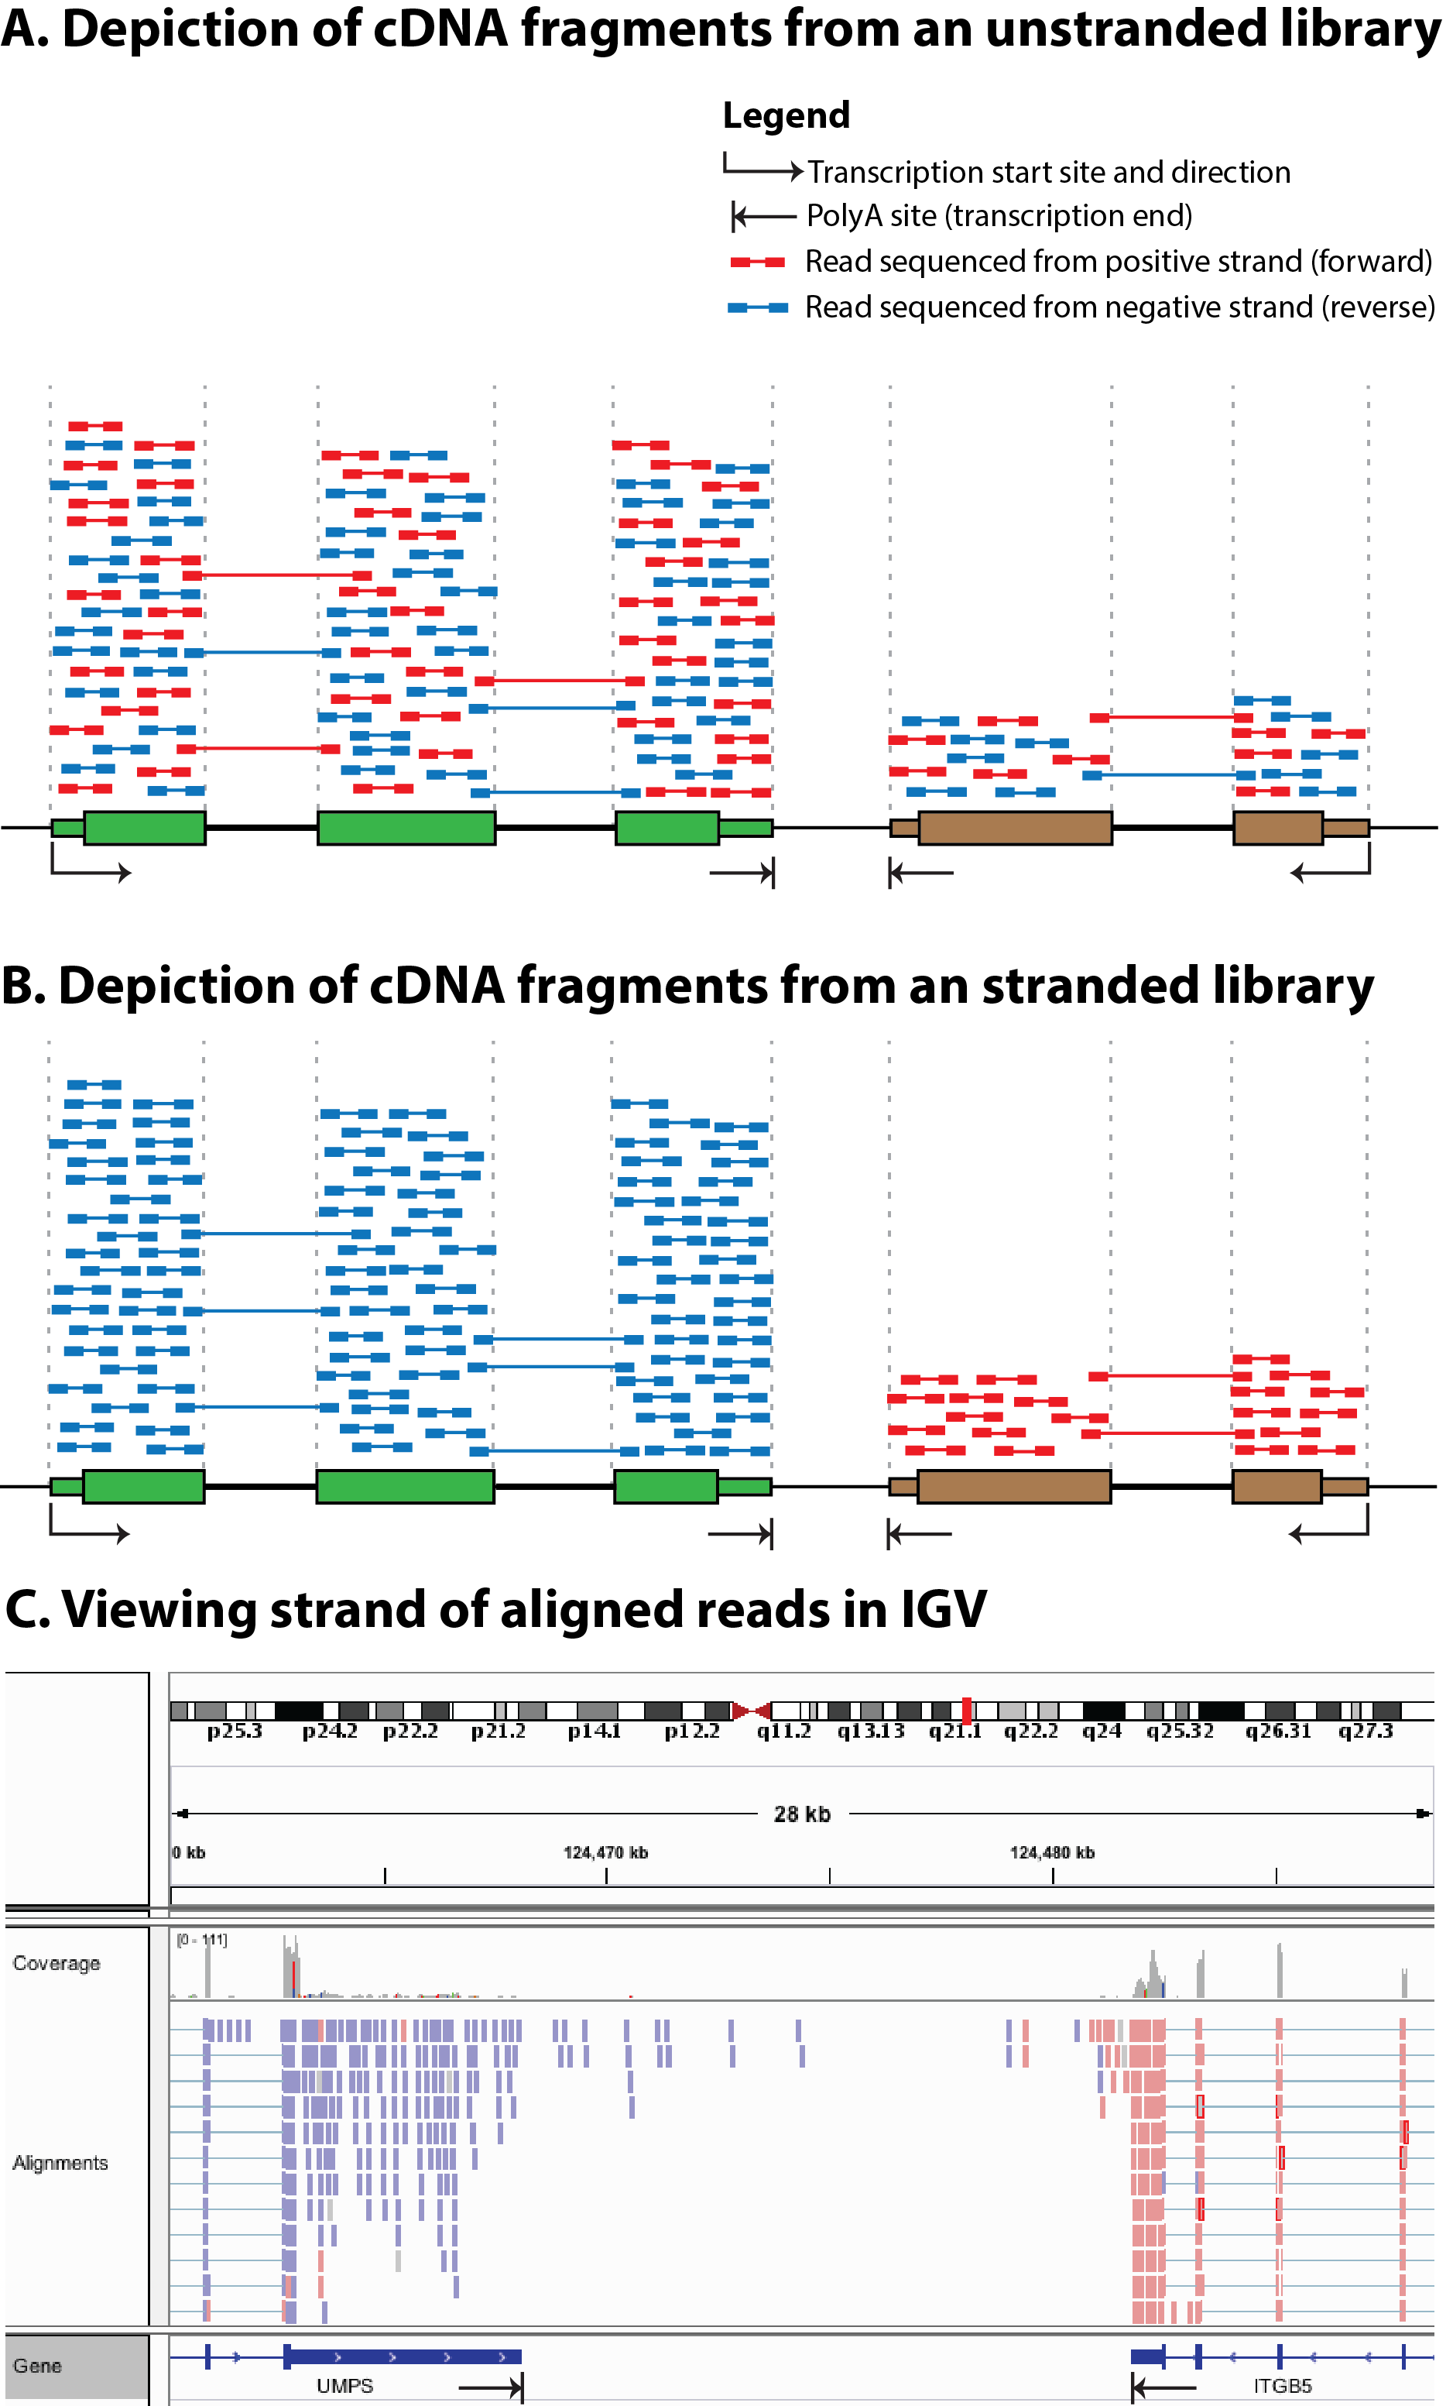
Stranded vs. unstranded
Notes:
Comparison of stranded and unstranded RNA-seq library methods and their influence on interpretation and analysis. (A) Many RNA-seq library construction protocols do not maintain the strand identity of RNA transcripts in the sequence data (S1 Table). In these “unstranded” strategies, doublestranded cDNA is sequenced, and knowledge of the transcription strand of the RNA molecule is lost. This results in an even mix of reads from both strands. In panel A, a gene transcribed on the positive strand is shown in green, a second gene transcribed on the negative strand is shown in brown, and a third gene transcribed on the positive strand (partially overlapping the second gene) is shown in yellow. The first two genes are protein coding with the open reading frame (ORF) portion depicted as thick rectangles and the UTRs depicted as thin rectangles. The third gene is a noncoding RNA gene. Aligned paired-end read sequences (read 1 and read 2) are depicted as short colored bars connected by thin lines. The thin connecting line in each read pair depicts the portion of the cDNA fragment that remains unsequenced when the cDNA fragment is larger than two times the read length. Each read is colored according to the strand sequenced, blue for the positive (forward/sense) strand and red for the negative (reverse/antisense) strand. Using known annotations, the mapped position of each read, and knowledge of exon splicing patterns, the likely transcription strand of some reads can be inferred. However, for many aligned reads the transcription strand cannot be inferred and sense-antisense expression analysis is not possible. Note that for each gene, an approximately equal proportion of reads corresponding to each strand are observed. Also note that read pairing information can sometimes be used to infer which gene a read was likely derived from. These reads are referred to as “encompassing” read pairs, in which one read of a pair aligns within one exon and the second read of a pair aligns within another exon. However, reads that align within a region corresponding to overlapping genes cannot be unambiguously assigned to either gene (e.g., the portion of the brown and yellow genes that overlap). Note that in this figure we are not depicting any reads in which a single read of a read pair spans across an intron. These exon–exon “spanning” reads can usually be matched unambiguously to a transcript, even in an unstranded library, because the exon–exon junction alignments line up with known splice sites and exon boundaries. (B) More recent “stranded” RNA-seq library strategies allow the strand information to be retained. In the resulting alignments, depicted in panel B, the strand of the alignment corresponds in a predictable way to the transcription strand of the sequenced RNA molecule. Now we see that reads aligning within a gene are indicated as being derived from the expected transcription strand for that gene. Furthermore, in regions where two genes overlap on opposite strands, we can now unambiguously assign reads to each gene. (C) When strand information is maintained by the RNA-seq protocol, it can be visualized in genome browsers such as IGV [62]. For example, to make IGV color read alignments according to strand, use the “Color alignments” by “First-of-pair strand” setting (refer to S5 Table for more strand-related software settings).

Slide 17
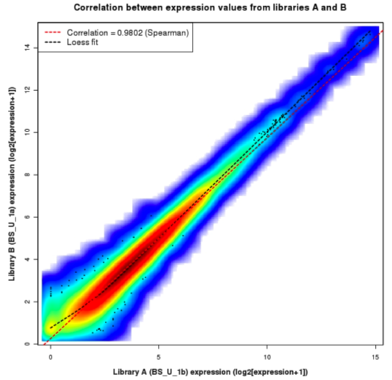
Replicates
Technical Replicate
Multiple instances of sequence generation
Flow Cells, Lanes, Indexes
Biological Replicate
Multiple isolations of cells showing the same phenotype, stage or other experimental condition
Some example concerns/challenges:
Environmental Factors, Growth Conditions, Time
Correlation Coefficient 0.92-0.98

Slide 18
Common analysis goals of RNA-Seq analysis (what can you ask of the data?)
Gene expression and differential expression
Alternative expression analysis
Transcript discovery and annotation
Allele specific expression
Relating to SNPs or mutations
Mutation discovery
Fusion detection
RNA editing

Slide 19
General themes of RNA-seq workflows
Each type of RNA-seq analysis has distinct requirements and challenges but also a common theme:
Obtain raw data (convert format)
Align/assemble reads
Process alignment with a tool specific to the goal
e.g. ‘cufflinks’ for expression analysis, ‘defuse’ for fusion detection, etc.
Post process
Import into downstream software (R, Matlab, Cytoscape, Ingenuity, etc.)
Summarize and visualize
Create gene lists, prioritize candidates for validation, etc.

Slide 20
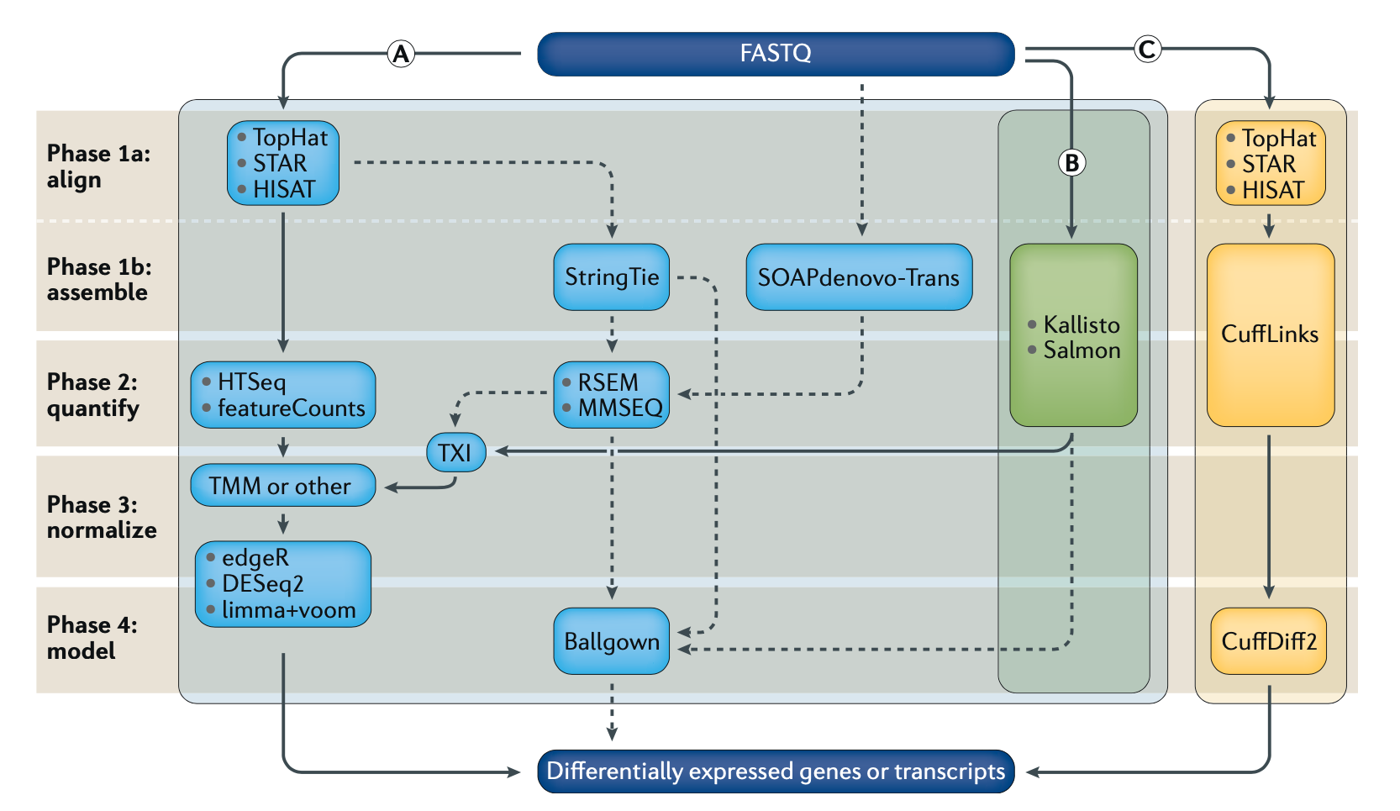
Examples of RNA-seq data analysis workflows for differential gene expression
Stark et al. 2019
Notes:
RNA-seq data analysis workflow for differential gene expression. Computational analysis for differential gene expression (DGE) begins with raw RNA sequencing (RNA-seq) reads in FASTQ format and can follow a number of paths. Three popular workflows (A, B and C, represented by the solid lines) are given as examples, and some of the more common alternative tools (represented by the dashed lines) are indicated. In workflow A, aligners such as TopHat, STAR or HISAT2 use a reference genome to map reads to genomic locations, and then quantification tools, such as HTSeq and featureCounts, assign reads to features. After normalization (usually using methods embedded in the quantification or expression modelling tools, such as trimmed mean of M-values (TMM)), gene expression is modelled using tools such as edgeR, DESeq2 and limma+voom, and a list of differentially expressed genes or transcripts is generated for further visualization and interpretation. In workflow B, newer, alignment-free tools, such as Kallisto and Salmon, assemble a transcriptome and quantify abundance in one step. The output from these tools is usually converted to count estimates (using tximport (TXI)) and run through the same normalization and modelling used in workflow A, to output a list of differentially expressed genes or transcripts. Alternatively, workflow C begins by aligning the reads (typically performed with TopHat, although STAR and HISAT can also be used), followed by the use of CuffLinks to process raw reads and the CuffDiff2 package to output transcript abundance estimates and a list of differentially expressed genes or transcripts. Other tools in common use include StringTie, which assembles a transcriptome model from TopHat (or similar tools) before the results are passed through to RSEM or MMSEQ to estimate transcript abundance, and then to Ballgown to identify differentially expressed genes or transcripts, and SOAPdenovo-trans, which simultaneously aligns and assembles reads for analysis via the path of choice.

Slide 21
Common questions: Should I remove duplicates for RNA-seq?
Maybe… more complicated question than for DNA
Concern.
Duplicates may correspond to biased PCR amplification of particular fragments
For highly expressed, short genes, duplicates are expected even if there is no amplification bias
Removing them may reduce the dynamic range of expression estimates
If you do remove them, assess duplicates at the level of paired-end reads (fragments) not single end reads

Slide 22
Common questions: How much library depth is needed for RNA-seq?
Depends on a number of factors:
Question being asked of the data. Gene expression? Alternative expression? Mutation calling?
Tissue type, RNA preparation, quality of input RNA, library construction method, etc.
Sequencing type: read length, paired vs. unpaired, etc.
Computational approach and resources
Identify publications with similar goals
Pilot experiment
For DGE analysis only, 30-40 million reads is a common recommendation. More replicates can be more valuable than deeper libraries. Short (e.g. 50-75bp), single-end reads may be used to drive cost down as low as possible.

Slide 23
Common questions: What mapping strategy should I use for RNA-seq?
Depends on read length
< 50 bp reads
Use aligner like BWA and a genome + junction database
Junction database needs to be tailored to read length
Or you can use a standard junction database for all read lengths and an aligner that allows substring alignments for the junctions only (e.g. BLAST … slow).
Assembly strategy may also work (e.g. Trans-ABySS)
> 50 bp reads
Spliced aligner such as Bowtie/TopHat, STAR, HISAT, etc.

Slide 24
Common questions: What if I don’t have a reference genome for my species?
Have you considered sequencing the genome of your species?
If that is not practical or you simply prefer a transcript discovery approach that does not rely on prior knowledge of the genome or transcriptome there are some tools available ...
Unfortunately de novo transcriptome assembly is currently beyond the scope of this workshop
The good news is that the skills you learn here will help you figure out how to install and run those tools yourself
Also we provide example tools in Supplementary Table 2.
https://github.com/griffithlab/rnaseq_tutorial/wiki/Kallisto

Slide 25
More common questions (and answers)
Supplementary Table 7
Malachi Griffith*, Jason R. Walker, Nicholas C. Spies, Benjamin J. Ainscough, Obi L. Griffith*. 2015. Informatics for RNA-seq: A web resource for analysis on the cloud. 11(8):e1004393. 2015.
http://journals.plos.org/ploscompbiol/article?id=10.1371/journal.pcbi.1004393

Slide 26
Introduction to tutorial
(Module 1)

Slide 27
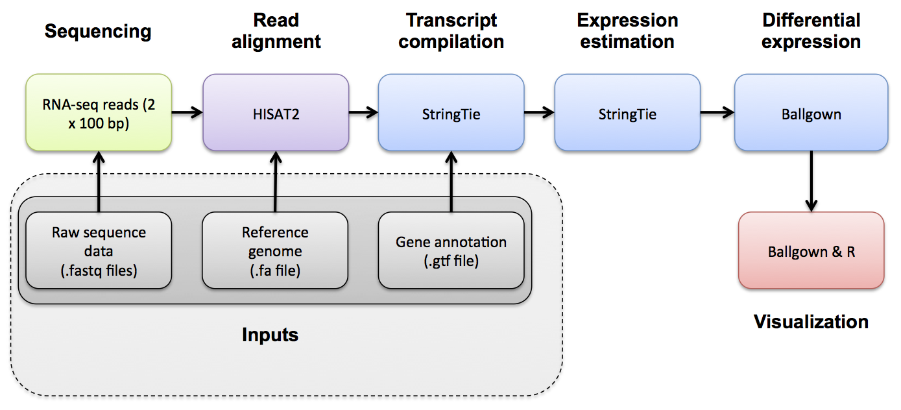
HISAT2/StringTie/Ballgown RNA-seq Pipeline
Module 1

Slide 28






We are on a Coffee Break & Networking Session
Workshop Sponsors:

