Slide 1
Introduction to Genome Arithmetic
Aaron Quinlan, Joshua Mincer, Jason Kunisaki
CSHL Advanced Sequencing Technologies 2022
11/16/2022

Slide 2
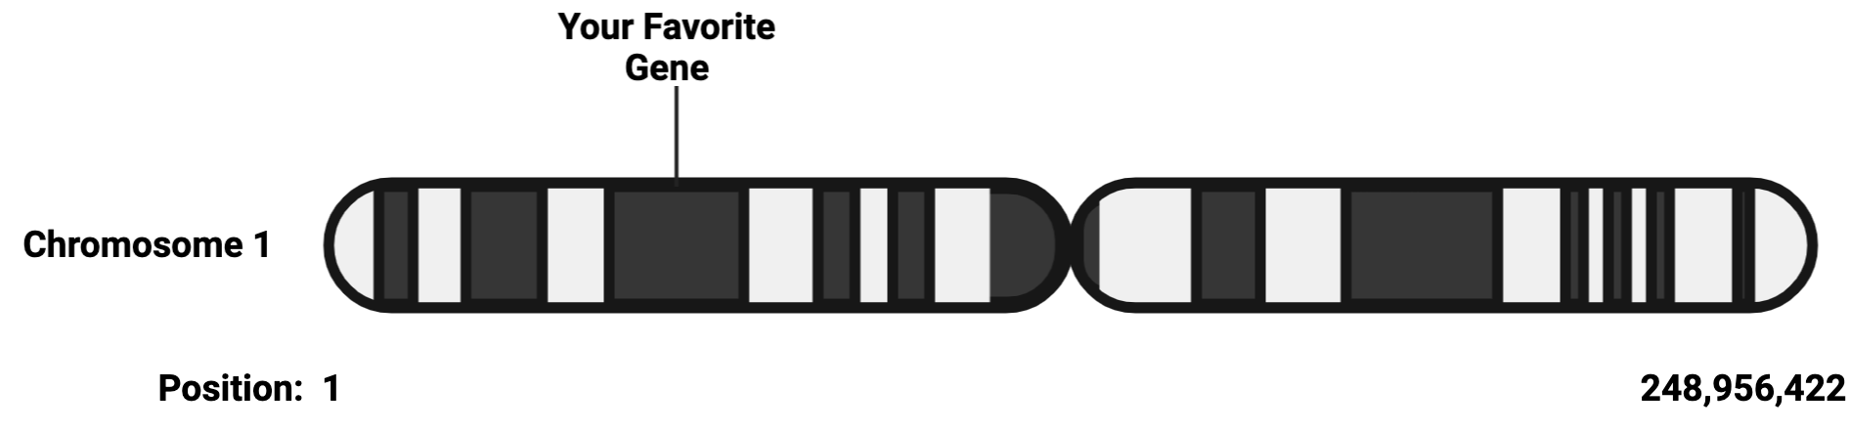
A reference genome is a coordinate system

Slide 3
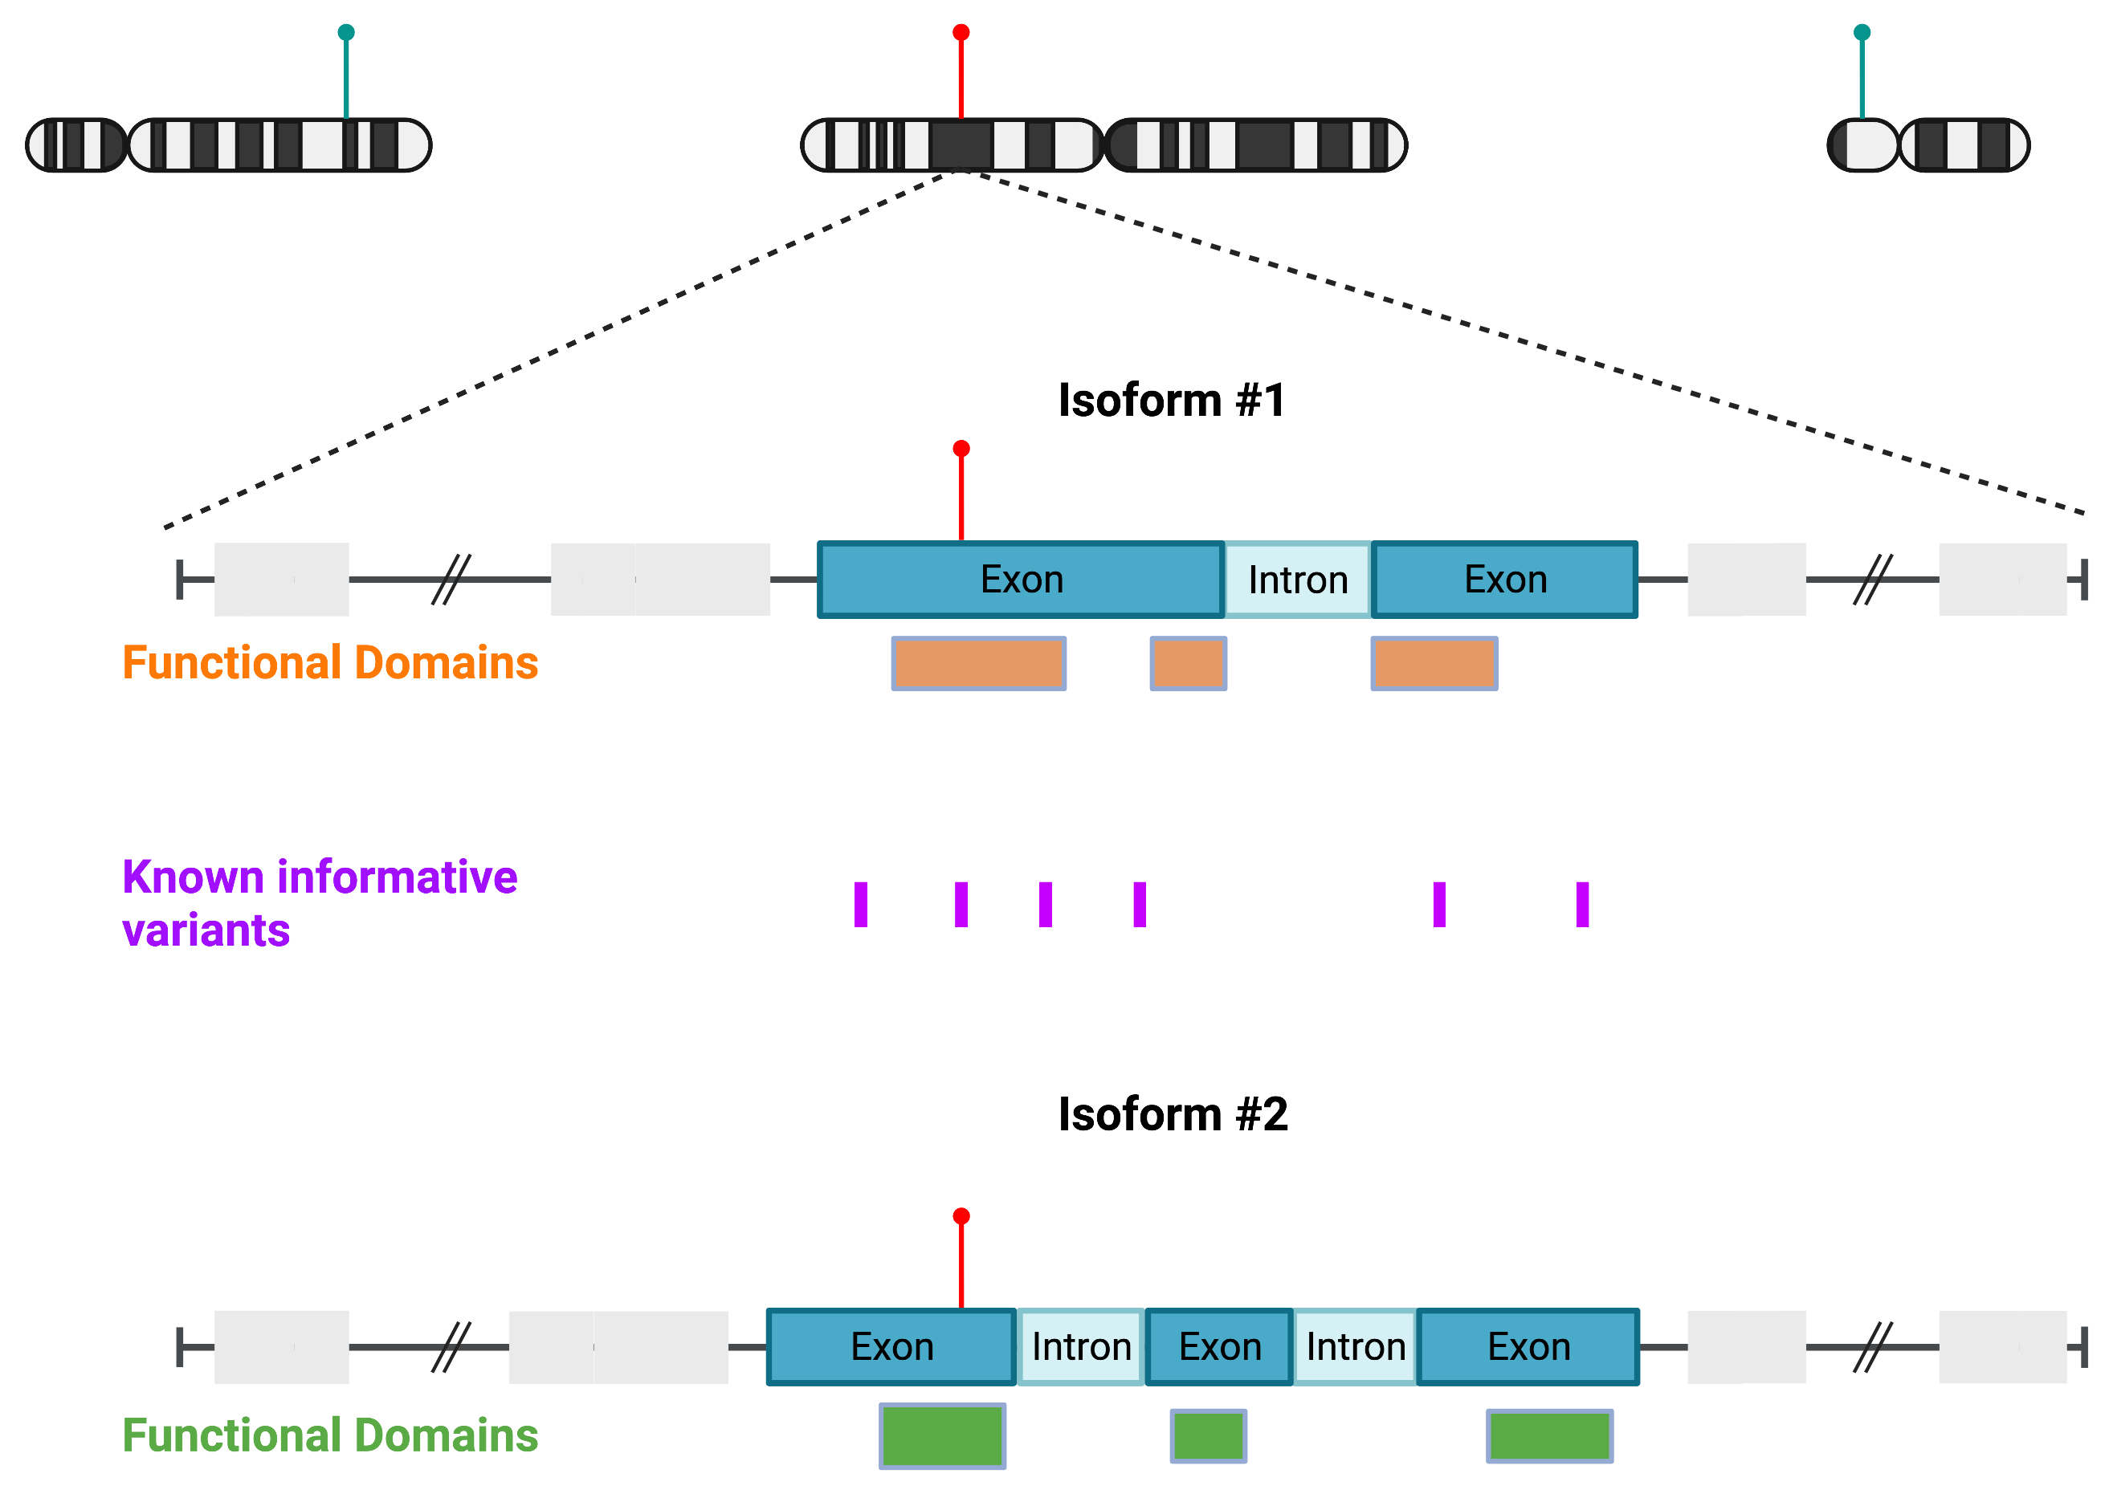
Genome coordinates are essential
Identifying exact variant position
Determining functional consequence of a variant
Variant in a functional domain?
Tumor vs normal comparisons
Rare in the population?
Designing a targeted sequencing panel

Slide 4

Learning Objectives
Chromosome 10
A T G C T G A T G C A T C G
Chromosome 11
G A T A C C C G T A G T T T
Chromosome 12
C G T C G A G C A C T A C G
What are genome coordinates and how are they used?
How to incorporate intervals to analyze specific regions of the genome
Concepts in genome arithmetic – bedtools
High level strategy to generate a targeted sequencing panel
Figures adapted from Obi Griffith’s biostars tutorial and Aaron Quinlan’s bedtools tutorial

Slide 5

Genome coordinates identify a specific location of interest in the reference genome
World coordinates:
41.8781ºN, 87,6298ºW
Chicago
Genome coordinates:
Chromosome: chr10
Start: 3
End: 3
chr10:3-3
Chromosome 10
A T G C T G A T G C A T C G
Genome coordinates:
chr10
Start: 8
End: 10
chr10:8-10

Slide 6
1-based system numbers nucleotides in a sequence
Chromosome 10
A T G C T G A T G C A T C G
1-based position:
1
2
3
4
5
6
7
8
9
10
11
12
13
14
Genome coordinates (1-based):
Chromosome: chr10
Start: 3
End: 3
chr10:3-3

Slide 7
0-based system numbers between nucleotides
Chromosome 10
A T G C T G A T G C A T C G
1-based position:
1
2
3
4
5
6
7
8
9
10
11
12
13
14
0-based position:
0
1
2
3
4
5
6
7
8
9
10
11
12
13
14
Genome coordinates (1-based):
Chromosome: chr10
Start: 3
End: 3
chr10:3-3
Genome coordinates (0-based):
Chromosome: chr10
Start: 2
End: 3
chr10:2-3

Slide 8
Practice exercises in 0 and 1 base coordinates
Chromosome 10
A T G C T G A T G C A T C G
1-based position:
1
2
3
4
5
6
7
8
9
10
11
12
13
14
0-based position:
0
1
2
3
4
5
6
7
8
9
10
11
12
13
14
Exercise 1: specify genome coordinates for the T allele in red
1-based position = ?
0-based position = ?
Exercise 2: specify genome coordinates for the ATCG sequence in blue
1-based position = ?
0-based position = ?

Slide 9
Add example R and python code to go through this
DNA Sequence =
A T G C A G C T A G C T A C G
1-based position:
1
2
3
4
5
6
7
8
9
10
11
12
13
14
15
0-based position:
0
1
2
3
4
5
6
7
8
9
10
11
12
13
14
15
5 minute exercise: using R (google “substr”) and python, answer the following questions where DNA_seq = ATGCAGCTAGCTAGC:
Identify the 5th nucleotide in the sequence
Identify the sequence of the 8-14th nucleotides

Slide 10
R’s 1-index system is similar to 1-based coordinates
DNA Sequence =
A T G C A G C T A G C T A C G
1-based position:
1
2
3
4
5
6
7
8
9
10
11
12
13
14
15
0-based position:
0
1
2
3
4
5
6
7
8
9
10
11
12
13
14
15
Notes:
## Get the 5th nucleotide
res <- substr(DNA_seq, 5,5)
print(res)
## Get the 8-14th nucleotide
res <- substr(DNA_seq, 8, 14)
print(res)

Slide 11
Python’s 0-index system is analogous to 0-base coordinates
DNA Sequence =
A T G C A G C T A G C T A C G
Index (R):
1
2
3
4
5
6
7
8
9
10
11
12
13
14
15
Index (python):
0
1
2
3
4
5
6
7
8
9
10
11
12
13
14
0-based position:
0
1
2
3
4
5
6
7
8
9
10
11
12
13
14
15
Notes:
## Get the 5th nucleotide:
res = DNA_seq[4]
print(res)
## Could also do this. This is
## analogous to the 0-based system
res = DNA_seq[4:5]
print(res)
## Get the 8-14th nucleotide
res = DNA_seq[7:14]
print(res)

Slide 12
Defining 1-based variant coordinates
TAGC
Reference chr10
A T G C T G A T G C A T C G
Tumor chr10
A T G C A G A T G -- A T C G
1-based position:
1
2
3
4
5
6
7
8
9
10
11
12
13
14
0-based position:
0
1
2
3
4
5
6
7
8
9
10
11
12
13
14
Variant | Genomic Coordinate | Ref>Alt | Variant Coordinate | 0 or 1-based
Single nucleotide variant | chr10:5-5 | T>A | chr10:5-5 T/A | 1 based
Deletion (C deleted) | chr10:10-10 | DEL | chr10:10-10 C/- | 1 based
Insertion (TAGC inserted) | chr10:13-14 | INS | chr10:13-14 -/TAGC | 1 based

Slide 13
Defining 0-based variant coordinates
TAGC
Reference chr10
A T G C T G A T G C A T C G
Tumor chr10
A T G C A G A T G -- A T C G
1-based position:
1
2
3
4
5
6
7
8
9
10
11
12
13
14
0-based position:
0
1
2
3
4
5
6
7
8
9
10
11
12
13
14
Variant | Genomic Coordinate | Ref>Alt | Variant Coordinate | 0 or 1-based
Single nucleotide variant | chr10:4-5 | T>A | chr10:4-5 T/A | 0 based
Deletion (C deleted) | chr10:9-10 | DEL | chr10:9-10 C/- | 0 based
Insertion (TAGC inserted) | chr10:13-13 | INS | chr10:13-13 -/TAGC | 0 based

Slide 14
Why does 0-based or 1-based matter?
Widely used genomic file formats use different coordinate systems
Consistent reference to nucleotides is critical for reproducible research
Aaron will go through different file formats in the next session
0-based | 1-based
BAM (alignments) | SAM (alignments)
BED (start position only) | BED (end position only)
IGV (the file type - *.igv) | IGV (the viewer)
 | VCF (variants)
 | GFF (genomic features)
 | UCSC Genome Browser

Slide 15
Let’s use IGV to visualize the “fun” of 0 and 1-based coordinates
We will look at exons in FGFR3 with the UCSC Genome Browser
Genome browser > tools > table browser > specify track > download
https://training.incf.org/lesson/how-do-i-get-coordinates-and-sequences-exons-using-ucsc-genome-browser
Step 1: Download genomic coordinates for exons (BED file)
Make a new folder on your Desktop called bedtools
mkdir ~/Desktop/bedtools
Step 2: Open IGV and look at FGFR3
Step 3: Copy and paste coordinates directly from BED file into IGV
Step 4: Load BED file into IGV

Slide 16
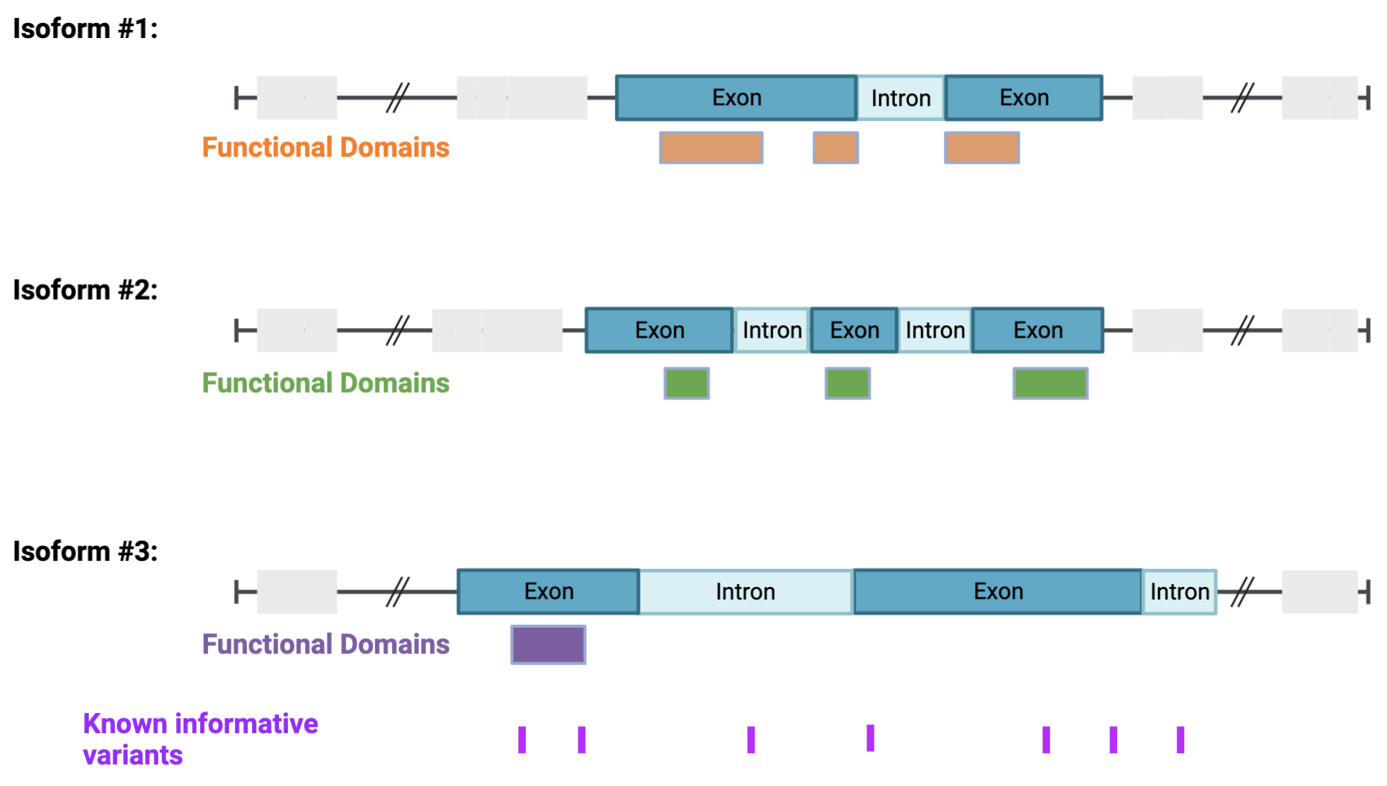
Case study of genome arithmetic: designing a custom sequencing panel
Overall goal: identify informative genomic intervals in coding regions for sequencing and subsequent mutation analysis
Things to account for:
Tissue-specific isoforms
Isoform-specific:
Exons
Functional domains
Sites of known mutation hotspots
Verify intervals included in sequencing panel using IGV

Slide 17
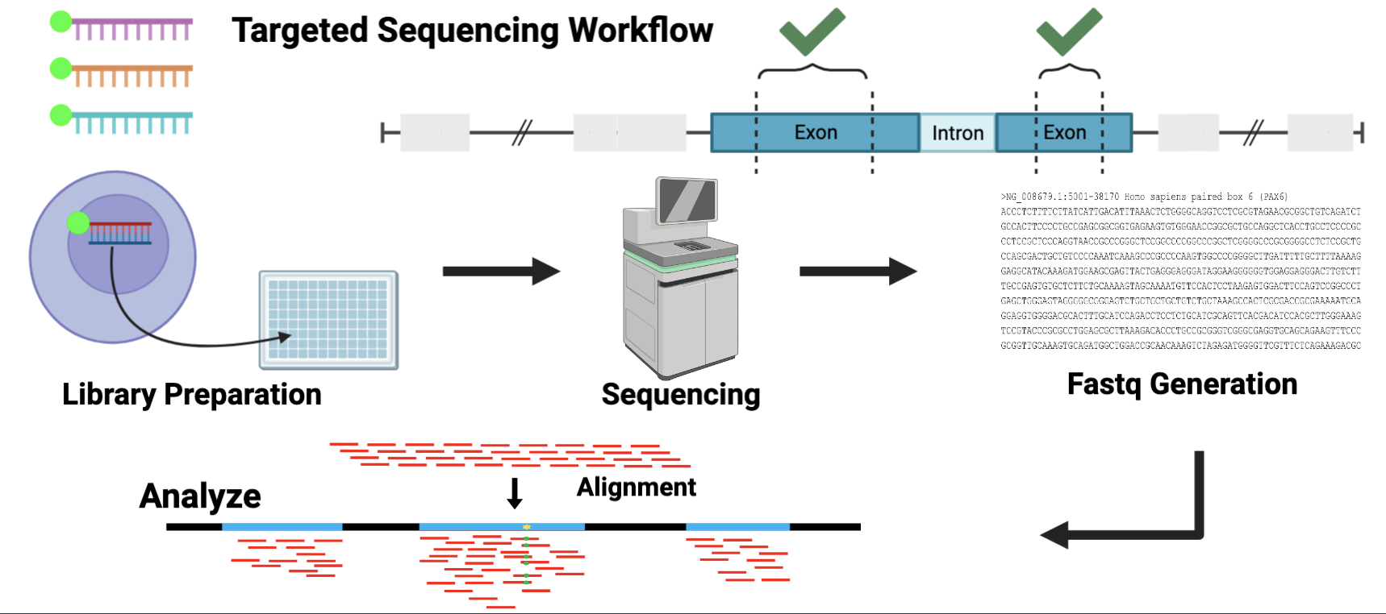
Designing sequencing panel is the first step for targeted sequencing

Slide 18
Programmatically extract information from specific isoforms
FGFR3 has multiple isoforms:
ENST00000340107
ENST00000352904
ENST00000412135
ENST00000440486
ENST00000481110
Exercise: get exon coordinates from the FGFR3_exons.bed file for the above two transcripts in bash
How would we do this in python? How about R?
Which would you prefer?
Now we have a list of exon coordinates we are broadly interested in
Aaron: process coordinate/interval files to get specific regions of interest
Notes:
cat FGFR3_exons.bed | grep "ENST00000440486\|ENST00000481110"

Slide 19
“Verbs” in Genome Arithmetic

Slide 20
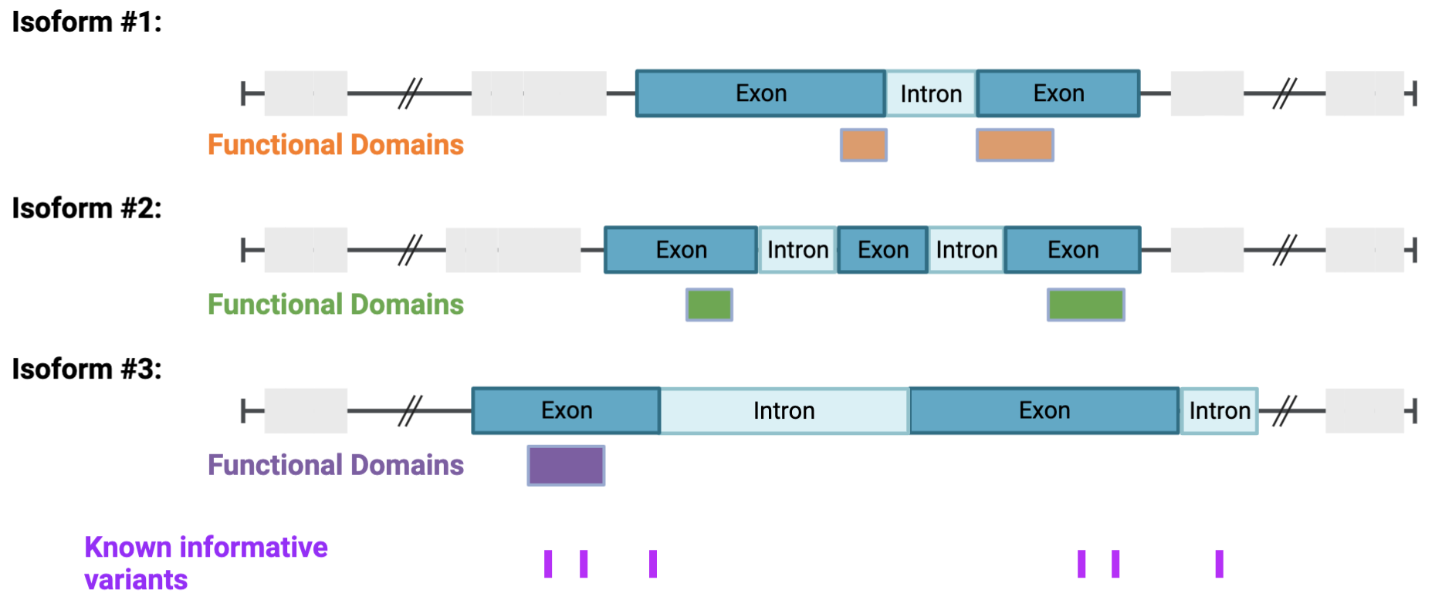
Merge: combine overlapping intervals Capture all coding exons across all isoforms
Final Interval

Slide 21
Merge: combine overlapping intervals Capture all coding regions across isoforms #1 and #2
Final Interval #1
Final Interval #2

Slide 22
How would we do this in R/python??
Copy and paste the R code from slack into Rstudio
What if we could do this in one single line with three words:
`bedtools merge [file]`

Slide 23
Intersection: identify and isolate overlapping features Identify exons harboring informative variants (1+ variant must be in the exon) → then merge across all isoforms

Slide 24
Intersection: identify and isolate overlapping features Identify any exons in individual isoforms without informative variants (no variant can be in the exon at any position)

Slide 25
Intersection: identify portions of exons from any isoform without informative variants and overlaps with a functional domain (functional domain cannot harbor informative variant)

Slide 26
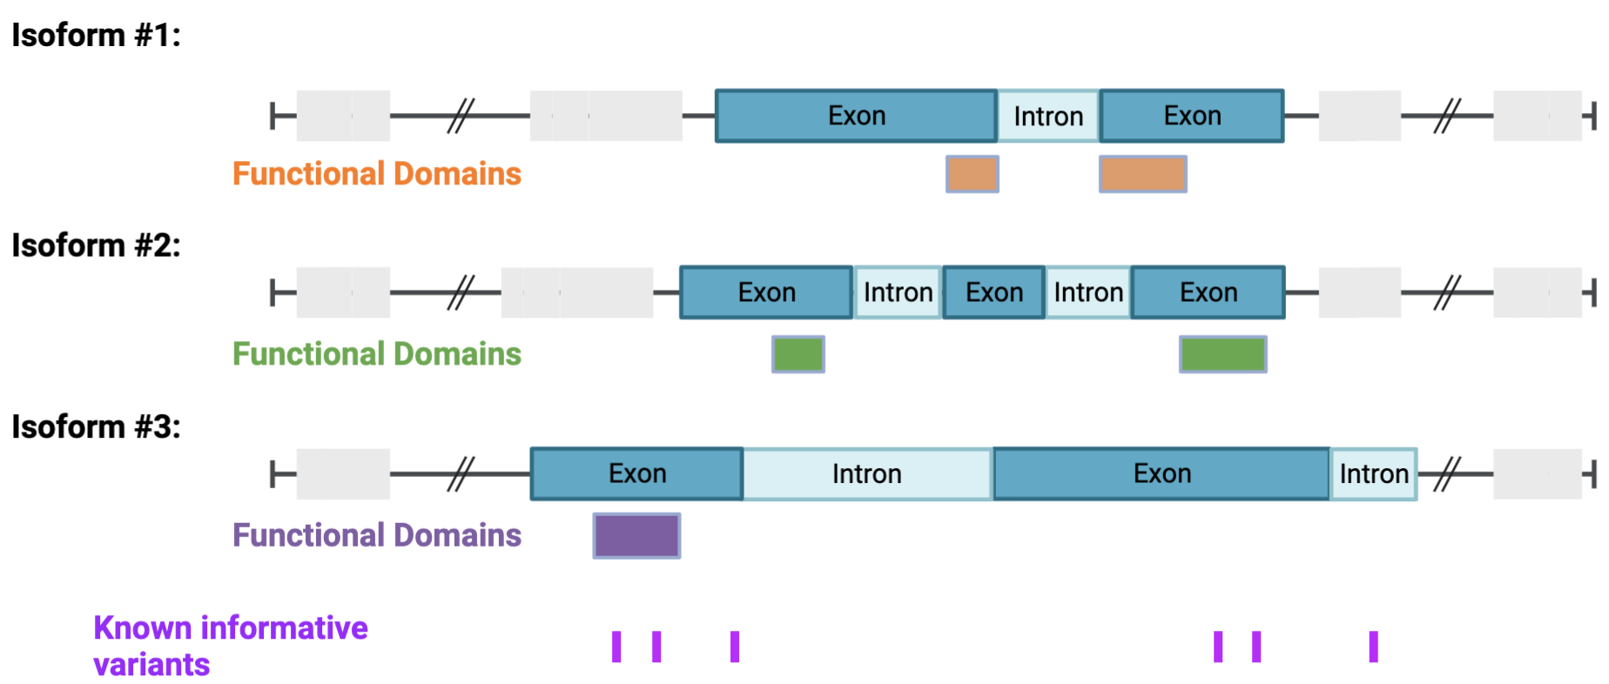
Complement: identify intervals not covered by genomic features Get non-functional domain regions across all isoforms (if any isoform has a FD, exclude)

