Slide 1

Working w/ clusters, shell profiles,
UNIX extras.
Applied Computational Genomics, Lecture 25
https://github.com/quinlan-lab/applied-computational-genomics
Aaron Quinlan
Departments of Human Genetics and Biomedical Informatics
USTAR Center for Genetic Discovery
University of Utah
quinlanlab.org

Slide 2
Revisiting Unix tools and maybe some new ones
ps
top
kill
diff
sleep
chmod
history
Ctrl+R

Slide 3
.bash_profile : run a set of commands each time you login
cat ~/.bash_profile
echo "Hi Aaron. What’s the criac?"
# Get the aliases and functions
if [ -f ~/.bashrc ]; then
. ~/.bashrc
fi
https://www.chpc.utah.edu/documentation/software/slurm.php#submit

Slide 4
.bash_profile versus .bashrc
.bash_profile is executed each time you login to a machine with a username and password.
.bashrc is executed each time you open a new terminal window once already logged in.
The exception is OSX - it always calls .bash_profile
cat ~/.bashrc
PATH=$PATH:~u6000771/bin
alias ll='ls -ltr'
alias grep='grep --color'
http://www.joshstaiger.org/archives/2005/07/bash_profile_vs.html

Slide 5
The UNIX ps command
NAME ps - report process status SYNOPSIS ps [options] DESCRIPTION ps gives a snapshot of the current processes. If you want a repetitive update of this status, use top. This man page documents the /proc-based version of ps, or tries to.
# get details about the processes I have running on this machine
ps -ef | grep u1007787

Slide 6
The UNIX ps command
sleep 100
# get details about the processes I have running on this machine
ps -ef | grep u1007787
root 12767 4286 0 06:05 ? 00:00:00 sshd: u1007787 [priv]
u1007787 13106 12767 0 06:05 ? 00:00:00 sshd: u1007787@pts/0
u1007787 13107 13106 0 06:05 pts/0 00:00:00 -bash
u1007787 48272 13107 0 06:46 pts/0 00:00:00 sleep 100
u1007787 48791 13107 11 06:46 pts/0 00:00:00 ps -ef
u1007787 48792 13107 0 06:46 pts/0 00:00:00 grep --color u1007787

Slide 7
The UNIX kill command
# Use kill command to terminate a process. First get the process id using ps -ef command, then use kill -9 to kill the running Linux process as shown below. You can also use killall, pkill, xkill to terminate a unix process.
$ ps -ef | grep bedtools
arq5x 8945 7222 9 22:43 pts/2 00:00:00 bedtools
$ kill -9 8945

Slide 8
The UNIX top command
NAME
top - display Linux processes
SYNOPSIS
top -hv|-bcHiOSs -d secs -n max -u|U user -p pid -o fld -w [cols]
The traditional switches `-' and whitespace are optional.
DESCRIPTION
The top program provides a dynamic real-time view of a running system. It can display system summary information as well as a list of processes or threads currently being managed by the Linux kernel. The types of system summary information shown and the types, order and size of information displayed for processes are all user configurable and that configuration can be made persistent across restarts. The program provides a limited interactive interface for process manipulation as well as a much more extensive interface for personal configuration -- encompassing every aspect of its operation.
And while top is referred to throughout this document, you are free to name the program anything you wish. That new name, possibly an alias, will then be reflected on top's display and used when reading and writing a configuration file.

Slide 9
The UNIX top command
top
Once running, type "u" followed by your username to see solely the processes you are running.
%Cpu(s): 1.4 us, 1.2 sy, 0.0 ni, 97.3 id, 0.1 wa, 0.0 hi, 0.1 si, 0.0 st
KiB Mem : 65926632 total, 8219192 free, 13037824 used, 44669616 buff/cache
KiB Swap: 16777212 total, 3059908 free, 13717304 used. 44904348 avail Mem
PID USER PR NI VIRT RES SHR S %CPU %MEM TIME+ COMMAND
28791 u1012898 20 0 115952 712 284 S 28.1 0.0 25:59.39 rsync
28213 u1012898 20 0 146872 5684 960 S 6.6 0.0 6:11.49 sshd
10541 u0105911 20 0 559992 13204 4660 S 3.3 0.0 227:13.23 sview
3468 dbus 20 0 38032 6440 900 S 2.3 0.0 169:06.49 dbus-daemon
7868 u6000251 20 0 1128992 5312 3872 S 2.0 0.0 121:29.44 mate-settings-d
20284 u0743456 20 0 7371152 595544 127712 S 2.0 0.9 11:54.73 MATLAB
25653 u1062985 20 0 263692 1884 1684 S 2.0 0.0 164:37.22 vmd_LINUXAMD64
4369 fastx 20 0 1821332 865596 5324 S 1.3 1.3 40:14.44 node
7913 u6000251 20 0 430836 37624 2196 S 1.3 0.1 38:55.86 gvfs-udisks2-vo
44738 u6012438 20 0 1135096 12240 3884 S 1.3 0.0 12:34.53 mate-settings-d
1 root 20 0 293312 107076 1524 S 1.0 0.2 59:25.56 systemd
3930 u0253283 20 0 439084 38928 2196 S 1.0 0.1 46:47.20 gvfs-udisks2-vo
4021 u1007787 20 0 157160 3652 1532 R 1.0 0.0 0:00.21 top
4451 polkitd 20 0 983200 241688 2676 S 1.0 0.4 105:08.02 polkitd
...

Slide 10
The UNIX chmod command: change file mode (permissions)
NAME
chmod - change file mode bits
SYNOPSIS
chmod [OPTION]... MODE[,MODE]... FILE...
chmod [OPTION]... OCTAL-MODE FILE...
chmod [OPTION]... --reference=RFILE FILE...
DESCRIPTION
This manual page documents the GNU version of chmod. chmod changes the file mode bits of each given file according to mode, which can be either a symbolic representation of changes to make, or an octal number representing the bit pattern for the new mode bits.
The format of a symbolic mode is [ugoa...][[+-=][perms...]...], where perms is either zero or more letters from the set rwxXst, or a single letter from the set ugo. Multiple symbolic modes can be given, separated by commas.
A combination of the letters ugoa controls which users' access to the file will be changed: the user who owns it (u), other users in the file's group (g), other users not in the file's group (o), or all users (a). If none of these are given, the effect is as if a were given, but bits that are set in the umask are not affected.
The operator + causes the selected file mode bits to be added to the existing file mode bits of each file; - causes them to be removed; and = causes them to be added and causes unmentioned bits to be removed except that a directory's unmentioned set user and group ID bits are not affected.

Slide 11
The UNIX chmod command: change file mode (permissions)
touch testfile
ls -ltr testfile
-rw-r--r-- 1 u1007787 quinlan 0 Apr 13 06:57 testfile
user's permissions
r = read privileges
w = write privileges
x = execute privileges
group's permissions
anyone's permissions

Slide 12
The UNIX chmod command: change file mode (permissions)
User
Group
All
rwx rx ---
111 101 000
7 5 0

Slide 13
The UNIX chmod command: change file mode (permissions)
chmod 777 my_file

Slide 14
The UNIX chmod command: change file mode (permissions)
User
Group
All
rwx rwx rwx
111 111 111
7 7 7

Slide 15
The UNIX chmod command: change file mode (permissions)
chmod 400 my_file

Slide 16
The UNIX chmod command: change file mode (permissions)
User
Group
All
rwx rwx rwx
100 000 000
4 0 0
You and only you can read the file. For example, SSH keys for Amazon EC2

Slide 17
The UNIX chmod command: change file mode (permissions)
# add write privileges for my group (e.g., lab)
chmod g+w testfile
ls -ltr testfile
-rw-rw-r-- 1 u1007787 quinlan 0 Apr 13 06:57 testfile
# nevermind, I don't trust them
chmod g-w testfile
ls -ltr testfile
-rw-r--r-- 1 u1007787 quinlan 0 Apr 13 06:57 testfile

Slide 18
Making a script executable
cat sleep.sh
#!/usr/bin/bash
sleep 10
./sleep.sh
bash: sleep.sh: command not found...
ls -l sleep.sh
-rw-r--r-- 1 u1007787 quinlan 25 Apr 13 07:08 sleep.sh
chmod u+x sleep.sh
ls -l sleep.sh
-rwxr--r-- 1 u1007787 quinlan 25 Apr 13 07:08 sleep.sh
./sleep.sh

Slide 19
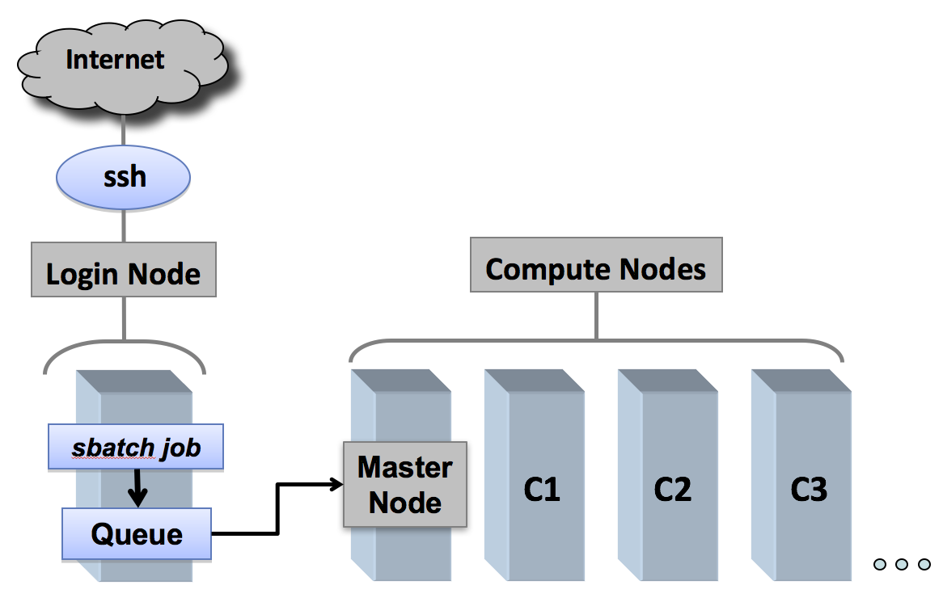
Academic compute clusters
https://cvw.cac.cornell.edu/environment/slurm_intro

Slide 20
Bash script that accepts a sample name and reference genome from the CL
vim run2.sh
sample=$1
genome=$2
bwa mem -t 16 $genome $sample.1.fq $sample.2.fq > $sample.sam
samtools view -Sb $sample.sam > $sample.bam
samtools sort -@ 8 -m 1G $sample.bam -o $sample.sorted.bam
samtools index $sample.sorted.bam
freebayes -f $genome $sample.sorted.bam > $sample.vcf
<type Esc then :wq then Enter to save and quit>

Slide 21
Run script separately (in parallel) for each sample. What is the limitation?
bash run2.sh sample1 ref.fa
bash run2.sh sample2 ref.fa
...
bash run2.sh sampleN ref.fa

Slide 22
We need to send each job to an available computing resource
bash run2.sh sampleA ref.fa
bash run2.sh sampleB ref.fa
bash run2.sh sampleC ref.fa
...
bash run2.sh sampleJ ref.fa

Slide 23
We need to make the bash script compatible with SLURM
#!/bin/sh
#SBATCH --account=quinlan-kp
#SBATCH --partition=quinlan-kp
#SBATCH -o %j-%N.out # file to capture STDOUT, job name, Node
#SBATCH -e %j-%N.err # file to capture STDERR, job name, Node
#SBATCH --time=6:00:00 # expected walltime
#SBATCH --mail-type=FAIL,END
#SBATCH --mail-user=youremail@mail.com
# -----------------------------------------------------------------
sample=$1
genome=$2
bwa mem -t 16 $genome $sample.1.fq $sample.2.fq > $sample.sam
samtools view -Sb $sample.sam > $sample.bam
samtools sort -@ 8 -m 1G $sample.bam -o $sample.sorted.bam
samtools index $sample.sorted.bam
freebayes -f $genome $sample.sorted.bam > $sample.vcf
echo "I am done"
https://www.chpc.utah.edu/documentation/software/slurm.php#submit

Slide 24
Submitting jobs to the cluster using SLURM
sbatch run2.sh sampleA ref.fa
sbatch run2.sh sampleB ref.fa
sbatch run2.sh sampleC ref.fa
...
sbatch run2.sh sampleJ ref.fa

Slide 25
Checking job status
# checking all jobs running on cluster
squeue
# checking all of my jobs running on cluster
squeue -u u1007787
JOBID PARTITION NAME USER ST TIME NODES NODELIST(REASON)
2541980 quinlan-k foo.sh u1007787 PD 0:09 1 kp240
squeue -u u1007787
JOBID PARTITION NAME USER ST TIME NODES NODELIST(REASON)
2541980 quinlan-k foo.sh u1007787 R 0:02 1 kp240
Pending
Running

Slide 26
Checking job status
# List all of my jobs stuck in a pending state (queued)
squeue -u u1007787 -t PENDING
# List all of my running jobs
squeue -u u1007787 -t RUNNING
# List detailed information for a job (useful for troubleshooting):
scontrol show jobid -dd <jobid>
# List status info for a currently running job:
sstat --format=AveCPU,AvePages,AveRSS,AveVMSize,JobID -j <jobid> --allsteps

Slide 27
Killing a job
# checking all of my jobs running on cluster
squeue -u u1007787
2541952 quinlan-k foo.sh u1007787 CG 0:01 1 kp244
# oops, I ran the wrong script
scancel 2541952

Slide 28
Killing many jobs
# checking all of my jobs running on cluster
for jobid in `squeue -u u1007787 | awk '{print $1}' | grep -v "JOBID"`;
do
scancel $jobid;
done

