Slide 1



RNA-Seq Module 2:
SAM/BAM/BED file formats
Felicia Gomez, Charlz Jerold, Obi Griffith, Malachi Griffith,
My Hoang, Mariam Khanfar, Chris Miller, Kartik Singhal, Jennie Yao
Advanced Sequencing Technologies & Bioinformatics Analysis November 10-21, 2025

Slide 2
Introduction to the SAM/BAM format
The specification
  http://samtools.sourceforge.net/SAM1.pdf
SAM is uncompressed text data
BAM is a compressed version of SAM
  lossless BGZF format
BAM files are usually ‘indexed’
  A ‘.bai’ file will be found beside the ‘.bam’ file
  Indexing provides fast retrieval of alignments overlapping a specified region without going through all alignments.
  BAM must be sorted by the reference ID and then the leftmost coordinate before indexing

Slide 3
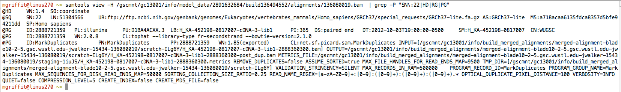
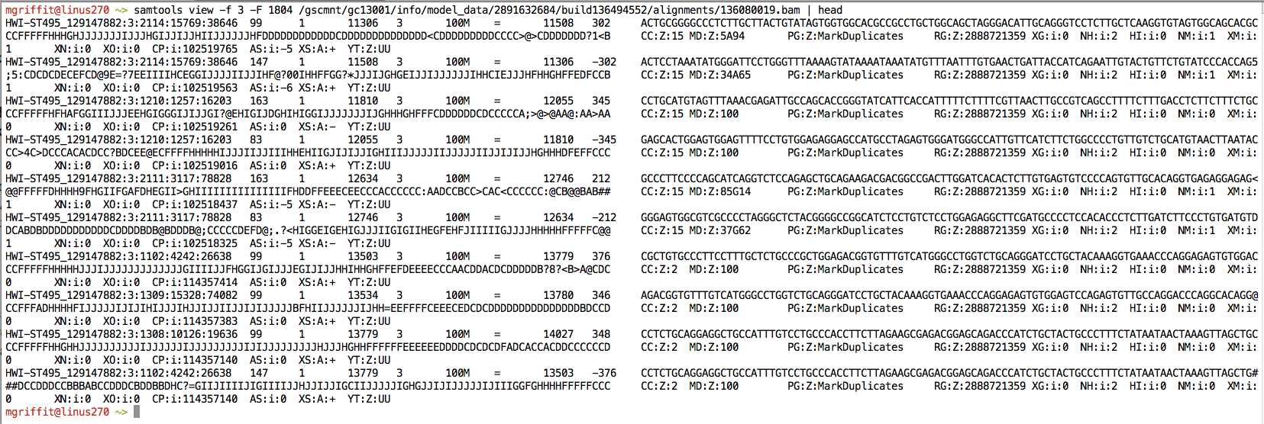
Example of SAM/BAM file format
Example SAM/BAM/CRAM header section (abbreviated)
Example SAM/BAM/CRAM alignment section (only 10 alignments shown)

Slide 4
SAM/BAM header section
Used to describe source of data, reference sequence, method of alignment, etc.
Each section begins with character ‘@’ followed by a two-letter record type code. These are followed by two-letter tags and values:
  @HD The header line
    VN: format version
    SO: Sorting order of alignments
  @SQ Reference sequence dictionary
    SN: reference sequence name
    LN: reference sequence length
    SP: species
  @RG Read group
    ID: read group identifier
    CN: name of sequencing center
    SM: sample name
  @PG Program
    PN: program name
    VN: program version

Slide 5
A BAM file is divided in header and alignment sections
Example SAM/BAM header section (abbreviated)
Version (VN) and sort order (SO) - Important!
Reference sequence (SQ)
and sequence length (LN)
Read group (RG) and sample (SM)
Programs (PG) that have been run on the data

Slide 6
A BAM file is divided in header and alignment sections
Example SAM/BAM alignment section (only 10 alignments shown)

Slide 7
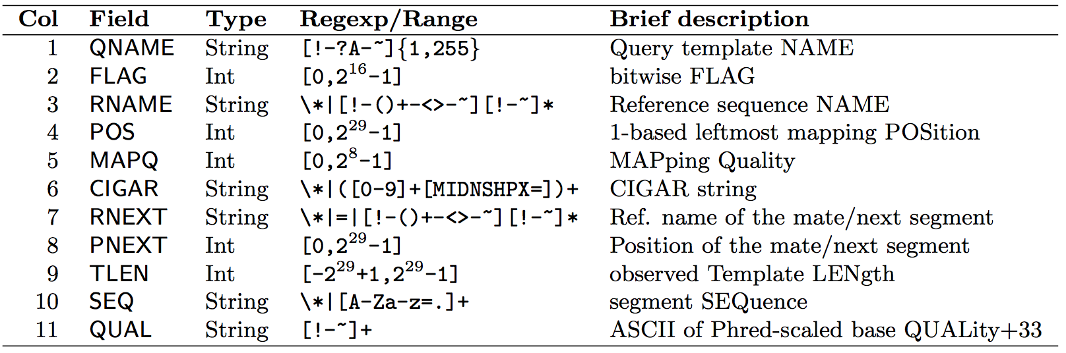
SAM/BAM alignment section
Example values
QNAME e.g. HWI-ST495_129147882:1:2302:10269:12362
FLAG e.g. 99
RNAME e.g. 1
POS e.g. 11623
MAPQ e.g. 3
CIGAR e.g. 100M
RNEXT e.g. =
PNEXT e.g. 11740
TLEN e.g. 217
SEQ e.g. CCTGTTTCTCCACAAAGTGTTTACTTTTGGATTTTTGCCAGTCTAACAGGTGAAGCCCTGGAGATTCTTATTAGTGATTTGGGCTGGGGCCTGGCCATGT
QUAL e.g. CCCFFFFFHHHHHJJIJFIJJJJJJJJJJJHIJJJJJJJIJJJJJGGHIJHIJJJJJJJJJGHGGIJJJJJJIJEEHHHHFFFFCDCDDDDDDDB@ACDD

Slide 8
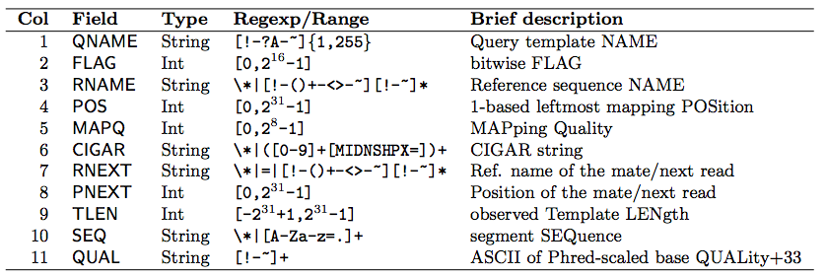

SAM Format – Information Fields
1
2
3
4
5
6
7
8
9
10
Slide courtesy of Andrew Farrell

Slide 9
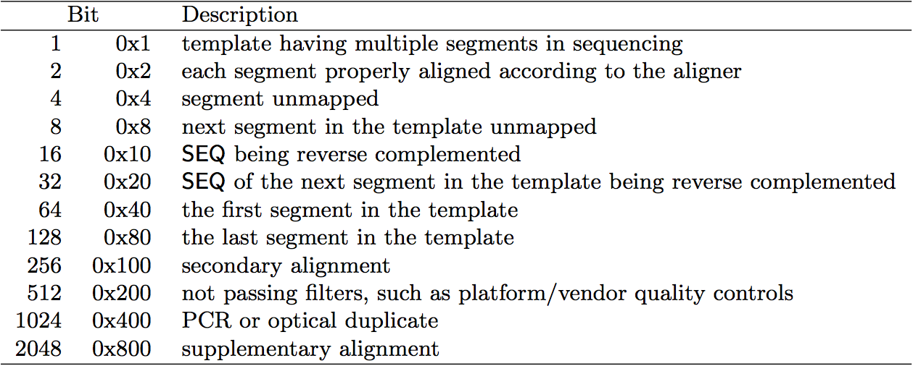
SAM/BAM flags explained
12 bitwise flags describing the alignment
Stored as a binary string of length 12 instead of 12 columns of data
Value of ‘1’ indicates the flag is set. e.g. 001000000000
All combinations can be represented as a number from 0 to 4095 (i.e. 2¹²-1). This number is used in the BAM/SAM file.
You can specify ‘required’ or ‘filter’ flags in samtools view using the ‘-f’ and ‘-F’ options respectively
Note that to maximize confusion, each bit is described in the SAM specification using its hexadecimal representation (i.e., '0x10' = 16 and '0x40' = 64).
http://broadinstitute.github.io/picard/explain-flags.html

Slide 10
SAM Format – Information Fields
1
2
3
4
5
6
7
8
9
10
Slide courtesy of Andrew Farrell

Slide 11
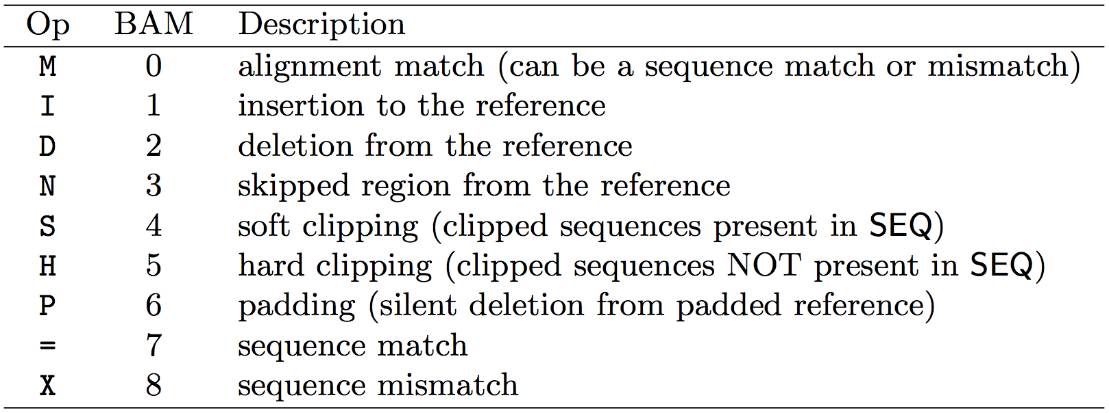
CIGAR strings explained
The ‘CIGAR’ (Compact Idiosyncratic Gapped Alignment Report)
The CIGAR string is a sequence of base lengths and associated ‘operations’ indicating which bases align to the reference (either a match or mismatch), are deleted, are inserted, represent introns, etc.
e.g. 81M859N19M
  A 100 bp read consists of: 81 bases of alignment to reference, 859 bases skipped (an intron), 19 bases of alignment

Slide 12
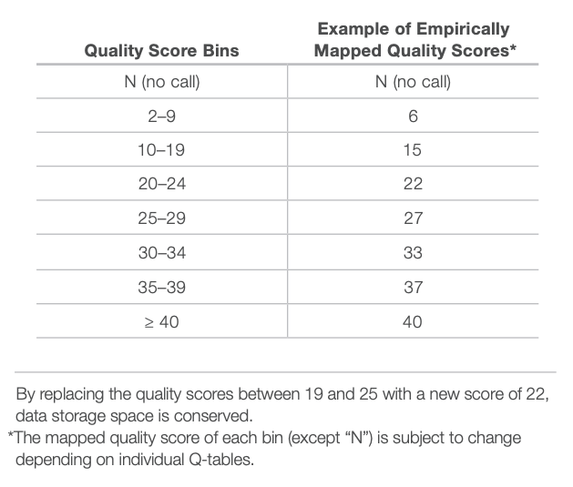
CRAM files
CRAM is an ultra-compressed version of a BAM file
  Usually between 30-60% smaller than the corresponding BAM
Stores “diffs” from the reference genome
  requires the matching reference genome to restore original data!
Base quality binning may be used as well
Some tools still require conversion back to bam

Slide 13
Introduction to the BED format
When working with BAM files, it is very common to want to examine a focused subset of the reference genome
  e.g. the exons of a gene
These subsets are commonly specified in ‘BED’ files
  https://genome.ucsc.edu/FAQ/FAQformat.html#format1
Many BAM manipulation tools accept regions of interest in BED format
Basic BED format (tab separated):
  Chromosome name, start position, end position (BED3)
  Coordinates in BED format are 0 based

Slide 14
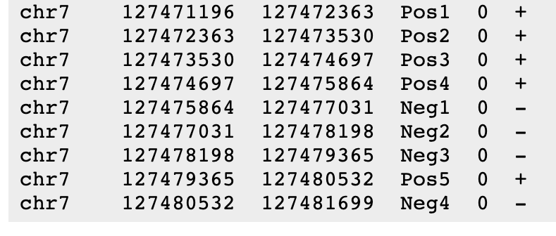
Introduction to the BED format
There are several flavors of BED format: BED3, BED4, BED6, BED8, etc
First 3 fields always required: chr, start, stop
Followed by up to 9 additional optional fields: name, score, strand, thickStart, thickEnd, itemRGB, blockCount, blockSizes, blockStarts

Slide 15

Manipulation of SAM/BAM and BED files
Several tools are used ubiquitously in sequence analysis to manipulate these files
SAM/BAM files
  samtools
  bamtools
  Picard
BED files
  bedtools
  bedops

Slide 16
Common sources of confusion
Genomic coordinate systems
Genome builds
Variant representation

Slide 17
Genomic coordinates – 1 vs 0 based
chr1 |  | T |  | A |  | C |  | G |  | T |  | C |  | A
1-based |  | 1 |  | 2 |  | 3 |  | 4 |  | 5 |  | 6 |  | 7
0-based | 0 |  | 1 |  | 2 |  | 3 |  | 4 |  | 5 |  | 6 |  | 7
 | 1-based | 0-based
Indicate a single nucleotide | chr1:4-4 G | chr1:3-4 G
Indicate a range of nucleotides | chr1:2-4 ACG | chr1:1-4 ACG
Indicate a single nucleotide variant | chr1:5-5 T/A | chr1:4-5 T/A
1-based : Single nucleotides, variant positions, or ranges are specified directly by their corresponding nucleotide numbers
  GFF, SAM, VCF, Ensembl browser, …
0-based: Single nucleotides, variant positions, or ranges are specified by the coordinates that flank them
  BED, BAM, UCSC browser, …

Slide 18
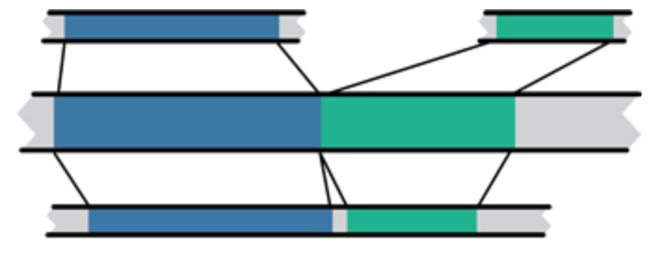
Genome builds
Reference Genome builds
Current human: GRCh38, hg38, b38
alternates: GRCh38v2_ccdg, GRCh38_full_analysis_set_plus_decoy_hla
Previous human: GRCh37, hg19, b37
Current mouse: GRCm38, mm10
Lift-over
Mouse mm10
Human hg19
Human GRCh37
For a detailed discussion of various human reference genome flavors refer here:
https://pmbio.org/module-02-inputs/0002/02/01/Reference_Genome/

Slide 19
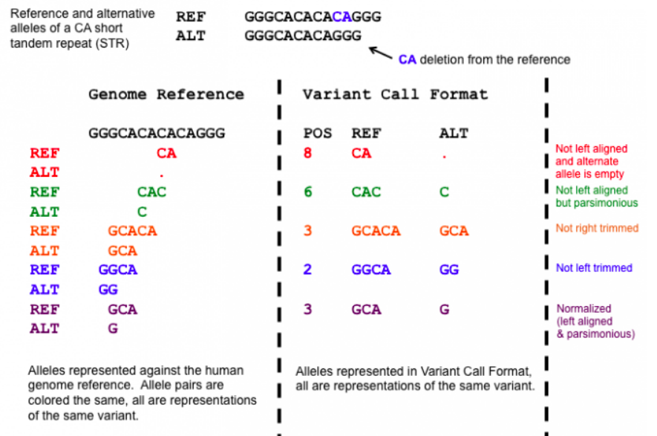
Variant shifting (alignment) and parsimony/trimming
Parsimony: representing variant in as few nucleotides as possible without reducing the length of any allele to 0
Left (right) aligning = shifting the start position of a variant as far to the left (right) as possible
Notes:
https://genome.sph.umich.edu/wiki/Variant_Normalization
Parsimony means representing a variant in as few nucleotides as possible without reducing the length of any allele to 0.
Left aligning a variant means shifting the start position of that variant to the left till it is no longer possible to do so.
The representation of variants in a VCF file requires that no alleles in the REF and ALT field are represented with an empty string (empty allele). The red indel has an illegal VCF representation.
The green variant is not left aligned as you can prefix an A nucleotide on the left side of the variant's alleles and truncate the C on the right side of the variant's alleles. It is however parsimonious.
The orange variant is left aligned but is not right parsimonious.
The blue variant is left aligned but not left parsimonious.
The maroon variant is left aligned and parsimonious.

Slide 20
How should I sort my SAM/BAM file?
Generally BAM files are sorted by position
  This is for performance reasons
    When sorted and indexed, arbitrary positions in a massive BAM file can be accessed rapidly
Certain tools require a BAM sorted by read name
  Usually this is when we need to easily identify both reads of a pair
    The insert size between two reads may be large
    In fusion detection we are interested in read pairs that map to different chromosomes

Slide 21
We are on a Coffee Break & Networking Session

