Slide 1


Canadian Bioinformatics Workshops
www.bioinformatics.ca
bioinformaticsdotca.github.io
Supported by

Slide 2
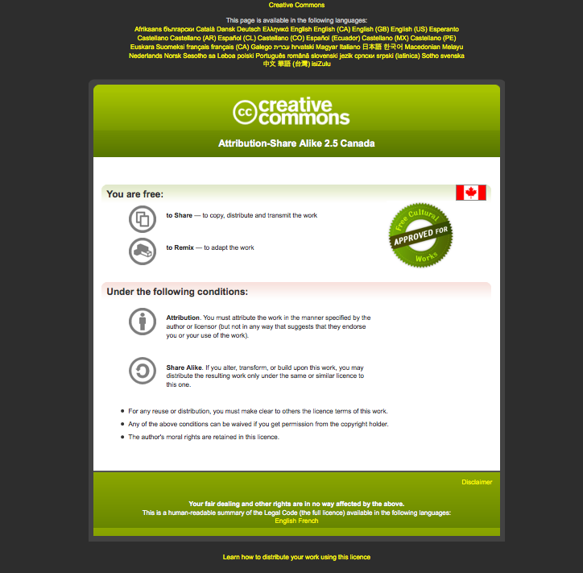

Slide 3
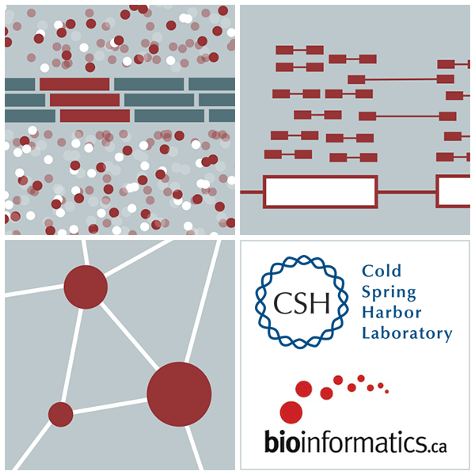
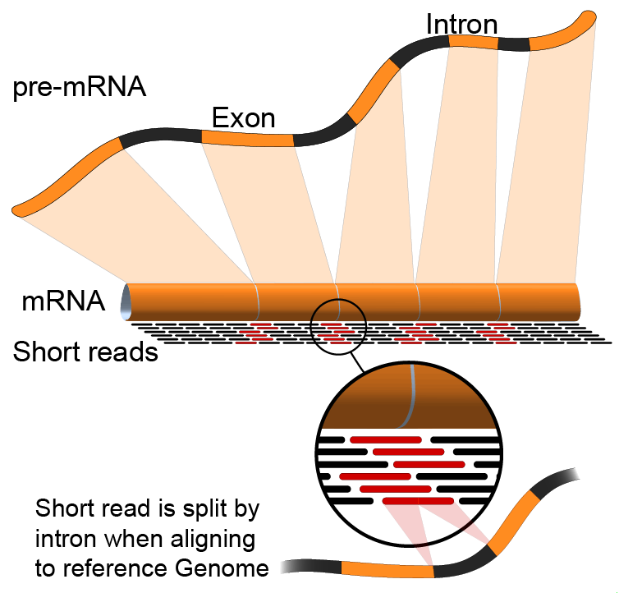

Indexing
Emma Bell, Felicia Gomez, Obi Griffith, Malachi Griffith, Huiming Xia
RNA-Seq Analysis
Sep 8th-10th, 2021

Slide 4
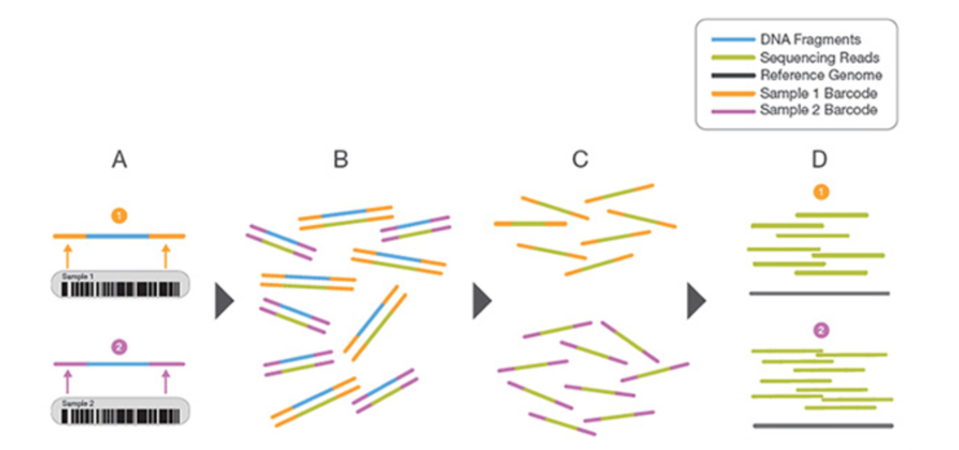
“Index” has many different meanings
Indexes can refer to unique barcodes used for multiplexing DNA before sequencing
https://www.illumina.com/science/technology/next-generation-sequencing/multiplex-sequencing.html

Slide 5
Indexing in bioinformatics/CS enables rapid access
Indexing is a recurring theme in genome analysis
Files are *big* - scanning through them can take a long time
Indexing builds a table-of-contents so that we can jump directly to specific positions
Indexing may require significant compute/time but typically only occurs once
Each application may require a different indexing strategy

Slide 6
What’s inside a fasta’s index file? (.fai)
byte index of the file where the contig begins
bases per line
bases in contig
contig name
bytes per line
chr1 248956422 6 60 61
chr2 242193529 253105708 60 61
chr3 198295559 499335802 60 61
chr4 190214555 700936293 60 61
chr5 181538259 894321097 60 61
chr6 170805979 1078885000 60 61
chr7 159345973 1252537752 60 61
chr8 145138636 1414539498 60 61
chr9 138394717 1562097118 60 61
chr10 133797422 1702798421 60 61

Slide 7
Example index applications and associated files
Source file | Indexed file | Indexing tool | Use case
.bam | .bai | samtools index | Visualize bam in IGV
.fasta | .fai | faidx | Extract specific sequences from ref genome
.vcf | vcf.gz.tbi | bgzip/tabix | Pull out specific variants
.bed | .bed.gz.tbi | bgzip/tabix | extract specific genomic regions

Slide 8
Indexing is also essential for alignment
Finding out where to place a read in the genome is impractical unless matches can be quickly found
All read aligners use some kind of indexing
These indices must be “built” once for a reference genome, but can then be used every time the aligner is run
Different aligners use different indexing schemes that are not compatible
Notes:
Sometimes indexing even changes between versions of aligners

Slide 9






We are on a Coffee Break & Networking Session
Workshop Sponsors:

