Slide 1


Canadian Bioinformatics Workshops
www.bioinformatics.ca
bioinformaticsdotca.github.io
Supported by

Slide 2
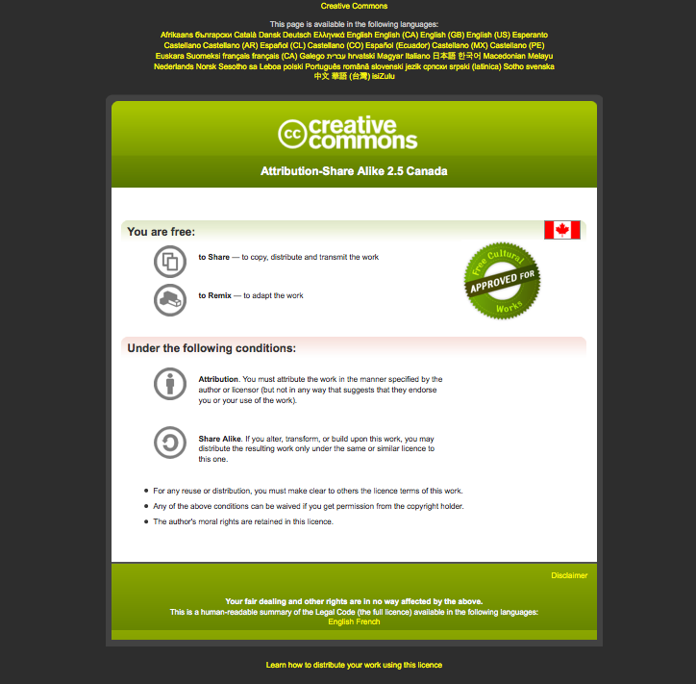

Slide 3
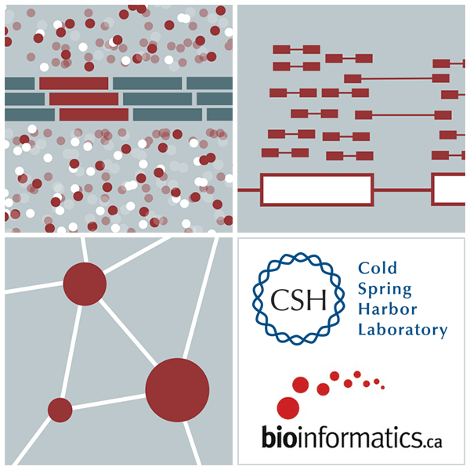
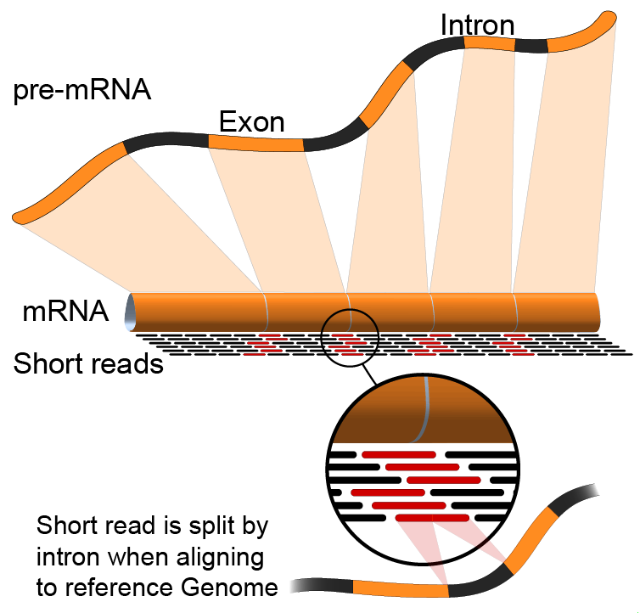

Alignment vs Assembly vs Pseudoalignment
Emma Bell, Felicia Gomez, Obi Griffith, Malachi Griffith, Huiming Xia
RNA-Seq Analysis
Sep 8th-10th, 2021

Slide 4
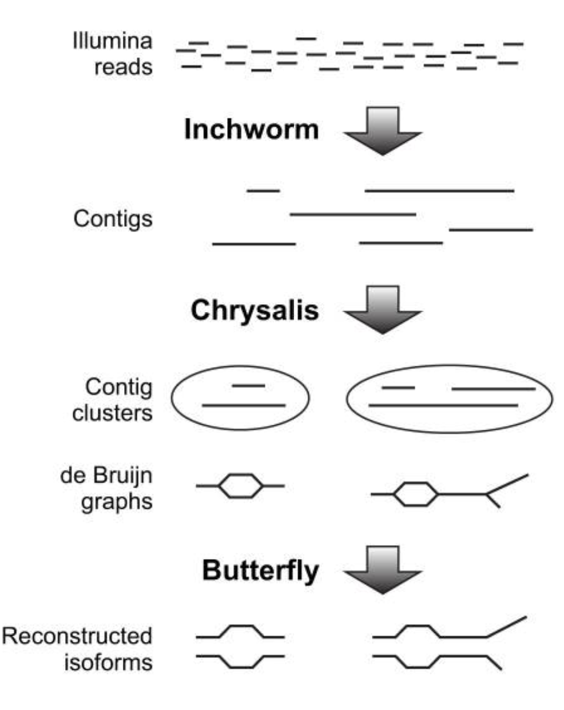
Assembly
Infer transcript structure directly from the data
Useful when you do not have a reference sequence
Other uses – highly rearranged genomes (some cancers)
Computationally expensive
Tools: Trinity, Velvet, SPAdes
Haas, et al (2013) doi: 10.1038/nprot.2013.084

Slide 5
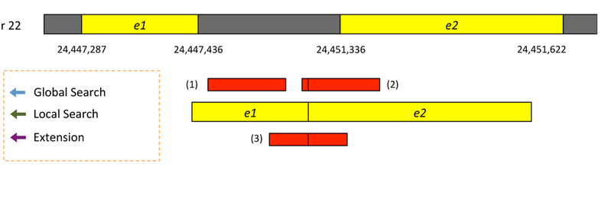
Alignment
Uses a reference genome/transcriptome to map reads
Capable of some novel transcript inference
Relatively fast runtime
Tools: HISAT2, STAR, GSNAP
Kim et al. 2015. Nat Methods 12:357–360

Slide 6
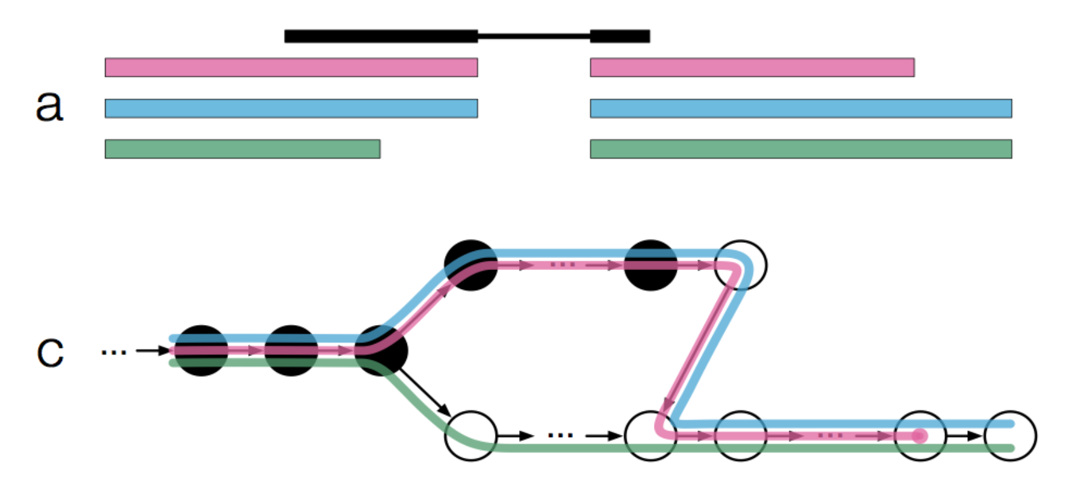
Pseudoalignment
Does not determine where in the genome a read lies, only which transcripts it is compatible with
Very fast!
Does not produce a bam by default (though pseudo-bams can be created), not useful for variant detection.
Tools: Kallisto, Sailfish
Bray, 2016 doi:10.1038/nbt.3519 https://tinyheero.github.io/2015/09/02/pseudoalignments-kallisto.html

Slide 7






We are on a Coffee Break & Networking Session
Workshop Sponsors:

