Slide 1


Canadian Bioinformatics Workshops
www.bioinformatics.ca
bioinformaticsdotca.github.io
Supported by

Slide 2


Slide 3
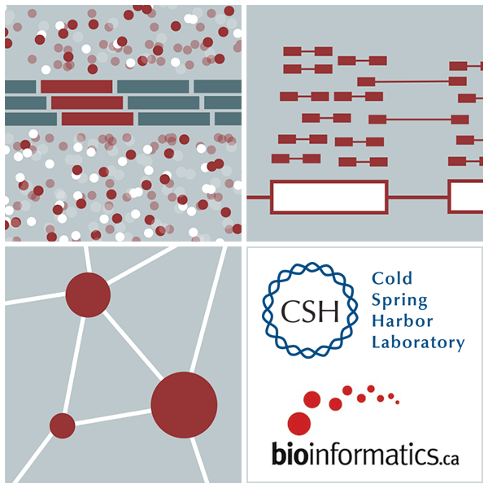
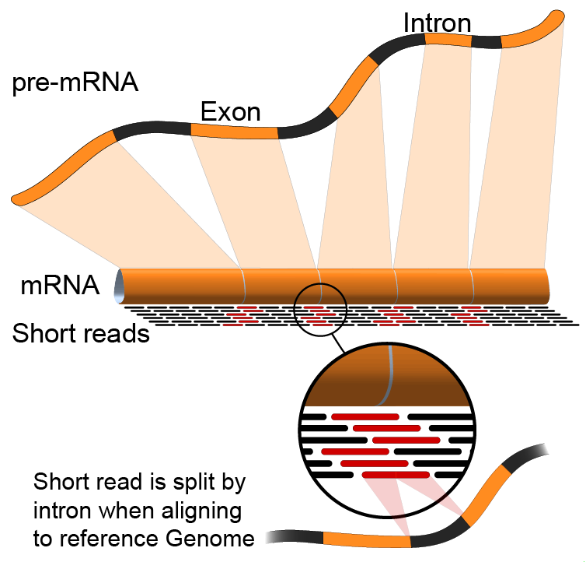

Alignment QC
Emma Bell, Felicia Gomez, Obi Griffith, Malachi Griffith, Huiming Xia
RNA-Seq Analysis
Sep 8th-10th, 2021

Slide 4
Learning objectives of module 3
Visualization of RNA-seq alignments in IGV
Alignment QC Assessment
BAM read counting and determination of variant allele expression status

Slide 5
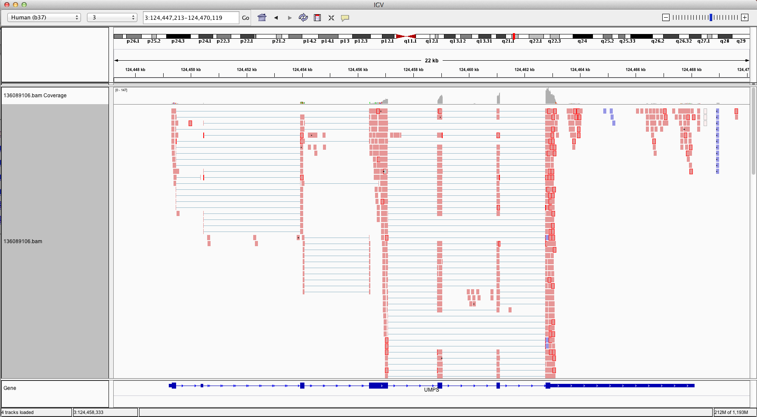
Visualization of RNA-seq alignments in IGV browser
Ideogram
Coverage
pileup
Control pop-up info
Viewer position
Coverage
track
Coverage
scale
Single reads, not spliced
+ve
strand
-ve
strand
Reads track
Single reads, spliced
Gene track

Slide 6
Alternative viewers to IGV
Alternative viewers to IGV
http://www.biostars.org/p/12752/
http://www.biostars.org/p/71300/
Artemis, BamView, Chipster, gbrowse2, GenoViewer, MagicViewer, Savant, Tablet, tview

Slide 7
Alignment QC Assessment
3' and 5' Bias
Nucleotide Content
Base/Read Quality
PCR Artifact
Sequencing Depth
Base Distribution
Insert Size Distribution

Slide 8
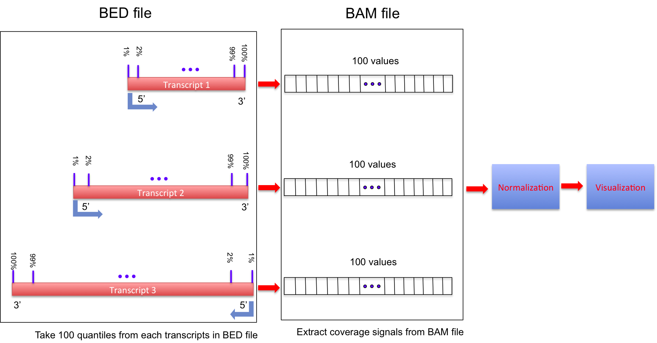
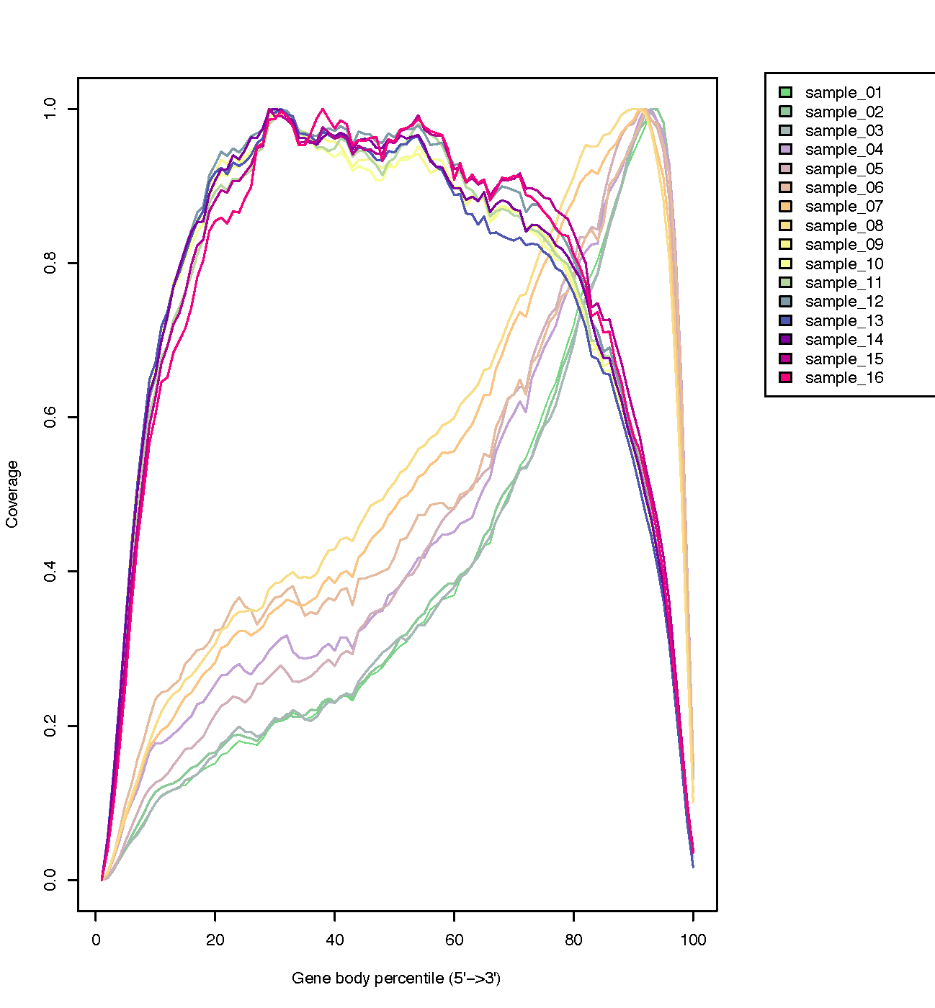
Alignment QC: 3' & 5' Bias
http://rseqc.sourceforge.net/

Slide 9
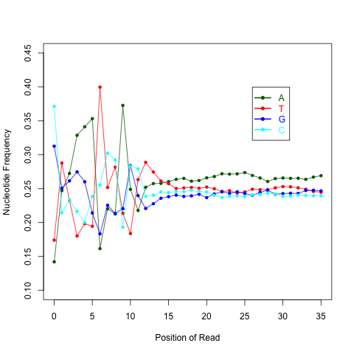
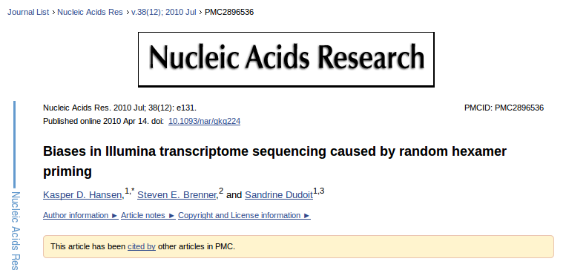
Alignment QC: Nucleotide Content
Random primers are used to reverse transcribe RNA fragments into double-stranded complementary DNA (dscDNA)
Causes certain patterns to be over represented at the beginning (5’end) of reads
Deviation from expected A%=C%=G%=T%=25%
http://rseqc.sourceforge.net/

Slide 10
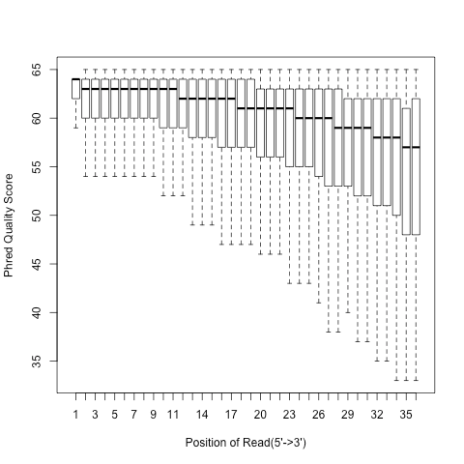
Alignment QC: Quality Distribution
Phred quality score is widely used to characterize the quality of base-calling
Phred quality score = -10xlog(10)P, here P is probability that base-calling is wrong
Phred score of 30 means there is 1/1000 chance that the base-calling is wrong
The quality of the bases tend to drop at the end of the read, a pattern observed in sequencing by synthesis techniques

Slide 11
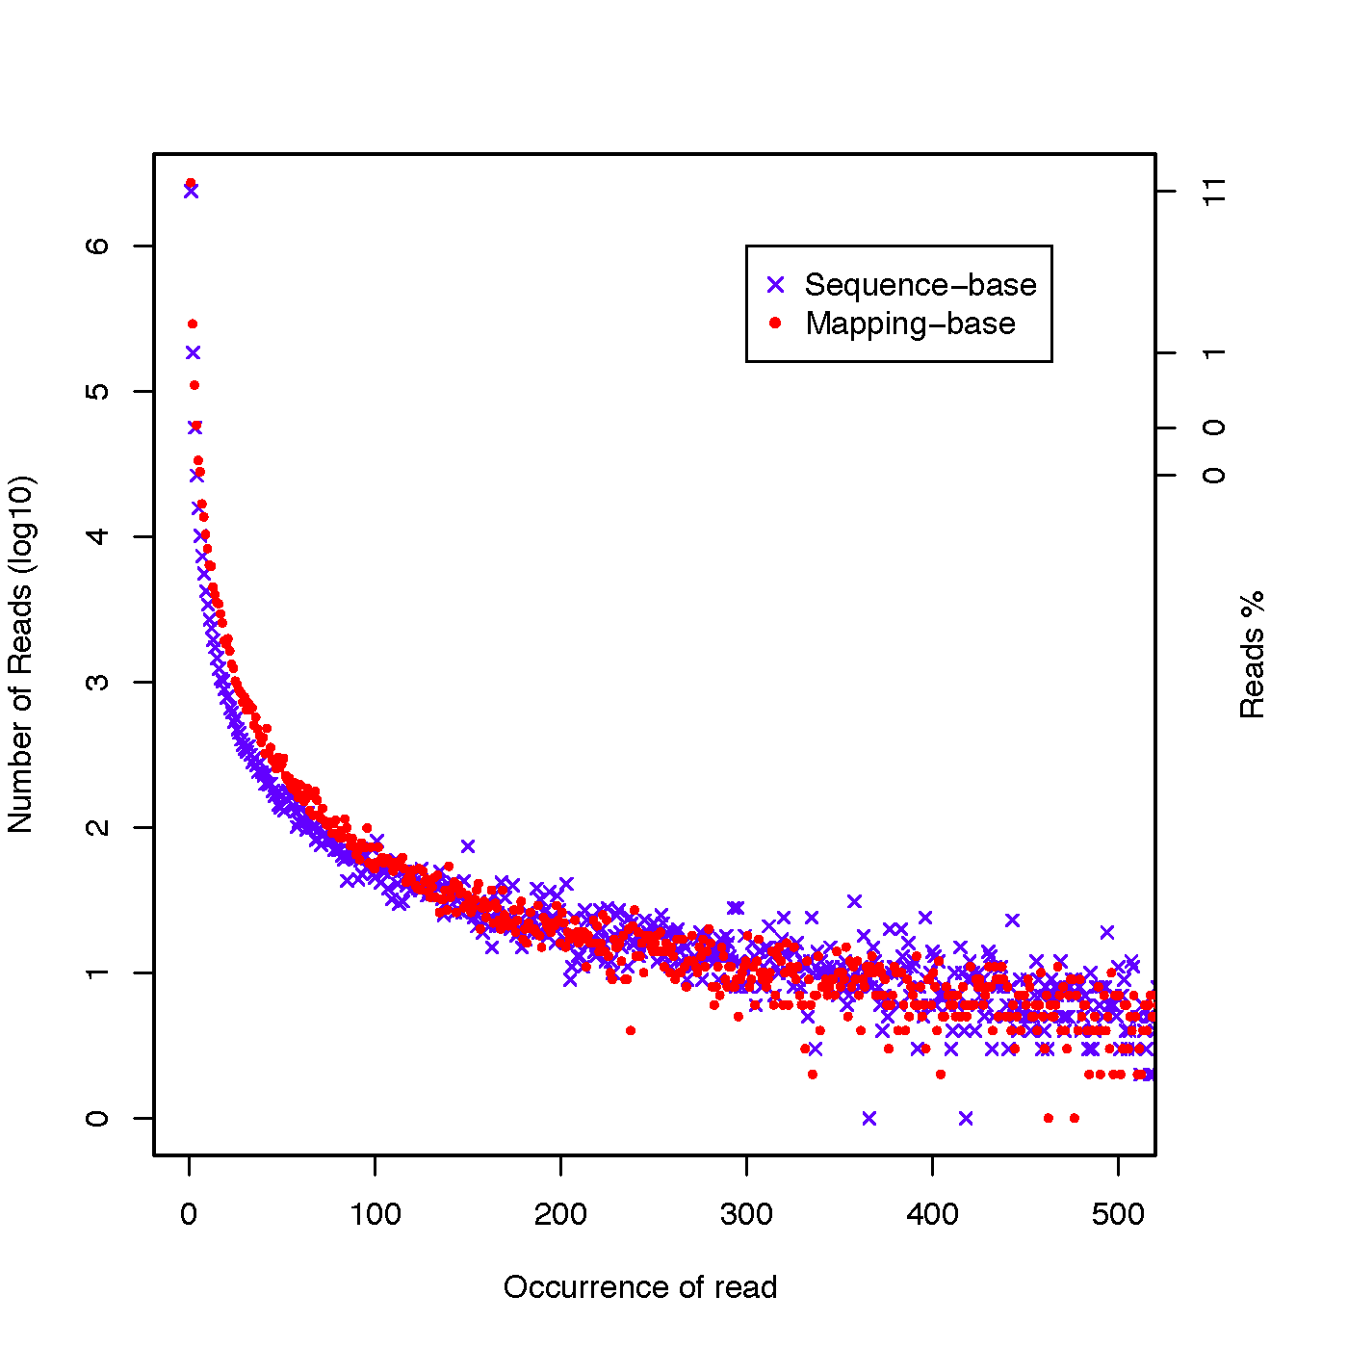
Alignment QC: PCR Duplication
Duplicate reads are reads that have the same start/end positions and same exact sequence
In DNA-seq, reads/start point is used as a metric to assess PCR duplication rate
In DNA-seq, duplicate reads are collapsed using tools such as picard
How is RNA-seq different from DNA-seq?
http://rseqc.sourceforge.net/

Slide 12
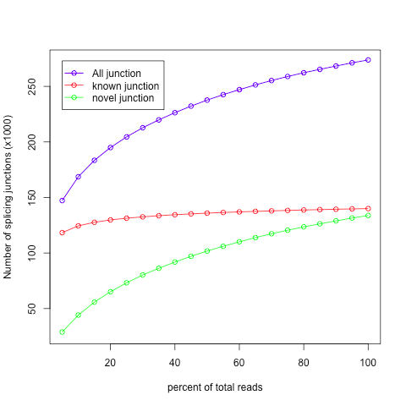
Alignment QC: Sequencing Depth
Have we sequenced deep enough?
In DNA-seq, we can determine this by looking at the average coverage over the sequenced region. Is it above a certain threshold?
In RNA-seq, this is a challenge due to the variability in gene abundance
Use splice junctions detection rate as a way to identify desired sequencing depth
Check for saturation by resampling 5%, 10%, 15%, ..., 95% of total alignments from aligned file, and then detect splice junctions from each subset and compare to reference gene model.
This method ensures that you have sufficient coverage to perform alternative splicing analyses

Slide 13
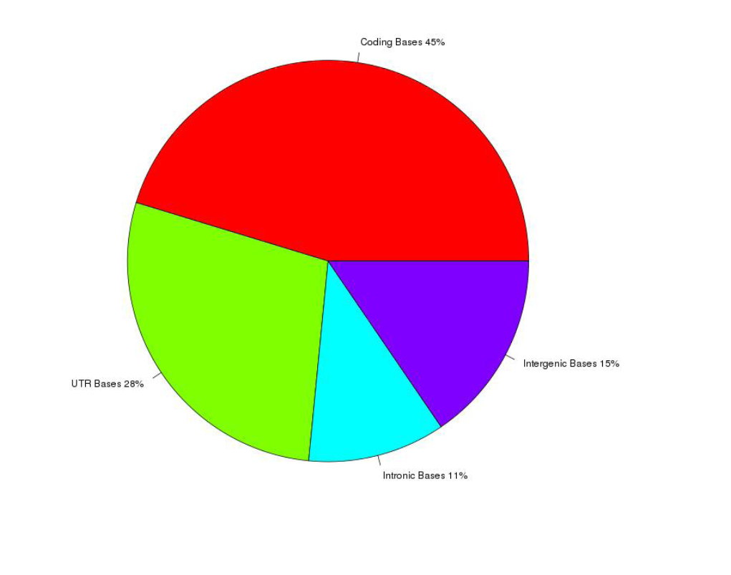
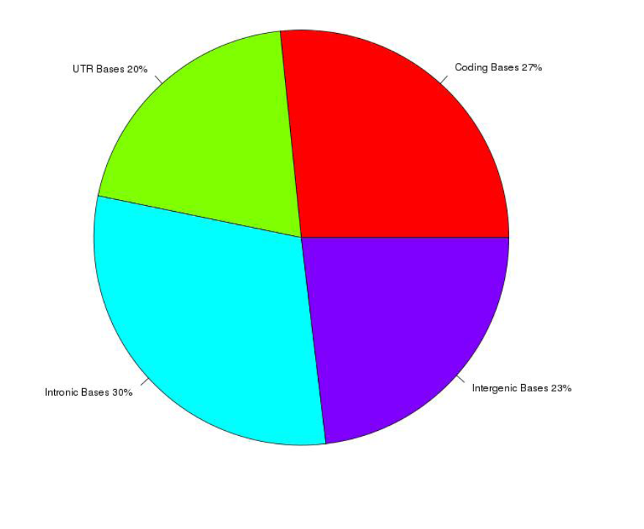
Alignment QC: Base Distribution
Whole Transcriptome Library
PolyA mRNA library
Your sequenced bases distribution will depend on the library preparation protocol selected

Slide 14
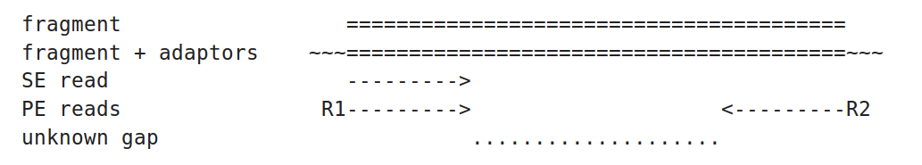
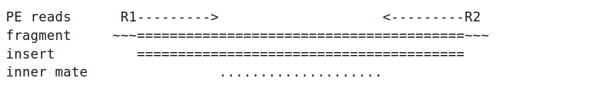
Alignment QC: Insert Size
http://thegenomefactory.blogspot.ca/2013/08/paired-end-read-confusion-library.html

Slide 15
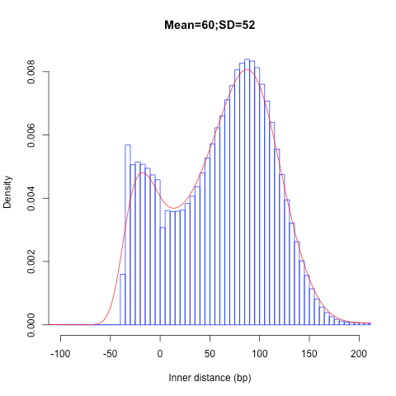
Alignment QC: Insert Size
Consistent with library size selection?
http://rseqc.sourceforge.net

Slide 16
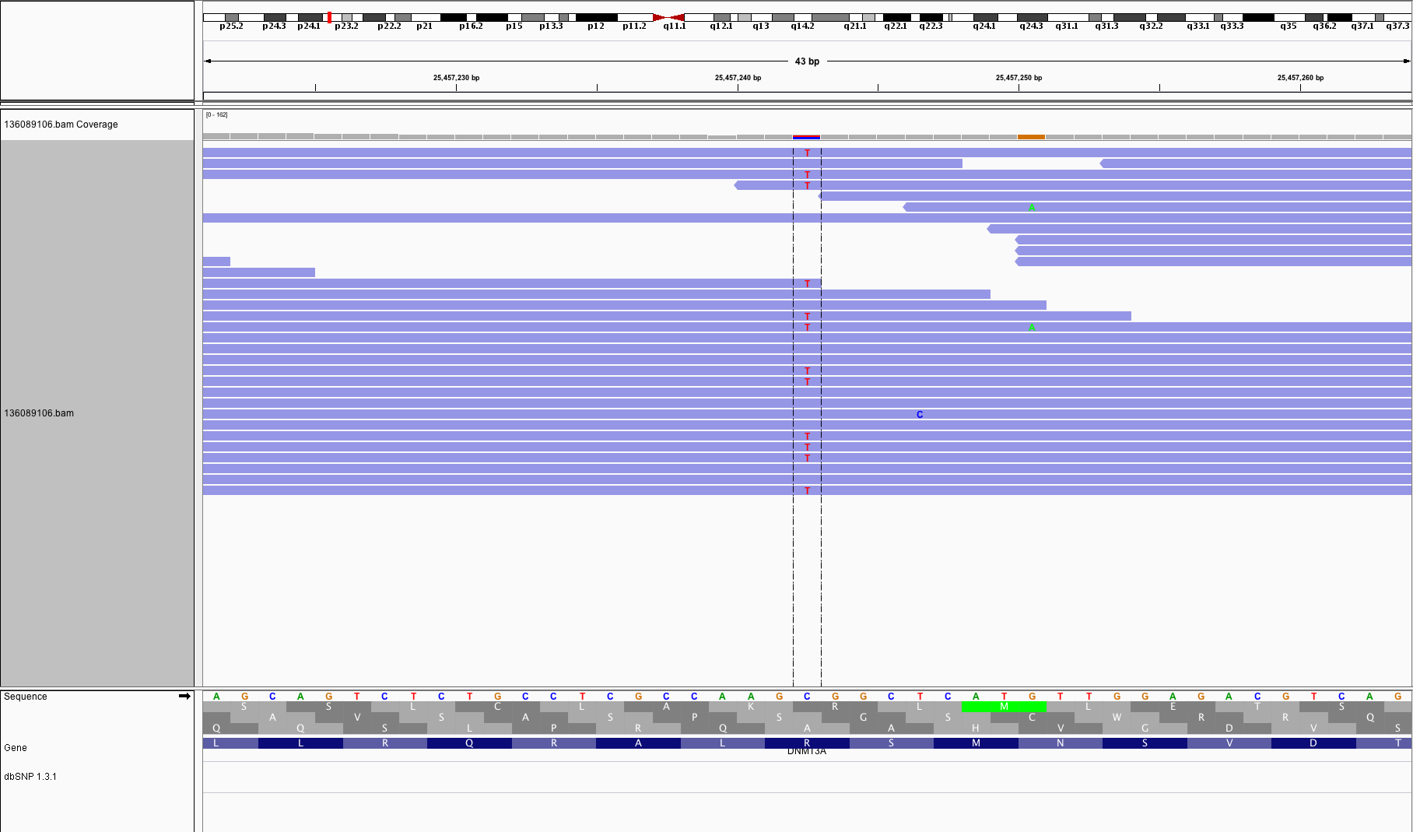
BAM read counting and variant allele expression status
A variant C->T is observed in 12 of 25 reads covering this position. Variant allele frequency (VAF) 12/25 = 48%.
Both alleles appear to be expressed equally (not always the case) -> heterozygous, no allele specific expression
How can we determine variant read counts, depth of coverage, and VAF without manually viewing in IGV?

Slide 17






We are on a Coffee Break & Networking Session
Workshop Sponsors:

