Slide 1


Canadian Bioinformatics Workshops
www.bioinformatics.ca
bioinformaticsdotca.github.io
Supported by

Slide 2


Slide 3
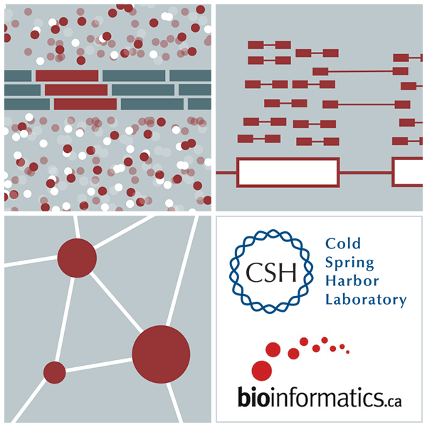
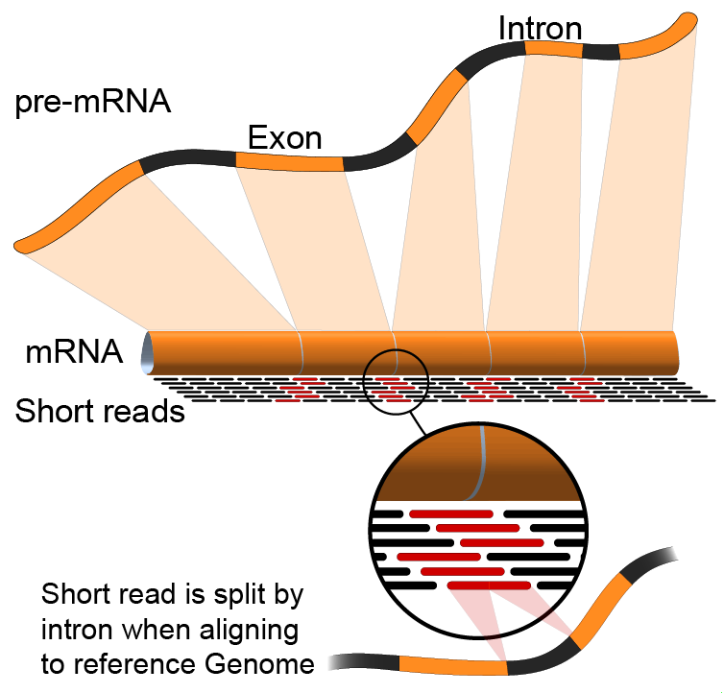

Abundance Estimation
Emma Bell, Felicia Gomez, Obi Griffith, Malachi Griffith, Huiming Xia
RNA-Seq Analysis
Sep 8th-10th, 2021

Slide 4
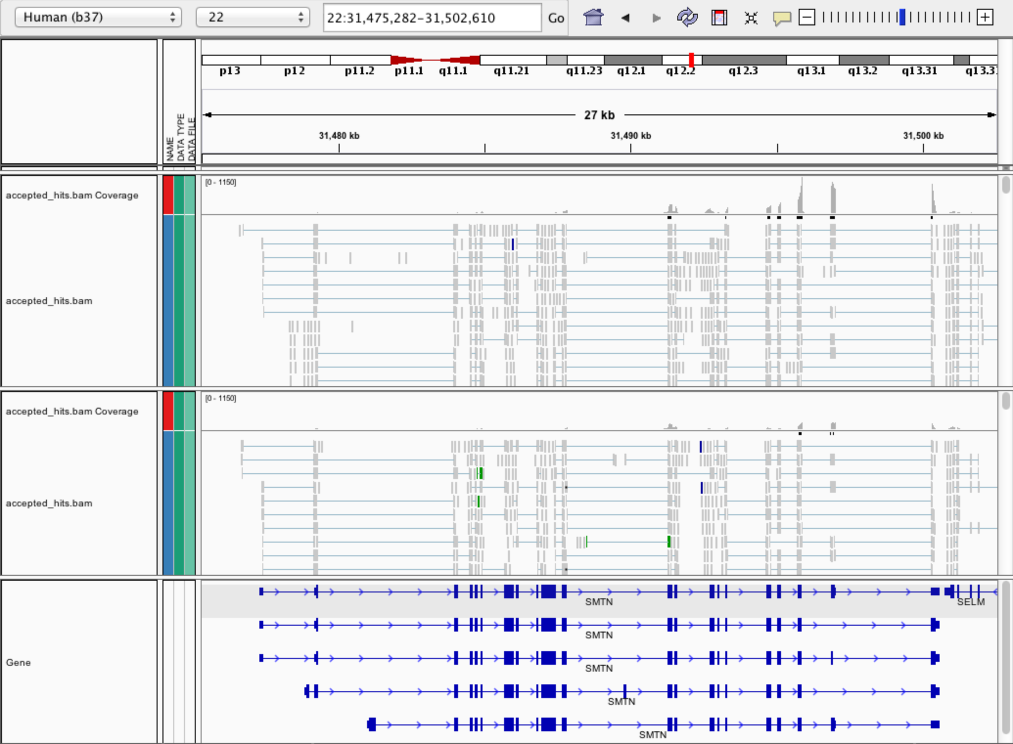
Expression estimation for known genes and transcripts
3’ bias
Down-regulated

Slide 5
What is FPKM (RPKM)
RPKM: Reads Per Kilobase of transcript per Million mapped reads.
FPKM: Fragments Per Kilobase of transcript per Million mapped reads.
No essential difference - Just a terminology change to better describe paired-end reads!

Slide 6
What is FPKM
Why not just count reads in my RNAseq data?
The relative expression of a transcript is proportional to the number of cDNA fragments that originate from it. However:
# fragments is biased towards larger genes
# fragments is related to total library depth
Fragments
Per Kilobase of transcript
per Million mapped reads.

Slide 7
What is FPKM
FPKM attempts to normalize for gene size and library depth
remember – RPKM is essentially the same!
FPKM = (10^9 * C) / (N * L)
C = number of mappable reads/fragments for a gene/transcript/exon/etc
N = total number of mappable reads/fragments in the library
L = number of base pairs in the gene/transcript/exon/etc
More reading:
http://www.biostars.org/p/11378/
http://www.biostars.org/p/68126/

Slide 8
How do FPKM and TPM differ?
TPM: Transcript per Kilobase Million
The difference is in the order of operations:
FPKM
1) Determine total fragment count, divide by 1,000,000 (per Million)
2) Divide each gene/transcript fragment count by #1 (Fragments Per Million)
3) Divide each FPM by length of each gene/transcript in kilobases (FPKM)
TPM
1) Divide each gene/transcript fragment count by length of the transcript in kilobases (Fragments Per Kilobase)
2) Sum all FPK values for the sample and divide by 1,000,000 (per Million)
3) Divide #1 by #2 (TPM)
The sum of all TPMs in each sample is the same. Easier to compare across samples!
http://www.rna-seqblog.com/rpkm-fpkm-and-tpm-clearly-explained/
https://www.ncbi.nlm.nih.gov/pubmed/22872506
Notes:
When you use TPM, the sum of all TPMs in each sample are the same. This makes it easier to compare the proportion of reads that mapped to a gene in each sample. In contrast, with RPKM and FPKM, the sum of the normalized reads in each sample may be different, and this makes it harder to compare samples directly.

Slide 9
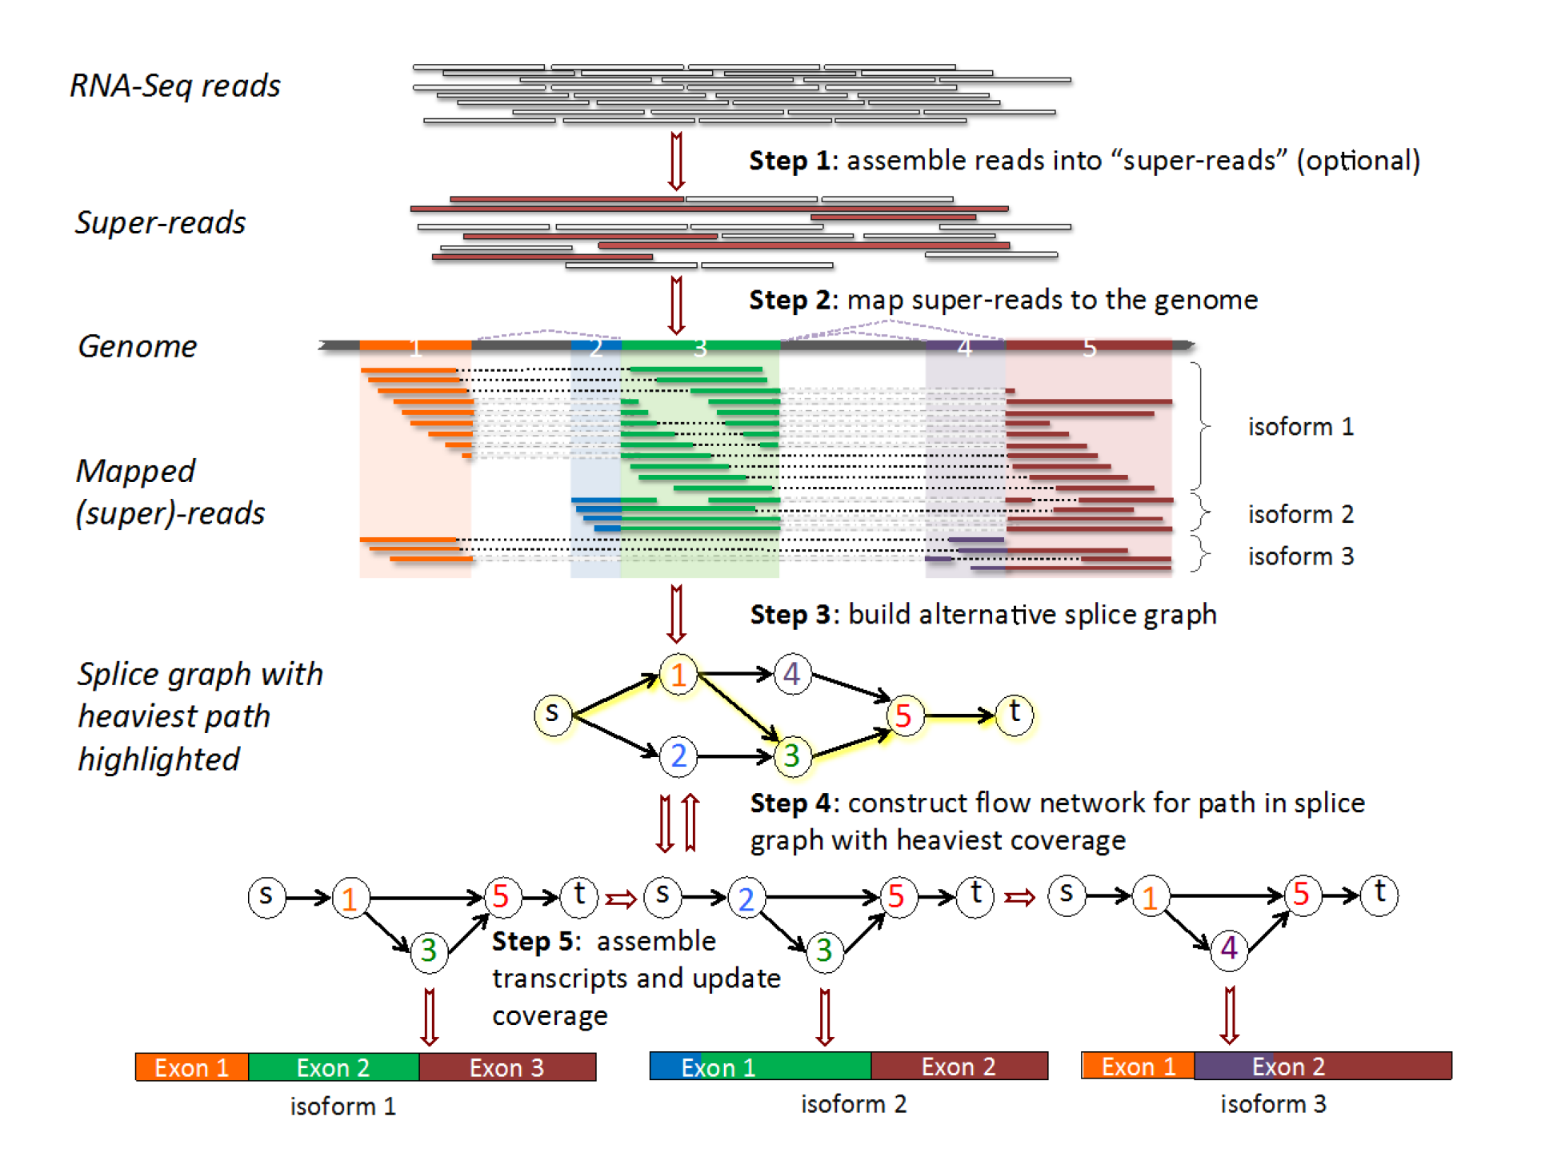
How does StringTie work?
Map reads to the genome
Infer isoforms:
iteratively extract the heaviest path from a splice graph
construct a flow network
compute maximum flow to estimate abundance
update the splice graph by removing reads that were assigned by the flow algorithm
This process repeats until all reads have been assigned.
Pertea et al. Nature Biotechnology, 2015
Notes:
The StringTie algorithm: RNA-seq reads are assembled into super-reads (Step 1) and then super-reads plus un-assembled reads are mapped to the genome (Step 2). In Step 3, mapped reads and super-reads are used to build an alternative splice graph. We use the path from source (s) to sink (t) with the heaviest coverage to build a flow network corresponding to the transcript represented by that path (Step 4). The maximum flow in this network represents the coverage of one assembled transcript, which is removed from the splice graph (Step 5). Steps 4 and 5 are repeated until no more transcripts can be assembled.

Slide 10
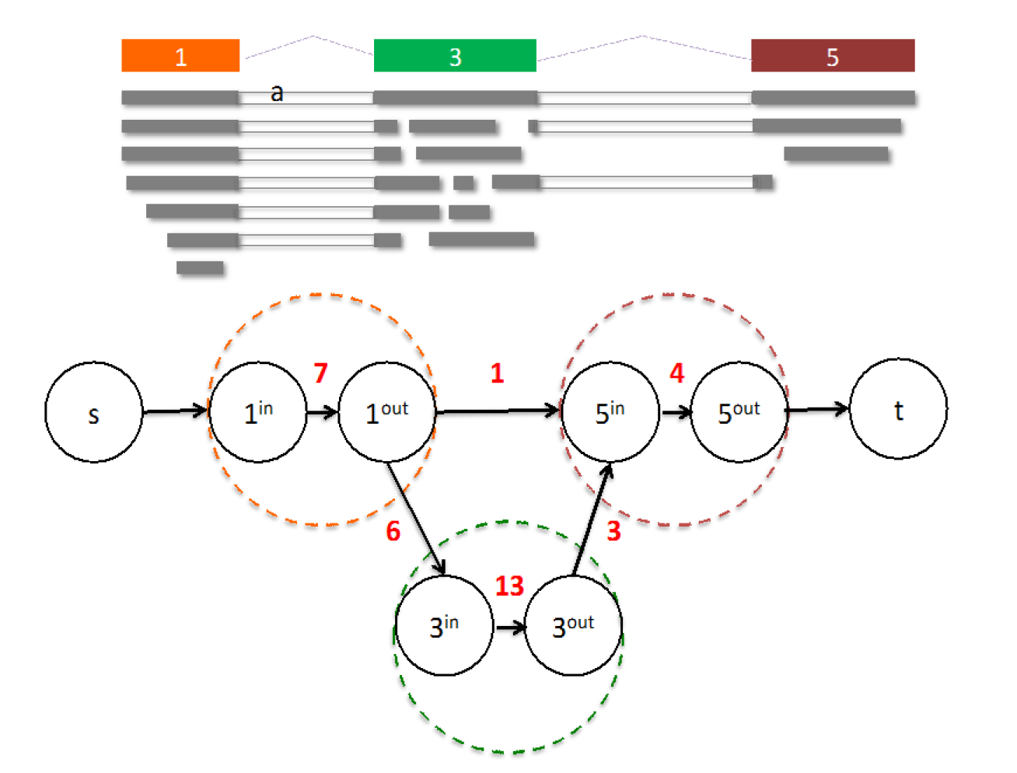
From flow network for each transcript, maximum flow is used to assemble transcript and estimate abundance
StringTie uses basic graph theory (splice graph), custom heuristics (heaviest path), more graph theory (flow network) and optimization theory (maximum flow). See StringTie paper for definitions and math.
Notes:
Flow network associated with a transcript (shown with colored nodes). 15 fragments (shown in grey) align to the transcript. Two nodes in the flow network are connected if a fragment starts and ends at those nodes. E.g., nodes 1 and 5 are connected because fragment (a) starts at node 1 and ends at node 5. For each colored node in the transcript, two nodes are created in the flow network. Capacities on edges (not connecting source or sink) are shown in red.
In the first node (corresponding to exon1) there are 7 fragments. One of these fragments is connected to exon5 (starts at beginning of exon1 and ends at end of exon5), while 6 fragments are connected to exon3. In the second node (corresponding to exon3) there are 13 fragments, of which 3 are connected to exon 5. The final node (corresponding to exon5) has 4 supporting fragments. The maximum flow is clearly 1 – 3 – 5.
StringTie estimates the coverage level of the transcript by solving a maximum-flow problem that determines the maximum number of fragments that can be associated with the chosen transcript.
The maximum flow problem is a well-studied problem in optimization theory.

Slide 11
StringTie -merge
Merge together all gene structures from all samples
Some samples may only partially represent a gene structure
Incorporates known transcripts with assembled, potentially novel transcripts
For de novo or reference guided mode, we will rerun StringTie with the merged transcript assembly.
Pertea et al. Nature Protocols, 2016

Slide 12
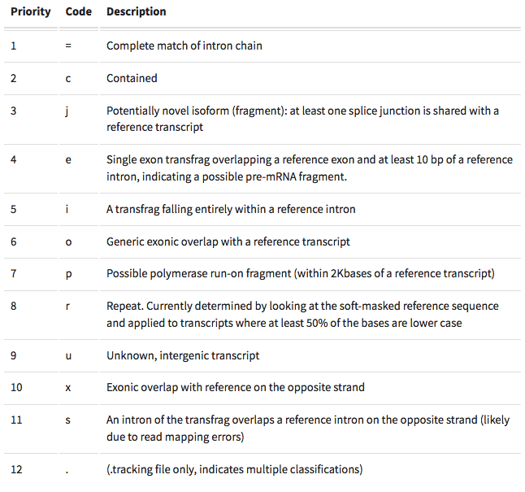
gffcompare
gffcompare will compare a merged transcript GTF with known annotation, also in GTF/GFF3 format
http://cole-trapnell-lab.github.io/cufflinks/cuffcompare/index.html#cuffcompare-output-files

Slide 13






We are on a Coffee Break & Networking Session
Workshop Sponsors:

