Slide 1


Canadian Bioinformatics Workshops
www.bioinformatics.ca
bioinformaticsdotca.github.io
Supported by

Slide 2


Slide 3

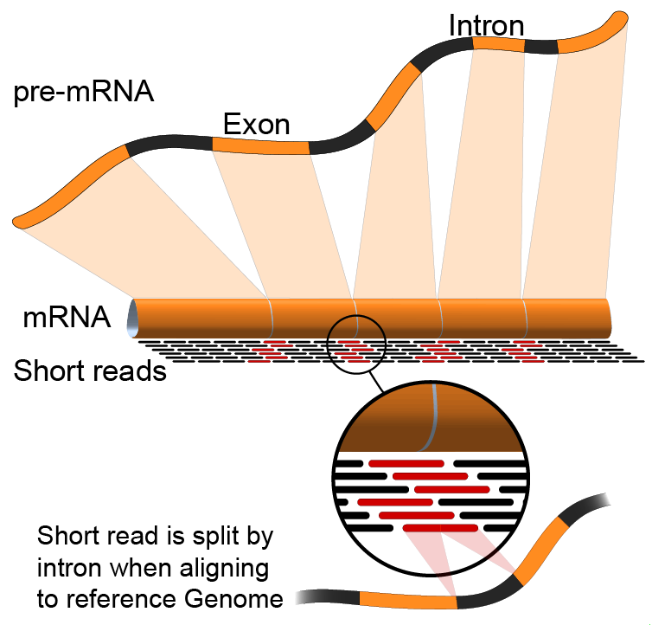

HT-Seq
Emma Bell, Felicia Gomez, Obi Griffith, Malachi Griffith, Huiming Xia
RNA-Seq Analysis
Sep 8th-10th, 2021

Slide 4
Alternatives to FPKM
Raw read counts for differential expression analysis
Assign reads/fragments to defined genes/transcripts, get “raw counts”
Transcript structures could still be defined by something like cufflinks
HTSeq (htseq-count)
http://www-huber.embl.de/users/anders/HTSeq/doc/count.html
Caveats of ‘transcript’ analysis by htseq-count:
Designed for genes - ambiguous reads from overlapping transcripts may not be handled!
http://seqanswers.com/forums/showthread.php?t=18068
htseq-count --mode intersection-strict --stranded no --minaqual 1 --type exon --idattr transcript_id accepted_hits.sam chr22.gff > transcript_read_counts_table.tsv

Slide 5
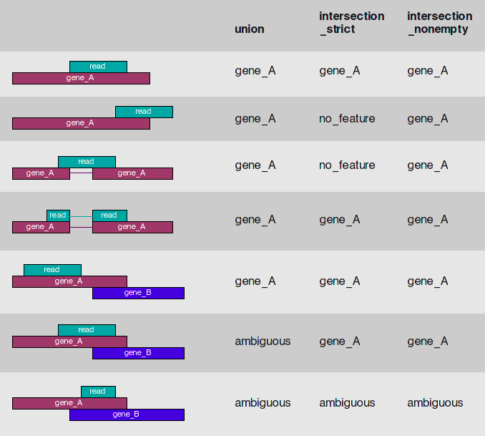
HTSeq-count basically counts reads supporting a feature (exon, gene) by assessing overlapping coordinates
Whether a read is counted depends on the nature of overlap and “mode” selected
Notes:
We recommend intersection_strict

Slide 6






We are on a Coffee Break & Networking Session
Workshop Sponsors:

