Slide 1


Canadian Bioinformatics Workshops
www.bioinformatics.ca
bioinformaticsdotca.github.io
Supported by

Slide 2
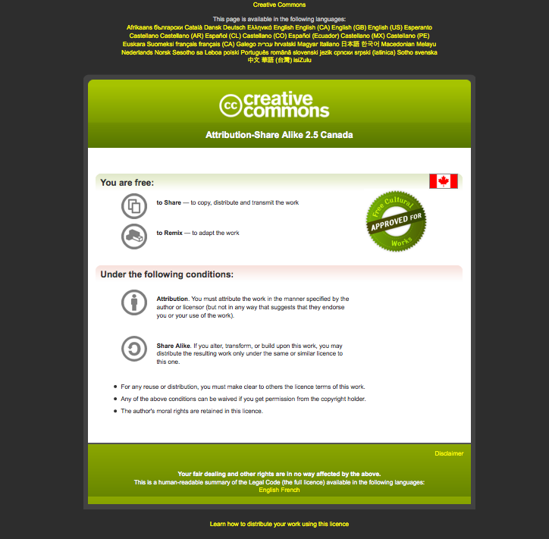

Slide 3
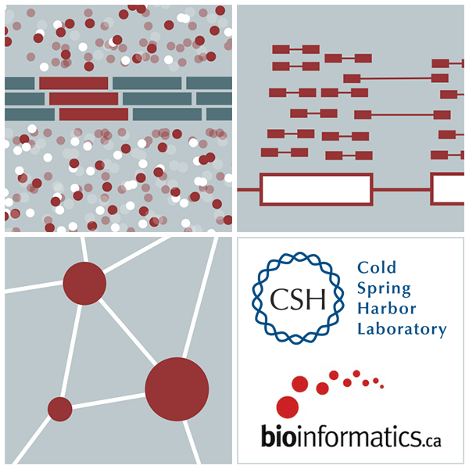
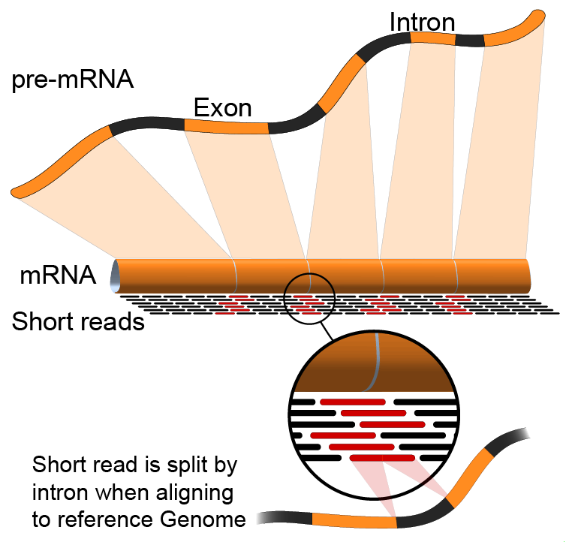

Differential Expression
Emma Bell, Felicia Gomez, Obi Griffith, Malachi Griffith, Huiming Xia
RNA-Seq Analysis
Sep 8th-10th, 2021

Slide 4
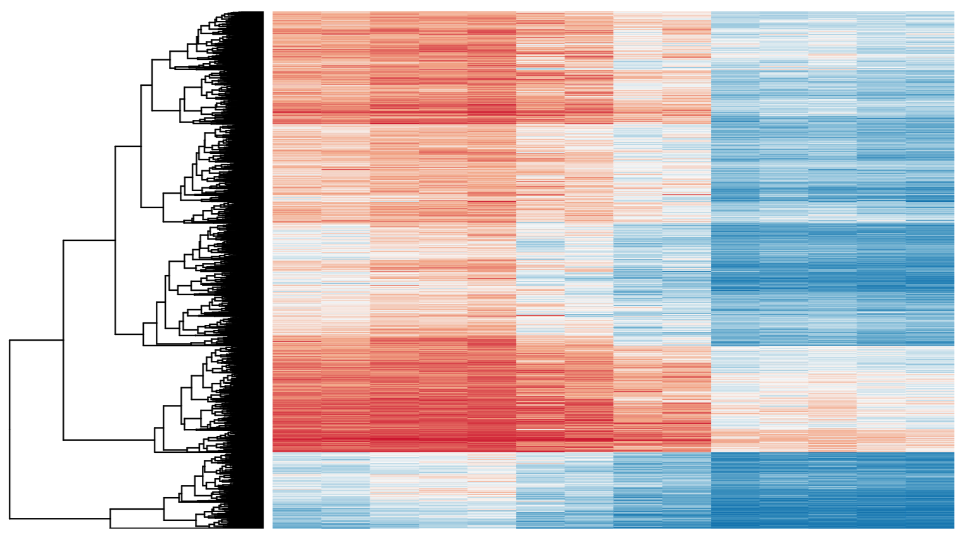
Differential Expression
Tying gene expression back to genotype/phenotype
What genes/transcripts are being expressed at higher/lower levels in different groups of samples?
Are these differences ‘significant’, accounting for variance/noise?
Examples (used in course):
UHR cells vs HBR brain
Tumor vs Normal tissue
Wild-type vs gene KO cells

Slide 5
Differential Expression with Ballgown
Parametric F-test comparing nested linear models
Two models are fit to each feature, using expression as the outcome
one including the covariate of interest (e.g., case/control status or time) and one not including that covariate.
An F statistic and p-value are calculated using the fits of the two models.
A significant p-value means the model including the covariate of interest fits significantly better than the model without that covariate, indicating differential expression.
We adjust for multiple testing by reporting q-values:
q < 0.05 the false discovery rate should be controlled at ~5%.
Frazee et al. (2014)

Slide 6
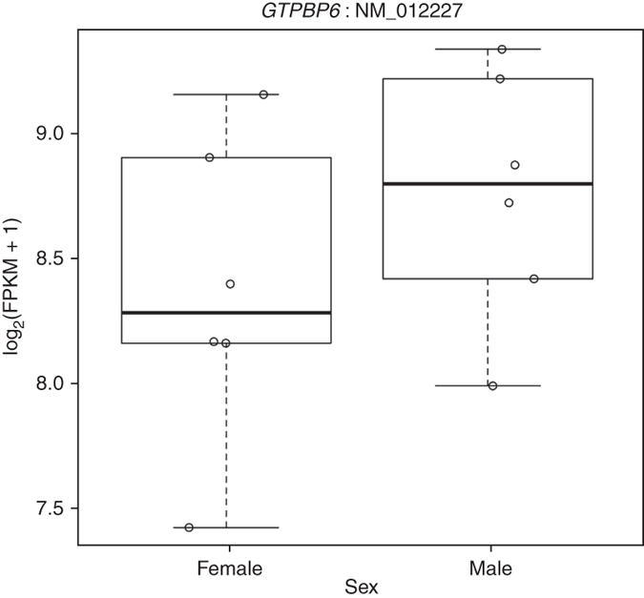
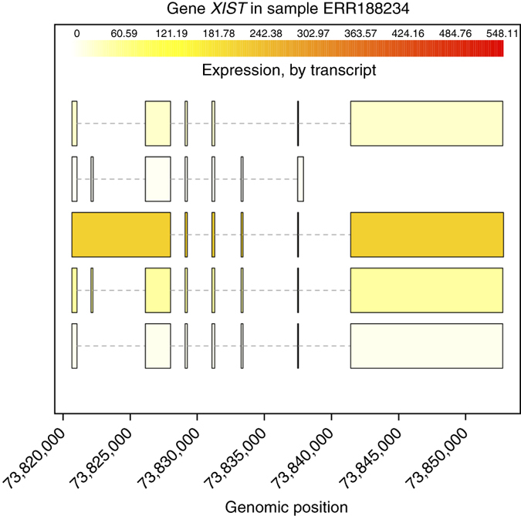
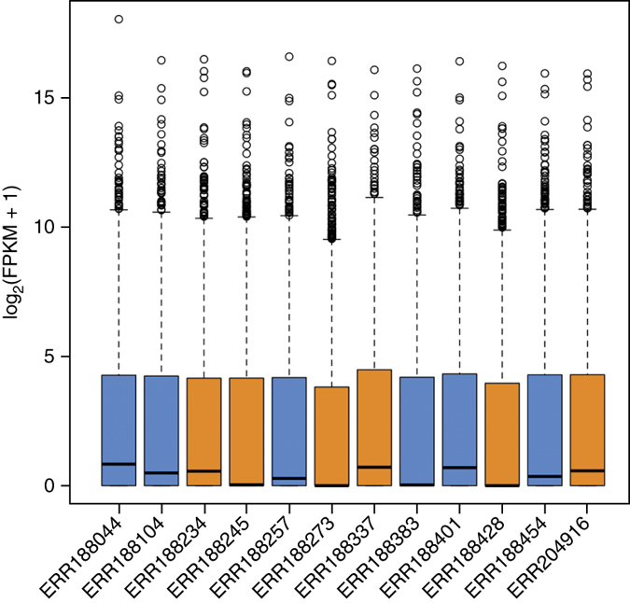
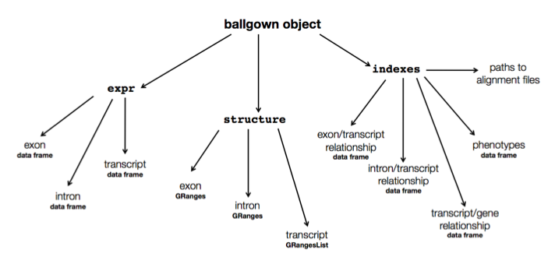
Ballgown for Visualization with R

Slide 7
Alternative differential expression methods
Raw count approaches
DESeq2 - http://www-huber.embl.de/users/anders/DESeq/
edgeR - http://www.bioconductor.org/packages/release/bioc/html/edgeR.html
Others…

Slide 8
‘FPKM/TPM’ expression estimates vs. ‘raw’ counts
Which should I use?
Long running debate, but the general consensus:
FPKM/TPM
When you want to leverage benefits of tuxedo suite
Isoform deconvolution
Good for visualization (e.g., heatmaps)
Calculating fold changes, etc.
Counts
More robust statistical methods for differential expression
Accommodates more sophisticated experimental designs with appropriate statistical tests

Slide 9
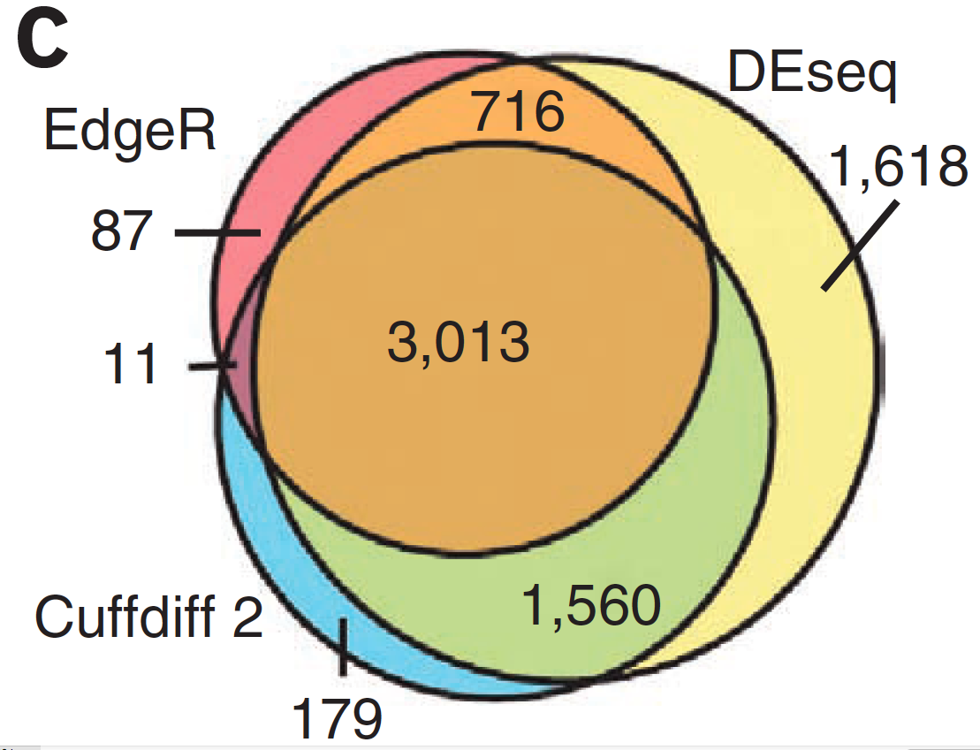
Multiple approaches advisable

Slide 10
Lessons learned from microarray days
Hansen et al. “Sequencing Technology Does Not Eliminate Biological Variability.” Nature Biotechnology 29, no. 7 (2011): 572–573.
Power analysis for RNA-seq experiments
http://euler.bc.edu/marthlab/scotty/scotty.php
RNA-seq need for biological replicates
http://www.biostars.org/p/1161/
RNA-seq study design
http://www.biostars.org/p/68885/

Slide 11
Multiple testing correction
As more attributes are compared, differences due solely to chance become more likely!
Well known from array studies
10,000s genes/transcripts
100,000s exons
With RNA-seq, more of a problem than ever
All the complexity of the transcriptome gives huge numbers of potential features
Genes, transcripts, exons, junctions, retained introns, microRNAs, lncRNAs, etc
Bioconductor multtest
http://www.bioconductor.org/packages/release/bioc/html/multtest.html

Slide 12
Downstream interpretation of expression analysis
Topic for an entire course
Expression estimates and differential expression lists from StringTie, Ballgown or other alternatives can be fed into many analysis pipelines
See supplemental R tutorial for how to format expression data and start manipulating in R
Clustering/Heatmaps
Provided by Ballgown
For more customized analysis various R packages exist:
hclust, heatmap.2, plotrix, ggplot2, etc.
Classification
For RNA-seq data we still rarely have sufficient sample size and clinical details but this is changing
Weka is a good learning tool
RandomForests R package (biostar tutorial being developed)
Pathway analysis
GSEA, IPA, Cytoscape, many R/BioConductor packages: http://www.bioconductor.org/help/search/index.html?q=pathway
https://genviz.org/module%204/0003/12/31/Expression_Profiling_and_Visualization/

Slide 13
HISAT2/StringTie/Ballgown RNA-seq Pipeline
Sequencing
Read alignment
Transcript compilation
Expression estimation
Differential expression
RNA-seq reads (2 x 100 bp)
HISAT2
StringTie
StringTie
Ballgown
Raw sequence data
(.fastq files)
Reference genome
(.fa file)
Gene annotation
(.gtf file)
Ballgown & R
Inputs
Visualization
Module 9

Slide 14






We are on a Coffee Break & Networking Session
Workshop Sponsors:

