Slide 1


Canadian Bioinformatics Workshops
www.bioinformatics.ca
bioinformaticsdotca.github.io
Supported by

Slide 2
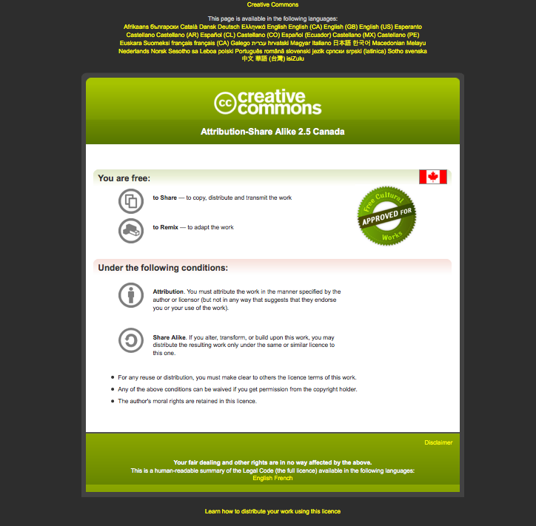

Slide 3
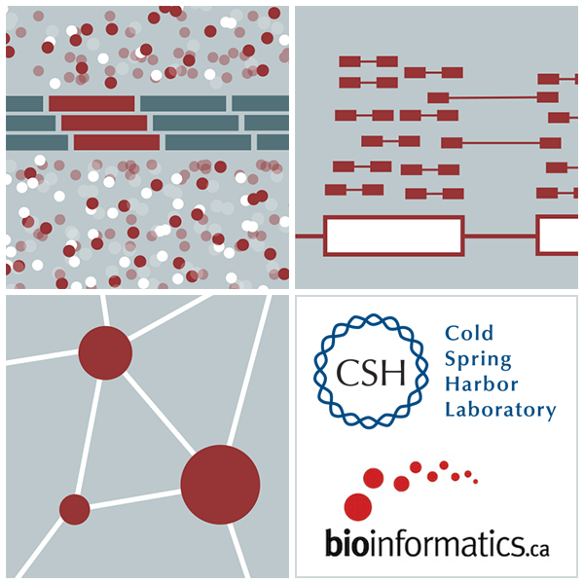
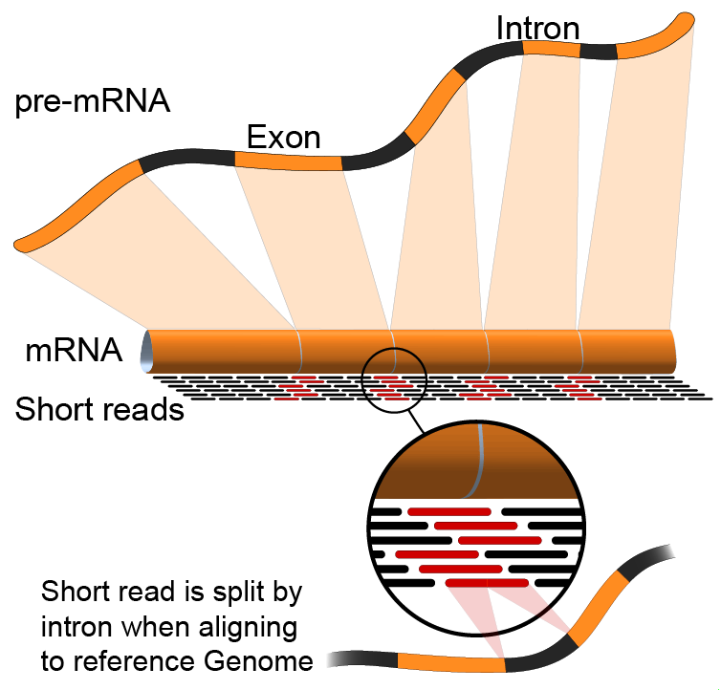

Alignment Free Expression Estimation (Kallisto)
Emma Bell, Felicia Gomez, Obi Griffith, Malachi Griffith, Huiming Xia
RNA-Seq Analysis
Sep 8th-10th, 2021

Slide 4
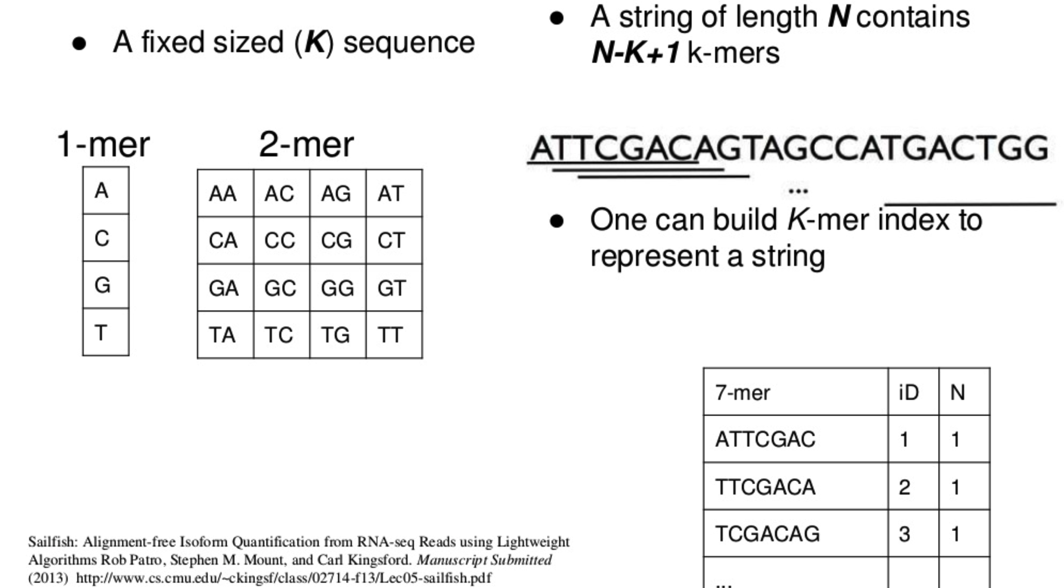
What is a k-mer?
https://www.slideshare.net/duruofei/cmsc702-project-final-presentation
Notes:
As k-mers get longer, there are more possible unique combinations. For k-mers representing strings of DNA sequence there are 4^k possible unique k-mers where k is the length of the k-mer.
Alignment free transcript abundance estimation methods obtain fast performance in part by keeping an index of k-mers in memory. Longer k-mers require more memory.
K-mer length must be shorter than read and transcript lengths to be useful
Default k-mer length for Kallisto is 31

Slide 5
Alignment free approaches for transcript abundance
Obtain reference transcript sequences
- e.g. Ensembl, Refseq, or GENCODE
Build a k-mer index of all of the k-mers in each transcript sequence
- Store each k-mer and its position within the transcript. “hashing”

Slide 6
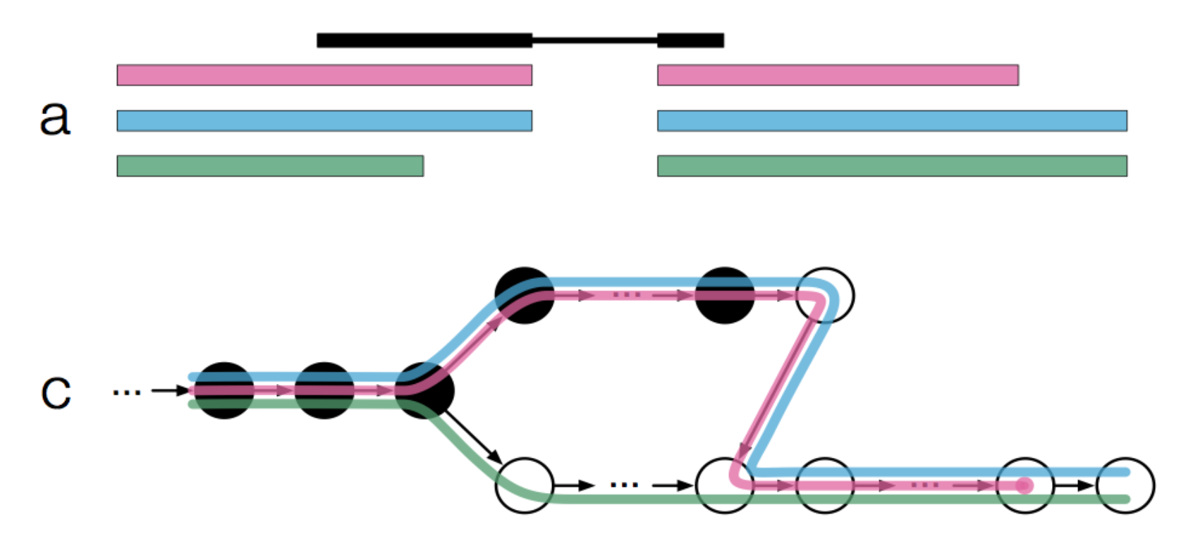
Alignment free approaches for transcript abundance
3. Count number of times each k-mer occurs within each RNAseq read
Model relationship between RNA-seq read k-mers and the transcript k-mer index.
What transcript is the most likely source for each read?
Called “pseudoalignment” , “quasi-mapping”, etc.
4. Handle sequencing errors, isoforms, ambiguity, and determine abundance estimates
Transcriptome de Bruijn graphs, likelihood function, expectation maximization, etc.
Bray, 2016 doi:10.1038/nbt.3519 https://tinyheero.github.io/2015/09/02/pseudoalignments-kallisto.html

Slide 7
Advantages/disadvantages of alignment free approaches
Advantages
Very fast and efficient
Similar accuracy to alignment based approach but with much, much shorter run time.
Do not need a reference genome, only a reference transcriptome
Disadvantages
You don’t get a proper BAM file (though a pseudo-bam can be created)
Information in reads with sequence errors may be ignored
Limited potential for transcript discovery, variant calling, fusion detection, etc.

Slide 8
Common alignment free tools
Sailfish
“Sailfish enables alignment-free isoform quantification from RNA-seq reads using lightweight algorithms.” 2014
https://www.ncbi.nlm.nih.gov/pubmed/24752080
RNA-Skim
“RNA-Skim: a rapid method for RNA-Seq quantification at transcript level.” 2014
https://www.ncbi.nlm.nih.gov/pubmed/24931995
Kallisto
“Near-optimal probabilistic RNA-seq quantification.” 2016
https://www.ncbi.nlm.nih.gov/pubmed/27043002
Salmon
“Salmon provides fast and bias-aware quantification of transcript expression.” 2017
https://www.ncbi.nlm.nih.gov/pubmed/28263959

Slide 9
Which is best?
Somewhat controversial …
https://liorpachter.wordpress.com/2017/08/02/how-not-to-perform-a-differential-expression-analysis-or-science/
Various sources suggest that Salmon, Kallisto, and Sailfish results are quite comparable
Usability, documentation, and supporting downstream tools could be used to decide

Slide 10




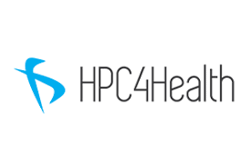

We are on a Coffee Break & Networking Session
Workshop Sponsors:

