Slide 1


Canadian Bioinformatics Workshops
www.bioinformatics.ca
bioinformaticsdotca.github.io
Supported by

Slide 2
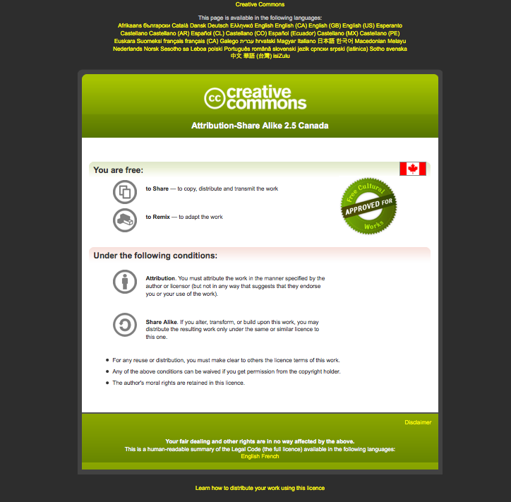

Slide 3
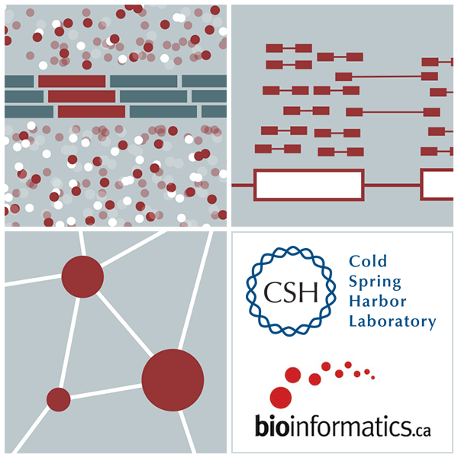
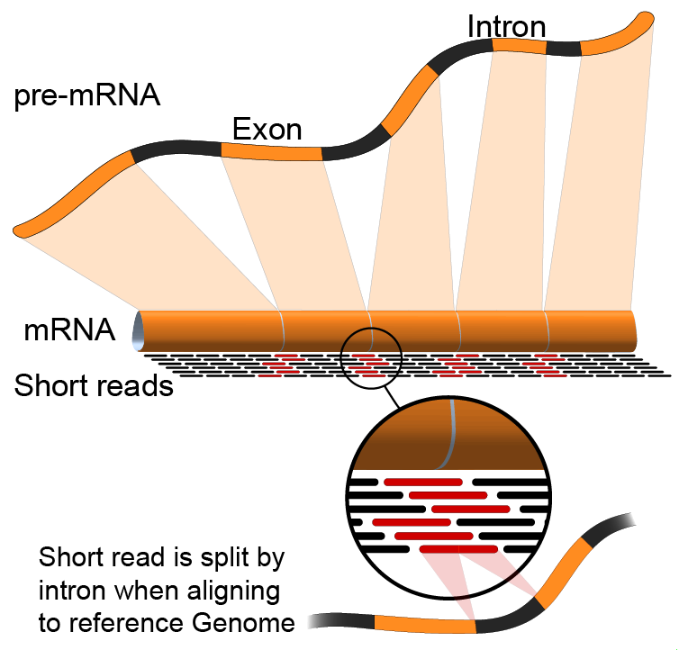

Alternative Splicing Analysis
Emma Bell, Felicia Gomez, Obi Griffith, Malachi Griffith, Huiming Xia
RNA-Seq Analysis
Sep 8th-10th, 2021

Slide 4
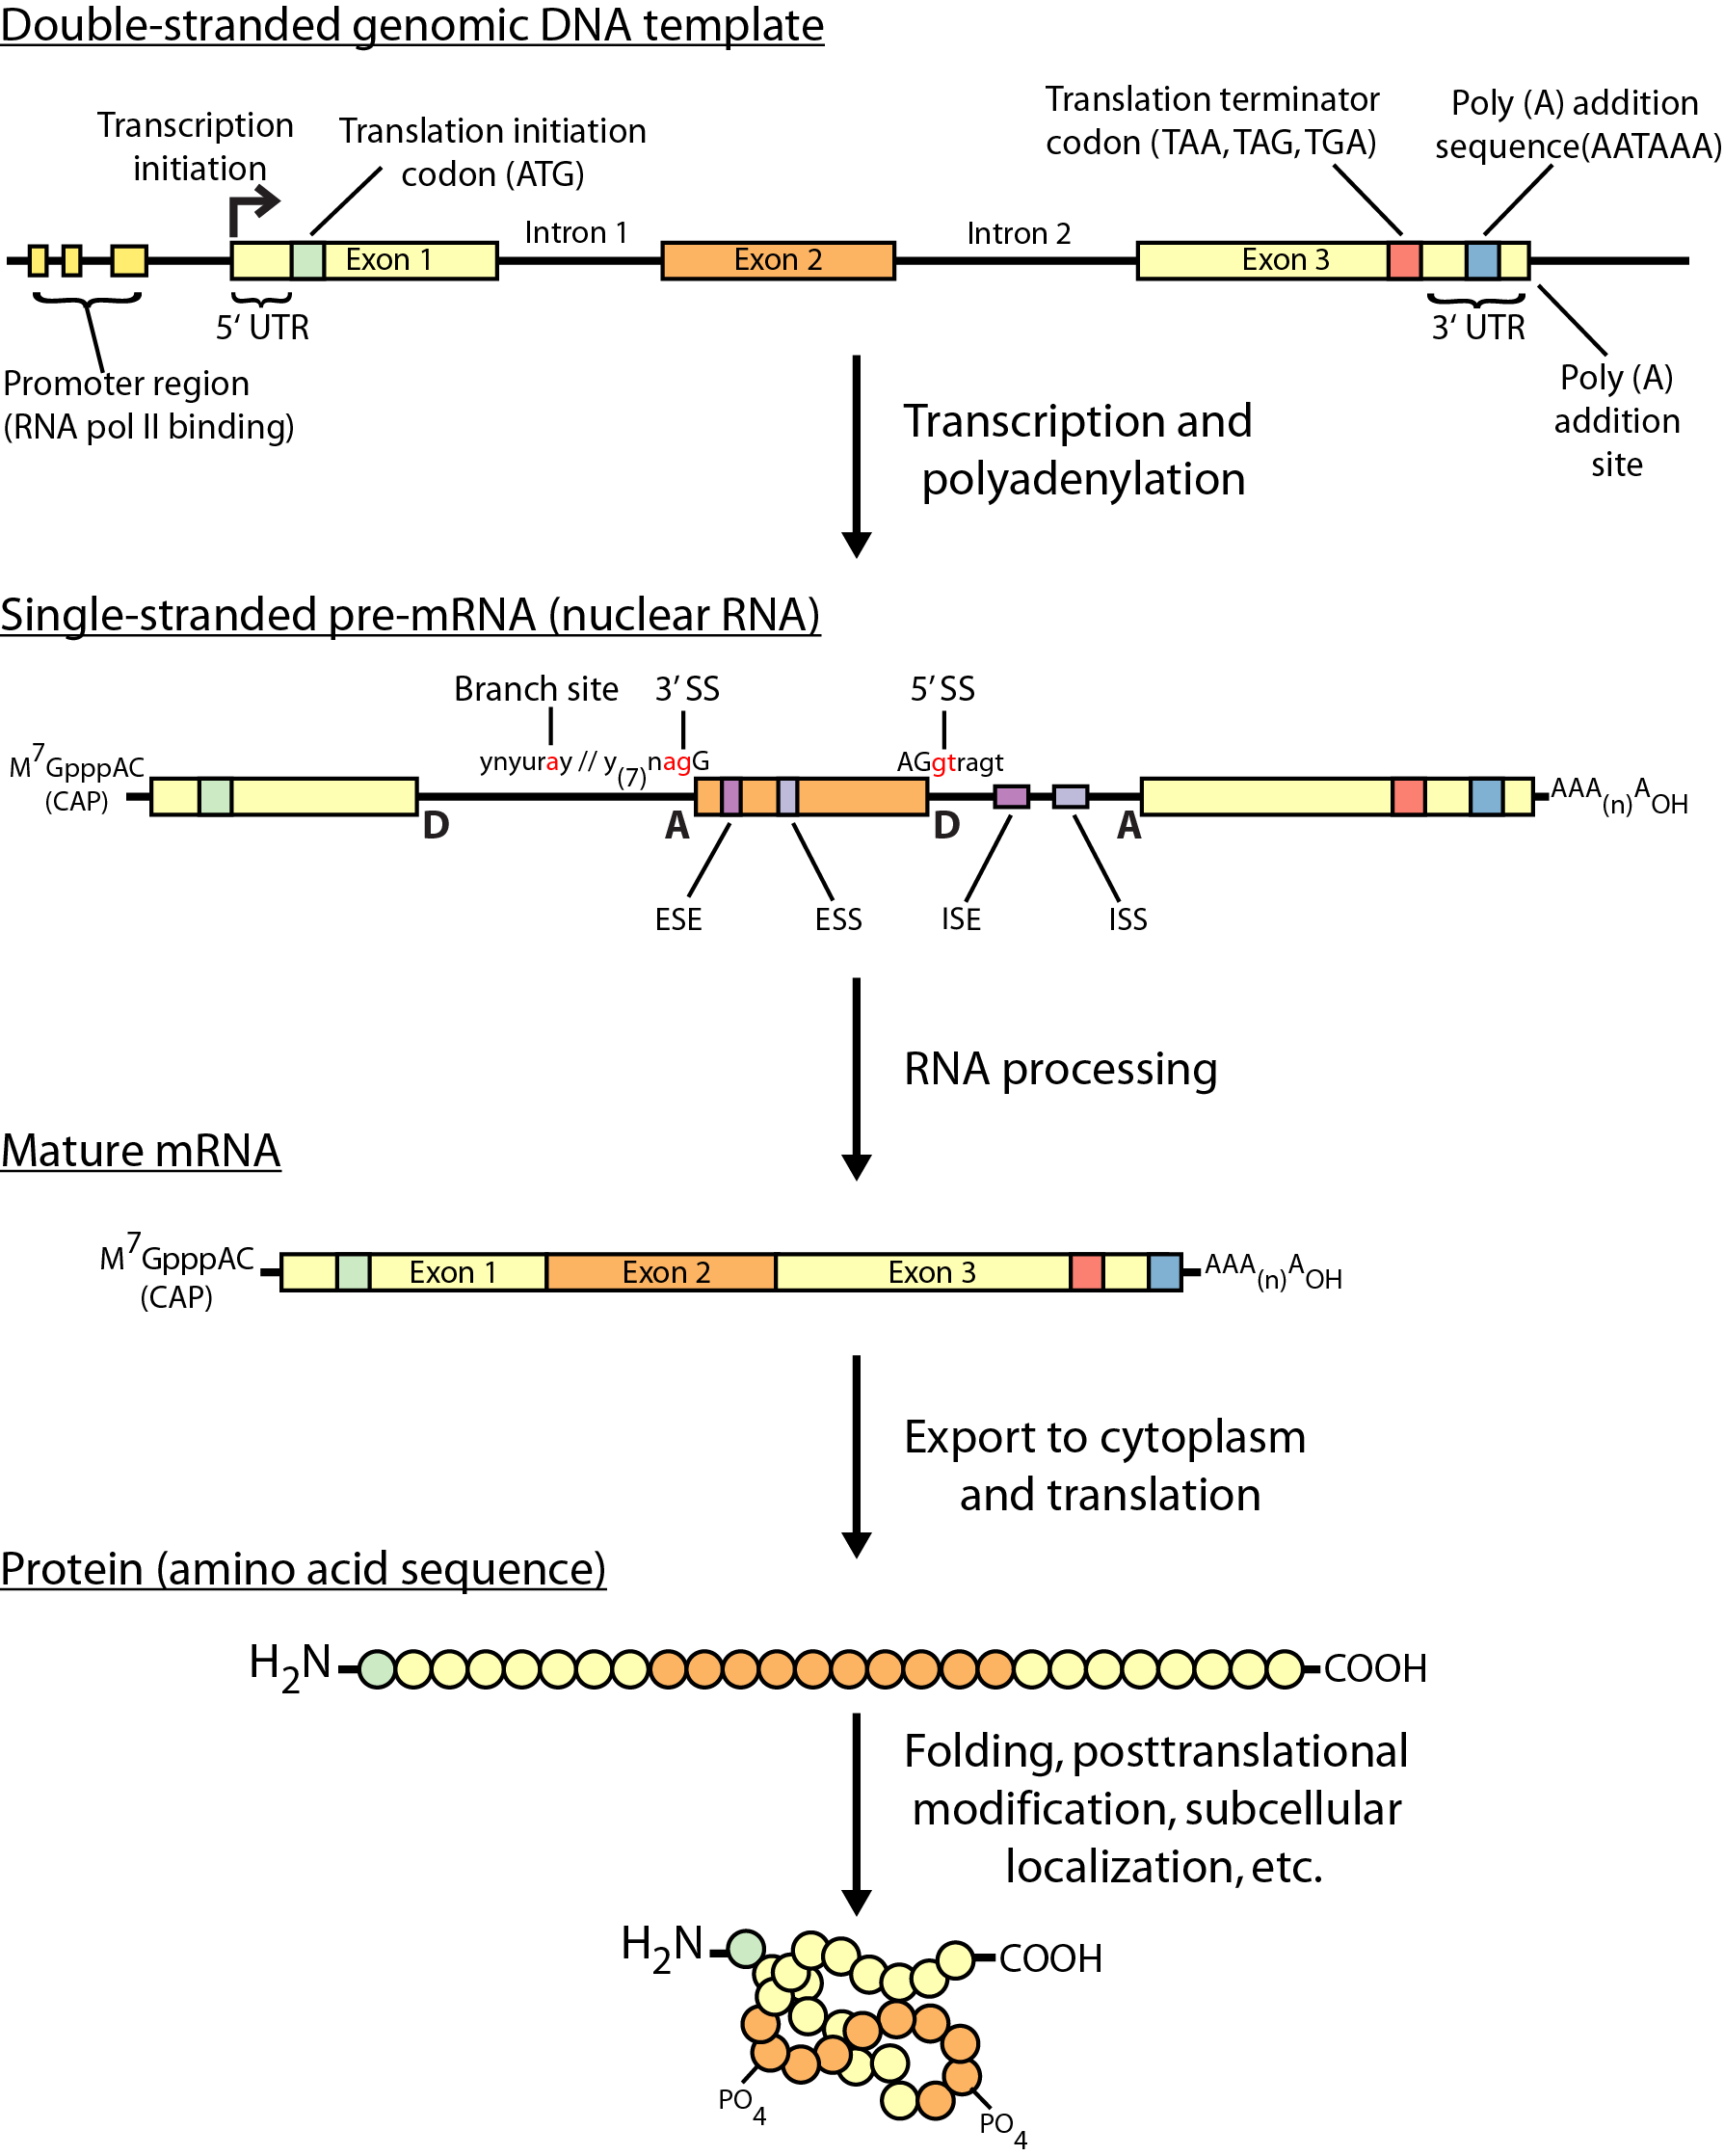
Review of gene expression

Slide 5
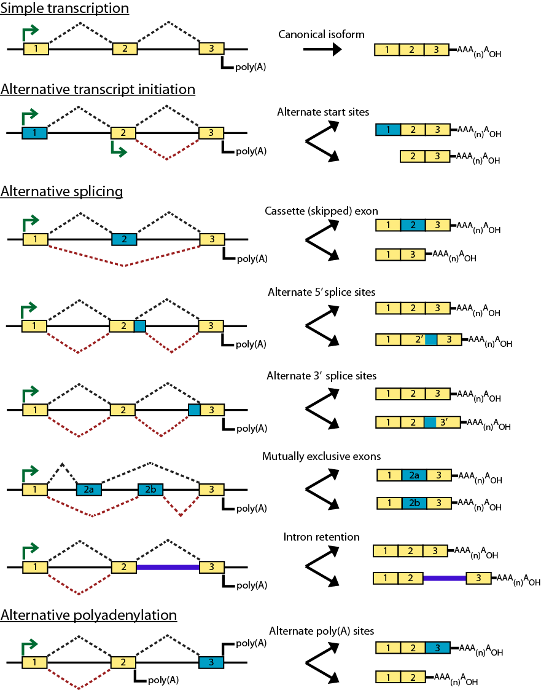
Types of alternative expression - part 1

Slide 6
Types of alternative expression – part 2

Slide 7
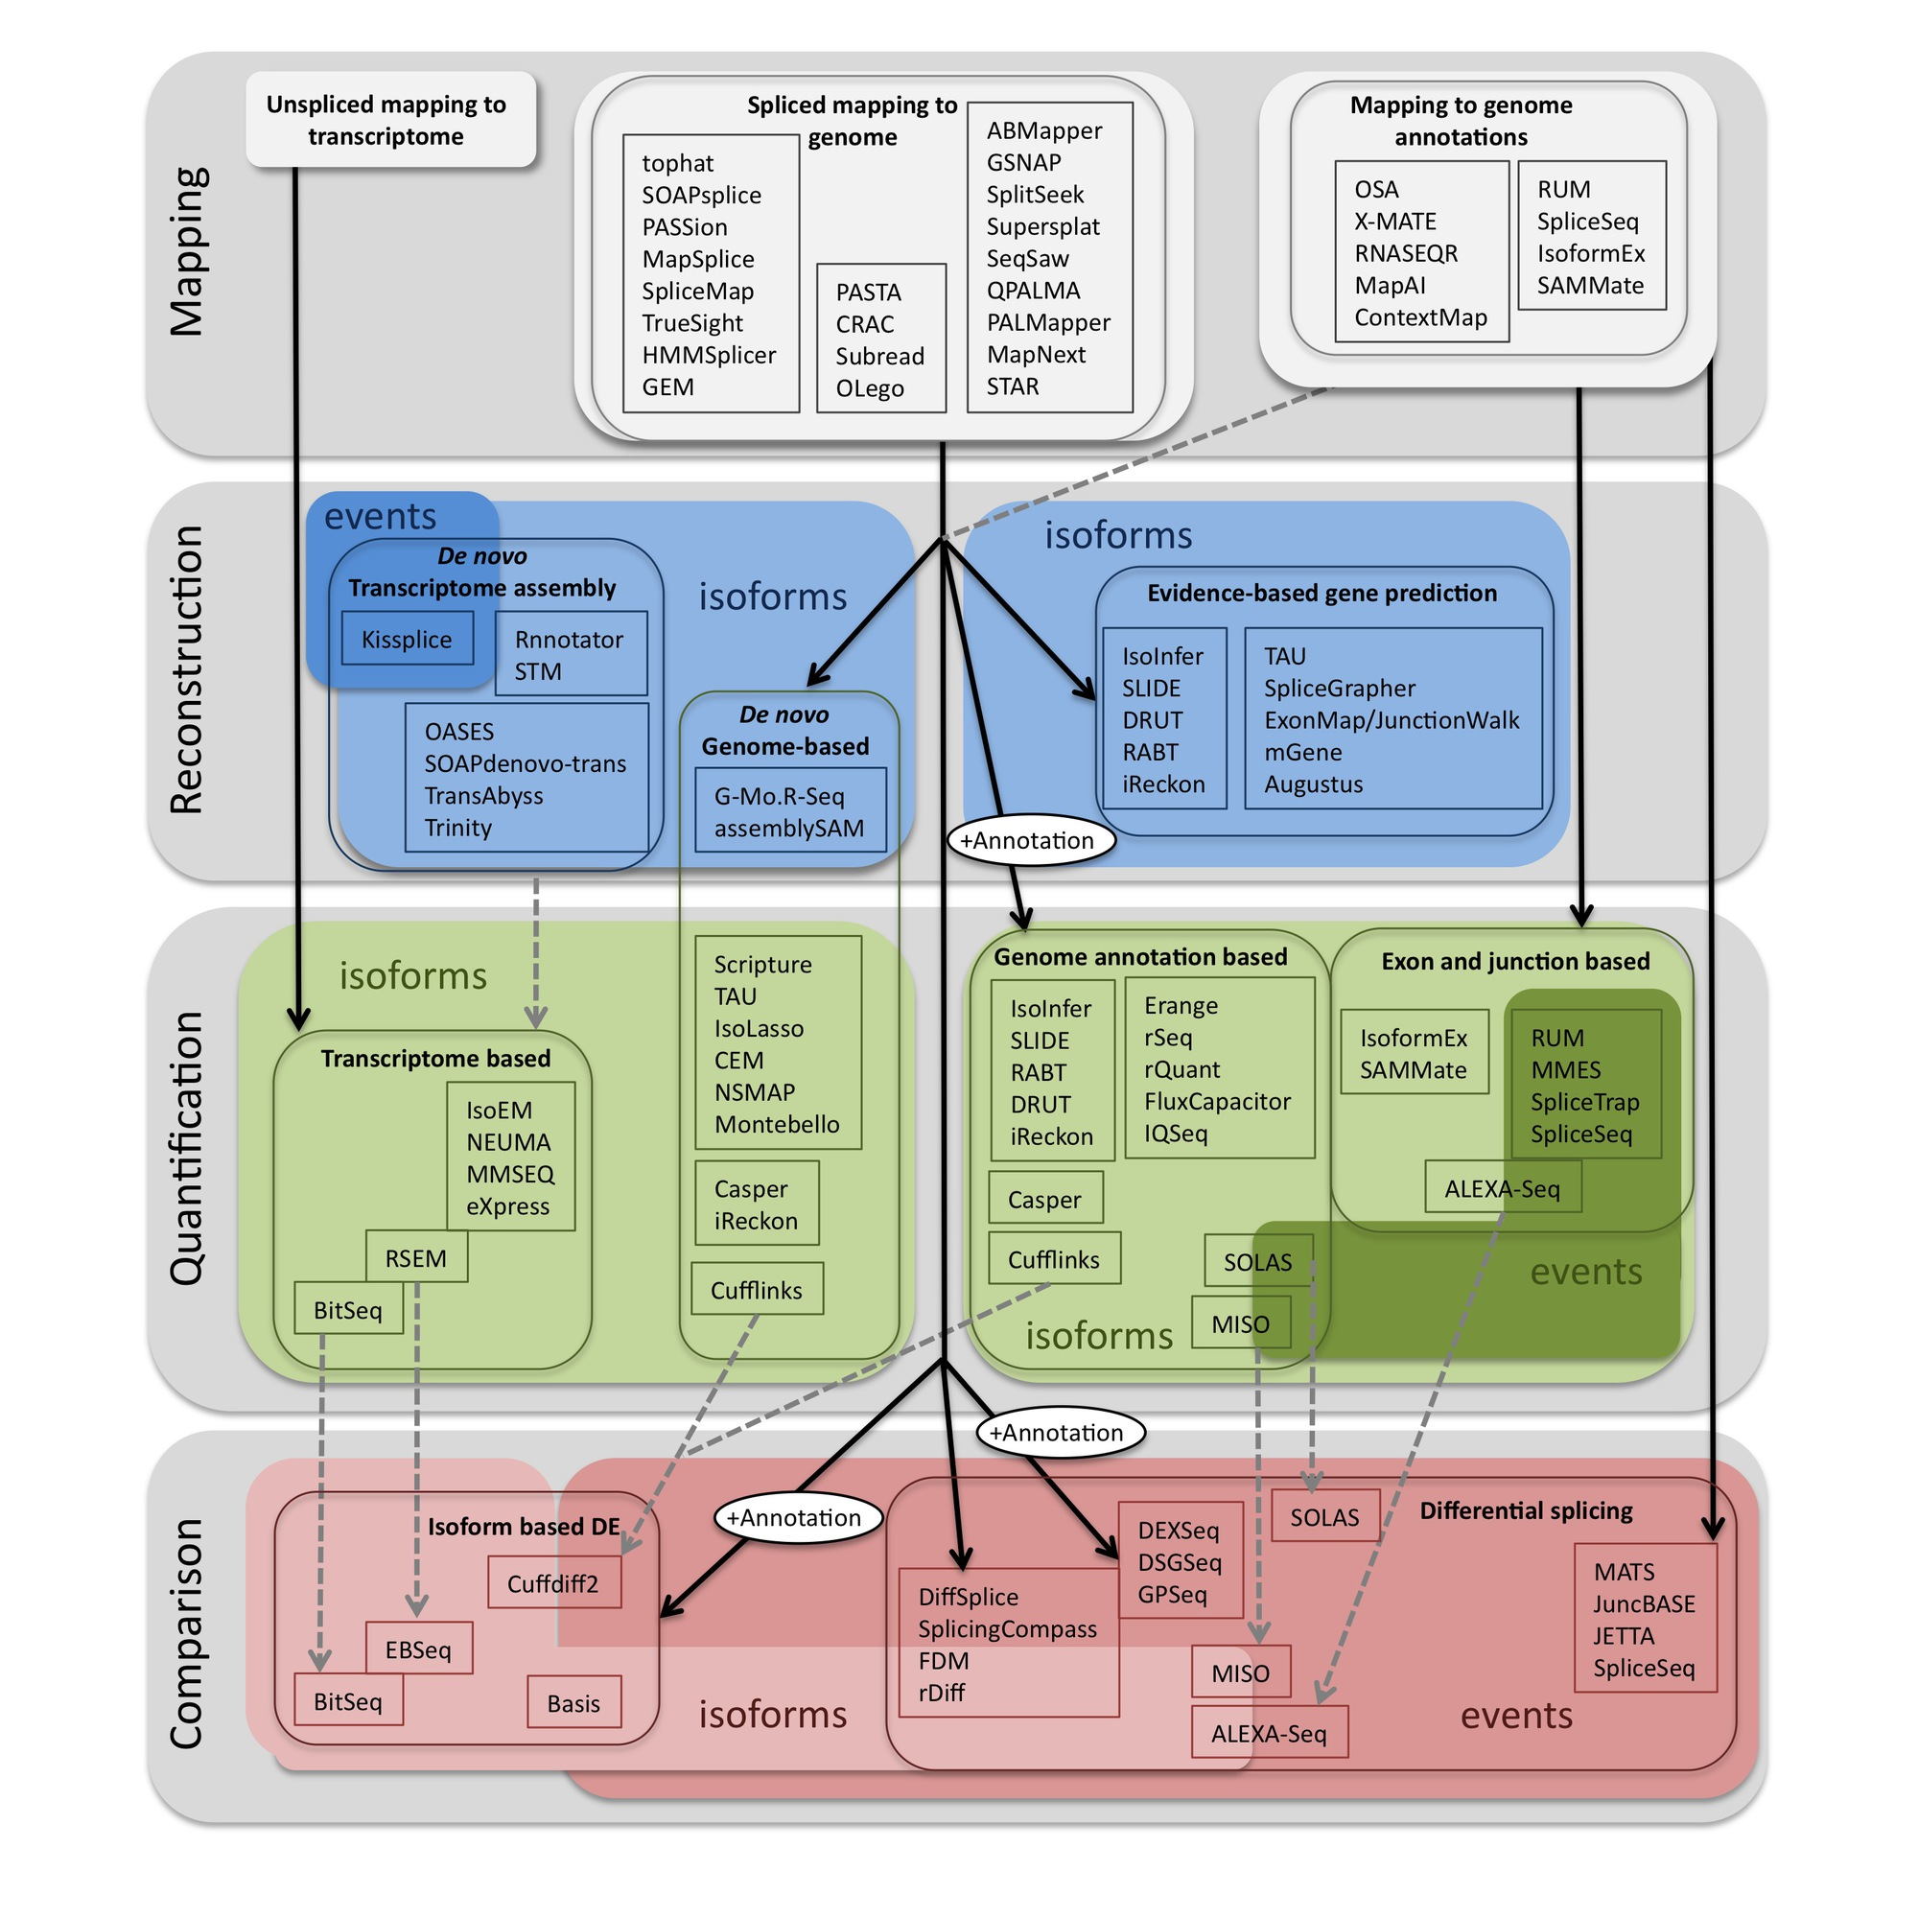
Methods to study splicing by RNA-seq
http://www.rna-seqblog.com/data-analysis/splicing-junction/methods-to-study-splicing-from-rna-seq/
http://arxiv.org/ftp/arxiv/papers/1304/1304.5952.pdf

Slide 8
Methods to study splicing by RNA-seq
http://www.rna-seqblog.com/data-analysis/splicing-junction/methods-to-study-splicing-from-rna-seq/
http://arxiv.org/ftp/arxiv/papers/1304/1304.5952.pdf

Slide 9
Useful resources and discussion
Best approach to predict novel and alternative splicing events from RNA-seq data
http://www.biostars.org/p/68966/
http://www.biostars.org/p/62728/
Alternative splicing detection
http://www.biostars.org/p/65617/
http://www.biostars.org/p/11695/
Identifying genes that express different isoforms in cancer vs normal RNA-seq data
http://www.biostars.org/p/50365/
Cufflinks / Cuffdiff Output - How are tests different?
http://www.biostars.org/p/13525/
Visualization of alternative splicing events using RNA-seq data
http://www.biostars.org/p/8979/

Slide 10
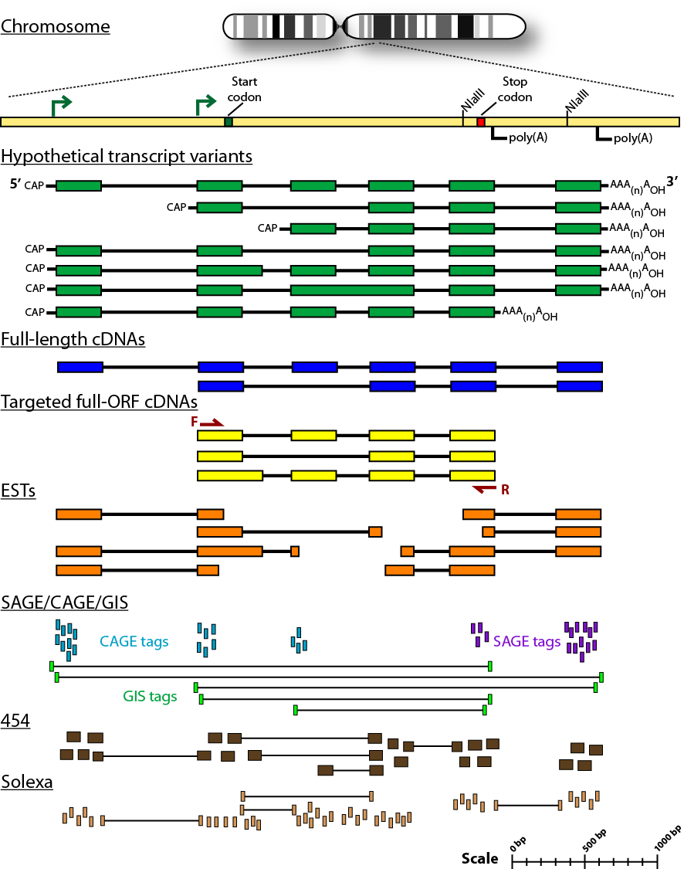
Sequencing methods for studying alternative isoforms

Slide 11






We are on a Coffee Break & Networking Session
Workshop Sponsors:

