Slide 1
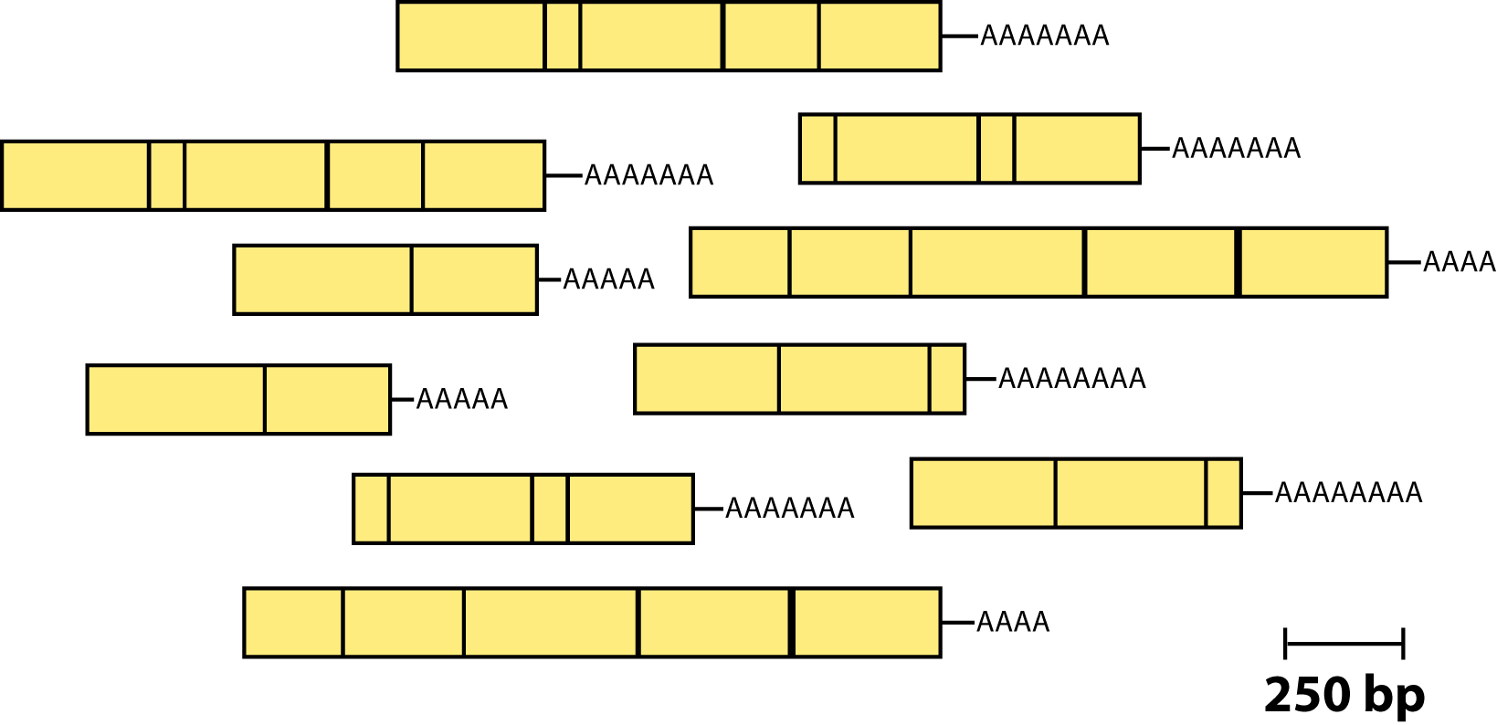
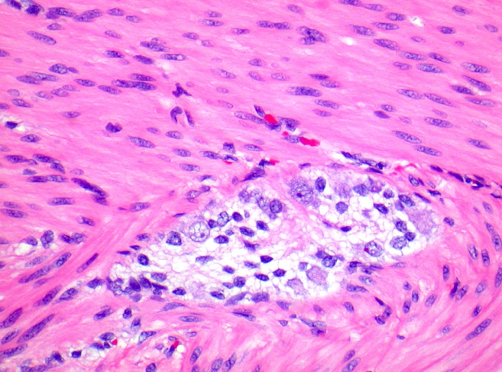
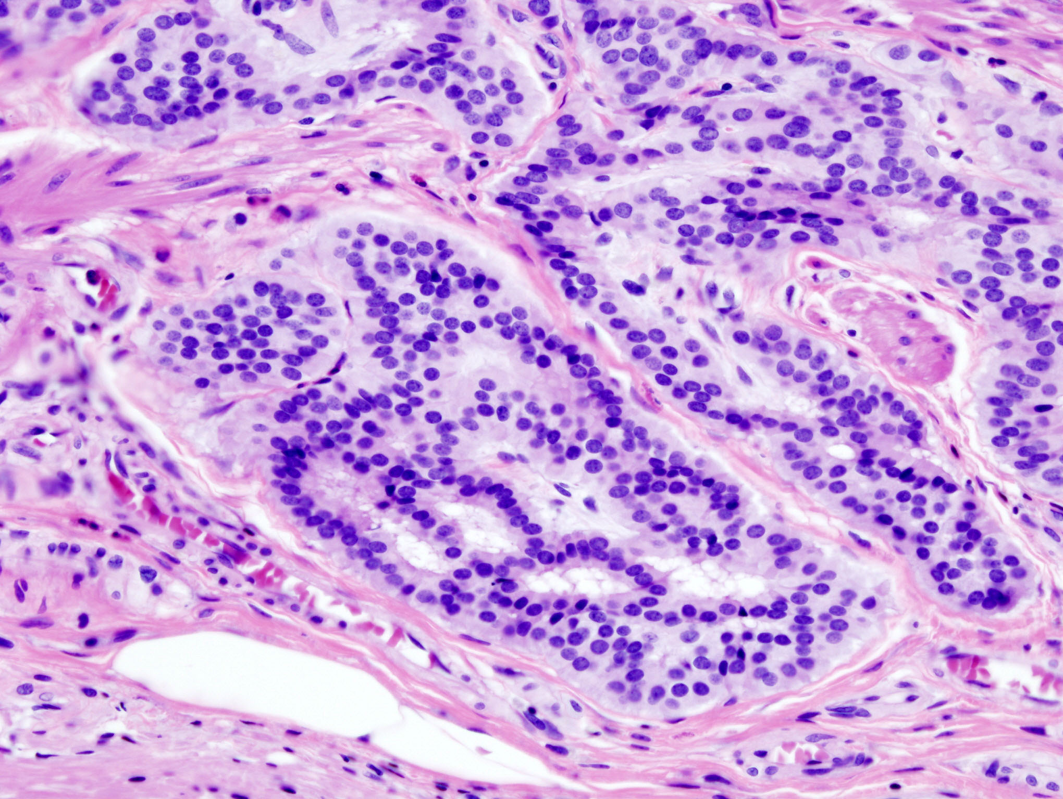
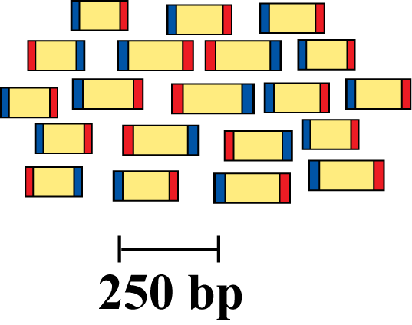
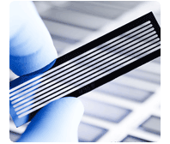
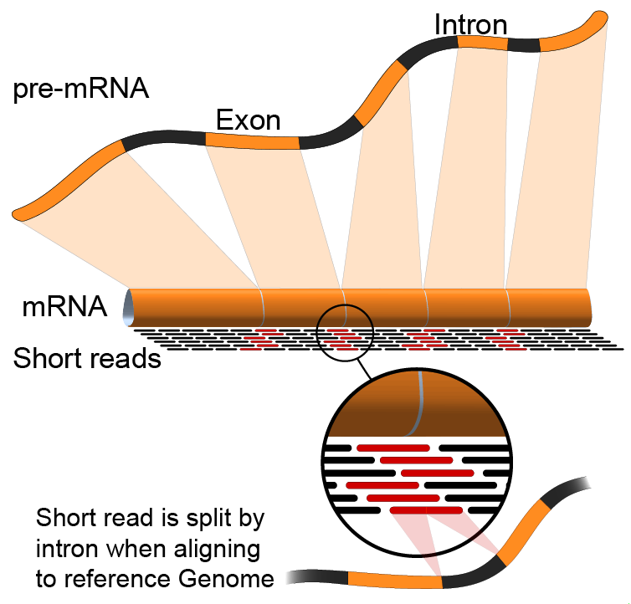
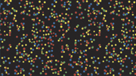
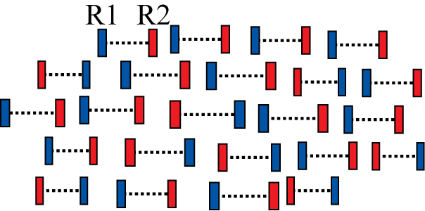
Isolate RNAs
Generate cDNA, fragment, size select, add linkers
Samples of interest
Condition 1
(e.g. normal)
Condition 2
(e.g. tumor)
Sequence ends
Map to genome, transcriptome, and predicted exon junctions
Hundreds of millions of paired reads
Tens of billions bases of sequence
Downstream analysis

