Slide 1

Hybrid quantum-classical campaign selection
Team (solo): Sergey Grigorovich
01 Predict
02 Select
03 Simulate
100 probabilities
Six customer IDs
Campaign probability
Boosting + quantum SVM
300 labelled customers
QAOA optimization
Exact classical comparison
Six independent Ry rotations
Exact + sampled validation
Top 10 candidates
Within resource limits
P(at least 3 subscribe)

Slide 2
Stage 1: Hybrid soft voting improves validation probabilities
A hybrid 50:50 soft vote combines classical shallow boosting with the calibrated quantum SVM
The resulting score outperforms both classical baseline and quantum-only SVM
Model | ROC-AUC ↑ | AP ↑ | Brier ↓
Logistic regression | 0.555 | 0.174 | 0.110
Shallow boosting | 0.610 | 0.235 | 0.103
Quantum SVM | 0.632 | 0.199 | 0.101
50:50 hybrid | 0.645 | 0.255 | 0.099
Quantum branch
Omit "campaign“ variable
Four PCA components
Input scale 0.25
ZZ feature map, 2 repetitions
QSVC + sigmoid calibration
Refit on all 300 training customers, then score and rank the 100 test customers.
3-fold validation repeated for five seeds

Slide 3
Stage 2: Six customers maximize expected net value
Ten candidates define 210 possible six-customer subsets
Business objective
Constraints
Maximize Σ xᵢ (pᵢ vᵢ − cᵢ)
Exactly 6 customers
Contact cost ≤ 25
Capacity units ≤ 22
pᵢ: subscription probability vᵢ: deposit value
cᵢ: contact cost xᵢ: select or omit
Quantum objective on 10 qubits
Minimize −Σ uᵢ xᵢ + 1.1 (Σ xᵢ − 6)²

Slide 4
Stage 2: Every depth samples the optimal selection
Net value 24.30 with zero gap. Selected cost 12/25 and capacity 14/22
Transpiled. 10 logical qubits. Three starts, max 1,000 evaluations/start. 1,024 shots per p.
QAOA | P(feasible) | P(optimum) | Depth* | CX gates* | Time, s
p=1 | 53.74% | 0.318% | 59 | 90 | 1.83
p=2 | 60.83% | 0.455% | 94 | 180 | 14.60
p=3 | 61.86% | 0.850% | 129 | 270 | 29.48
p=3 improves sampling probabilities at 3× the CX count of p=1.
Exact enumeration checks all 210 subsets. All three QAOA depths sample the optimum.
Submitted p=3, original/transpiled: depth 44/129, 1Q gates 70/315, 2Q gates 135/270, SWAPs 0.

Slide 5
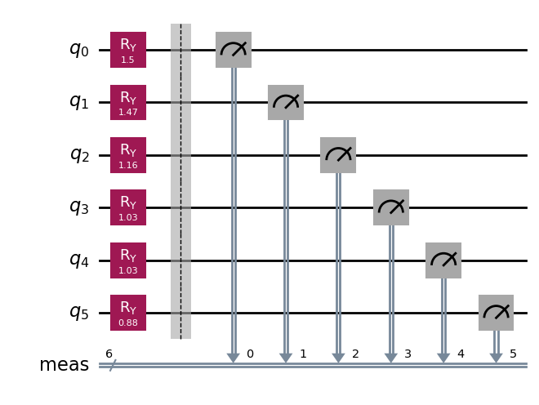
Stage 3: About a 28% chance of three subscriptions
Each selected customer contributes one qubit with P(1) equal to their Stage 1 probability
Customer
Method | P(≥3) | Error, pp
Exact reference | 27.59% | —
Quantum sampling | 27.73% | 0.14
Classical MC | 30.47% | 2.88
C0081
C0031
C0079
C0170
C0327
Each uses 1,024 draws. SE ≈ 1.40 pp.
C0256
1.88 expected subscribers
θᵢ = 2 * arcsin(sqrt(pᵢ))
The three-subscription target remains
unlikely under the model.
Success: at least three measured

