Slide 1


Introduction to Data Science course
Grigory Babkin Islomjon Shukhratov Anastasiia Ivaniuk

Slide 2

Task description
Customer
Expresso is an African telecommunications company that provides customers with airtime and mobile data bundles. The objective of this challenge is to develop a machine learning model to predict the likelihood of each Expresso customer “churning,” i.e. becoming inactive and not making any transactions for 90 days.
This solution will help Expresso to better serve their customers by understanding which customers are at risk of leaving.

Slide 3
Problem statement
01.
We solved this problem using data science and machine learning algorithm to clear data and build robust prediction model.. We tried two types of ensembling methods with Gradient Boosting Machine from Scikit-learn as well as XGBoost classifier from XGBoost.
We have deleted some Columns such as Region, because it is impossible to fill with random or predicted value with high accuracy. And some missing values we filled with gaussian distribution.
To solve this problem we have undersampled data so “0” and “1” values became the balanced.
They have different tariffs and want to know in which cases the client leaves: regions, how much he earns, how many times he calls. And churn — whether the client stays with such values or leaves.
A great amount of missing values.
Amount of “0” values is much greater than “1” values
02
03

Slide 4
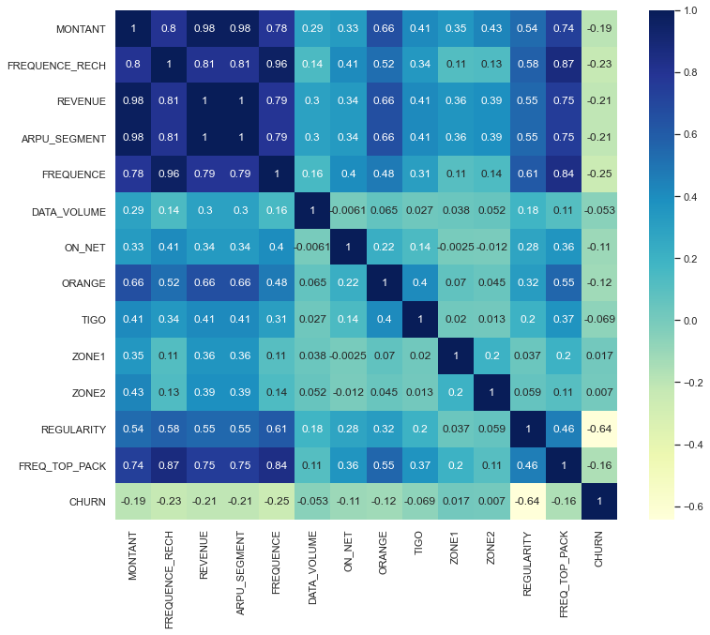
01.
Basics
Observations
We have 2,154,048 rows of data with 18 features and 1 target. More than half of features are float, while rest of them are objects or integers values.

Slide 5
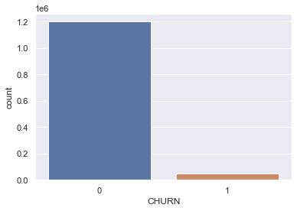
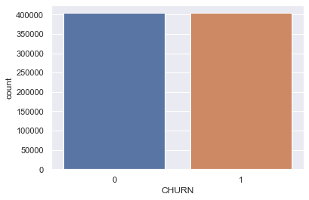
Balance the data
We have class-imbalance dataset. In order to balance the dataset as well as to win processing time, we:
01.
Made undersampling, removing entries where values are equal to 0.
There is a caveat, we will lose majority data. However, later we can retrain with full dataset with tuned hyperparameters.
02.

Slide 6
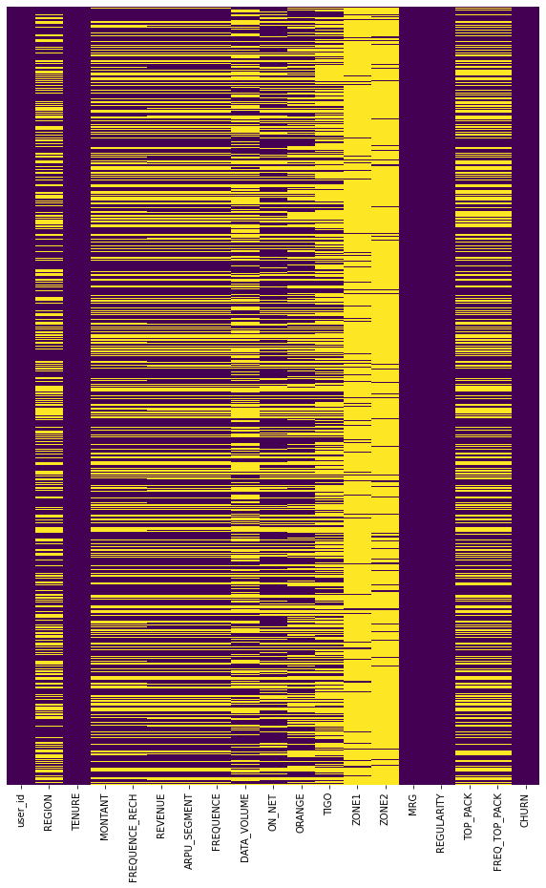
Missing values
01.
Drop features that have large chunks of missing values as well as features that can't be imputed such as Region.
Instead of filling missing values with average of features, we decided to fill some of them with normal distribution of their mean and standard deviation. Thus every missing entry will have different values.
02.

Slide 7
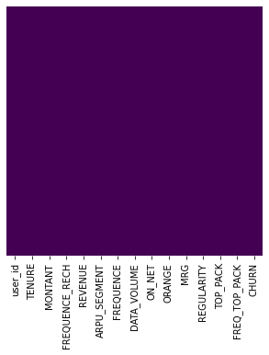
Missing values
03.
For Top Package we decided to use imputer to handle missing values to get the maximum occuring category as well as giving some weight for filled NAN by creating new column.
04.
So now it is much better! However, TOP_PACKAGE has a lot of categories. By observing dataset we can conclude that some categories can be grouped together.

Slide 8
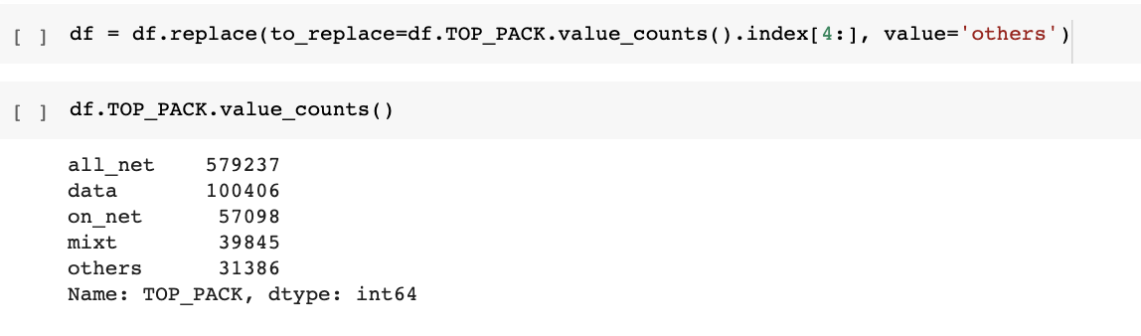
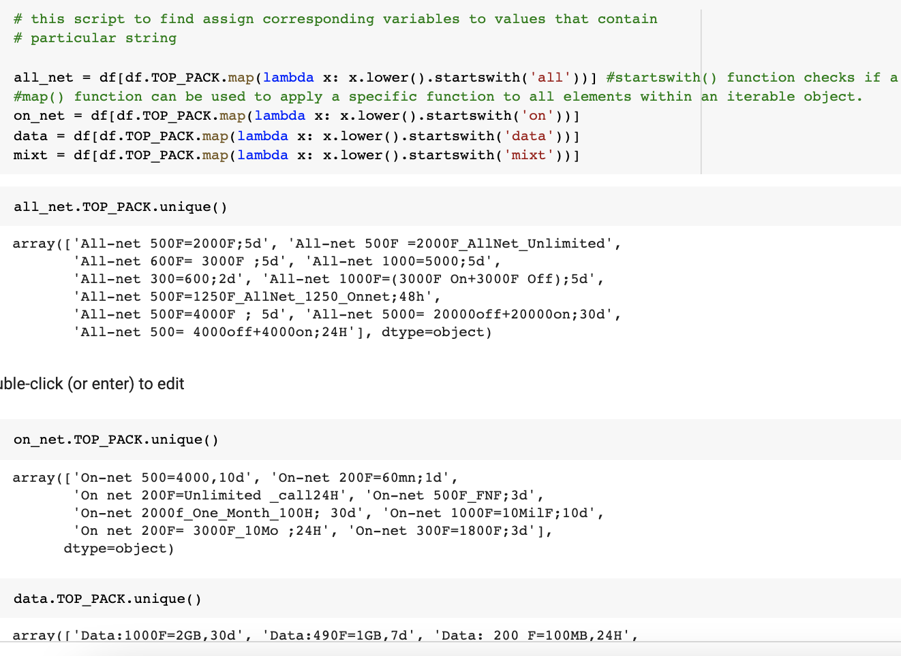
Categorical values
01.
TOP_PACKAGE has a lot of categories. By observing dataset we can conclude that some categories can be grouped together.
02.
So we grouped only frequent packages and merge the rest of the values to 'others' category.

Slide 9
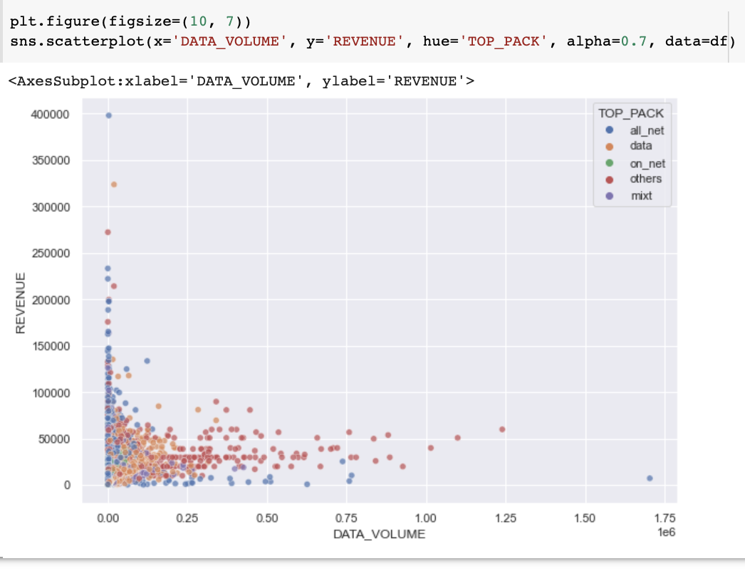
02.
Connections
Let's see whether the is the dependency on clients income and how many connections they have according to their packages
Pattern 1
More generally, features do not strongly correlate with target column, so logistic regression is not the case to use.
PATTERNS TO DEFINE ML MODEL
Pattern 2
Some features relate to each other with strong correlation, and it would be wise to try Gradient Boosting Ensemble with hyperparameters tuning.

Slide 10
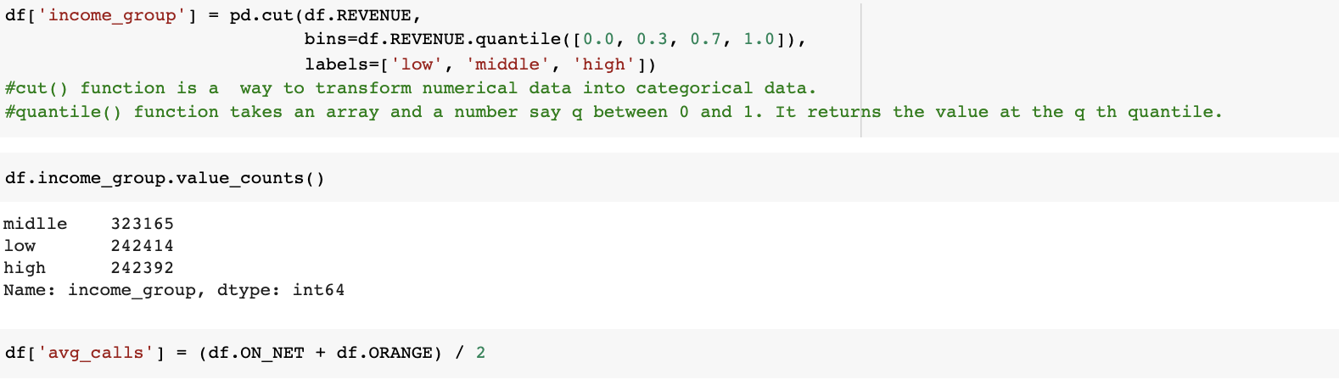
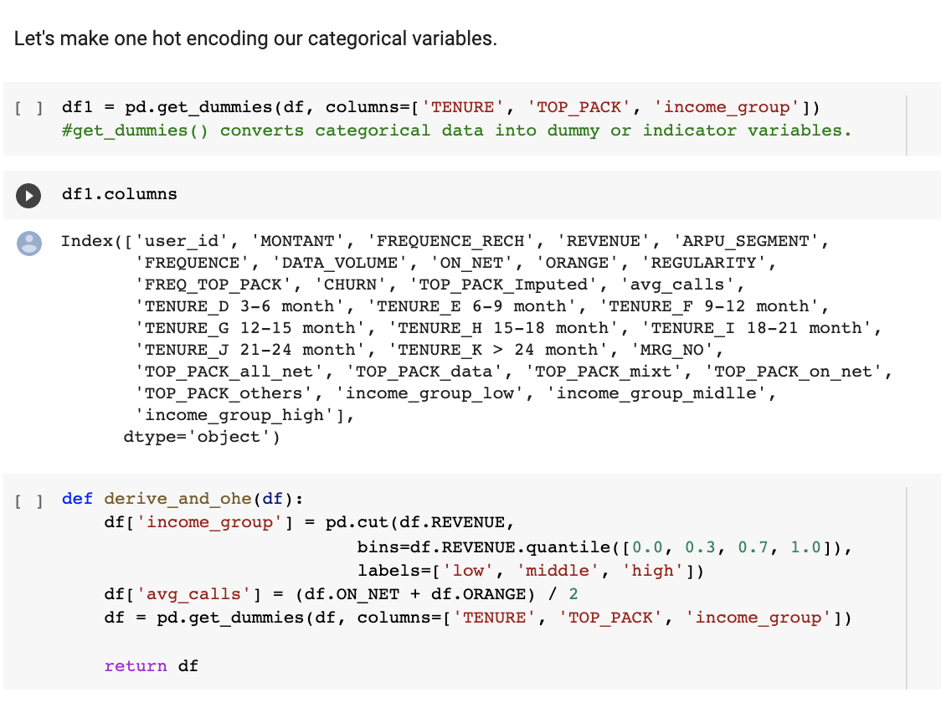
New columns derivation
01.
Some value can be categorized or grouped. Thus we can create more features. Revenue — low, middle, high.
Average of ON_NET and ORANGE, so new feature column that creates average of call across the packages
02.

Slide 11
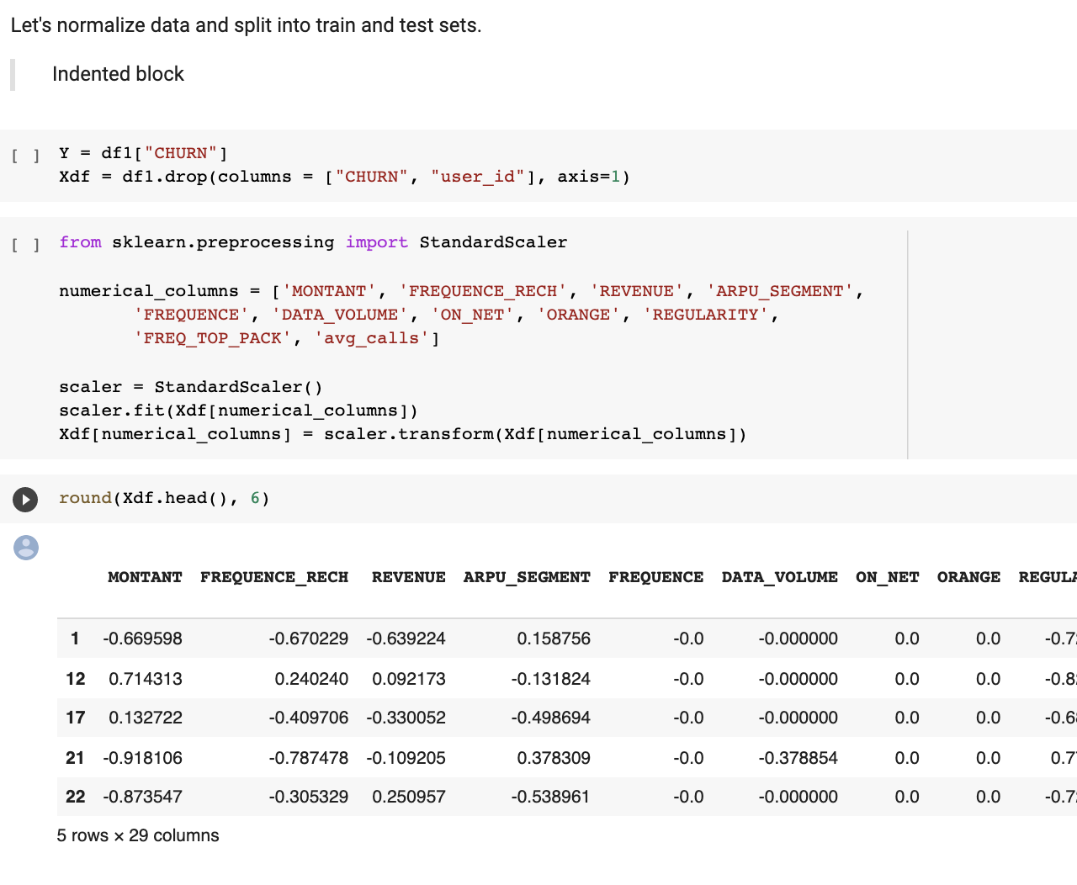
Train & test data
01.
Let's normalize data and split into train and test sets.

Slide 12
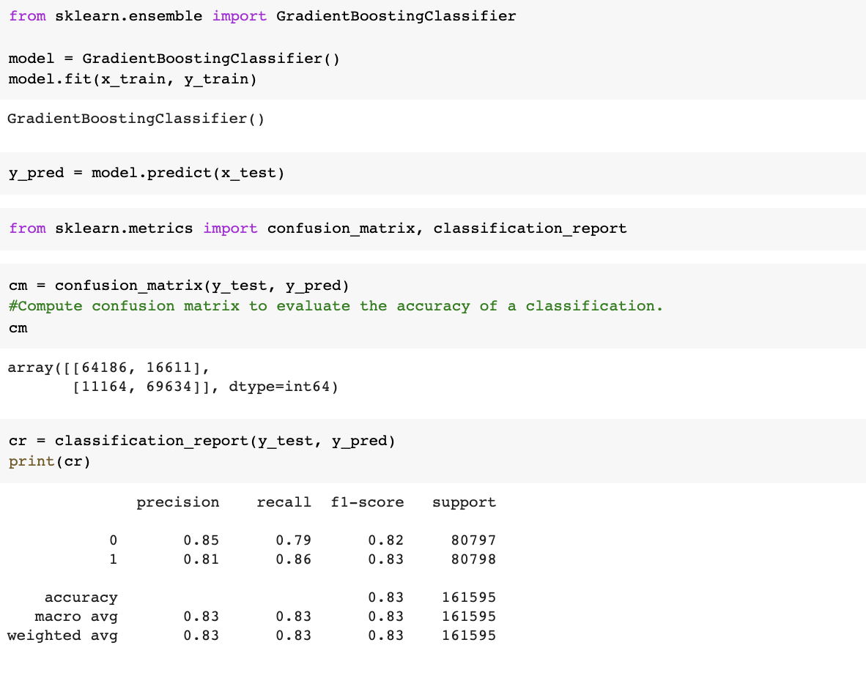
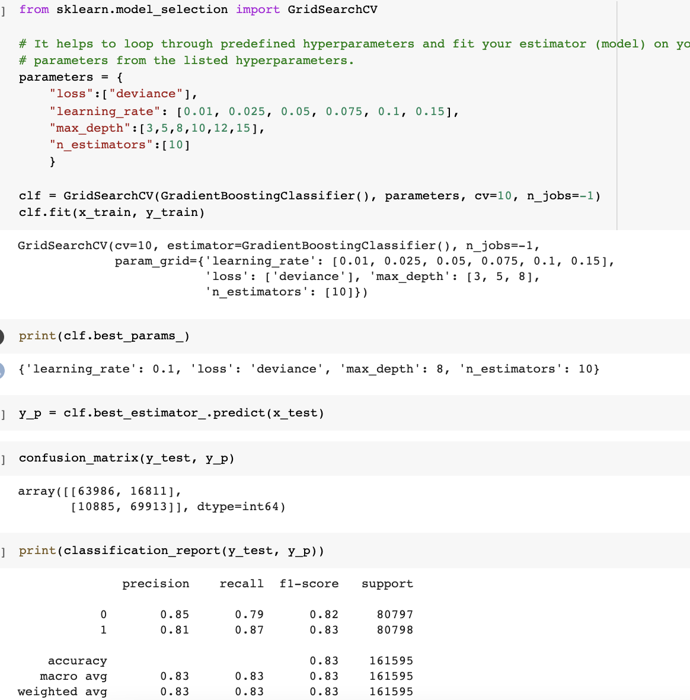
Two approaches
Among many machine learning algorithms, considering lack of time to try them all, and amount of data to train, we decided to use Gradient Boosting Classifier. Boosting grants power to machine learning models to improve their accuracy of prediction. Boosting algorithms are one of the most widely used algorithm in data science.
01.
Well, after training, our hyperparameter tuned model did not give great results. It showed only slightly increase in recall. Nevertheless, let's try also XGBClassifier from xgboost library and see the results for XGBClassifier and its ROC AUC curve.
02.

Slide 13
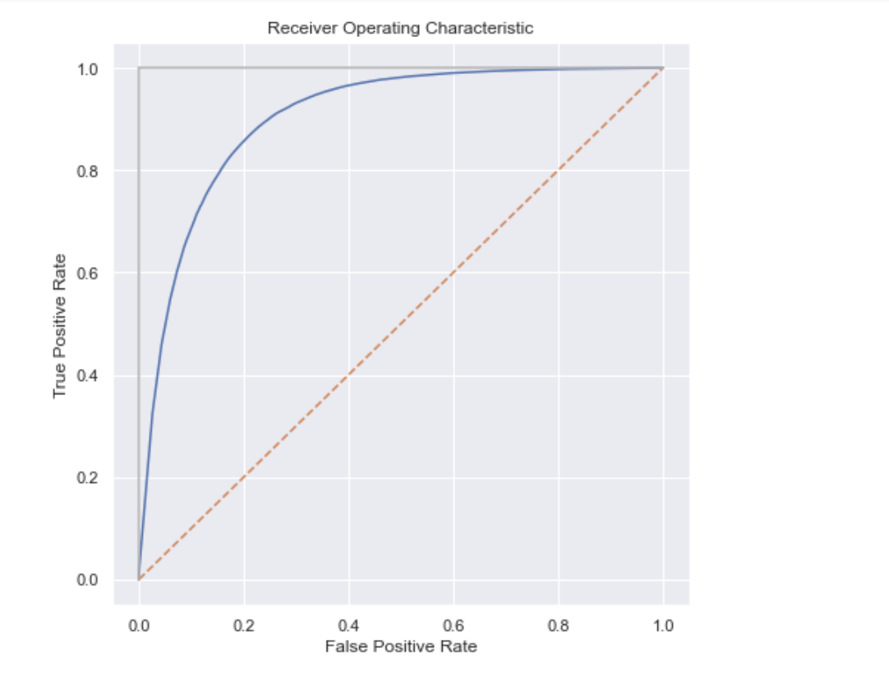
ML MODELS
CROSS-VALIDATION PROCEDURE
Select measure of quality
Accuracy of 83%, F1 score, recall
Use the prepared cross-validation procedure to estimate the quality of prediction.
01.
ML model
ROC AUC curve
02.
Set of hyperparameters
loss
learning rate
maximum depth
number of estimators
03.

Slide 14
03.
Results
ROC AUC curve
Accuracy of 83%, F1 score and recall both 0.83
We have solved the problem stated in the beginning

Slide 15
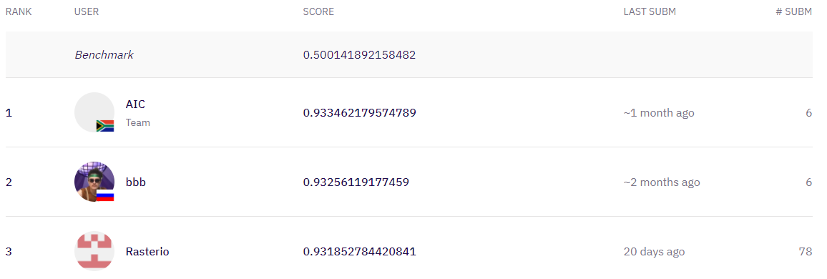
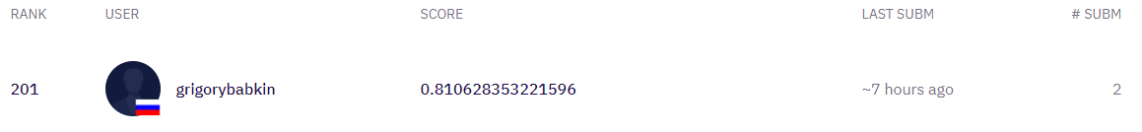

Slide 16

Solution and Further steps
The solution has a growth potential. We hope that retraining model with better performance. Customer can really understand in what cases its clients churn.
Further step #1
Retrain model with original imbalance dataset
Further step #2
Use different data manipulations to derive better features
Further step #3
Tuning hyperparemeters and understanding in which places model gets lowless accuracy.

Slide 17
THANKS FOR YOUR ATTENTION
Grigory Babkin Islomjon Shukhratov Anastasiia Ivaniuk

