Slide 1
Data Desk■
Questions about the business, answered from the data warehouse in minutes.
How are opportunities developing compared with last year?
Ask
Notes:
Data Desk lets SAE decision-makers ask questions about the business in their own words and get an answer from the data warehouse within minutes. I will show what kinds of questions work, four examples from the app, and what we ask of beta testers.

Slide 2
Ask the way you would ask an analyst
What can I ask?
Short answer
How many new enrolments does the current intake have so far, measured against target?
One figure, put in context
Chart
Show opportunities for the current intake week by week compared with last year.
A development over time
Comparison
Compare the conversion rate from opportunity to enrolment across campuses for the last completed intake.
Campuses, products or intakes side by side
Follow-up
And how does that look without top-ups?
Refines the previous answer
Interactive dashboard
Build a dashboard for the current intake: opportunities and enrolments by campus vs. last year, filterable by product.
Charts and filters, a few minutes
In English or German. The answer comes in the language of the question.
Notes:
No report to find, no query language. You type the question as you would ask a colleague in BI. These five kinds of questions are also built into the app as examples to start from.

Slide 3
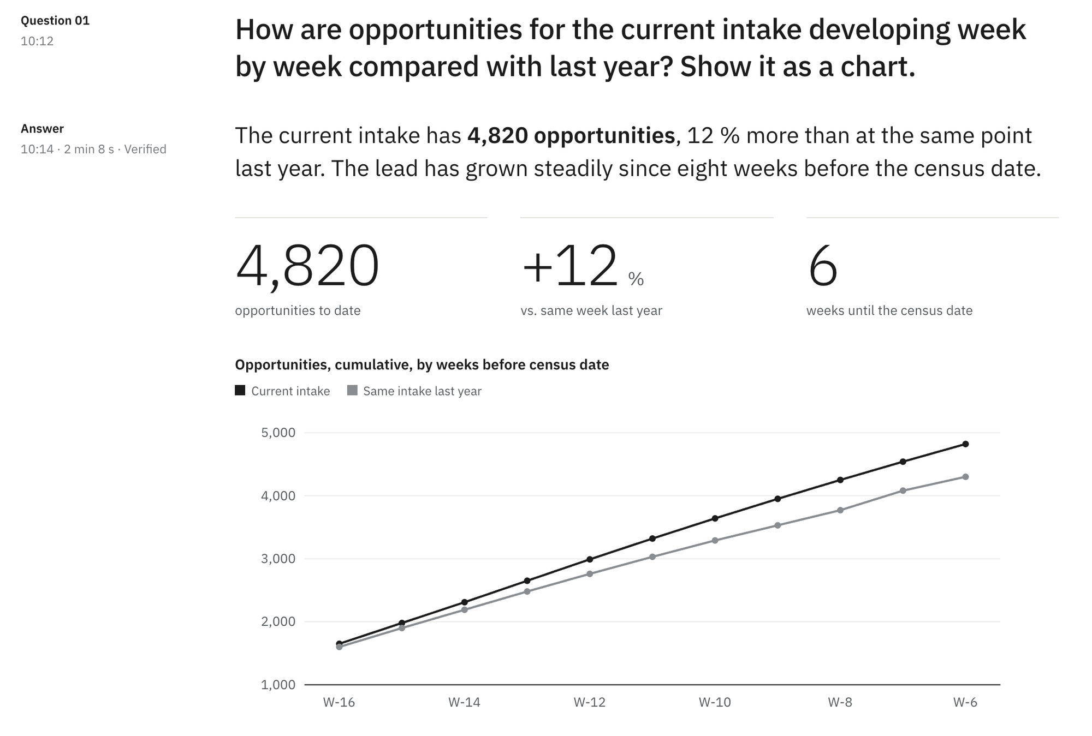
One question: a finding, a chart and its evidence
Example 1 of 4
CHART
The figure first
Key finding in one to three sentences.
Chart and table
Every chart with the values behind it.
Evidence
Data, period and definition in words.
2 min
from question to verified answer
Illustrative example · figures invented
Notes:
A typical question about the current intake. Within about two minutes: the key figure, a chart with its table, and the evidence, so anyone can see what was counted. This answer was also verified by a second, independent check.

Slide 4
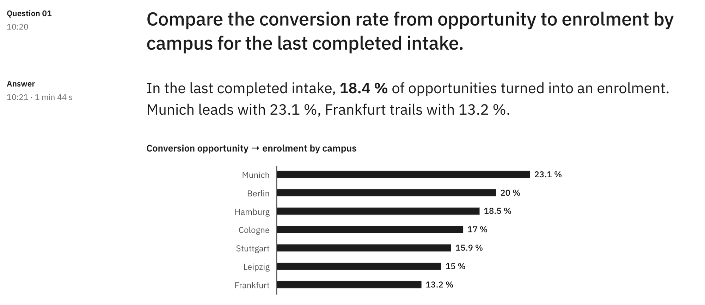
Campuses side by side, ranked and explained
Example 2 of 4
COMPARISON
One view
Campuses, products or intakes.
SAE definitions
Calculated as SAE defines the KPI.
Assumptions stated
What is included is said openly.
1 min 44 s
from question to answer
Illustrative example · figures invented
Notes:
Comparisons are where Data Desk saves the most time: a ranking across campuses with the figures behind it. The evidence says which definition was used and what is included, here top-ups.

Slide 5
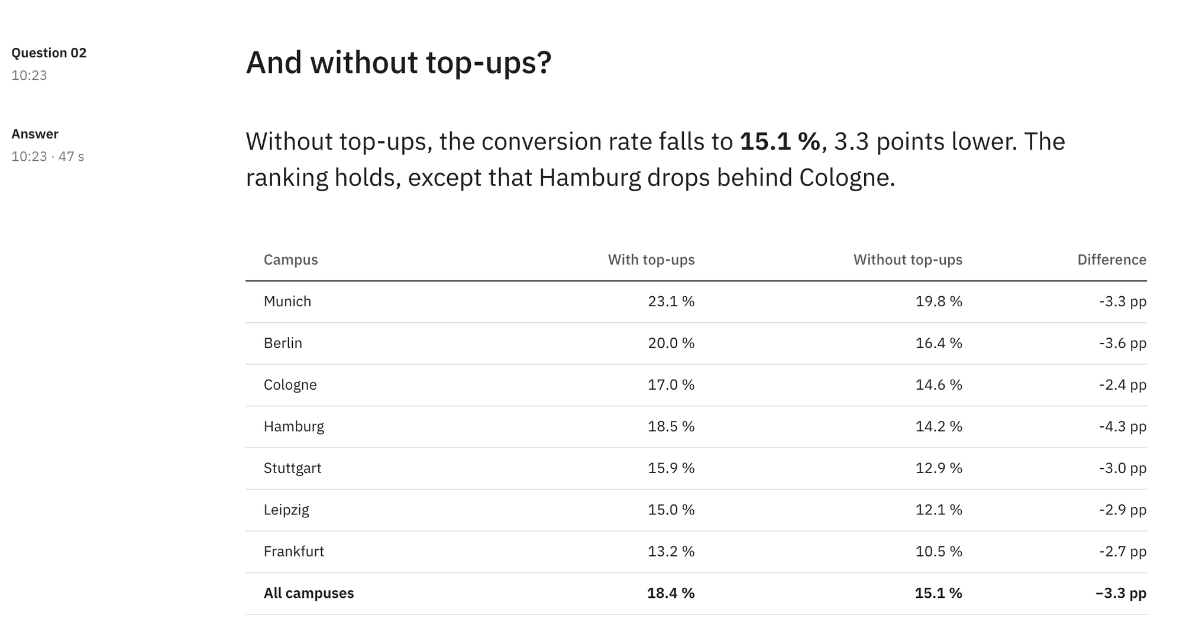
Follow-ups refine the answer, no need to start over
Example 3 of 4
FOLLOW-UP
A conversation
Each question builds on the last.
Short is enough
“And without top-ups?” is understood.
Pick up later
Conversations continue after a break.
47 s
for the follow-up
Illustrative example · figures invented
Notes:
Decisions rarely stop at the first figure. A short follow-up like 'And without top-ups?' is enough, because Data Desk knows the conversation. That is the difference to a fixed dashboard.

Slide 6
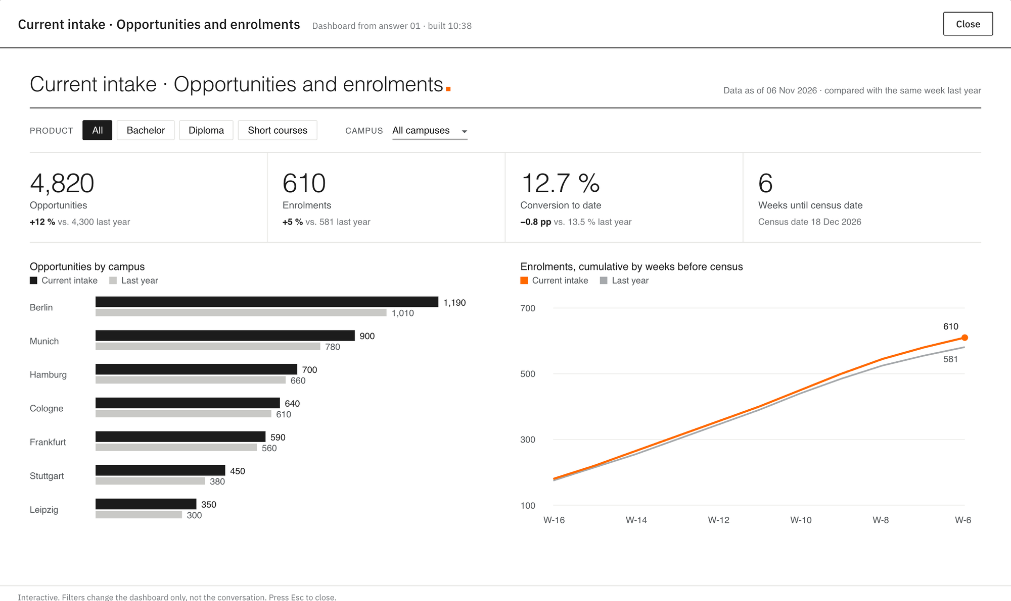
One sentence, an interactive dashboard
Example 4 of 4
DASHBOARD
“Build a dashboard for the current intake: opportunities and enrolments by campus vs. last year, filterable by product.”
Opens right in the app, with filters for product and campus.
8 min
to a finished dashboard
Illustrative example · figures invented
Notes:
For a recurring view or a meeting, Data Desk builds an interactive dashboard from one sentence, in about five to thirteen minutes. It opens in the app, the filters work, and the key values are also in the answer text.

Slide 7
Answers in minutes, when you need them
What changes for you
ANSWERS
DASHBOARDS
SHARING
< 3 min
5–13 min
PDF or Excel
for most answers
for an interactive dashboard
export of the conversation
Ask, refine with follow-ups, decide. No request, no waiting.
Built from one sentence, with filters, right in the app.
Ready to pass on to your team or into a meeting.
All figures follow the SAE KPI definitions agreed with the BI team.
Notes:
The value in one sentence: the question that would have become a request or waited for a dashboard is answered in minutes, the next question in the same conversation, and the result can be passed on as a PDF report or Excel file.

Slide 8
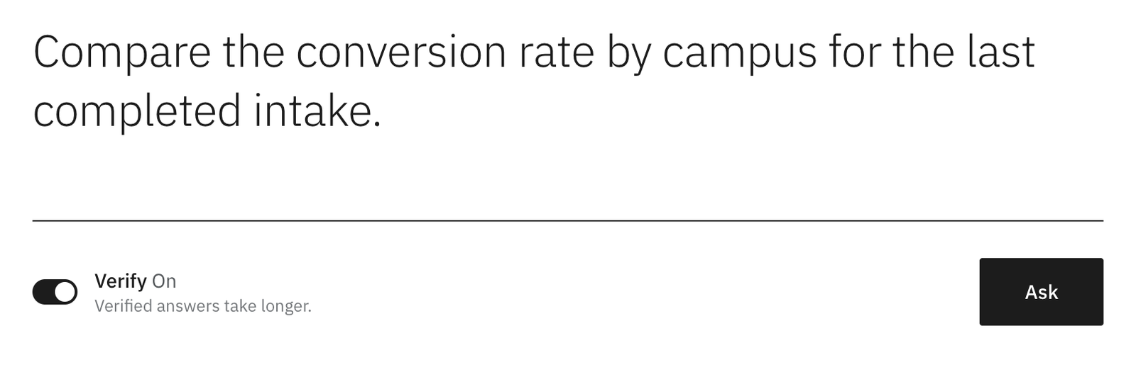
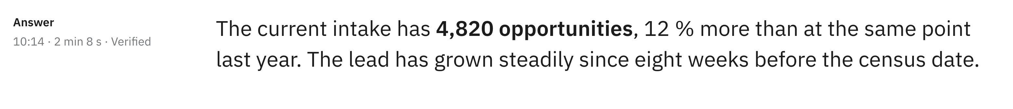
Reliable and confidential
Trust
VERIFY · SWITCH IT ON WHEN IT MATTERS
Verify on request
A second, independent check recalculates the answer before you see it.
Evidence with every answer
What was counted, for which period, with which definition.
Protected data
A read-only copy. Sensitive data such as reasons for dropping out is excluded.
Nothing kept
After the beta, conversations are not stored: when the session ends, they are gone.
The answer then shows “Verified”, or “Corrected after verification”.
Illustrative example · figures invented
Notes:
Two things matter for trust. First, reliability: every answer shows its evidence, and for figures you will pass on you switch on Verify, a second, independent check that recalculates the answer before you see it. The answer then says 'Verified'. Second, confidentiality: the AI only works on a read-only copy, sensitive data is not included, and after the beta nothing is kept once a session ends.

