Slide 1

Course Project
The C++ Programming Language

Slide 2
IT 919-S EDA
Tetris Game(Console version)
Bachelor 3rd Year
Student Grigori Verdyan

Slide 3
01
How would you describe TETRIS?

Slide 4
Tetris is a video game created by Russian designer Alexey Pajitnov in 1985 that allows players to rotate falling blocks strategically to clear levels. Pajitnov claimed he created the name of the game by combining the Greek prefix tetra, which refers to the four squares contained in each block, with the word tennis.

Slide 5
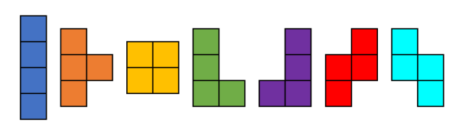
Types of tetrominos
I T O L J Z S

Slide 6

02
How I implemented my version of TETRIS (or at least tried to)

Slide 7
Structure of my project
When running the codes first what you can see is the menu, which consists of 5 sections:
PLAY
RECORDS
INSTRUCTIONS
ABOUT GAME
EXIT

Slide 8
PLAY
RECORDS
INSTRUCTIONS
ABOUT GAME
The main game - TETRIS
Scores of players (supposed to be)
Describing navigation rules in the project
Displating info about TETRIS
EXIT
Finishing execution of the program

Slide 9
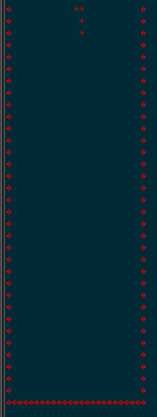
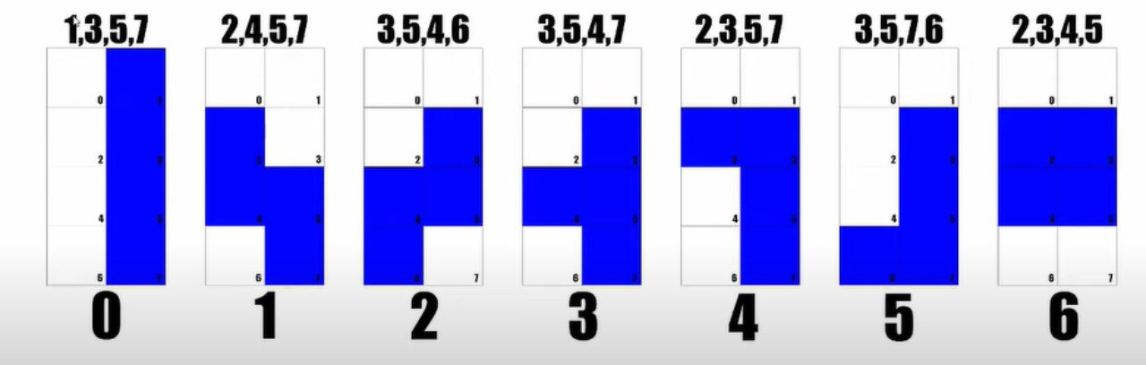
Play Section
My playing section is not finished yet. I would describe my version of TETRIS as ugly and buggy sister of original one.
Here is how I solved tetrominos’ figures implementation. I have a matrix of tetrominoes, which each line is one tetrominos, with given values.

Slide 10
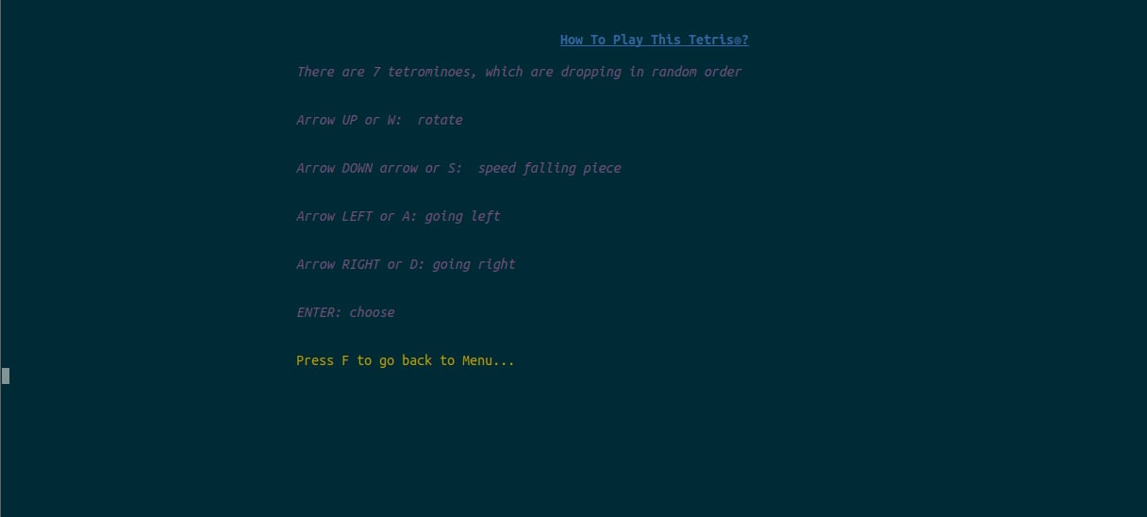
INSTRUCTIONS Section

Slide 11
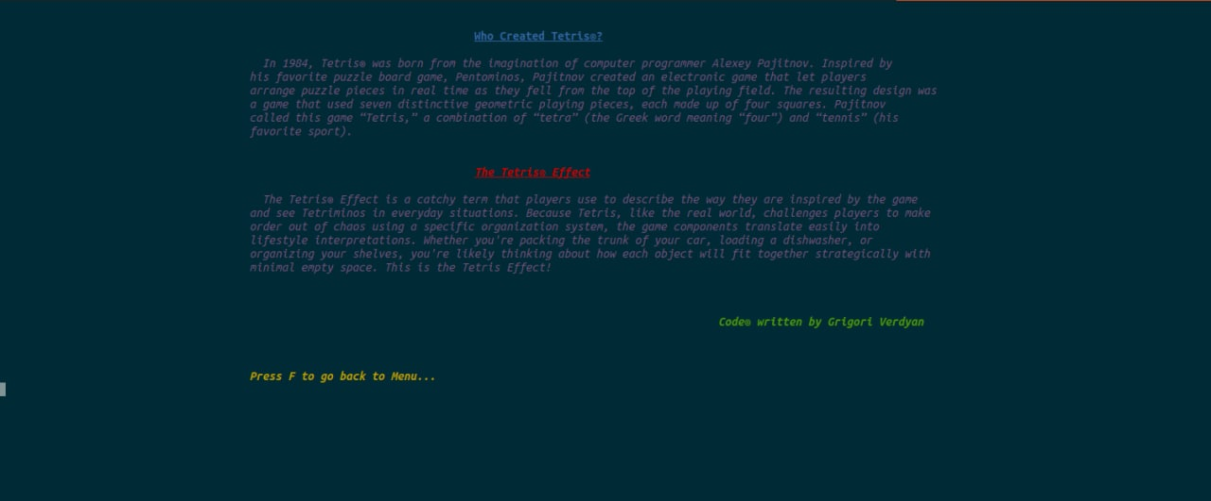
ABOUT GAME Section

Slide 12
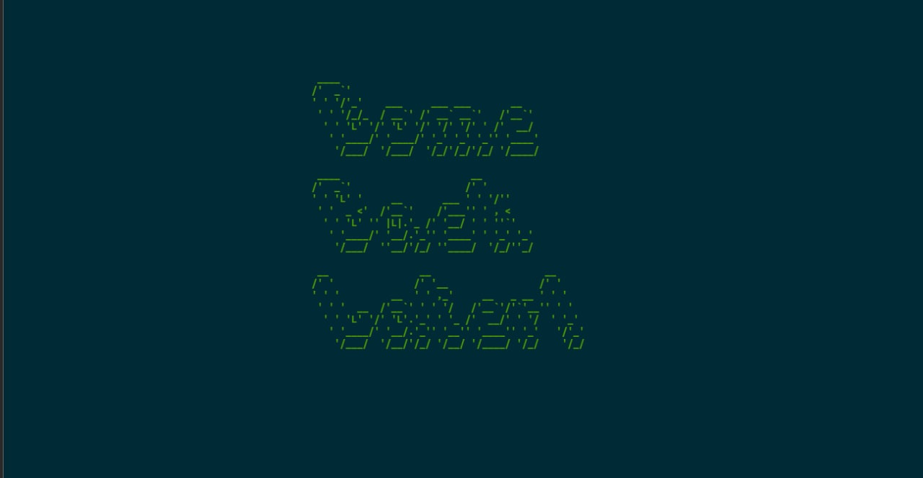
EXIT Section

Slide 13
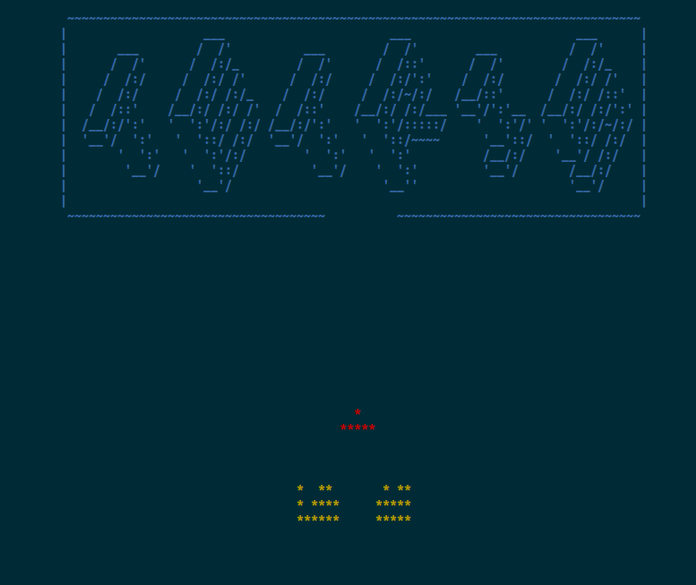
Little in-menu animation

Slide 14
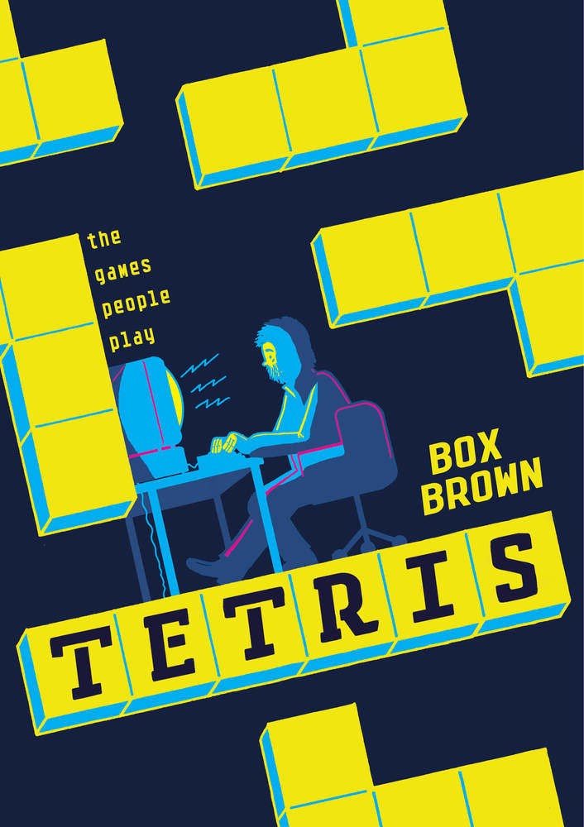
About my experience
To write the console version of game TETRIS I did a lot of research. I learned to work with multiple code files at the same time. I improved my working skills VIM. Learned how to google correctly to find necessary things, and to surprise for me I discovered for myself that it is not every time that Google knows everything.

Slide 15

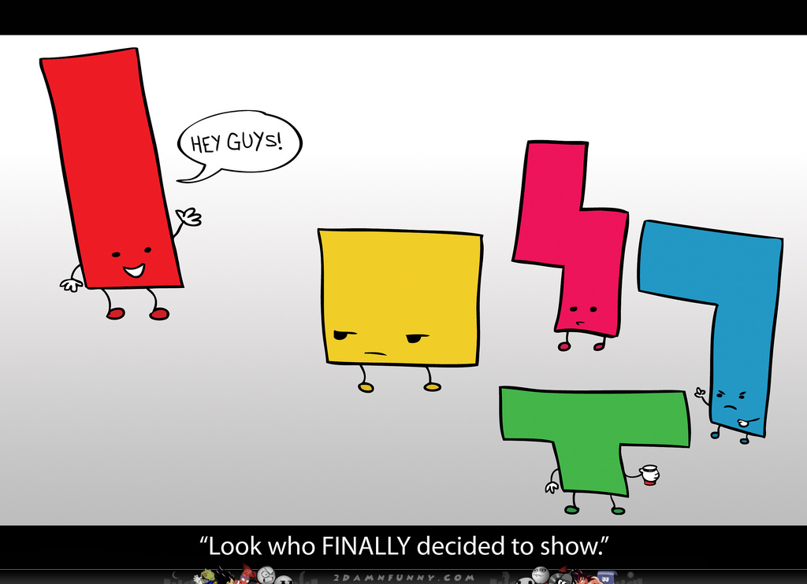
THANKS!
Developed by Grigori Verdyan
verdyan01@gmail.com
+37494398616

