Slide 1

YCSB – A
Aaron Grill (27011203)
Supervisor Dr. Julian Kunkel / Dr Bryan Lawrence

Slide 2
What is YCSB?
The Yahoo! Cloud Serving Benchmark was developed by Yahoo in 2010 with the aim in mind of being able to provide an apples-to-apples comparison of then particularly increasingly popular, NoSQL data stores. [1]
The client, written in Java, defines multiple workloads each said to be indicative of a different use case on the database (read / write splits, heavy update) [2].
Provides a database interface for a vast number of data stores [3].
Despite some decrease in popularity, still used frequently in ‘benchmark marketing’ different data stores.
Designed to be extensible for alternate use cases, but also two additional tiers were suggested in the original paper as an extension to the already devised 4 in the initial client.
Numerous extensions have been created covering a wide array of uses. [4,5,6,7]

Slide 3
YCSB-A
Typically, the extensions follow the pattern of an adaptation of the YCSB name suffixed with a letter to describe the extension.
With an interest in distributed programming and NoSQL data stores I found this to be an intriguing area of research to take part in.
The A in YCSB-A stands for availability, an extremely important concept amongst data stores and service providers alike.[8] This was one of the additional tiers proposed in the original YCSB paper and I thought it would be useful to provide a reproducible extension that other people may use on additional data stores (past those that I experiment with in this research).
Additionally, to this day the proposed method of running this benchmark suite in parallel / on multiple clients is to manually start it on each client and then manually aggregate results. I saw this as an area for improvement

Slide 4
Objectives
Through discussions with my supervisor and own research we decided on a list of deliverables that would be appropriate to improve the client, with the broad goal of making it more representative and ‘up-to-date’.
Existing research by Pokluda and Sun [10] and Nelubin & Engber [11] took a stab at creating an availability benchmark, with the latter providing a more representative attempt.
Both would create a cluster, let it run and then use a sig-9 kill command during execution and measure the effect that it had on the data store.
Objective 1: This, as stated in the original YCSB paper, is insufficient as a measure of availability and a true benchmark would examine a variety of faults.
Objective 2: When examining NoSQL data stores you expect to be able to stress the database under large workloads via parallelization, I wanted to implement this
Objective 3: Allow the data produced from the benchmarks to be more digestible and useful.

Slide 5
Technical High-Level Goals
To create scripts that allow injection of faults into a database node. Minimum of three different faults (kill-9, split brain, problems introduced via a firewall)
To be able to drive a benchmark run from a single master node and allow clients (as many as the user wants) to join the run via SSH or other means.
Automatic division of the workload for distribution amongst clients.
To have automatic aggregation of results from clients, rather than having to do so manually.
To produce useful graphs from these results (such as time series graphs) that allow for thorough analysis of the effect of the faults on the data stores.

Slide 6
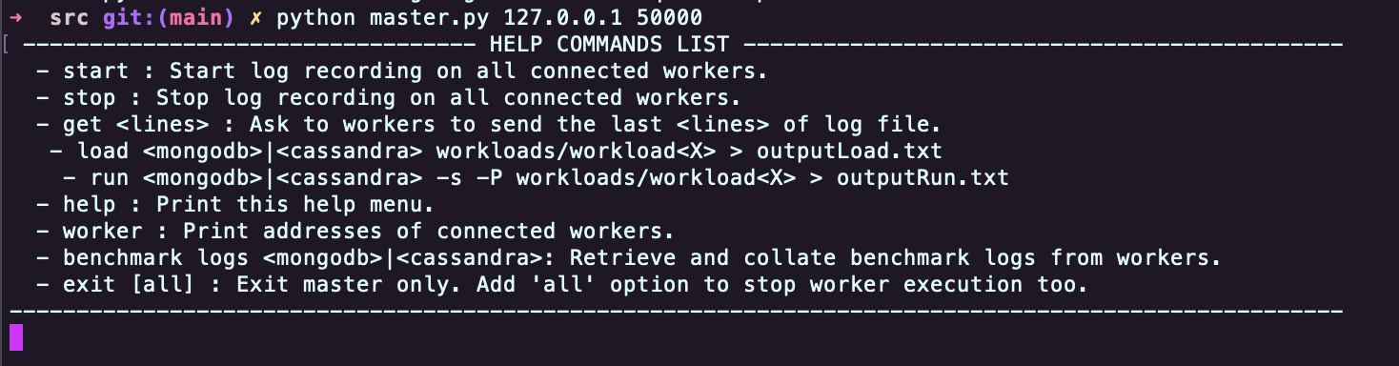
Functionality
The GitHub repository provides instructions for provisioning client and master machines alike.
Benchmark runs are driven from a command line interface, nodes may join whenever, dynamically.
System was designed with emphasis on its robustness being stressed from my supervisor.
Help menu and error messages provided, to my knowledge haven’t experienced any unhandled error cases.
Figure 1 below shows the initiation of a master node.

Slide 7
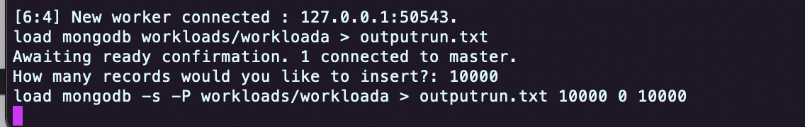
Functionality
Master node started, any number of clients can connect to this master by providing an IP address and a port number.
For load and run phases of the database, the workload is distributed evenly via total work / number of nodes available. Comes in handy for stress testing with large datasets.
After each benchmark run the results are saved locally to each machine, and returned to the master node and aggregated together for use in data analytics.
These results can then be converted to a time series graph among others, at the users discretion as to not waste disk space.
Figure 2 shows the load phase of a benchmark being distributed to one worker node and a part of the output on the worker node.

Slide 8
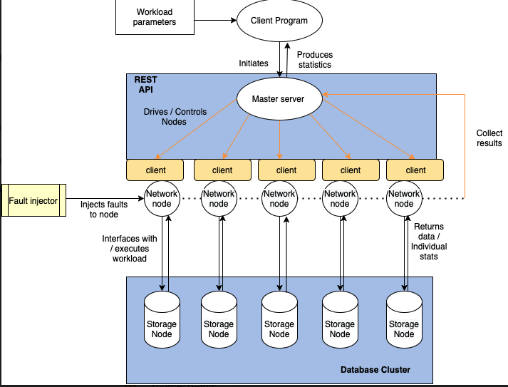
Implementation & Testing
Python programming primarily used, with some smaller bash scripts and pieces of Python code. Python was the best tool for the job, high level abstractions to enable the required distributed functionality.
Initially was fixated on using Scala due to its distributed nature but having emailed the authors of NoSQL mark paper for their opinion, suggested no need to reinvent the wheel / add unnecessary complexity – focus on the important parts of the research.
Each node will require a copy of YCSB and the YCSB-A
wrapper to allow the extended functionality.
Currently the client allows for testing on MongoDB and
CassandraDB. Two of the most popular NoSQL data stores. [12]
Will be looking to expand past this in future work.

Slide 9
Results / Conclusions
At the time of writing the actual results for each individual database aren’t available to be displayed here but will be available in the final report. (ECF)
I have hypothesized that MongoDB will outperform Cassandra in its recovery characteristics, due to the extensive mechanisms that MongoDB has in place to ensure high availability. Not least to mention their sharded clusters with replication sets and genius underlying technologies such as elections amongst nodes in the case of failure and configurable heartbeat responses that decide whether to accommodate for a failed node.
I could have provided responses on a local configuration here, but as I’m talking about big distributed data stores and the need for parallelization, I’ve configured AWS instances for testing (see report).
^ Other professional and industrial standard YCSB extensions do it this way so that the database can properly be examined under duress.
Also, to put my software to the test under extreme workloads working with huge datasets and realistic set ups. Test runs will include different sized clusters, optimized and different numbers of threads

Slide 10
Reflections
Looking back on messages with my supervisor, the amount of knowledge I’ve gained has been immense. Messages to him asking what a node is compared to what I feel like I know now has been so rewarding.
DevOps, AWS, Python programming, Distributed Programming, Bash scripts, Terminal use, soft skills such as research skills and coding practices the list is endless.
Think I felt a bit of imposter syndrome during development that what I was making wasn’t good for some reason however looking back on the initial messages with Julian on what I said I’d create back in November and seeing that I’ve fulfilled almost every requirement I set out feels really rewarding.
Before this dissertation I would have considered myself a far more capable practitioner than theoretician, however this projects boosted my confidence massively and In response I have subsequently applied for an MsC at Reading University.
If I had to critique myself, I would improve my time management, as I went through periods of doing loads and then neglecting it a bit and then doing loads, which wasn’t optimal.

Slide 11
References
[1] - https://www2.cs.duke.edu/courses/fall13/cps296.4/838-CloudPapers/ycsb.pdf
[2] - https://github.com/brianfrankcooper/YCSB/wiki/Core-Workloads
[3] - https://github.com/brianfrankcooper/YCSB
[4] – https://ieeexplore.ieee.org/abstract/document/7008801?casa_token=caZSIGgZyHIAAAAA:tQuwjirPnyPGnr2xxzP
-umWAHSxDrvDWmiIgS4btqMD6hNHqkWYGLL726bjxge_2usFT2Uu0
[5] – https://www.doc.ic.ac.uk/~wjk/publications/haughian-osman-knottenbelt-dexa-2016.pdf
[6] – https://ieeexplore.ieee.org/abstract/document/8817088?casa_token=peXLj-CJ93gAAAAA:Geb8PCOD0OmzMAa_QTFg4rqUiS8ZqNE516k71Hdjx4NSQVdNsLtTiGTaKHVSD1l9SA-Bf8QG
[7] – https://ieeexplore.ieee.org/abstract/document/6906872?casa_token=dcbj6MwrtooAAAAA:-Ra7qURVW8um1sTKmVF8-Ph6FWhFL0KcGnY_45NUl9yITTl3WR3i5zUOkegnxtFTyWuUfv_y
[8] - https://petri.com/availability-requirements-for-cloud-computing#:~:text=Availability%20in%20this%20context%20is,about%20five%20minutes%20per%20year.
[9] - https://github.com/brianfrankcooper/YCSB/wiki/Running-a-Workload-in-Parallel
[10] – http://www.alexanderpokluda.ca/coursework/cs848/CS848%20Project%20Report%20-%20Alexander%20Pokluda%20and%20Wei%20Sun.pdf
[11] - http://www.benstopford.com/wp-content/uploads/2014/03/NoSQL-Failover.pdf
[12] - https://db-engines.com/en/ranking

