Slide 1
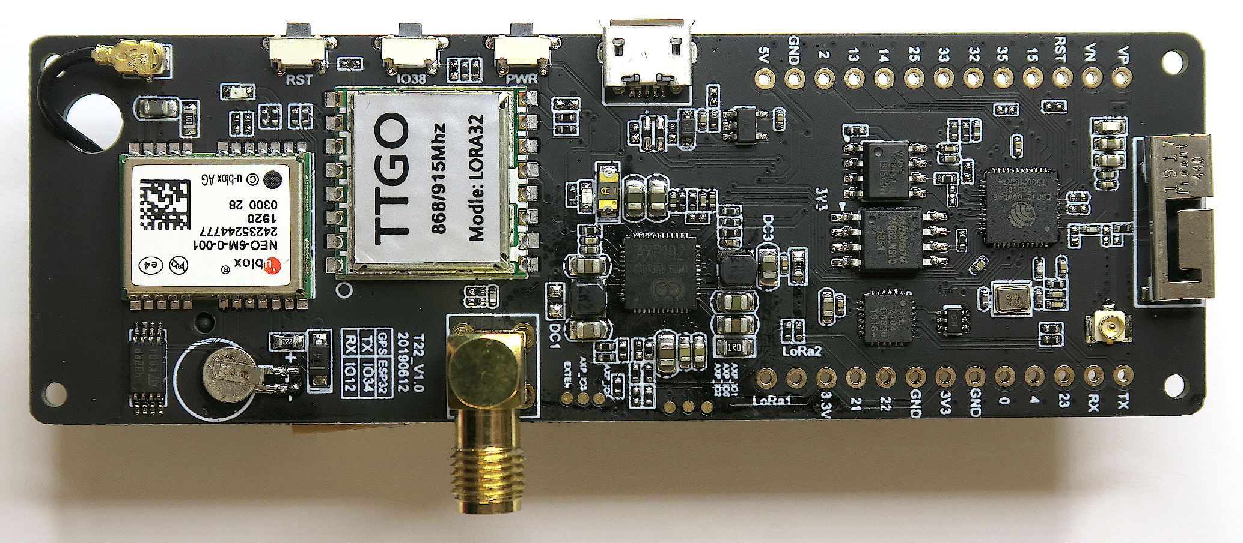
u-blox
NEO-6M-0-001
GPS module
HPDTEK
HPD13A
LoRa 868 MHz
RF transceiver
with SX1276
espressif
ESP32-D0WD
µC dual core
no flash
WiFi b/g/n
BT/BLE dual mode
4A2D
voltage
regulator
IPUS
IPS6404L-SQ
64 MBit SPI RAM
ST
432RP
EEPROM
X-Powers
AXP192
voltage regulators,
Li-Ion charging,
ADCs
SIL 2104 F032U
USB to UART
bridge
winbond
25Q32JV SIQ
32 MBit SPI flash

